Slide 1
What You Need to Know About Financial Aid
Nanci Regehr
Financial Aid Director, Rio Salado College
nanci.regehr@riosalado.edu
We place you at the heart of what we do.
mindfulness • empathy • happiness • resilience

Slide 2
Topics We Will Discuss
What is financial aid?
Cost of attendance (COA)
Expected family contribution
Financial need
Types and sources of financial aid
Free Application for Federal Student Aid (FAFSA)
Special circumstances

Slide 3
What is Financial Aid?
Financial aid consists of funds provided to students and families to help pay for postsecondary educational expenses
Scholarships
Grants
Federal Work Study
Student Loans
Parent Loans
Veterans Educational Benefits

Slide 4
What is Cost of Attendance (COA)?

Slide 5
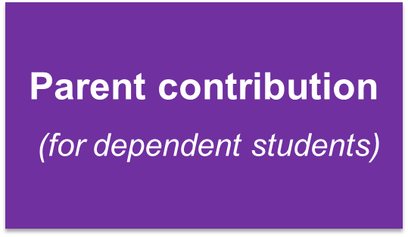
What is Expected Family Contribution (EFC)?

Slide 6
What is Financial Need?

Slide 7
Types of Financial Assistance

Slide 8
Scholarships – Gift Aid
Money that does not have to be paid back
Awarded based on merit, skill, or unique characteristic
Where do I look?
Financial Aid/Scholarship Website
Career Center Website
World Wide Web
Parents employment
Community
Fastweb.com

Slide 9
Grants – Gift Aid
Criteria is Predominantly Need Based
Various Types
-Pell Grant (Max Pell Grant $6,895/year for 2022-23)
-Institutional and Other Federal Grants

Slide 10
Loans – Self Help
Money students and parents borrow to help pay college expenses
Repayment begins 6 months after education is finished
Federal Direct Subsidized, Unsubsidized, and PLUS
Private

Slide 11
Loans – Self Help
Only borrow what is really needed. The loan will be dually and equally disbursed during your enrollment period.
Look at loans as an investment in your future
Keep in mind there are aggregate loan limits

Slide 12
Loan Limits
Year | Dependent Undergraduate Student (except students whose parents are unable to obtain PLUS Loans) | Independent Undergraduate Student (and dependent students whose parents are unable to obtain PLUS Loans)
First Year: 0-29 credits | $5,500—no more than $3,500 of this amount may be in subsidized loans | $9,500—no more than $3,500 of this amount may be in subsidized loans
Second Year: 30+ credits | $6,500—no more than $4,500 of this amount may be in subsidized loans | $10,500—no more than $4,500 of this amount may be in subsidized loans
Maximum total debt from Federal Direct Loans (Aggregate Loan Limits) | $31,000—no more than $23,000 of this amount may be in subsidized loans | $57,500—no more than $23,000 of this amount may be in subsidized loans

Slide 13
Federal Work Study – Self Help
Job on Campus
Payment is a Paycheck for Work Performed
America Reads/America Counts
Not Reported on the FAFSA when that year's income is reportable

Slide 14
Free Application for Federal Student (FAFSA)

Slide 15
FAFSA
Collects demographic and financial information
Information used to calculate the expected family contribution (EFC)
Colleges use EFC to offer financial aid
May be filed at any time during an academic year, but no earlier than October 1st prior to the academic year for which the student requests aid
For the 2023-24 academic year, the FAFSA may be filed beginning October 1, 2022
Colleges may set FAFSA priority dates

Slide 16
Ways to Complete the FAFSA

Slide 17
FAFSA on the Web (FOTW)

Slide 18
Benefits of Using FOTW
Built-in edits to prevent costly errors
Skip-logic allows student and/or parent to skip unnecessary questions
Option to use Internal Revenue Service (IRS) Data Retrieval Tool to import tax data
More timely submission of original application and any necessary corrections
More detailed instructions and “help” for common questions
Ability to check application status online
Simplified application process in the future

Slide 19
FSA ID
•Student and parent must each have FSA ID
•Parent without SSN cannot obtain FSA ID. Must print, sign, and mail paper signature page
•Only the owner should create an FSA ID
• Apply at:
https://studentaid.gov/fsa-id/create-account/launch

Slide 20
IRS Data Retrieval Tool (DRT)
Allows for certain tax return information to be transferred from the IRS database
Participation is voluntary and student chooses whether to transfer data to FOTW
IRS will authenticate taxpayer’s identity
If tax record is found, IRS transfers information to populate the FAFSA
Reduces documents requested by financial aid office

Slide 21
IRS Data Retrieval Tool
Certain tax filers cannot use the
IRS Data Retrieval Tool
Did not indicate on FAFSA a tax return was completed
Marriage date is January 2022, or later
First three digits of the SSN are 666
Filed a non-U.S. tax return
Married and filed as head of household, or filed separate returns
Neither married parent entered a valid SSN
Non-married parent or both married parents entered all zeroes for the SSN

Slide 22
Who Is Included in Household Size?
Dependent filers
Student and parent(s)
Independent filers
Student and spouse (if married)
Student’s siblings and children*
Unborn children and siblings of the student*
Other persons who live in household*
Student’s children*
Unborn children of student (and spouse)
Other persons who live in household*
* Included only if receiving more than half support between 7/1/23 to 6/30/24.

Slide 23
Special Circumstances
Conditions exist that cannot be documented with the FAFSA
Send written explanation and documentation to your college’s financial aid office
College will review and request additional information if necessary
Decisions are final and cannot be appealed to U.S. Department of Education

Slide 24
Questions?

