Slide 1
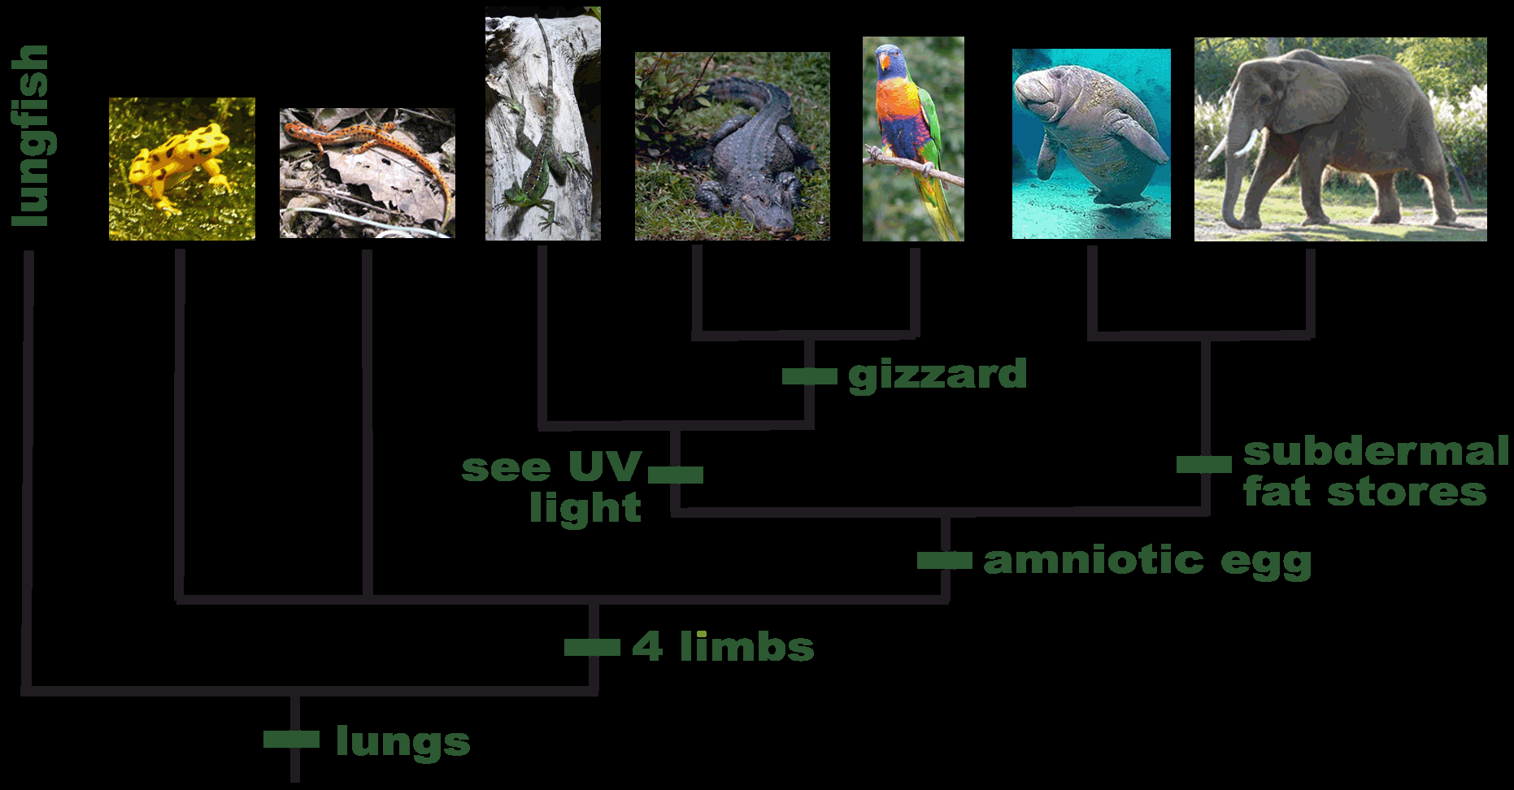
How Can We Tell the Difference Between Species?

Slide 2
Evolution: Classification
Classification Background
Phylogeny
Cladistics
Dichotomous Keys
Unit Objective: apply the basics of next generation taxonomy and classification and evaluate anatomical and molecular homologies to establish evolutionary relationships.

Slide 3
Classification
How do scientists classify & identify organisms?
Scientists identify organisms by studying their structure and functions.
Classification is based on similarities and differences
What are the reasons scientists do this?
A lot has to do with first, discovering our ancestry, helping to identify new organisms, predict the behaviors of organisms based upon the structures, functions, and behaviors of other organisms.
But most importantly, it helps us connect with the world so we can do things like find cures and treatments for diseases.

Slide 4
Biological Species Concept
Developed by biologist Ernst Mayr in 1942…
A species is a natural population that interbreeds reproductively isolated from other populations.
The Biological Species Concept blends the taxonomical philosophy of Linnaeus with the new information discovered in DNA.
  There are other ways of classifying species, but the technique of using the homologies in DNA & traits is the most common.
In large part, the importance of species in biology derives from their importance in systematics, which is responsible for the taxonomic framework used in all branches of biology.

Slide 5
How Do We Name Organisms?
With all the diversity, how do we name organisms?
Taxonomy:
  The science of naming and classifying organisms.
We group species based on what we infer about their evolutionary relationships.

Slide 6
Classification
We use “The Linnaean System”
  It’s in Latin = so globally, everyone can understand what you’re talking about.
SPECIES ARE GROUPED INTO SUCCESSIVE LEVEL OF HEIRARCHY.

Slide 7
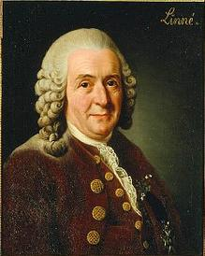
Linnaean Classification
Carolus Linneaus ranked organisms into ever more inclusive categories (taxa)
  Domain
  Kingdom
  Phylum
  Class
  Order
  Family
  Genus
  Species

Slide 8
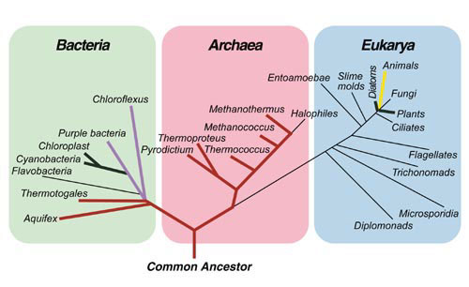
The 3 Domain Classification System

Slide 9
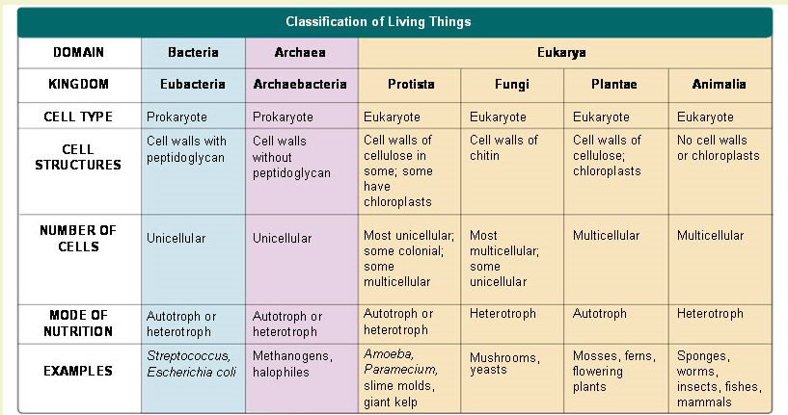
The 6 Kingdom Classification System

Slide 10
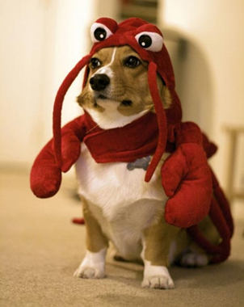
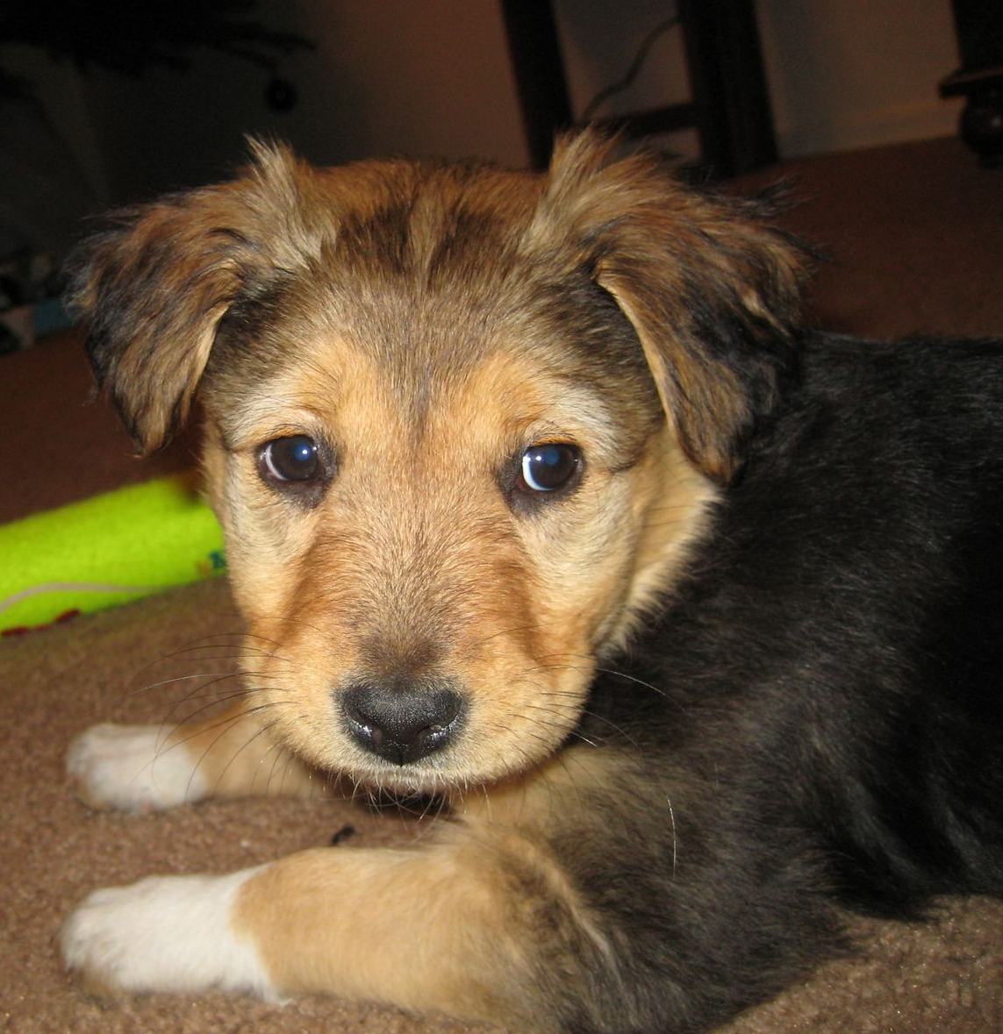
Dog Taxonomical Classification
Has cells with nuclei, but so do a lot of organisms…
Are heterotrophic & multi-cellular, but so are many others…
Domain | Eukarya
Kingdom | Animalia
Phylum | Chordata
Class | Mammalia
Order | Carnivoria
Family | Canidae
Genus | Canis
Species | Lupus
Possesses a spinal chord, but so do 75,000 others…
Is warm-blooded and produces milk for its young, but so do others…
Eats other organisms for food, but there are hundreds of carnivores…
Is dog-like, but so are wolves, foxes, and coyotes…
Is considered a subspecies of wolf…
The most specific category for our common dogs.

Slide 11
Naming Species
The Linnaean system give each species a unique, two-part scientific name
This is called BINOMIAL NOMENCLATURE
  Examples:
    the dog rose, Rosa canina
    The wolf, Canis lupus
      Meaning “dog wolf”
    The dog, Canis lupus (familiaris)
    Humans, Homo sapien
      Meaning “wise (or thinking) human”

Slide 12
Example: Scientific Name for a dog.
First word = Genus
Second word = species
Canus lupus
First word: capitalized
Second word: lowercase
In type, both italicized

Slide 13

How Do We Classify Organisms?
Ideally, classification should be based on homology; that is, shared characteristics that have been inherited from a common ancestor.
The Logic: The more recently two species have shared a common ancestor,
  the more homologies they share, and
  the more similar these homologies are.

Slide 14
The Challenge With Taxonomy & The New Solution
Because of the fluid nature of evolution and speciation, it is difficult to properly name and classify organisms.
There exists challenges that make it less than 100% accurate on how scientists classify organisms.
  Deciding which traits to focus on.
  Missing links.
  Unknown organisms.

Slide 15
The Challenge With Taxonomy & The New Solution
What was once based primarily on homologous structures is now being updated with the use of technologies that allow us to see similarities on a molecular level.
  DNA
  Proteins
The benefit of using molecules is that they mutate at a reasonably constant rate.
Still, what is the better way to determine phylogeny; molecular or morphological?
  Remember, natural selection only acts on physical traits.

Slide 16
With All This Life Out There, How Can We Discover Evolutionary Relationships?

Slide 17
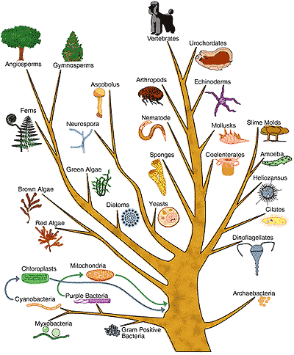
Identifying Species’ Relatedness
The difficult task of the identification of species’ relationships is under the discipline of systematics.
Accomplished primarily through discovering phylogeny.
  Phylogeny = The ancestral relationship between species.
Phylogeny is united with systematics through cladistics.
  Cladistics = Analysis that infers phylogeny through the careful comparisons of related characters (traits).

Slide 18
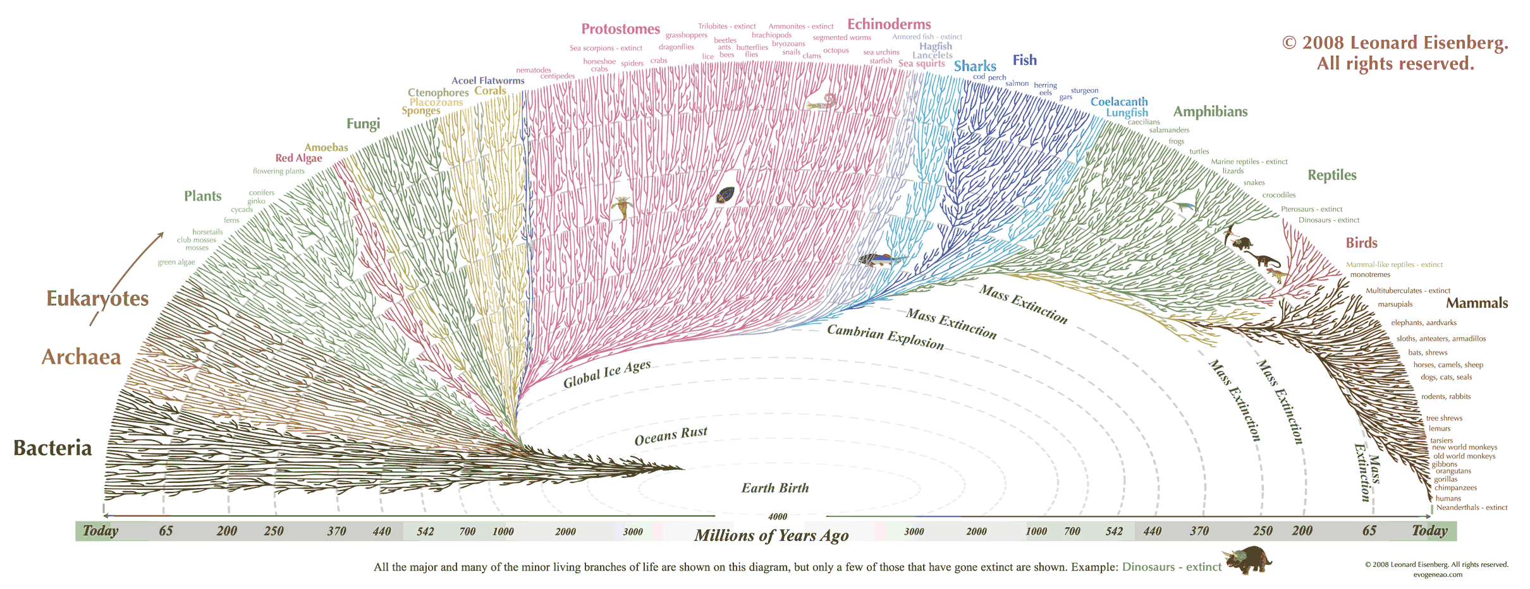
Phylogenetic Tree
(15) A phylogenetic tree or evolutionary tree is a branching diagram or "tree" showing the inferred evolutionary relationships among various biological species or other entities based upon similarities and differences in their physical and/or genetic characteristics.
(16) The taxa joined together in the tree are implied to have descended from a common ancestor.
  -wikipedia.org
  Notice that function is not evidence…
Humans
The common ancestor

Slide 19
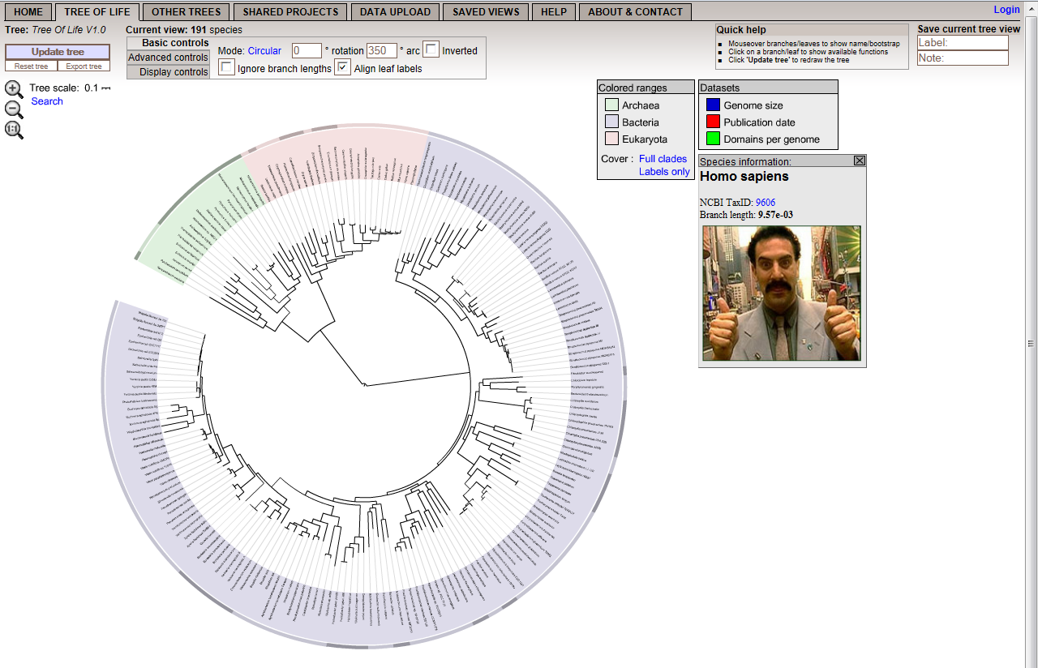
Phylogenic/ Evolutionary Trees
Interactive
http://itol.embl.de/itol.cgi

Slide 20
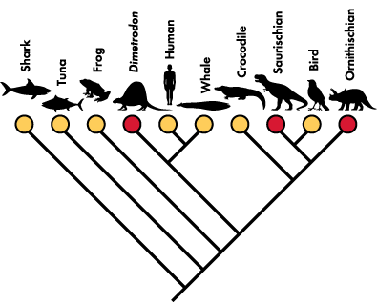
Cladograms
A cladogram is a diagram used in cladistics which shows relations among organisms.
A cladogram is not, however, an phylogenic tree because it does not show how ancestors are related to descendants or how much they have changed; many evolutionary trees can be inferred from a single cladogram.
  Wikipedia.org

Slide 21
Cladograms
Cladistic analysis is used to select the most likely phylogeny among a given set of organisms.
The logic of establishing the phylogeny in cladograms is based on interpreting the evidence that establishes the relationships.
  Morphology (Structure)
  Molecular Evidence (DNA & Proteins)
    Order & Time (DNA mutates at a constant rate so divergence can be approximated)
You will construct both kinds.

Slide 22
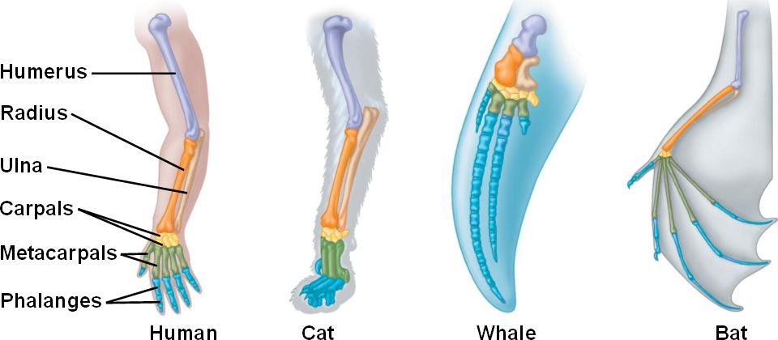
Comparative Morphology
We can look at similar traits in different organisms.
These traits must result from evolution.
Structural homology (how something’s built) strongly implies relatedness.

Slide 23
Using Proteins as a “Molecular Clock”
This chart shows the similarity among organisms based upon the number of amino acids that are similar in hemoglobin.
The human beta chain (1 of 4) of the hemoglobin protein contains 146 amino acid residues, as do most of the others, but they are not the same residues in different organisms.
What does this information provide evidence for?
What has been found is that DNA mutates at a constant rate, much like the ticking of a clock’s hands.
As species diverge, they accumulate more and more mutations at a semi-predictable rate making genes and their proteins more different than other species’ as time goes on.
The more DNA a species has in common with another (& proteins), the closer related they are in phylogeny.
Human beta chain | 0
Gorilla | 1
Gibbon | 2
Rhesus monkey | 8
Dog | 15
Horse, cow | 25
Mouse | 27
Gray kangaroo | 38
Chicken | 45
Frog | 67
Lamprey | 125
Sea slug (a mollusk) | 127
Soybean (leghemoglobin) | 124

Slide 24
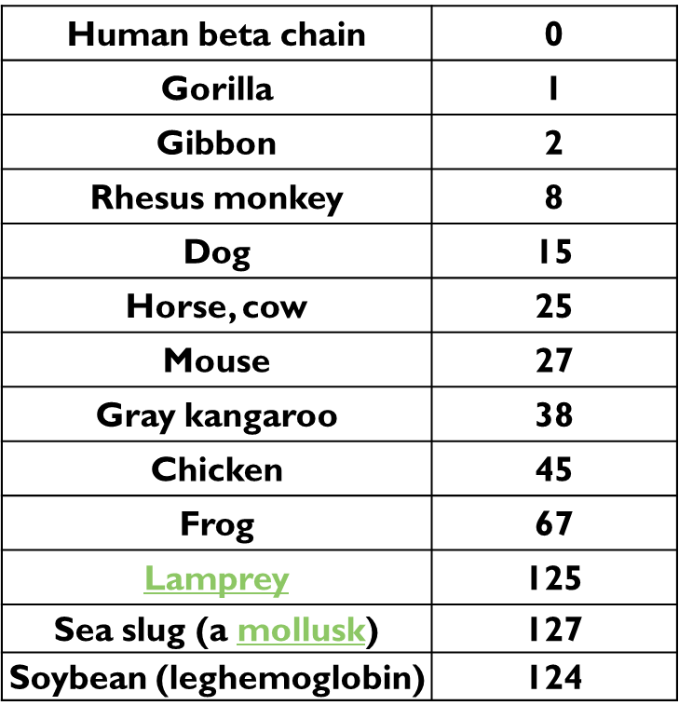
Human
Soybean
124 differences
Loosely related & probably diverged paths hundreds of millions of years ago.
Likely close to 125 million years.

Slide 25
Rhesus monkey
Human
8 differences
Closely related & probably diverged paths a few million years ago.
Approximately 8 million years ago to be more specific.
Soybean

Slide 26
How Do We Decide the Relationship Between All Of Life’s Diversity?

Slide 27

HOW?
We need data to compare…
TRAITS

Slide 28
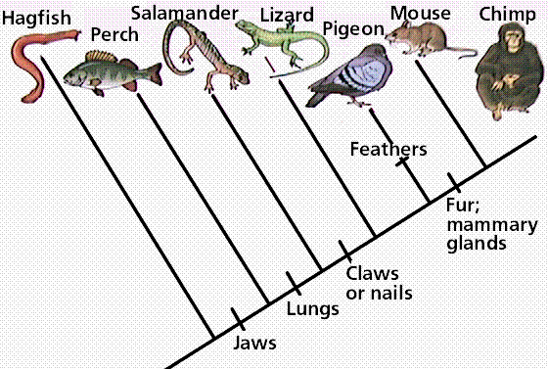
Cladistic Analysis
Focuses on Shared Traits (Implies shared ancestry)
& Identification of Derived Traits (Implies divergence)
DERIVED trait that evolved after BIRDS
SHARED trait for LIZARDS, PIGEONS, MICE, & CHIMPS
Node: where divergence occurs to cause speciation

Slide 29
How Do You Construct Cladograms?
To make a cladogram, scientists first collect data on the features of all the organisms they hope to classify.
This data is then analyzed to determine which characteristics were present in what could have been a common ancestor and which might have been developed in later times.
SO: You need to know/observe/discover
  When the species evolved (oldest to youngest)
  Good traits to focus on.

Slide 30
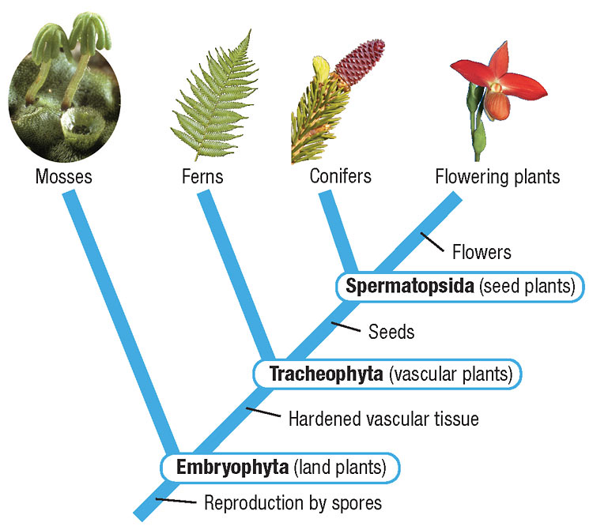
How did Plants Evolve?
Ferns → Flowering Plants → Conifers? → Mosses?
Mosses → Flowering Plants → Ferns → Conifers?
Conifers → Ferns → Mosses → Flowering Plants?
Flowering Plants → Conifers → Mosses → Ferns?
Ferns → Mosses → Conifers → Flowering Plants?
Mosses → Flowering Plants → Conifers → Ferns?
How do you decide?
You have to know the traits they share and what they have that’s unique!

Slide 31
Constructing a Cladogram
Type of Plants | Seeds | Vascular Tissue | Flowers
Mosses | No | No | No
Conifers | Yes | Yes | No
Ferns | No | Yes | No
Flowering Plants | Yes | Yes | Yes
1. Identify the outgroup. The outgroup is the group that does not share any of the characters in this list. [remember that a character is also called a trait] Draw a diagonal line and then a single branch from its base. Write the outgroup at the tip of this first branch.
2. Identify the most common character. Just past the “fork” of the first branch, write the most common derived character. This character should be present in all of the subsequent groups added to the tree.
3. Complete the tree. Repeat step 2 for the second most-common character. Repeat until the tree is filled with all of the groups and characters from the table.
Notes:
Draw on board as an example.

Slide 32
Type of Plants | Vascular Tissue | Seeds | Flowers
Mosses | No | No | No
Ferns | Yes | No | No
Conifers | Yes | Yes | No
Flowering Plants | Yes | Yes | Yes

Slide 33
Using Molecular Evidence. Comparing Amino Acid Sequences
Circle all the differences between the human and primate amino acid sequences. Develop a cladogram based upon the evidence.
Sequence #1 Human DNA for Hemoglobin
A-G-G-C-A-T-A-A-A-C-C-A-A-C-C-G-A-T-T-A
Sequence #2 Chimpanzee DNA for Hemoglobin
A-G-G-C-C-C-C-T-T-C-C-A-A-C-C-G-A-T-T-A
Sequence #3 Gorilla DNA for Hemoglobin
A-G-G-C-C-C-C-T-T-C-C-A-A-C-C-A-G-G-C-C
Organism | Differences from human
Human | 0
Chimpanzee | 5
Gorilla | 10

Slide 34
Cladogram Construction
Following the directions on the handout, construct cladogram for the 2 examples.
Answer the analysis questions.
Take 5 minutes then we’ll take a look at what you come up with for the 1st example.

Slide 35
First Practice Problem
 | Four legs | Amniotic egg | Hair
Tuna | no | no | no
Frog | yes | no | no
Lizard | yes | yes | no
Cat | yes | yes | yes
LIZARD
CAT
FROG
HAIR
TUNA
AMNIOTIC EGG
4 LEGS

Slide 36
Construct a Cladogram of the following organisms.
Taxon | Trait
 | Jaw | Limbs | Hair | Lung | Hair Loss
Lamprey | No | No | No | No | No
Trout | Yes | No | No | No | No
Cat | Yes | Yes | Yes | Yes | No
Gorilla | Yes | Yes | Yes | Yes | Yes
Lungfish | Yes | No | No | Yes | No
Lizard | Yes | Yes | No | Yes | No

Slide 37
Cladogram
Taxon | Trait
 | Jaw | Limbs | Hair | Lung | Tail Loss
Lamprey | No | No | No | No | No
Trout | Yes | No | No | No | Mo
Cat | Yes | Yes | Yes | Yes | Mo
Gorilla | Yes | Yes | Yes | Yes | Yes
Lungfish | Yes | No | No | Yes | No
Lizard | Yes | Yes | No | Yes | No
Conclusions
CAT
GORILLA
LIZARD
LUNGFISH
TROUT
HAIR LOSS
LAMPREY
HAIR
LIMBS
LUNG
JAW

Slide 38
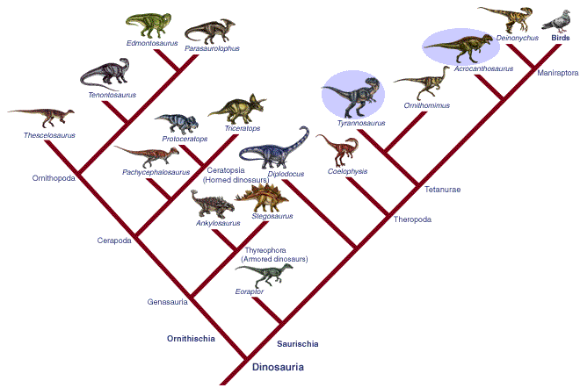
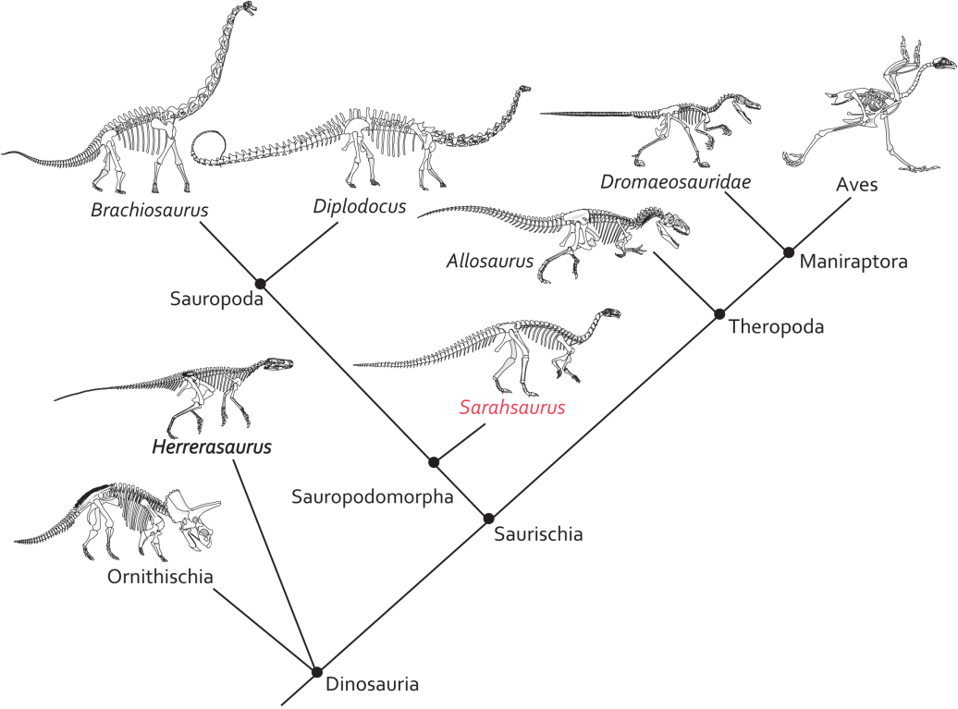
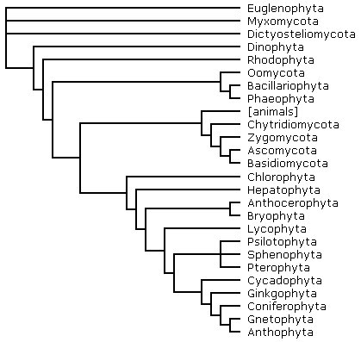
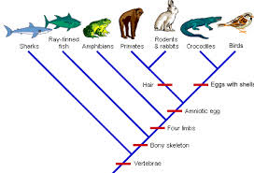
Cladograms come in all shapes as long as the criteria are all accounted for.

Slide 39



Who Knows What a Field Guide Is?

Slide 40
Biologists’ Field Guide
Field guides are a way for individuals not acquainted with the immediate area to avoid deadly situations (or less morbid, to gather relative biological information about an area).
In biology we use field guides to determine what species we are observing in the wild.
If we discover new organisms, we create new field guides of sorts, called dichotomous keys, that help us classify these organisms in an organized way.

Slide 41
Dichotomous Key
A dichotomy is any splitting of a whole into exactly two non-overlapping parts, meaning it is a procedure in which a whole is divided into two parts. It is a partition of a whole (or a set) into two parts (subsets) that are:
  jointly exhaustive: everything must belong to one part or the other, and
  mutually exclusive: nothing can belong simultaneously to both parts.
    Wikipedia.org

Slide 42
Dichotomous Key
In biology, a dichotomy is a division of organisms into two groups, typically based on a characteristic present in one group and absent in the other.
Such dichotomies are used as part of the process of identifying species, as part of a dichotomous key, which asks a series of questions, each of which narrows down the set of organisms.
A well known dichotomy is the question "does it have a backbone?" used to divide species into vertebrates and invertebrates.
  Wikipedia.org
This “either-or” technique can be used to help identify and classify individuals or groups of organisms.

Slide 43
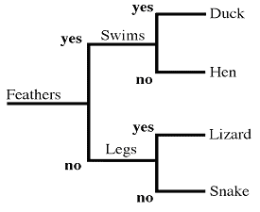
Dichotomous Key
Following a key is relatively easy.
Your put into a position that makes you decide one of two choices.
Just read the steps and make your selection.
The difficult part is making one that someone else can follow…

Slide 44
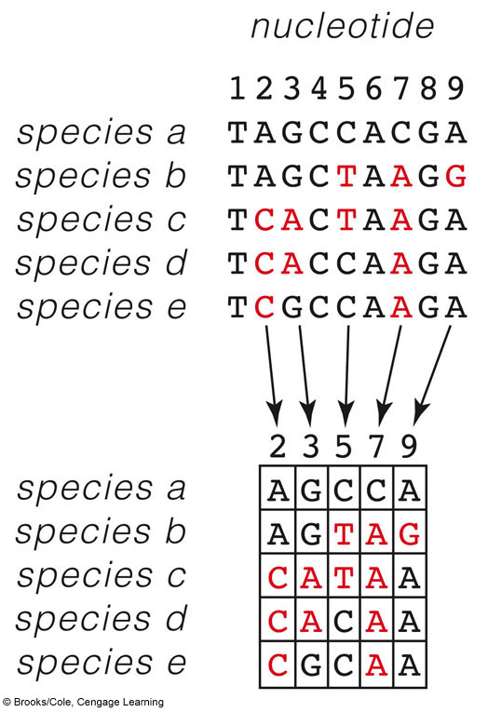
Species | Amino Acids Sequence
A | GDAEKG | 1
B | GSVKKG | 4
C | GDVAKG | 3
D | GDVEKG | 2
E | GSVSKE | 5
GDAEKG
GDVEKG
GDVAKG
GSVKKG
GSVSKE

Slide 45
A Character Matrix
Which are most similar?
A. a & e
How would you order these organisms?
A→E→(B or D)→C

