Slide 1
Physical v Chemical Properties Recap
Which questions represent physical properties?
Which questions represent chemical properties?

Slide 2
Section 4: Focus on Density
Objectives:
Define Density and understand how scientists use density.
Perform sample calculations with density.

Slide 3
Matter & Its Properties
Knowing fundamental physical and chemical properties of matter can help you:
Identify a substance and test its purity
Determine an appropriate substance for a particular application
To separate substances in a mixture
You’ve studied several.
Today we’ll be
Reviewing some measurement calculations &
Looking closely at the physical property called density.

Slide 4
How to get the units
It’s important to remember how exactly you get numbers you use for measurements.
Length (in meters) (therefore area and volume too) are measured using a ruler of some sort.
Volume (in liters) of a fluid-like or oddly shaped object can be achieved using a graduated cylinder or beaker.
It can also be calculated when you length, width, and depth.
Mass (in grams) is measured using a triple beam or digital balance.
& Remember…all measurements need the ACCURATE NUMBER (the last will always be a decimal) & UNITS to be complete.

Slide 5
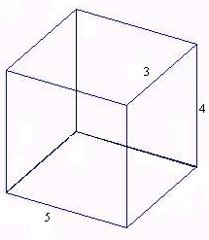
Measurements: Recall…
Volume is the amount of space an object takes up and is found by multiplying length times width times height.
V = l x w x h
It’s units are read as “cubic units”
What is the volume of this cube (it’s in cm)?
5cm x 3cm x 4cm
60cm³
You can also calculate volume using a beaker or graduated cylinder.

Slide 6
Measurements: Recall…
Mass is the amount of matter in a substance (# of atoms)
Weight is the mass of an object times the force of gravity.
Density is how much of a substance is packed into a given amount of space.
How many actual molecules.
m = 120g
V = 60cm³
Density is found by mass divided by volume.
Density = mass/Volume
It’s unit is read: “grams per cubic (unit)”
If the mass of the same block is 120 grams, what is it’s density?
120g/60cm³ = 2grams per cubic cm

Slide 7
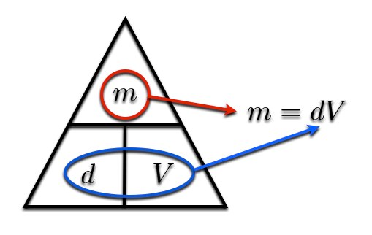
The Density Triangle
This tool can be used to remember the equation for finding density, mass, or volume when working with density problems…

Slide 8
Why Study Density?
Density is determined for substances because of several factors:
Identification of an unknown.
The density of a substance can determine its purity.
What is the difference between 24ca. And 14 ca. gold?
Silver, copper, cadmium, iron, nickel, zinc, all can be added
Mixing substances of varying densities can change the properties of the mixture.
We can increase the viscosity of a substance by mixing in denser fluids
Denser objects sink in substances of lower densities

Slide 9
Application: Measuring Fluid Density: With a Graduated Cylinder
Density of a liquid can be determined by weighing an accurately known volume of a liquid, using a graduated cylinder.
Measure a container’s mass using a balance.
Pour a known (or measured) volume of a fluid in the container to measure its volume.
Measure the new mass.
Subtract the new mass from the original mass to determine the mass of the solution.
Divide the mass by the volume.
When reading the volume of a liquid, take the reading at the lowest part of the meniscus.

Slide 10
Plot These Data
On the graph provided, plot these data points.
Draw a straight line through the points and determine the slope of these lines.
Use the equation RISE = Slope
RUN
Water |  |  | Mercury
Volume (mL) | Mass (g) |  | Volume (mL) | Mass (g)
0 | 0 |  | 0 | 0
5 | 5 |  | 2 | 27.1
10 | 10 |  | 3 | 40.65
15 | 15 |  | 4 | 54.2
20 | 20 |  | 5 | 67.75

Slide 11
Water |  | Mercury
Volume (mL) | Mass (g) | Volume (mL) | Mass (g)
0 | 0 | 0 | 0
5 | 5 | 2 | 27.1
10 | 10 | 3 | 40.65
15 | 15 | 4 | 54.2
20 | 20 | 5 | 67.75

Slide 12
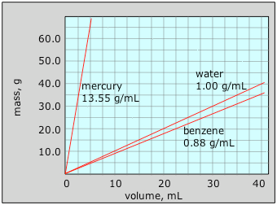
What You Have Determined…
Mass and Volume are two types of measured data.
The slope of these two properties (volume and mass) reveals the substance’s density at STP (at normal temperature and pressure).

Slide 13
Standard: The Density of Water
Water is the baseline for many measurements.
Temperature
Densities
Etc.
The standard density for water is 1.0g.mL.
But density depends on temperature!
Solid (ice): 0.9167 g/cm³
Liquid (water): 1.0 g/cm³ (at 4°C)
Gas (vapor): varies considerably
but warm moist air is less dense than cold dry air, hence the reasons why clouds hover in the sky.

Slide 14
Practice
You have 5 minutes to complete this practice.
Find the area of each side of A (A, B, & C).
Find the area of each side of B (use your handouts to calculate the volume of a cylinder)
Find the volume of A & B.
Find the density of A & B.
B.
r = 3cm
π = 3.14
Mass = 100g
B
A. mass = 64g
2cm
4cm
C
A
4cm
4cm

Slide 15
Independent Practice
You have been given practice problems to work on.
Work through the example problems until class ends.
These are due tomorrow.
L = 5m
W = 5m
H = 3m
r = 5cm
h = 2cm
r = 4m
d = 9m
Mass = 9g
L = 6cm, w = 2cm, h = 3cm.
Mass 10g

Slide 16
5m x 5m x 3m = 75m³ | 3.14 x (5cm)² x 2cm 3.14 x 25cm² x 2cm =157cm³
6cm x 2cm x 3cm = 36cm³ 10g = 0.28g/cm³ 360cm³ | 3.14 x (4m)² x 9m = 452.16m³ 9g = 0.111g/m³ 452.16m³
L = 5m
W = 5m
H = 3m
r = 5cm
h = 2cm
L = 6cm, w = 2cm, h = 3cm.
Mass 10g
r = 4m
d = 9m
Mass = 9g

