Slide 1
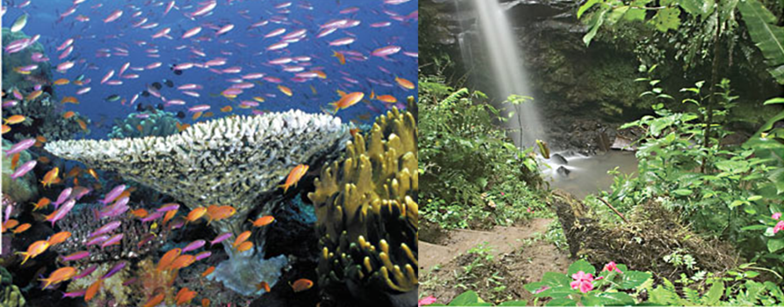
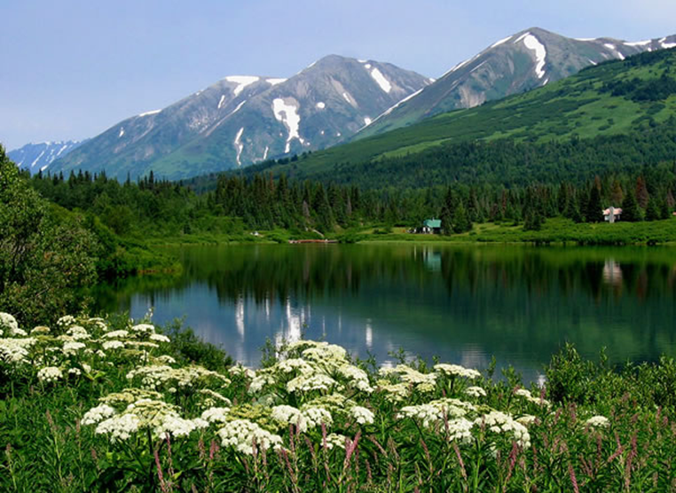
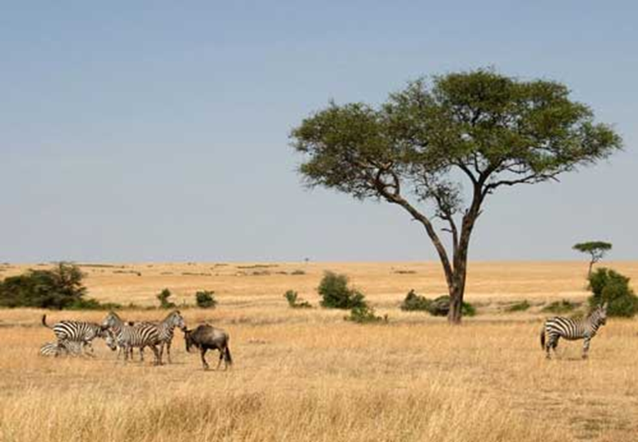
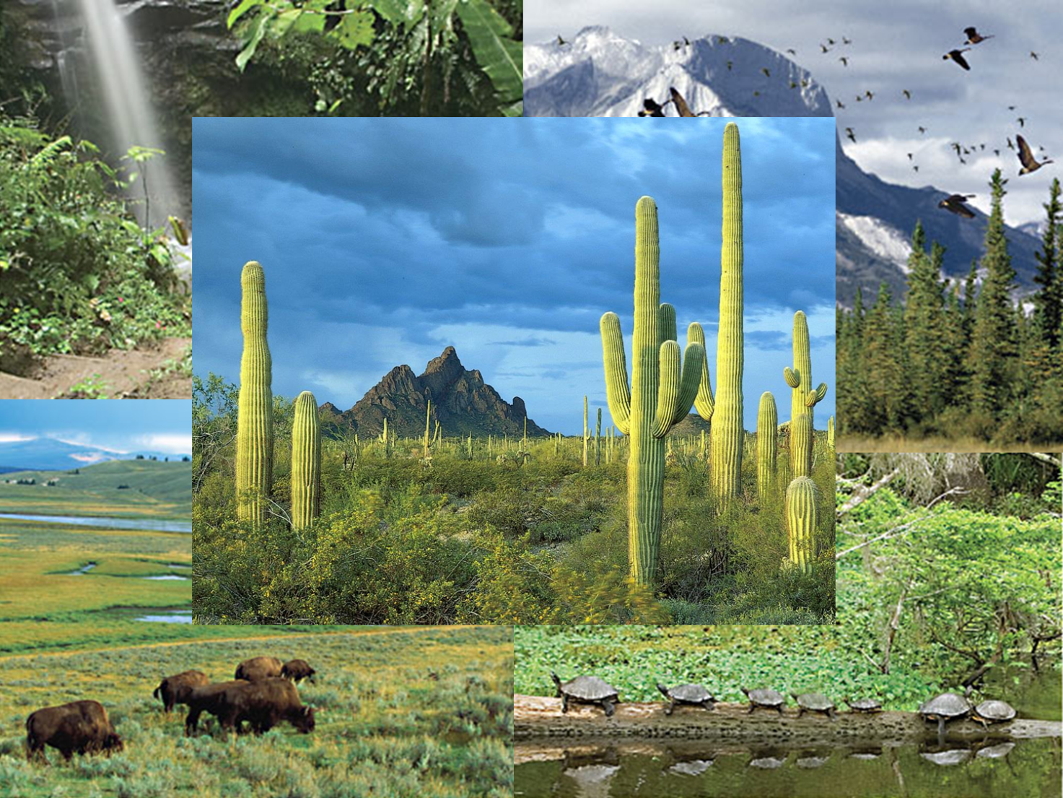
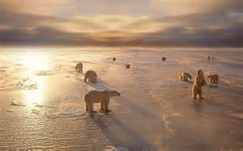
Part 1. Ecosystems

Slide 2
Objectives Part I: Ecosystems
Describe the difference between an ecosystem and a community.
Explain how an ecosystem responds to change.
Identify the three major groups of terrestrial biomes.
Describe the four types of aquatic ecosystems.
Identify two factors of climate that determine a biome.

Slide 3
Vocabulary
Community
Ecosystem
Habitat
Biodiversity
Succession
Climate
Biome

Slide 4
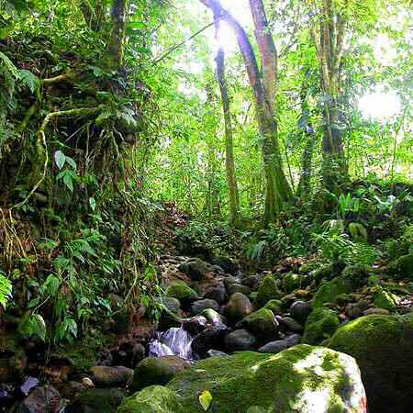
Ecosystems
In any environment you encounter you witness a multitude of many different organisms.
That you may not witness or may not know is that most, if not all, of the organisms in the environment interact.
The fact is that all organisms that live together are interdependent.
Either directly (like predators and prey) or indirectly (like
This means they rely upon and are affected by one another.

Slide 5
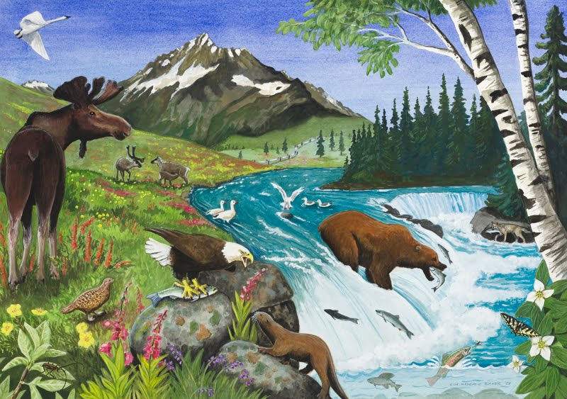
Ecosystems
A group of organisms, along with the living and nonliving environment, make up an ecosystem.
Every ecosystem is unique and if you apply yourselves, you will learn to identify the key features of an ecosystem and identify the interconnectedness that exists in any you encounter.

Slide 6
Ecosystems
Are broken down into two parts.
Biotic = The living part of an ecosystem involve the communities of organisms that live there.
This includes the animals and plants of the ecosystem.
Abiotic = The physical, non-living part.
Includes an organism’s habitat = the physical makeup of where it lives.
Examples: the air (oxygen), water, rocks, sand, sunlight, temperature, and climate.

Slide 7
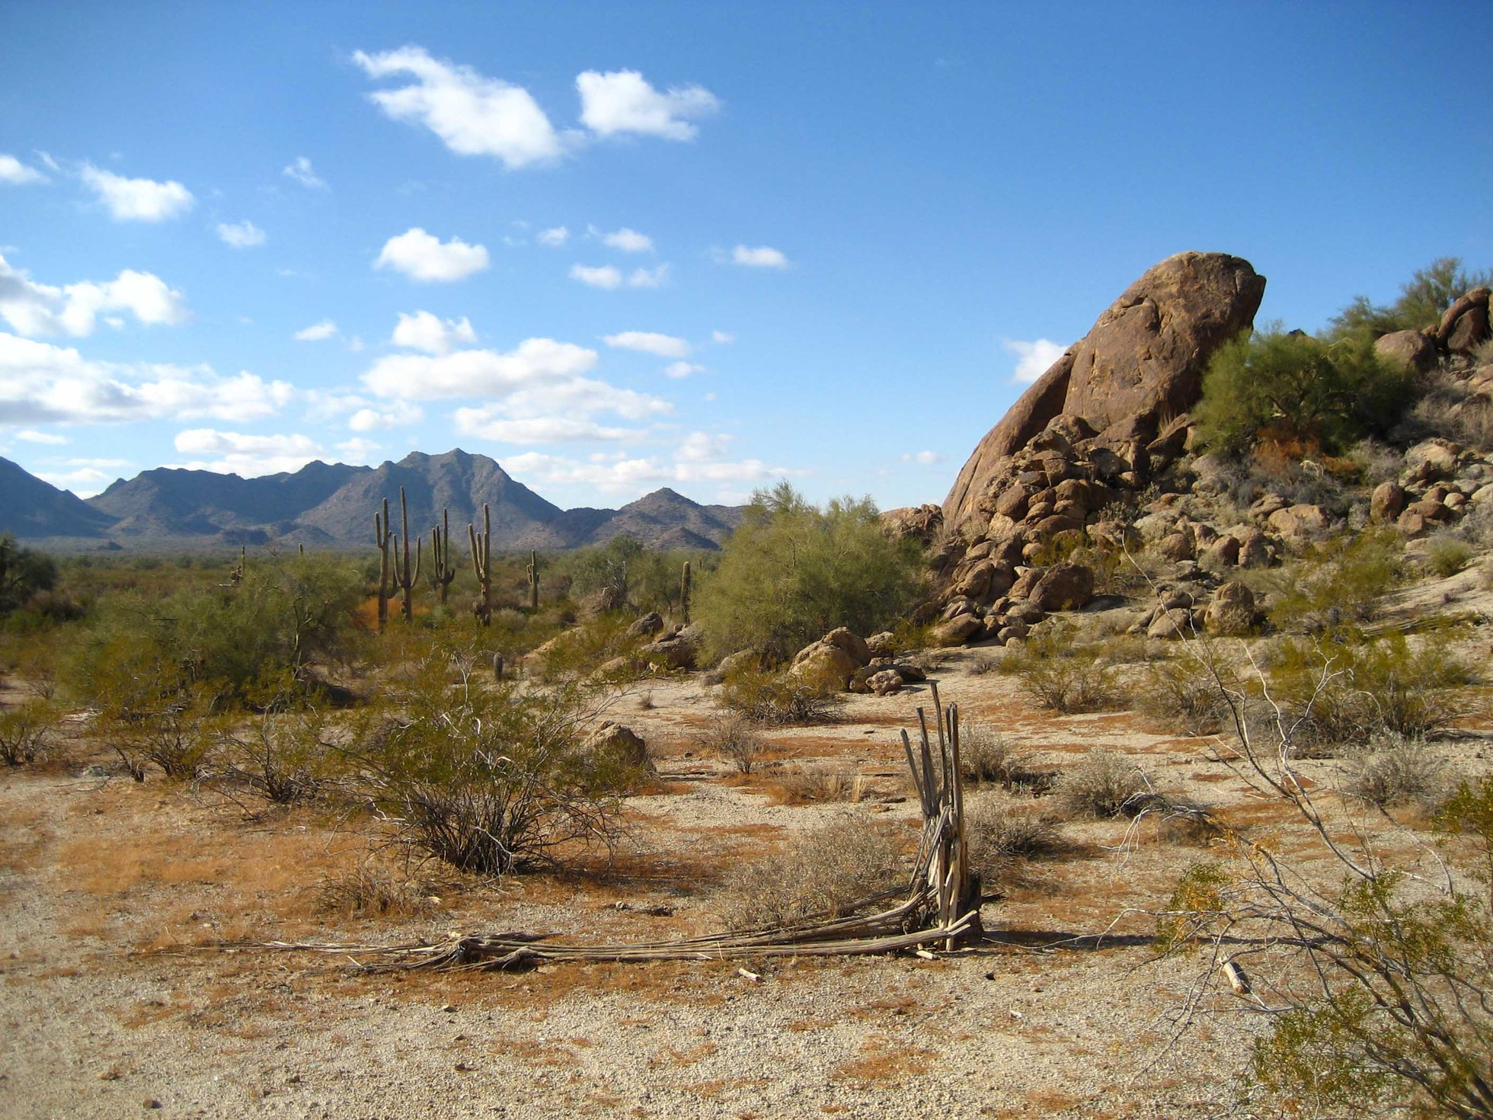
Ecosystems & Abiotic Factors
The weather & climate
Abiotic factors are the non-living factors that affect life.
They are what’s left after everything living has been taken out.
Examples:
Biotic factors are the living influences on life.
Examples:
The moving organisms
The habitat
The plant life
The soil

Slide 8
Ecosystems & Biotic Factors
A community includes everything (all plants, animals, bugs etc.) that is alive in a location,
But not every ecosystem is the same when you look across the world.
The differences are evidence in the diversity of life all across the Earth’s many ecosystems.
Meaning…that there is a great number of different types of organisms in any one area.
The measure of the variety of organisms in a given area determines the ecosystem’s biodiversity.

Slide 9
Ecosystem Diversity = Biodiversity
Biodiversity is an important aspect when studying ecosystems.
Tells how healthy and responsive an ecosystem is.
The biodiversity of the ecosystem will determine how well it responds to changing abiotic factors (such as temperature and rainfall), as well as, natural and man-made disasters (such as…?).
Ecosystems with high biodiversity are better at responding to change, therefore more resilient.
This response is measured by how quickly life can return to normal levels after a disaster.

Slide 10
The Effects of Biodiversity.
Systems with low biodiversity can be severely damaged easily.
This is because of the low number of organisms to have offspring (plants, food sources, prey, and predators alike).
When biodiversity changes in any ecosystem, that ecosystem’s health changes too.
Regardless, an ecosystem will respond (when it can) in such a way as to restore the ecosystem back to equilibrium & balance.
The higher the biodiversity the easier it is to stay in equilibrium.

Slide 11
Concept Check
Get into groups.
Examine the following ecosystems. Rate the ecosystems 1-4 (1 being the lowest) based upon the biodiversity. Give 2 pieces of evidence as support.
Identify how this ecosystem would respond to great change and how easy it would be to return to equilibrium.

Slide 12
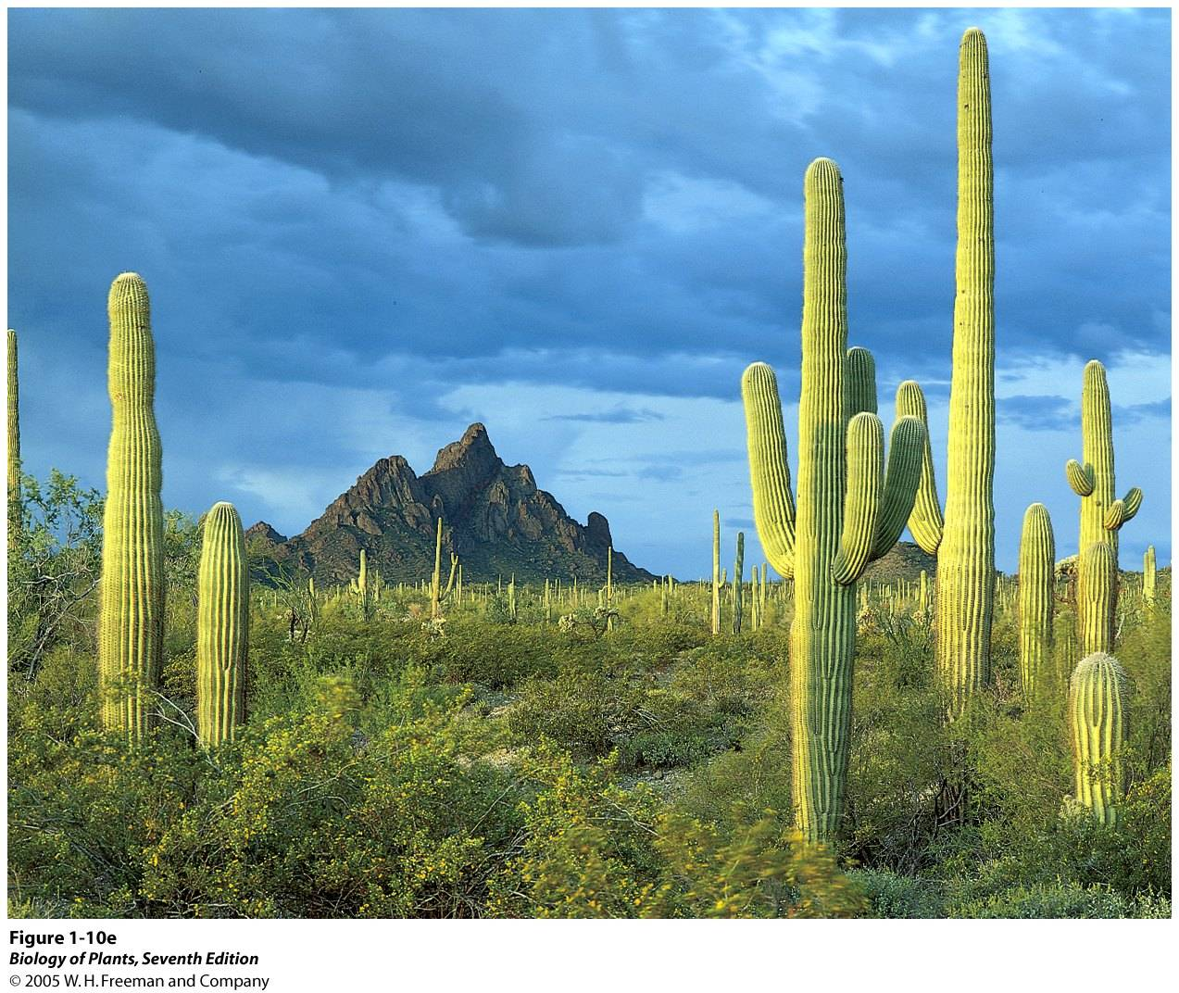
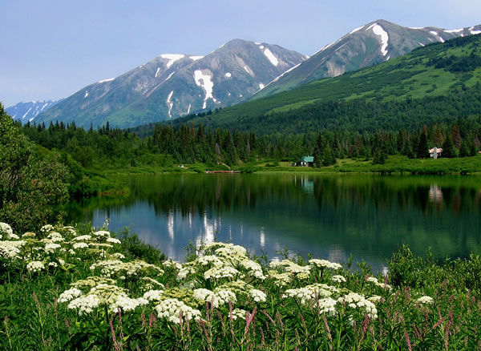
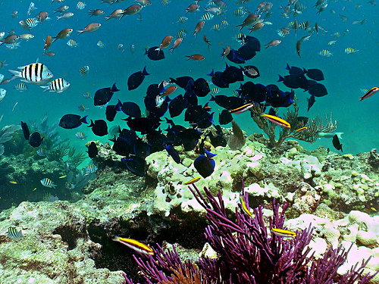
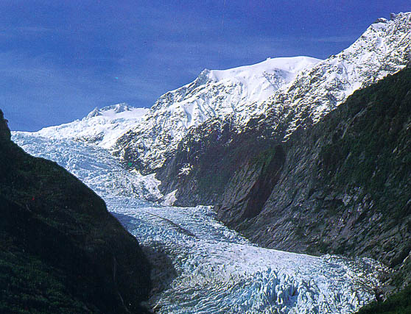
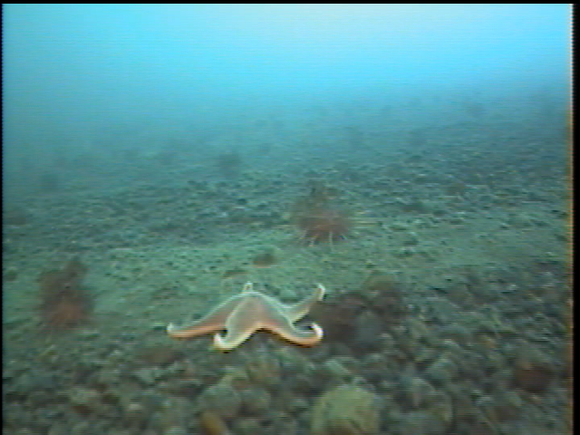
Rate the ecosystems according to its biodiversity on a scale of 1-4. Give 2 pieces of support.
1. The Savana
2. The Sonoran Desert
3. Southeastern Alaska
4. Gulf of Mexico

Slide 13
Evolution of an Ecosystem: Succession
Some ecosystems respond rapidly to change, some are very gradual…almost unnoticeable.
Environmental organizations claim that every ecosystem goes through great changes over long periods of time.
The estimate is that roughly every 10,000 years every climate can change drastically, causing a shift in the biodiversity of an ecosystem.
The process where one community replaces another community over long periods of time is succession.
This could be considered the evolution of an ecosystem.

Slide 14
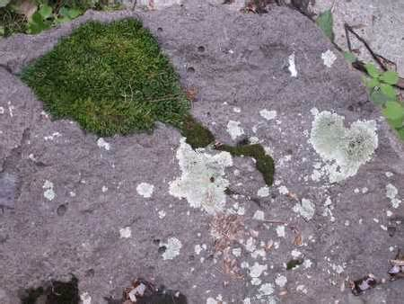
Pioneer Species
When an ecosystem is created life is initiated by a pioneer species.
Primary Succession starts with a pioneer species.
the first organisms to appear in a newly made habitat.
Often they change the habitat in such a way that other species can live in the ecosystem.
By decomposing and providing nutrients for new species.
EX. Lichen or moss

Slide 15
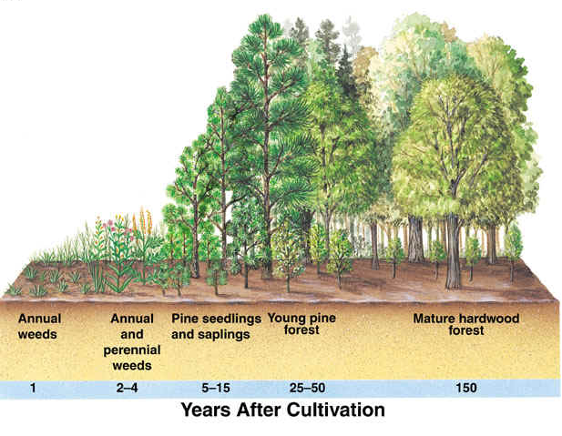
Then Primary Succession Occurs
Once the lichen & moss have deposited their remains in the soil it will become fertile enough for the larger weeds.
Then they’ll die & decompose, further fertilizing the soil.
Then larger and larger plants can grow and be sustained.
Primary Succession
Primary succession

Slide 16
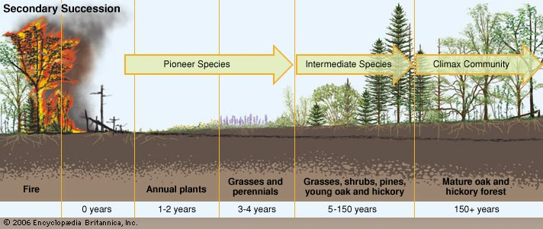
Secondary Succession
Succession can also occur in an established ecosystem.
When a catastrophic event takes place, such as a forest fire or volcano, the barren soil left behind will recover.
Secondary succession happen when a previously established ecosystem recovers from a natural disaster.
The biodiversity of surrounding ecosystems will play a role in how fast this occurs.

Slide 17
Ecological Succession at Glacier Bay

Slide 18
Ecosystems The Earth Has Now
After millions of years of evolution, erosion, natural disasters, shifting climates, plate tectonics, and everything else that has shaped our Earth, we are given the extreme diversity in habitats we see today.
The physical landscapes helped shape the biodiversity present.
Biology would be incomplete if we didn’t take time to study the environments that influence life.

Slide 19
Biomes: Major Biological Communities
A biome is a region, much larger than an ecosystem, characterized by a specific kind of climate and certain kinds of plant and animal communities.
It’s the environment that really defines what can live where.
The kinds of species that live in a particular place are determined partly, if not completely, by climate.
the average weather conditions (sunlight, rain & temperature) in an area over a long period of time.
You can notice this just by driving from here to Flagstaff.
How many different species of life (not just animal – plants included) can you find from here to there?
As a result of the diversity in habitat, species (trees, animals, insects) that live in a climate do so because they are specifically built for it, as a part of a biome.

Slide 20
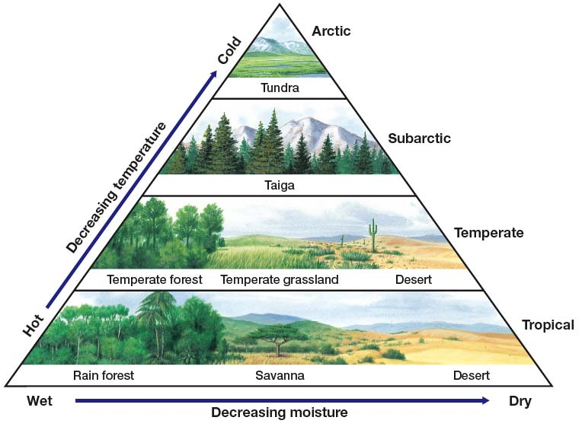
Elements of Climate

Slide 21
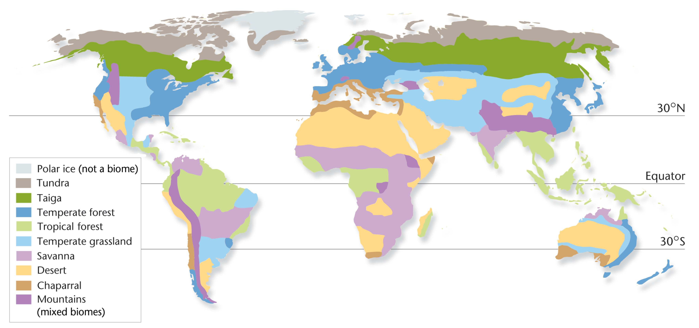
Major Biological Communities
Biomes are very diverse but can be categorized into major groups.
Their boundaries are determined first by latitude, then by climate.

Slide 22
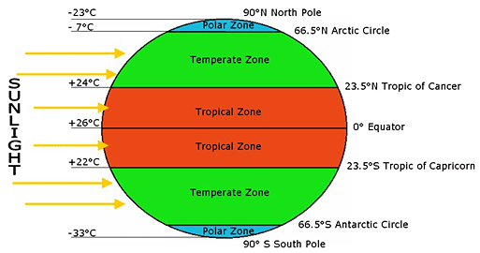
1st Basic Ecosystem Condition: Latitude
The first condition to define a biome is by how close to the equator it is.
Give us three major categories:
Tropical
Temperate
High-latitude
High Latitude Biomes
Temperate Biomes
Tropical Biomes
Temperate Biomes
High Latitude Biomes

Slide 23
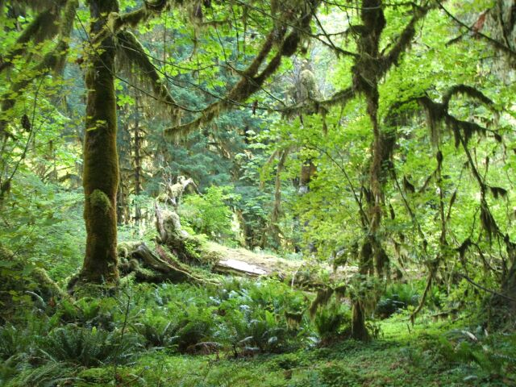
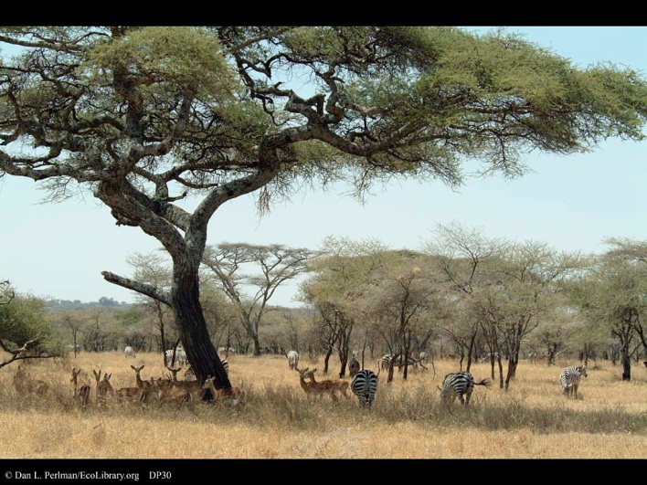
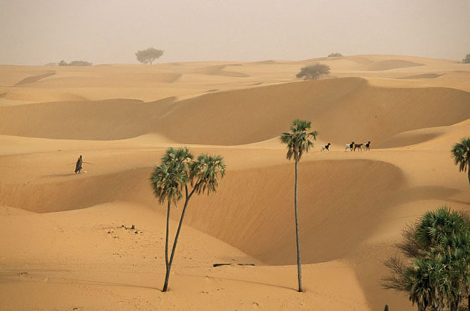
Terrestrial Biomes,
Tropical Biomes
Because they are located at low latitudes near the equator, all tropical biomes are warm.
Tropical rain forests receive large amounts of rain and are warm all year. They have the greatest biodiversity of any land biome.
Savannas are tropical grasslands that have long dry seasons and shorter wet seasons.
Tropical deserts get very little rain. Because deserts are drier, they have fewer plants and animals than other biomes.

Slide 24
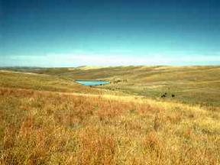
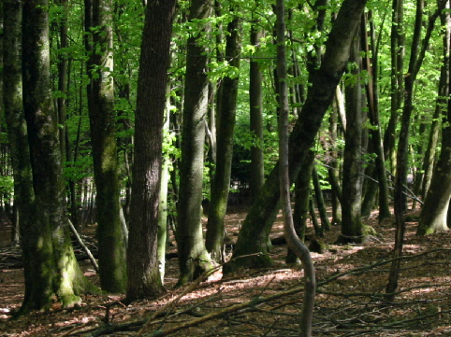
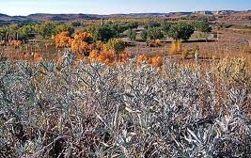
Terrestrial Biomes, continued
Temperate Biomes
Biomes at mid-latitudes have a wide range of temperatures throughout the year.
Temperate grasslands have moderate precipitation and cooler temperatures than savannas do. Temperate grasslands are often used for agriculture.
Temperate forests grow in mild climates that receive plenty of rain.
Temperate deserts receive little precipitation, but have a wide temperature range throughout the year.

Slide 25
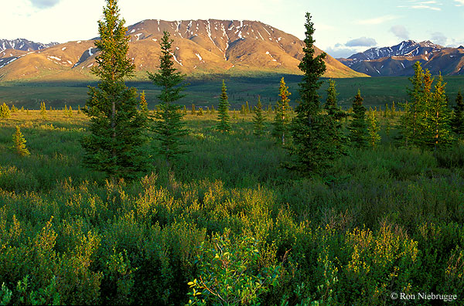
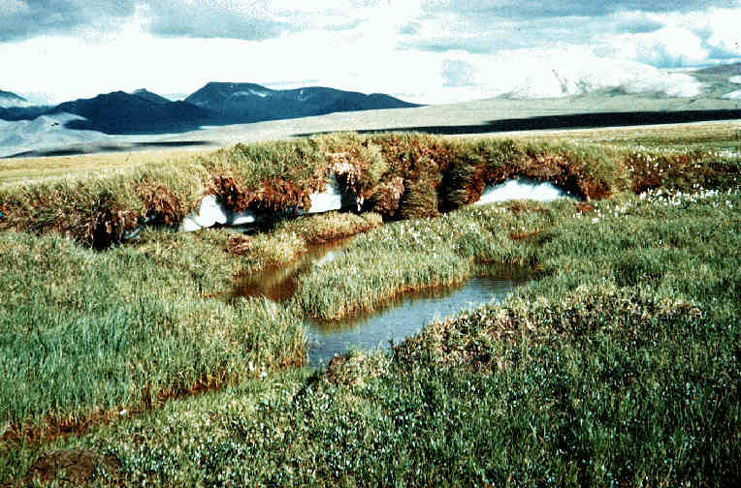
Terrestrial Biomes, continued
High-Latitude Biomes
Biomes at high latitudes have cold temperatures.
Coniferous forests in cold, wet climates are called taiga. Winters are long and cold. Most of the precipitation falls in the summer.
The tundra gets very little rain, so plants are short. Much of the water in the soil is not available because the water is frozen for most of the year.

Slide 26
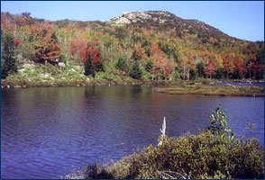
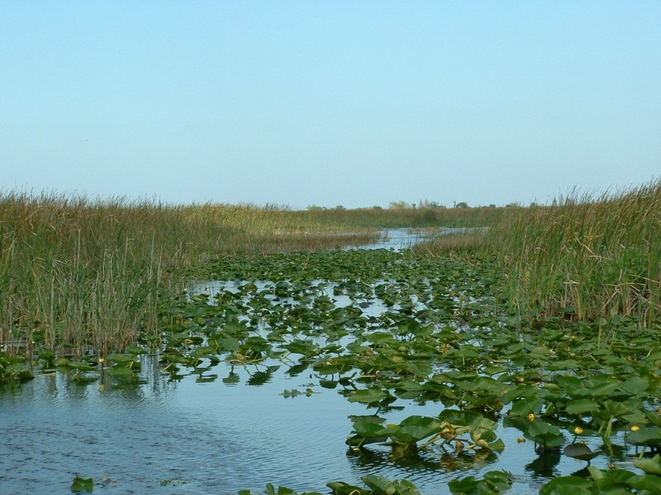
Aquatic Ecosystems
Aquatic ecosystems are organized into freshwater ecosystems, wetlands, estuaries, and marine ecosystems.
Freshwater ecosystems are located in bodies of fresh water, such as lakes, ponds, and rivers. These ecosystems have a variety of plants, fish, arthropods, mollusks, and other invertebrates.
Wetlands provide a link between the land and fully aquatic habitats. Water-loving plants dominate wetlands. Wetlands moderate flooding and clean the water that flows through them.

Slide 27
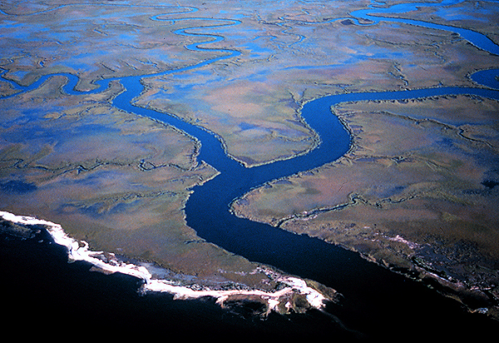
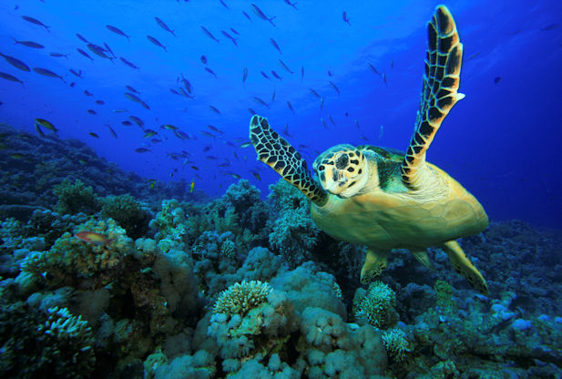
Aquatic Ecosystems
An estuary is an area where fresh water from a river mixes with salt water from an ocean. Estuaries are productive ecosystems because they constantly receive fresh nutrients from the river and the ocean.
Marine ecosystems are found in the salty waters of the oceans. Kelp forests, seagrass communities, and coral reefs are found near land. The open ocean, far from land, has plankton and large predators, such as dolphins, whales, and sharks.

Slide 28
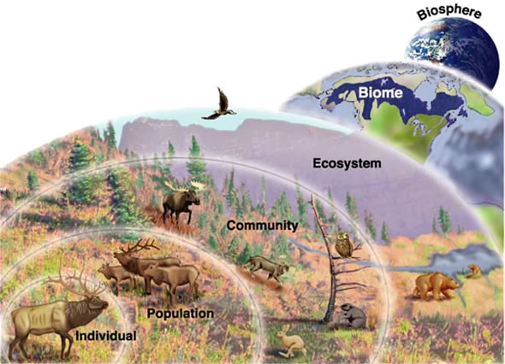
Ecosystem Levels of Organization
How do these concepts fit together?

Slide 29
Concept Check
Which is bigger and more inclusive, communities or populations?
Which has only 1 type of organism?
If a new island formed in the Pacific Ocean, what kind of organism would be the first to establish a population there?
After a volcanic eruption has covered an area with lava, what type of ecological succession occurs?
What is biodiversity?
Why is biodiversity important to take notice of?
What type of biome would include the grasslands of the Serengeti?
What type of biome do we live in here in Arizona?
What type of biome has the most biodiversity on Earth?
What type of biome has the least biodiversity on Earth?

Slide 30
POGIL Answers.
Tundra/Desert
Tropical rainforest
Deserts
Temperate forests
.
Coniferous, deciduous (temperate), tropical
Taiga
.
Temperate
Little water but freezing temps
.
Precipitation
Not enough water
The combination of precipitation and temperature are indicators of these type of forests that exist in the N. American biomes.
.
The trend in biodiversity = how many organisms live in the region.
How far from the equator the biome is.
The distance from the equator relates to the average temperatures. The farther from the equator the lower the temps get.
Q: (Addition) Do you think this graph is set up correctly? Consider the variables involved, do you think that distance responds to biodiversity (as the graph would indicate) or the other way around? A: the dependent variable (in this case biodiversity) goes on the y-axis.
.
Tundra
Taiga
Desert
Grassland
Deciduous forest
Tropical rain forests
See Map
.
Artic
Tundra
Tropical
Rain forest
.
Tropical rain forest
Moderate temps & lots of rain
Tundra
Low temps, little precipitation
Biodiversity, dependent upon temps and precipitation, increase moving towards the equator.
.
Temperatures + Precipitation
Desert
Decreased food supply of the basic grain variety.
Tropical rain forests support many different organisms. W/out the forests many species would suffer.

