Slide 1
Paleoclimatology

Slide 2
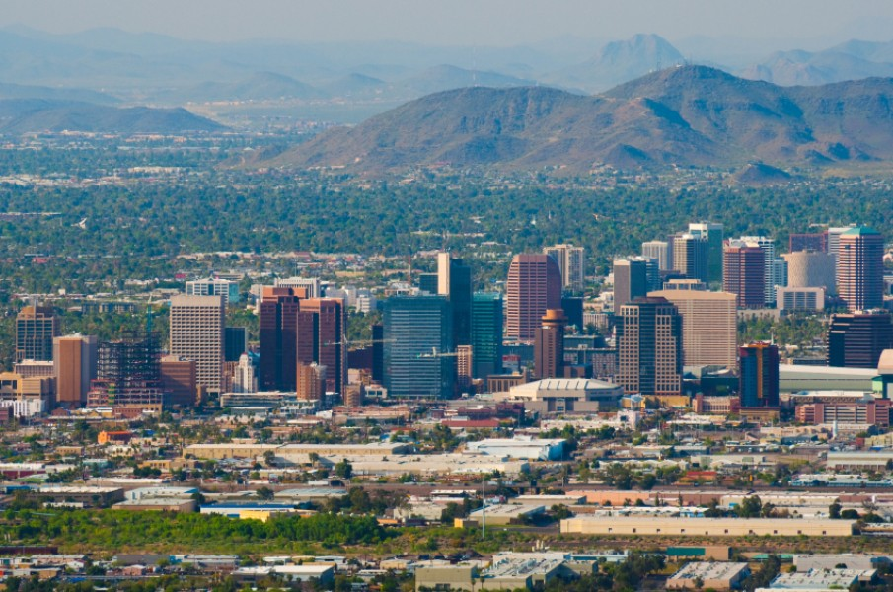
Introduction
If we think about the differences in climate between Phoenix and Moscow what do we know?
Has this always been the case?
Will this continue to be the case?
Knowing how to predict climate in the current state of things on Earth is one thing.
Being able to analyze long-term data to make predictions is something else entirely.
This next section focuses on how scientists use particular types of long-term data to make inferences about historical weather patterns and help shape predictions for the future.

Slide 3
Define: 1. Paleoclimatology
Paleoclimatology is the study of changes in climate taken on the scale of the entire history of Earth. (or at least as much as possible!)
Long-term climate characteristics for the Earth and particular regions therein are determined by using proxy climates.
Proxy climates are imprints of characteristics of the atmosphere throughout time trapped in several mediums we can examine.

Slide 4
What Types of Data Exists?
Geological artifacts
Displaced geological artifacts
Fossils
Sediment Layers
Ice Cores
Tree Rings

Slide 5
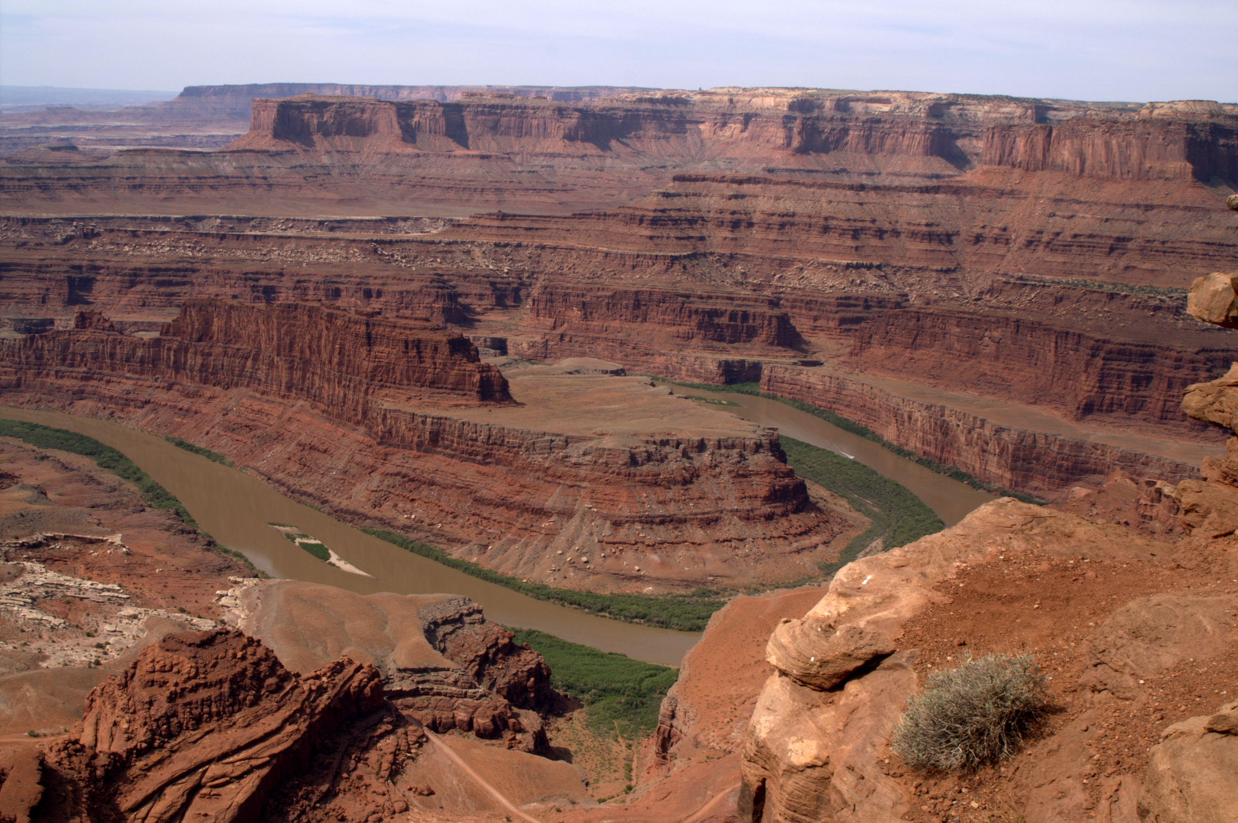
The Grand Canyon
Most of us have had the opportunity to see this natural wonder of the world.
What is one feature of this canyon that could help us investigate historical atmospheric conditions?

Slide 6
2. Law of Superposition
To help better understand how we use data in paleoclimatology you must understand the Law of Superposition and how it is used to help determine the composition of the ground where data is collected.
Superposition is the principle that when layers form the lowest is the oldest.
Superposition works like this.
Land forms (volcanos, etc.).
Some force (like oceans, volcanos, rivers, etc.) brings in more land in (as sediment, ash, silt, sand, etc.)
This new land positions itself on top of the old land.
This process continues over many years making the bed of layers thicker and diversified.
Sediment
Sand
Sediment
Silt
Sediment
Original Earth

Slide 7
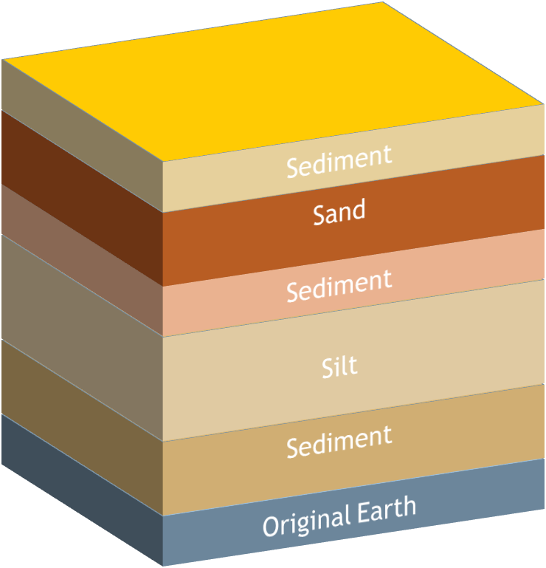
What Superposition Tells Us
Superposition tells us that whatever data we collect from a layer should have occurred during the time the layer formed.
If we think logically, we can understand that the oldest layers are laid down first.
Followed by younger and younger layers.
Think about anything living there that may be trapped in the layers as they’re laid down.
What do you think would be the result?
If depends on what it is and the speed the layers are laid down.
Rocks and other solid things will be trapped and likely preserved.
If slowly created, then soft organic features of living things dissolve away over time.
If rapid though, remains of living things may be trapped, leaving signs behind, like fossils.
YOUNGEST LAYER
OLDEST LAYER

Slide 8
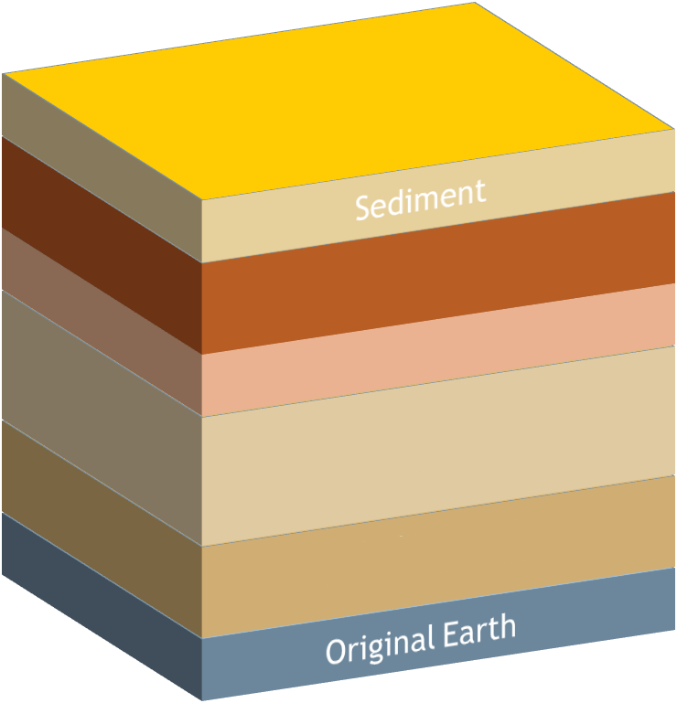
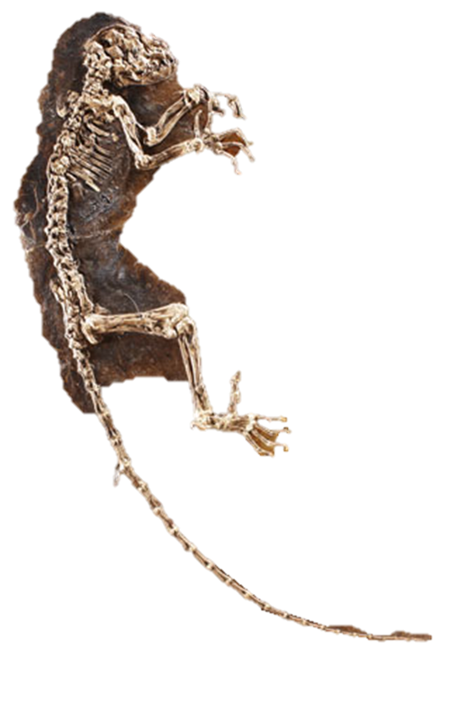
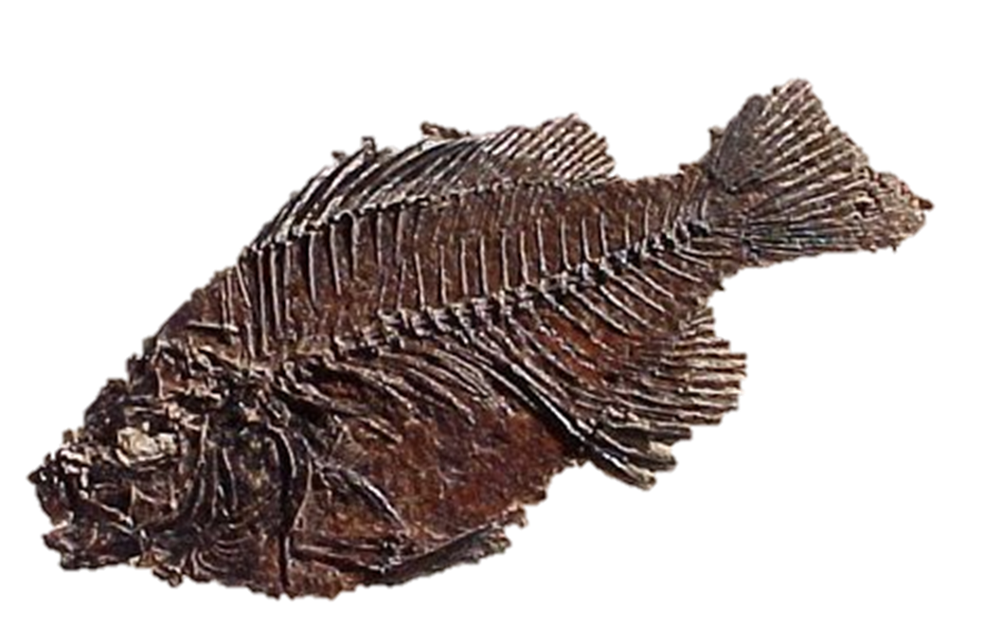
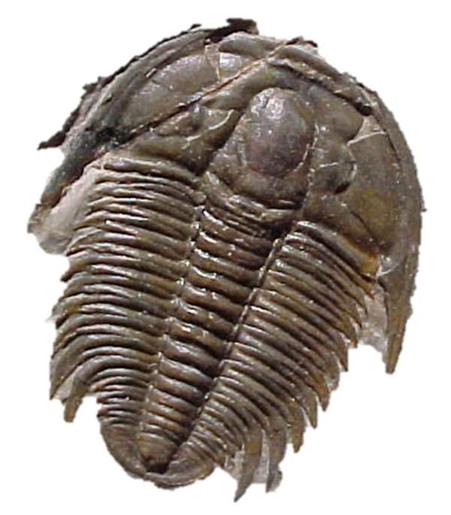
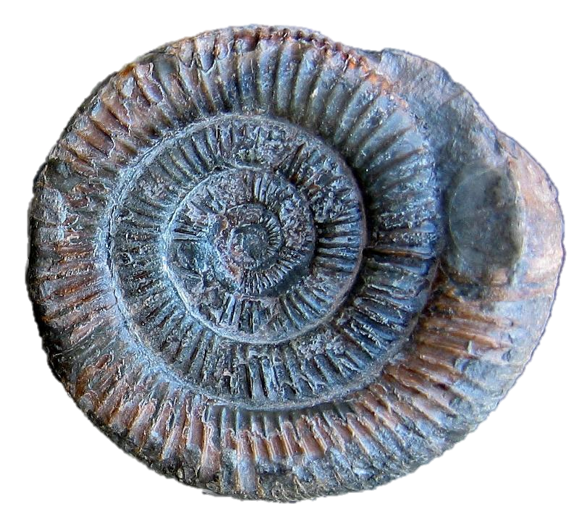
Other Data
So, oldest on bottom, youngest on top.
What about the fossils then?
The fossils in the bottom layer are presumed to be older than those on top too.
(if no geological disturbance happens)
In addition, these layers can contain chemical traces of the environment when they were laid down.
Levels of CO₂, O₂, Methane, etc.
Sometimes temperatures and other aspects can be identified.
We can collect data about:
Organisms (plants, animals)
Atmospheric conditions
Geologic activity that caused the layer.
Younger and more complex organisms
Youngest Layer
Older and simpler organisms
Oldest Layer

Slide 9
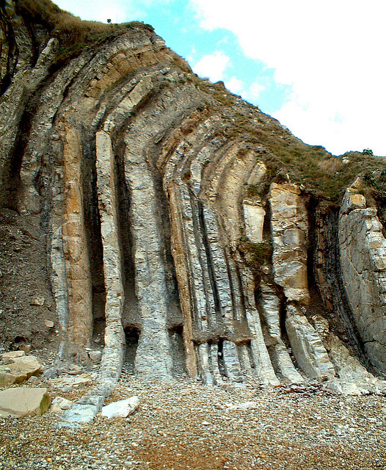
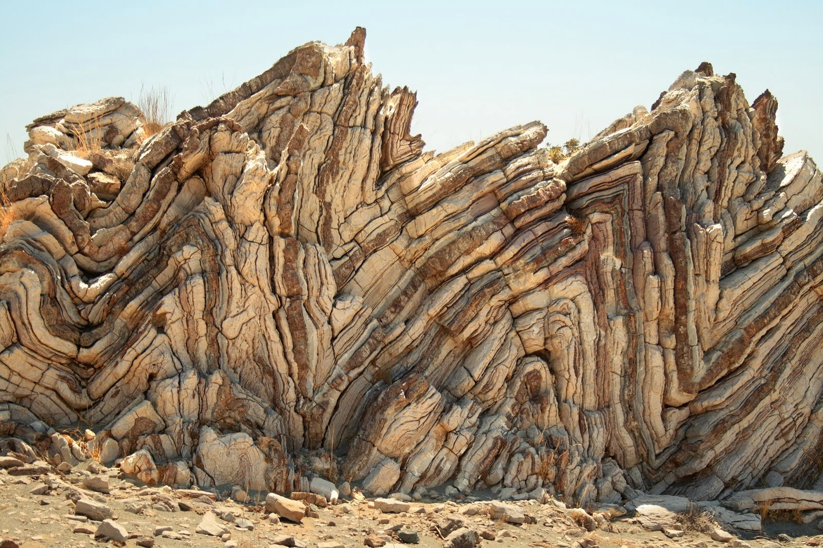
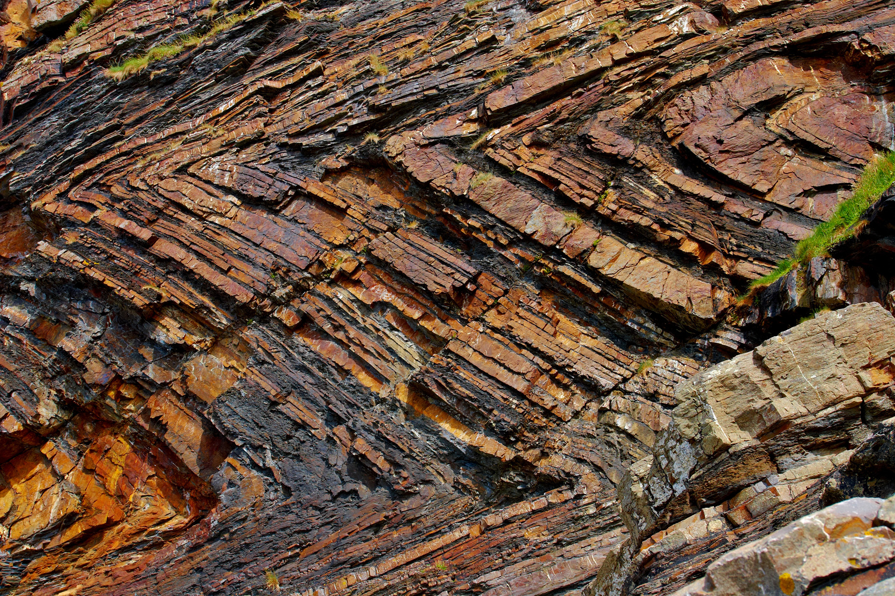
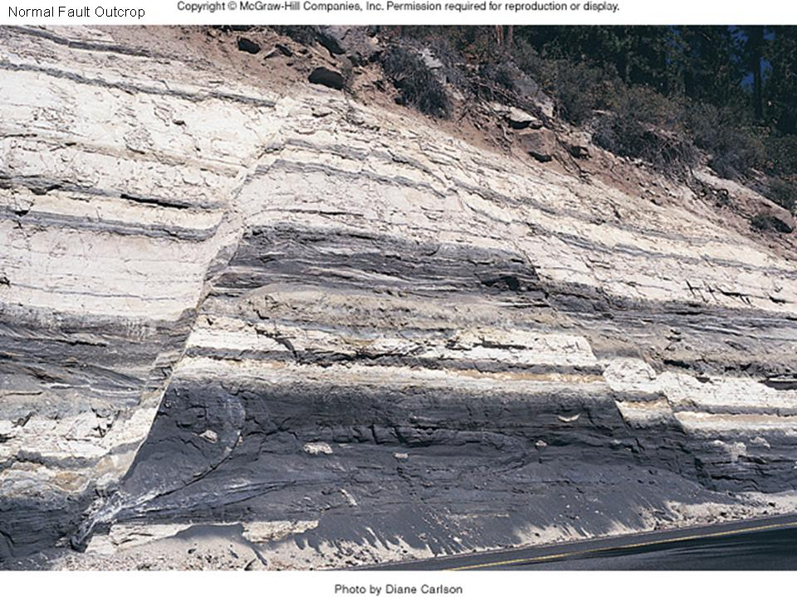
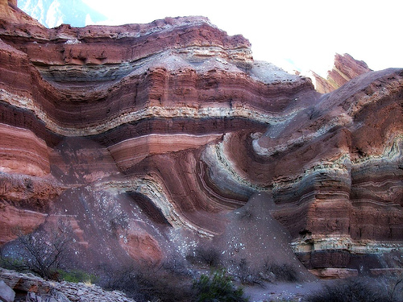
Geological Manipulations
We should also understand that our Earth is constantly changing.
Floods, fault lines, earthquakes, plate tectonics, erosion, volcanos, and other major processes are constantly reshaping the Earth’s layers.
This can create confusion to the untrained eye.
We won’t go into depth on geological features, but understand that looking under the ground is a complex undertaking.

Slide 10
Mediums for Evidence
We determine climate over long periods of time by studying artifacts that exist in numerous places and forms on Earth.
Fossils
Natural Hydrocarbons (Oil, Natural Gas, Coal)
Sediment Cores
Ice Cores
Tree Rings

Slide 11
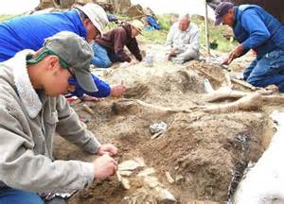
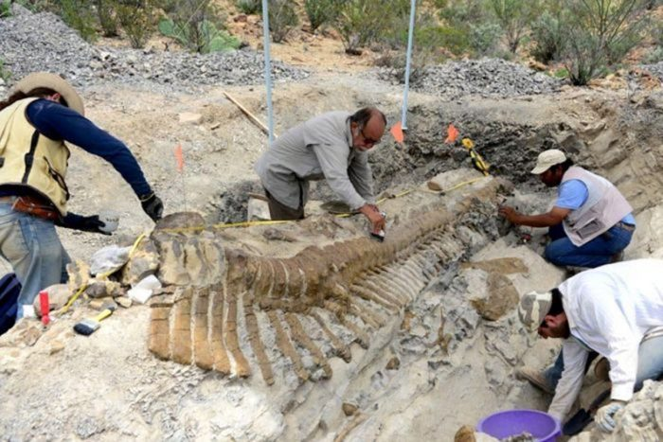
3. Fossils
Fossils are the left over remains of organisms that lived long ago.
Their carbon-based skeletons (either internal or external) are left behind when the living organism was quickly trapped under sediment or in other mediums (like sap).
They appear as a result of…
Impressions or molds, which shows an impression of the original
Replacement chemical reactions: minerals in ground water seepage replace the bones
Permineralization: minerals from ground water seepage fill up empty spaces in the organism and solidify it.
Fossils are excavated out of fossil beds on land or by taking core samples of ocean, sea, and lake beds.

Slide 12
Fossils
Fossils are useful to study for three reasons:
We can determine characteristics of the organism’s habitat (physical surroundings) by how it’s built:
Does it have legs, wings, fins, shells, etc? That can tell us if it lived in an aquatic or terrestrial ecosystem.
We can sometimes use fossil composition [what the fossil is made of] to determine atmospheric conditions.
For example, shelled creatures create their shells from the minerals in their surroundings. What we find is that there is a different composition to the shells of organisms that lived in different times indicating that the environment has changed.
We can obtain the relative ages of the fossils using dating techniques.
We know the order things existed in by determining their age. This becomes a source of debate as science is split on the most reliable dating method (mostly carbon-dating), however, most of science agrees in their order in time.

Slide 13
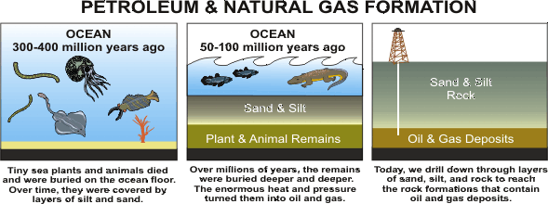
4. Natural Hydrocarbons
The dead remains of organic life forms have accumulated over thousands of generations, being buried by silt and sediment.
As time passed and pressure on top of these organisms built, the remains were transformed into hydrocarbons like oil, natural gas, or coal usually trapped in shale.
This is important because we can guess that if there are hydrocarbons in a region that must mean that the region has been inhabited by a lot of previous plant and animal life.
For example, part of the reason we know that the Arabian peninsula was once a lush forest is because of all the oil there now!

Slide 14
Superposition. Organic Layers

Slide 15
5. Sediment*
In general, species composition within sediment can help determine climate conditions when that layer formed.
What is studied:
The size of the layers: Indicate the length of climate stage.
The number of layers: Indicate the rate at which the climate changed.
Microorganisms: the types of living things in the layers and what they’re made of give clues to climate conditions. (because they absorb them)
Charcoal: Could indicate major fire events.
Pollen: Pollen is released during the reproductive season of plants. The more pollen found in a stratum indicates wetter climates.

Slide 16
A sediment core drilled from Blacktail Pond, Yellowstone National Park. Photo courtesy of the Montana State University Paleoecology Lab.

Slide 17
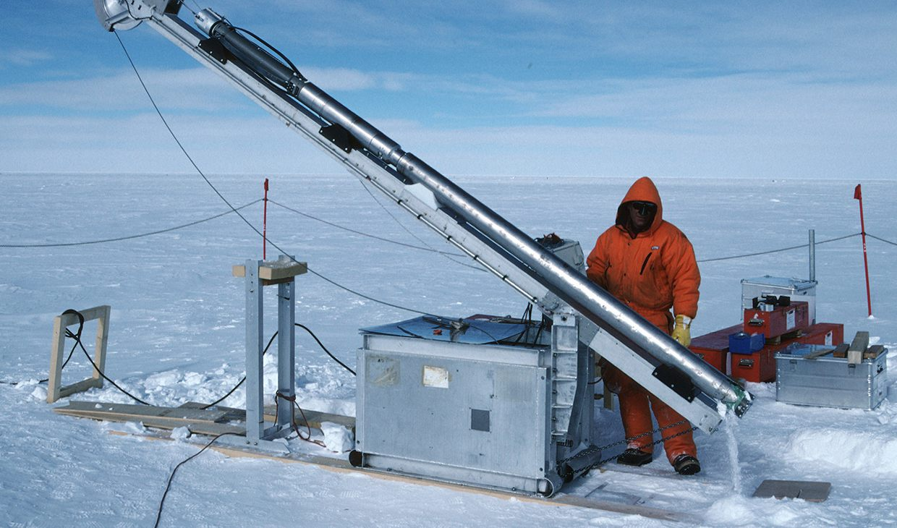
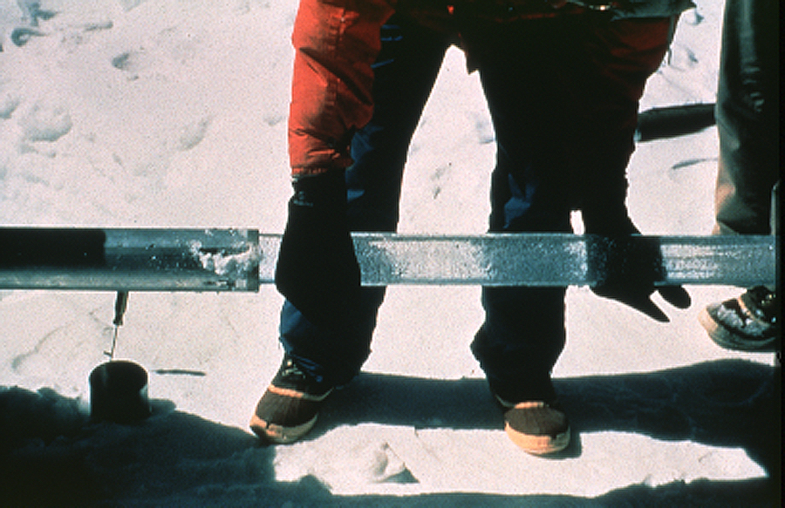
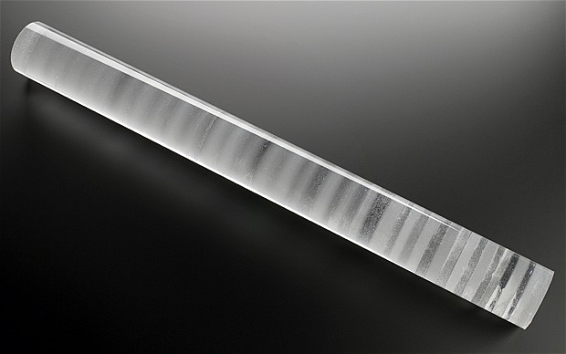
6. Ice Cores*
Glaciers are thick slabs (thousands of feet at times) of permanent ice made of multiple unique layers.
Glaciers still exist in several places on Earth.
They form from snow falling on land, but can only form if the snow doesn’t melt year to year.
The snow accumulates over many years.
As the snow accumulates the weight of the snow on top compresses the snow below into ice.
When the layers on bottom are compressed, any air trapped within the snow is stored in the ice.
Scientists can then drill into the glaciers and extract ice cores.
These ice cores, which contain samples of the air within the atmosphere when the snow originally fell, can be studied by scientists to get an idea of what the conditions were when made.
Two important features of ice cores are important: the depth at which the ice was found (determining age) and what chemicals in the air were trapped inside (determining the composition of the atmosphere).

Slide 18
Ice Core Drill

Slide 19
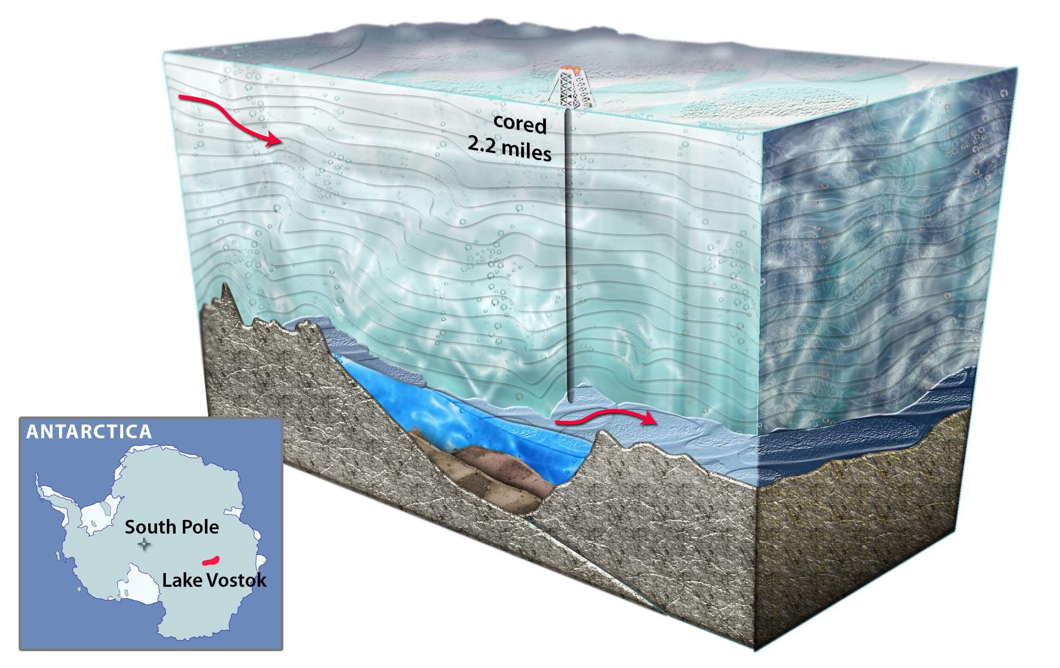
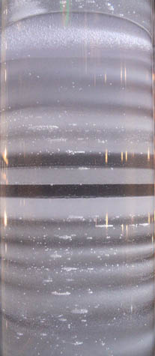
Ice Cores*

Slide 20
Tree Ring Analysis*
The study of annual tree rings is called Dendrochronology.
Why it’s done:
to put the present in proper historical context
to better understand current environmental processes and conditions
to improve understanding of possible future environmental issues

Slide 21
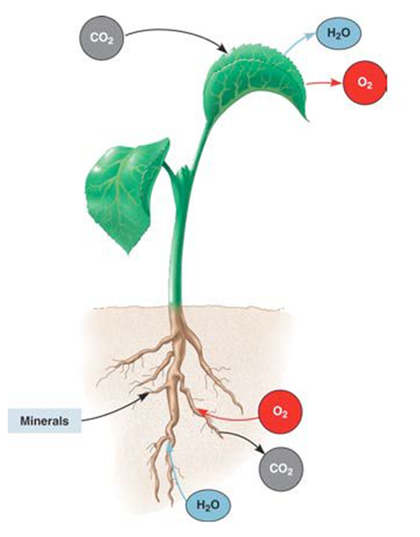
Tree Rings*
Tree ring analysis is similar to ice cores, but you need to understand how a tree develops.
When a new tree germinates (breaks through the ground) for the first time it contains only one ring.
The tree develops and matures by absorbing carbon dioxide into its leaves from the atmosphere as well as absorbing nutrients and water into its roots from the ground.
As a tree ages, it gains rings.
Sometimes 1 ring in a few years.
Sometimes multiple rings in one year.
The size and frequency of the rings are studied to determine climate conditions that resulted in the growth.
CO₂
Minerals
H₂O

Slide 22
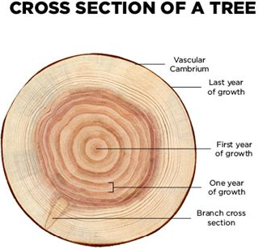
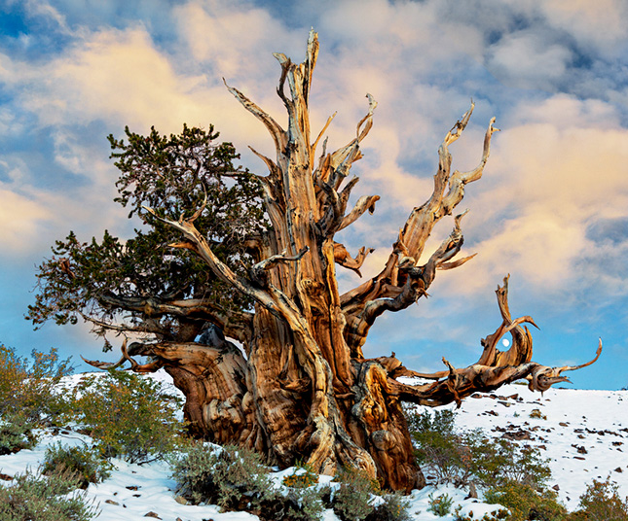
Tree Ring Analysis*
The number and size of rings a tree gains is directly dependent upon the water, nutrients, & temperature available.
Trees rings are analyzed two ways:
The number of rings = helps determine the age of the tree
The thickness of the rings = helps determine the atmospheric conditions when the ring was made.
One tree, however, isn’t enough.
Multiple trees can be sampled, analyzed (called cross-dating), and compared to one another to get a larger understanding of climate change through the lives of trees.
This is limited to about 4,000 years (the age of the oldest living thing on Earth… a bristlecone pine).

Slide 23
Tree Ring Core*
Tree cores are cut from the bark to the pith.
This cross section can be examined by looking at the
Number of rings (determining age from pith to last ring)
Width of the rings (determining atmospheric conditions, wider is more growth)
Pith Bark →
How old is this tree?
12 Years old.

Slide 24
Tree Ring Cross Dating
Cross Dating:
Different cores taken from the same area are aligned by similar rings patterns to get information for a longer time period.

