Slide 1
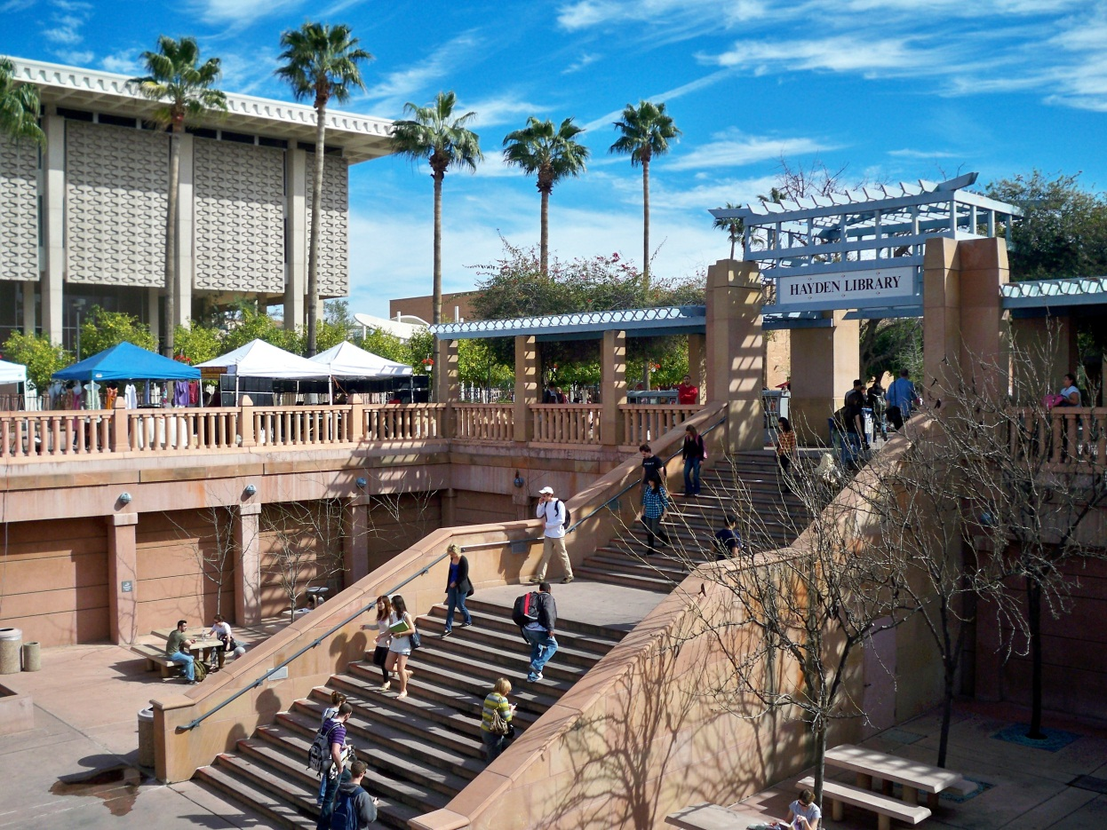
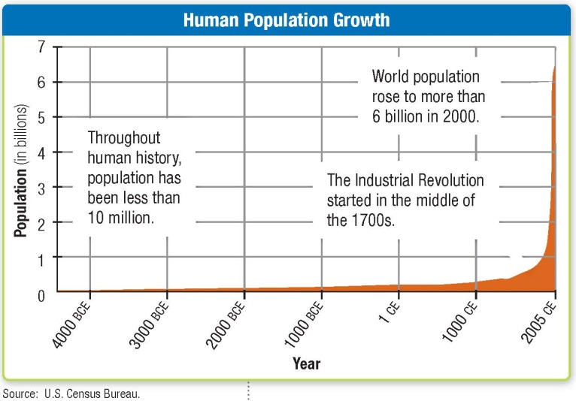
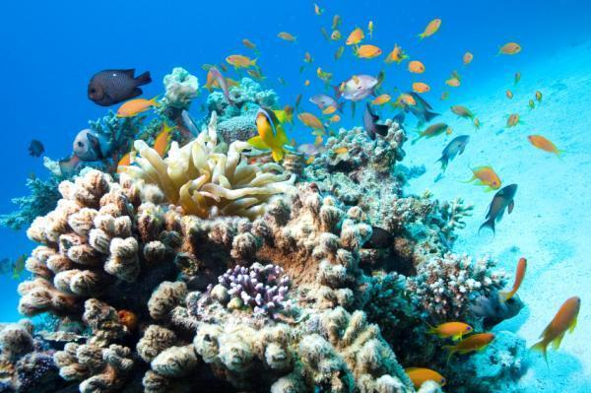
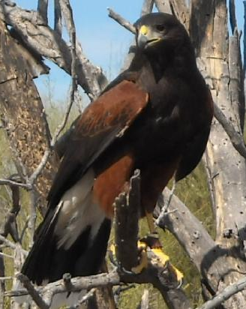
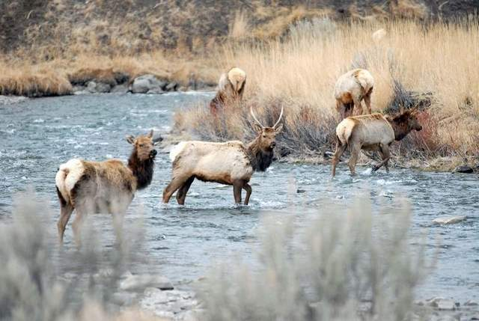
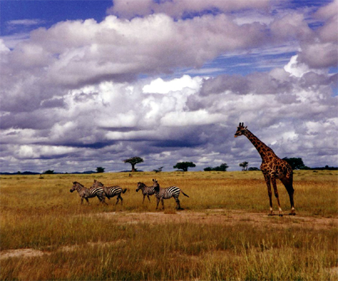
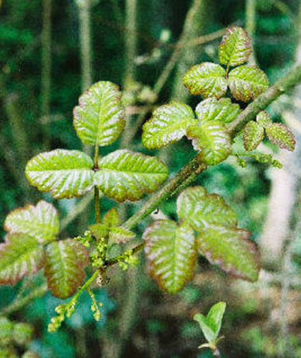
Part 2
Populations & Communities

Slide 2
Question
You have just been hired for a summer job for the month of July. You have two options on how you would be paid. You can be paid $50/hour (Option A). Or (Option B) you can be paid one cent on the first day of the month. Each day following, your pay will be double what it was the previous day. Which option would you choose?

Slide 3
Where We Came From…
Where We’re Going.
You learned about ecosystems in Part 1.
What are some themes from that section?
  Biodiversity
  Succession
  What defines an ecosystem
  What are the major terrestrial biomes and what distinguishes them from on another.
Life is interconnected: this is one that you should remember.
We are going to take this and couple that with another theme of biology… how populations are quantified and what influences them.
Sustainable growth can only happen as long as there is balance with everything else we share this Earth with.
This is a fact of life that the human population is going to have to come to terms with.

Slide 4
Objectives Populations
Explain the importance of studying populations.
Compare exponential growth with logistical growth.
Identify factors that affect population sizes.
Explain how science and technology have affected human population growth.

Slide 5
Vocabulary
Population
Carrying capacity

Slide 6
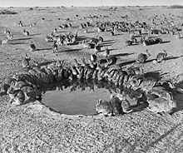
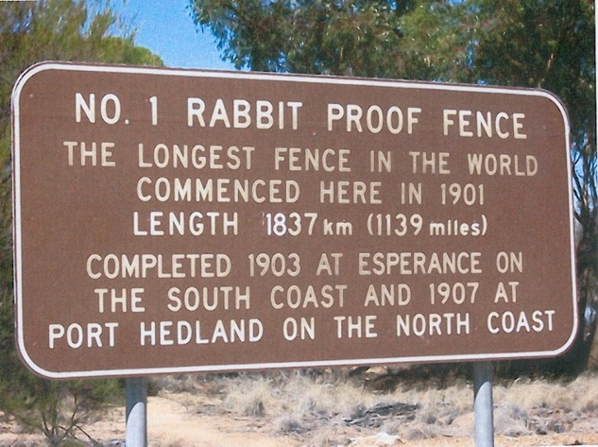
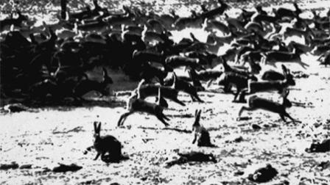
Studying populations: A Case Study.
In the 1850’s, a man introduced two dozen (24) rabbits were to his new home in Australia, “to remind him of home”.
There was an abundance of food and no predators.
Sounds great for the rabbits!
By the 1950’s there were over 6 million rabbits!
Do you think that the rabbit population had an affect on their new ecosystem?
What do you think was affected by this new organism?
Think about these for a minute.

Slide 7
What Is a Population?
Studying populations and understanding population growth is important because populations of different species interact and affect one another, including human populations.
A population is made up of a group of organisms of the same species that live together in one place at one time and interbreed.
  Populations can be small or large.
  Some populations stay stable at nearly the same number for years.
  Some populations change from lack of resources, disease, man-made influences, migrations, natural disasters, or predation.
  Other populations can grow rapidly, uncontrolled.
Remember, life is almost always interconnected… sometimes much more than is understood.
This means that nearly every population in an ecosystem affects the other around it.

Slide 8
Population Growth…How Populations Grow?
Whether a population grows or shrinks depends on obvious things like births & deaths, but organisms can enter or leave populations too.
The four major ways organisms enter or leave populations:
(1) Births +…
(2) Immigration is the movement of individuals into a population.
& (3) Death +
(4) Emigration is the movement of individuals out of a population.
Growth = (births + immigration) – (deaths + emigration)
These are terms for all organisms.
The result is that populations can grow (+Growth) or shrink (-Growth).

Slide 9
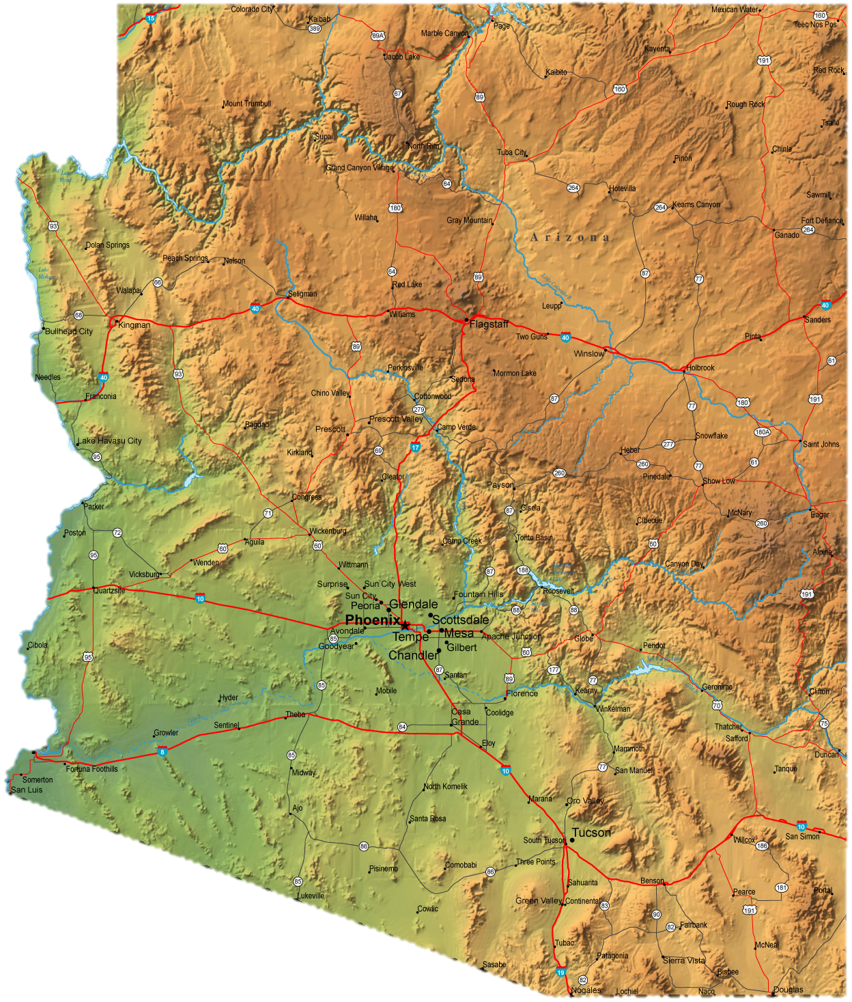
Immigration
Emigration
Immigration
Emigration
Emigration
Immigration
Emigration
Immigration

Slide 10
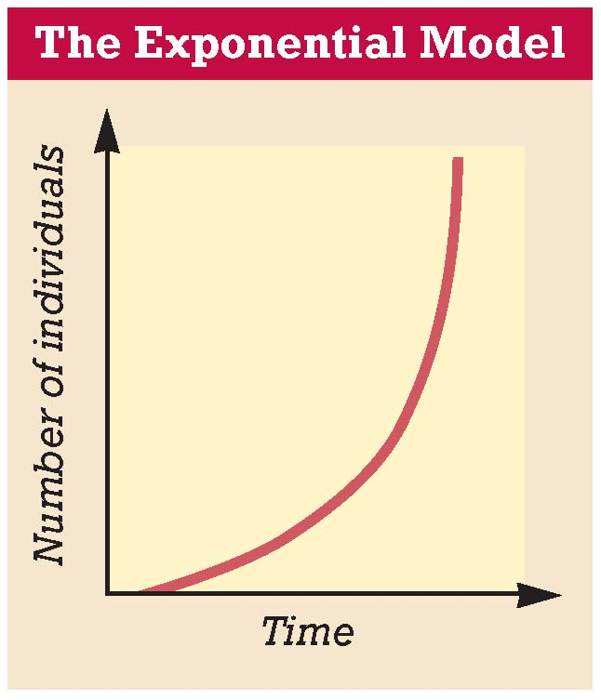
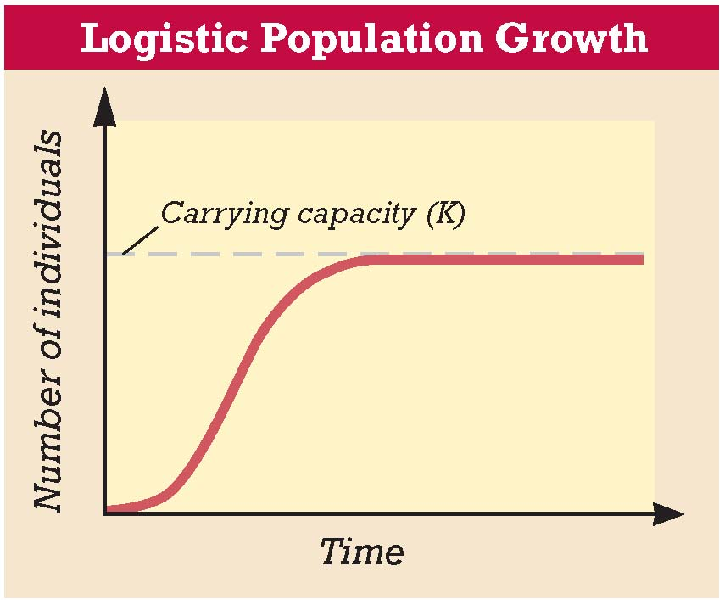
Two Population Growth Models
To study populations completely you need to understand the population models and be able to interpret them.
A simple population model describes the rate of population growth as the difference between birthrate, death rate, immigration, and emigration as a function of time.
J-shaped
S-shaped

Slide 11
Population Growth, continued
Exponential growth occurs when numbers increase by a certain factor in each successive time period.
For example:
  X² (time) = Y (# of individuals)
This type of increase gives the J-shaped curve of exponential growth.
In exponential growth, population size grows slowly when it is small. But as the population gets larger, growth speeds up dramatically.

Slide 12
Exponential Growth…Revisit the first question
If you start with 1 penny and double it every day after that.
How many pennies would you have after 5 days?
How many after 10 days?
How many after 15 days?
How many after 20 days?/25?/30?
What would graph of time versus pennies look like?
1 | 2 | 4 | 8 | 16
32 | 64 | 128 | 256 | 512
1024 | 2048 | 4096 | 8192 | 16384
32768 | 65536 | 131072 | 262144 | 524288
Day 25 = $167,772.16 |  |  | Day 30 = $5,368,709.12
vs. $37, 200 @ $50/hr

Slide 13
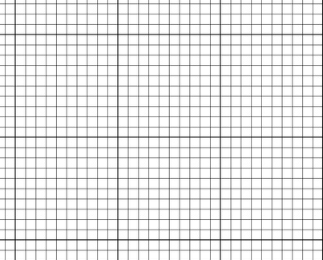
What would graph of time versus pennies look like?
Doubling every day.
Number of Pennies (thousands)
1 2 3 4 5 6 7 8 9 10
Hourly
5 10 15 20
Days

Slide 14
Population Growth
Logistic growth is population growth that starts with a minimum number of individuals and reaches a maximum depending on the carrying capacity of the habitat.
There are three growth rates in logistical growth.
Initial slow growth
A stage of exponential growth
Stabilization around the carrying capacity.
Take note of the shape. What does it look like?

Slide 15
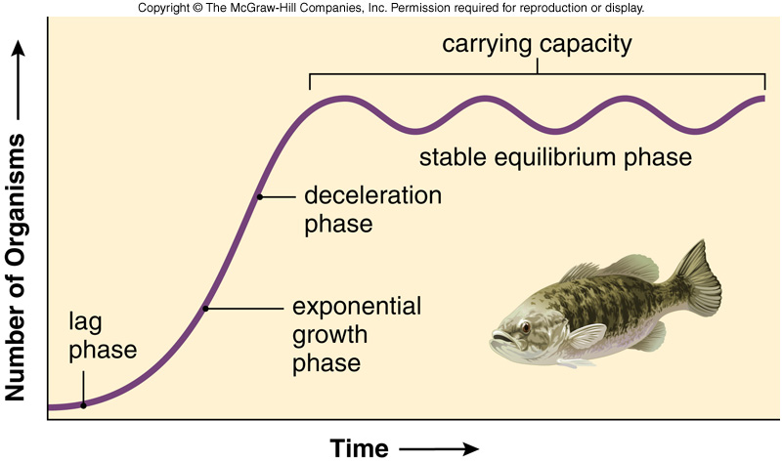
What’s Limits Population Growth?
Eventually, (even with exponential growth) population growth usually slows and may stabilize or even crash.
This is because an ecosystem can support only so many organisms due to limited resources such as water and food.
Whatever the case, the largest population that an environment can sustain (support for long periods of time) at any given time is called the carrying capacity.
When the carrying capacity of an ecosystem is reached, one characteristic exists…
death rate (& other negatives) equals the birthrate (& other positives)
Natural populations usually fluctuate as they stabilize around the carrying capacity of the environment and reach a balance between the organisms and the resources in the area.

Slide 16
Two Population Growth Models
J-shaped
S-shaped

Slide 17
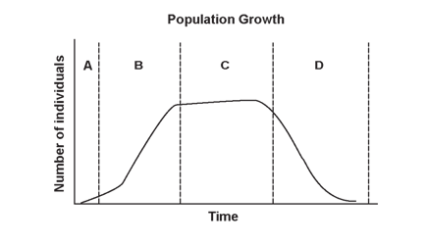
Concept Check
Choose the best answer for these 4 questions.
1. Which time period shows the largest growth of the population?
a. A c. C
b. B d. D
2. During which time period are the birth rate and death rate equal?
a. A c. C
b. B d. D
3. During which time period does the growth of the population equal
zero?
a. A c. C
b. B d. D
4. During which time period does the population decrease?
a. A c. C
b. B d. D

Slide 18
Population Growth
Things to consider:
Growth causes organisms to come into contact more often.
Competition for food, shelter, and mates increases between individuals of a population as it grows.
Furthermore, the more of a certain type of prey will mean more food to support predators.
This infers that predator and prey populations are interdependent.
These causes affect the rate of growth and cause it to slow until stability is reached.

Slide 19
Factors That Affect Population Size
Most populations increase or decrease a little.
  Some change with the seasons.
  Others have good years and bad years.
A combination of 4 factors cause populations to grow and shrink.
They include;
  Biotic Factors: Living things
  Abiotic Factors: Non-living things
  Density-Dependent Factors: How close an organism is to another.
  Density-Independent Factors: Cause changes regardless of proximity

Slide 20
Population Growth
You learned that biotic and abiotic factors shape ecosystems and influence population growth.
Population growth is also controlled by two density-related factors:
  Density refers to the number of organisms in a specific habitat
Density-dependent factors are variables affected by the number of organisms present in a given area.
  Examples include:
    nesting sites,
    amount of food/water.
Density-independent factors are variables that affect a population regardless of the population density.
  Examples of density-independent factors are
    weather,
    floods, and
    fires.
  These will happen regardless of how many organisms are alive there…these are the wild-cards of population growth.
What factor do you think disease is?

Slide 21
Factors Affecting Population
Nesting Sites
Water
Camouflage
Natural Disaster
DENSITY DEPENDENT
Food
Mates
Number of Offspring
Predation
Non-living Living
ABIOTIC FACTORS
How many individuals live in the area.
BIOTIC FACTORS
Weather
Climate
Natural Disaster
?
DENSITY INDEPENDENT

Slide 22
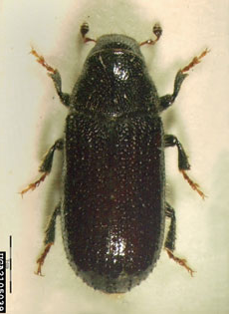
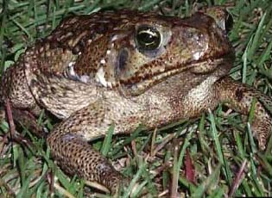
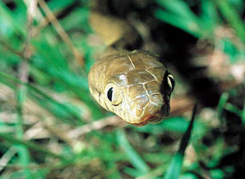
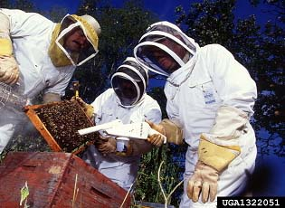
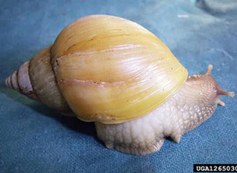
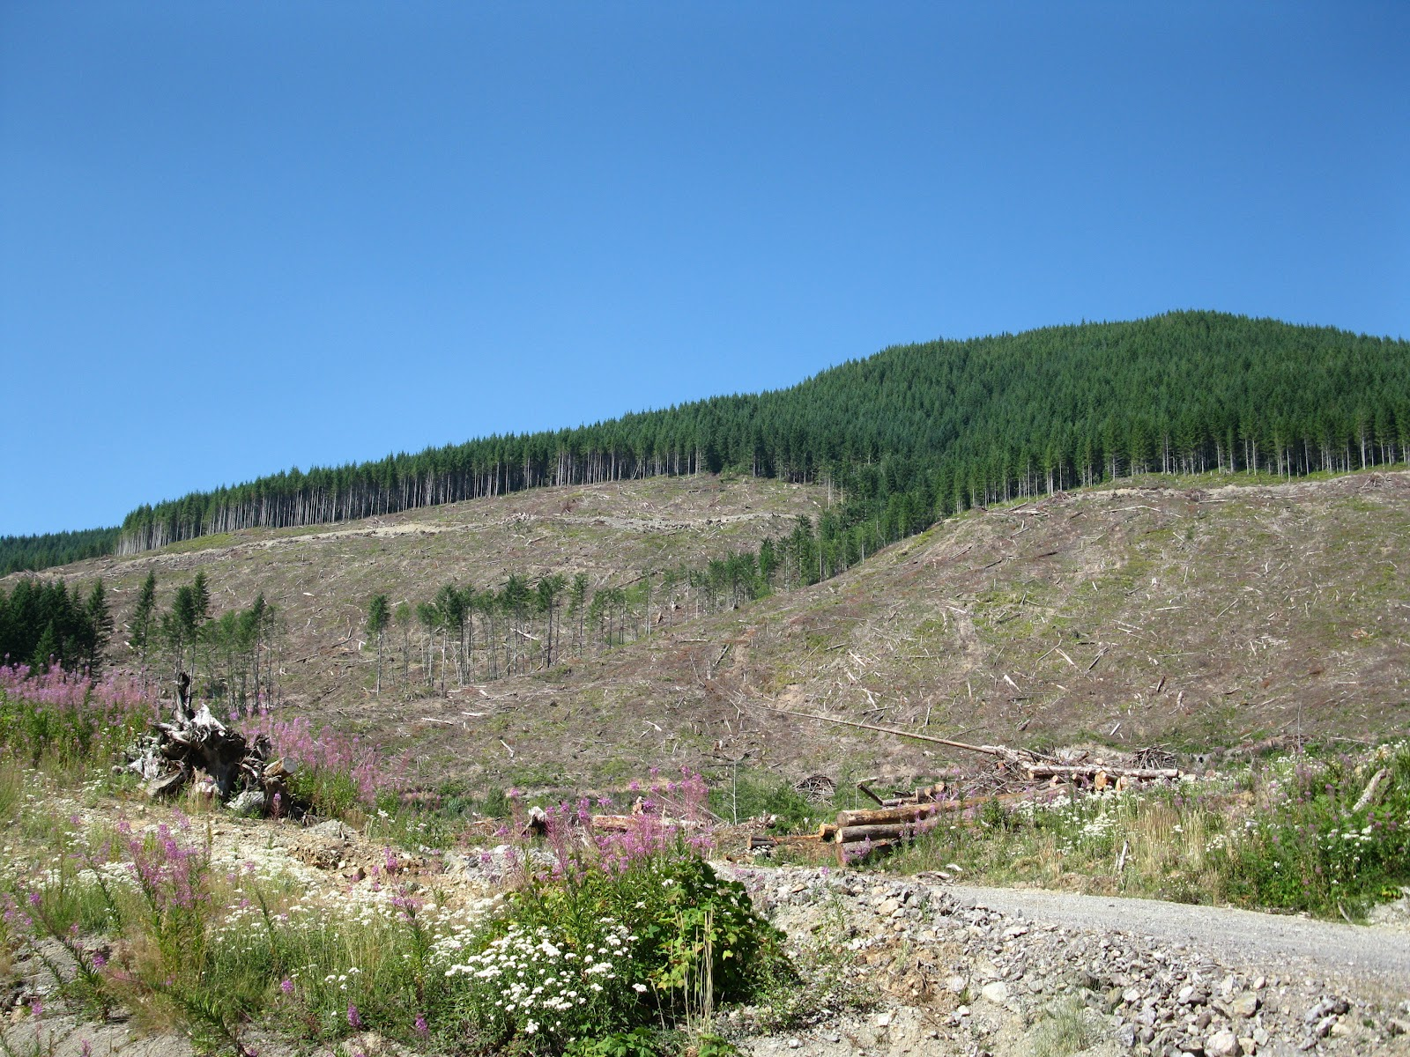
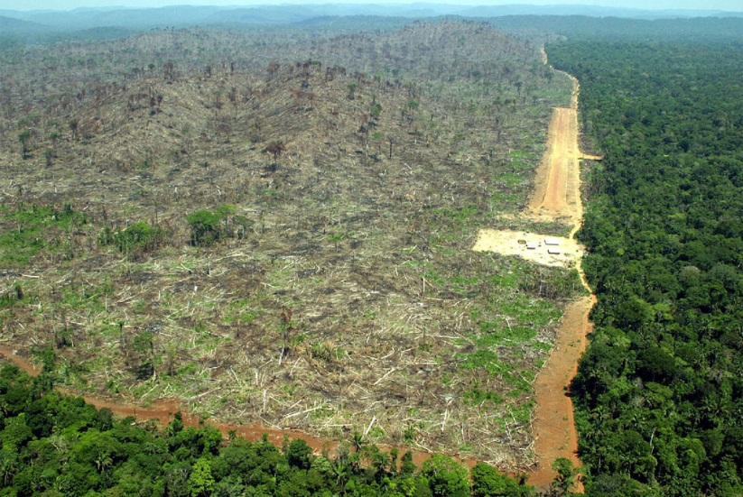
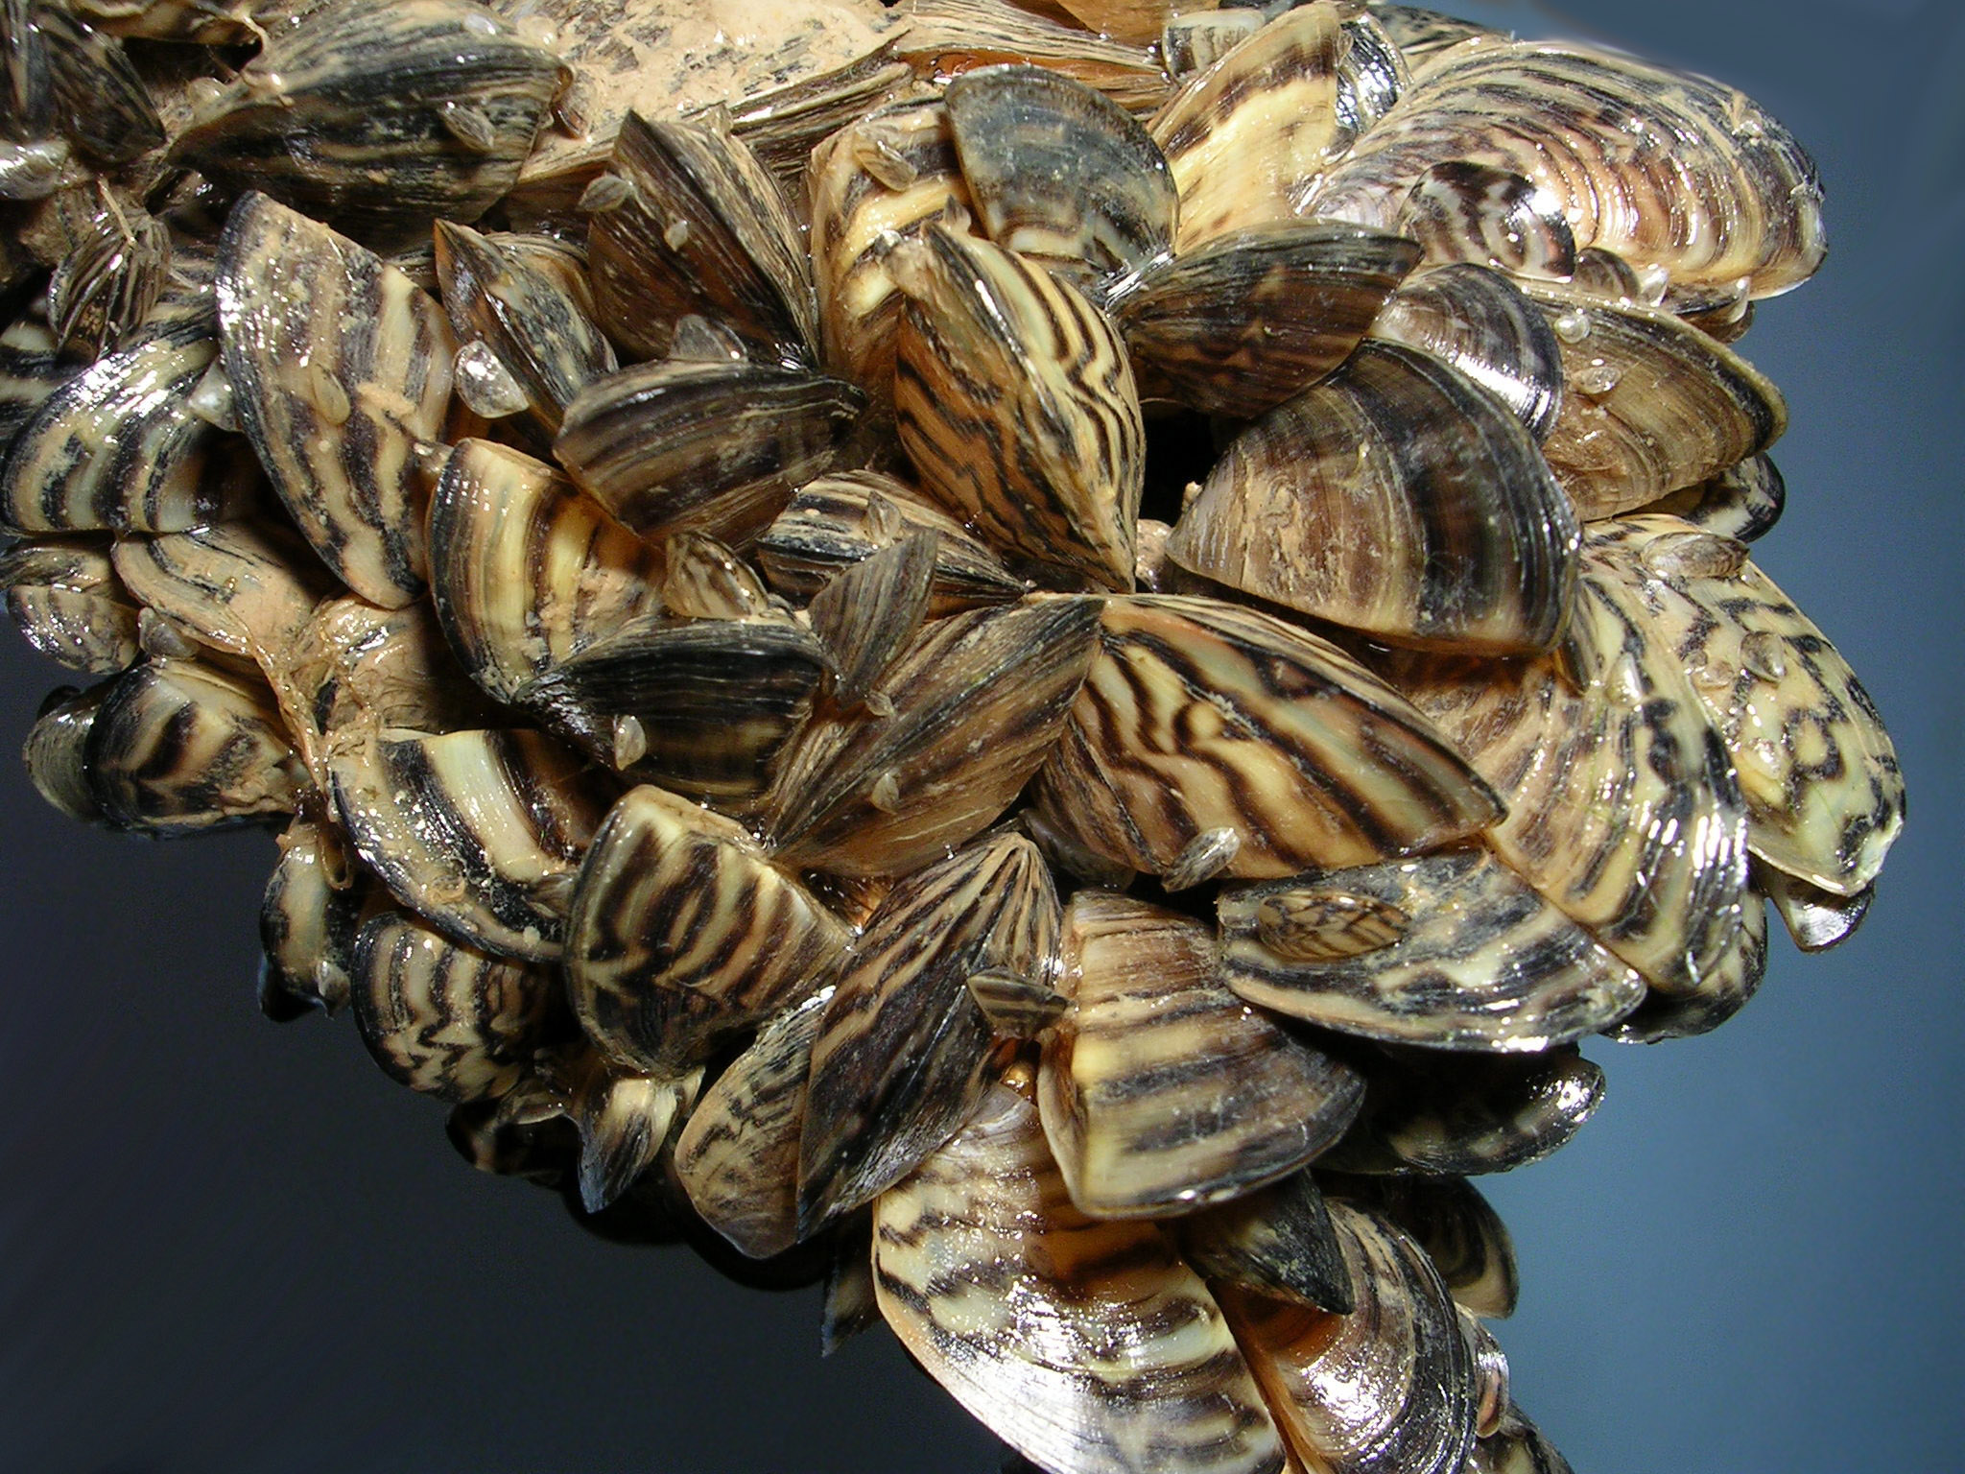
Human Impacts That Affect Populations
There are always other factors…
Humans affect populations of many species as well.
Most of the time, humans cause populations to drop by disrupting or destroying habitats, introducing diseases, or introducing nonnative species (invasive species).

Slide 23
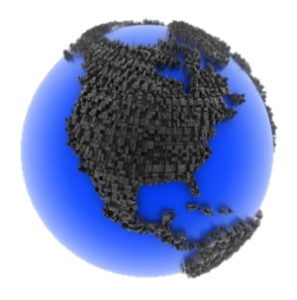
Human Population
For most of human history, there have been fewer than 10 million people on the entire planet.
Two thousand years ago, there were only 300 million people.
Around the time of the Industrial Revolution, (the late 1700s) the human population started to accelerate rapidly, exponentially.
Now, there are close to 7 billion people, and some scientists think that the population will grow to 9 billion in 50 years.
What biotic & abiotic factors are going to be a significant problem?

Slide 24

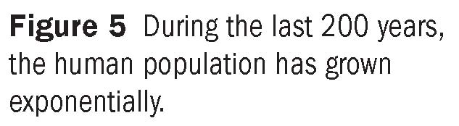
Human Population Growth. What type of growth is this indicative of?
Exponential Growth
Linear Growth

Slide 25
An Interesting Comparison
The human growth rate is unique in nature because we haven’t found our ecosystem’s carrying capacity yet.
WE ARE UNIQUE IN NATURE!!!
  We keep increasing and increasing in numbers with no sign of slowing.
  What is our ecosystem?
  What are abiotic factors that influence our growth?
    Global warming? Loss of land? Pollution/trash?
  What are the biotic factors that could have an influence?
    Lack of food or contaminated food? Disease?
  Is disease density-dependent or density dependent?

Slide 26
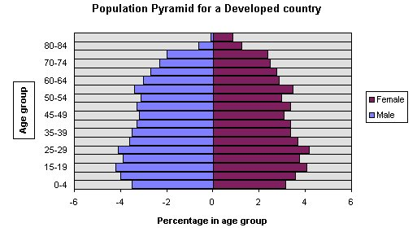
Population Pyramids
Population pyramids break down populations by age and sex to see exactly how these pieces of data compare to other countries.
They can indicate whether or not a population is growing, shrinking or stabilized.
Population of a Stable Country
Factors to consider:
  Everyone will die but how many live to see old age?
  The middle-aged people are the one who have children.
  Children will soon grow to reproductive age, contributing to the population.

Slide 27
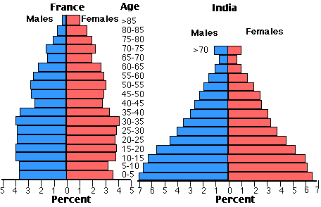
Population Pyramids
Which country is stable?
Which country is facing rapid growth?
Indication of life spans
Parents having more babies than parents.
Babies eventually grow to have babies.

Slide 28
Exponential growth
In the beginning, there are just a few breeding pairs. Growth was slow and linear in the beginning. At a certain point, the population reached a point of exponential growth.
Eventually, population will stabilize around its carrying capacity.
Roughly 2025.
Close to 9 billion.
Exponential growth.
Predicted out to 3050, based upon the prediction that the growth rate starts to slow, the model will start to look more like the logistical growth model and the population may stabilize around 9 million.

