Slide 1
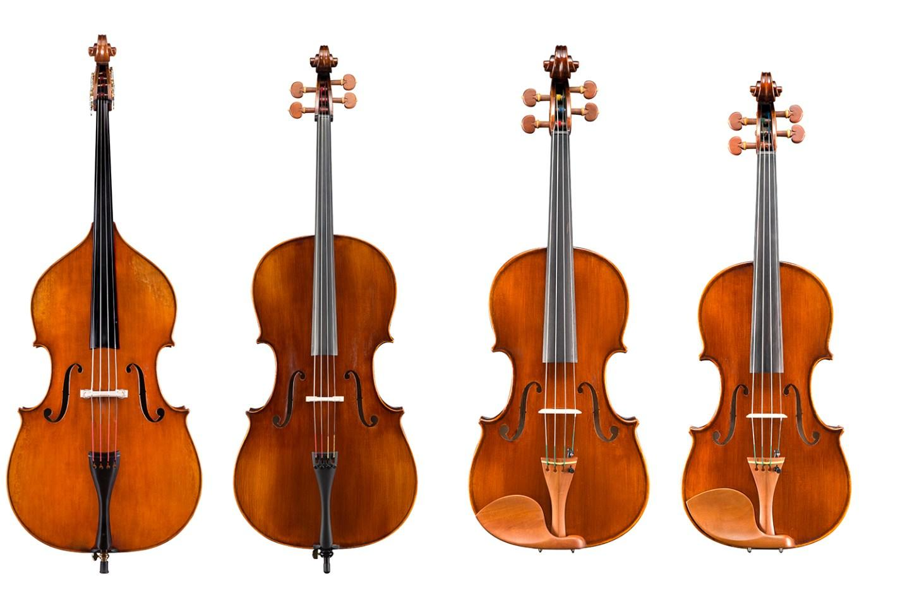
How To Tune Your Instrument

Slide 2
Why do I need to tune my instrument?
Instruments go “out of tune”
(meaning the string tension changes). We need to tune (adjust fine tuners or pegs) to help our instruments produce the correct pitches.

Slide 3
But…. why does my instrument go out of tune?!?
Temperature
Temperature changes cause the wood on your instrument to expand and contract, changing the string tension.
Humidity
Changes in humidity (moisture in the air) also cause the wood to expand and contract.
**Your instrument can also go out of tune if you bump it into things.

Slide 4
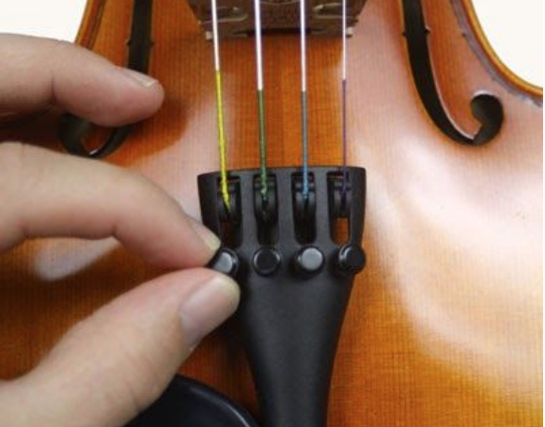
What is the difference between fine tuners and pegs?
Fine tuners are used to make small adjustments and are located on the tailpiece near the bridge (Basses - You don’t have these!)
Use the fine tuners first. Only use the pegs if you have to!

Slide 5
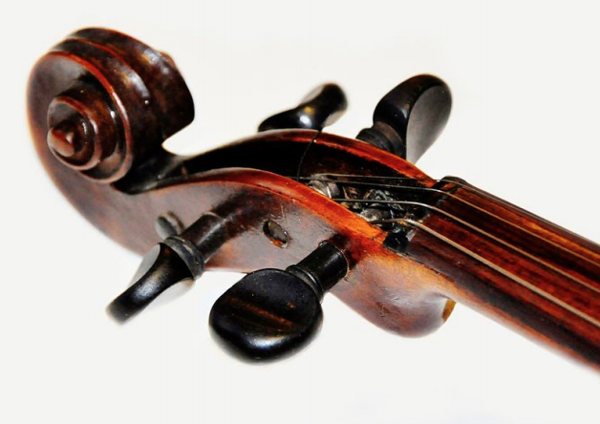
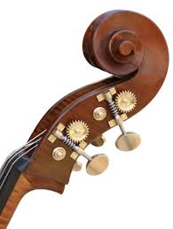
PEGS
Pegs are used to make larger adjustments (like when your string is wiggly like spaghetti!).
Avoid using these at first, as it is
very easy to break a string!
Please read our directions before using the pegs.
Bass Tuning Gears
Basses tune with pegs ONLY because they don’t have fine tuners.

Slide 6
How do I use a tuner to tune my instrument?
FIRST: You need a tuner.
If you don’t have a tuner at home, there are many FREE apps available for phones and tablets. Ask an adult to help you find a tuner.
We have found this tuner to be excellent for string players:
insTuner: https://apps.apple.com/us/app/instuner-free-chromatic-tuner/id603425027
Here is one you can use on Chromebook: https://tuner.ninja/
**Our preference is insTuner, but this will work fine as well!

Slide 7
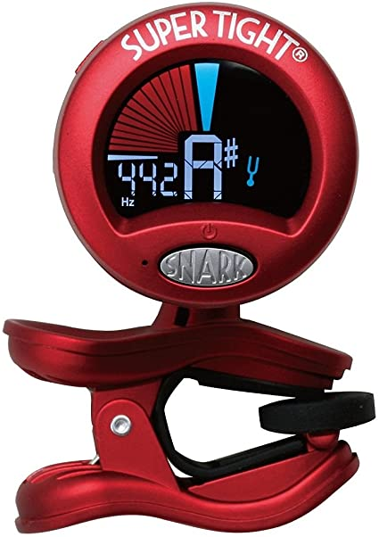
The tuners we use at school.
You do NOT need to purchase a tuner to be successful at tuning.
However, if you would like to purchase a tuner, we buy clip-on tuners for school called:
SNARK TUNERS
Here is an example on Amazon.

Slide 8
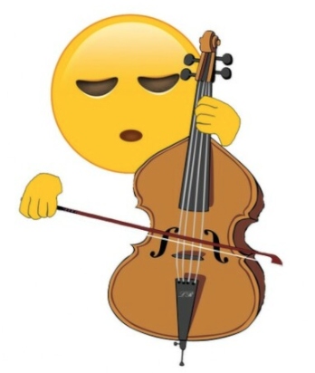
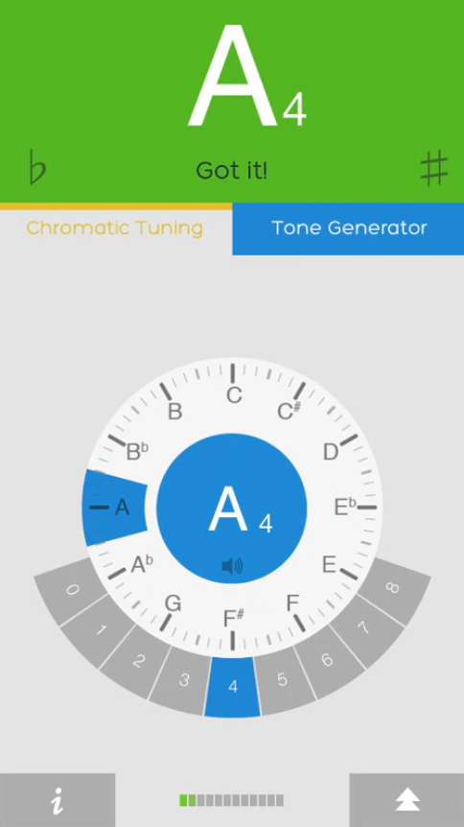
I’ve Got a Tuner… NOW WHAT?
BASSES! Click here to see basses only page.
Turn on the tuner.
Start with the A string. Pluck the string gently to let the tuner hear the note.
If the tuner says the correct string name and the “needle” is in the middle, then the string is perfectly in tune and you don’t need to do anything. (Yay!)
But if it isn’t in tune...

Slide 9
The tuner doesn’t Say the correct String Name!
A
G
F
E
D
C
B
A
If the tuner displays the incorrect string name, you may still be able to use the fine tuner.
Example 1: If your A string is a G#, you can tighten the fine tuner to bring it UP to an A.
Example 2: If your A string is an A#, you can loosen the fine tuner to bring it DOWN to an A.
Feel free to email your teacher if you have questions :)

Slide 10
The tuner says the correct string name!
The tuner says the correct string name, but the needle is not in the center (it’s to the left or right)... You’re getting close!!! :)
Needle pointing to LEFT:
TOO LOW > TURN FINE TUNER TO HIGHER STRING
Needle pointing to RIGHT:
TOO HIGH > TURN FINE TUNER TO LOWER STRING

Slide 11
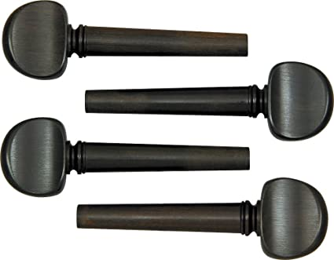
CLICK HERE TO GO TO TUNING WITH THE PEGS!

Slide 12
BASSES ONLY! PAGE 1
Basses do not have regular pegs or fine tuners.
Basses have tuning gears.
Please note: Tuners may have trouble picking up the low pitches of the bass. It will help if you play with a continuous, strong sound using pull and push bows. Make sure your bow is loaded with rosin! :)
Start with the G STRING.
Play G string with bow and look at tuner.
If the tuner says the correct string name and the “needle” is in the middle, then the string is perfectly in tune and you don’t need to do anything. (Yay!)
But if it isn’t in tune...

Slide 13
BASSES ONLY! PAGE 2
The tuner doesn’t Say the correct String Name!
A
G
F
E
D
C
B
A
If the tuner displays the incorrect string name, you need to turn the peg until you find the correct pitch. Here’s how!
Example 1: If your G string is an F#, you can tighten the peg to bring it UP to a G.
Example 2: If your G string is a G#, you can loosen the peg to bring it DOWN to a G.
Feel free to email your teacher if you have questions :)

Slide 14
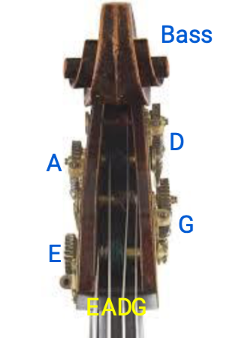
BASSES ONLY! PAGE 3
TURN THE PEGS!
Needle pointing to LEFT:
TOO LOW > Tighten string.
Needle pointing to RIGHT:
TOO HIGH > Loosen string.
When tuning, if the needle isn’t moving the right way,
turn your peg the other way!

Slide 15
Tuning with the Pegs!
We wish we could be there in person to help you tune, but will walk you through this slowly to help you do your best!
PLEASE do this with an adult.
TWO BIGGEST TIPS: GO SLOWLY AND CAREFULLY.
See next page for steps!

Slide 16
Steps to tune with the pegs:
**Remember: Use fine tuners first. These are a last resort!
Hold your instrument in front of you with the strings facing you.
2. Pluck the string you are trying to tune.
3. If your tuner says the pitch (note) of the string is too LOW (example: your A string is an F, or it is so loose that it can’t make a sound), you will need to tighten the string.
4. Find the peg for the string you are tuning (see pictures on next page).

Slide 17
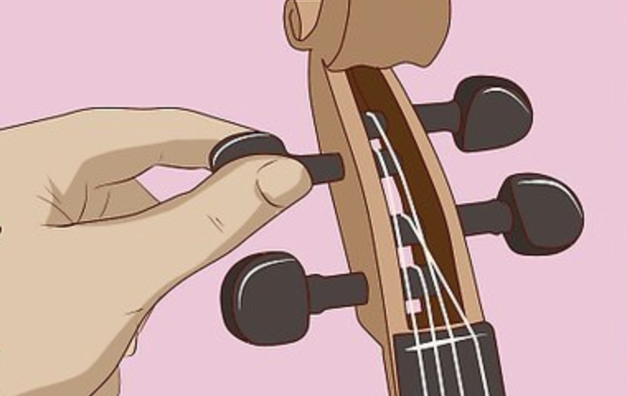
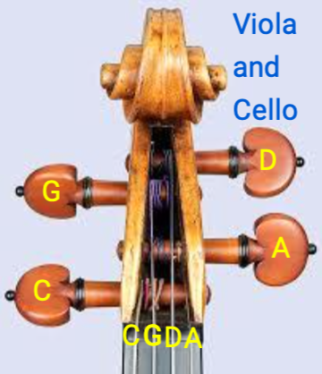
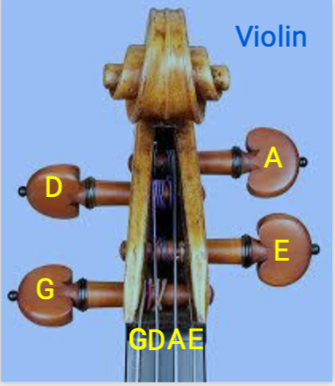
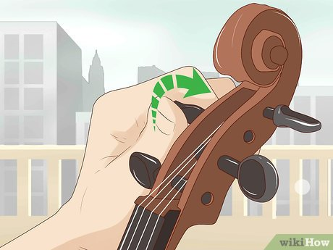
See next page for next steps!
These photos were retrieved from Wikihow.

Slide 19
Tuning with the pegs continued!
5. Loosen the peg slightly by turning it towards you, then turn the peg away from you while simultaneously pushing it in.
***Turn the peg a little bit at a time to avoid breaking the string (it should barely feel like you are turning it - think about turning only 1 millimeter at a time).
6. If the peg slips after you let go of it, you will need to push in a little harder while you are turning it. (You can do it!!!)
7. Continue to turn the peg slightly and check with a tuner until it is at the correct pitch. You may then continue to tune with the fine tuners.

Slide 20
Happy Tuning!
You Got this!
And if not…
Ask an adult or EMAIL YOUR STRING TEACHER!

