Slide 1

Principal - Michael Franklin
IB Diploma Coordinator - Jacque Hartrick
IB Career Program Coordinator - Courtney Kemp
IB Middle Years Program Coordinator - Laura Helt

Slide 2
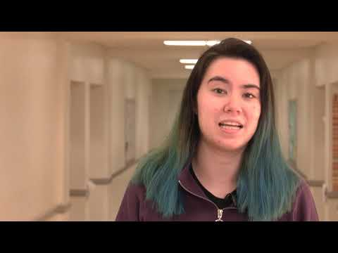
What is IB? From our student’s point of view.

Slide 3
2020-2021 IB Students
Average IB Diploma GPA: 4.65
100% of IB Diploma students are attending a 4 year University
Approximately $9 million in scholarships were offered to IB students
Universities that IB Students are attending:
Air Force ASU Chaminade University of Honolulu
Concordia University Duke East Tennessee University
Fordham GCU Howard University
Indiana University NAU Northwestern University
Navy Regis Louisiana State University
Texas Tech U of A University of Oregon
Vanguard University USC University of Michigan
JUST TO NAME A FEW…….

Slide 4
Goals for the presentation:
A general understanding of IB
Programs offered at Chandler High School
  Diploma Program (11th / 12th grade)
  Career Program (11th / 12th grade)
  Course Program (11th / 12th grade)
What’s next?

Slide 5
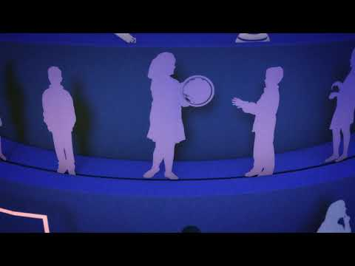
AN OVERALL VIEW OF IB

Slide 6
Diploma Programme in Review
The DP Programme:
Was developed in Switzerland
Uses a holistic approach to learning
Complete assessments in each IB subgroup (6 areas)
3 Standard Level and 3 Higher Level
Puts more emphasis on writing
Develops critical-thinking skills
Requires an Extended Essay (a college-style research paper)
Community Service
Requires students attend a theory of knowledge course

Slide 7
Career Diploma Programme in review
The Career Programme:
Was founded in 2012 to address the needs of students engaged in career-related education.
Requires students to take 2 IB courses over 2 years with an Internal Assessment for each course
Requires students to take a CTE course over 2 years. (i.e. Woods, Auto, Graphics, programming, etc.)
Requires a Personal Project
Community Service
Language Portfolio
Requires the IB Personal and Professional Skills course

Slide 8
Course Programme in review
The Course Programme:
Designed for students who want to take challenging courses
Certificates are awarded
Internal Assessments are required for each course
No community service is required but it is encouraged!

Slide 9
Creativity, Action, and Service (Diploma)
Service Learning (Career)
CAS and Service Learning are a key component of the IB program. We are looking for students to explore varying ways to give back to the community as well as reflect on their experiences. Since COVID, it has been difficult for students to volunteer. This year, we are planning excursions to various places to volunteer. Students will have the opportunity to sign up. We will acquire a bus for transportation. Some of the possible places are:
Feed My Starving Children
United Food Bank
Phoenix Rescue Mission – Soup Kitchen
How to Pack a Shoebox – Samaritan’s Purse
Students can always complete their own service but we thought this would help them get started. More information will be shared with students at our monthly IB meetings. These meetings will be offered during lunch.

Slide 10

EXAMPLES OF SERVICE LEARNING

Slide 11
What’s next?
Students will be asked to sign up for testing in their IB courses.
The IB administration will register them for testing through the IB program. Students will be asked to sign an outline of what courses they are registered for and the fees associated with their testing.
Students will work on all the requirements for their particular course throughout the year (or 2 years if it is a 2 year course). They will work on their internal assessment in the year that they will test in that course.

Slide 12
Cost
For all Diploma and Career program students, they have 2 fees associated with IB testing.
A $15 Managebac fee will be assessed. This is a program that students use to monitor and update their community service hours (CAS). They will need to go into detail for each activity that they perform. They will also have access to various other resources through Managebac. Pamoja lesson Suites is located in Managebac which may be used by some of their teachers.
Testing fee assessed. The fee for IB testing is $120 per test.

Slide 13
MORE ON COST
Please do not let cost be a barrier to completing an IB course. Applications for scholarships will be available in late October for students to apply.
All monies must be paid to the bookstore no later than March 1, 2022. If we do not receive funds by that date, a student may not be allowed to sit for the assessment. Please contact either Jacque, Courtney, or Laura if you need additional financial assistance.
Students on free and reduced lunch are eligible for a reduced fee. You must present the email that you received from CUSD confirming your free and reduced lunch status to the bookstore at the time of payment.

Slide 14
DUAL ENROLLMENT
Some IB courses have teachers who are dual credit certified through the Maricopa Community Colleges. Some courses will offer AP testing in their subject as well. There are fees associated with both of these options.
** Not all IB courses qualify for dual enrollment.
** Open House is tomorrow, Thursday, 8/5. Please check with the IB teacher to see if they are dual credit certified for their course or offer AP testing if you are interested. **

Slide 15
College Credit
All of the main 4 year colleges in Arizona offer college credit for IB courses. You can find a list of all the courses and the number of college credits offered by each college on our website. Go to cusd80.com website and select Chandler High School from the “Our Schools” tab at the bottom of the page. You can then click on Academics and then IB. There is a link there for University Support and IB Opportunities for Students.
Many out of state college also offer college credit for IB courses. Please check with your particular college for more details.

Slide 16
Thank you!
PLEASE ATTEND OPEN HOUSE ON THURSDAY, 8/5 STARTING AT 6:00 P.M. IN THE CHANDLER CENTER FOR THE ARTS.
Please feel free to contact any of us if you have questions.

