Slide 1
Narrative Writing
A Review – 10 Things to Remember When Writing a Narrative

Slide 2
Number 1 – Your Story Beginning
Your story needs a strong beginning. You can achieve this using one of the following methods:
Dialogue (Conversation)
A Question
A Vivid Description
An Interesting Fact
Sound Effects
http://www.learnnc.org/lp/pages/2992

Slide 3

Dialogue
The one-ton Holstein bull stood in front of me like a black-and-white locomotive. “Willie’s in a lot of pain, Doc. He hasn’t put that foot down in two days and he won’t even let me touch it. What are we gonna do?” Strange, that a man who had been around cattle all his life would be asking me for help!
--Robert T. Sharp “No Dogs in Heaven?”

Slide 4
A Question
Have you ever had a day when you wished you had stayed in bed? As I rushed to catch the bus on what seemed to be a perfectly normal day I had no idea what was ahead of me.

Slide 5
A Vivid Description
On December 8th, 1915, Meggie Gleary had her fourth birthday. After the breakfast dishes were put away, her mother silently thrust a brown paper parcel into her arms and ordered her outside. So Meggie squatted down behind the gorse bush next to the front gate and tugged impatiently. Her fingers were clumsy, the wrapping heavy; it smelled faintly of the Wahine general store, which told her that whatever lay inside the parcel had miraculously been bought, not homemade or donated.
-- Colleen McCullough “The Thorn Bird”

Slide 6
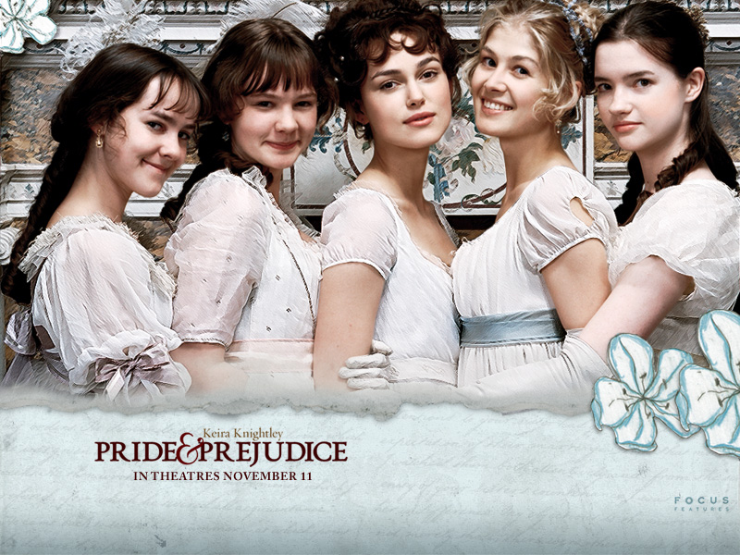
An Interesting Fact
It is a truth universally acknowledged that a single man in possession of a good fortune must be in want of a wife.
--Jane Austin “Pride and Prejudice”

Slide 7
Sound Effects
“Buzzzzzz!” The sound of my alarm clock droned in my ears as I struggled to come awake. With a start I sat straight up in my bed. This was my big day and I had to be on time.

Slide 8
Number 2 - Paragraphs
Be sure your story has paragraphs. They tell when you're switching time, place, topic or speaker, and they help break the page up so it is not just a solid block of writing.

Slide 9
How Do I Know When To Start a New Paragraph?
There are a few standard times to make a new paragraph:
When you start in on a new topic
When you skip to a new time
When you skip to a new place
When a new person begins to speak
When you want to produce a dramatic effect
http://www.saidsimple.com/content/When-to-Make-a-New-Paragraph

Slide 10
Number 3 - Capitalization & Punctuation
Capitalize
  Beginnings of Sentences
  Proper Nouns
Punctuate
  End Marks (question mark, period, exclamation marks)
  Commas when joining two sentences with a conjunction, addressing a person, with quotations, etc.

Slide 11
Number 4 – Use Rich Words
Remember words such as said, went, and put are DEAD. Use words that describe the action.

Slide 12
Went
NOT
My dad went to work.
BUT
My dad raced to work.

Slide 13
Said
NOT
Jane said she had a secret.
BUT
Jane whispered to Peter a wonderful secret.

Slide 14
Number 5 - Wow Words
Show your reader that you have a high-quality, first-class, superior, excellent, exceptional, outstanding, brilliant, extraordinary, incomparable vocabulary.

Slide 15
Don’t Use | Use These Instead:
good | acceptable, admirable, commendable, praiseworthy, virtuous, accomplished, skilled,
bad | Defective, erroneous, inadequate, substandard, corrupt, vile, distressing, severe, offensive, immoral
thing | material object, article, concept, entity, apparatus, device, detail, statement, items.
big | considerable, colossal, immense, sizable, vast, eminent, influential, paramount, prime, prominent
small | diminutive, immature, minute, slight, negligible, petty, trivial, limited.
important | far-reaching, grave, momentous, significant, substantial, prominent, notable
happy | content, joyous, jubilant, thrilled, advantageous, favorable, fortunate,
sad | sorrowful, cheerless, dismal, gloomy, melancholy, mournful, somber grievous
http://alon.hasharon.k12.il/new_ataralon/mikzoot/english/.%5Cdenise_text%5Cforcedownload.asp?fileToDownload=wowWords12class6.doc

Slide 16
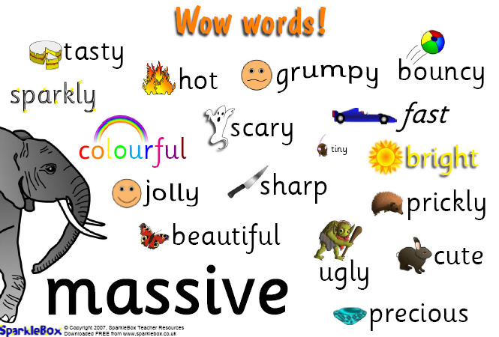
Wow Words
http://resources.sparklebox.me.uk/501-999/sb665.pdf

Slide 17
Number 6 - Show, Don’t Tell
The Show, Don’t Tell method of writing is when the writer is able to create a picture in the reader's mind, to get away from the repetition of such empty words like went, big, or said.

Slide 18
NOT
Susan exercised.
BUT
Sweat poured from Susan’s forehead as she continued to do one hundred sit-ups .

Slide 19
Number 7 - Conversation
The Five Rules for Writing Direct Quotations
Rule 1 | Rule 2 | Rule 3 | Rule 4 | Rule 5
Add quotation marks. | Separate source phrase from quote. | Capitalize the first word of the direct quotation. | Add end marks. | Add needed capitalization and punctuation.

Slide 20
Conversation
Remember
You must make a new paragraph every time a different person speaks!!!!

Slide 21
Number 8 - Sentences
Vary your sentences.
  Are some of your sentences long and others short?
  Do you start the beginnings differently?
  Do some sentences start with a part of speech other than a noun or pronoun?

Slide 22
Number 9 – Figurative Language
Use a little figurative language to add interest to your story.
Simile
Metaphor
Alliteration
Onomatopoeia

Slide 23
Simile
comparison between two unlike things that have something in common using like or as
Examples
It's been a hard day's night and I've been working like a dog. - The Beatles
My heart is like an open highway. - Jon Bon Jovi
like two peas in a pod
like Christmas in summer
as hungry as a bear
as nutty as a fruitcake
as quick as lightning

Slide 24
Metaphor
Metaphor– comparison between two unlike things that have something in common without using like or as
Examples
Patty was a raging tiger when she lost her lunch money.
During the night the forest was a dark, frightening battlefield.

Slide 25
Alliteration
repetition of usually initial consonant sounds in two or more neighboring words or syllables
Examples
  down in the dumps
  do or die
  right as rain
  sink or swim
  pay the price
  back to the basics
  green as grass
  live the life

Slide 26
Onomatopoeia
the imitation of natural sounds in word form. These words help us form mental pictures about the things, people, or places that are described
Examples
  buzz
  hiss
  roar
  woof
  bang
  pop
  hiss
  sizzle

Slide 27
Number 10 - Plot Structure
http://www.learner.org/interactives/story/cinderella.html
a plot, including setting and characters
a climax (This is when the plot is solved.)
an ending

Slide 28
United Streaming
Parts of a Story: Huck and Jim [05:34]
http://player.discoveryeducation.com/index.cfm?guidAssetId=20D49155-2509-447F-8C47-69C9B3D2128A&blnFromSearch=1&productcode=US

Slide 29
Beginning
In the beginning of your story, you should introduce your characters.
The reader should also know about the world your characters live in (the setting) and the something about each of the characters in your story.
The beginning of your story is also the place where your plot (the problem) is first introduced.

Slide 30
Middle
Your story needs to build to something exciting, the climax. Write about a simple conflict, a task that must be completed, a question that must be answered, or a barrier that must be overcome.
Climax
Rising Action
Falling Action
Beginning
Resolution

Slide 31
Middle
Include
  Actions
  Dialogue
  Sensory Details
  Thoughts and Feelings
  Suspense (Remember to build to a climax.)

Slide 32
The End
This is the big finish. The end should reveal how you overcame your problem. All conflicts are resolved and everything goes back to normal.

