Slide 1
Citations… What are they, and why do we need to use them?

Slide 2
ci·ta·tion
/sīˈtāSHən/
Noun
A quotation from or reference to a book, paper, or author, esp. in a scholarly work.

Slide 3
A citation is like the source's address: you need to include the RIGHT information in the RIGHT order. Otherwise, we’re all lost.

Slide 4
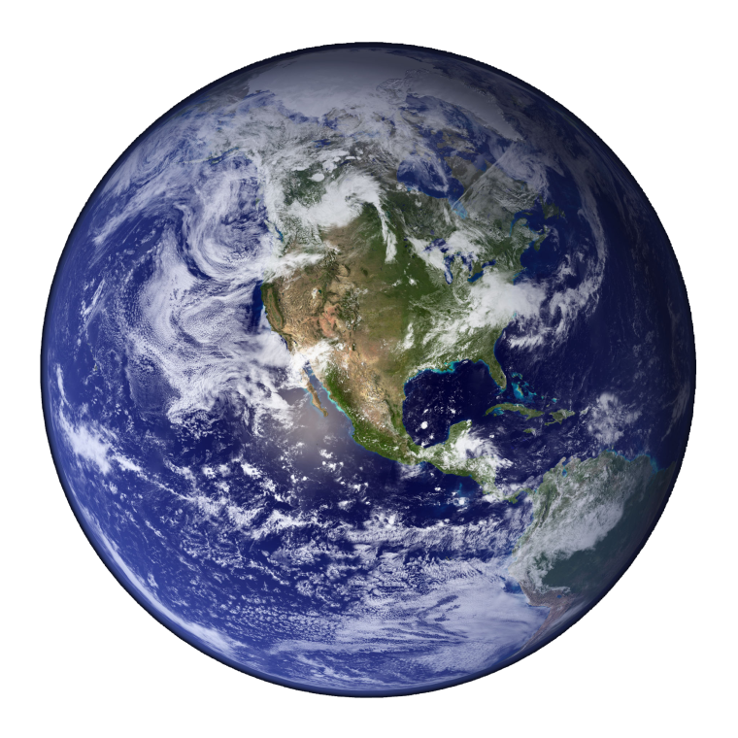
Because when we get the correct address…
Why should we care where in the world is
Vallejo 94589 Fairgrounds 1001 Dr. CA?

Slide 6
We can get somewhere awesome

Slide 7
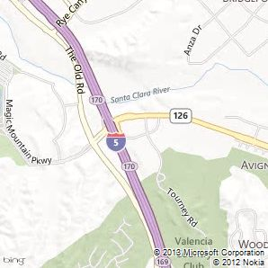
A complete and accurate citation not only tells your reader WHERE you got your information, but HOW you got there.

Slide 9
When to Cite
Cite
Do not Cite
Common knowledge
Author’s idea
Author’s thought
Author’s opinion
Author’s research
Quotations
Summary of someone’s work / research
Other people’s pictures, illustrations, etc.
Your opinion
Your artwork/
pictures
Your thoughts
Your ideas

Slide 10
Purpose for Citing your sources
Why do we need to use them?
Academic Integrity
Prevents Plagiarism
Identify the sources used
In text Citation matching

Slide 11
Citation Generators
Easybib
Citation Machine
SJHS Library

Slide 12
In Text Citation Matching Game
MLA Citation Game
MLA Citation Practice
MLA Citation

Slide 13
Lead Ins…
To effectively introduce sources, use a variety of lead-ins and action verbs:
According to Johnson, ….
Jackson and Thomas, experts in popular culture, found that ….
Smith and Wess speak to these concerns:
Cruze insists…..
Admits | Agrees | Argues | Asserts
Believes | Claims | Compares | Confirms
Contends | Declares | Denies | Emphasizes
Insists | Notes | Observes | Points Out
Reasons | Refutes | Rejects | Reports
Responds | Suggests | Thinks | Writes

Slide 14
What is Parenthetical Documentation?
It is a way to let people know where your information came from. Whenever you use material that you got from another source, you must let your audience know immediately where it came from, right after your use it. MLA interacts with the works cited list, as each reference cited MUST match to a bibliography on the Works Cited page.
Why should you use it?
It lets your reader know that you want to make clear to them which ideas and words are someone else’s. If you don’t cite sources, you are committing plagiarism.
When do I have to do it?
Direct quotations
Paraphrased quotations (these are quotes whose words you have changed somewhat)
Statistical Data (numbers about things)
Original ideas that are attributed to someone else, even if you put them in your own words.
How do I do it?
You can use parenthetical documentation. Parenthetical means (parenthesis).

