Slide 1
ART MASTERPIECE
JOSEPH STELLA ( 1877-1946 )

Slide 2
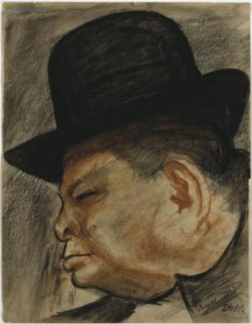
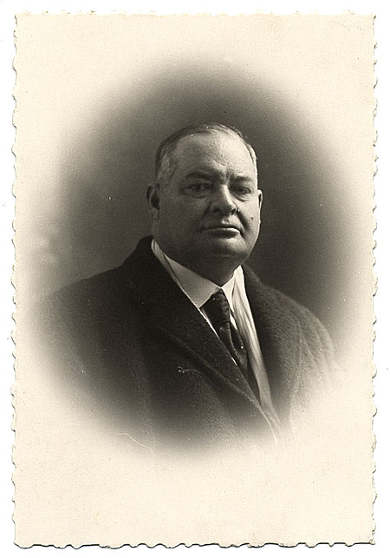

Slide 3
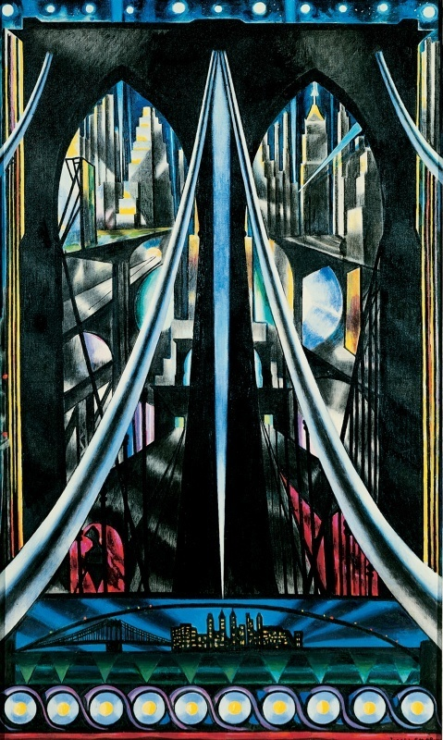
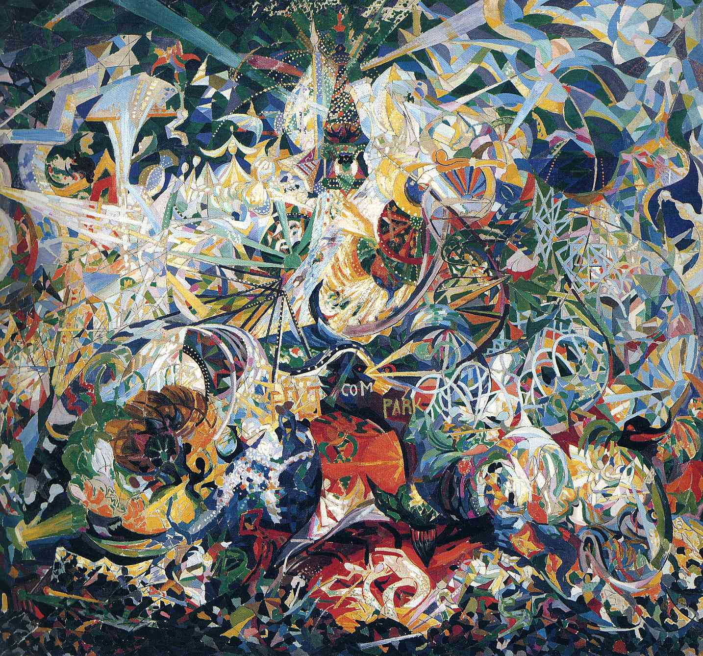
Italian-born Joseph Stella is hailed as America’s first Futurist painter and is best remembered for his dynamic paintings of New York monuments such as Coney Island and the Brooklyn Bridge.
Brooklyn Bridge
Coney Island –Battle of the Lights

Slide 4
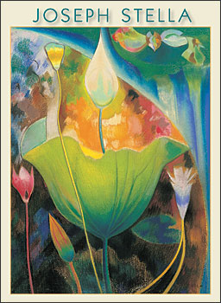
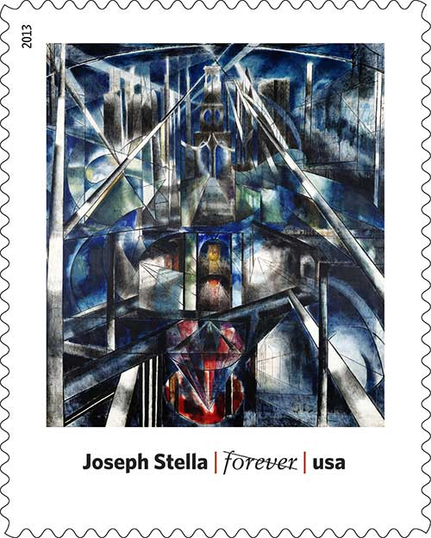
His work has been made into such things as postage stamps, puzzles & posters…

Slide 5
Flowers, Italy 1931

