Slide 1
Basha High School Swim Meet Timer’s Training

Slide 2
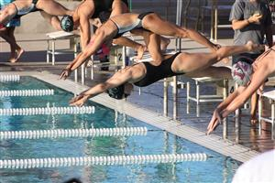
Thank you for Volunteering!
We appreciate your support in helping to make Basha swim meets successful!
Your job is important and we need you!
We can’t do this without your help!

Slide 3
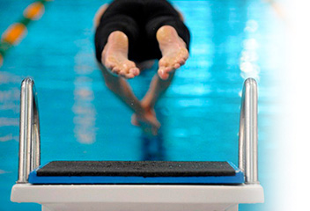
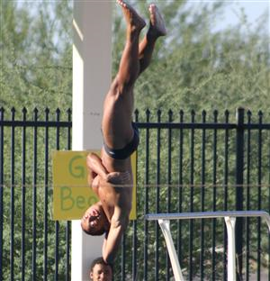
Important Reminders:
Prepare to get wet… it’s not a bad thing! You have the best seat in the house!
Wear comfortable shorts and shoes that can get wet or be taken off easily as well as sunglasses, sunscreen and hats. You’ll be glad you did.
Remember that we are representing Basha and need to be professional in both appearance and behavior.
As tempting as it is, we are not allowed to have anything in the pool… hands, feet, legs, etc.

Slide 4
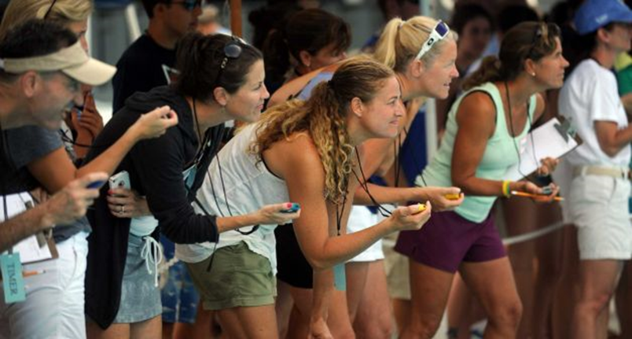
About the Meet
There are 11 events at a swim meet. Each event will have girls and a boys heat (race). There may be additional heats (races) that are considered exhibition – not scoring. This depends on how the coaches structure the meet.
Schools alternate lanes (1-8) with Lanes 4 & 5 typically hosting the fastest swimmers. Only the first race of an event and the three fastest times will score. You will either have Basha kids or other team in your lanes for the entire meet.

Slide 5
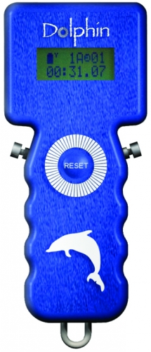
The Dolphin
There are two timers per lane. Each will have a dolphin timer.
This timer will start once the race begins – do not push any buttons until the race is over. Either button will stop the timer.
Please don’t push the reset button unless the head official asks you to.

Slide 6
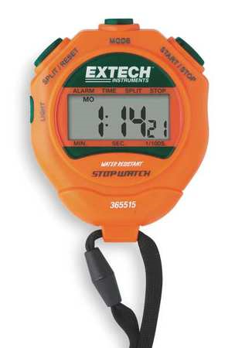
Stopwatch
In addition, one timer will have the backup manual stopwatch timer and the other will have the clipboard to record the times.
Make sure you familiarize yourself with how to start, stop and clear the stopwatch.
The timer with the stopwatch must watch the head official’s light at the beginning of each race. Do not listen for the sound– light travels and every millisecond counts! You can position yourself so you can see but then move out of the way of the swimmers – especially during a relay.

Slide 7
Clipboard
The timer with the clipboard must record the times on the correct racing sheet, record each time to the hundredth place (two decimals) and write the times in the same order for each race.
The manual stopwatch time should always be written in the last space.

Slide 8
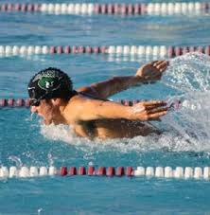
Strokes
There are four different strokes – backstroke, breaststroke, butterfly (fly) and freestyle (free)
It is very important that you know what race we are on and how long each race is.
You must watch your swimmer and know when he or she is about to finish so you can stop the timers. Count the laps.
The time stops as soon as any body part of the swimmer touches the side of the pool.

Slide 9
The Race!
Each length of the pool is 25 yards (from one side to the other). Events are as follows:
200 Medley Relay (8 lengths of the pool; 4 swimmers, each has a different stroke down and back) 200 Freestyle (8 lengths, 1 swimmer, 1 stroke) 200 Individual Medley (IM) (8 lengths, 1 swimmer, 4 strokes – down and back each stroke) 50 Freestyle (2 lengths, 1 swimmer, 1 stroke down and back) ***this is a fast one*** 100 Butterfly (4 lengths, 1 swimmer, 1 stroke) 100 Freestyle (4 lengths, 1 swimmer, 1 stroke) 500 Freestyle (20 lengths, 1 swimmer, 1 stroke) *** this is a long one*** 200 Free Relay (8 lengths, 4 swimmers, 1 stroke, each down and back) 100 Backstroke (4 lengths, 1 swimmer, 1 stroke) 100 Breaststroke (4 lengths, 1 swimmer, 1 stroke) 400 Free Relay (16 lengths, 4 swimmers, 1 stroke, each down and back twice)

Slide 10
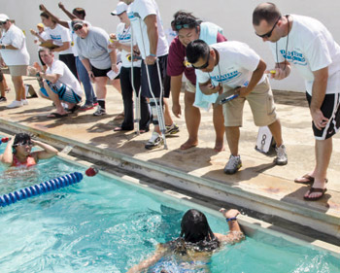
Important Stuff!
The deck gets crowded – especially during a relay. Make sure you stay out of the way of the swimmers so they can get on the block. At the end of the race, you are more important - kindly move swimmers out of the way so you can see the finish.
Both timers must LOOK OVER THE EDGE OF THE POOL when a swimmer finishes the race. Dolphin timers start on their own but must be clicked to stop. Stopwatch timers must be started and stopped manually. Try to click both timers at the same time. Stop the time as soon as any body part touches the side of the pool.
Sometimes the swimmers will want to know their time and it’s ok to tell them the quickest number. Even 1/100 of a second is a big deal to most so accuracy is paramount!

Slide 11
More important stuff!
A runner will come by to take your timing sheet after each race. Be prepared to give it to them while still paying attention to the next race.
If your stopwatch timer fails, notify the head timer for a replacement stopwatch as soon as possible.
Meets typically take 2 hours – prepare to stay the whole time. It doesn’t help to only be there part of the meet… and it’s HOT! Make sure you get water and stay hydrated!
Remember that we represent Basha High! Please don’t play or horse around on deck and we must stay out of the pool. Phones should remain put away for the entire meet.
Thank you so much for agreeing to help! You are AWESOME!

