Slide 1
Lesson 9
Airport Operations &
Air Traffic Control

Slide 2
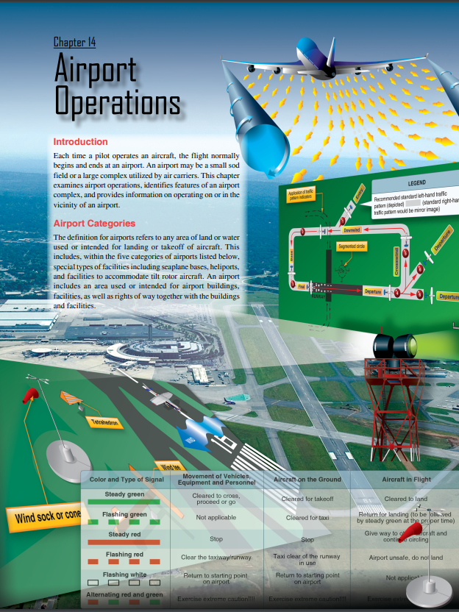
Key Reference
https://www.faa.gov/regulations_policies/handbooks_manuals/aviation/phak/media/16_phak_ch14.pdf

Slide 3
Overview & Objectives
Types of Airports & Levels of Airport Control
  Airport specific airspace will be covered in more detail in the ‘Airspace’ lesson which follows
Sources of Airport Information
Airport Markings, Signs, Lighting
Airport Traffic Patterns & Wind Indicators
Comm & Clearing Procedures
Air Traffic Control (ATC) Services
Automatic Dependent Surveillance-Broadcast (ADS-B)
Wake Turbulence & Vortex Avoidance
ATC Instructions & Runway Incursion Avoidance
Lesson Review & Summary
Questions
Quiz

Slide 4
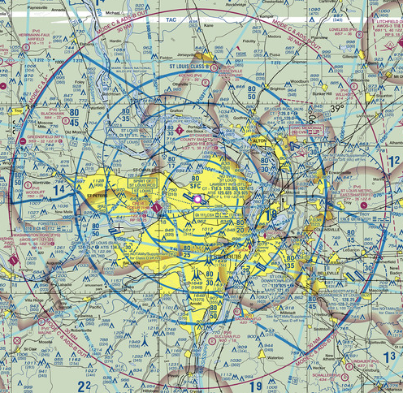
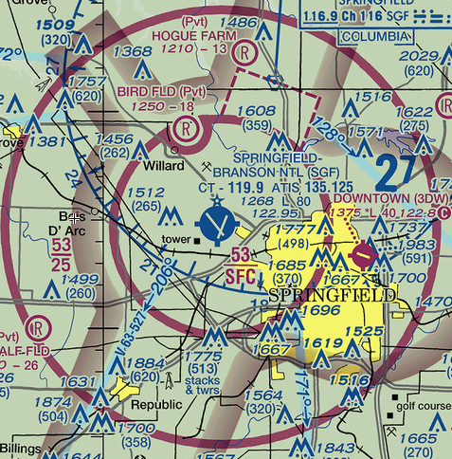
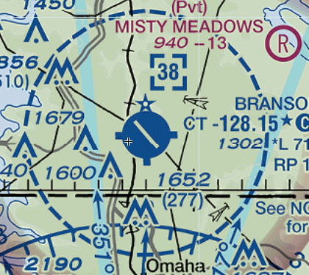
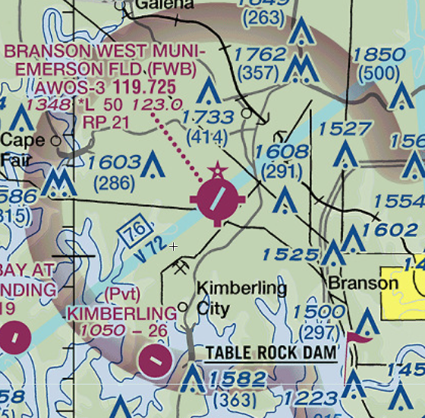
Airports & Levels of Control
General Types of Airports = Civil, Military, and Private
Uncontrolled Airports (Class G or Class E Surface areas) – NO control – pilot must clear visually and verbally if radio equipped
Controlled Airports (Class B, C, D airports) – Tower Controlled
  Class D airports are controlled part-time (tower closes evening/re-opens morning)
  Class D airport/airspace reverts to Class E airspace without control at night
Class B, C airports have full time tower controllers for landing/takeoff and add departure and approach radar controllers to guide traffic to/from the airport
  Class B, C airports also will have Ground Controllers to give taxi clearance and ‘Clearance Delivery’ to provide flight plan clearances/modifications
Class B
Tower & Radar Control
(inner tower surface ring and multiple ‘radar’ rings)
Class C
Tower & Radar Control (inner tower surface ring & a ‘radar’ ring)
Typical Class G/E
Uncontrolled airport
(note magenta airport symbol for uncontrolled airports)
Class D
Part-time Tower

Slide 5
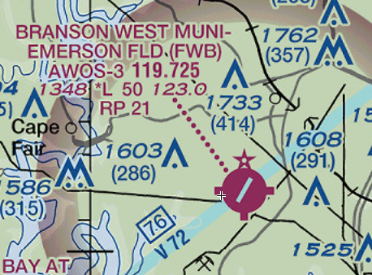
Sources of Airport Information
Sectional Map includes most critical established info (see graphic/discussion below)
Chart Supplements (found online via skyvector.com/others/FAA.GOV)
NOTAMS (online via Skyvector.com/others/FAA.GOV)
Forecasts (forecast weather – several versions/options)
ATIS / AWOS / ASOS (current weather conditions – ATIS offers runway/airfield info)
FSS (they can only read data to you from published sources and can assist in diverts or finding frequencies to support your flight)
Other Pilots or FBO at uncontrolled airports
Discussion: Cadets should interpret all possible
info from the airport shown here: Airport name?
ICAO Identifier (be careful)? Controlled (tower)?
Services? Weather Info Freq?
CTAF Freq for Comm? Airport MSL Altitude?
Longest Runway? Pilot Controlled Lighting?
Any non-standard Patterns? Refer to the Sectional Map
Legend (and Chart Supplement) if you must.

Slide 6
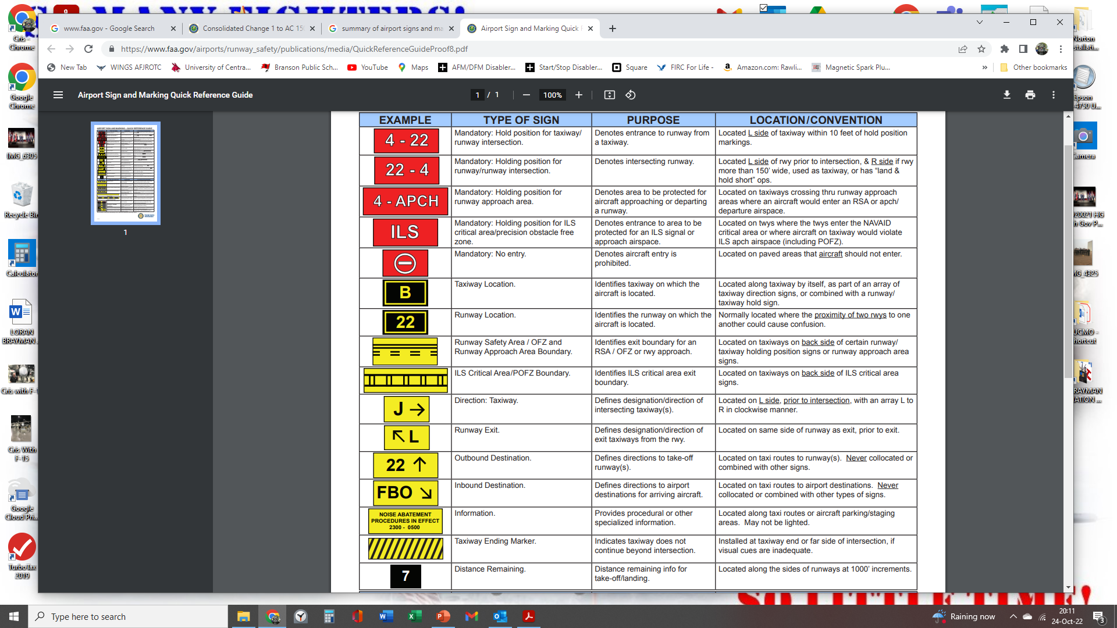
Airport Marking & Signs Summary Table

Slide 7
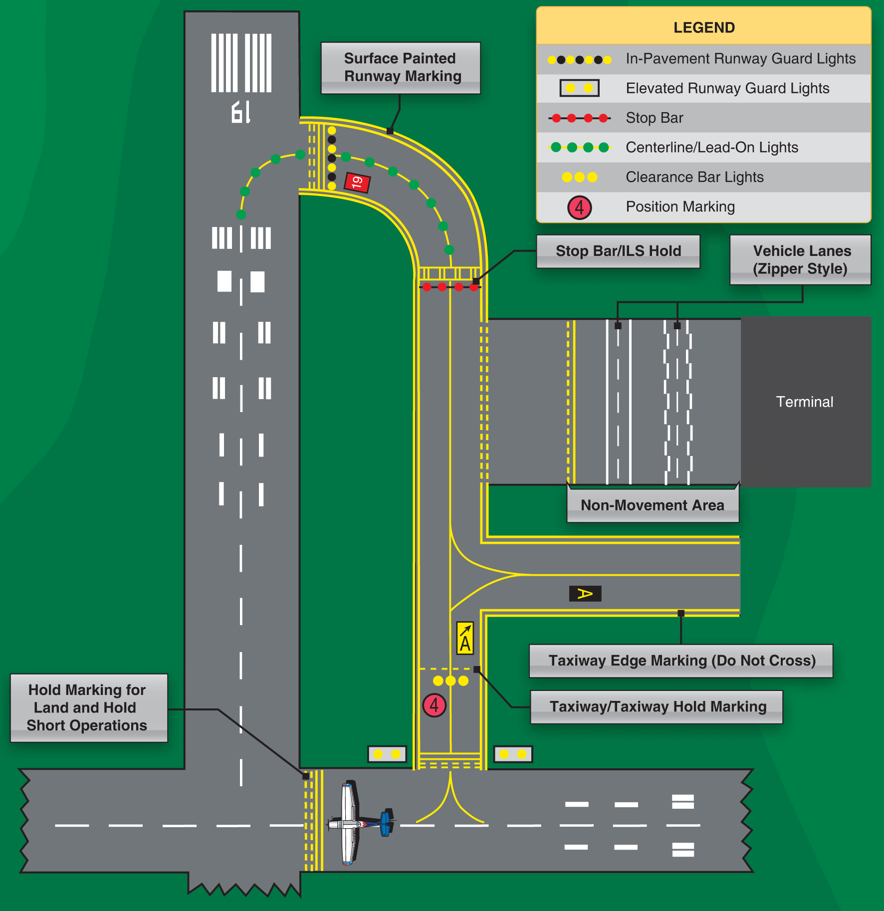
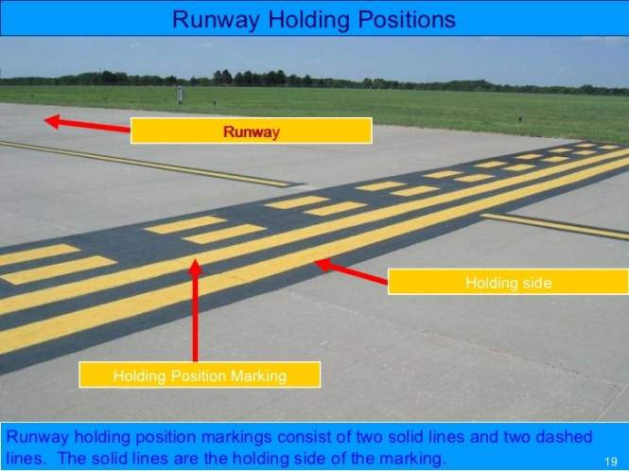
Key Airport Surface Markings

Slide 8
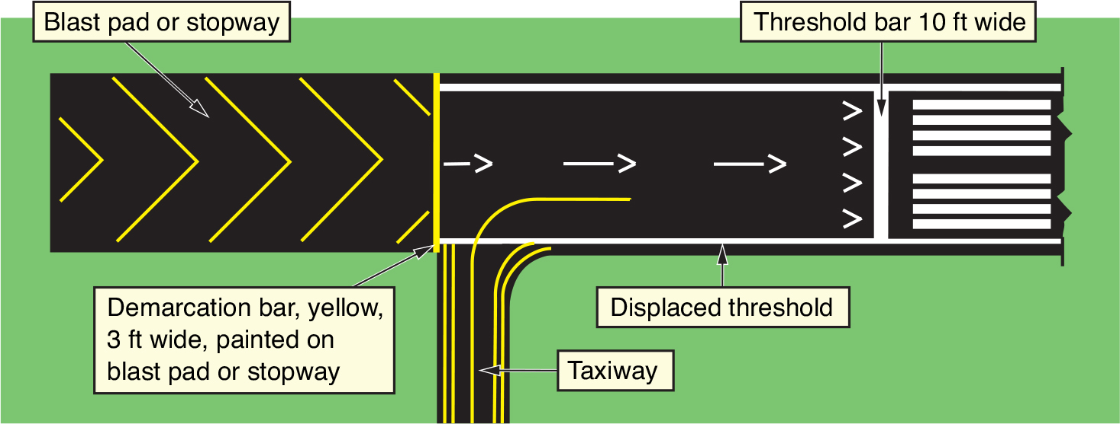
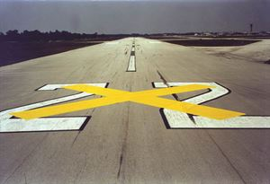
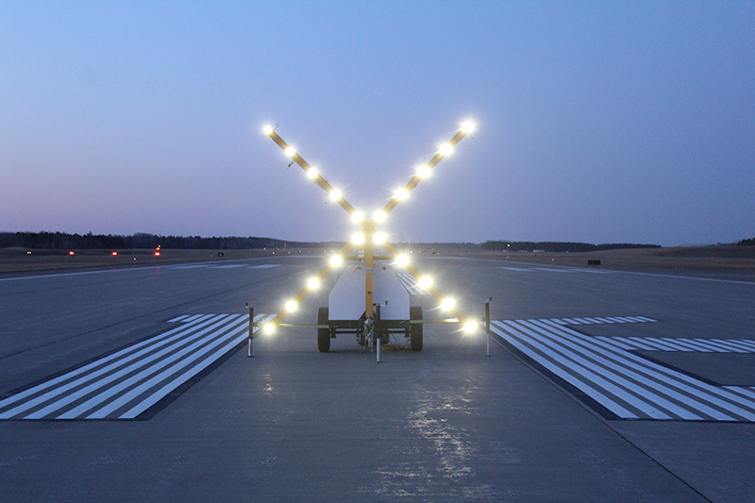
Key Airport Runway Markings
Taxi/Takeoff O.K. (NO Landing) on Displaced Threshold
Emergency use only
< Runway ‘Closed’
Markings >

Slide 9
Runway Holding Markings
‘Dashed on the side you go Dashing’
This is nearly ALWAYS on the test!

Slide 10
Airport Lighting
Key Airport Lighting
  Airport Beacon (another pilot joke… “Find an airport beacon in Las Vegas!”)
    Green/White for civil airport … Green/White/White for Military or Civil-Mil Dual Use Airport
    Other colors/combinations for water airports
  Runway and Taxiway Lights
    Runway lights WHITE (may have amber/red near runway end) / Taxiway lights “cool relaxed” BLUE
  VASI and PAPI (glideslope) Lights
    VASI = Visual Approach Slope Indicator … normally 1 light near/ 1 far (you want red over white)
    PAPI = Precision Approach Path Indicator … normally 4 lights horizontal (you want 2 red, 2 white)
    Standard glidepath informs pilot of a 3 degree decent on final (can vary due to obstacles, terrain, etc.)
Use of Pilot Controlled Lighting (PCL)
  Controls runway/taxi lights at uncontrolled fields
  Also works at night when D towered airport becomes a Class E uncontrolled field)
  Click mike on CTAF Frequency …
    3 clicks for Low Intensity Airport Lighting (runway and taxiway lights turn on)
    5 clicks for Med
    7 clicks for High (High setting bugs me on dark nights, but you be you)
Lighting graphics follow…

Slide 11
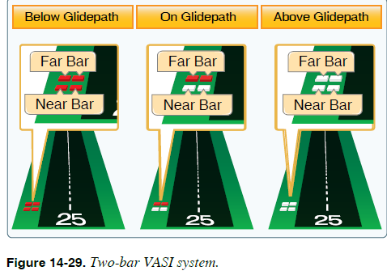
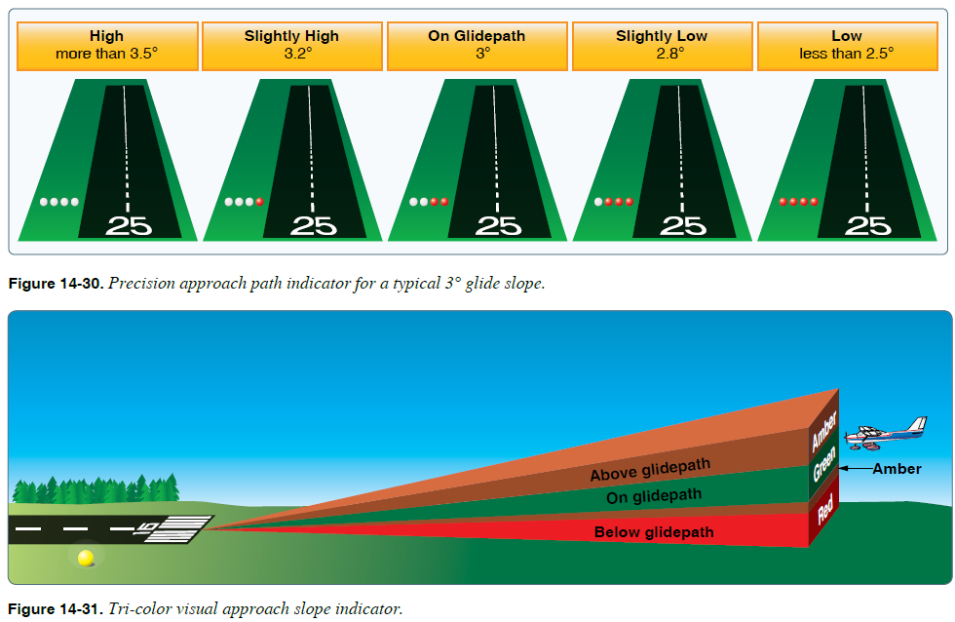
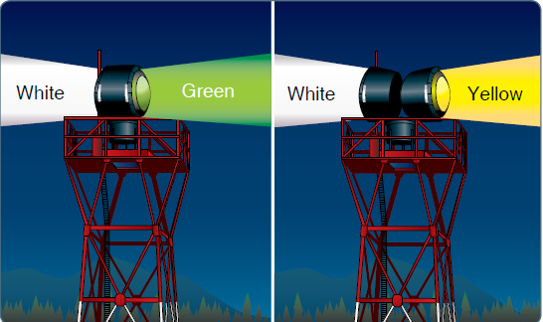
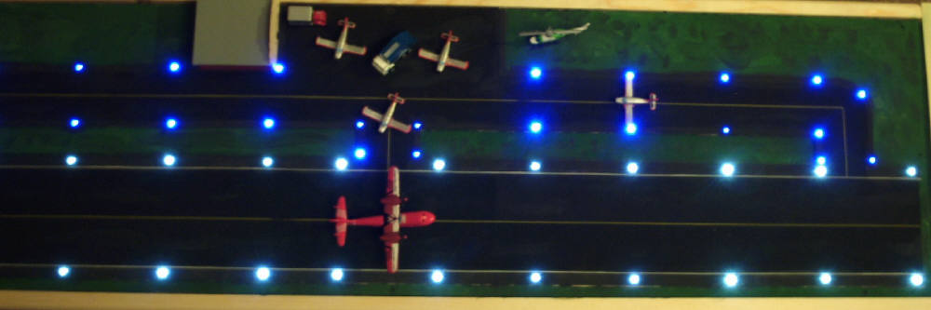
Airport Visual Approach
& Surface Lighting
PAPI
VASI
You will likely never see this Tri-colored VASI
WHITE Runway lights and BLUE Taxiway lights
White/Green
Civil Land Airport
(Military is White/White/Green)
White/Yellow
Water Airport
(Heliport is White/Yellow/Green)

Slide 12
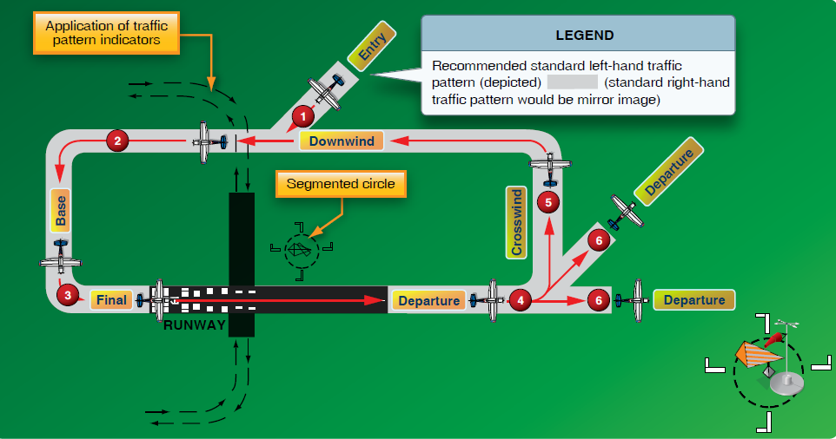
Airport Traffic Patterns
Standard pattern is LEFT hand at 1,000ft AGL for light aircraft (read the Chart Supplement to confirm any published non-standard patterns

Slide 13
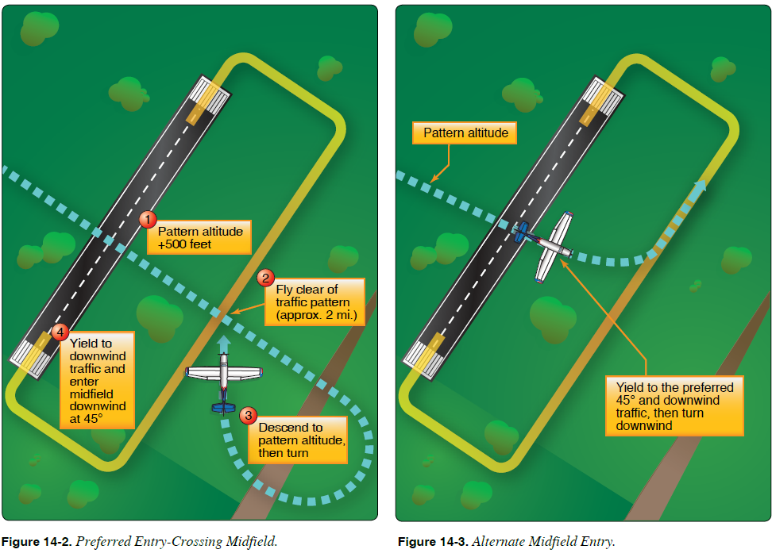
Uncontrolled Airfield
Traffic Pattern Entry
When approaching an airport on the downwind side simply enter a “45° to downwind” as in position 3 below … when approaching from the side opposite of the preferred downwind, enter as shown with the
“up-over-out-down” method.
This method may be legal but tends to be dangerous … 45° entry from outside of downwind makes clearing safer and more effective!
Note that when arriving at towered airports, the controller DIRECTS your entry and pattern, so it is simpler in a way. At uncontrolled fields, you are coordinating your own plan/flight path.

Slide 14
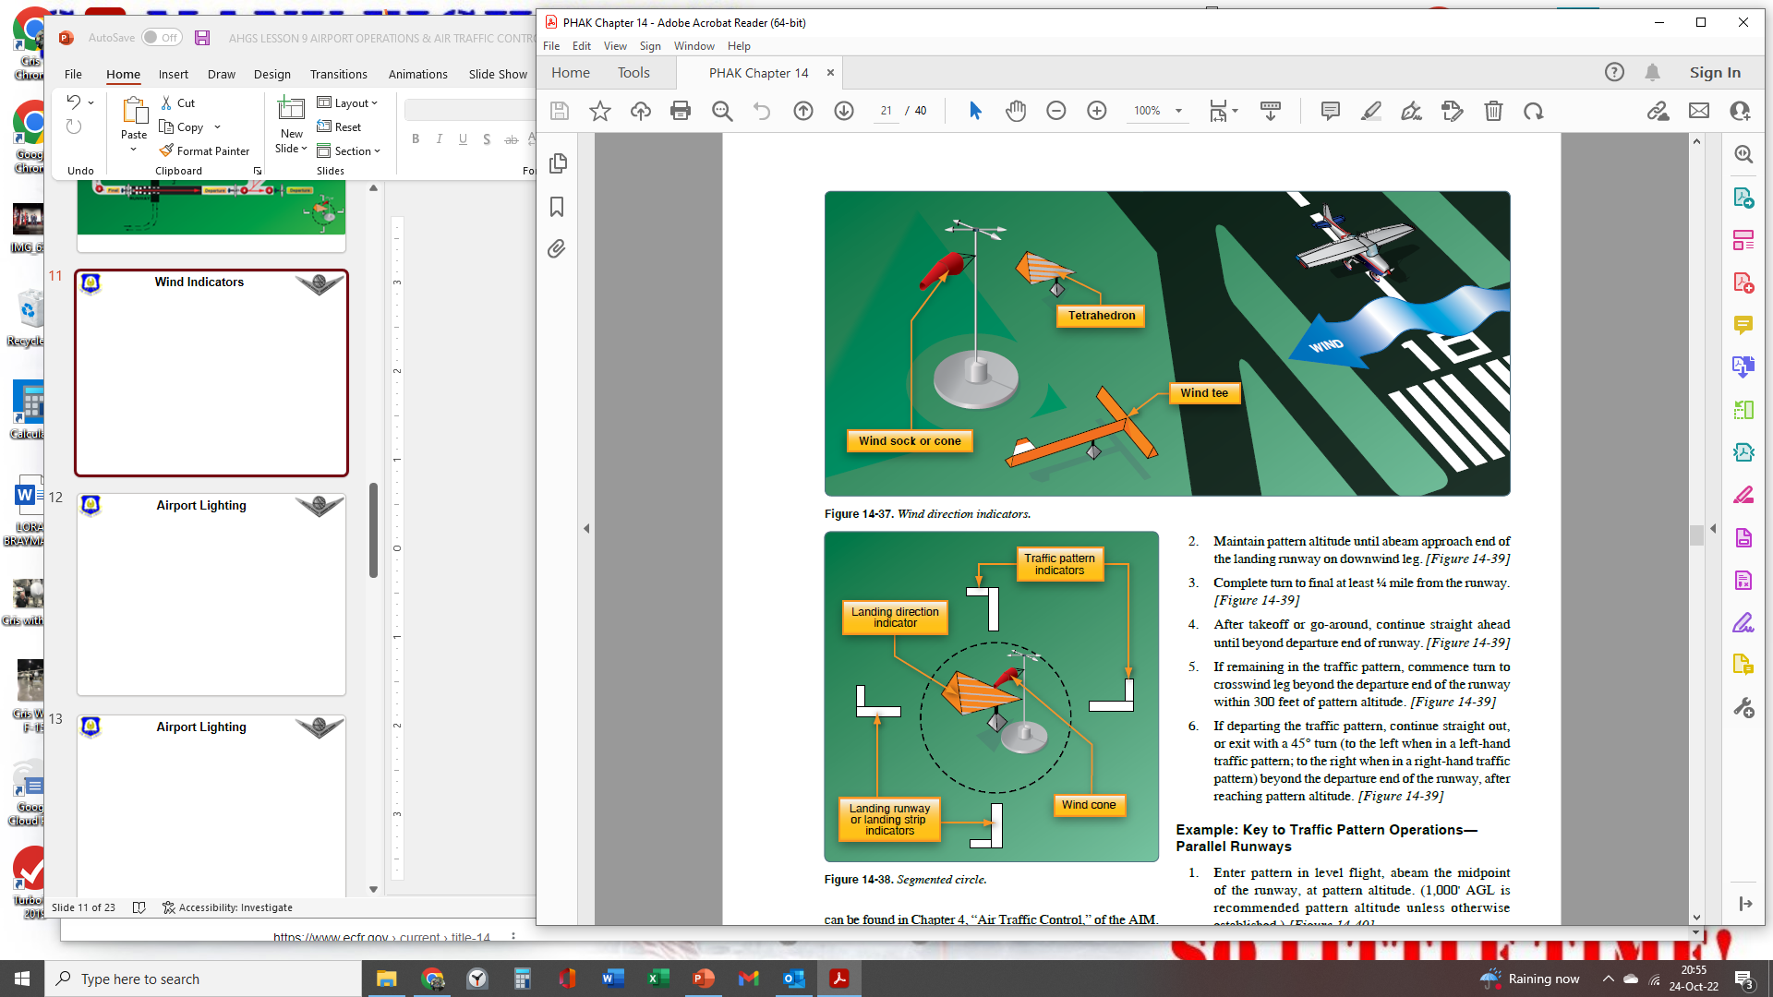
Wind Indicators
Segmented Circle, when present, indicates that all patterns are NOT standard (left) patterns
Various types of wind indicators
(Wind SOCK is most common)
18
9
27
36
Pilot joke that, “Wind indicators work great on the ground before takeoff as you taxi by them. But, they are not a factor for landing since they are too small to see from the air and they are NEVER lighted well at night, helping pilots to guess rather than be confused by (good) decisions!” This is close to the truth.
L-shaped markers indicate “base -to- final” turn direction. The above markers indicate LEFT pattern to runways 36 and 9 but RIGHT pattern to runways 18 and 27

Slide 15
Comm & Clearing Procedures
Communication with a towered airport or an un-towered (uncontrolled) airport, should begin with listening to the airport ATIS or AWOS for weather/runway info
If arriving at a radar service airport (Class C and B) you should get ATIS, THEN make a radio call to approach
  Pilot: “Springfield Approach, Cherokee N123AF”
  Approach: “Cherokee N123AF go ahead”
  Pilot: “Cherokee 3AF is 20 South with Information “D” (Delta is the ATIS info at the time)
  Approach: “Cherokee 3AF, cleared direct, remain VFR, expect Runway 22”
  Pilot: “Cherokee 3AF Roger and airport in sight”
  Approach: “Cherokee 3AF, contact Springfield Tower 118.9”
  Pilot: “Cherokee 3AF WILCO” … “Springfield Tower, Cherokee 3AF 5 South for landing (Class D, start here)
  Tower: “Cherokee 3AF, follow the Learjet on 2 mile final to Runway 22”
  Pilot: “Cherokee 3AF has Learjet in sight”
  Tower: (after Learjet lands) … “Cherokee 3AF, cleared to land Runway 22”
  Pilot: “Cherokee 3AF, cleared to land Runway 22” (it is VERY important to acknowledge landing clearance and specific runway cleared to land on when working with tower)
If arriving at an uncontrolled airport: 1. Get AWOS/ASOS 2. Call distance out w/intentions (“Branson West Cherokee 3AF, 5 West for landing, Branson West”) 3. Coordinate as necessary with other pilots as you approach the airport and enter downwind (“Branson West, Cherokee 3AF left downwind 03, Branson West”) … then clear, call base in a similar manner, land…
  Remember: uncontrolled airports (E, G) do not require pilots to have radios, so clear with your ears AND your eyes!

Slide 16
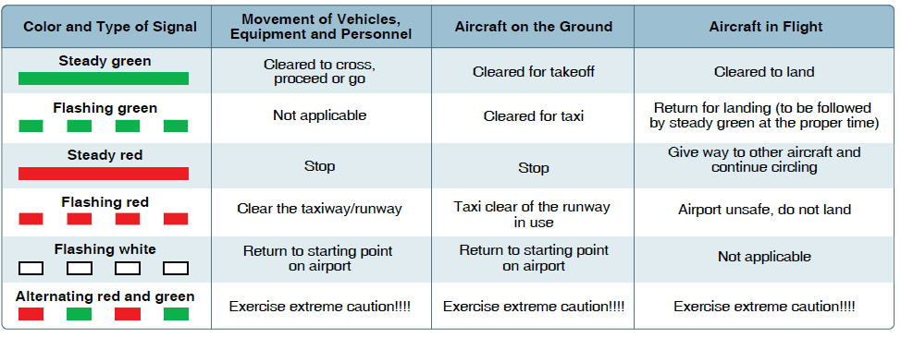
NORDO Aircraft Tower Signals
No tower, no problem, just clear and land!
Test loves these 2 light signals
When radio fails (‘NORDO’) squawk 7600 to highlight your radio-out situation to ATC radar services in the area – they will then contact airports where it appears you will be landing. Pilot can also blink landing lights and rock wings if at a towered airport, to indicate they are NORDO)

Slide 17
ATC Services
ATC Services Continuum
  PLANNING/DECISION SUPPORT
    Flight Service Station/FSS
  CLEARANCES
    Received from ‘Clearance Delivery’ or sometimes tower controller at smaller airports – clearance confirms or modifies route, frequencies, initial altitudes, and transponder codes to squawk at takeoff
  GROUND CONTROL
    Ground controllers are available at towered (B, C, D) airports – direct traffic to/from runways
  TOWER (VISUAL) CONTROL
    Verbal clearance for LANDING & TAKEOFF at B, C, D, airports
  DEPARTURE (RADAR) CONTROL
    Available where radar is available – B, C airports (“multiple rings = radar services”)
  ENROUTE CONTROL
    ‘Approach’ or ‘center’ radar controllers support enroute traffic for traffic/weather avoidance
    Local approach controllers usually support lower altitude VFR traffic (Regional Center for high traffic)
    Regional center controllers usually support IFR/high altitude turboprop and jet traffic
  ARRIVAL (RADAR) CONTROL
    Opposite of DEPARTURE CONTROL for arrival at B, C, airports (will sometimes support other fields)
When enroute ATC can only see your ground track, not your wind-adjusted heading… when traffic calls are made by ATC it references your ground track so you may have to adjust where you look for traffic

Slide 18
ADS-B
Not strictly an airport issue…
Automatic Dependent Surveillance-Broadcast (ADS-B): An integrated air-ground system to automatically broadcast aircraft data, position, parameters, weather, NOTAMS, etc. From aircraft-to-ATC & aircraft-to-aircraft
Became a FAR Part 91 requirement in January 2020
We will discuss more in the following lessons…there are specific altitudes/airspaces which require ADS-B OUT on aircraft
  In general ADS-B OUT is required when:
    In radar controlled airspace; i.e., Class B/C airports
    Above Class B/C airports
    Above 10K’ MSL in Class E airspace
    Class A airspace (at and above 18,000’ MSL) … VFR pilots cannot fly in Class A airspace
Everywhere that requires ADS-B, also requires a Transponder w/ Mode C (altitude transmission capability) … the vast majority of aircraft have Mode C capable transponders
Reviewing the ‘Airspace’ lesson will assist in remembering ADS-B requirements vs. airspace

Slide 19
Wake Turbulence &
Vortex Avoidance
Wake Turbulence is caused by higher pressure air below wings escaping to lower pressure above the wings … motion at the tip of a wing is from bottom to top around the wingtip
The vortices caused by this dynamic make air rotate up and over toward the fuselage of the aircraft creating the vortices
Worst case vortex creator is a HEAVY, CLEAN (no flaps down), SLOW aircraft
  Discussion: Reason why this is the case… especially determine why a vortex is less dangerous when the flaps of the creating aircraft are down?
Vortices caused by this dynamic, especially behind heavy aircraft can be dangerous
Light aircraft should delay 2 minutes or land above/beyond landing point of a heavy aircraft or takeoff before/above the takeoff point of a heavy aircraft and avoid the flight path of the aircraft ahead
Wake turbulence is worst when a light quartering tailwind is present since this can hold the vortex of the upwind wing, over the runway landing zone
Graphics follow…

Slide 20
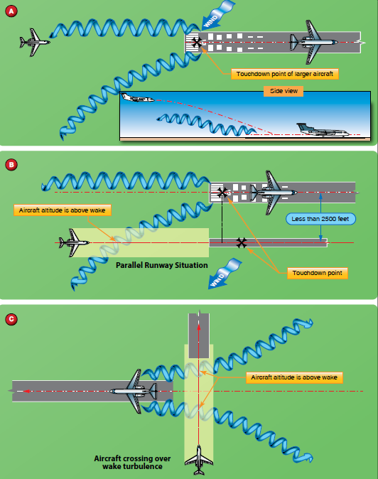
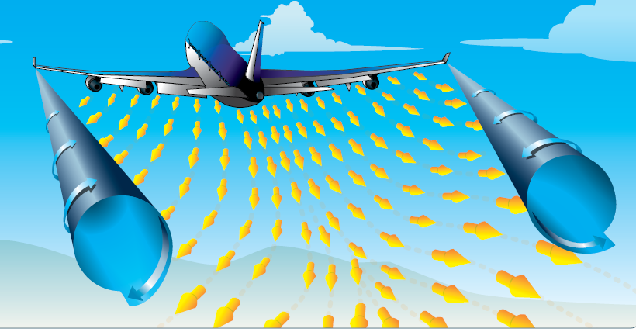
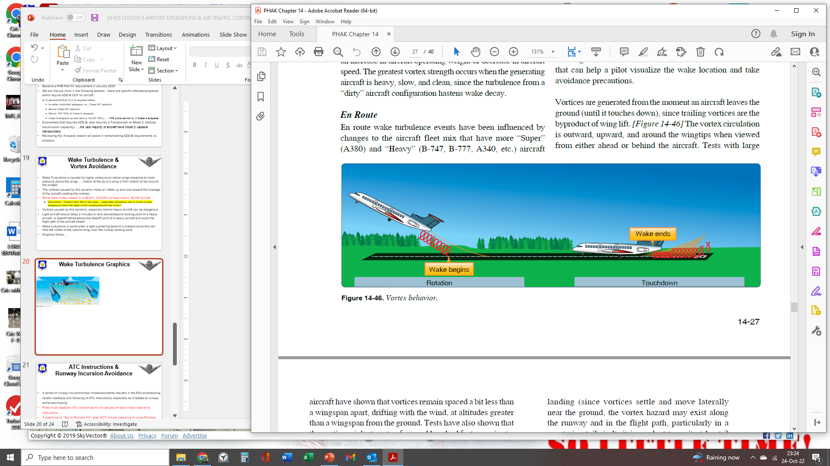
Wake Turbulence Graphics

Slide 21
ATC Instructions &
Runway Incursion Avoidance
A series of runway incursions/near misses/accidents resulted in the FAA emphasizing careful readback and following of ATC Instructions, especially as it relates to runway entrance/crossing
Pilots must readback ATC clearances to include ground taxi/runway clearance instructions
A clearance to “Taxi to Runway XX” does NOT include clearance to cross Runway YY enroute unless SPECIFICALLY “Cleared to cross Runway YY”
A pilot may NOT enter a runway (at a towered airport) until hearing:
  “N123AF cleared for takeoff Runway YY” or…
  “N123AF cleared to line-up and wait Runway YY”
Hotspots (“HS”) are indicated on select airport diagrams where incidents have occurred or are likely dangerous runway crossings/intersections (example shown on next slide)

Slide 22
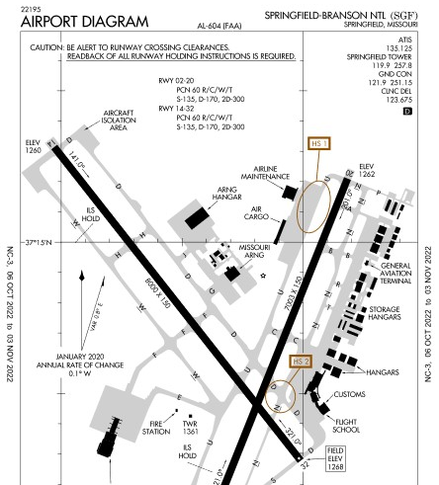
Airport Hot Spots (“ HS # ”)

Slide 23
Lesson Review & Summary
Types of Airports & Levels of Airport Control
  Again, airport specific airspaces will be covered in more detail in the ‘Airspace’ lesson which follows
Sources of Airport Information
Airport Markings, Signs, Lighting
Airport Traffic Patterns & Wind Indicators
Comm & Clearing Procedures
Air Traffic Control (ATC) Services
Automatic Dependent Surveillance-Broadcast (ADS-B)
Wake Turbulence & Vortex Avoidance
ATC Instructions & Runway Incursion Avoidance
Quiz to follow…

Slide 24
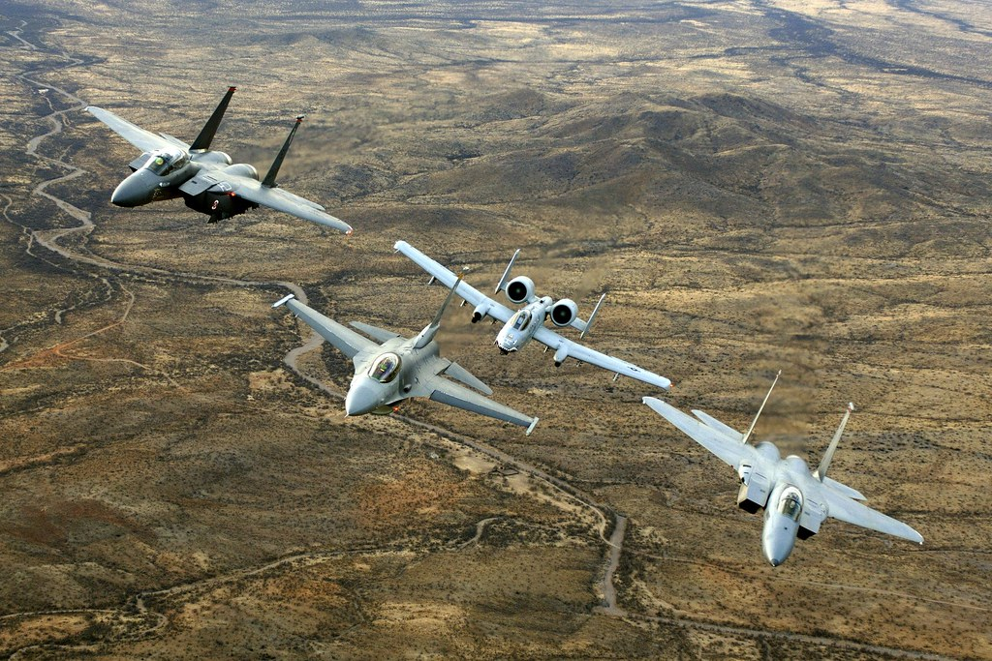
Questions?
Next Up:
Airspace
Ref: PHAK Chapter 15

