Slide 1

NCAA
Registration and eligibility
BASHA HIGH SCHOOL

Slide 2

NCAA clearinghouse Website
Eligibilitycenter.org
https://web3.ncaa.org/ecwr3/

Slide 3
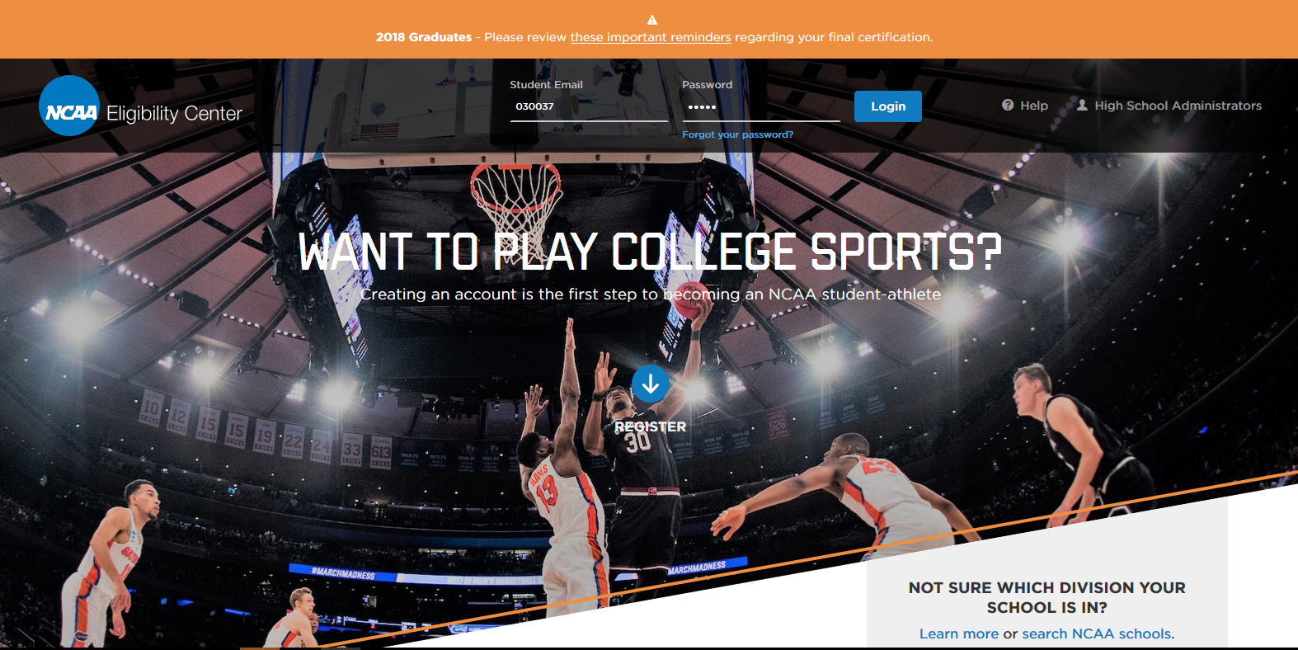
Click Here

Slide 4
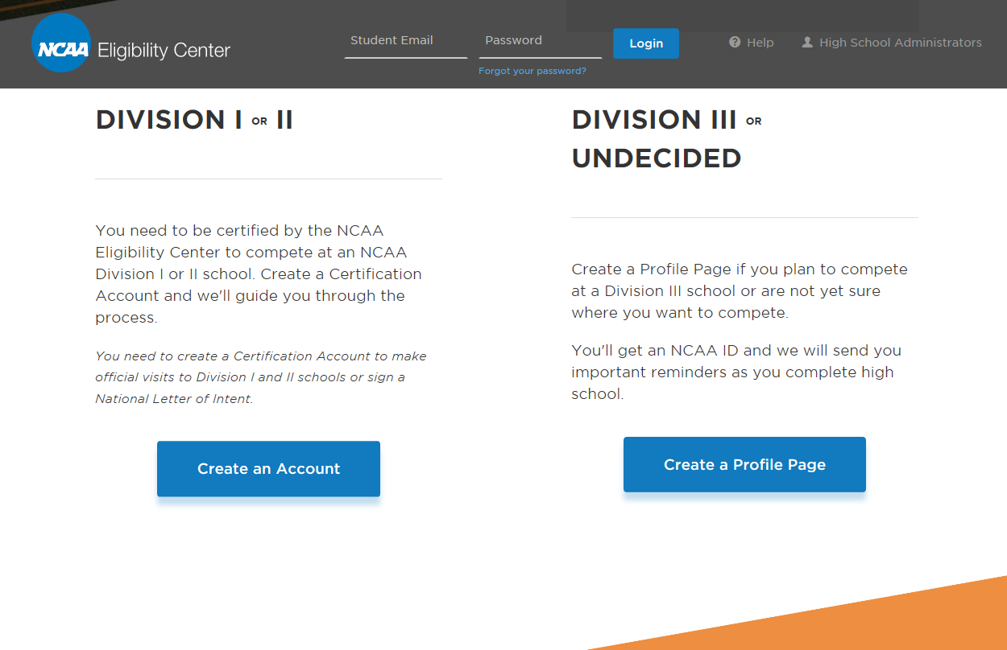
Choose

Slide 5
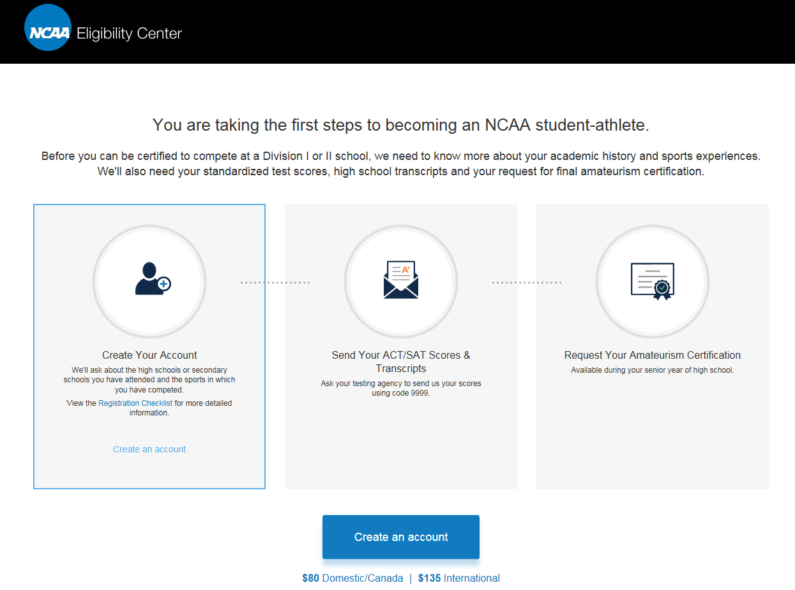
Step 1
Step 2
Step 3
Click here

Slide 6

Registration Fee Payment
Your account will be eligible for processing once the
registration fee has been paid (or submission of a fee waiver
if you are eligible). You may pay online by debit, credit card
or e-check. Beginning Sept. 1, 2016, the registration fee will
be $80 for students in the United States, U.S. territories and
Canadian students (U.S. territories include American Samoa,
Guam, Northern Mariana Islands, Puerto Rico and U.S. Virgin
Islands); and $135 for all other international students.
All fees are nonrefundable once you have successfully
registered.

Slide 7
Registration FEE Waiver
You are eligible for a waiver of the registration fee if
you have received a waiver of the SAT or ACT fee.
This is not the same as a U.S. state voucher. You must
have an authorized high school official submit your fee
waiver documentation online once you complete your
registration.
ACT
In order to be eligible for an ACT fee waiver, you must
meet one of these indicators of economic need:
• Your family receives low-income public
assistance.
• Your family income is at or below the Bureau of
Labor Statistics Low Standard Budget.
• You are a ward of the state.
• You live in a foster home.
• You are homeless.
• You participate in free or reduced-price lunch
program at school.
• You participate in federally funded TRIO Program
such as Upward Bound.
SAT
You are eligible for consideration for an SAT fee waiver if you are
a United States citizen or a foreign national taking the SAT in the
United States or its territories and you meet one of the following
requirements:
• You are enrolled in a program for the economically
disadvantaged such as AVID or TRIO.
• Your family’s annual income falls within the levels listed
by the U.S. Department of Agriculture (USDA) for free or
reduced-price lunches.
• Your family receives public assistance.
• Your family lives in federally subsidized public housing.
• You live in a foster home.

Slide 8
Complete the registration process
Once You Have Created Your Account Check Your Email and Log in to Finish the Registration Process

Slide 9
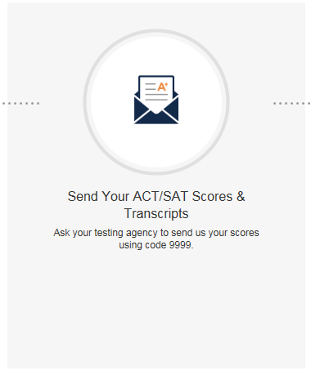
Register for the Clearinghouse SOPHOMORE Yr.
Once you have created your account, you need to have every high school you have attended submit your complete official transcripts. This includes submitting your information at the end of your senior year. Second, you need to have the SAT or ACT testing center send your official test results directly to the NCAA Eligibility Center. Each time you take the SAT or ACT, you will want to have the test scores submitted to the NCAA.
https://www.parchment.com/u/registration/598213/account

Slide 10
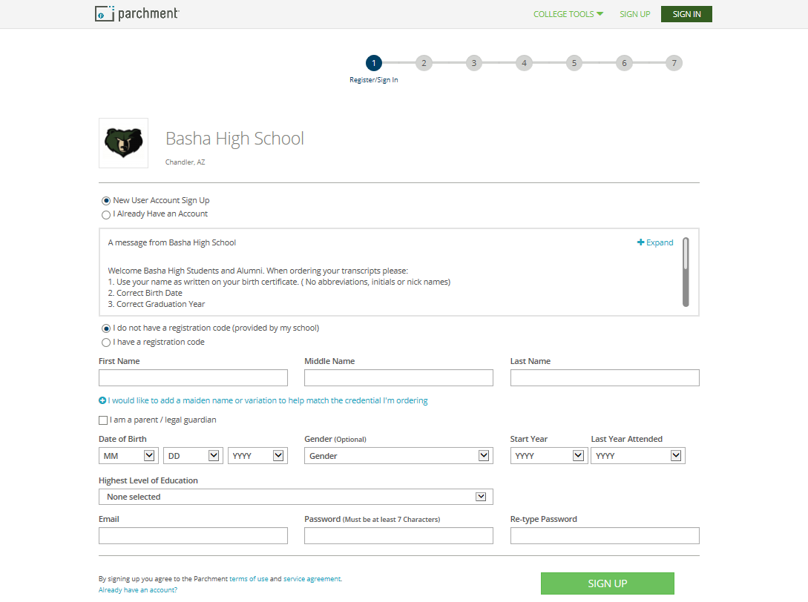

Slide 11
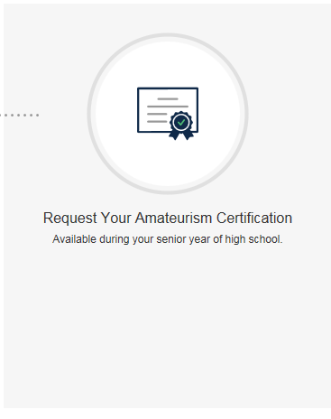
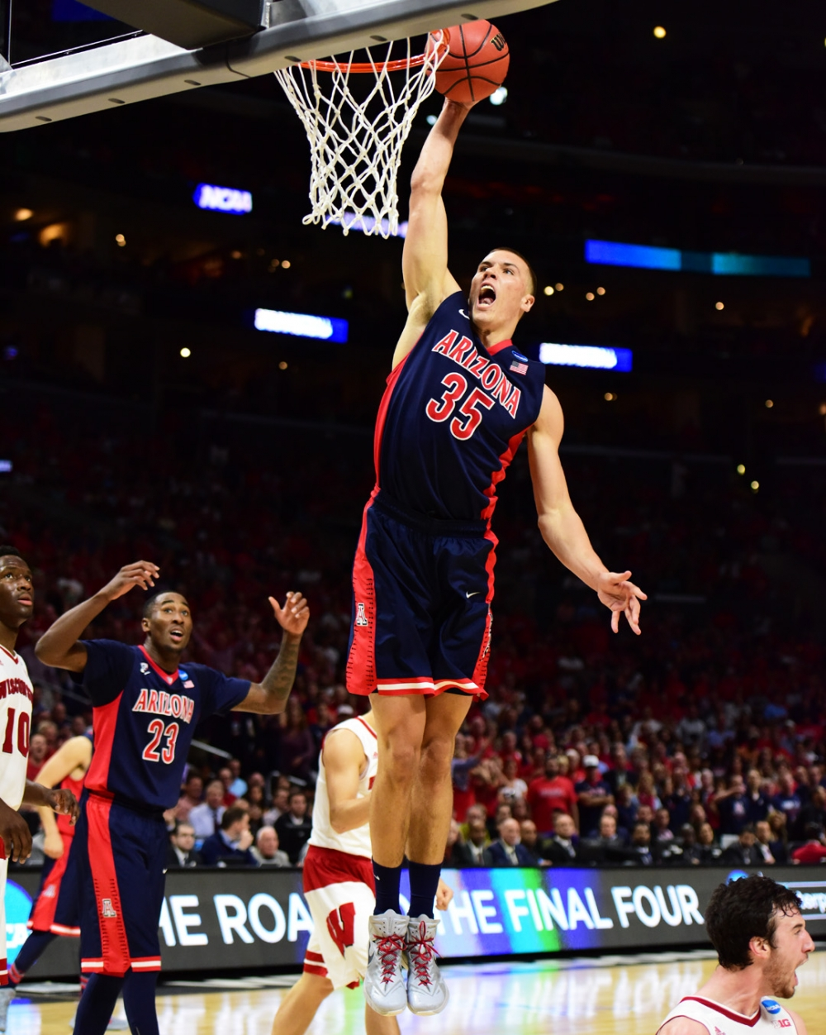

Senior Year
Request your certificate

Slide 12
Senior Year
Send your final transcripts at the completion of 12th grade
https://www.parchment.com/u/registration/598213/account
Use Code: 9999

Slide 13
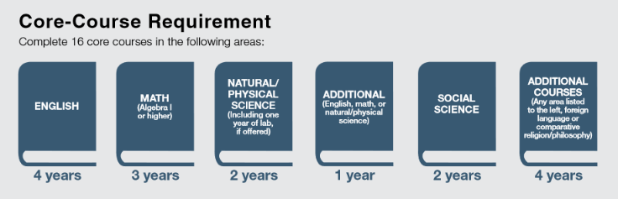
Div. 1 High School Course requirements

Slide 14
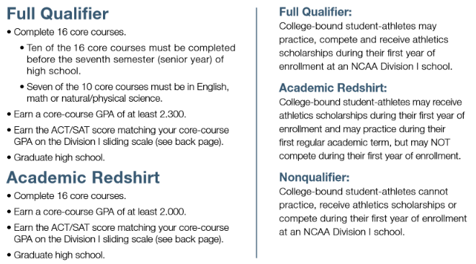
Div. 1 High School Course requirements
*If you plan to attend a Division I school, you must complete 16 NCAA-approved core courses in eight academic semesters or four consecutive academic years from the start of ninth grade. If you graduate from high school early, you must still meet core-course requirements.

Slide 15
DIV. 2 High School course Requirements
If You Enroll BEFORE Aug. 1, 2018
If You Enroll AFTER Aug. 1, 2018
1.Complete a total 16 core courses in the following areas:
3 years of English.
+ 2 years of math (Algebra 1 or higher).
+ 2 years of natural/physical science (including one
year of lab science if offered).
+ 2 years of social science.
+ 3 additional years of English, math or natural/
physical science.
+ 4 additional years of English, math, natural/
physical science, social science, foreign language,
comparative religion or philosophy.
2. Earn at least a 2.000 GPA in your core courses.
3. Earn an SAT combined score of 820 or an ACT sum
score of 68. SAT scores earned during or after March
2016 will be evaluated based on concordance tables
established by the College Board.
1.Complete a total of 16 core courses in the following
areas:
3 years of English.
+ 2 years of math (Algebra 1 or higher).
+ 2 years of natural/physical science (including one
year of lab science if offered).
+ 2 years of social science.
+ 3 additional years of English, math or natural or
physical science.
+ 4 additional years of English, math, natural or
physical science, social science, foreign language,
comparative religion or philosophy.
2. Earn an SAT combined score or ACT sum score that
matches your core-course GPA (minimum 2.200) on the
Division II competition sliding scale.

Slide 16
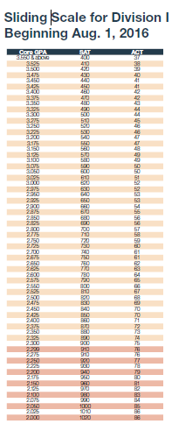
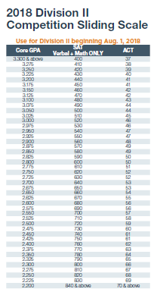
GPA/ACT/SAT Sliding scale

Slide 17
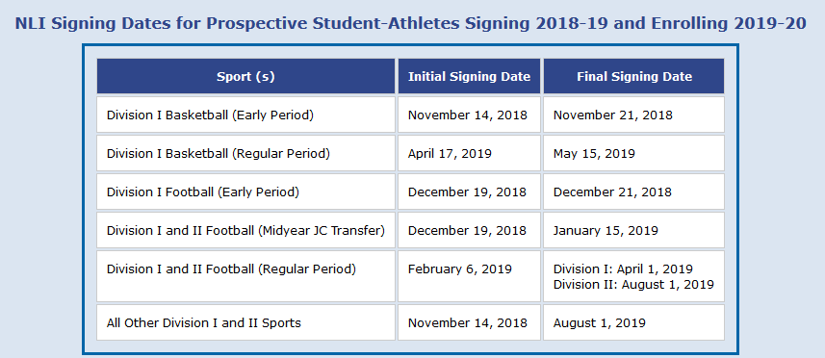
National Letter of Intent dates

Slide 18
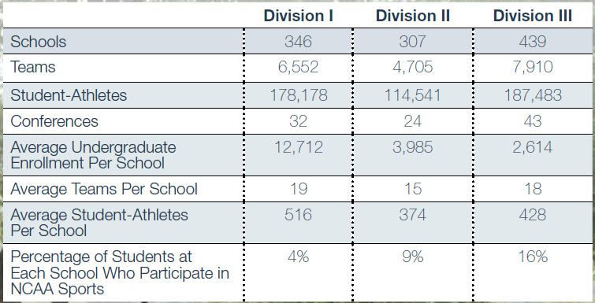
NCAA Athlete Breakdown

Slide 19
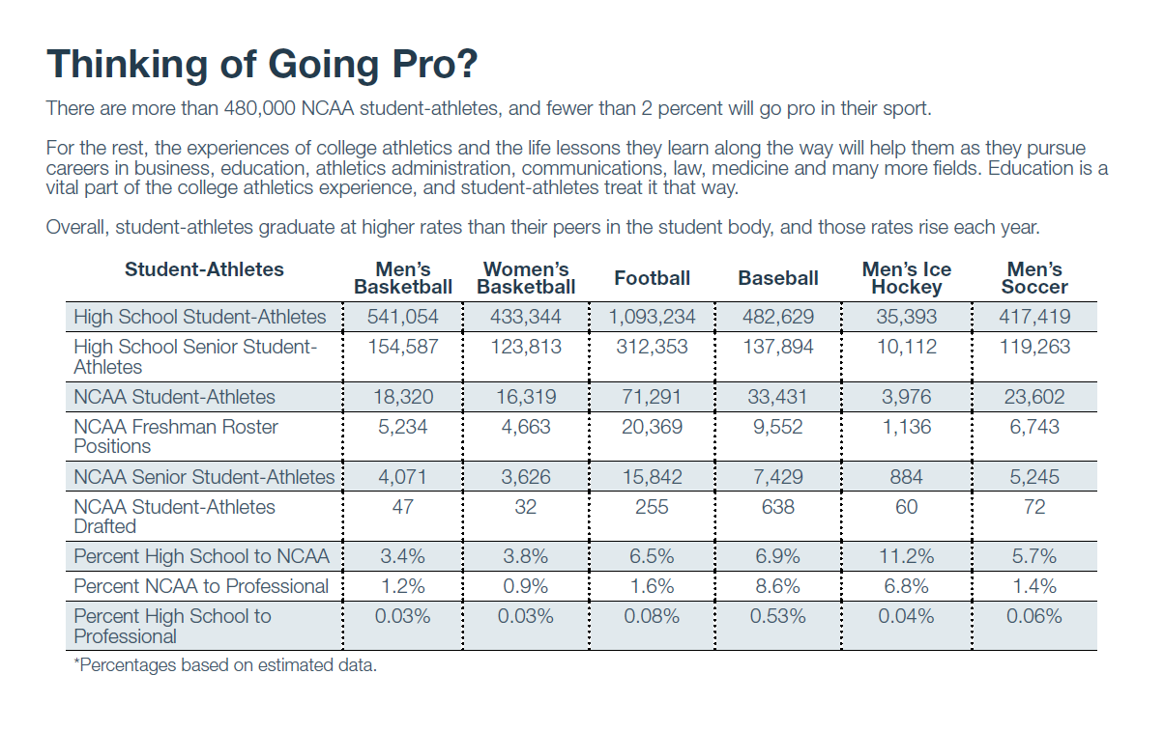
REALITY CHECK

Slide 20
Frequently Asked Questions
What is a contact?
A contact occurs any time a college coach says more than hello during a face-to-face contact with a college-bound student-athlete or his or her parents off the college’s campus.
What is a contact period?
During a contact period a college coach may have face-to-face contact with college-bound student-athletes or their parents, watch student-athletes compete and visit their high schools, and write or telephone student-athletes or their parents.
What is an evaluation period?
During an evaluation period a college coach may watch college-bound student-athletes compete, visit their high schools, and write or telephone student-athletes or their parents. However, a college coach may not have face-to-face contact with college-bound student-athletes or their parents off the college’s campus during an evaluation period.
What is a quiet period?
During a quiet period, a college coach may only have face-to-face contact with college-bound student-athletes or their parents on the college’s campus. A coach may not watch student-athletes compete (unless a competition occurs on the college’s campus) or visit their high schools. Coaches may write or telephone college-bound student-athletes or their parents during this time.

Slide 21
Frequently Asked Questions Cont.
What is a dead period?
During a dead period a college coach may not have face-to-face contact with college-bound student-athletes or their parents, and may not watch student-athletes compete or visit their high schools. Coaches may write and telephone student-athletes or their parents during a dead period.
What is the difference between an official visit and an unofficial visit?
Any visit to a college campus by a college-bound student-athlete or his or her parents paid for by the college is an official visit. Visits paid for by college-bound student-athletes or their parents are unofficial visits.
During an official visit the college can pay for transportation to and from the college for the prospect, lodging and three meals per day for both the prospect and the parent or guardian, as well as reasonable entertainment expenses including three tickets to a home sports event.
The only expenses a college-bound student-athlete may receive from a college during an unofficial visit are three tickets to a home sports event.
What is a National Letter of Intent?
A National Letter of Intent is signed by a college-bound student-athlete when the student-athlete agrees to attend a Division I or II college or university for one academic year. Participating institutions agree to provide financial aid for one academic year to the student-athlete as long as the student-athlete is admitted to the school and is eligible for financial aid under NCAA rules. Other forms of financial aid do not guarantee the student-athlete financial aid.
The National Letter of Intent is voluntary and not required for a student-athlete to receive financial aid or participate in sports.
Signing an National Letter of Intent ends the recruiting process since participating schools are prohibited from recruiting student-athletes who have already signed letters with other participating schools.
A student-athlete who has signed a National Letter of Intent may request a release from his or her contract with the school. If a student-athlete signs a National Letter of Intent with one school but attends a different school, he or she will lose one full year of eligibility and must complete a full academic year at their new school before being eligible to compete.
What are recruiting calendars?
Recruiting calendars help promote the well-being prospective student-athletes and coaches and ensure competitive equity by defining certain time periods in which recruiting may or may not occur in a particular sport.

Slide 22
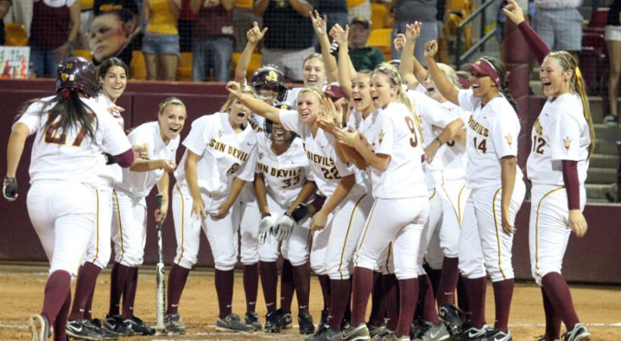
2016-17 Division I and II Recruiting Calendars
http://www.ncaa.org/student-athletes/resources/recruiting-calendars/2016-17-division-i-and-ii-recruiting-calendars

Slide 23
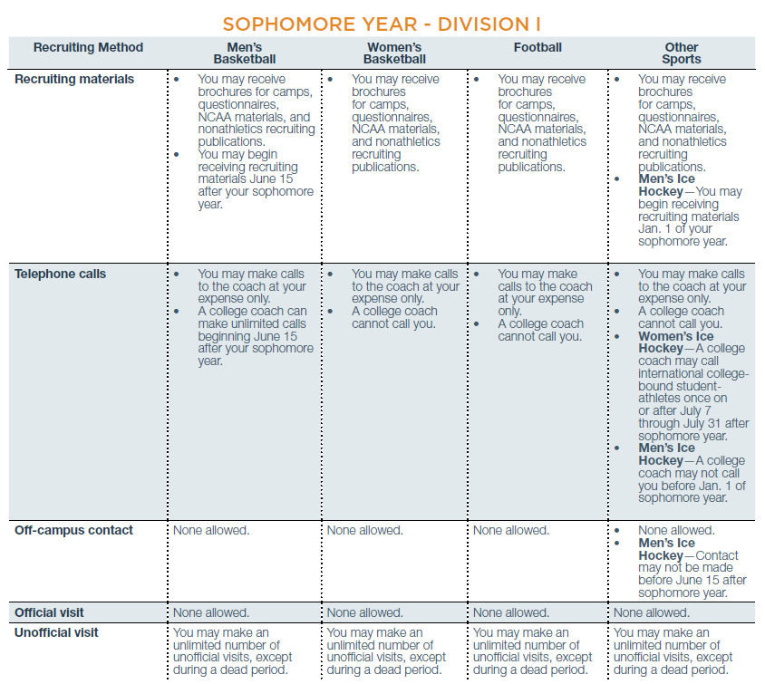
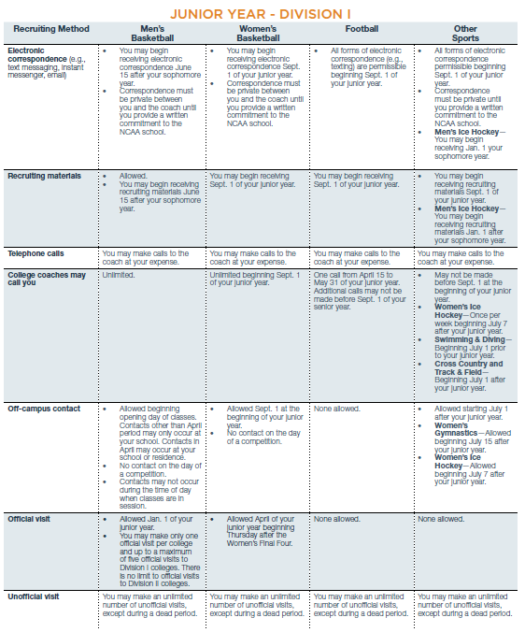
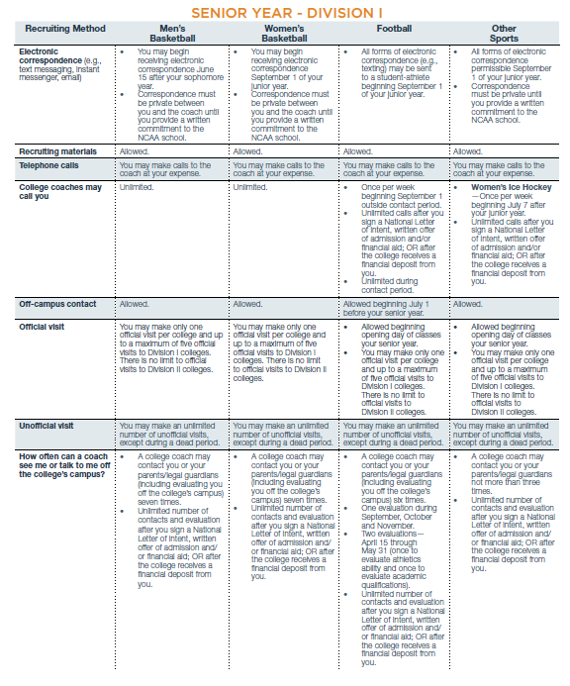
Recruiting calendars
http://www.ncaa.org/student-athletes/resources/recruiting-calendars/2018-19-division-i-and-ii-recruiting-calendars

