Slide 1
Anatomical Parts of Animals
August 8, 2014

Slide 2
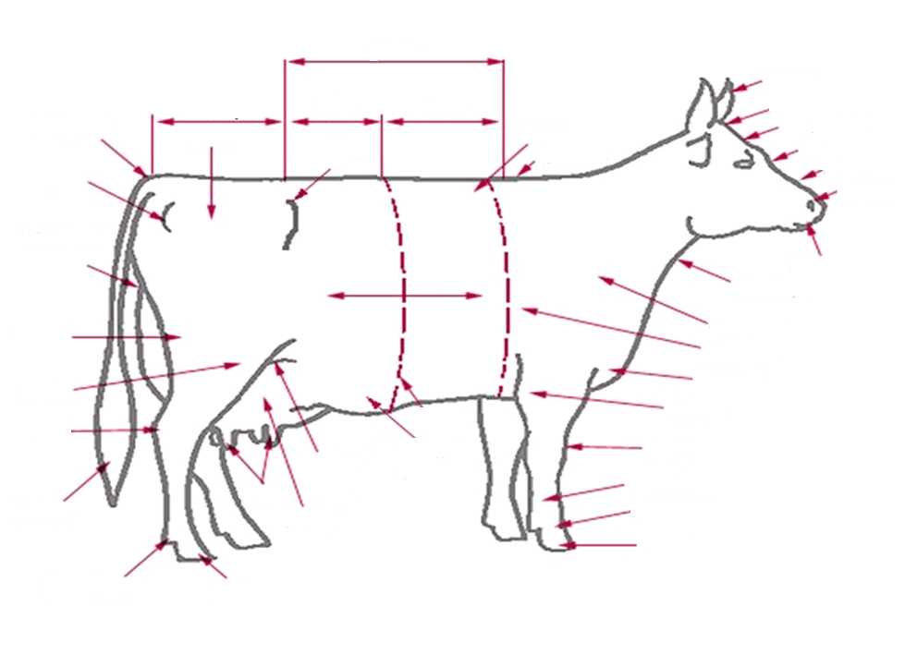
Back
Horns
Tail head
Rump
Loin
Chine
Poll
Crops
Forehead
Thurl
Face
Hook
Wither
Nose
Pin
Nostril
Rear Udder Attachment
Muzzle
Ribs
Dewlap
Shoulder
Thigh
Heart Girth
Brisket
Stifle
Barrel
Elbow
Hock
Mammary Vein
Knee
Flank
Fetlock
Udder
Teat
Pastern
Switch
Coffin
Dewclaw
Hoof
Parts of a Dairy Cow

Slide 3
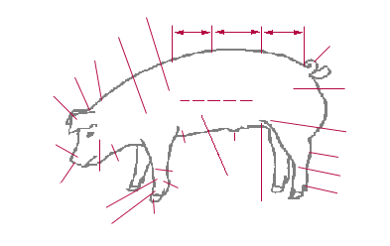
Parts of a Hog
Crops
Back
Loin
Rump
Shoulder
Tail
Neck
Poll
Ham
Ears
Side
Stifle Joint
Snout
Sheath
Fore Flank
Hock
Jowl
Knee
Cheek
Cannon
Nostrils
Belly
Fetlock
Fore Leg
Dewclaw
Rear Flank
Pastern
Hoof

Slide 4
Parts of a Sheep
Top of Shoulder
Poll
Forehead
Neck
Crop
Face
Rump
Loin
Rack
Nostril
Dock
Mouth
Shoulder
Leg
Breast
Stifle
Elbow
Rear Flank
Belly
Fore shank
Hock
Last Rib
Knee
Fetlock
Fore flank
Pastern
Cannon
Hoof
Coffin

Slide 5
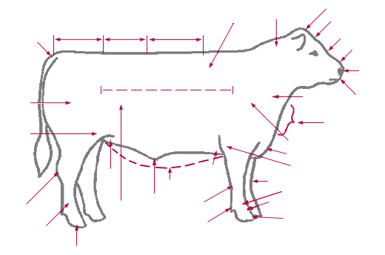
Poll
Fore Head
Crop
Neck
Rump
Loin
Back
Tail Head
Face
Nose
Nostril
Body
Quarter
Muzzle
Shoulder
Dewlap
Stifle
Shoulder
Brisket
Fore flank
Elbow
Rear Flank
Knee
Underline
Fetlock
Hock
Sheat
Pastern
Last Rib
Cannon
Coffin
Dewclaw
Cannon
Parts of Beef
Hoof

Slide 6
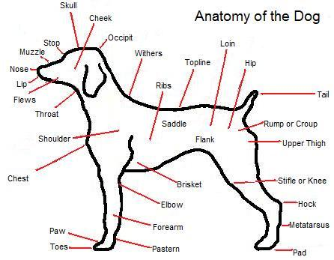
Parts of a Dog

Slide 7
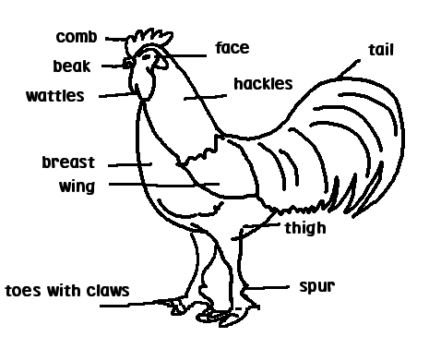
Parts of a Chicken

