Slide 1
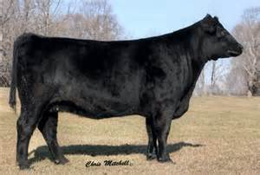
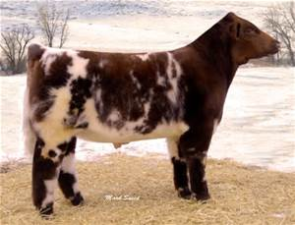
Warm-Up 8/1/2016
Compare and contrast these cattle.

Slide 2
Livestock 101
Classes and Breeds

Slide 3
What is a class of livestock?
A class of livestock is a group of animals having common characteristics and are used for similar purposes.

Slide 4
What are the major classes of livestock?
Dairy
Beef
Sheep
Swine
Goats

Slide 5
What are the types of livestock in each of the four classes?
Dairy- milk and dual purpose
Beef- meat and dual purpose
Sheep- wool and mutton
Swine-meat
Goats- meat, dairy, and mohair

Slide 6
What is a breed of livestock?
A breed of livestock is a group of animals with like characteristics that transmit these characteristics to their offspring generation after generation.

Slide 7
What are the general feeding requirements of the different classes of animals?
Dairy- high amount of roughage, medium amount of concentrate, produces milk, meat (veal and beef). Needs well bedded, protected from wind, snow, sun, rain and good sanitation.
Beef- high amount of roughage, medium amount of concentrate, produces meat. Needs well bedded, protected from wind, snow, sun, and rain
Sheep and Goats- high amount of roughage, medium amount of concentrate, produces wool and meat. Needs well bedded, protected from wind, snow, sun, and rain
Swine- Low amount of roughage high amount of concentrate produces meat. Needs good temperature control, ventilation, and sanitation

Slide 8
Define purebred and crossbred animals?
Purebred-
A purebred animal is one whose sire and dam are of the same breed. A purebred tends to transmit breed characteristics more uniformly than a crossbred animal does.
Crossbred-
A crossbred animal is one whose sire and dam are of two or more different breeds. They possess some traits from each of the breeds, which are included within their genetic makeup.

Slide 9
Why do purebred animals tend to transmit breed characteristics more uniformly than do crossbred animals?
Purebred animals transmit breed characteristics more uniformly because the individual characteristics in purebred animal remain pure. There is no intermixing of genes from different breeds.

