Slide 1
Giving Medications to animals by injection

Slide 2
Principles of Injections
Follow your veterinarians guidleines for all injections
Choose an area of clean, dry skin as the site for the injection.

Slide 3
Routes of Administration
Intramuscular (IM)
Subcutaneous (Sub-Q)
Intravenous (IV)
Intreperitoneal (IP)
Nasal
Oral

Slide 4
Intramuscular
Injection will be given into the muscle
  Choose a site that is less valuable to the consumer to inject
  Give IM injections deep into a muscle.
    Use a needle long enough to penetrate skin, subcutaneous tissue and fat to reach the muscle.
    The needle should enter the skin perpendicular to the skin surface

Slide 5
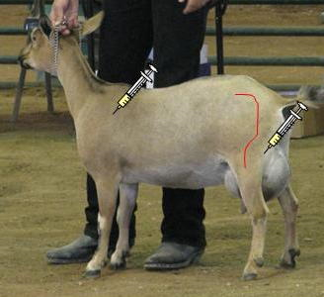
Intramuscular

Slide 6
Subcutaneous (Sub-Q)
Injection will be given under the skin
  If bottle says you can give IM or Sub-Q choose Sub-Q
  Give SQ injections half way up the neck in front of the shoulder, or over the ribs well behind the shoulder.
  Use a 0.5 to 1 inch long needle.
    To give SQ injections for cattle, lift a fold of skin to make a skin "tent". Insert the needle through one side of the tent at an angle of 30 to 45 degrees relative to the surface of the body.
    For swine, it won't be possible to make a "tent", so slide the needle under the skin at an angle of about 30 degrees from parallel to the skin surface and inject.

Slide 7
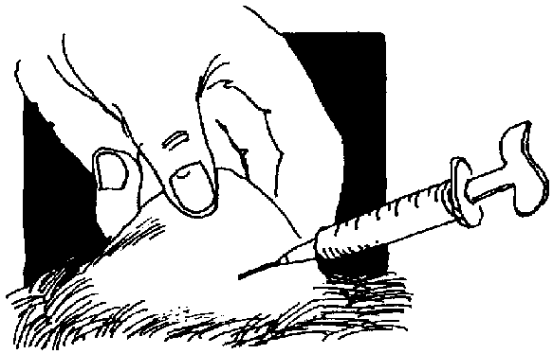
Subcutaneous

Slide 8
Intravenous (IV)
Will be delivered directly into the vein of an animal
  Done when large amounts of a drug need to be given
  Apply pressure on the vein to make it swell so you can find it more easily.
  Push the needle into the vein. When the needle enters the vein, blood will enter the syringe through the needle.
  Take pressure off or release the vein.
  Slowly inject the rest of the content of the syringe.
  Once finished, remove the needle.
  Apply pressure on the site with cotton moistened with 70¾ alcohol.

Slide 9
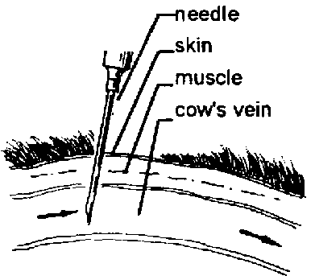
Intravenous (IV)

Slide 10
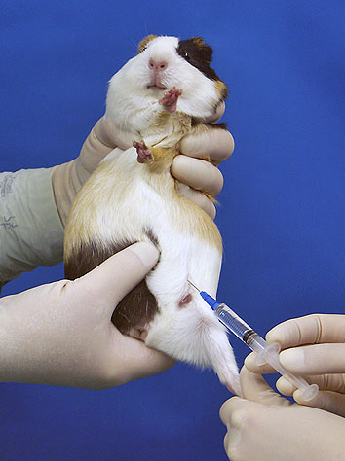
Intraperitoneal (IP)
Given into the peritoneal (body cavity)
  Used mostly in animals when large amounts of fluid are needed or when blood pressure is too low to allow for IV

Slide 11
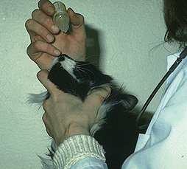
Nasal
Pharmaceuticals are delivered into the nose by squirting them into the nasal cavity

Slide 12
Oral
Medications are delivered by mouth
  Usually pill or liquid form

Slide 13
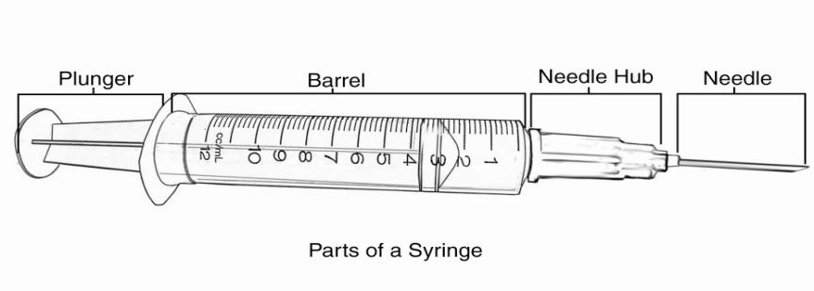
Parts of a Syringe

Slide 14
How to Read a Syringe
1 cc = 1 mL of fluid
Typical syringes come in the following sizes
  1 cc
  3 cc
  5 cc
  10 cc
  12 cc
  20 cc
  35 cc
  60 cc

Slide 15
How to Read a Syringe
Lines on the side of the syringe represent how much fluid you will be administering

Slide 16
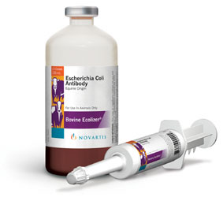
What is a vaccine?
  A vaccine produces a reaction which leads to antibody formation without actually producing the disease. An antibody is a substance that opposes the action of another substance, i.e. a disease organism.

Slide 17
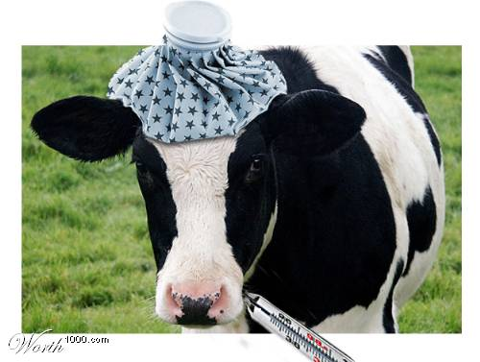
Why are vaccinations important?
  Vaccinations provide livestock with immunity to disease.
  An effective vaccination program will keep a livestock herd healthy and prevent losses from disease.

Slide 18
Vaccine vs. Serum
  Vaccines: Contain live, modified or killed pathogenic organisms which under certain conditions are capable of producing the disease for which the immunity is intended.
  Serum: Contains no pathogenic organisms. Is prepared from the blood of animals which have previously been vaccinated for or exposed to the disease.

Slide 19
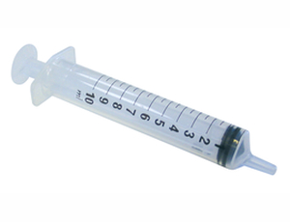
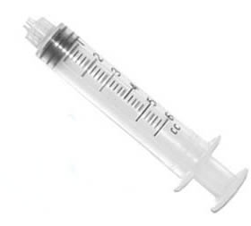
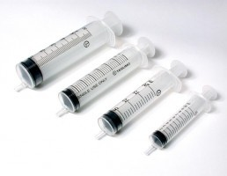
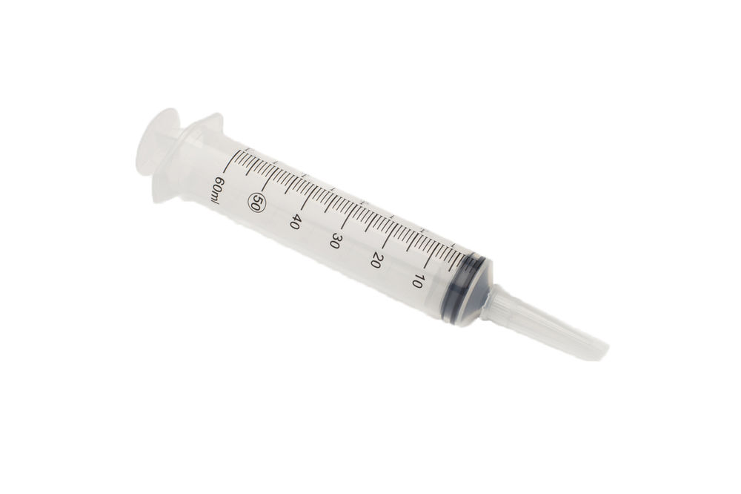
Types of Syringes
Lure Lock
Slip
Catheter Tip
Eccentric

Slide 20

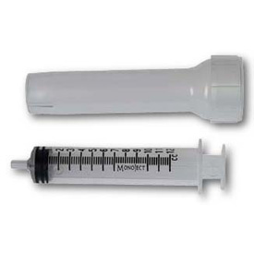

What kinds of syringes are available?
  Disposable and Reusable

Slide 21
Proper Care for Reusable Syringes
  Boiling is the most satisfactory method of sterilization.
    Dismantle plunger, barrel, and barrel case and place in cool water along with needles and bring to boil. Boil for approximately ten minutes.
    After cooling, reassemble using gloves and other safety precautions to avoid contamination.
  Chemical sterilization with alcohol or other disinfectants is unsatisfactory for instruments to be used for administering modified live virus vaccines.

Slide 22
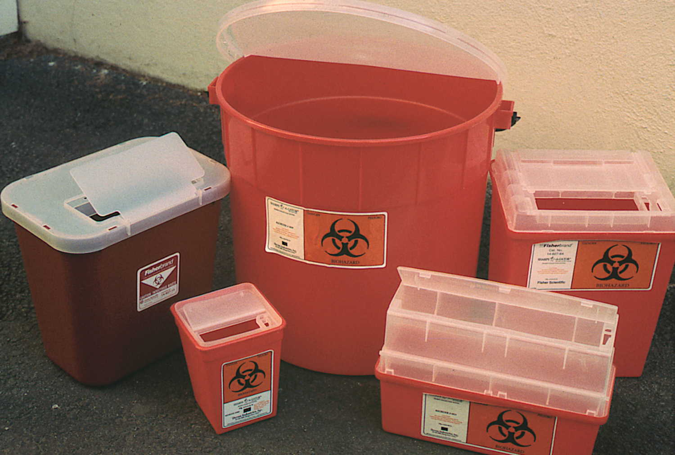
Proper Disposal
How should you dispose of syringes and needles?
  Puncture proof, sealed container
  i.e. SHARPS container

Slide 23
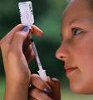
How to Fill a Syringe
Begin with the plunger pushed fully down.
Insert the needle into the rubber cap of the vial of medication.
  Hold the vial upside down so that the syringe and needle are pointing towards the ceiling.
Gently pull back the plunger to begin the flow of medication into the syringe.
  Draw slightly more than you need, then push the excess out by pushing the plunger back in; this will get rid of air bubbles that were drawn up from the vial.
  If you still see air bubbles in the syringe, hold it pointed toward the ceiling and flick or tap your finger against the side of the syringe; this forces the bubbles up toward the hub of the syringe and you can push the collected air out of the needle.

Slide 24
How to Fill a Syringe
When you are ready to administer the injection, make sure that the medication is flush up against and into the hub of the syringe.
If the medication will not flow into the syringe, you will need to start with some air in the syringe.
  Before inserting needle into the bottle of fluid, draw back on the plunger to pull in 1 cc or so of air.
  After the needle is inserted into the fluid, push down on the plunger to transfer the air in the syringe into the bottle of fluid, then pull back and begin filling your syringe.

