Slide 1
Meiosis –
Vocabulary and Notes

Slide 2
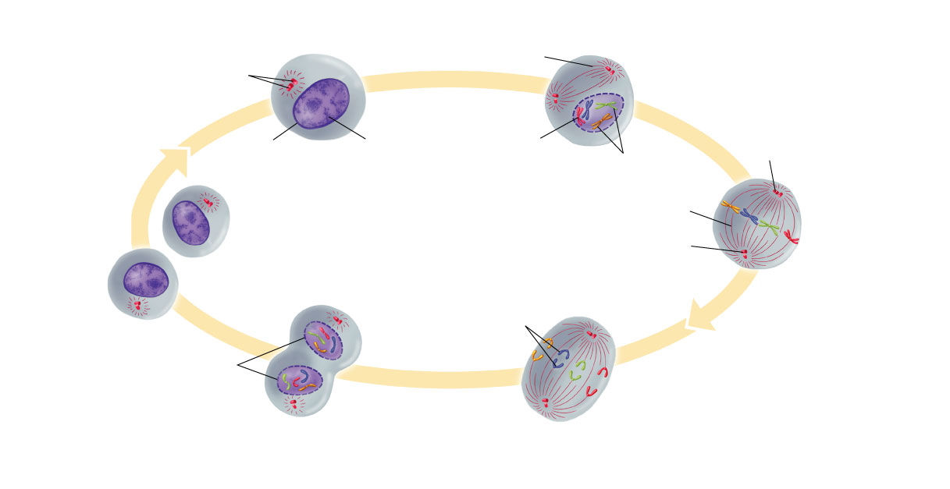
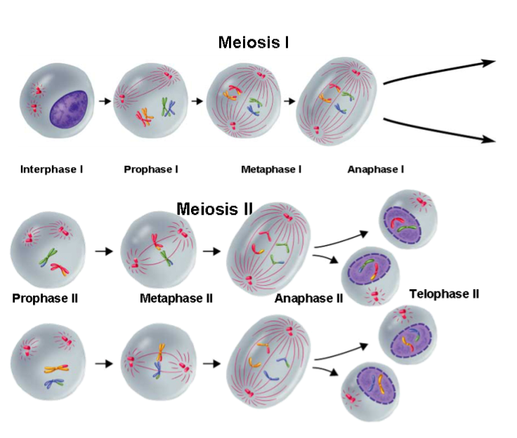
What looks similar between mitosis and meiosis?
What looks different?
Interphase
Prophase
Mitosis
Cytokinesis
Telophase
Anaphase
Metaphase
Meiosis

Slide 3
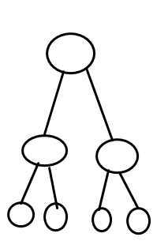
Vocabulary- Meiosis
Process of reduction division in which the number of chromosomes per cell is cut in half through the separation of homologous chromosomes in a diploid cell.

Slide 4
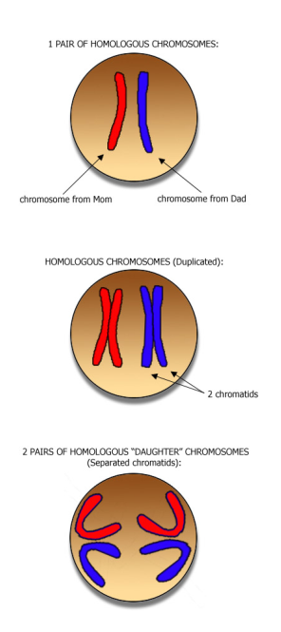
Vocabulary- Homologous
a pair of chromosomes, one from each parent, which carry genes for the same traits.

Slide 5
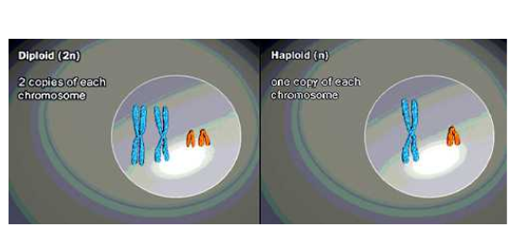
Vocabulary- Diploid
term used to refer to a cell that contains both sets of homologous chromosomes.

Slide 6
Vocabulary- Haploid
term used to refer to a cell that contains only a single set of genes.

Slide 7
Check for Understanding
A diploid cell has __________ number of chromosomes.

Slide 8
Check for Understanding
A haploid cell has __________ number of chromosomes.

Slide 9
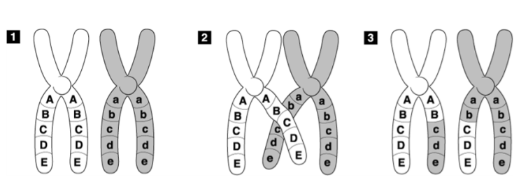
Vocabulary- Crossing Over
process in which homologous chromosomes exchange portions of their chromatins during meiosis.

Slide 10
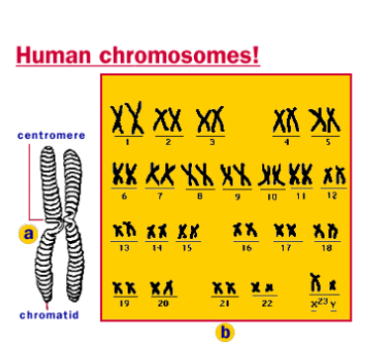
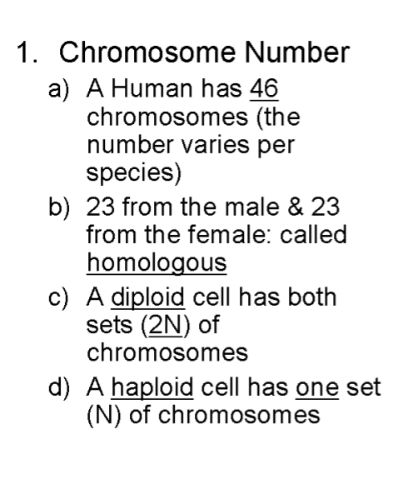
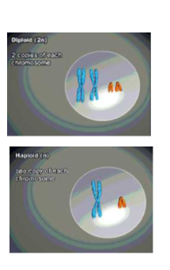
Notes
Sexual Repro Meiosisi.mov

Slide 11
Check for Understanding
How many Chromosomes do humans have?

Slide 12
Check for Understanding
How many Chromosomes do you get from your mom?

Slide 13
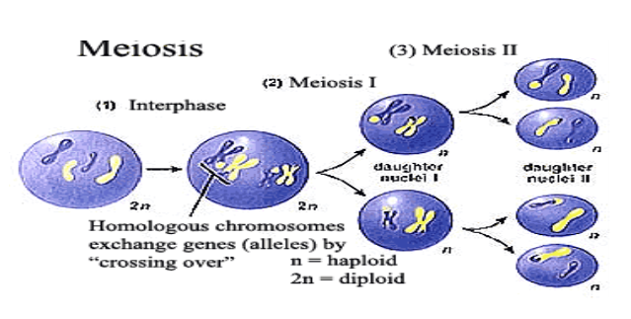
2. Phases of Meiosis
a) Meiosis: cell division where the chromosome number is cut in half by separating homologous chromosomes in a diploid cell
b) There are two stages: Meiosis I and Meiosis II

Slide 14
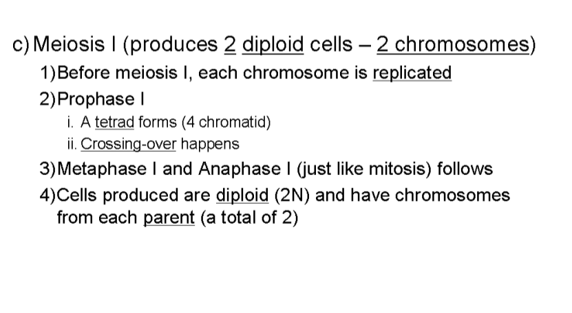
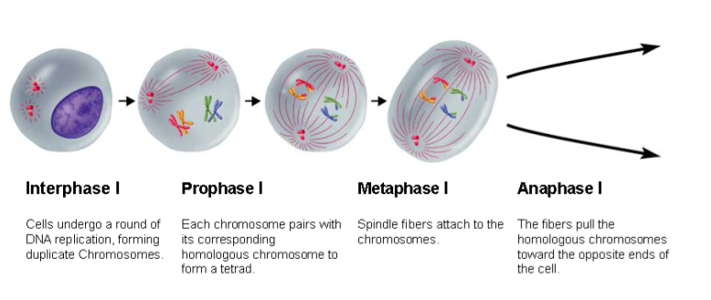
Visualizing Meiosis (938.0K)

Slide 15
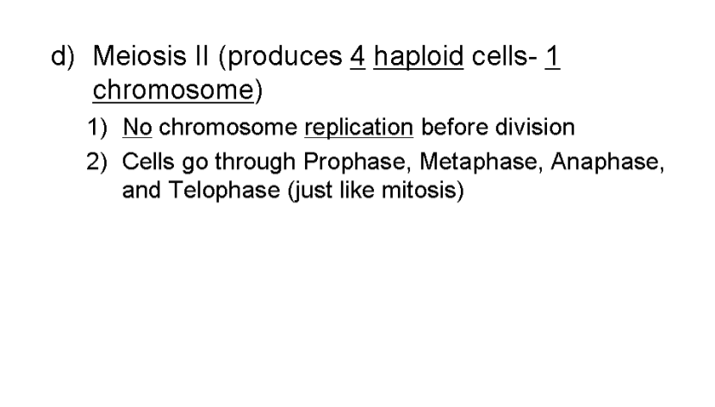
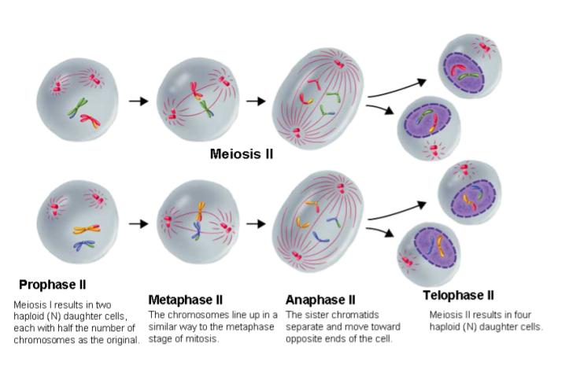

Slide 16
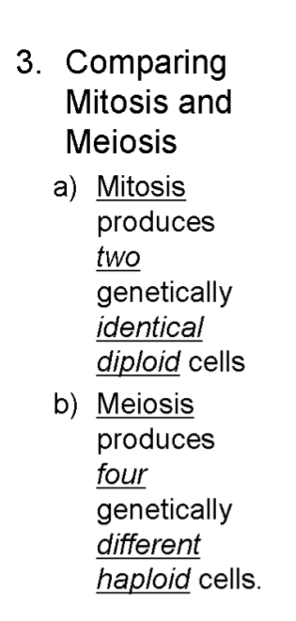
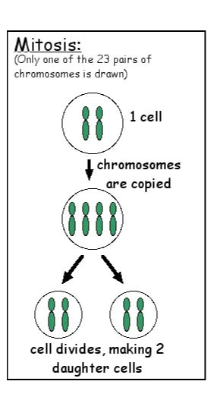
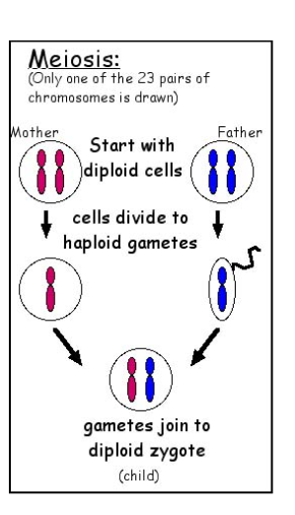
Links
Meiosis.mov
Mitosis and Meiosis - B (9.0K)
http://www.pbs.org/wgbh/nova/baby/divi_flash.html

Slide 17
Check for Understanding
True/False
Mitosis produces four haploid cells.

Slide 18
Check for Understanding
True/False
Meiosis produces identical cells.

Slide 19
Check for Understanding
Knowing that a human has 2N=46 chromosomes. How many chromosomes would you expect to find in a sperm cells?

Slide 20
Check for Understanding
How many chromosomes would you expect to find in a white blood cell?

Slide 21
