Slide 1
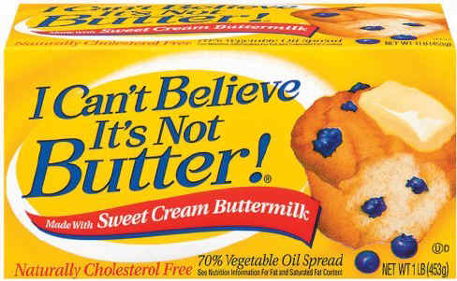
Bell Work
What was the first food product permitted by law to have artificial coloring?
Butter

Slide 2
Describing Meat Grading

Slide 3

Grading 101
After the carcasses are cooled, they are graded according to USDA standards.
Federal Meat Grading was established in 1925 by the Agricultural Marketing Service (AMS) of USDA.

Slide 4

Certification
Inspection for wholesomeness is mandatory and is paid for out of tax dollars. Grading for quality is voluntary.
The meat grade certifies the class, quality, and condition of the agricultural product examined to conform with uniform standards.

Slide 5
Grading
There are two groups of Grades:
Quality & Yield.
Quality Grades
  Prediction for tenderness, juiciness, and flavor.
  Based on the amount of marbling (flecks of fat within the lean), color, and maturity.

Slide 6
Quality Grade Determination
Grades are determined by the age of the animal at slaughter and the amount marbling.
Age is determined by the maturity of the cartilage and bones in the carcass.
Animals older than 42 months cannot receive the highest 2 grades.

Slide 7
Determining Age
NOTE:
Graders inspect the rib cage and vertebrae for the degree of bone and cartilage hardening – Ossification
As the animal ages, vertebrae in the lower end of backbone tend to fuse or grow together.

Slide 8
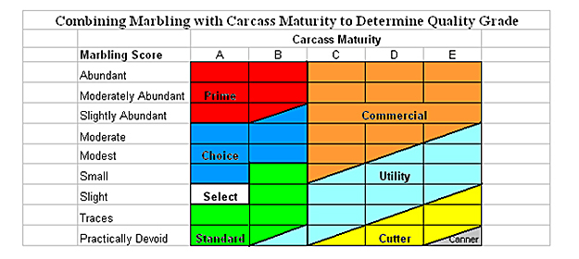

Slide 9
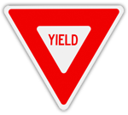
Yield Grades
Yield Grades
  Range from "1" to "5" and indicate the amount of usable meat from a carcass.
  Yield grade 1 is the highest grade and denotes the greatest ratio of lean to fat; yield grade 5 is the lowest yield ratio.

Slide 10

Yield Grade Determination
The yield grade is determined by a formula used by the grader.
Veal- 5 Grades
Lamb- 5 Grades
Pork- Not Graded
Poultry- A, B, C
1: Clean/muscular
5: Very fat/ Light Muscle
Grade A: Highest Quality

Slide 11
Beef
There are eight quality grades for beef: prime, choice, select, standard, commercial, utility, cutter, and canner.
BEEF
ITS
WHATS
FOR
DINNER

Slide 12
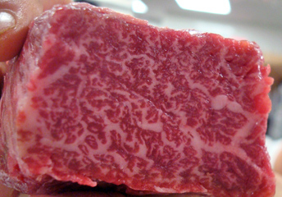
Marbling
The fat, known as marbling, shows up as specks of white across the rib eye. The more specks of fat that are visible, the higher the grade

Slide 13

Piece it Together…
Prime (BEST)
Muscle:
Fat:
  Fat is what gives the meat flavor and juiciness

Slide 14
F-A-C-T-S
Fat is expensive to put on animals, so the leaner grades are less expensive.
Those that feed animals to grade prime usually cater to the restaurant trade.
    Most feedlot owners want their animals to grade a low choice at slaughter.

Slide 15
F-A-C-T-S
Most beef bought in the grocery store is choice grade.
A few market chains are selling the leaner select grade as a low fat meat

