Slide 1
Warm-Up 7/27/2015
The Scientific Method is a universal process for experimentation that is used to explore observations and answer scientific questions.
Why is it important that the scientific method be universal?

Slide 2



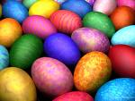

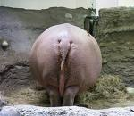
The Scientific Method
The Pathway of Scientific Discovery

Slide 3
What is the SCIENTIFIC METHOD?
A set of sequential steps that scientists invariably follow to answer scientific questions.
1. Ask a Question or State a Problem
2. Conduct Research
3. State a Hypothesis
4. Design and Conduct Experiment
5. Collect Data
6. Form a Conclusion

Slide 4
1. Ask a Question or State a Problem
Ask a question or develop a problem that can be solved through experimentation.
1 o’clock = Here sits a young man in a thinking session pondering the World crisis.

Slide 5
2. Conduct Research
Conduct research for your
topic of interest.
2 o’clock = Over here is a young girl searching for a prom date on a computer on Facebook sorting through the jerks, trying to find the right one.

Slide 6
Types of Research/Information:
Qualitative: Data that cannot be counted. It is usually grouped by characteristics and is subjective information.
Quantitative: Data that can be counted and sorted based on numbers. This is objective information.

Slide 7
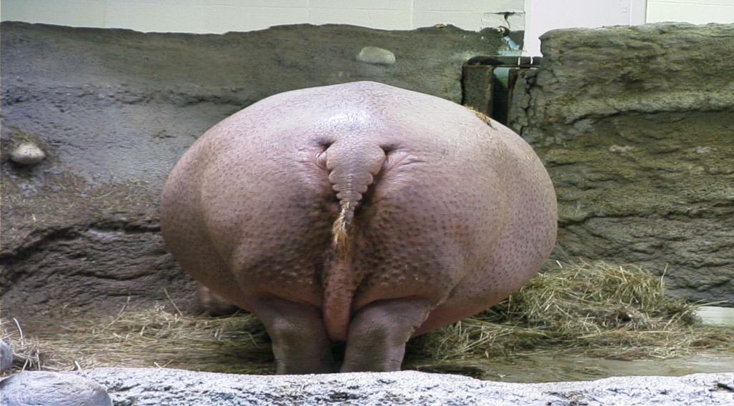
3. State a Hypothesis
Predict a possible answer to the problem or question. State a hypothesis.
3 o’clock = Over here in the state of North Dakota at a zoo is a hippopotamus looking forward to warmer weather in the summer.

Slide 8
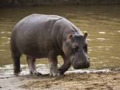
Hypothesis: a testable explanation for a problem or question.
Stated as “if______, then_________.”

Slide 9
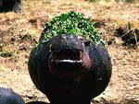
The hypothesis is directly related to the dependent and independent variables.
Hypothesis: If fertilizer is applied to plants, then the plants will stop growing.
Independent: Fertilizer application
Dependent: Plant growth
Constants: Type of plant, environment (water, sunlight, soil)

Slide 10
Hypothesis: If Bt corn is exposed to ECB, then the Bt corn will produce higher corn yields than traditional corn varieties.
Independent variable: Bt corn
Dependent variable: corn yields
Constants: EBC infestation

Slide 11
Hypothesis:
If I do this (independent variable),
then this will happen (dependent variable)
Independent Variable: What you will change
Dependent Variable: What you will measure
* The measurement should DEPEND on what you changed (independent variable)

Slide 12

4. Design & Conduct Experiment
Set up and conduct an experiment
4 o’clock = A new train conductor sucking on a peppermint testing his locomotive.

Slide 13
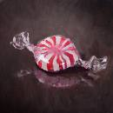
To Design An Experiment ,You Need to Identify…
Independent Variable: (what you want to test/change)
Dependent Variable: (what you want to measure)
Control Group: How will you know the independent variable caused a change in the dependent variable?
Experimental Group: Group tested. All conditions are kept the same EXCEPT the independent variable.

Slide 14
What Are Our Constants?
  Factors that are kept the same and not allowed to change.
  It is important to control all, but one variable at a time to be able to interpret data.

Slide 15
Replications-
Conduct several trials or replications
  The more replications, the better we can conclude that our data and findings are due to changes in the independent variable rather than chance (error).

Slide 16
5. Collect Data
Collect quantitative and qualitative data obtained from the experiment
5 o’clock = The Easter bunny is preparing for the big day by collecting eggs laying them out on a table labeling each one with a date insuring they will be fresh.

Slide 17
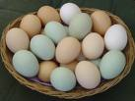
Collect Data:
Quantitative: Report in quantity/numbers
SI: International System of Measurement
    Length in meters
    Mass in grams
    Volume in liters
    Time in seconds
    Temperature in Celsius degrees
Qualitative: Reports as descriptions

Slide 18
6. Form a Conclusion
Form a Conclusion. Decide if your data either supported your hypothesis or did not
6 o’clock = A magician looks at all that have gathered before him and alludes it’s all an illusion.

