Slide 1
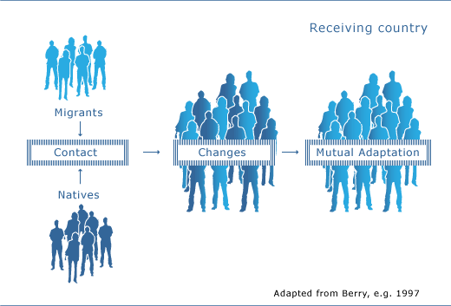
ACCULTURATION
Key Question: Discuss how acculturation influences individual attitudes, identities and behaviours.

Slide 2
Hector Tobar’s article on acculturation: your responses please! https://www.nytimes.com/2016/11/15/opinion/the-spanish-lesson-i-never-got-at-school.html?_r=1

Slide 3
What is acculturation?
Acculturation is the process of changing and assimilating into a different culture from the original one into which we were born.
It is a two way process, whereby the host culture also changes to adapt to the newcomers, as well as individuals themselves having to adapt.
How are the following images examples of acculturation? And if some of them are not acculturation, what are they instead?

Slide 4
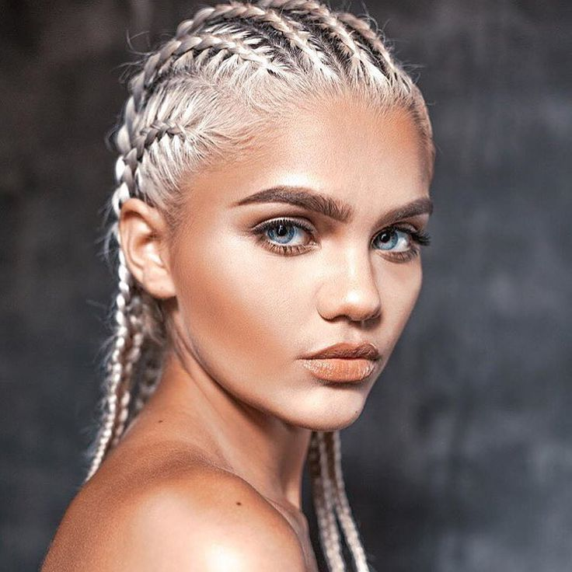
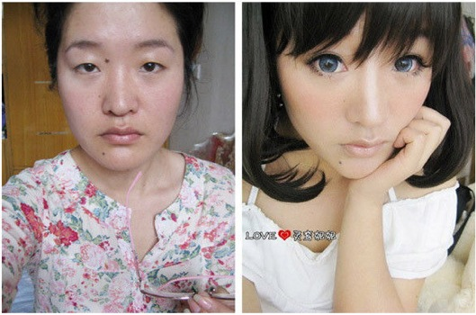

Slide 5
Berry’s model:
STRATEGY DEFINITION
Assimilation When individuals do not wish to maintain their own culture and seek daily interactions with people from the dominant culture.
Separation When individuals wish to maintain their own culture and do not wish to integrate, therefore they avoid contact with the dominant culture.
Integration When individuals wish to interact with the dominant culture, while maintaining their own identity as well.
Marginalisation When individuals have no interest in integration or assimilation into the dominant culture, even though they have lost their own.
Come up with one example for each of these and then the class will try to guess which strategy you are defining e.g. ‘Adnan’s family are from India. He has married a white British woman but he still maintains some family traditions and aspects of his religion’ = Integration.

Slide 6
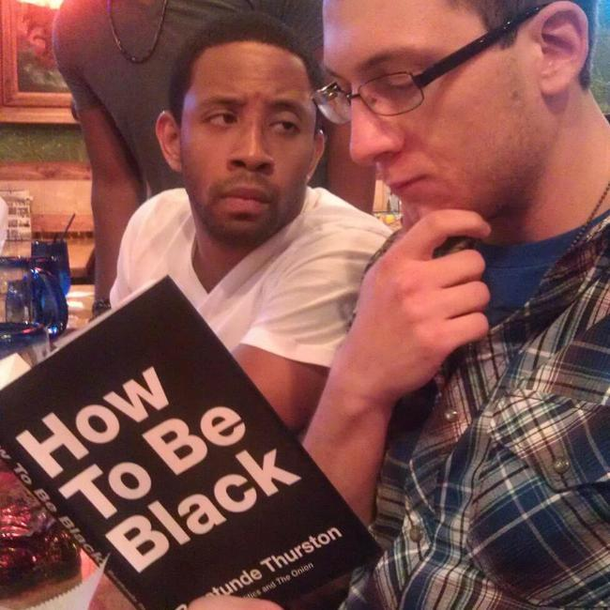
Acculturative Stress:
This happens when there is a clash: when the norms of the dominant and the non-dominant cultures differ and the person in the middle feels conflicted about their loyalties.
How does the following film clip encapsulate these ideas:
https://www.youtube.com/watch?v=mqdAluSLB9o
Integration = low stress.
Marginalisation = high stress.
Clip #1
Clip #2
Clip #3
Clip #4
After watching these clips, respond to the following prompt:
* How do different cultures influence individual acculturation? Give specific examples from the given clips.

Slide 7
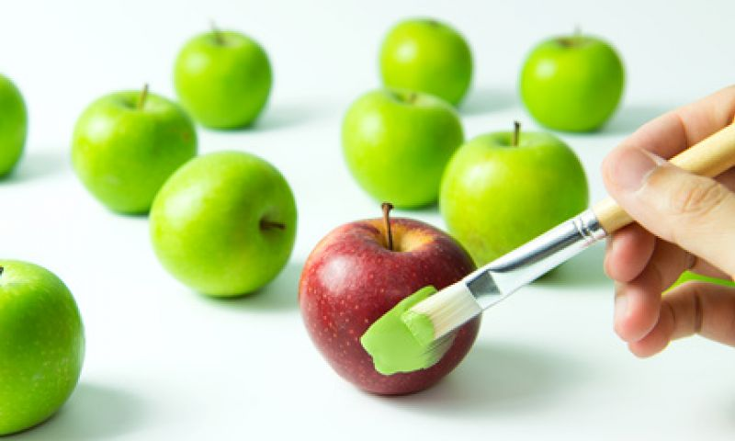
Make a little table…
…outlining the strengths and limitations of Berry’s model. Some of the evaluation points should be FROM YOUR OWN GENIUS HEAD, not just copied from the book. You should include the Critical Thinking point as part of the evaluation. Okay???.....

Slide 8
Acculturation and individual identities:
Benet-Martinez & Haritatos (2002)
Aim: To investigate variation within, rather than between cultures using the experience of participants with a mixed cultural identity.
Procedure: we are going to partially replicate this now.
You will view a series of images on the following slides. You do not need to do anything in response to these images, just look at them.

Slide 9
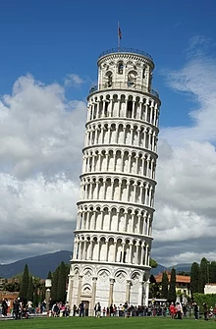
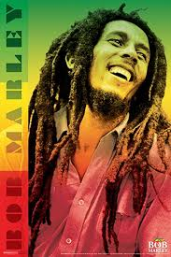
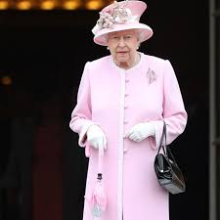
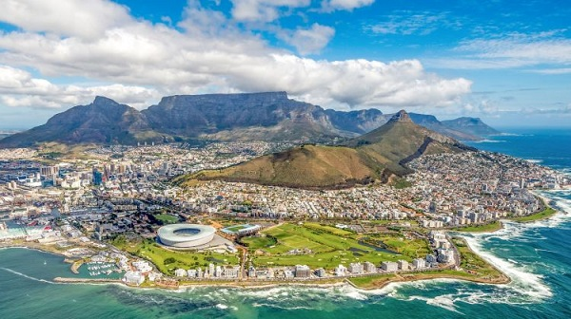
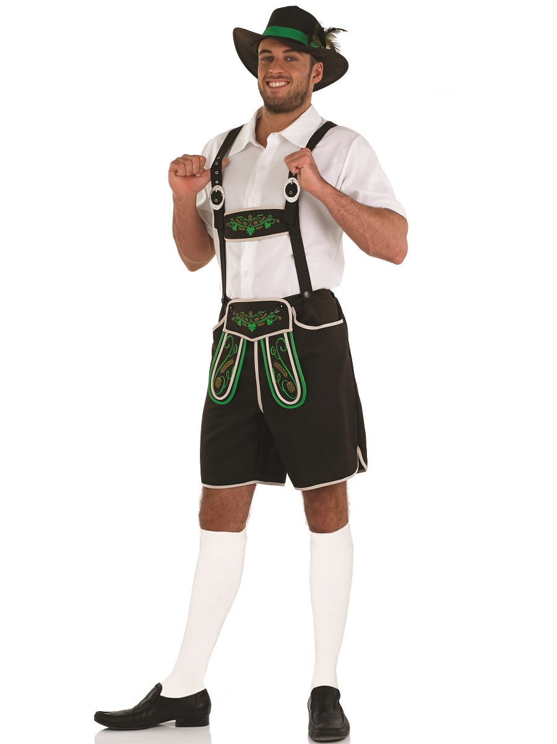
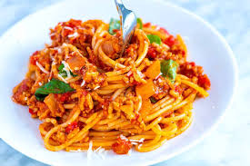

Slide 10
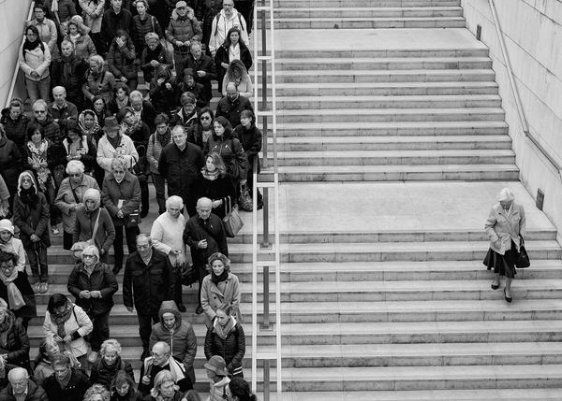
Look at this image and ask yourself, which person/people do you identify with and why?

Slide 11
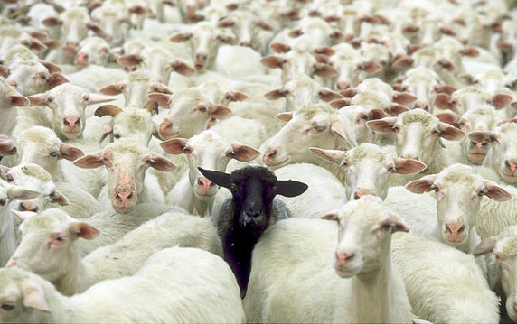
Benet-Martinez & Haritatos (2002).
Read through the study – can you see how the task you’ve just done with the images relates to this study?

