Slide 1
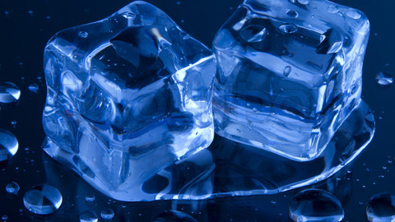
Experiment Salty Ice

Slide 2
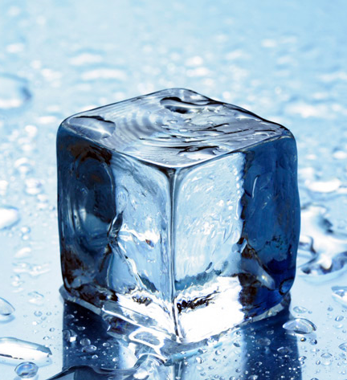
Question
What type of salt, sea salt, epsom salt, or pink himalayan salt makes ice melt the fastest?

Slide 3
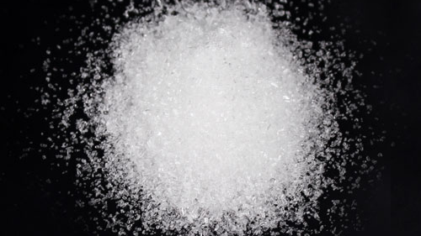
Research
Sea salt is produced through evaporation of ocean water or water from saltwater lakes, usually with little processing. Depending on the water source, this leaves behind certain trace minerals and elements. The minerals add flavor and color to sea salt, which also comes in a variety of coarseness levels.
Now, Epsom Salt is also a 'salt' but instead of being made of magnesium, oxygen and carbon, as is the case with the carbon salt, its constituents are magnesium, oxygen and sulphur. Chemically it is known as Magnesium Sulphate.
Himalayan salt contains many minerals, including sodium chloride, which is also known to geologists as the mineral halite. Sodium chloride has a cubic structure and is white, but the pink in Himalayan salt comes from iron oxides.

Slide 4
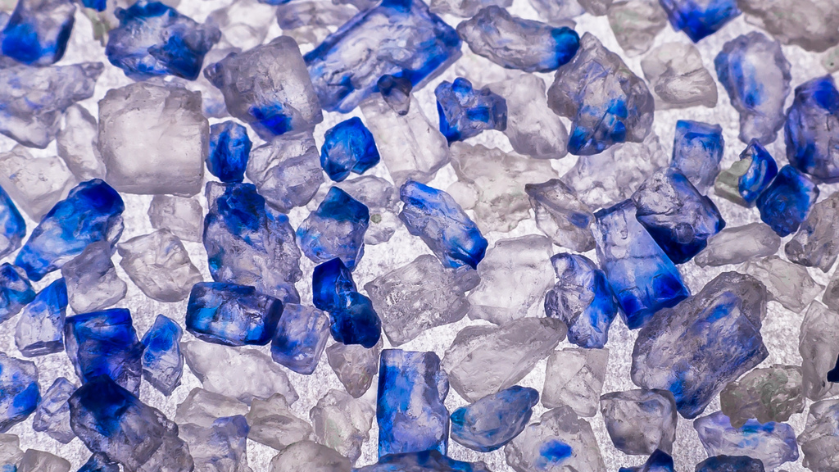
Research
The elements that make up common table salt are sodium and chlorine. Sodium choride is the name of the crystaline solid compound called table salt.
Table salt or common salt is a mineral composed primarily of sodium chloride, a chemical compound belonging to the larger class of salts; salt in its natural form as a crystalline mineral is known as rock salt or halite. Salt is present in vast quantities in seawater, where it is the main mineral constituent. The open ocean has about 35 grams of solids per litre, a salinity of 3.5%.

Slide 5
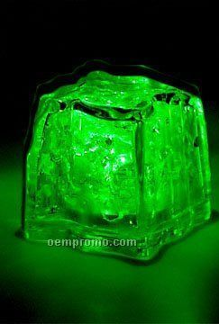
Research
Magnesium sulfate is an inorganic salt (chemical compound) containing magnesium, sulfur and oxygen, with the formula MgSO4. It is often encountered as the heptahydrate sulfate mineral epsomite (MgSO. 7H2O), commonly called Epsom salt.
Sea salt has sodium, cloride, sulfrate, and magnesium.
Sea salt is obtained by the evaporation of seawater. Its mineral content gives it a different taste and chemical composition from table salt, which is pure sodium chloride. The additional minerals include Sulfate, Magnesium, Potassium and Calcium among other trace minerals.

Slide 6
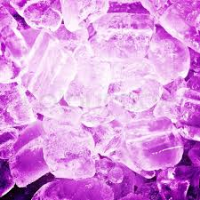
Hypothesis
Based on research the sea salt will melt the ice the fastest because of the halite and all the chemicals in sea salt including; sodium, chloride, sulfate, and magnesium.

Slide 7
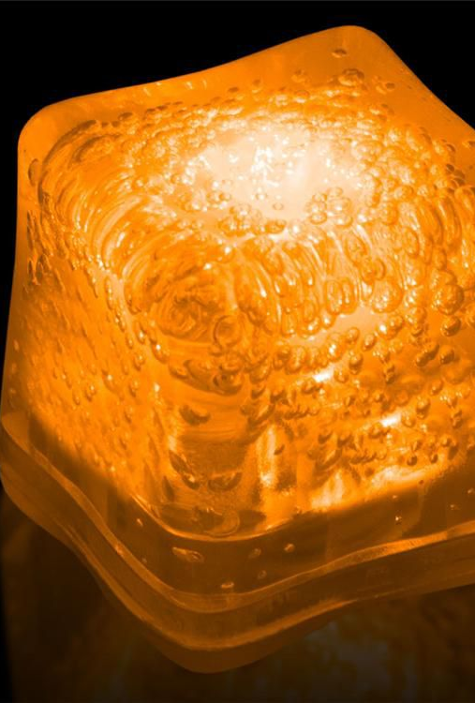
Materials
3 bowls
18 ice cubes
Sea salt
Epsom salt
Pink himalayan salt
Timer
3 tea spoons

Slide 8
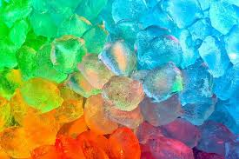
Procedures
Step 1:put 2 ice cubes in bowl
Step 2:put 1 tea spoon of sea salt on ice, cover surface area evenly
Step 3: start timer
Step 4: stop timer when water in solid form turns into liquid form
Step 5: repeat steps 1-4 for epsom salt
Step6: repeat steps 1-4 for pink himalayan salt
Step 7: record data

Slide 9
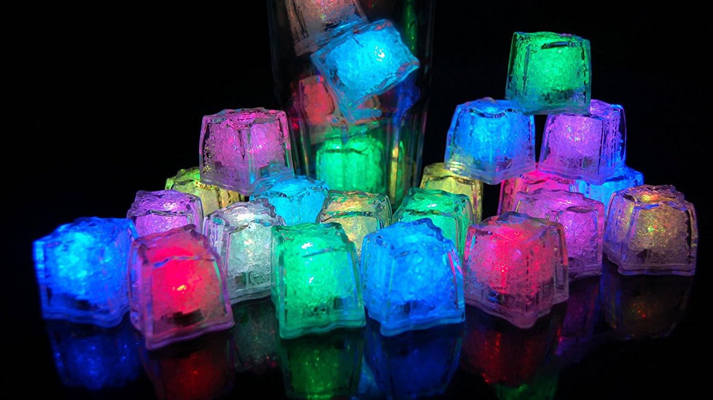
Data Analysis
The first test all the salts melted fast except for sea salt. The pink himalayan salt ahd pink water at the end. At the end pink himalayan salt melted first at the time of 39.21 minutes, epsom salt melt melted at 45.6 minutes, and sea salt melted at 48.2 minutes. The second test we didn’t have enough time. The epsom salt made a bubble. The Pink himalayan salt made a dent in the ice. The third test pink himalayan salt made a bubble again pink himalayan salt melted at 60.2 minutes, sea salt melted at 63.7 minutes, and epsom salt melted at 65.8 minutes. The 4th and last test pink himalayan salt melted at 41 minutes, sea salt melted at 55 minutes, and epsom salt melted at 60.21 minutes.

Slide 10
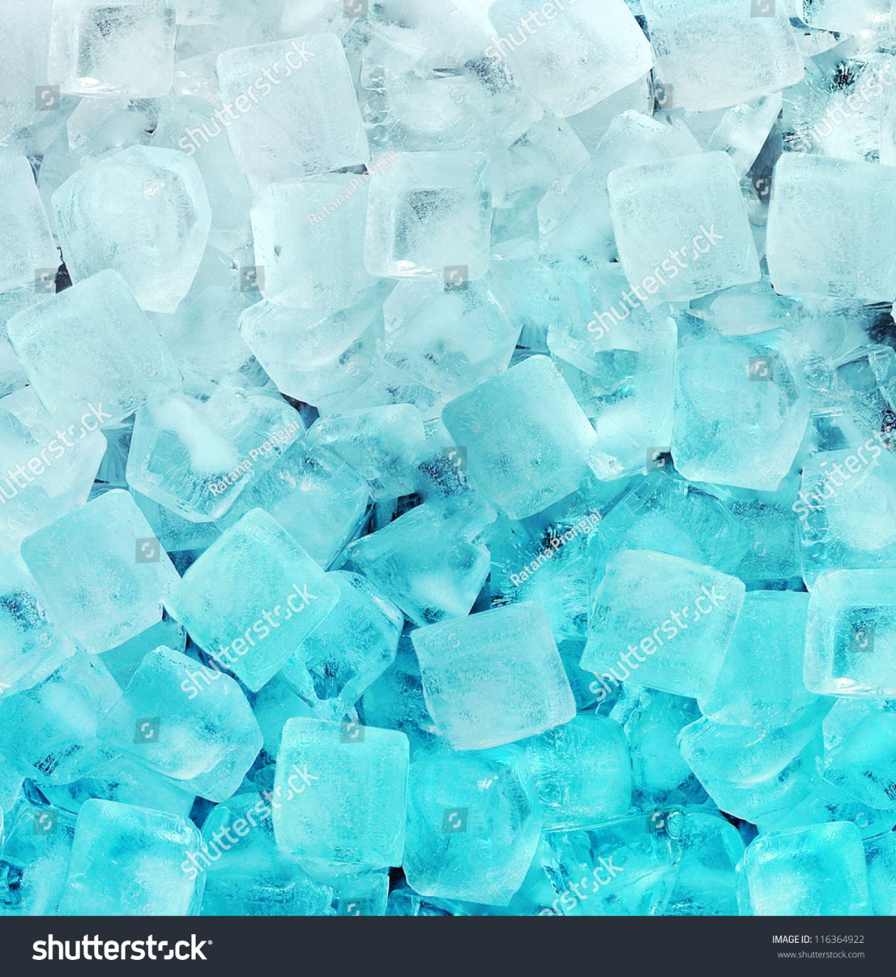
Conclusion
Through weeks of testing and research it was determined that pink himalayan salt melts ice the fastest. The hypothesis was not supported because the amount of halite in pink himalayan salt is greater than the other salts. Sea salt and pink himalayan salt were close but pink himalayan salt melted faster. When finished testing it has been agreed that when ice is put on salt it takes a long time to melt. When ice needs to be melted by salt the fastest way possible pink himalayan salt will melt ice the fastest.

Slide 11
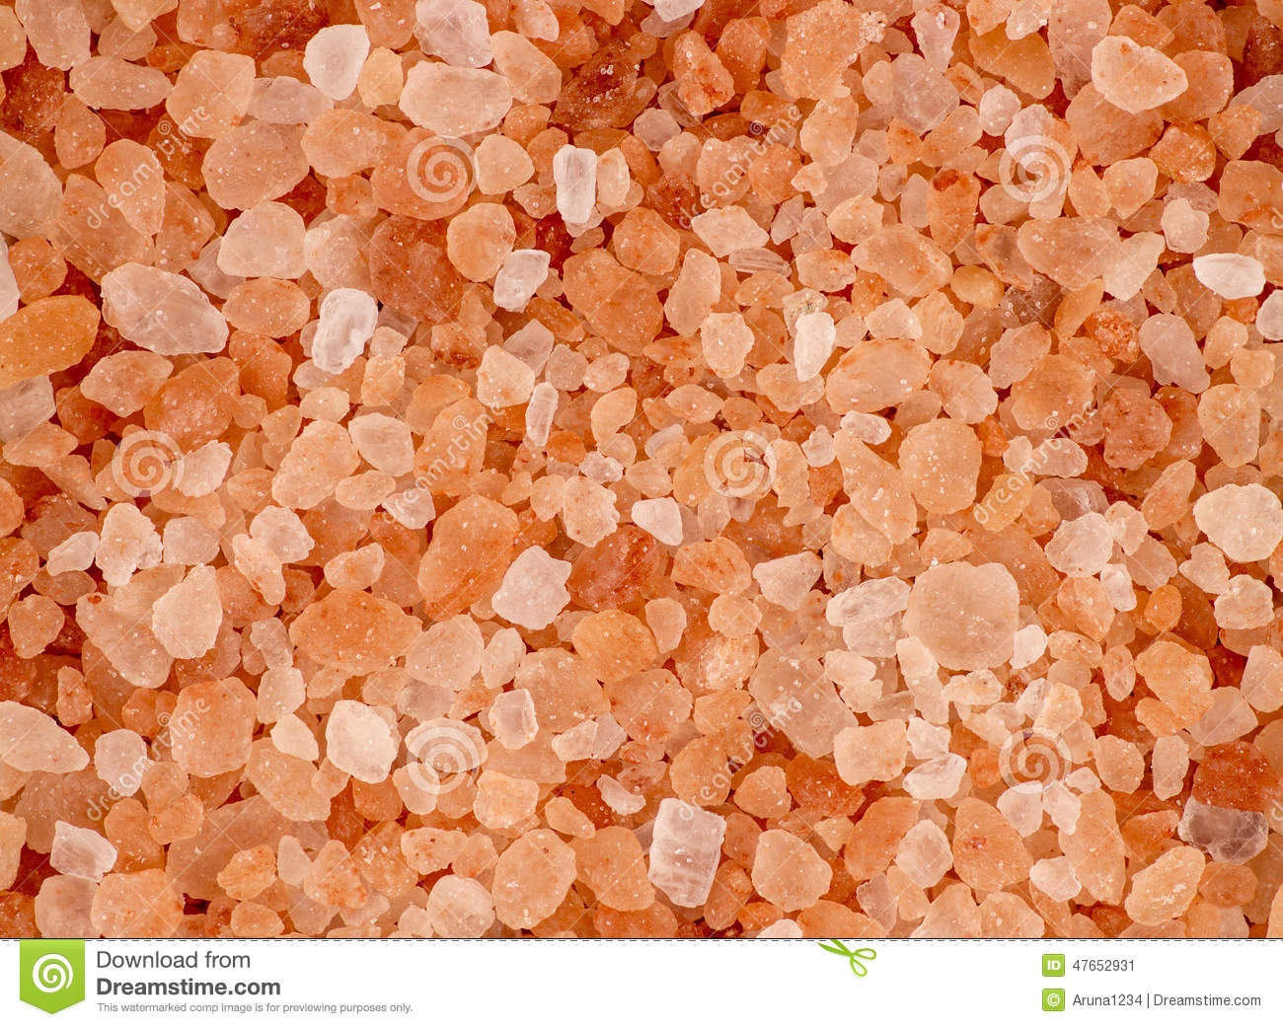
Future Research
If the expirement was to be re done the salts would be different. The variable would be different too. The question would be, of which of the three salts table salt, flake salt, and celtic sea salt will melt the slowest.

Slide 12
Graph and Table 1
Type of salt | Half Time | Finish Time
Sea salt | 24 min. | 48 min.
Epsom salt | 22.5 min. | 45 min.
Pink Himalayan salt | 18.5 min. | 39 min.

Slide 13
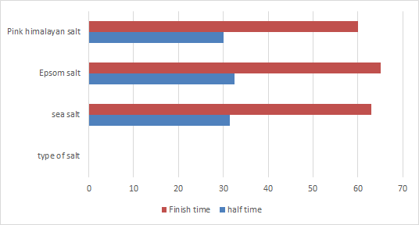
Graph and Table 2
Type of salts | Half time | Finish time
Sea salt | 31.5 min. | 63 min.
Epsom salt | 32.5 min | 65 min.
Pink himalayan salt | 30 min. | 60 min.

Slide 15
Biblography
How salt melts the freezing point of ice author Anne Marie Helmenstine https://www.thoughtco.com/why-does-salt-melt-ice-607896
“Chemistry Stack Exchange.” Edited by Melanie Shebel, Chemistry Stack Exchange, 1 Feb. 2017 http://chemistry.stackexchange.com
L.D., Katherine Zeratsky R.D. “Sea Salt vs. Table Salt: What's the Difference?” Mayo Clinic, Mayo
Foundation for Medical Education and Research, 4 May 2016, www.mayoclinic.org/healthy- lifestyle/nutrition-and-healthy-eating/expert-answers/sea-salt/faq-20058512.

