Slide 1
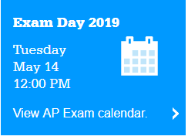
Ultimate Guide to Passing the AP Human Geography Exam!

Slide 2
How to Study for AP Human Geography
Understand the structure of the exam:
The exam is 2 hours and 15 minutes long and has two sections — multiple choice and free-response.
Section I: Multiple Choice | 75 Questions | 1 hour | 50% of Exam Score
Define, explain, and apply geographic concepts
Interpret geographic data
Section II: Free-Response | 3 Questions | 1 hour and 15 minutes | 50% of Exam Score
Questions may require you to:
Synthesize different topical areas
Analyze and evaluate geographical concepts
Supply appropriately selected and well-explained real-world examples to illustrate geographic concepts
Interpret verbal descriptions, maps, graphs, photographs, and/or diagrams
Formulate responses in narrative form

Slide 3
How to Study for AP Human Geography
2. Don’t procrastinate! You’ve probably heard this tip many times before – but that’s because it is one of the most important study tips ever. Too often, students say things like “I’ll review that later,” or “I’ll read that chapter next week.” If you find yourself saying these things often, you are probably procrastinating. The thing is, you can’t afford to procrastinate in an AP course. Of course, it’s okay to put things off every once in a while. We aren’t perfect. But if you’re doing it regularly, you need to reevaluate and come up with a plan. Try to study a little bit each day. It sounds terrifying to have to study for one class every single day, but it doesn’t have to be a two-hour long study session each day. Aim to go through a pile of flashcards for 15 minutes every day. Try to read a few pages of an AP Human Geography review book after you’ve done your homework for the night. Go over your class notes after sports practice. Just try to incorporate studying into your everyday routine to combat procrastination.

Slide 4
How to Study for AP Human Geography
Use a Review book!
Make Flashcards! The CollegeBoard has a great aggregate list of all the APHG vocabulary terms you should know.
Talk out loud when studying! here is research that shows studying out loud can help improve information retention and memorization. This is especially true if you are an auditory learner. You may feel ridiculous at first, but try it out next time you’re studying in your bedroom. Take a flashcard and read the word out loud three times. Now read the definition of the word out loud three times.

Slide 5
How to Study for AP Human Geography
6. Join or form an AP study group. Sometimes studying alone can become tedious. You can start to lose focus, get distracted, and just have a hard time motivating yourself to even start studying. That’s why study groups are beneficial. Ask some of your AP Human Geography classmates if they want to meet once or twice a week to go over the materials. Your teacher may even want to join in and offer after school study sessions. Overall, study groups are a great way to add accountability and can help break up some of the monotony of studying by yourself.

Slide 6
How to Study for AP Human Geography
7. Follow/like AP Human Geography social media accounts. Whether you use Twitter, Facebook, Pinterest, Instagram, or all four, there are teachers and students who run social media accounts dedicated to AP Human Geography. By following or liking these accounts, you will be incorporating APHG facts, study resources, videos, and graphics into your everyday life. These accounts aren’t always boring or dry, either – you can find humorous takes on the exam, read about personal experiences, and get first-hand knowledge from real AP Human Geography teachers. So get out there and start following some accounts! Try following @APHumanGeog on Twitter, this AP Human Geography board on Pinterest, and Thornton Academy’s AP Human Geography Facebook page. Do some research of your own to find accounts that you find helpful and interesting.

Slide 7
How to Study for AP Human Geography
8. Watch AP Human Geography videos on YouTube. Look up YouTube videos about certain topics in Human Geography. Use keywords like “crash course” or “review” when searching for videos. There are entire playlists dedicated to AP Human Geography, as well as student-made videos, and videos created by teachers.
9. Read/watch the news regularly.
10. Listen to AP Human Geography podcasts. A quick Google search comes up with a wide variety of free AP Human Geography podcasts, which cover certain topics. Listen to them while you’re at the gym, before bed, on your bus ride to school, or whenever you have extra time. Studying for the AP Human Geography exam is all about accumulating knowledge from different sources. This keeps things interesting and stops you from feeling bored.

Slide 8
How to Study for AP Human Geography
11. Know geographic models and theories inside and out. Many past FRQs and multiple-choice questions have been about specific geographic models and theories. Make sure you know more than just the definitions, but also the significance and how the models and theories apply to real-life situations in the past and present.
12. Manage your stress. It can be very easy to become stressed out when preparing for the exam, which is why positive affirmations, confidence, and trusting in your abilities are important when studying.

Slide 9
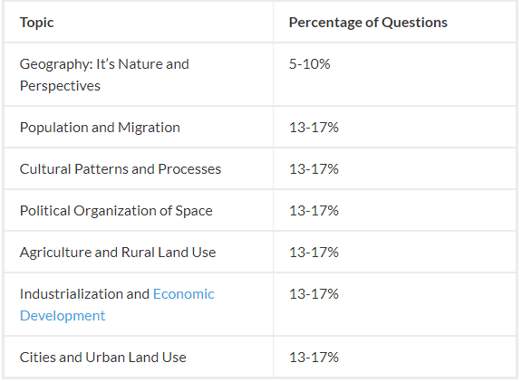
AP Human Geography Multiple-Choice Review Tips
1. Focus on specific themes. It’s helpful to know that the multiple-choice questions on the AP Human Geography exam follow a pattern and are not just randomly selected. Based on previous exam, the breakdown goes like this:

Slide 10
AP Human Geography Multiple-Choice Review Tips
2. Pay attention to keywords and commands in the question. When you first look at a multiple-choice question, circle the commands (EXCEPT, NOT, ALL, BEST, etc.). Sometimes, questions can trip you up if you don’t read them correctly. By circling the commands, you’re making sure you don’t misinterpret the question or confuse yourself. Similarly, underline keywords in the questions, such as words that relate to places, people, vocabulary words, etc. This will help keep you focused and maybe even help jog your memory. By picking apart the questions, you can get a better understanding of it.

Slide 11
AP Human Geography Multiple-Choice Review Tips
3. Don’t skip any questions! On the APHG exam, there is no guess-penalty. This means that you don’t get docked for answering a question incorrectly. It goes without saying that even if you have no idea what the answer to a question is, just make an educated guess! The key here is an educated guess, which will give you a better chance of getting the correct answer than if you just circled an answer willy-nilly.

Slide 12
AP Human Geography Multiple-Choice Review Tips
4. Take lots of practice tests. Taking practice exams is an extremely beneficial way to determine your strengths and weaknesses. When you’re first staring out studying, don’t be too concerned with the 60-minute time limit. Just take however long you need to finish the questions. Once you’ve finished, grade the test and really take a look at the answers you got wrong. Why was your answer wrong? Make flashcards of the terms in the questions you answered incorrectly and make a note to study them in more depth. As you get more experience taking practice tests, you will need to factor in the time limit. Set a timer for 60-minutes each time you take a mock multiple-choice exam. Practicing under the same conditions as the actual exam will help show you what to expect on exam day.

Slide 13
AP Human Geography Multiple-Choice Review Tips
5. Don’t spend too much time on any one question. Think about it this way: if you manage to answer all 75 multiple-choice questions, within the time-limit, and get most of them right, you can end up with the same score as if you answered only 60 questions and got all of them right. Using this fact, make sure you’re not spending too long on any one question. Your goal is to answer every single question, which can be difficult in the 60-minute time limit. Don’t get stuck choosing between two options. Rule out answers, look at your remaining options, and take an educated guess. The goal here is to be efficient, without sacrificing accuracy.

Slide 14
AP Human Geography Multiple-Choice Review Tips
6. Know the types of multiple-choice questions. It’s important that you familiarize yourself with the types of questions on the AP Human Geography exam. There are several types of multiple-choice questions you will encounter, which are detailed in the following table

Slide 15
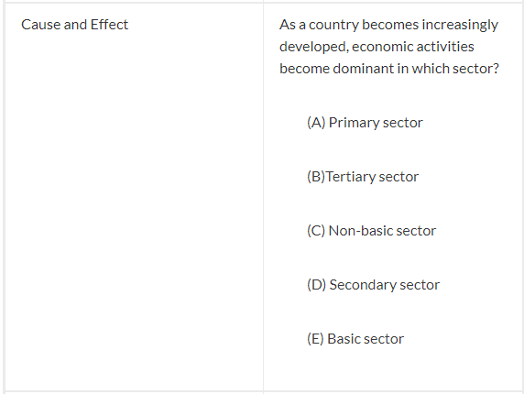
AP Human Geography Multiple-Choice Review Tips

Slide 16
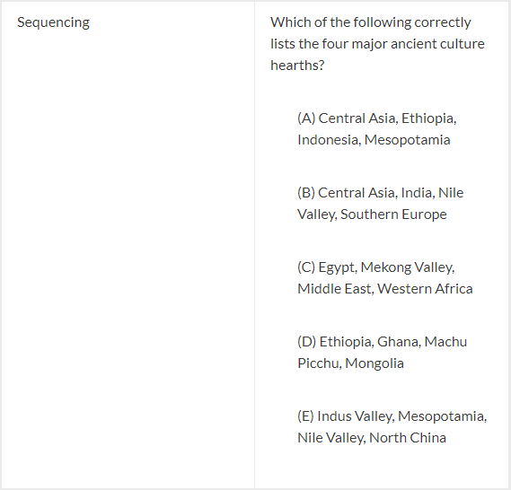
AP Human Geography Multiple-Choice Review Tips

Slide 17
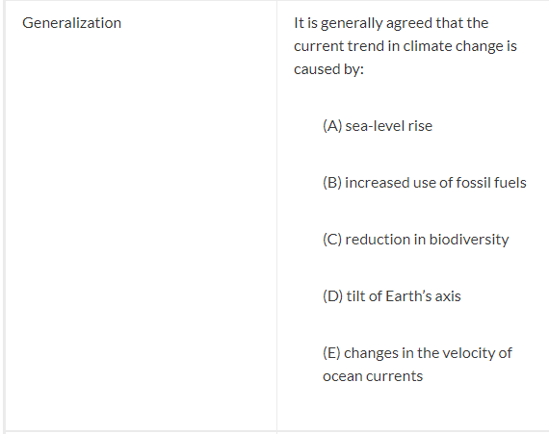
AP Human Geography Multiple-Choice Review Tips

Slide 18
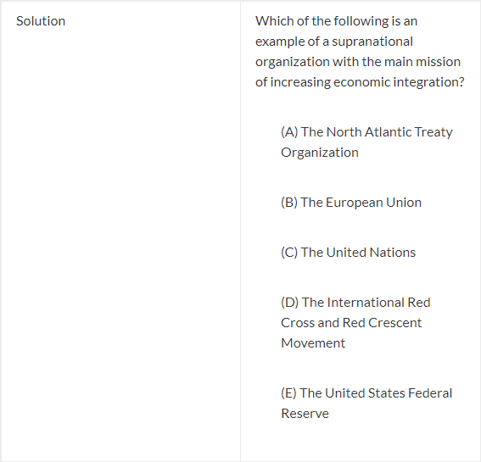
AP Human Geography Multiple-Choice Review Tips

Slide 19
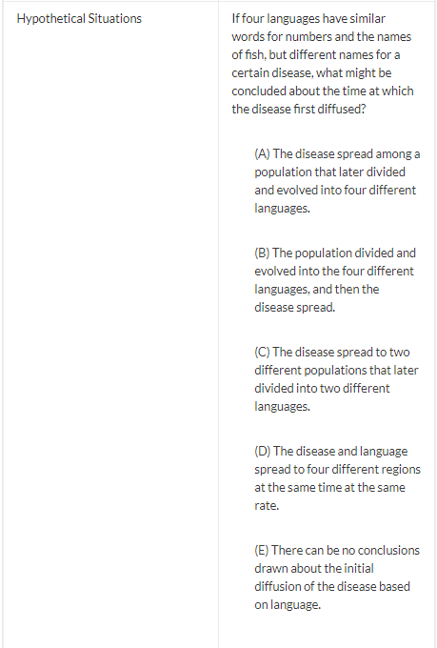
AP Human Geography Multiple-Choice Review Tips

Slide 20
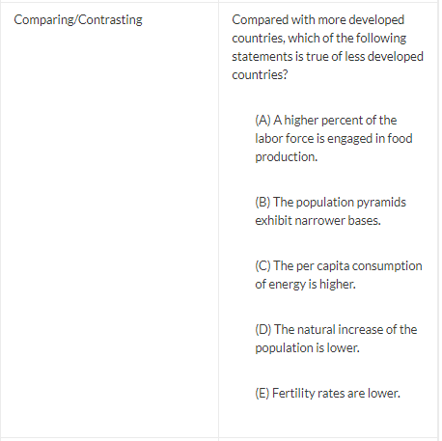
AP Human Geography Multiple-Choice Review Tips

Slide 21
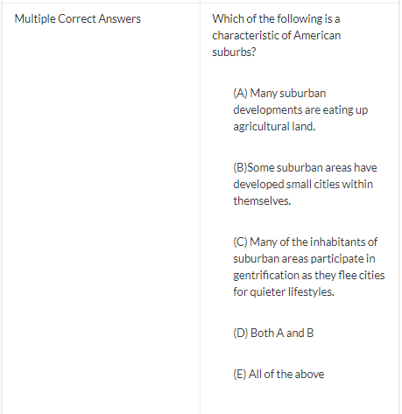
AP Human Geography Multiple-Choice Review Tips

Slide 22
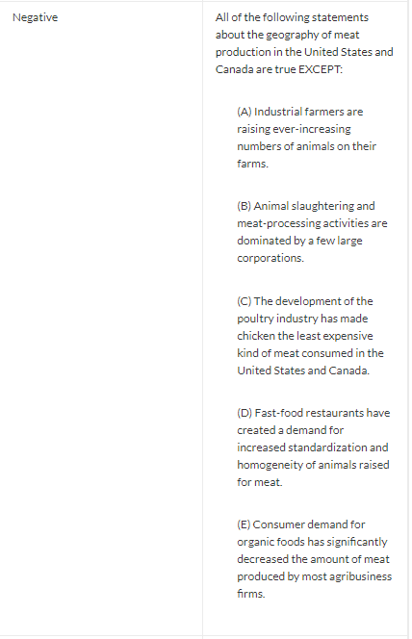
AP Human Geography Multiple-Choice Review Tips

Slide 23
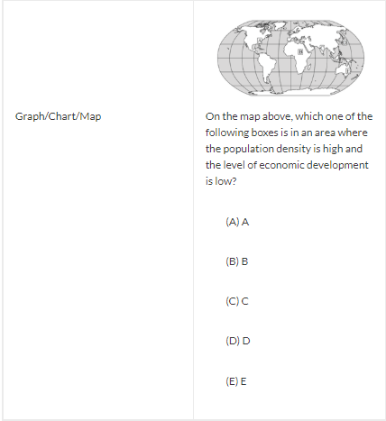
AP Human Geography Multiple-Choice Review Tips

Slide 24
AP Human Geography Multiple-Choice Review Tips
7. Write your own multiple-choice questions.
8. Know how to interpret graphs, maps, charts and illustrations.
9. Take good notes.
10. Teach concepts to your friends or family members.
11. Read the question and think of the answer. Before you even look at the possible answer choices, think of what answer you would give if the question were a fill-in-the-blank type question. This can help you select the correct answer without being distracted or swayed by too many possibilities.

Slide 25
AP Human Geography Free Response Tips
1. Practice previous free-response essay questions. Practice makes perfect. The single most important FRQ tip for the AP Human Geography exam is to practice, practice, practice. The CollegeBoard website has valuable resources to help you do just that. There, you will find past free-response essay questions, scoring guidelines, and sample responses. Take advantage of this resource!
2. Read and reread the question several times. Do not start writing immediately! Too often, students jump right into writing, without really understanding what the prompt is asking you. You need to carefully read and reread the question to make sure you know what’s being asked. Spend a good 5 minutes planning out each essay, always referring back to the question to make sure you’re staying on topic.

Slide 26
AP Human Geography Multiple-Choice Review Tips
3. Locate the verb in the question. Locating the verbs in FRQ questions can really help you understand which action you should take when forming your response. The following verbs are common on AP Human Geography FRQs:
Analyze: Using at least 2 sentences, find the relationship between two events or concepts. Explain this relationship and come to a conclusion using solid evidence, details, and specifics.
Assess/Evaluate: Discuss the advantages and disadvantages of something using specific examples.
Identify/Define: Using examples, craft a simple list (in narrative form) of factors or characteristics, or give well thought out definitions.
Explain: Using specific details, discuss the logical connections or cause and effects of concepts, themes, or events.
Discuss: Taking both points of view, debate about something using details. Use at least 3 sentences in your response.

Slide 27
AP Human Geography Multiple-Choice Review Tips
No matter what the question asks you to do, always use specific details and supporting evidence!
4. Figure out what geographic themes you can incorporate. Once you’ve read and reread the question and have a full understanding of the prompt, start to consider what geographic themes you can use in your response. You must remember that the exam is a Human Geography exam, which means you have to use geographic themes in your response. Incorporate information from maps or diagrams given to you. Write down evidence you learned during your studying that you think relates to the question. Find a way to connect these themes and ideas. Be sure to use “for instance” and “for example” in your response, so that you know you’re including evidence and specific details.

Slide 28
AP Human Geography Multiple-Choice Review Tips
5. Answer the question and nothing more. It may be tempting to just write down everything you know about a given topic in the hopes that at least one or two of your answers are correct. This is called a brain dump and you should not do this! Only answer the question and nothing more. If a question asks for two examples, do not give three in your response and do not restate the question in your answer. The APHG FRQ is not about adding flowery language and opinions (do not include “I think” or “in my opinion” in your response). You need to be succinct, while still making sure you’re answering the question fully.

Slide 29
AP Human Geography Multiple-Choice Review Tips
7. Don’t panic if you don’t know how to answer the question. We’ve all been there. You read a question and you have absolutely no idea how to answer it. Maybe you don’t understand the question, or maybe you just didn’t focus enough of your study time on that particular topic. It’s easy to freak out in these sorts of situations. Do not panic! Take a deep breath and reread the question. Break it down. Figure out what you can answer and answer it. Look at the map or charts given to you and try to find context clues. Move on to an essay prompt you’re more comfortable with. This can help boost your confidence and even jog your memory. Whatever you do, don’t leave the essay response blank. Answer the question any way you can, adding examples you think might relate to the prompt. You never know, you could make a lucky guess!

Slide 30
AP Human Geography Multiple-Choice Review Tips
8. Think geographically. It’s important to remember that the AP Human Geography exam is a geography test, not a history test. You need to think about the interconnections between people and places. Location, scale, time, and spatial perspective are important. You should think about your viewpoint when answering FRQs, meaning use local, regional, and global examples.

Slide 31
AP Human Geography Multiple-Choice Review Tips
9. Make it easy for the reader to follow your thoughts. Remember that AP readers have to go through large volumes of FRQ responses. Make it easy for them to follow your answer. Label and number each part of your response in the margins of your answer booklet. Underline key terms and words you are defining. When using maps or charts in your response, use corresponding labels in your answer. It’s also extremely important to keep your handwriting neat and legible. If the AP reader cannot read your response, you won’t get the points, regardless of whether or not your answer is correct.

Slide 32
AP Human Geography Multiple-Choice Review Tips
10. Manage your time wisely. Since you’re given a large block of 75 minutes to complete 3 essays, it is imperative that you manage your time effectively. The best way to do this is to dedicate 5 minutes of planning for each essay and 20 minutes of writing for each essay. Make sure you bring a watch on exam day to monitor your time. Do not be tempted to spend more time on any one exam. It may be helpful to write the essays you’re most comfortable with first because you might be able to write those faster, leaving more time for essays that are more difficult.

Slide 33
AP Human Geography Multiple-Choice Review Tips
11. Be specific. This is one of the most important tips for the AP Human Geography FRQ. Make sure you are giving specific examples in your response. This means names of geographers, models, theories, concepts, and vocabulary words. Do not be vague. If a sentence does not include something specific, it does not need to be there.

Slide 34
Work Cited Page
Learnwithalbert. (2019, January 04). The Ultimate List of AP Human
Geography Tips. Retrieved April 2, 2019, from
https://www.albert.io/blog/ap-human-geography-tips/

