Slide 1
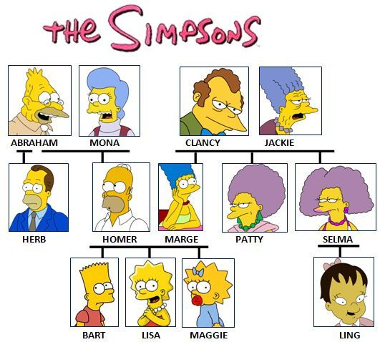
Mythology Family Tree

Slide 2
As I Present:
Record the name of each God/Goddess in the blank family tree provided
Please include an “M” beside the name if the individual is male
Please include an “F” beside the name if the individual is female
Beside/under each name jot down a brief description of the God/Goddess. (BE BRIEF- We will explore them in detail later on in the quarter)

Slide 3

Chaos
Chaos (Greek χάος khaos) refers to the formless or void state preceding the creation of the universe or cosmos in the Greek creations myths, more specifically the initial "gap" created by the original separation of heaven and Earth.

Slide 4

From Chaos Came:
Oranos (M) meaning "sky" or "heaven“- was the primal Greek god personifying the sky.
Gaea (F) was the goddess or personification of Earth in ancient Greek religion, one of the Greek deities. Gaia was the great mother of all: the heavenly gods, the Titans and the Giants were born from her union with Uranus.

Slide 5

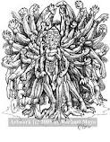
Born from Oranos and Gaea:
Cyclops
Hecatonchires
Titans

Slide 6
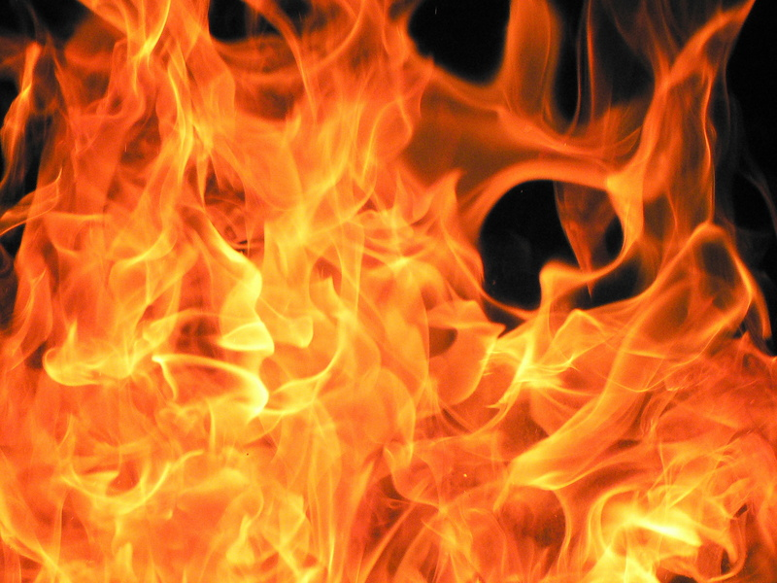
Some of the Titans Include:
Prometheus (M) a Titan, culture hero, and trickster figure who in Greek mythology.
He is known for his intelligence, and as a champion of mankind.

Slide 7
Cronus (M): the leader and the youngest of the first generation of Titans, divine descendants of Gaea, and Oranos.
He overthrew his father and ruled during the mythological Golden Age, until he was overthrown by his own son, Zeus.

Slide 8
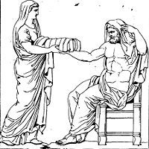
Rhea (F): Titaness daughter of the sky god Oranos and the earth goddess Gaea, in Greek mythology. In early traditions, she was known as "the mother of gods" and was therefore strongly associated with Gaea

Slide 9
Epimetheus (M): was the brother of Prometheus
While Prometheus is characterized as ingenious and clever, Epimetheus is depicted as foolish.

Slide 10
From the Titans Came the Olympians
Hestia (F)
Poseidon (M)
Zeus (M)
Hera (F)
Hades (M)
Demeter (F)
Notes:
Hestia:In Ancient Greek religion Hestia (Ancient Greek: Ἑστία, "hearth" or "fireside") is the virgin goddess of the hearth, architecture, and the right ordering of domesticity, the family and the state. In Greek mythology she is a daughter of Cronus and Rhea.[1]
Poseidon: Poseidon or Posidon (Greek: Ποσειδῶν) is one of the twelve Olympian deities of the pantheon in Greek mythology. His main domain is the ocean, and he is called the "God of the Sea“
Zeus: In the ancient Greek religion, Zeus (Ancient Greek: Ζεύς, Zeús; Modern Greek: Δίας, Días) is the "Father of Gods and men" (πατὴρ ἀνδρῶν τε θεῶν τε, patḕr andrōn te theōn te)[3] who rules the Olympians of Mount Olympus as a father rules the family. He is the god of sky and thunder in Greek mythology.
Hera: Hera ( /ˈhɛrə/; Greek Ἥρα, Hēra, equivalently Ἥρη, Hērē, in Ionic and Homer) was the wife and one of three sisters of Zeus in the Olympian pantheon of Greek mythology and religion. Her chief function was as the goddess of women and marriage.
Hades: Hades ( /ˈheɪdiːz/; from Greek ᾍδης (older form Ἀϝίδης), Hadēs, originally Ἅιδης, Haidēs or Άΐδης, Aidēs (Doric Ἀΐδας Aidas), meaning "the unseen"[1]) was the ancient Greek god of the underworld.
Demeter: In ancient Greek religion and myth, Demeter (/diˈmiːtər/; Attic Δημήτηρ Dēmētēr. Doric Δαμάτηρ Dāmātēr) is the goddess of the harvest, who presided over grains and the fertility of the earth

Slide 11
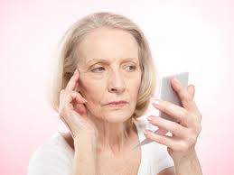

From Zeus and Hera Came:
Ares (M): God of War
Hebe (F): Goddess of Youth
Hephaestus (M): Greek god of technology, blacksmiths, craftsmen, artisans, sculptors, metals, metallurgy, fire and volcanoes.[

Slide 12
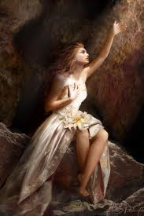
From Demeter Came:
Persephone (F): the daughter of Zeus and the harvest-goddess Demeter, and queen of the underworld.

Slide 13
Zeus’ Other Children Include:
Dionysys (M): the god of the grape harvest, winemaking and wine, of ritual madness and ecstasy.
Apollo & Artemis (M&F TWINS):
Apollo (M) has been variously recognized as a god of light and the sun.
Artemis (F) is the goddess of the hunt, wild animals and wilderness.

Slide 14
Zeus’ Other Children Include Cont:
Hermes (M): god of transitions and boundaries. He is known as the messenger God.

Slide 15

On the Side:
Aphrodite (F) From the Ocean Waves and Blood:
The Greek goddess of love, beauty, pleasure, and procreation.

Slide 16
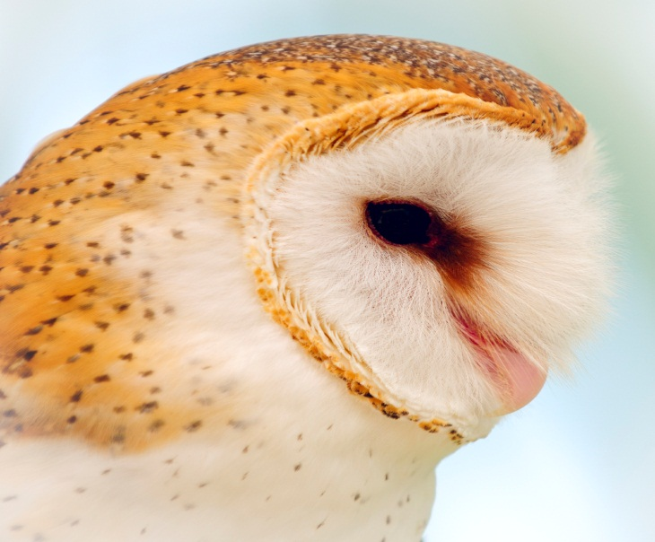

On the Side:
Athena (F) Out of Zeus’ Head:
The goddess of wisdom, courage, inspiration, civilization, law and justice, just warfare, mathematics, strength, strategy, the arts, crafts, and skill.

Slide 17
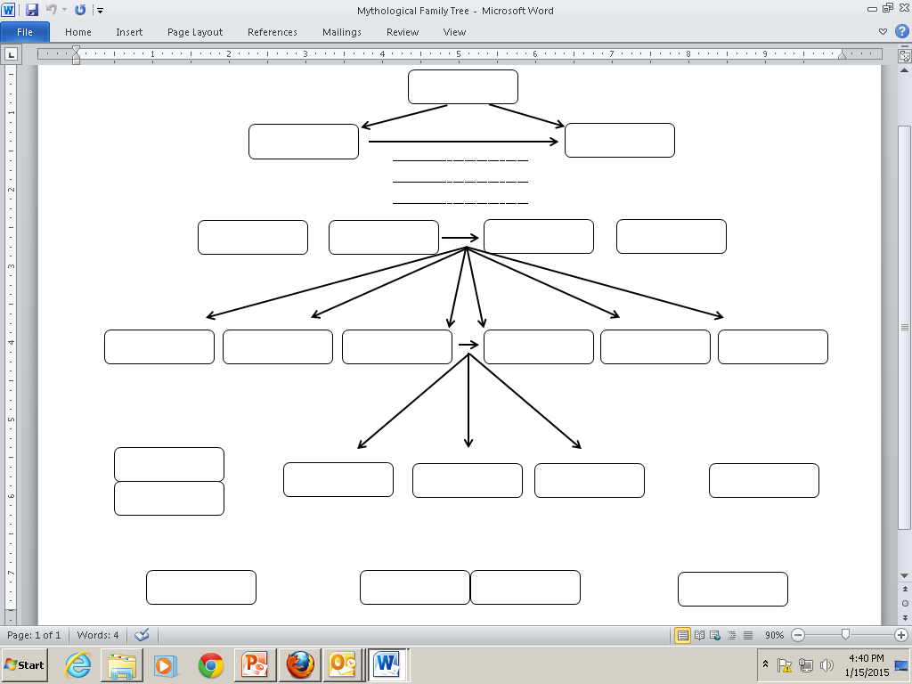
Check Our Answers!

Slide 18
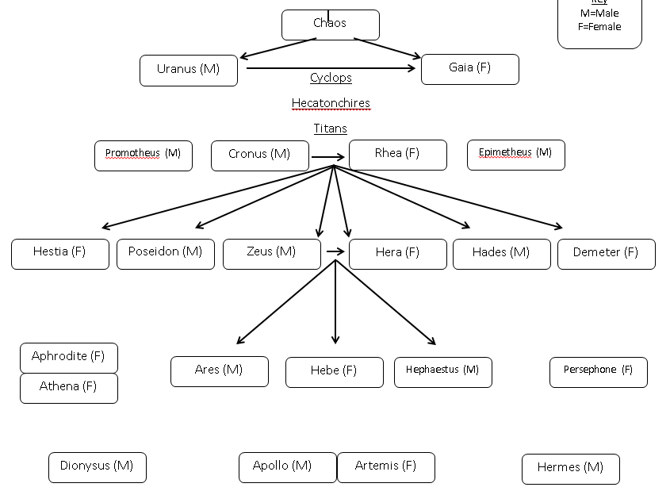

Slide 19

STAR
Place a star (or 2, or 3…) on your family tree beside any god/goddess that you would be interested in researching in the near future ☺

Slide 20
Quick Write
On the back of your paper, write a 2 paragraph short story including at least 2-3 Greek Gods/Goddesses. Use your imagination!
Your paragraphs must be 5-7 sentences.

Slide 21

Greek Mythology In Film
https://www.youtube.com/watch?v=4fHiIPnUgN0

