Slide 1
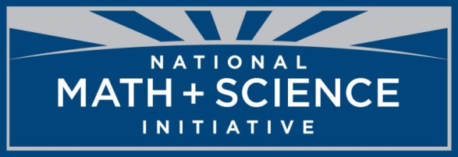
The Structure and Function of Macromolecules: Carbohydrates, Lipids & Phospholipids
Notes:
A fair amount of this material will be new to students. Although some of this material is not directly tied to the framework, it is still fundamental to the understanding of
Big Idea 2, EK 2.A.3: Organisms must exchange matter with the environment to grow, reproduce and maintain organization. a) Molecules and atoms from the environment are necessary to build new molecules. Evidence of student learning is a demonstrated understanding of each of the following: 1. Carbon moves from the environment to organisms where it is used to build carbohydrates, proteins, lipids for nucleic acids. Carbon is used in storage compounds and cell formation in all organisms.

Slide 2
The FOUR Classes of Large Biomolecules
All living things are made up of four classes of large biological molecules:
Carbohydrates
Lipids
Protein
Nucleic Acids
Macromolecules are large molecules composed of thousands of covalently bonded atoms
Molecular structure and function are inseparable
Notes:
This lesson will deal with carbohydrates and lipids, with protein and nucleic acids coming in a separate lesson. Emphasize yet again that within the molecule, the intramolecular forces are covalent bonds, but the intermolecular forces (IMFs) between molecules will vary due to the polarity of the molecule as a whole.

Slide 3
The FOUR Classes of Large Biomolecules
Macromolecules are polymers, built from monomers
A polymer is a long molecule consisting of many similar building blocks
These small building-block molecules are called monomers
Three of the four classes of life’s organic molecules are polymers
Carbohydrates
Proteins
Nucleic acids
Notes:
Emphasize that monomers join through covalent bonding (a pair, or more, of electrons is shared between two monomers). Take a moment to assess what students already know. Can they cite examples of carbohydrates, proteins and nucleic acids. If so, try to use the examples they came up with during your discussions.

Slide 4
The synthesis and breakdown of polymers
A dehydration reaction occurs when two monomers bond together through the loss of a water molecule
Polymers are disassembled to monomers by hydrolysis, a reaction that is essentially the reverse of the dehydration reaction
Notes:
Ask if students know what “dehydration” means in a colloquial sense. “Athletes drink a lot of water to prevent dehydration.” Water exits when a covalent bond is formed (synthesis), water enters when a covalent bond is broken (decomposition). Scroll over the image to reveal the “play” command for the animation.

Slide 5
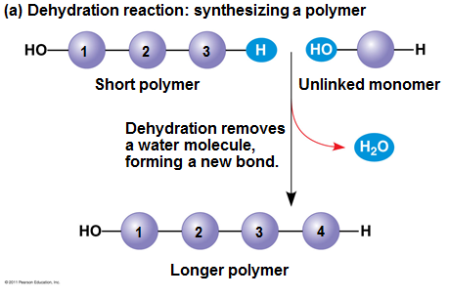
Dehydration Synthesis
Notes:
Emphasize the “ends” of the molecule, one end has an –OH group, the other has an –H. Each group leaves an electron attached to the monomer or polymer and those 2 electrons form a covalent bond while the H and OH form a water molecule.

Slide 6
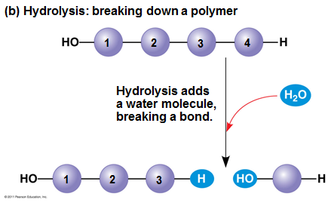
Hydrolysis
Notes:
Hydrolysis literally means (water splitting). A water molecule “adds across” a covalent bond and cleaves off one monomer at a time. Drink lots of water if your goal is to disassemble fats!

Slide 7
The Diversity of Polymers
Each cell has thousands of different macromolecules
Macromolecules vary among cells of an organism, vary more within a species, and vary even more between species
An immense variety of polymers can be built from a small set of monomers
Notes:
See if your students can give you examples of various kinds of polymers from their prior learning.

Slide 8
Carbohydrates Serve as Fuel & Building Material
Carbohydrates include sugars and the polymers of sugars
The simplest carbohydrates are monosaccharides, or single sugars
Carbohydrate macromolecules are polysaccharides, polymers composed of many sugar building blocks
Notes:
Ask them to name some sugars they remember from Biology I. See if they can really show off and give you the chemical formula for glucose or sucrose (or any other disaccharide from glucose-type monomers). Glucose: C₆H₁₂O₆, sucrose: C₁₂H₂₂O_{11.} What’s missing from a simple doubling of the subscripts on glucose? 2 H’s and an O! That’s a water molecule! It was “released” during the dehydration synthesis when the two monomers (monosaccharide in this case) bonded to form a dimer (disaccharide in this case).

Slide 9
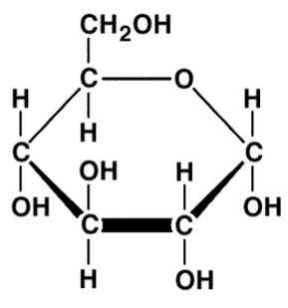
Sugars: Monosaccharides
Monosaccharides have molecular formulas that are usually multiples of CH₂O
Glucose (C₆H₁₂O₆) is the most common monosaccharide
Monosaccharides are classified by
The location of the carbonyl group
The number of carbons in the carbon skeleton
Notes:
Emphasize they are “carbo-hydrates” as in “carbon-water” as is evidenced from the (CH₂O)_{n} general formula. It is not necessary to emphasize how they are classified.

Slide 10
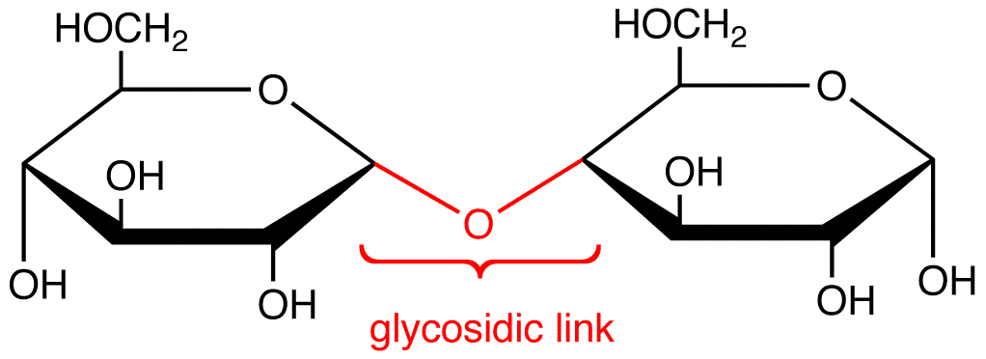
Sugars: Disaccharides
A disaccharide is formed when a dehydration reaction joins two monosaccharides
This covalent bond is called a glycosidic linkage
Notes:
Ask students how these “hexagons” differ from the one in the previous slide. Point out to them that it is customary to leave C’s and even H’s off the “art” in the interest of focusing on what is really important with regard to a given bond formation. It is not necessary they know “glycosidic linkage”, it’s just necessary that they know a water was released and helpful to know that an oxygen remains in tact.

Slide 11
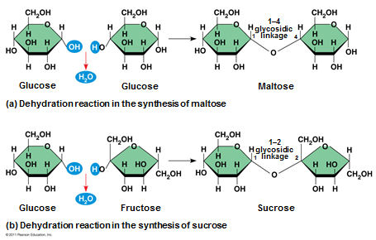
Synthesizing Maltose & Sucrose
Notes:
No need to memorize! Just reemphasizing “mono+mono = di” saccharide through a dehydration synthesis.

Slide 12
Polysaccharides
Polysaccharides, the polymers of sugars, have storage and structural roles
The structure and function of a polysaccharide are determined by its sugar monomers and the positions of glycosidic linkages
Notes:
Same dehydration synthesis song, second verse. Scroll over the image to reveal the “play” command for the animation.

Slide 13
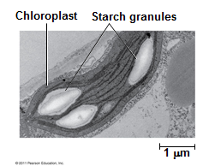
Types of Polysaccharides: Storage
Starch, a storage polysaccharide of plants, consists entirely of glucose monomers
Plants store surplus starch as granules within chloroplasts and other plastids
The simplest form of starch is amylose
Notes:
Emphasize the link between structure and function. It is not necessary to memorize the names of starches.

Slide 14
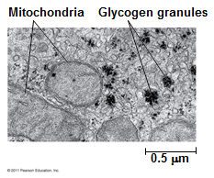
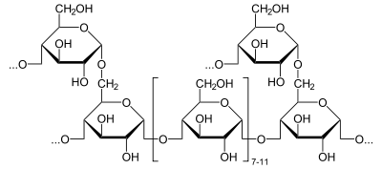
Types of Polysaccharides: Storage
Glycogen is a storage polysaccharide in animals
Humans and other vertebrates store glycogen mainly in liver and muscle cells
Notes:
Glycogen may have been referred to as “animal starch” in their middle school or Biology I course.

Slide 15
Types of Polysaccharides: Structural
The polysaccharide cellulose is a major component of the tough wall of plant cells
Like starch, cellulose is a polymer of glucose, but the glycosidic linkages differ
The difference is based on two ring forms for glucose: alpha (α) and beta (β)
Notes:
While cellulose may not be all that exciting, it is interesting that termites cannot digest it until they establish a symbiotic relationship with a protozoan that can! To digest cellulose, organisms must produce the enzyme cellulase. Humans and termites are unable to produce cellulase themselves but termites have living in their gut simple organisms (protozoa and bacteria) which can produce the enzyme.
This is an example of mutualism - a relationship between two species in which both organisms benefit. The protoza and bacteria benefit by receiving a constant supply of food (wood) from the termite. The termite benefits from the energy-rich sugar released from the cellulose by the termites. Read more: http://wiki.answers.com/Q/Why_termites_can_digest_cellulose_but_human_cannot#ixzz23pblQhQb

Slide 16
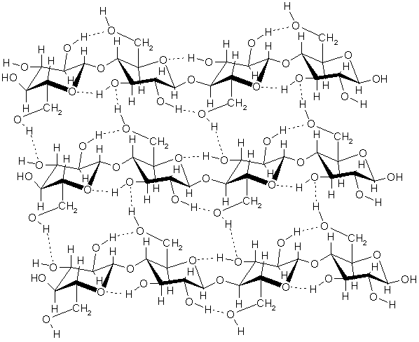
Cellulose: A termite’s best friend!
Note the
H-bonds
Notes:
Once more with enthusiasm, emphasize the difference between H-bonds (dotted lines, a special case of dipole-dipole IMF’s) and bonded H’s (solid lines representing a shared pair of electrons, thus a covalent bond.)

Slide 17
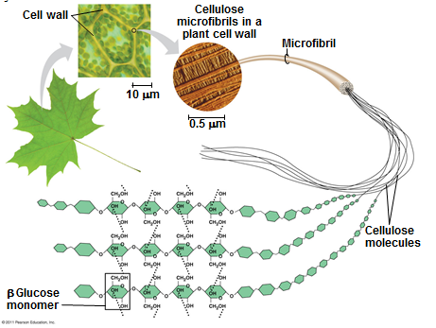
Such Elegance!
Notes:
Emphasize the structural hierarchy from monomer to polymer to cellulose to a grouping of cellulose into a microfibril to the structure of the cell wall to the plant cell to the leaf. Whew!

Slide 18
Polysaccharide Random Acts of Biology
Cellulose in human food passes through the digestive tract as insoluble fiber
Some microbes use enzymes to digest cellulose
Many herbivores, from cows to termites, have symbiotic relationships with these microbes
Chitin, another structural polysaccharide, is found in the exoskeleton of arthropods (crunch!)
Chitin also provides structural support for the cell walls of many fungi
Notes:
Just site these as common examples of organisms that utilize carbohydrates.

Slide 19
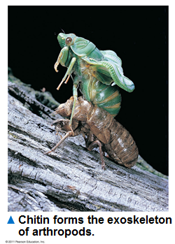
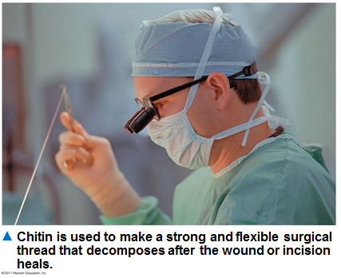
Who knew?

Slide 20
Lipids Are Hydrophobic
Lipids are a diverse group of hydrophobic molecules
Lipids are the one class of large biological molecules that do not form polymers
The unifying feature of lipids is having little or no affinity for water (water fearing)
Lipids are hydrophobic because they consist mostly of hydrocarbons, which form nonpolar covalent bonds
The most biologically important lipids are fats, phospholipids, and steroids
Notes:
“Hydrophobic” means “water fearing”. If you’re up for a demo, you can use a couple of clear containers (beakers, etc.) partway filled with water to demonstrate that neither oil nor shortening, etc. will dissolve in water. Also, since this is the first time “steroid” has appeared, you may want to take a moment and discuss anabolic (building up) versus catabolic (tearing down) processes and that the sum of these processes is “metabolism”. Also point out that testosterone and estrogen are steroids.

Slide 21
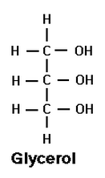
Fats: Start with a Simple Little Glycerol Molecule
Fats are constructed from two types of smaller molecules: glycerol and fatty acids
Glycerol is a three-carbon alcohol with a hydroxyl group attached to each carbon
A fatty acid consists of a carboxyl group attached to a long carbon skeleton
Notes:
Remind students that an –OH group attached to a hydrocarbon skeleton makes an alcohol, NOT A BASE!

Slide 22
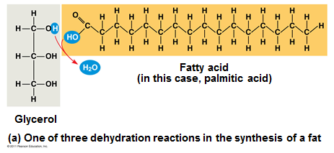
Dehydration Rxn 1: Add a Fatty Acid
Next, add a “fatty acid” through a dehydration synthesis reaction
What makes it an acid? The C double bond O, single bond OH!
Notes:
Glycerol is on its way to make a triglyceride, which they may have heard talk of if anyone in their family is struggling with too many triglycerides in their diet.

Slide 23
Dehydration Rxn 2!!
Next, add a SECOND “fatty acid” through a dehydration synthesis reaction
Notes:
Sorry, the picture is not pretty, but it does convey the idea. One more fatty acid to add before this becomes a triglyceride.

Slide 24
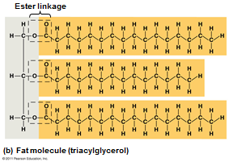
Dehydration Reaction THREE!!!
The joining of the C of the fatty acid to the O of the hydroxyl group of the glycerol is called an ester linkage.
Notes:
No need to memorize “ester linkage”. Ask students how many water molecules it will take to disassemble this molecule! Ans: THREE!

Slide 25
Fats Are Insoluble In Aqueous Environments
Fats separate from water because water molecules form hydrogen bonds with each other and exclude the fats
In a fat, three fatty acids are joined to glycerol by an ester linkage, creating a triacylglycerol, or triglyceride
Notes:
Students may know the phrase “likes dissolve likes” from Chemistry I. If so, this is an example of a nonpolar fat not being at all attracted to a polar water molecule.

Slide 26
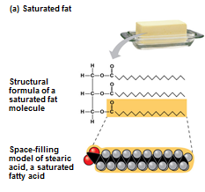
Saturated or Unsaturated?
Fats made from saturated fatty acids are called saturated fats, and are solid at room temperature
Most animal fats are saturated (lard)
Saturated fatty acids have the maximum number of hydrogen atoms possible and no double bonds
Notes:
Ask students “saturated with what, exactly”? Saturated with H’s. These diagrams have the fatty acid molecules with all single bonds so the “tails” are fairly straight.

Slide 27
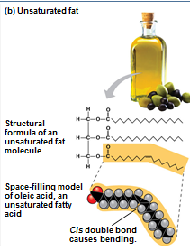
Saturated or Unsaturated?
Fats made from unsaturated fatty acids are called unsaturated fats or oils, and are liquid at room temperature
Plant fats and fish fats are usually unsaturated
Unsaturated fatty acids have one or more double bonds
Notes:
Unsaturated means a PAIR of H’s is now “missing” thus a double bond forms between neighboring C’s in the carbon chain of the fatty acid. Note this causes a “bend” or “kink” in the chain which alters the shape or conformation of the fat. Ask students what they think “polyunsaturated” fat means.

Slide 28
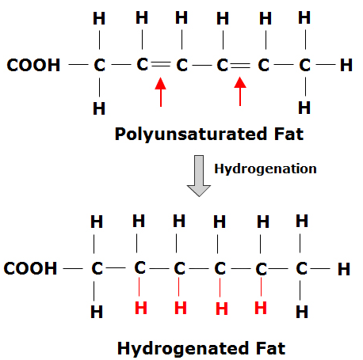
Saturated or Unsaturated?
A diet rich in saturated fats may contribute to cardiovascular disease through plaque deposits
Hydrogenation is the process of converting unsaturated fats to saturated fats by adding hydrogen
Notes:
Point out that a pair of hydrogen atoms must be “added” across the double bond to form 2 covalent bonds between 2 different carbons and the 2 different hydrogen atoms added.

Slide 29
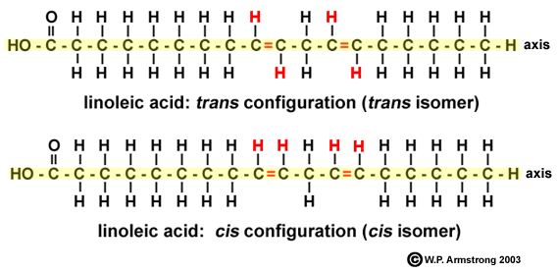
What’s a Trans fat?
Hydrogenating vegetable oils also creates unsaturated fats with trans double bonds
These trans fats may contribute more than saturated fats to cardiovascular disease
Notes:
Just in case you are asked, the prefix trans means “across” as in transatlantic cruise (across the Atlantic ocean). So, the H’s are located “across” the double bond. Cis means “same side”, so the H’s are located on the same side of the double bond.
Refer back to a lock and key analogy with students, if we want an enzyme to react with or digest a trans fat, then it does so they way only one key fits with a given lock. For humans, we have way more cis-identifying enzymes than trans-identifying enzymes, thus the trans-fats are not digested as efficiently and build up contributing to cardiovascular disease. More detail than needed, but interesting none the less.

Slide 30
Saturated or Unsaturated?
Certain unsaturated fatty acids are not synthesized in the human body
These must be supplied in the diet
These essential fatty acids include the omega-3 fatty acids, required for normal growth, and thought to provide protection against cardiovascular disease
Notes:
Couldn’t resist a nutrition moment. No need to memorize!

Slide 31
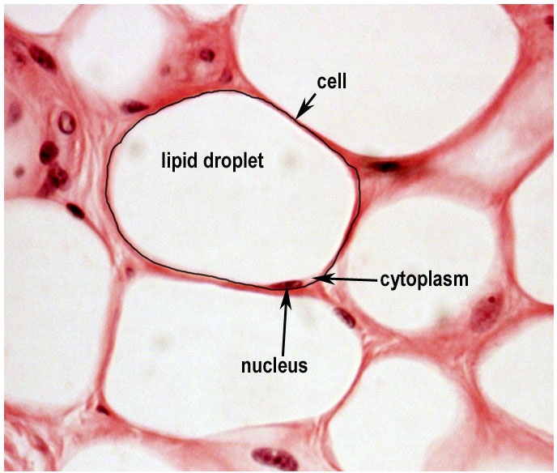
Fats: Major function is storage!
The major function of fats is energy storage
Humans and other mammals store their fat in adipose cells
Adipose tissue also cushions vital organs and insulates the body
Notes:
Adipose tissue is from hormonally inert, adipose tissue has in recent years been recognized as a major endocrine organ, as it produces hormones such as leptin, estrogen, and resistin. More than you need to have students know, but interesting none the less!

Slide 32
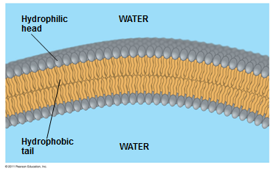
Phospholipids
When phospholipids are added to water, they self-assemble into a bilayer, with the hydrophobic tails pointing toward the interior
The structure of phospholipids results in a bilayer arrangement found in cell membranes
Phospholipids are the major component of all cell membranes
Notes:
You know where this is headed…bring on the cell membrane unit!

Slide 33
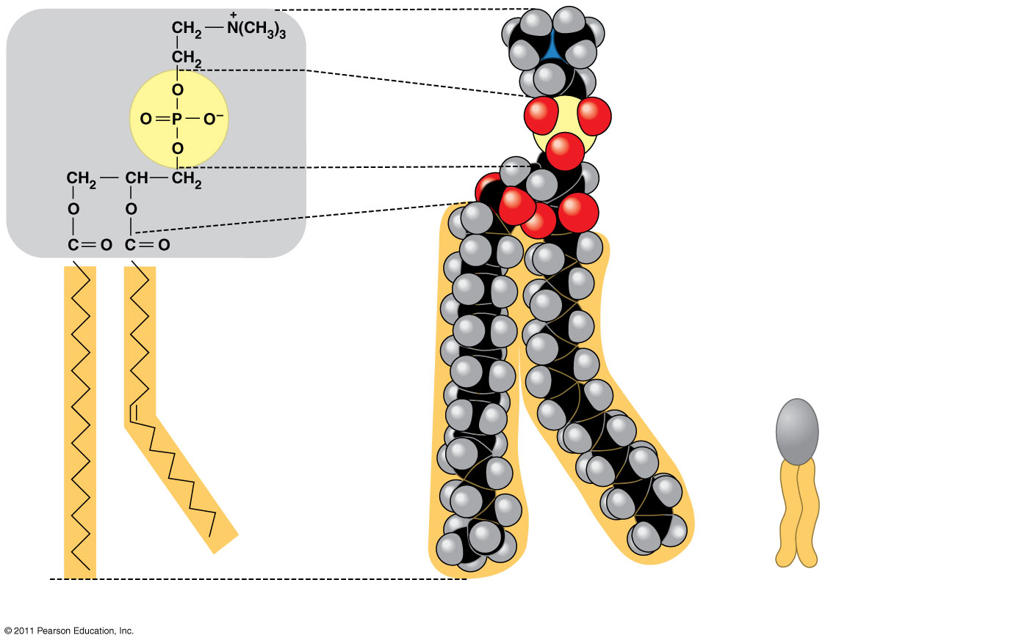
A Single Phospholipid Molecule
Choline
Hydrophilic head
Phosphate
Glycerol
Fatty acids
Hydrophobic tails
Hydrophilic head
Hydrophobic tails
(a) Structural formula
(b) Space-filling model
(c) Phospholipid symbol
Notes:
The structure of a phospholipid.

Slide 34
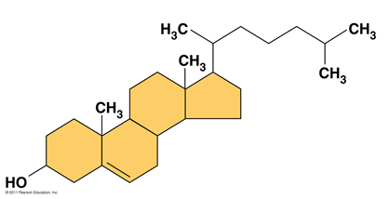
Steroids
Steroids are lipids characterized by a carbon skeleton consisting of four fused rings
Cholesterol, an important steroid, is a component in animal cell membranes
Although cholesterol is essential in animals, high levels in the blood may contribute to cardiovascular disease
Notes:
See how many “steroids” your students can name.

Slide 35
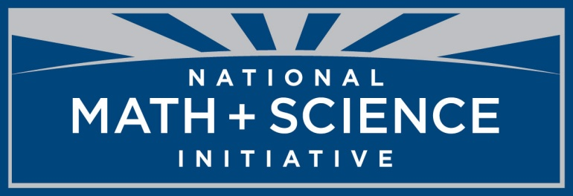
Created by:
René McCormick
National Math and Science
Dallas, TX

