Slide 1
Personality
Unit 8: Chapter 13

Slide 2
Psychoanalytic/psychodynamic Theories
Chapter 13, Section 1, pages 422-425, 428-429

Slide 3
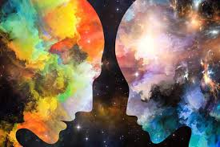
What is Personality?
Some may include temperament and character
Temperament- an individual’s innate disposition or behavioral style and typical emotional response
Character- value judgments about an individual’s morals, values, and ethical behaviors
Personality- our unique and relatively stable pattern of thoughts, feelings, and actions
Do you think that you choose your own behaviors freely, or do you believe that your current behaviors are determined by previous behaviors and events? Explain.

Slide 4
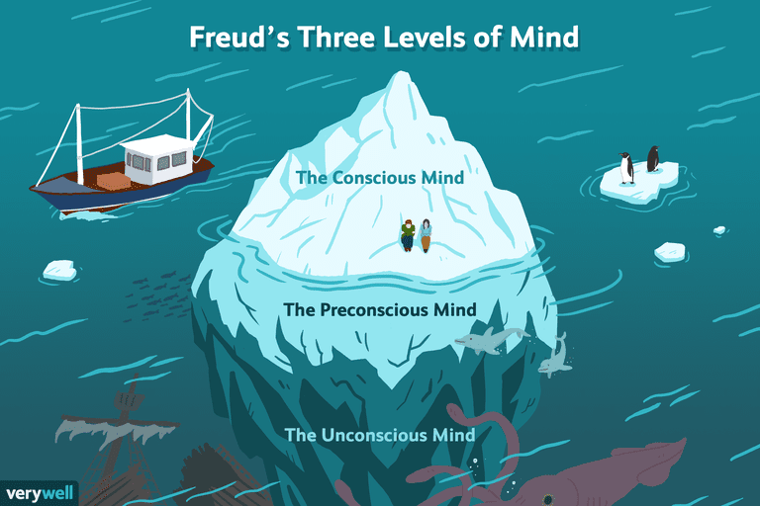
Freud’s Psychoanalytic Theory
According to Freud, we have an unconscious that lies just outside of our awareness
In the unconscious, we have unacceptable thoughts and feelings that are repressed until dreams or Freudian slips reveal these feelings

Slide 5
Freud’s Levels of Consciousness
Conscious- thoughts or motives that a person is currently aware of
Preconscious- thoughts, motives, or memories that exist just beneath the surface of awareness and can be called to consciousness when necessary
Unconscious- the reservoir of largely unacceptable thoughts, feelings, memories, and other information that lies beneath conscious awareness
Subliminal processing that lies beneath the absolute threshold

Slide 6
Freud’s Personality Structure
Three mental structures of our personality
Id- completely unconscious and strives to satisfy basic drives (hunger, aggression)
What the person wants to do
Operates on the pleasure principle- like a newborn
Superego- develops last and provides internalized ideals and standards for judgement
What the person should do
Operates as the center of morality
Aka the conscience
Ego- somewhat conscious, develops out of the need to deal with the demands of the real world
What the person plans to do
Operates on the reality principle
Not the same as the colloquial usage
Which part of the personality- id, ego, superego- do you think is the most important? Explain.

Slide 7
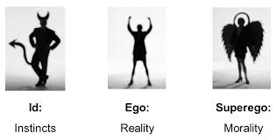
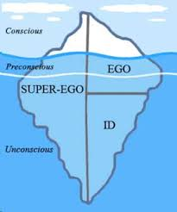
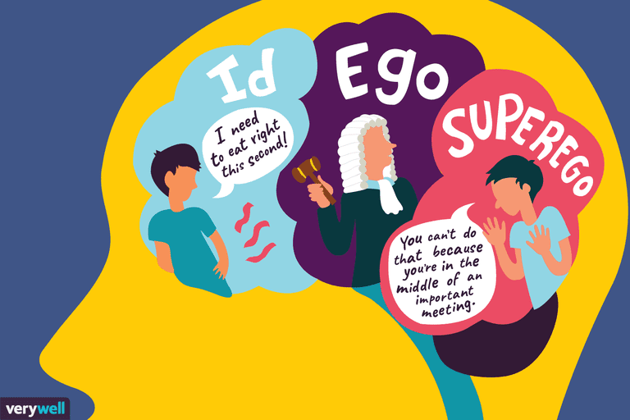
Freud’s Personality Structure
The ego works to meet the demands of both the id and superego, finding a compromise
https://www.youtube.com/watch?v=tMgpFnycZCg

Slide 8
Defense Mechanisms
If the ego fails to satisfy the id and superego, anxiety comes into the conscious awareness (conscious anxiety) and we become uncomfortable
To avoid feeling uncomfortable and reduce anxiety, we use defense mechanisms
Defense mechanisms- strategies the ego uses to reduce anxiety by unconsciously distorting reality or increase self-deception
We will explore more when we look at stress and health
Can be healthy if used in moderation or temporarily
Can also create destructive habits

Slide 9
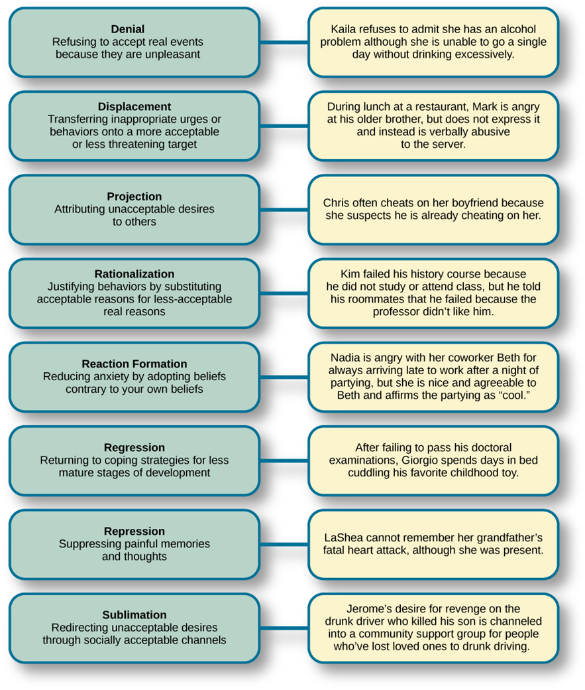
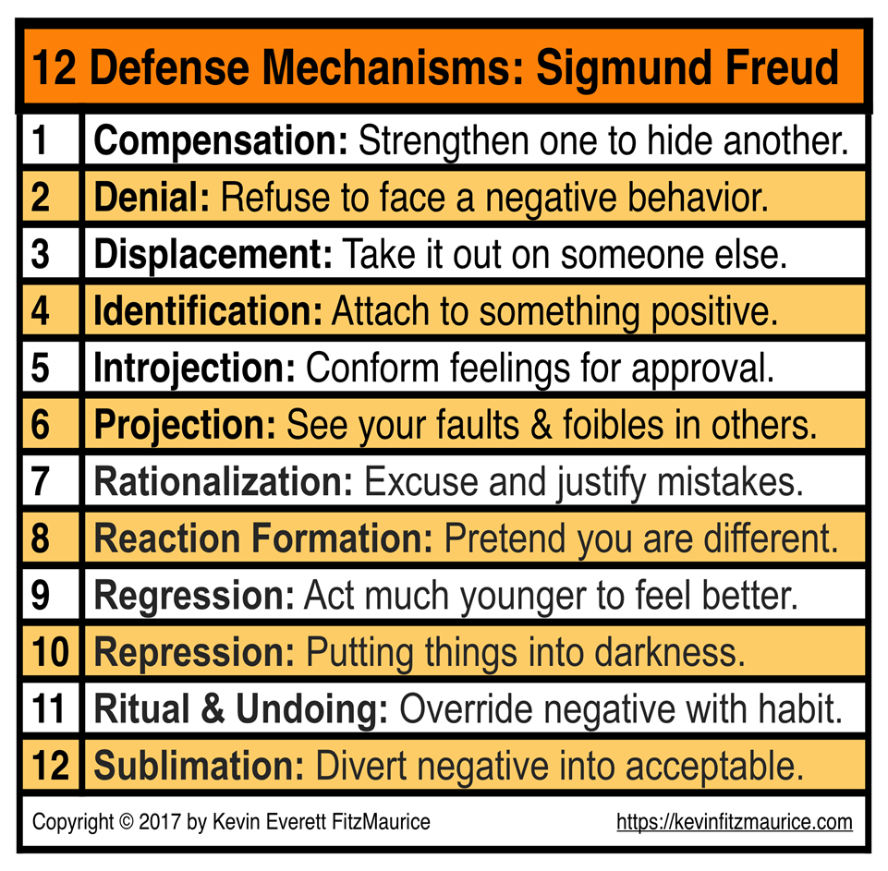

Slide 10
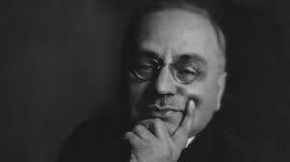
Alfred Adler
Developed individual psychology for personality development
Believes our behavior is purposeful and we are motivated by our goals to obtain security and overcome inferiority
We all have an inferiority complex- feelings of inferiority developed from early childhood experiences of helplessness and incompetence
We respond by either developing superiority over others through aggression, etc. or creativity and gaining a mastery over our lives

Slide 11
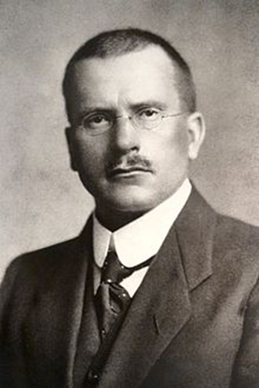
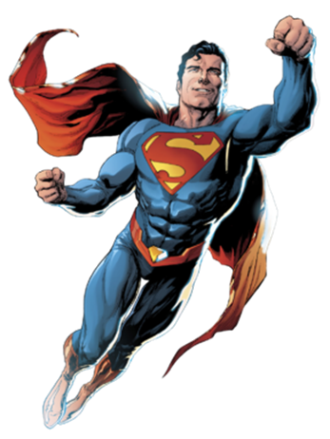
Carl Jung
Developed analytical psychology for personality development
Emphasized unconscious processes but also that the unconscious contains positive and spiritual motives too
We have two forms of the unconscious mind
Personal conscious- created from our individual experiences
Collective conscious- the deepest layer of the unconscious, which contains universal memories and archetypes shared by all people due to our common ancestral past
This holds archetypes- the collective, universal images and patterns in the unconscious that have symbolic meaning for all people; i.e. gender roles
Many stories give examples of archetypes (Jack and the Beanstalk is essentially David and Goliath, Superman)

Slide 12
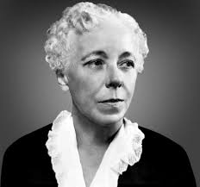
Karen Horney
Created a blend of Freud, Alder, and Jung, and added a feminist critique
Emphasized women’s positive traits and showed how many of Freud’s ideas reflect male bias
Personality development also depends on social relationships, especially between parent and child
Adult personalities are shaped by our childhood relationships- we either move toward, away, or against people based on these
An emotionally healthy person moves toward people
Basic anxiety- feelings of helplessness and insecurity that adults experience because as children they felt alone and isolated in a hostile environment

Slide 13
Evaluation of Psychoanalytic Theories
Critiques
Inadequate empirical support
Overemphasis on sexuality, biology, and unconscious forces
Sexism
Evidence for defense mechanisms and information processing occurring outside our conscious awareness
There is value in recognizing Freud’s insights about childhood experiences and unconscious influences

Slide 14
Trait Theories
Chapter 13, Section 2, pages 430-435

Slide 15
Early Trait Theory
Trait- a relatively stable personality characteristic that describes a pattern of thinking, feeling, and acting
Example- smart, nice, arrogant
Every trait applies to all people and every trait can be used to describe people
Researchers started with almost 4,500 words that fit personality traits
Cattell reduced this list to 16 traits, each of which operated on a continuum
Used factor analysis (mathematical technique that describes the extent to which different personality variables are related)
16 source traits (core of personality) contains 46 observable traits (surface traits)
Eysenck reduced the list further into three continuums: extraversion/introversion, neuroticism, psychoticism

Slide 16
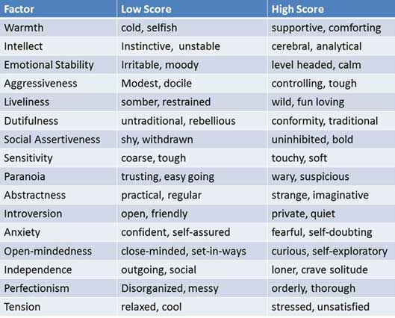

Slide 17
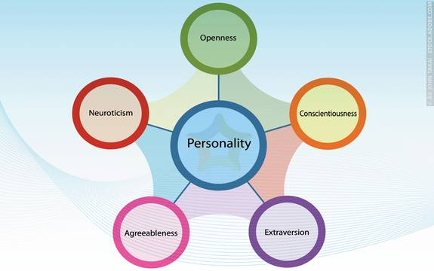
Modern Trait Theory- Five Factor Model
Using factor analysis again, five traits repeatedly came up using different tests
They spell OCEAN
Openness- willing to try new things vs. keep to routine
Conscientiousness- organized/dependable vs. often late/commonly misplace things
Extraversion- outgoing vs. quiet
Agreeableness- easy going vs. difficult to be around
Neuroticism (emotional stability)- anxious/moody vs. calm/even-tempered

Slide 18
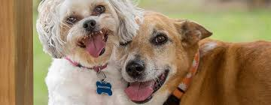
Modern Trait Theory- Five Factor Model
Extraversion vs. introversion
You don’t have to be one or the other, they each have different ways of interacting with others and processing information
Research has found strong evidence for trait theory being the most accurate, including research with social media
Also found evidence that these are linked with real-world outcomes
Extraversion and neuroticism linked with procrastination
Conscientiousness, agreeableness, openness are reliable predictors for success with conscientiousness strongly linked with GPA
Continued research show the nonhuman animals have a unique personality
Strangers and owners rated pets the same on certain traits
Apes showed four common traits with correlations for life expectancy

Slide 19
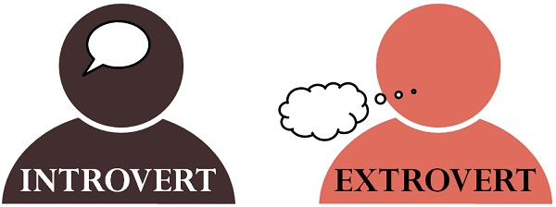
Extroversion vs. Introversion
Extravert
Needs and likes to be with people
Energizes self through interaction with others
Needs and wants many friends
Interested in what is happening in the external world
Tends to be expressive
Tolerates criticism well
Eager to jump into new situations
Which one is more like you?
Introvert
Needs to have “space” (territorial)
Comfortable being alone
Energizes self by being alone
Limits friendships, prefers close relationships
Interested in internal reactions
Tends to be hesitant to express ideas/feelings
Takes criticism personally
Often reluctant to jump into new situations

Slide 20
Evaluation of Trait Theories
Achieves goal of organizing personality characteristics using the smallest number of traits
Research widely supports it
Cross culturally, people agree on what traits are desirable- potentially because there is an evolutionary advantage
Studies show it predicts real-life preferences and behaviors (politics, music, social media, etc.)
Critics
FFM describes personality, doesn’t explain it
Fails to consider situational determinants or give explanation why people develop specific traits
Does not identify what traits are constant and what changes, as evidenced by research

Slide 21
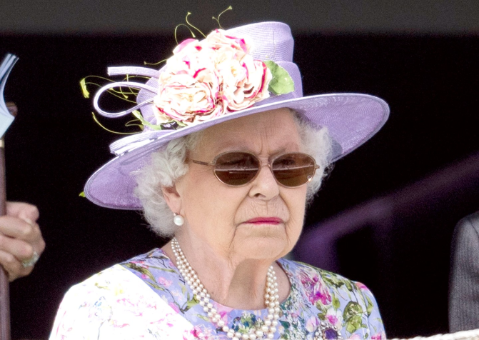
Can and Should We Change our Personalities?
Research shows you can change your personality through training
Through practice of certain behaviors, you can change personality traits
Example- writing thank you letters to improve gratitude
Research showed increased life satisfaction and greater well-being
We are only describing traits, not advising on changes- that is up to the individual, our traits are on a continuum with positive and negative characteristics

Slide 22
Humanistic theories
Chapter 13, Section 3, pages 435-438

Slide 23
Humanistic Theories
Emphasize internal feelings, thoughts, and sense of basic worth
Focus on the human’s movement to self-actualization- inborn drive to realize our full potential and develop all our talents and capabilities
Our personalities depend on how we perceive and interpret the world
Some opponents of the humanistic theory of personality have criticized it for promoting the “me first” approach to living. They believe that the theory encourages selfishness. Do you agree with these critics? Why or why not?

Slide 24
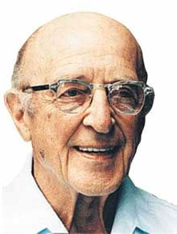
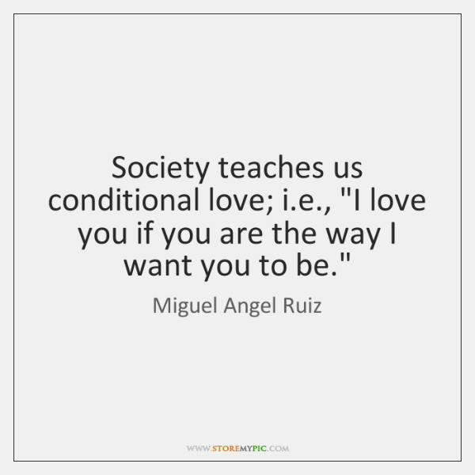
Carl Rogers’s Theory
Self-concept- the image of oneself that develops from interactions with significant others and life experiences
According to Rogers, our mental health depends on how much overlap/congruence (the more the better) there is between our real selves and our ideal selves
Poor self-concepts come from childhood experiences where love and acceptance is made conditional upon behaving in a certain way

Slide 25
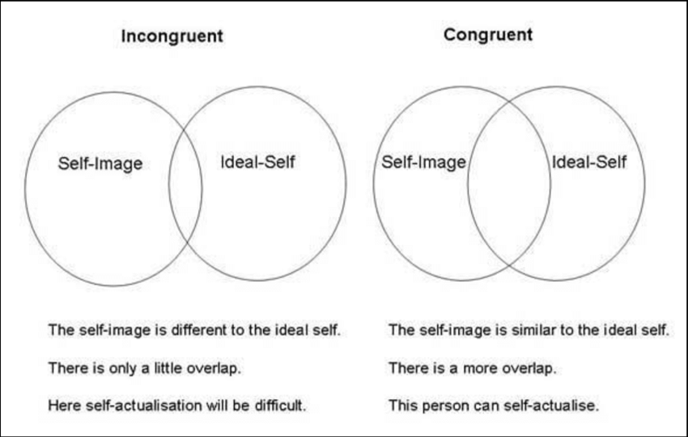
Roger’s Congruency
To develop to the fullest potential, a person needs unconditional positive regard- love and acceptance with no “strings” (contingencies) attached
Parents should show this for children, although focusing on positive behavior and discouraging negative behavior

Slide 26
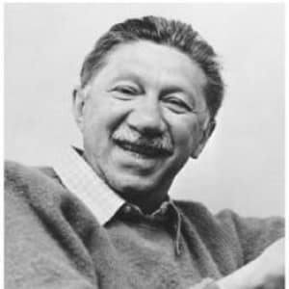
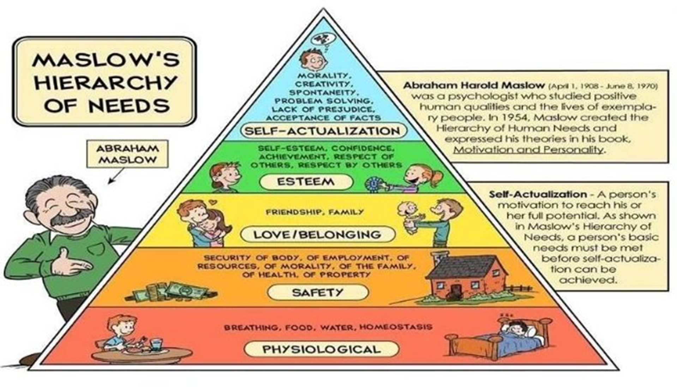
Abraham Maslow’s Theory
Personality development was a progression from lower to higher levels in his hierarchy of needs
Self actualization requires understanding our own potential, accepting ourselves and others as unique individuals, and taking a problem centered approach to life
Few people achieve it, according to Maslow, but it is a continuous process for all

Slide 27
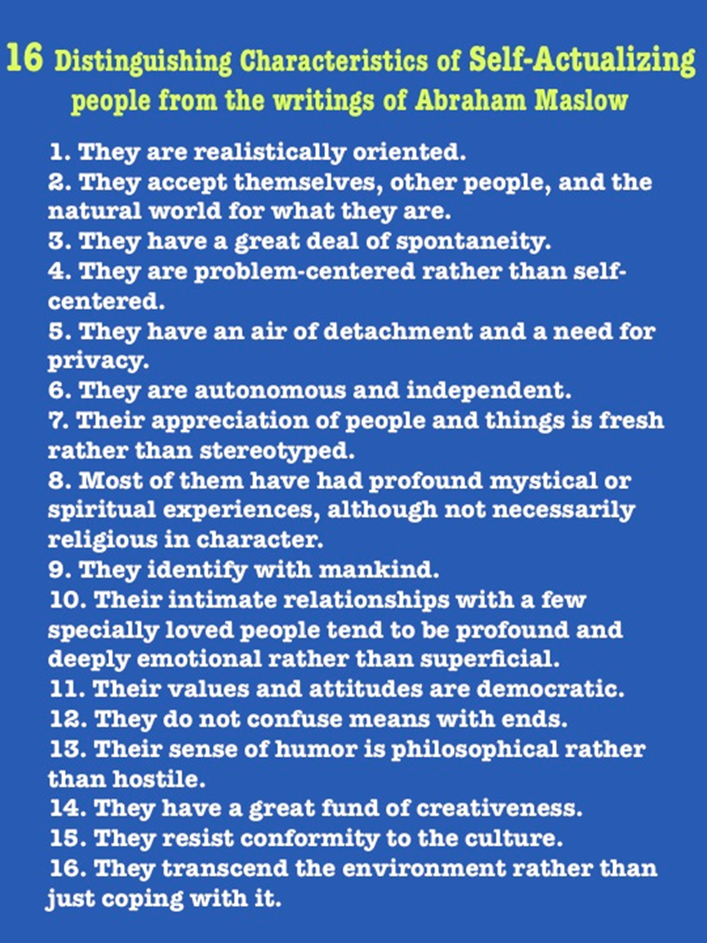
Are you self-actualized or do you possess some of the characteristics?

Slide 28
Evaluating Humanistic Theories
Praised for its positivity
Provide insights for personal growth and self-understanding, guiding practices in counseling, therapy, parenthood, education
Critiques
Naïve assumptions- overlooking the negative traits
Poor testability and inadequate evidence
Narrowness- describing not explaining

Slide 29
Social-cognitive theories
Chapter 13, Section 4, pages 438-441

Slide 30
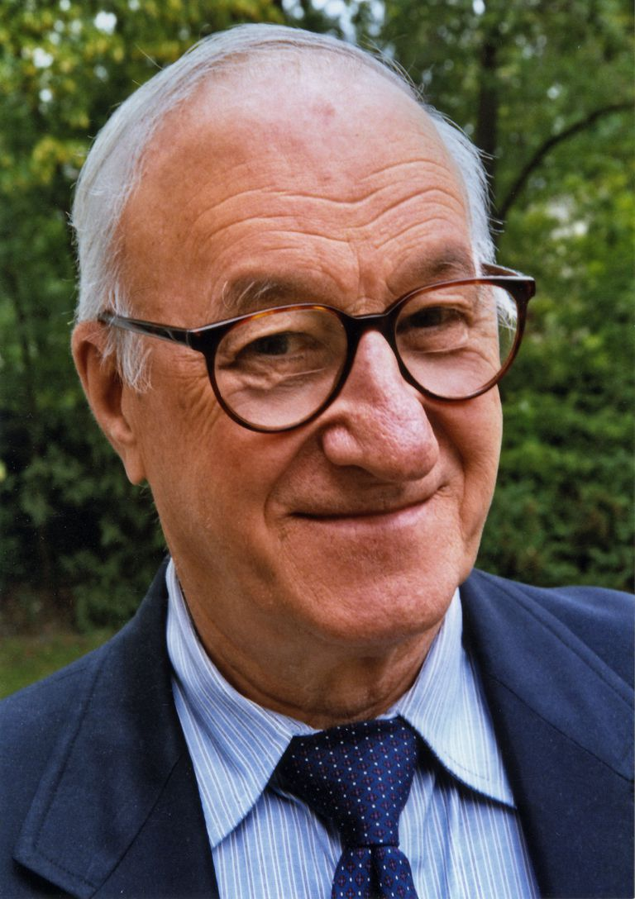
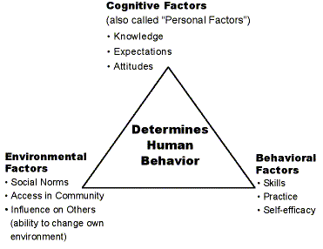
Albert Bandura’s Approach
Social-cognitive theories focus on the influence of our social interactions and our cognitions
Bandura focused on the concept of self-efficacy- a person’s learned expectation of success in a given situation, aka self-confidence
If you have a strong sense of self-efficacy, you believe you can generally succeed, regardless of past failures and this will affect the challenges you choose and effort you give
Self-efficacy is a learned expectation of success in a specific situation, but can be transferred to other situations with reminders of your skills and successes in similar situations
Personality is shaped by reciprocal determinism- internal personal factors, the environment, and the individual’s behavior all work as interacting (reciprocal) determinants of each other

Slide 31
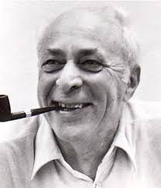
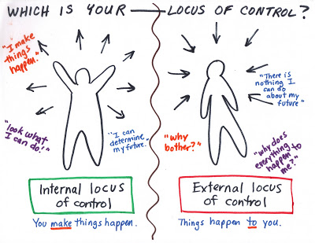
Julian Rotter’s Theory
Similar to Bandura, involving cognitive expectancies
Says the personality is determined by what you expect to happen following a specific action and the reinforcement value attached to a specific outcome
Focuses on internal vs. external locus of control- whether you think you can control the events in your life (internal) or if the environment has control on your life (external)

Slide 32
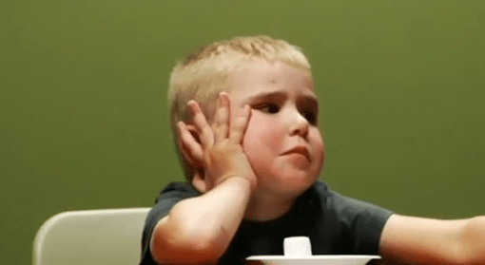
Evaluating Social-Cognitive Theories
Strengths
Testable hypotheses with empirical data
Emphasizes the role of cognitive processes
Shows link between behavior and real world situations
Self-efficacy and locus of control correlate with the Big Five which have research support
Critiques
Too much focus on situational influences
Fails to acknowledge stability of personality and other influences
Research- the Stanford Marshmallow Test
Studying delayed gratification (being able to put off a pleasurable experience in exchange for a larger but later reward)
If a child showed the ability to delay, they later showed higher SAT scores, lower levels of substance abuse, lower likelihood of obesity, better responses to stress, better academic and social skills
Shows the value of longitudinal research and making mindful choices
https://www.youtube.com/watch?v=QX_oy9614HQ

Slide 33
Biological theories
Chapter 13, Section 5, pages 442-443

Slide 34
Biological Contributors to Personality
Brain structures
fMRIs and other techniques show certain areas associated with impulsivity and decision making regarding risks
EEGs show left frontal lobes associated with extraversion and right frontal lobes associated with introversion
Hard to isolate relationships
Neurochemistry
High MAO (enzyme) is linked with sensation seeking (people who need higher physical arousal)
Dopamine linked with addictive traits, novelty seeking, and extraversion
Genetics
Behavioral genetics- the study of the relative effects of heredity and the environment on behavior and mental processes
We have found a niceness gene associated with prosocial behavior
Twin studies using the Big Five show that genetics is responsible for 40-50% of personality traits
Adoption studies also help show correlations

Slide 35
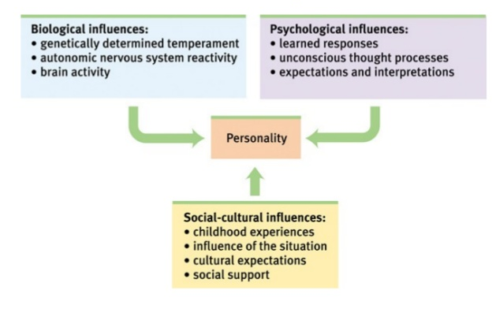
Evaluating Biological Theories
Have to be cautious saying one gene has an effect on specific trait, we do not want to generalize too quickly
Biopsychosocial approach still provides our best explanation for personality- combining biological, psychological, and social influences

Slide 36
Personality assessment
Chapter 13, Section 6, pages 444-449

Slide 37
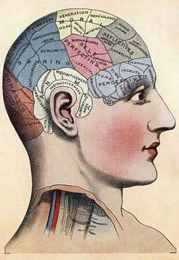
Personality Assessments: Pseudoscience and Interviews and Observations
There are a variety of pseudoscience assessments we have especially regarding personality
Horoscopes, fortune-tellers, tarot cards, phrenology (bumps on the head indicate personality)
These focus on generalized traits that applies to most people and are usually positive and flattering (or at least neutral)
Interviews and observations
May use structured (pursue information that comes up) or unstructured (to compare objectively)
Observing behavior- specific behaviors in situations
Social media can be used to predict traits
https://applymagicsauce.com/demo

Slide 38
Personality Assessments: Objective Tests
Aka inventories are most widely used because they can be administered widely to many people and data can be standardized
May measure one trait (like locus of control) or many (multiphasic)
Minnesota Multiphasic Personality Inventory (MMPI)- the most widely researched and clinically used self-report method of personality assessment;
Allows us to measure a range of personality traits
Originally designed to reveal abnormal personality traits and behaviors but can also be used for various screening purposes
Reveals habits, fears, delusions, sexual attitudes, and symptoms of psychological disorders by looking at patterns of scale scores
Paul Costa and Robert McCrae developed the NEO Personality Inventory- Revised which assesses the Big Five
They believe that personality is stable, universal, and has an effect on behavior

Slide 39
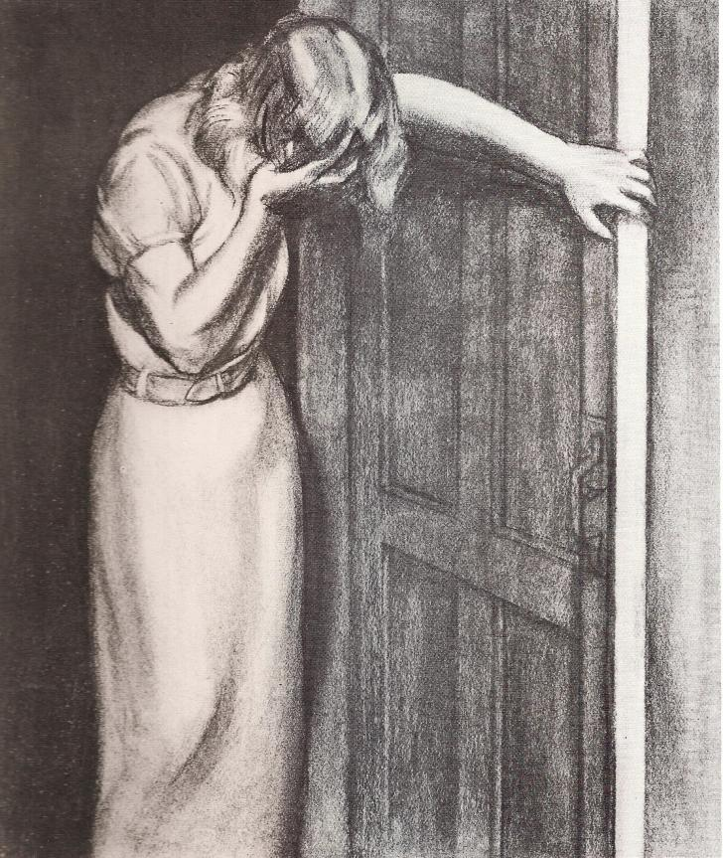
Personality Assessments: Projective Tests
Projective tests- uses a standardized set of ambiguous stimuli, such as inkblots or abstract drawings, which allow test takers to “project” their underlying motives, conflicts, and personality traits onto the test materials, potentially revealing their personality
Rorschach Inkblot Test- based on test takers’ projections onto 10 inkblots
Thematic Apperception Test (TAT)- based on the stories test takers make up about ambiguous scenes
Aptitude tests are used to measure your potential abilities while achievement tests measure what you already know/have learned

Slide 40
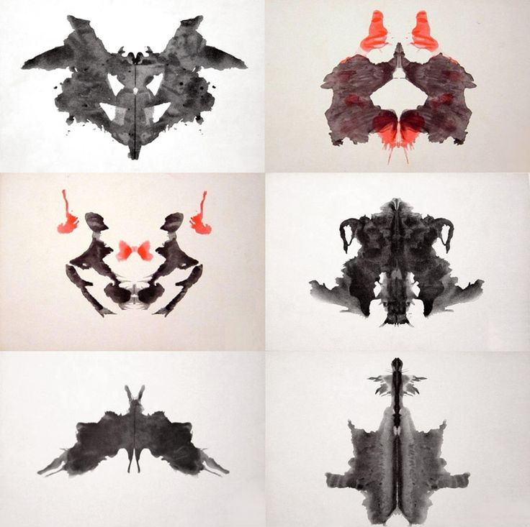

Slide 41
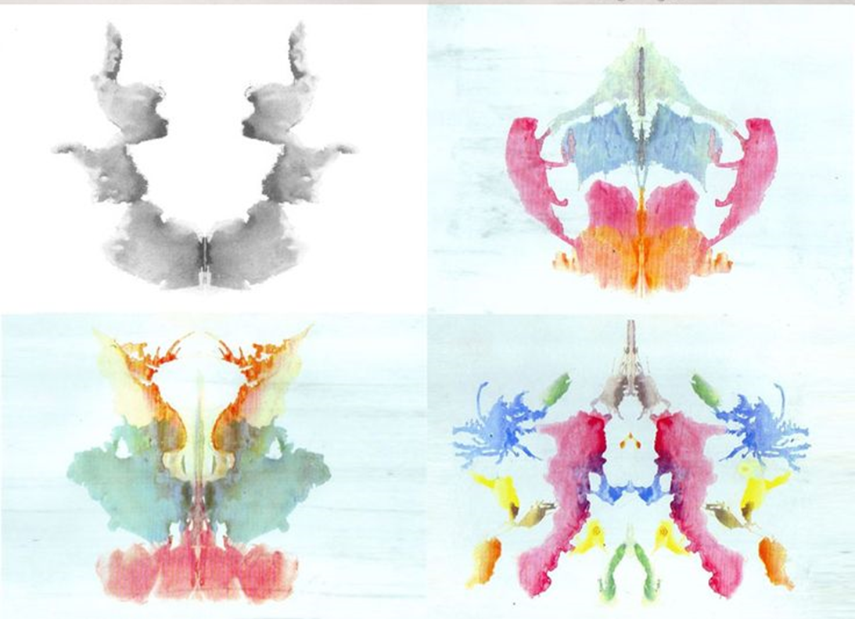

Slide 42
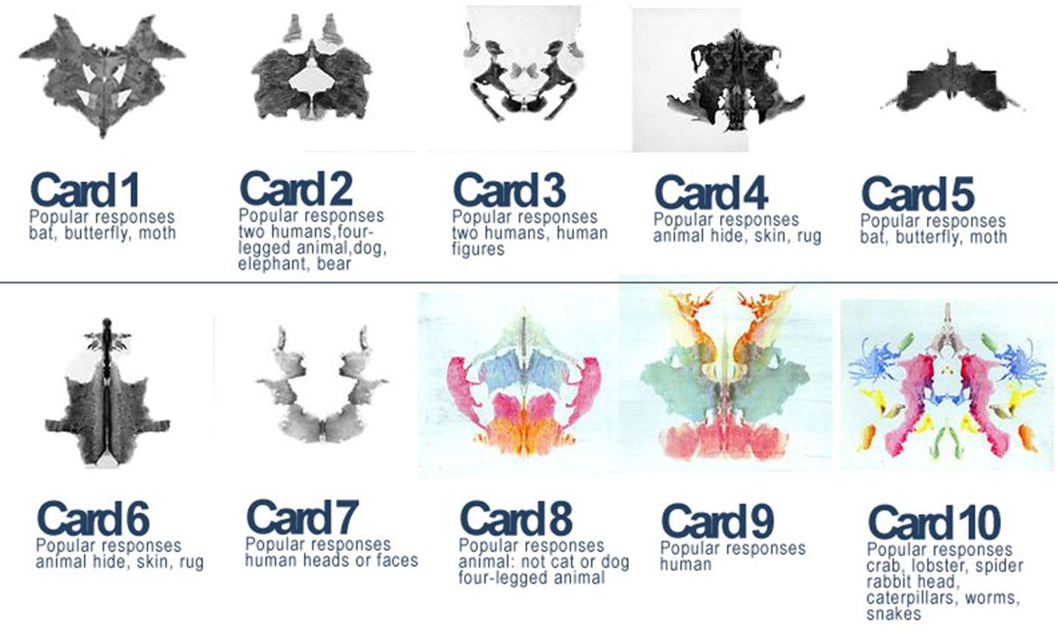

Slide 43
Evaluating Personality Assessments
Interviews and Observations- provide valuable insight but are time-consuming and expensive and researchers may disagree on their evaluations
Objective tests-
Main criticisms- problems with self-reports (validity scales used and may use others instead), diagnostic difficulties (overlapping items), cultural bias and inappropriate use (individualistic vs. collectivistic cultures show a different conclusion on common personality categories)
Projective tests- low reliability and validity
Pop-culture tests or pseudo-personality quizzes- Barnum effect, confirmation bias, self-serving bias

