Slide 1
Unit 4: Developmental Psychology
Chapter 9, 10, & 11.1 + 11.2

Slide 2
Life Span Development I
Chapter 9

Slide 3
Studying Development
Chapter 9, Section 1, pages 289-294

Slide 4
Developmental Psychology
Developmental psychology – studies age related changes in behavior and mental processes from conception to death
Stages of the lifespan
Stage | Approximate Age
Prenatal | Conception to birth
Infancy | Birth to 18 months
Early childhood | 18 months to 6 years
Middle childhood | 6-12 years
Adolescence | 12-20 years
Young adulthood | 20-45 years
Middle adulthood | 45-60 years
Later adulthood | 60 years to death

Slide 5
Theoretical Issues
Nature vs. nurture- what are we born with versus learn to develop?
Nature→ maturation has our development be triggered by automatic, genetically predetermined signals (internally programmed growth of a child)
Critical periods exist- a period of special sensitivity to specific types of learning that shapes the capacity for future development
Schedule remains the same but the age may differ
Nurture→ development occurs through experience and observation
We observed critical periods with the case study of Genie
https://www.youtube.com/watch?v=VjZolHCrC8E

Slide 6
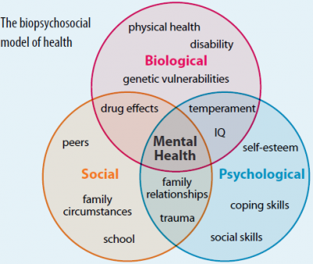
Theoretical Issues
Continuity vs. stages
Continuity- development is gradually occurring as we develop new abilities, skills, and knowledge
Stages- development occurs at different rates with periods of little change to periods of abrupt, rapid change
Stability vs. change
Do we maintain our personality from infant to adult (stability) or do we change?
On these issues- psychologists tend to conclude on a biopsychosocial view

Slide 7
How We Study Development
Cross-sectional- measures individuals of various ages at one point in time and gives information about age differences
May see cohort effects (the effect of growing up in different historical time periods)
Longitudinal- measures a single individual or group of individuals over an extended period and gives information about age changes
Often see dropouts
Both have issues with
generalizability

Slide 8
Gender and Cultural Diversity
Culture may be the most important determinant of development
E.g. Value of individualism
Human development cannot be studied outside its sociocultural context
We have to recognize the developmental niche
Each culture’s ethnotheories (explanations of the worlds) are important determinant of behavior
Culture is largely invisible to its participants

Slide 9
Physical Development
Chapter 9, Section 2, pages 295-305

Slide 10
Prenatal Physical Development
Conception- egg meets sperm to form zygote
Development of the baby occurs near to far (proximodistal) and head to tail (cephalocaudally)
Three stages
Germinal period- begins with conception and ends with implantation (becoming an embryo)
5-6 days= blastocyst (rapidly dividing ball of cells; inner group will become embryo, outer group will become cells to nourish and protect
Embryonic period- after uterine implantation through eight weeks with all major organ systems becoming differentiated (including hindbrain, midbrain, and forebrain)
Fetal period- eight weeks to birth with rapid weight gain and fine detailing

Slide 11
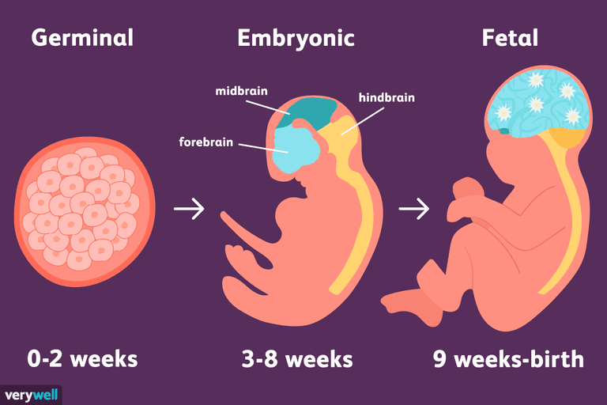
Prenatal Physical Development

Slide 12
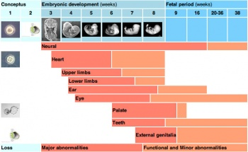
Hazards to Prenatal Development
Placenta provides a link for food and waste but also as a barrier to toxic substances
Teratogens- any environmental agent that causes damage during prenatal development
These include any consumed by the mother or potentially by anyone surrounding the mother
Malnutrition, stress, X-rays, legal and illegal drugs, diseases
Fetal alcohol syndrome (FAS)- combination of birth defects, including organ deformities and mental, motor, and/or growth delay, that results from maternal alcohol abuse

Slide 13
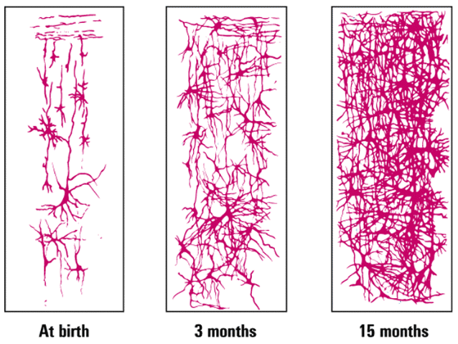
Early Childhood Physical Development
Brain- the brain begins as a neural tube, then develops rapidly
Neurons strengthen and connections become elaborate
Slows down in later childhood
At birth
3 months
15 months

Slide 14
Early Childhood Physical Development
The newborn is born with certain automatic movement patterns/specific responses that are triggered by specific stimuli- these are called reflexes and are an infant’s first motor movements
Some of these reflexes, such as rooting and sucking, appear to have survival implications
Other reflexes appear to be precursors for later voluntary motor behavior
The newborn’s reflexes may also reflect the health of the child’s nervous system, used by pediatricians

Slide 15
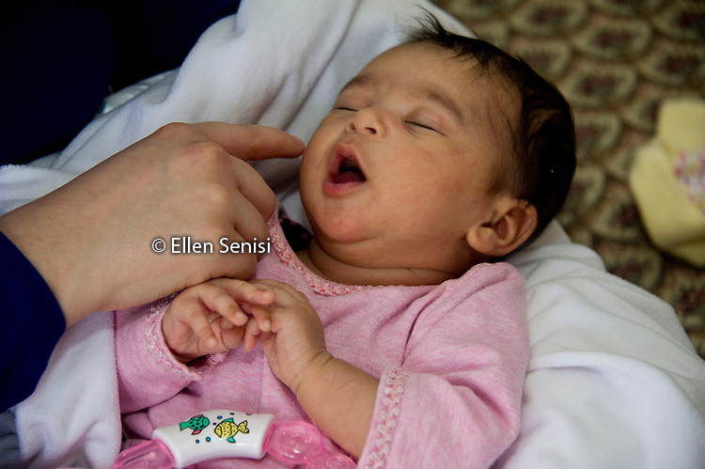
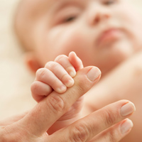
Infant Reflexes
Rooting- turning the head and opening the mouth in the direction of a touch on the cheek
Sucking- sucking rhythmically in response to oral stimulation
Grasping- curling the fingers around an object

Slide 16
Early Childhood Physical Development
Growth is more rapid in infancy than during any other period after birth
Infants double their weight by three months
Infants triple their weight by 1 year
Average is not the same as normal
Infant also shows some voluntary control over bodily parts, from maturation or environmental influences

Slide 17
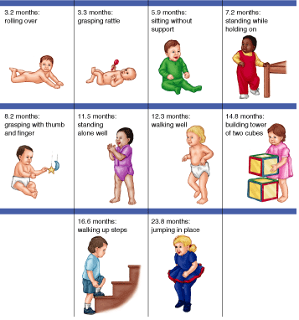
Milestones of Motor Development

Slide 18
Sensory and Perceptual Development
Good senses
Can smell most odors and taste most flavors, show preference for mother’s milk
Strong sense of touch and pain
Vision is poor (20/200 to 20/600) until about 2 years old
Hearing is well developed at birth and some evidence in the last few months in the womb, like their mother’s voice

Slide 19
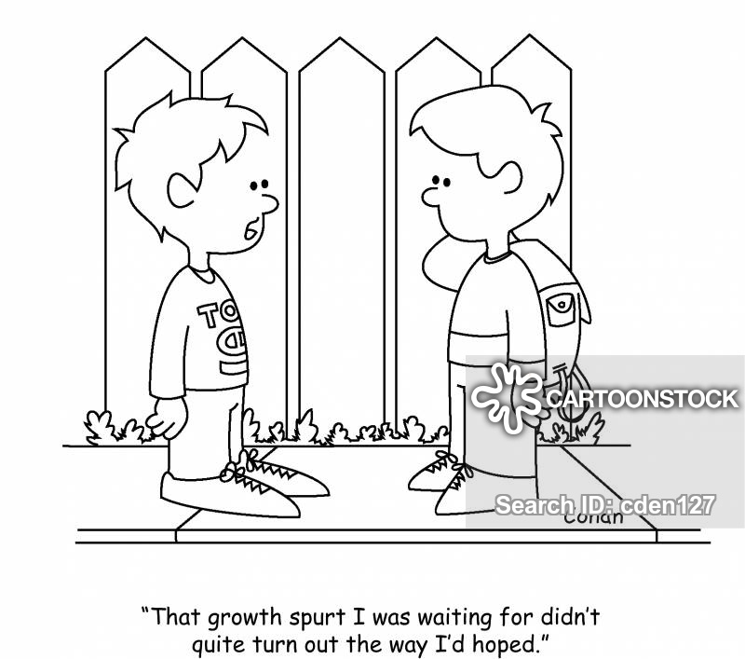
Adolescence
Puberty- biological changes during adolescence that leads to an adult-sized
body and sexual maturity
Growth spurt marks puberty
Triggered by chemicals released during deep sleep
Females- Gain fat tissue; first menstrual period; breast, pubic hair, and hip development
Males- Broad shoulders, thicker trunk, pubic and body hair, more muscle, deep voice
Everyone grows at individual rates

Slide 20
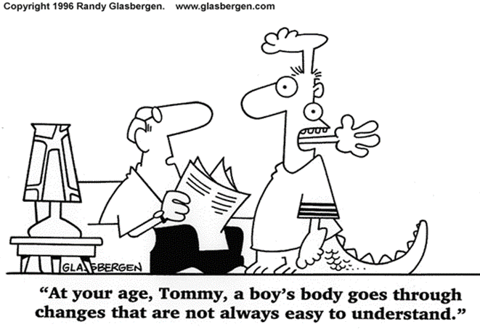
Adolescence
Asynchrony- condition during adolescence in which the growth or maturation of bodily parts is uneven
Reactions- vary based on societal standards; can become very self-conscious; long-term effects on personality
Adolescence is a loose psychological term
Synaptic pruning increases to make brain functioning more efficient
Maturity of the frontal lobes does not finish until mid-20s
Growth in the temporal and parietal lobes

Slide 21
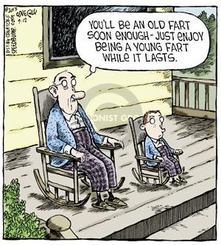
Emerging/Young Adulthood
Characterized by the search for a stable job, self-sufficiency, and/or marriage and parenthood
Distinguishing features
Identity exploration
Instability
Self-focus
Feeling in-between
Age of possibilities

Slide 22
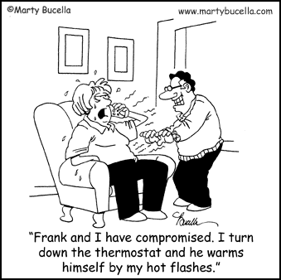
Middle Adulthood
Most physical changes aren’t noticed until late 30s, such as difficulty seeing at night, thin/gray hair, wrinkles, shrinking, weight gain
Menopause- biological event of natural cessation of menstruation and a woman’s production of estrogen is sharply reduced, causing some physical changes
Negative effects may be exaggerated by negative expectations; uncertainty of what to expect is common
Men have no equivalent but may experience decline and signs of aging such as weight gain, loss of muscle strength, gray/less hair, depression

Slide 23
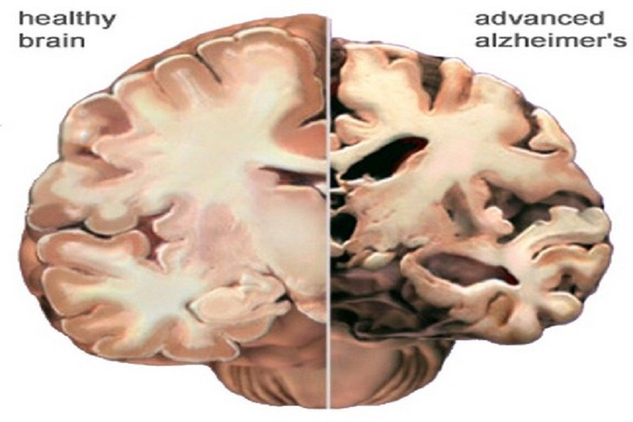
Late Adulthood
Most physical changes are gradual and occur in heart and arteries and sensory receptors
The acuity of senses declines
Decline in cardiac output, visual and hearing acuity, depth perception, smell sensitivity, cognitive and memory skills
Depictions of these years had led to ageism- prejudice or discrimination based on physical age
Forgetfulness in old age does not mean dementia, or Alzheimer’s, although age does seem to slow down speed of information processing
More recent focus has shifted to a
productive depiction of later years

Slide 24
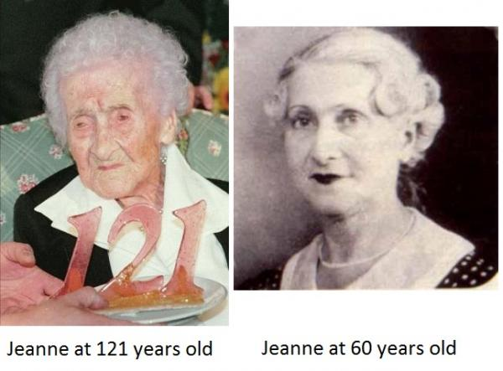
Aging and Death
Cellular clock theory- aging is genetic, cells eventually reach its limit and stop dividing
Hayflick limit- maximum life span currently around 110-120 years
Wear-and-tear theory- damage to cells and organs cause death
Oldest person ever- Jeanne Calment at 122 years, 167 days, 1875-1997

Slide 25
Cognitive Development
Chapter 9, Section 3, pages 306-313

Slide 26
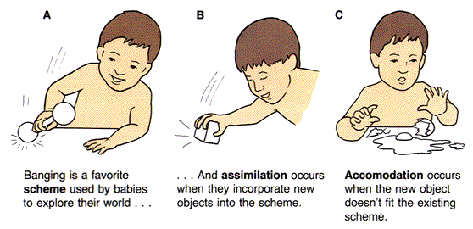
Ways of Organizing the World
Schemas- cognitive structures or patterns consisting of a number of organized ideas that grow and differentiate with experience
Assimilation- absorbing new information into existing schemas
Accommodation- adjusting old schemas or developing new ones to better fit with new information

Slide 27
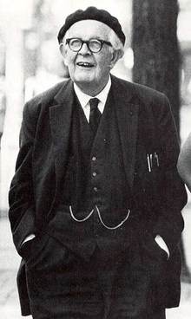
Jean Piaget: Stages of Cognitive Development: Birth to Adolescence
Sensorimotor stage- (birth to about 2 years)- in which schemas are developed through sensory and motor activities
No object permanence
Preoperational stage- (2 – 7 years)- characterized by the ability to employ significant language and to think symbolically, but the child lacks operations (reversible mental processes), and thinking is egocentric and animistic
Concepts are not operational/reversible, thinking is egocentric and animistic
Concrete operational stage- (7 – 11 years)- the child can perform mental operations on concrete objects and understand reversibility and conservation, but abstract thinking is not yet present
Formal operational stage- (11 years and beyond)- characterized by abstract and hypothetical thinking

Slide 28
Piaget Concepts
Abstract or hypothetical thought- a level of thinking about things that is removed from the facts of “here and now” and from specific examples of the things or concepts being thought about
*Accommodation- cognitive process of revising existing cognitive schemas, perceptions, and understanding so that new information can be incorporated
*Animism- the belief that all things are living (or animated)
*Assimilation- cognitive process of fitting new information into existing cognitive schemas, perceptions, and understanding
Centration- the tendency to focus on one salient aspect of a situation and neglect other, possibly relevant, aspects
*Conservation- understanding that certain physical characteristics (such as liquid volume) remain unchanged, even when their outward appearance changes
*Egocentrism- the inability to consider another’s point of view
Hierarchical classification- the ability to simultaneously sort things into general and more specific groups, using different types of comparisons
Irreversibility- a child falsely believes that actions cannot be reversed or undone
*Object permanence- an infant’s understanding that objects (or people) continue to exist even when they cannot be seen, heard, or touched directly
Pretend play- a taking on of a role other than oneself to act out a scene

Slide 29
Videos for Piaget Stages
If you do a search on YouTube for "Piaget", the result will include hundreds of clips. Below are four short clips for each of Piaget's stages of cognitive development. Piaget - Stage 1 - Sensorimotor, Object Permanence (1:03) http://www.youtube.com/watch?v=ue8y-JVhjS0&feature=related Piaget - Stage 2 - Preoperational, Lack of Conservation (2:16) http://www.youtube.com/watch?v=GLj0IZFLKvg&feature=related Piaget - Stage 3 - Concrete - Reversibility (0:56) http://www.youtube.com/watch?v=gA04ew6Oi9M&feature=related Piaget - Stage 4 - Formal - Deductive Reasoning (0:58) http://www.youtube.com/watch?v=zjJdcXA1KH8&feature=related

Slide 30
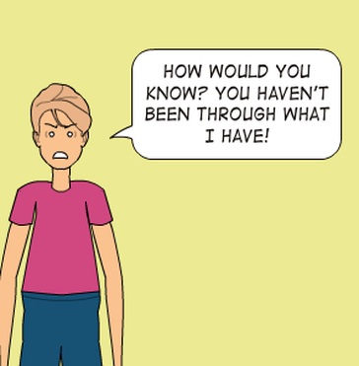
Problems with Early Formal Operational Thinking (In Adolescents)
Adolescent egocentrism is different than a child’s but may affect social interactions and problem solving
Personal fable- adolescents may conclude they are alone in having certain insights or difficulties and no one else could understand or sympathize
May induce risk taking
Imaginary audience- adolescent’s belief that they are the center of others’ thoughts and attentions

Slide 31
Criticisms of Piaget
Studies have shown that certain stages may underestimate abilities of children
Infants have shown abilities beyond Piaget, including empathy
Children have shown nonegocentric responses earlier than Piaget indicates
The stages do not take into account significant genetic and cultural differences

Slide 32
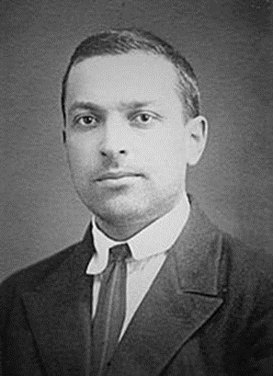
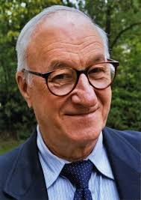
Criticisms of Piaget
Lev Vygotsky offers an alternative- social and cultural environments play a more influential role
Zone of proximal development (ZPD)- difference between what children can accomplish on their own and what they can accomplish with the help of others who are more competent
Theory of mind (ToM)- the understanding that other people don’t have the same thoughts and feelings that we do, which generally develops during early childhood
Explains Piaget’s egocentrism
Albert Bandura also believed that behavior is learned through the environment through observational learning
Notes:
Crash Course: https://www.youtube.com/watch?v=8nz2dtv--ok&list=PLFpBW2qnrJYocpUNIDLzRvxwGciuQBj30&index=1

Slide 33
Social-Emotional Development
Chapter 9, Section 4, pages 314-319

Slide 34
Attachment
Attachment- strong affectional bond with special others that endures over time
Arguments of nurturing with environment versus nature
Harry Harlow studied this with baby monkeys (contact comfort)
Imprinting- innate form of learning within a critical period that involves attachment to the first large moving object seen
Konrad Lorenz studied this with baby geese
Supports nature for attachment bonding
Cases where a person does not form any attachment show severe negative outcomes for the individual
Harlow’s
monkeys
Lorenz’s imprinted geese
Notes:
Harlow’s Monkey: https://www.youtube.com/watch?v=OrNBEhzjg8I

Slide 35
Strange Situation
Mary Ainsworth studied attachment styles through an experiment using the Strange Situation Classification she created
The experiment used eight stages
(1) Mother, baby, and experimenter (lasts less than one minute).
(2) Mother and baby alone.
(3) A stranger joins the mother and infant.
(4) Mother leaves baby and stranger alone.
(5) Mother returns and stranger leaves.
(6) Mother leaves; infant left completely alone.
(7) Stranger returns.
(8) Mother returns and stranger leaves.
Then scored children on four interaction behaviors
Proximity and contacting seeking
Contact maintaining
Avoidance of proximity and contact
Resistance to contact and comforting
She identified four styles of attachment:
Secure
Insecure avoidant
Insecure ambivalent/resistant
Disorganized (later identified)

Slide 36
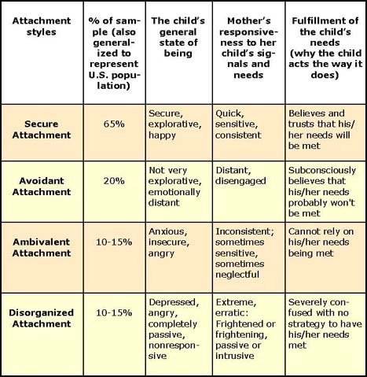
Ainsworth’s Attachment Styles

Slide 37
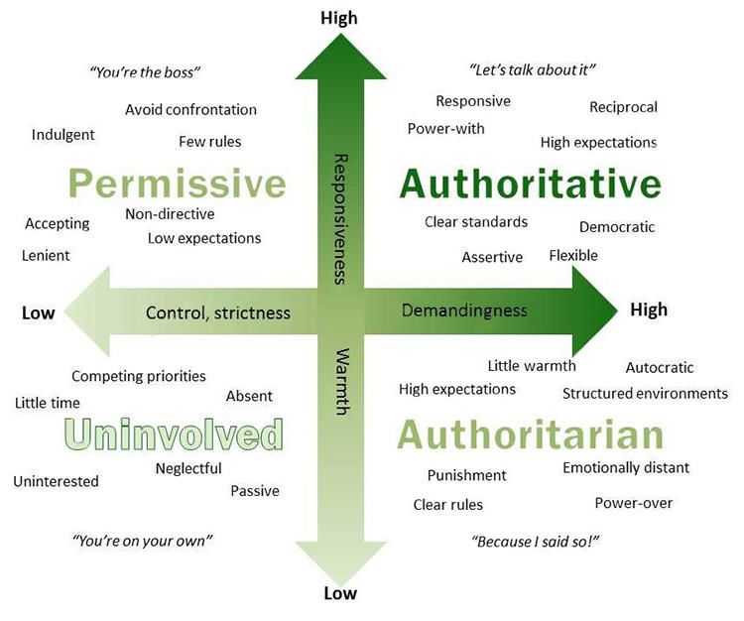
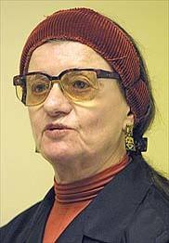
Parenting Styles
Diana Baumrind identified four parenting styles based on control/demandingness and warmth/responsiveness

Slide 38
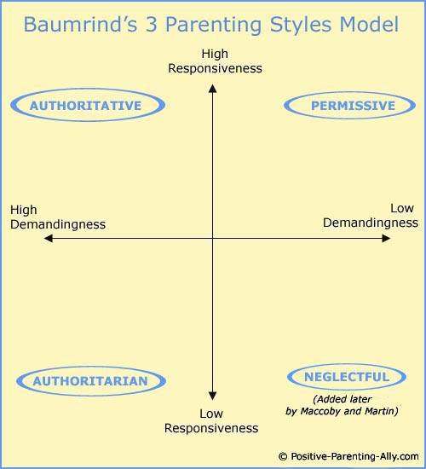
Baumrind’s Parenting Styles
Permissive neglectful- low on control and warmth
Often completely uninvolved
Children have poor social skills and self-control
Permissive indulgent- low on control, high warmth
Most tolerant, least likely to use discipline, children have the final say
Children fail to learn respect, maturity, and control
Authoritarian- high control, low warmth
Value obedience and use a high degree of power assertion
Children are easily upset and have poor communication skills
Authoritative- high control, high warmth
Children participate in decisions affecting their lives; parents set rules but are comforting
Children are best adjusted and self-reliant

Slide 39
Criticisms of Baumrind
Child temperament- the child’s natural predisposition to behave and react may cause a parenting style to develop
Child expectations- how a child expects a parent to act may influence how the child receives it
Parental warmth- many cultures have issues if parent rejects child
Limited attention to father’s role in parenting- consistent parenting with the same styles to be effective
Children develop attachments to any parent/guardian
Attachment styles in infancy can correlate to styles for romantic relationships; but they cannot predict adult attachments

Slide 40
Understanding the Essential Bond
When a baby is born it has certain needs.
Rank each item according to its importance to a baby’s health and well being.
Clothing
Food
Security blanket or stuffed animal
Being held by a parent or caregiver
Stimulation from toys or television
Sleep
https://www.youtube.com/watch?v=kwxjfuPlArY

Slide 41
Understanding the Essential Bond
What was the theory proposed by John Bowlby in regards to a child’s development?
In tests, scientists observed a child’s response to a parent leaving the room. How did an insecurely attached child react when the parent left the room? A securely attached child?
In terms of health, what psychological and biological ailments might people with adverse childhood experiences be susceptible to?
What is cortisol and what does it do?
How are low levels of security attachment and cortisol linked?
An early intervention program at the Center for Babies, Toddlers, and Families is building stronger attachments between struggling parents and children. How does the program measure and determine whether their intervention is successful?
After watching the video, would you change your ranking of the importance of an infant’s needs? Why or why not?

Slide 42
Moral Development
Chapter 10, Section 1, pages 324-328

Slide 43
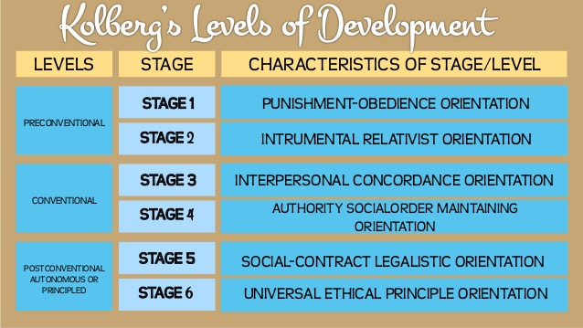
Lawrence Kohlberg’s Research
Morality- the ability to take the perspective of, or empathize with, others and to distinguish right from wrong
Researched extensively by Lawrence Kohlberg
Used Heinz’s dilemma and participant responses to develop universal and invariable stages

Slide 45
Kohlberg’s Stages: Preconventional
Preconventional: (birth to adolescence) self-centered; rewards/punishments
Stage 1 (punishment-obedience orientation)- self-interest focus to obey authority and avoid punishment; unable to take other views
Stage 2 (instrumental-exchange orientation)- can take other perspectives; based on reciprocity (exchanging of favors)

Slide 46
Kohlberg’s Stages: Conventional
Conventional: (adolescence and young adulthood) other-centered; focused on societal rules
Stage 3 (good-child orientation)- obeying rules to get approval; judging others based on their intention
Stage 4 (law-and-order orientation)- belief in doing the duty of obeying laws to keep order within society
Kohlberg believed this was the highest level most adults and adolescents reached

Slide 47
Kohlberg’s Stages: Postconventional
Postconventional: (adulthood) based on personal standards for right and wrong, abstract principles are considered
Stage 5 (social-contract orientation)- laws can be disobeyed if the majority disagree or they do not benefit most of society
Stage 6 (universal-ethics orientation)- what is right is determined by universal ethical principles (like nonviolence, human dignity, freedom) that all would view as fair whether or not they are reflected by the law

Slide 48
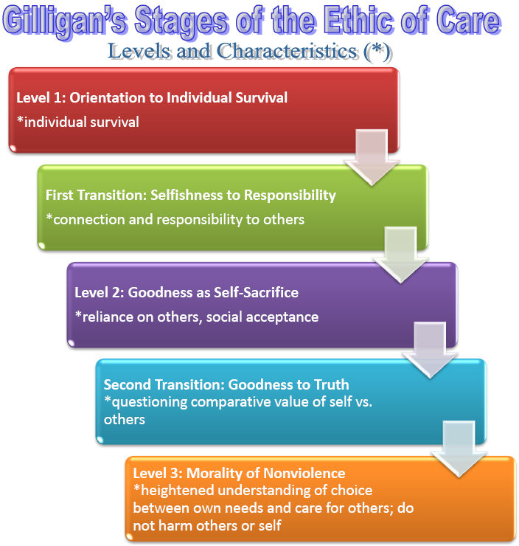
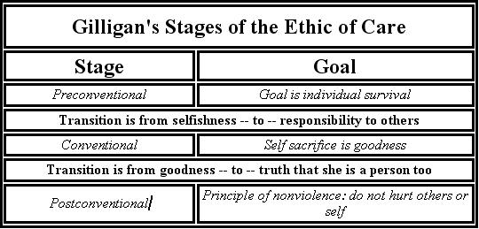
Criticisms of Kohlberg: Carol Gilligan
Moral reasoning versus behavior- situational factors may reflect different moral stages than hypothetical reasoning
Cultural differences- different cultures value social responsibilities differently, etc. leading to different responses
Possible gender bias- Carol Gilligan said his stages valued rationality/independence (traditionally male traits)
New research has mostly disregarded this
https://www.youtube.com/watch?v=U-WbYOO8nUQ
Notes:
Crash Course: https://www.youtube.com/watch?v=YcQg1EshfIE&list=PLFpBW2qnrJYocpUNIDLzRvxwGciuQBj30&index=2

Slide 49
Personality Development
Chapter 10, Section 2, pages 328-331

Slide 50
Temperament Theory
Studied by Thomas and Chess
Temperament- an individual’s innate behavioral style and characteristic emotional response
Three temperaments
Easy children- happy, easily adjustable
Difficult children- moody, easily frustrated
Slow-to-warm-up children- mild responses, shy, needs time to adjust
These may correspond with adult temperaments
Goodness of fit between a child’s nature, parental behaviors, and social/environmental setting influences personality development

Slide 51
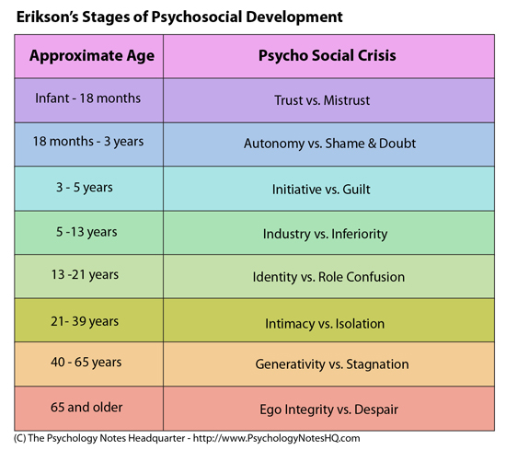
Erik Erikson’s Psychosocial Theory
Psychosocial stages- individuals pass through eight developmental stages, each involving a crisis that must be successfully resolved
Successful resolution of each crisis leads to a better chance of a healthy, happy life
Criticisms
Hard to scientifically test
The crises and the preferred resolution may be not appropriate across cultures

Slide 52
Erikson’s Eight Stages of Psychosocial Development
Stage 1: trust vs. mistrust (birth – age 1): learning to trust their needs will be met by the mother
Stage 2: autonomy vs. shame and doubt (ages 1 – 3): learning to exercise will, make choices, and control themselves
Stage 3: initiative vs. guilt (ages 3-6): learning to initiate activities and enjoy their accomplishments
Stage 4: industry vs. inferiority (ages 6-12): learning a sense of industry (production) and productive skills relevant to their culture

Slide 53
Erikson’s Eight Stages of Psychosocial Development
Stage 5: identity vs. role confusion (adolescence): developing a coherent sense of self and their role in society during an identity crisis
Stage 6: intimacy vs. isolation (early adulthood): forming intimate connection with others
Stage 7: generativity vs. stagnation (middle adulthood): developing a concern for establishing and influencing the next generation (generativity) vs. a concern with self and material possessions (stagnation)
Stage 8: ego integrity vs. despair (late adulthood): a period of reflection to find a sense of accomplishment and satisfaction with the lives they’ve lived

Slide 55
Gender and Cultural Diversity in Personality Development
The study of developmental psychology deals with studying the “self” but “self” is different depending on your culture
Individualistic cultures- needs and goals of the individual are emphasized over the needs and goals of the group
Emphasis on separateness, independence, individualism
Collectivistic cultures- needs and goals of the group are emphasized over the needs and goals of the individual
Emphasis on relatedness, connectedness, interdependence
70% of the world’s population

Slide 56
Cultural Influences
Notes:
Crash Course: https://www.youtube.com/watch?v=PzyXGUCngoU&list=PLFpBW2qnrJYocpUNIDLzRvxwGciuQBj30&index=3

Slide 57
HOMEWORK DUE FRIDAY
Ask 4 other people (not in this class) the three words or terms that come to mind when they hear “old person.”
Record their responses and the age of the person you asked.

Slide 58
Neurodevelopmental Disorders
Chapter 10, Section 3, pages 331-334

Slide 59
Neurodevelopmental Disorders
Neurodevelopmental disorders- a group of disorders that usually begin in early life, causing problems with communication, cognitive abilities, social relationships, and/or behavior
Usually begin in childhood
As a result of abnormal brain development

Slide 60
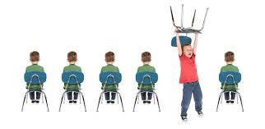
Attention-Deficit/Hyperactivity Disorder (ADHD)
Attention-deficit/hyperactivity disorder (ADHD)- a common developmental disorder characterized by a pattern of inattention and/or hyperactivity-impulsivity
5% of children, with twice as many boys
Caused by biological and psychosocial factors
Mostly neurological and genetic factors
Correlated to not getting enough high-quality sleep
Difficulties caused by ADHD
Hyperactivity- difficulty in school (sitting, directions), friends- following rules, patience
Inattention- school (turning in work), daydreaming, lost items
Some symptoms may decline (often hyperactivity)
Women are more likely to experience inattentive symptoms, men are more likely to experience impulsivity symptoms
Can cause difficulty in other areas- self-esteem, relationships, anxiety, depression, substance abuse

Slide 61
Attention-Deficit/Hyperactivity Disorder (ADHD)
Diagnosis- trying to standardize and control increasing numbers
Potentially being over-diagnosed (better control needed in early care, less time outdoor/exercise, increased pressure in school)
May be misdiagnosed- confused with other disorders, labeling normal behavior as pathological, medicine campaigning
Treated with a stimulant medication
Side effects may be difficult
Concern over increased recreational use of ADHD drugs- increased risk taking and sleep disruptions
Behavioral interventions are also helpful- clear steps, immediate feedback, warning before transitioning
Notes:
Why stimulants help add: https://www.youtube.com/watch?v=yoX0vEDn5a4
Where are all the women with adhd: https://www.youtube.com/watch?v=UBVC4DnxJyw
Overlooked connection between sleep and adhd: https://www.youtube.com/watch?v=7Eb-0VYN0k8
Is youtube giving us all adhd: https://www.youtube.com/watch?v=Pmu2OMgMiW4

Slide 62
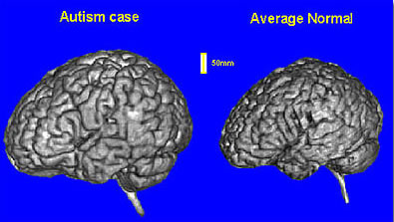
Autism Spectrum Disorder (ASD)
Autism spectrum disorder (ASD)- a developmental disorder that begins in early childhood and involves problems with social communication and social interaction, as well as restricted repetitive patterns of behavior, interests, or activities
Increased rates of diagnosis
Causes- complex but strongly biological factors
High heritability, abnormal infant brain development (especially of frontal lobes)
Lack of theory of mind
Not vaccines

Slide 63
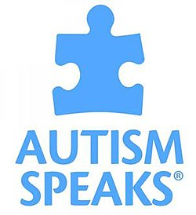
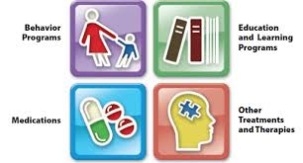
Autism Spectrum Disorder (ASD)
Recent change to DSM to recognize a range of symptoms
Symptoms: social/communicative and behavioral, all begin early
Social/communicative- difficulty with verbal/nonverbal communication, inappropriate responses, misinterpret emotional or abstract content
Behavioral- preference for routine, intense/restricted interests, possibly self-injury
Treatment- increasing effective communication, learning social skills, decreasing problematic behaviors
Often use operant conditioning
May need speech and/or occupational therapy
Notes:
A.I. links autism and genes: https://www.youtube.com/watch?v=YwlLRsInb0A
Unexpected link between estrogen and autism: https://www.youtube.com/watch?v=MQQwhnCVkXY

Slide 64
Meeting the Challenges of Adulthood and Grief and Death
Chapter 10, Section 4, pages 335-346

Slide 65
Committed Relationships
Marital satisfaction→ greater life satisfaction, lower stress, less depression, lower waking blood pressure
Divorces
If unhealthy→ emotional and practical difficulties, high risk for depression and physical health problems
If healthy → life enhancing if they let go, develop new social ties, redefine parental roles
Children in divorce-
Debate on the effects
Potential for negative effects like social and behavioral problems
Also potential for positive effect of a happier home life
Depends on child’s personality/individual attributes, attachment, qualities of custodial parents, continued involvement with noncustodial parents, resources/support systems, relationships between divorced parents
Important to keep marital expectations realistic
Keep in mind we are not a TV show, affairs are not the only things that cause divorces, etc.

Slide 66
Secrets to Enduring Love
Enhance your “love maps”
Nurture your fondness and admiration
Turn toward each other instead of away
Let your partner influence you
Solve your solvable problems
Overcome gridlock
Create shared meaning
Recommended from longitudinal research by John Gottman

Slide 67
The Challenges of Family Life
Family Violence
Can occur in any family, but we see it often in families experiencing marital conflict, substance abuse, mental disorders, and economic stress
One of our clearest identifiers of abuse potential is for individuals with high impulsivity and/or who are socially isolated
Biological factors: amygdala, prefrontal cortex, hypothalamus; low levels of serotonin and GABA
Treatment may mean drugs or family therapy
Treatment
Primary programs- identify vulnerable families, teach coping skills, publicize signs of abuse and encourage reports
Secondary programs- rehabilitate families after abuse has occurred

Slide 68
The Challenges of Family Life
Teen Pregnancy and Parenthood
Despite declining rates, the rate of single parents has increased
Single parents are at greater risk of poverty
Teen pregnancy brings higher health risks, lower educational achievement, higher depression risk for mother
Treatment
Comprehensive education and health-oriented services- greater age of onset for sexual activity, increased contraception use, reduced frequency of sex, reduced pregnancy rate
Programs focused on enhanced social development to show life options and hope
Many programs focus on economics and its affect on teen pregnancies, but we also need to consider psychological consequences

Slide 69
Resiliency
Resiliency- refers to ability to adapt effectively in the face of threats
Traits of the resilient child and its environment
Good intellectual functioning
Relationships with caring adults
Ability to regulate their attention, emotions, and behavior

Slide 70
Positive Careers and Rewarding Retirements
There are changing trends on what people look for in careers (money, service, etc.) versus the risk associated with these wants
Currently more than 200,000 job categories
Refer to the career center or vocational interest tests

Slide 71
Positive Careers and Rewarding Retirements
Life satisfaction mostly tied to good health, control over one’s life, social support, adequate income, social participation
Activity theory of aging- successful aging is fostered by a full and active commitment to life
Disengagement theory of aging- successful aging is characterized by mutual withdrawal between the elderly and society (mostly abandoned theory)
Socioemotional selectivity theory- a natural decline in social contact occurs as older adults become more selective with their time

Slide 72
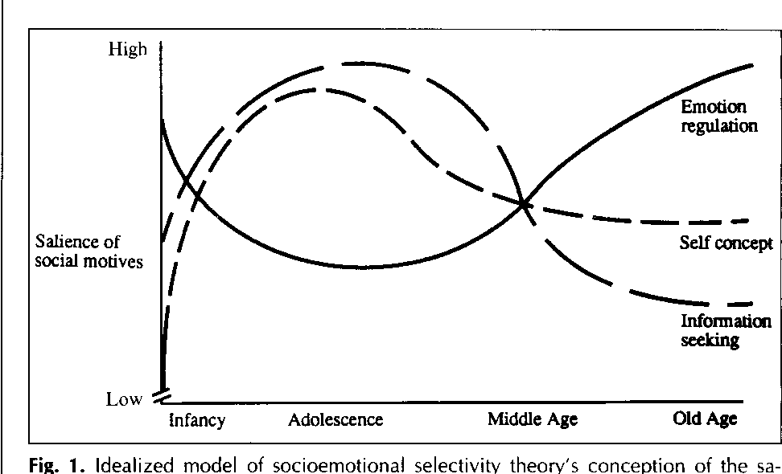
Aging Positively
Older people report increased happiness and well-being
Stronger relationships, value time more than money, more selective with time and friendships
Age-related positivity effect- the preference in older adults for positive over negative information and events in attention and memory
May increase immune functioning and overall well-being after charitable giving
Younger people show opposite approach
Brain research indicates that older people process positive emotions differently into the hippocampus
Gratitude exercises may be a way to increase positivity at a younger age
Enhances well-being, happiness, life satisfaction, interpersonal relationships, physical health

Slide 73
Aging Myths
The midlife crisis- popularized from Levinson, Sheehy, and Gould
A crisis at 35 for women, 40 for men
Often a time of reexamining one’s values and goals
Research says severe crisis may be rare
Empty nest syndrome- a painful separation and time of depression for mother, father, or both parents
Research says this may be an exaggeration of the pain experienced by a few people
Societal and cultural norms and quality of family relationships plays a role in perceptions
Parents may see decrease in conflicts and increase in marital satisfaction
Parent-child relationships continue once the child leaves home

Slide 74
Gender and Culture with Ageism
The stress of aging is less for people in societies who value older people as wise elders or keepers of valued traditions
Cultures that become more westernized show a decline in respect for the elderly
In the US, elderly men show higher social status and income, elderly women show more friends and family relationships
Ethnic minority elderly face ageism and racism, but also show stronger rates of community

Slide 75
Lessons in Survival
Distress and pain from these situations may be survival techniques passed down to bring help and support to those in pain
There is no right way to grieve- keep this in mind if supporting someone who is grieving or if you are grieving
Generally, we follow a grieving process
Shock and numbness
Yearning; searching; feelings of guilt, anger, resentment
Disorganization/despair
Resolution/reorganization/recovery
Dealing with your own grief
Recognize the loss and allow yourself to grieve
Expect the unexpected
Take care of yourself
Set up a daily activity schedule
Seek help

Slide 76
Cultural and Age Variations of Attitudes Toward Death and Dying
Depending on the culture, there may be joyful wakes, lack of emotional response on the outside, etc.
Adults understand death as permanent, universal, non-functional
Children usually understand this by age 7
Generally, our culture avoids death, leaving it to the experts
We are working on this with right-to-die and death-with-dignity advocates

Slide 77
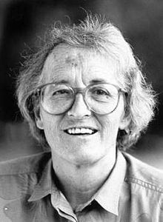
Kübler-Ross and Facing Death
Thanatology- the study of death and dying
Kübler-Ross said there are five stages a person goes through when facing death
5 Stages of Dying/Grief:
Denial
Anger/Why me?
Bargaining
Depression
Acceptance
Not universally demonstrated; may be different order or repeat stages, hard to scientifically test
Maybe should be seen as potential reactions or as a style of dealing with death
https://www.youtube.com/watch?v=G_Z3lmidmrY

Slide 78
HOMEWORK DUE MONDAY
Ask 4 other people (not in this class) the three words or terms that come to mind when they hear “old person.”
Record their responses and the age of the person you asked.

Slide 79
Sex and Gender
Chapter 11, Section 1-2, pages 352-363

Slide 80
Studying Human Sexuality
Sexuality- the ways in which we experience and express ourselves as sexual beings; includes sexual arousal, orientation, and behavior
Early 19th century- avoided mentioning anything covered by clothing
Led to medical experts doing incomplete examinations, recommending foods to discourage sexual behavior, spreading false information regarding the effects of certain behaviors
Modern research
Pioneered by Havelock Ellis
Alfred Kinsey and colleagues conducted first major survey/interview (despite some ethical concerns)
Continued research includes surveys, interviews, case studies, biological methods, lab experimentation, observational methods
First lab experimentation and observation conducted by William Masters and Virginia Johnson
Cross-cultural studies show cultural differences in attitudes about sexuality and help counteract ethnocentrism

Slide 81
Gender
Sex- (physical) the state of being biologically male or female; also, activities related to sexual behaviors
Gender- (mental) psychological and sociocultural traits typically associated with one sex
Formed within first few years of life
Gender role- the culturally and socially defined prescriptions and expectations about the thoughts, feelings, and actions of men and women
Children become aware of this by age 2
This influences people throughout their lives
Gender stereotypes- gender role prescriptions and beliefs that are overly generalized and applied to all men and women

Slide 82
Gender Role Development
Social learning theory of gender role development- gender roles are acquired through rewards, punishments, observation, and imitation
Cognitive-developmental theory- gender roles are acquired through social learning and active cognitive processing
Children are actively observing, interpreting, and judging the world around them
Gender schemas→ gender typed behaviors

Slide 83
Impact of Gender Roles
Gender income inequality can be caused by many factors such as occupational segregation, discrimination in compensation, recruitment, hiring, bonuses, promotions
Underrepresentation in STEM fields- males seen as more competent and hirable, given higher starting salary- from both male and female judges
Men also suffer from gender roles- conforming to masculine norms linked with poorer social functioning and mental health, and less willing to seek psychological help

Slide 84
Gender Identity
Gender identity- one’s sense of self-identification as belonging to the male or female sex, both, or neither
There is much research supporting that the majority of forcefully reassigned males to females have still shown masculine behavior
John/Joan case study
Transgender refers to a person having a gender identity that is opposite to their biological sex, versus transvestite that refers to just the adoption of the opposite sex dress and behavior
Research indicates that gender identity is biological
Transgender children and adults are more likely to experience ostracism, harassment, bullying, psychological problems
Sexual orientation- emotional and erotic attraction toward members of the same sex (homosexual, gay, lesbian), both sexes (bisexual), all forms of gender identity (pansexual), or other sex (heterosexual)

Slide 85
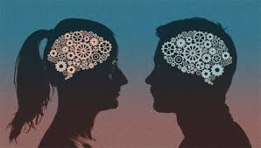
Sex and Gender Differences
Sex differences
Physical anatomy- primary and secondary sex characteristics
Males- taller, heavier, stronger, more likely to be bald and color blind, spermarche, relatively constant level of sex hormones, broader shoulders, slimmer hips, slightly longer legs in proportion to their height
Females- menarche, larger corpus callosum, cyclic sex hormone production
Other brain differences in hypothalamus, corpus callosum (larger in women), cerebral hemispheres, gray vs. white matter

Slide 86
Sex and Gender Differences
Gender differences
Cognitive abilities
Females tend to score higher on verbal skills, males score higher on math and visuospatial- is this biological or cultural, just correlational? Could be biological, psychoanalytical (Freud), social learning, cognitive-developmental
Aggression – men engage in more physical aggression, some research shows women were more indirectly aggressive (e.g. verbally)
Androgyny- exhibiting both masculine and feminine traits
Masculine and androgynous show higher self-esteem, academic scores, creativity, social competence, motivation to achieve, overall mental health- may be because masculine traits are seen as positive and societies often favor “tomboys”
Gender roles are becoming less rigid, but many still prefer traditional gender roles

Slide 87
Research-Supported Sex and Gender Differences (variations are statistically small and represent few meaningful differences)
Behavior | More Often Shown By Men | More Often Shown by Women
Sexual | Begin masturbating sooner in life cycle and higher overall occurrence rates Start sexual life earlier and have first orgasm through masturbation More likely to recognize their own sexual arousal More orgasm consistency with sexual partner | Begin masturbating later in life cycle and lower overall occurrence rates Start sexual life later and have first orgasm from partner stimulation Less likely to recognize their own sexual arousal Less orgasm consistency with sexual partner
Touching | Touched, kissed, and cuddled less by parents Less physical contact with other men and respond more negatively to being touched More likely to initiate both casual and intimate touch with sexual partner | Touched, kissed, and cuddled more by parents More physical contact with other women and respond more positively to being touched Less likely to initiate either casual or intimate touch with sexual partner
Friendship | Larger number of friends and express friendship by shared activities | Smaller number of friends and express friendship by shared communication about self
Personality | More aggressive from a very early age More self-confident of future success Attribute success to internal factors and failures to external factors Achievement more task-oriented; motives are mastery and competition More self-validating Higher self-esteem | Less aggressive from a very early age Less self-confident of future success Attribute success to external factors and failures to internal factors Achievement more social directed, with emphasis on self-improvement More dependent on others for validation Lower self-esteem
Cognitive abilities | Slightly superior in math and visuospatial skills | Slightly superior in verbal skills

