Slide 1
Abnormal Behavior
Unit 10
Chapters 3 and 14

Slide 2
Understanding Stress
Chapter 3, Section 1, pages 82-93

Slide 3
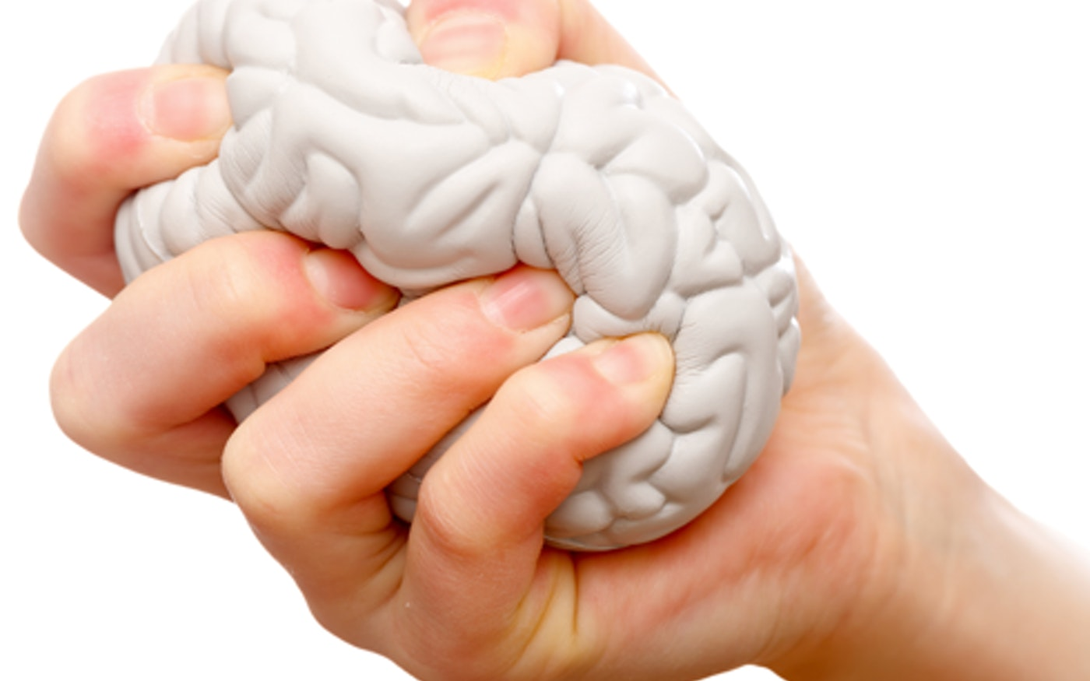
Stress
Stress- the interpretation of specific events, called stressors, as threatening or challenging; the physical and psychological reactions to stress are known as the stress response
Stressors- a trigger or stimulus that induces stress
A persons’ personality, coping skills, experiences, etc. all affect a person’s stress response

Slide 4
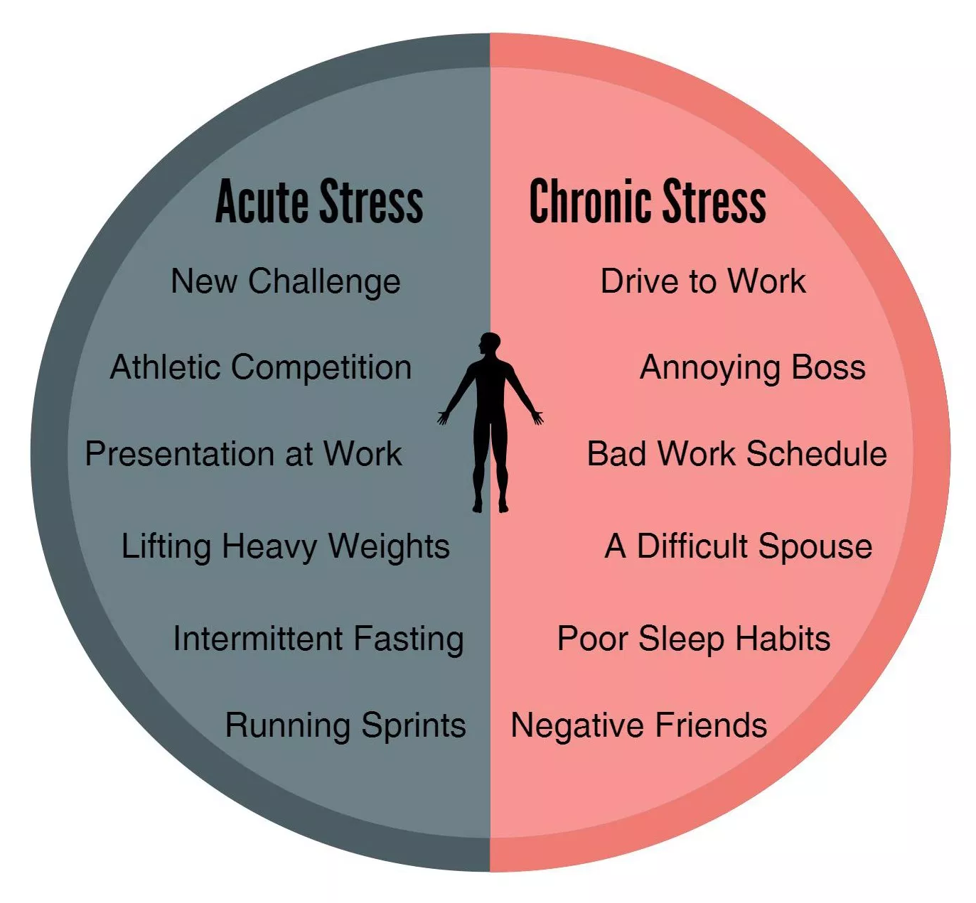
Sources of Stress
Acute stress- a short-term state of arousal in response to a perceived threat or challenge that has a definite endpoint
Can occur almost daily and lead to unhealthy emotions and physical reactions
Chronic stress- a continuous state of arousal in which demands are perceived as greater than the inner and outer resources available for dealing with them

Slide 5
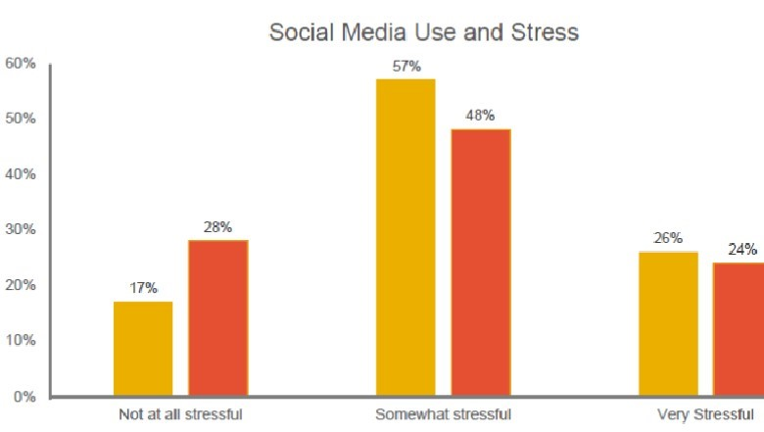
Sources of Stress
Social networks can help with stress, or cause it
Social media plays a new role
Stress level increases with number of friends
Acting in support of friends shows lower cortisol levels
More time on social media → lower levels of daily happiness, lower overall life satisfaction, higher levels of depressions because of social comparison
Life changes cause some stress as you readjust
The SSRS (Social Readjustment Rating Scale) measures this and predicts likelihood of illness (only a correlation)
Notes:
https://www.ted.com/talks/cal_newport_why_you_should_quit_social_media/transcript

Slide 7
Sources of Stress
Conflict- a forced choice between one or more incompatible goals or impulses
Three types of conflict
Approach-approach- a forced choice between two options, both of which have equally desirable characteristics, easiest to resolve and least stress
Approach-avoidance- a forced choice involving one option with equally desirable and undesirable characteristics
Avoidance-avoidance- a forced choice between two options, both of which have equally undesirable characteristics, most difficult and take the longest
The longer or more important the conflict, the more stress

Slide 9
Sources of Stress
Hassles- the small problems of daily living that may accumulate and become a major sources of stress
Burnout- a state of physical, mental, and emotional exhaustion resulting from chronic exposure to high levels of stress, with little personal control
May be more significant than major life changes
Frustration- the unpleasant tension, anxiety, and heightened sympathetic activity resulting from a blocked goal
The more motivated, the more frustrated

Slide 10
Sources of Stress
Cataclysmic events- a stressful occurrence that happens suddenly and generally affects many people simultaneously
Instead of widespread difficulty, there is a wide net of mutual social support, which may help with coping
Individuals will still most likely have to deal with the stress, potentially PTSD too
Acculturative stress- the stress resulting from the many changes and pressures of adapting to a new culture, aka culture shock
Many factors influence the level: if the person is forced to emigrate, if the new country is distrustful/negative towards newcomers, methods of coping by the individual
Integration (lowest stress), assimilation,
separation, marginalization (highest stress)

Slide 11
Reactions to Stress: GAS
General Adaptation Syndrome (GAS)- Hans Selye’s three-stage (alarm, resistance, exhaustion) reaction to chronic stress; a pattern of nonspecific, adaptational responses to a continuing stressor
Alarm phase- sympathetic nervous system activates
Research indicates fight, flight, or fright (freeze)
Resistance phase- your body starts using all of it resources, physiological arousal is high with a high output of stress hormones, people use coping methods
Exhaustion phase- resources are used up, individual becomes more susceptible to illness
Different stressors mean different responses, especially by individuals
Women often exhibit “tend and befriend” which may have come from need to help vulnerable individuals
We can handle short term stress, but our bodies are not meant to deal with chronic, lasting stress

Slide 12
General Adaptation Syndrome (GAS)

Slide 13
Reactions to Stress: SAM System and HPA Axis
SAM (sympatho-adreno-medullary) system- our body’s initial, rapid-acting stress response, involving the sympathetic nervous system and the adrenal medulla
HPA (hypothalamic-pituitary-adrenocortical) axis- our body’s delayed stress response, involving the hypothalamus, pituitary, and adrenal cortex
SAM system (first and rapid) and HPA axis (slower but longer-lasting) work together to increase arousal and energy levels to deal with stress
Stressor
Cerebral cortex interprets
Hypothalamus activates the SAM system and HPA axis
SAM is faster and rapid
SAM system stimulates the adrenal medulla to release norepinephrine and epinephrine
Increase in heart rate, blood pressure, respiration, and muscle tension; digestion decreases, blood vessels constrict
SAM system is shot down after stressor is removed
HPA axis is slower but longer-lasting
Pituitary gland activates the adrenal cortex, which releases glucocorticoids, including cortisol
Cortisol increases metabolism and blood sugar levels → increased energy
After stressor is resolved, high levels of cortisol tells brain to stop messages being sent to pituitary gland and restore body to homeostasis

Slide 14
SAM System and HPA Axis

Slide 15
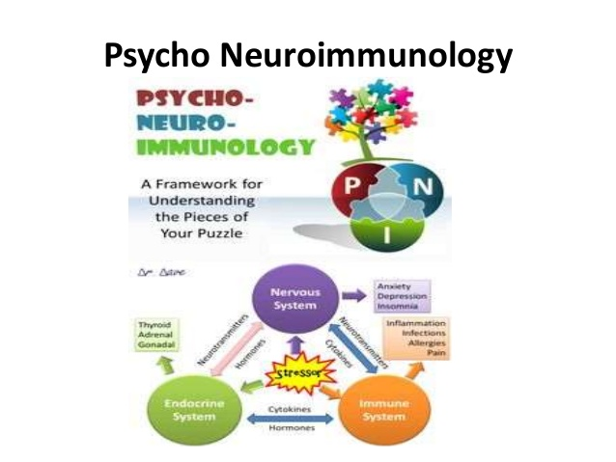
Stress and the Immune System
When stressed, we are less able to regulate the inflammation system, leading us to be more susceptible to numerous diseases like rheumatoid arthritis, the common cold, etc.
Psychoneuroimmunology- the interdisciplinary field that studies the effects of psychological and other factors on the immune system
Chronic/prolonged stress can lead to hypertension, depression, PTSD, drug abuse, premature aging, death
Increased cortisol levels are normal for dealing with stress at first, but if they stay high (as they do during chronic stress), the immune system is suppressed

Slide 16
Stress and Cognitive Functioning
Cortisol helps with our memory, but exposure to high levels of cortisol for short or long amounts of time can impair that
Short-term stress can hurt the retrieval of existing memories, the laying down of new memories, and general information processing
This explains why we have trouble remembering or become forgetful during stressful times (tests, escaping a fire, interviews, etc.)
Prolonged stress (and therefore prolonged exposure to high levels of cortisol) can lead to permanent damage to the hippocampus
If damaged, it cannot communicate properly with the hypothalamus (telling it to stop) so cortisol continues to be secreted
Research with mice shows it may also change the brain, leading to symptoms of depression and social avoidance
Living in poverty (a significant stressor) has shown similar effects, including on academic achievement

Slide 17
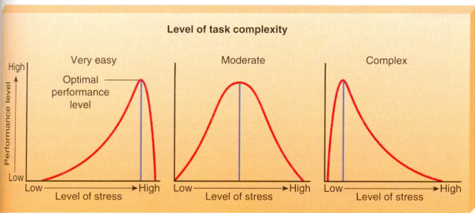
Benefits of Stress
Distress- the unpleasant, undesirable stress caused by aversive conditions
Eustress- the pleasant, desirable stress that arouses us to persevere and accomplish challenging goals
Example- physical exercise
Task complexity
Easy tasks require high stress
Hard tasks require low stress
May explain why athletes perform best at competitions
Stress and social support
Social support after a mass trauma can be beneficial and increase psychological well-being
Individual-level trauma does not have the same benefit

Slide 18
Stress and Illness
Chapter 3, Section 2, pages 94-98

Slide 19
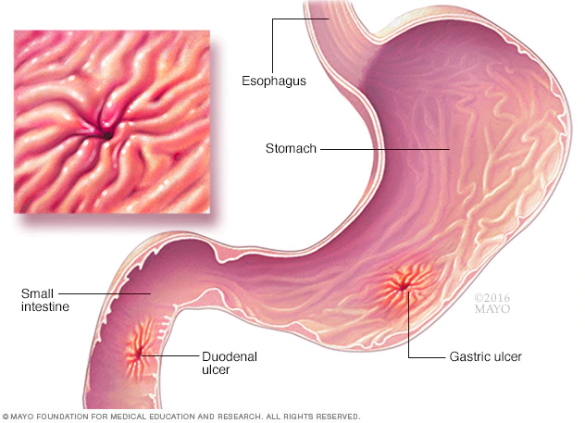
Ulcers
Ulcers- lesions/lumps on the lining of the stomach, esophagus, or upper small intestine that can be very painful
We have long ago made the link between people who are stressed and ulcers
Recently identified a bacterium (H. pylori) that causes these ulcers
Everyone has this bacterium but stress activates the bacterium to cause the ulcers

Slide 20
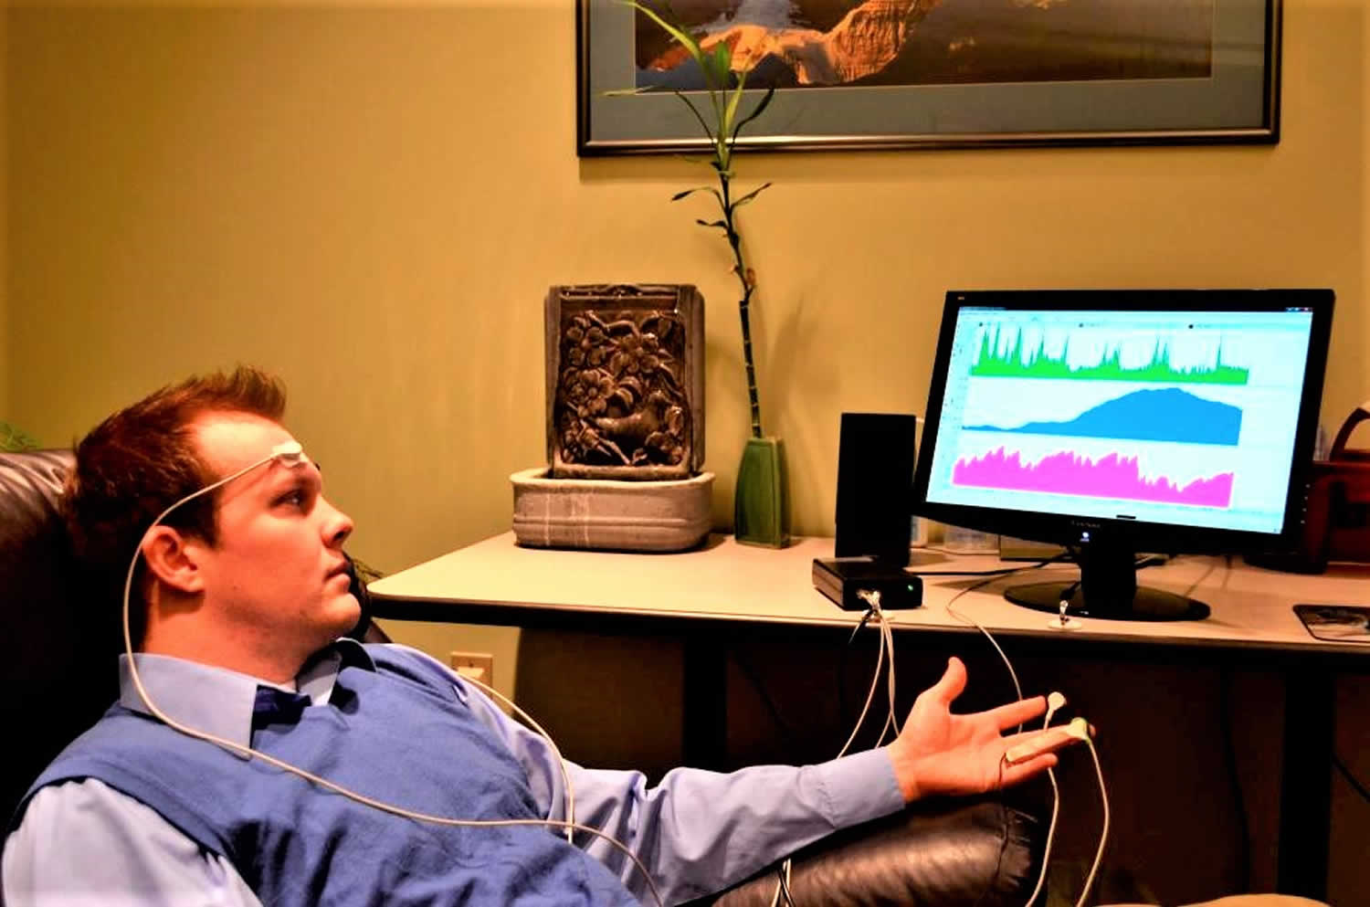
Chronic Pain
Chronic pain- continuous or recurrent pain over a period of six months or longer that generally does not serve a useful/survival function
Psychological stress does not usually cause the pain but it does exacerbate the psychological distress
Opioids are common treatment for the pain, but this can lead to addiction as we’ve seen with the current opioid crisis
Psychologists recommend other treatments
Behavioral interventions- start “well behaviors”
Biofeedback- usually with EMG for muscle tension, leading to self-awareness
Mindfulness-based meditation and relaxation techniques- to distract from the pain, not eliminate it

Slide 21
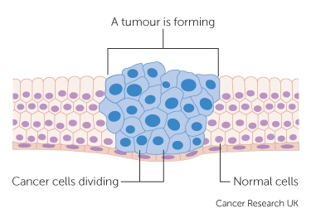
Cancer
Cancer is caused by rapidly dividing body cells that turn into a tumor that causes organ damage
In a healthy person, these cells would be attacked
Caused by environmental factors and genetic predispositions
Stress does not directly cause cancer
But we do know that chronic stress negatively affects the immune system, which may weaken its ability to fight cancer
It also seems that stress increases the spread of cancer cells

Slide 22
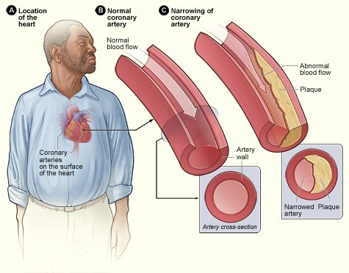
Cardiovascular Disorders
Heart disease includes disorders that affect heart muscle and leads to heart failure
One type is coronary heart disease, whose symptoms include angina and heart attacks
Stress is a major factor in causing heart disease
When we are stressed, epinephrine and cortisol is released → increased heart rate and glucose → without physical action, the fat is in the blood stream and may stick to the blood vessel walls, causing heart attacks
Other factors are included as well
There is some research that indicates that the perception of stress is what puts a person at greatest risk for heart disease

Slide 23
Posttraumatic Stress Disorder (PTSD)
Posttraumatic stress disorder (PTSD)- a long-lasting, trauma- and stressor- related disorder that overwhelms an individual’s ability to cope
Most people who experience a traumatic event do not suffer later from PTSD
The fight/flight/fright response in individuals with PTSD is modified or damaged → they continue to experience stress and fear even without danger
Characteristics
Direct exposure to trauma
Recurrent, intrusive symptoms, like flashbacks
Avoidance symptoms
Chronic heightened arousal and reactivity
Unfortunately, drugs are often used for coping and there is an increased risk for suicide
There is a long history of PTSD, being first thought to be a physical condition until we came to better understand during the Vietnam and Korean Wars

Slide 24
Coping with Crisis and Helping Someone with PTSD
If you have experienced it
Recognize your feelings
Be patient and kind to yourself
Recognize normal crisis reactions
Be mindful of your time
Get sleep and avoid negative coping mechanisms
Adopt stress management skills
Helping someone with PTSD
Be wiling to listen and encourage counseling if necessary
Don’t trivialize the disease
Don’t be a cheerleader who is going to fix it all
Educate yourself
Use empathy, unconditional positive regard, genuineness, and active listening
Get help

Slide 25
Stress Management
Chapter 3, Section 3, pages 99-105

Slide 26
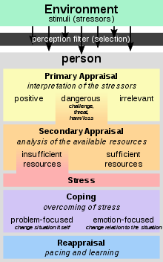
Cognitive Appraisal
When we first address a stressor, we start a primary appraisal to decide if the threat is harmless or harmful
Then we start assessing our resources for coping with the stress during secondary appraisal
Then we will start employing our problem-focused strategies, emotion-focused strategies, or a combination

Slide 27
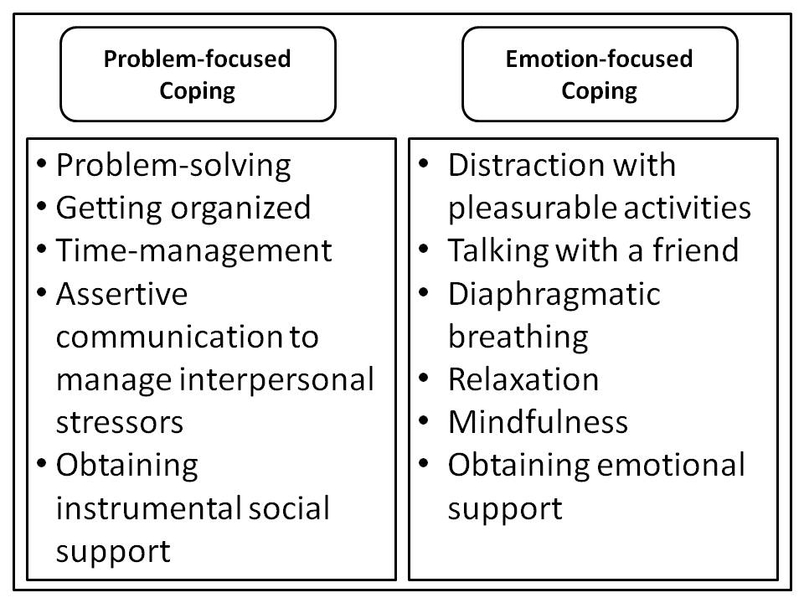
Cognitive Appraisal
Problem-focused coping- the strategies we use to deal directly with a stressor to eventually decrease it or eliminate it
Often used for situations that we have some control over
Emotion-focused coping- the strategies we use to relieve or regulate our emotional reactions to a stressful situation
Often used for situations we don’t have control over
These cannot change the problem, but it may help us feel better
May combine the two for a complex stressor or a changing stressor

Slide 28
Cognitive Appraisal
From Freud
If the ego fails to satisfy the id and superego, anxiety comes into the conscious awareness (conscious anxiety) and we become uncomfortable
To avoid feeling uncomfortable and reduce anxiety, we use defense mechanisms
Defense mechanisms- strategies the ego uses to reduce anxiety by unconsciously distorting reality or increase self-deception
Can be healthy if used in moderation or temporarily
Can also create destructive habits

Slide 29
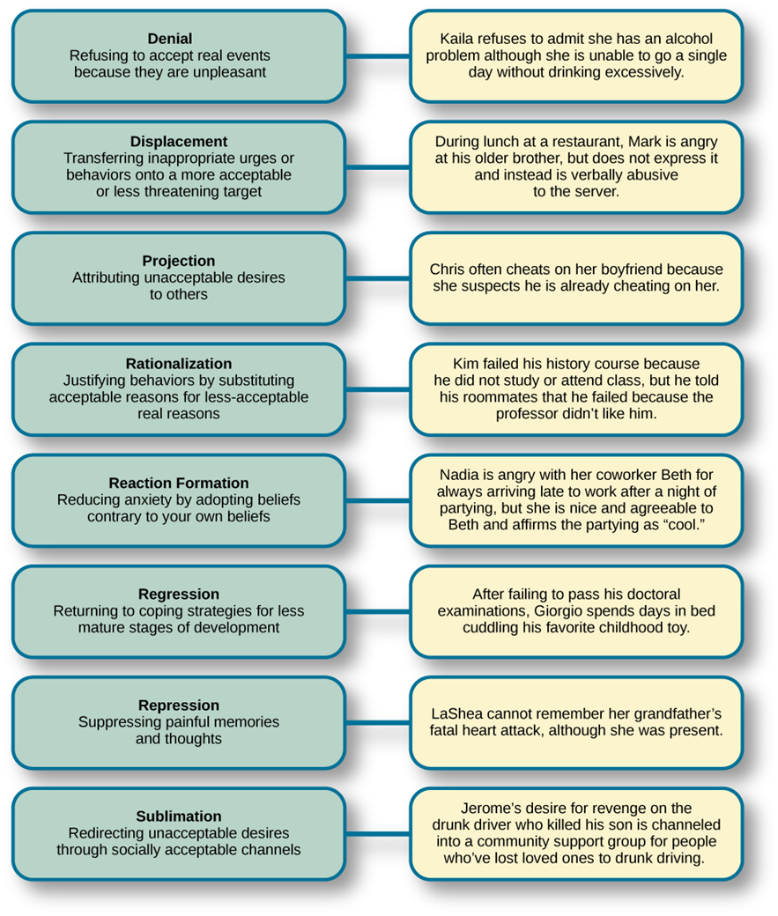

Slide 30
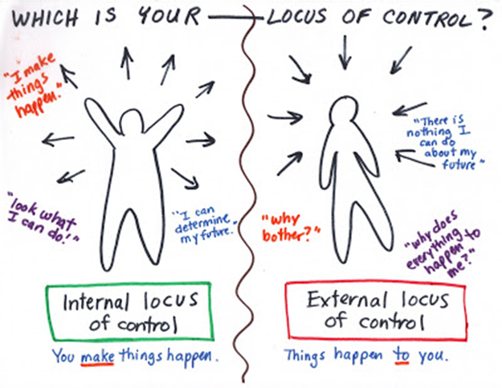
Personality and Individual Differences: Locus of Control
Internal locus of control- the belief that we control our own fate
More likely to make effective decisions, lead to healthier lifestyles, follow treatment programs, and positively cope with a situation
External locus of control- the believe that chance or outside forces beyond our control determine our fate
Feel powerless to change, less likely to make effective and positive changes, more likely to experience high stress

Slide 31
Personality and Individual Differences: Positive Affect and Optimism
Positive affect- the experience or expression of positive feelings (affect), including happiness, joy, enthusiasm, and contentment
Many positive associations
Fewer colds, fewer car accidents, sleep better, better quality of life, fewer physical symptoms, longer life
Optimism- a tendency to expect the best and to see the best in all things
Optimists are better at stress management
Also have many positive associations
Assumptions that bad times are temporary, better physical and psychological health, longer and happier lives
Pessimists show higher levels of cortisol, higher baseline levels of stress, and more difficulty coping

Slide 32
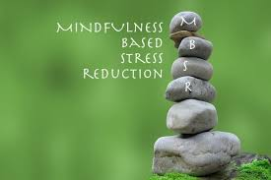
Resources for Healthy Living
Mindfulness-based stress reduction (MBSR)- a stress reduction strategy based on developing a state of consciousness that attends to ongoing events in a receptive and nonjudgmental way
Benefits of MBSR
Improved control over attention and mind wandering
Better reading comprehension and working memory capacity
Better adjustment to college environment
Better stress management
More optimistic, helpful, caring, liking by peers
Social support also plays a large role, even one close relationship
Other resources- exercise, social skills, behavior change, stressor control, material resources, relaxation

Slide 33
Health Psychology
Chapter 3, Section 4, pages 106-110

Slide 34
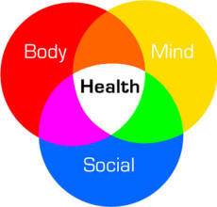
Health Psychology
Health psychology- a branch of psychology that studies how biological, psychological, and social (biopsychosocial) factors influence health, illness, and health-related behaviors
We’re interested in how change in behavior can improve health outcomes
Reduce unhealthy behaviors and distress
Educate the public about illness prevention and health maintenance
Educate about effects of stress, smoking, alcohol, lack of exercise, etc.

Slide 35
Stress and Work/Career: Job Stress
Chronic, extreme stress at work can increase the risk of death (from heart disease and stroke for example) or serious disabilities from strokes or diabetes
Job stress can come from unemployment, job change, and/or worries about job performance
Found to be higher in jobs with little security and make great demands on performance/concentration, with little or no allowance for creativity or advancement
Job stress can also increase risk of suicide
It can also increase stress at home
Characteristics of job satisfaction
Supportive colleagues
Supportive working conditions
Mentally challenging work
Equitable rewards

Slide 36
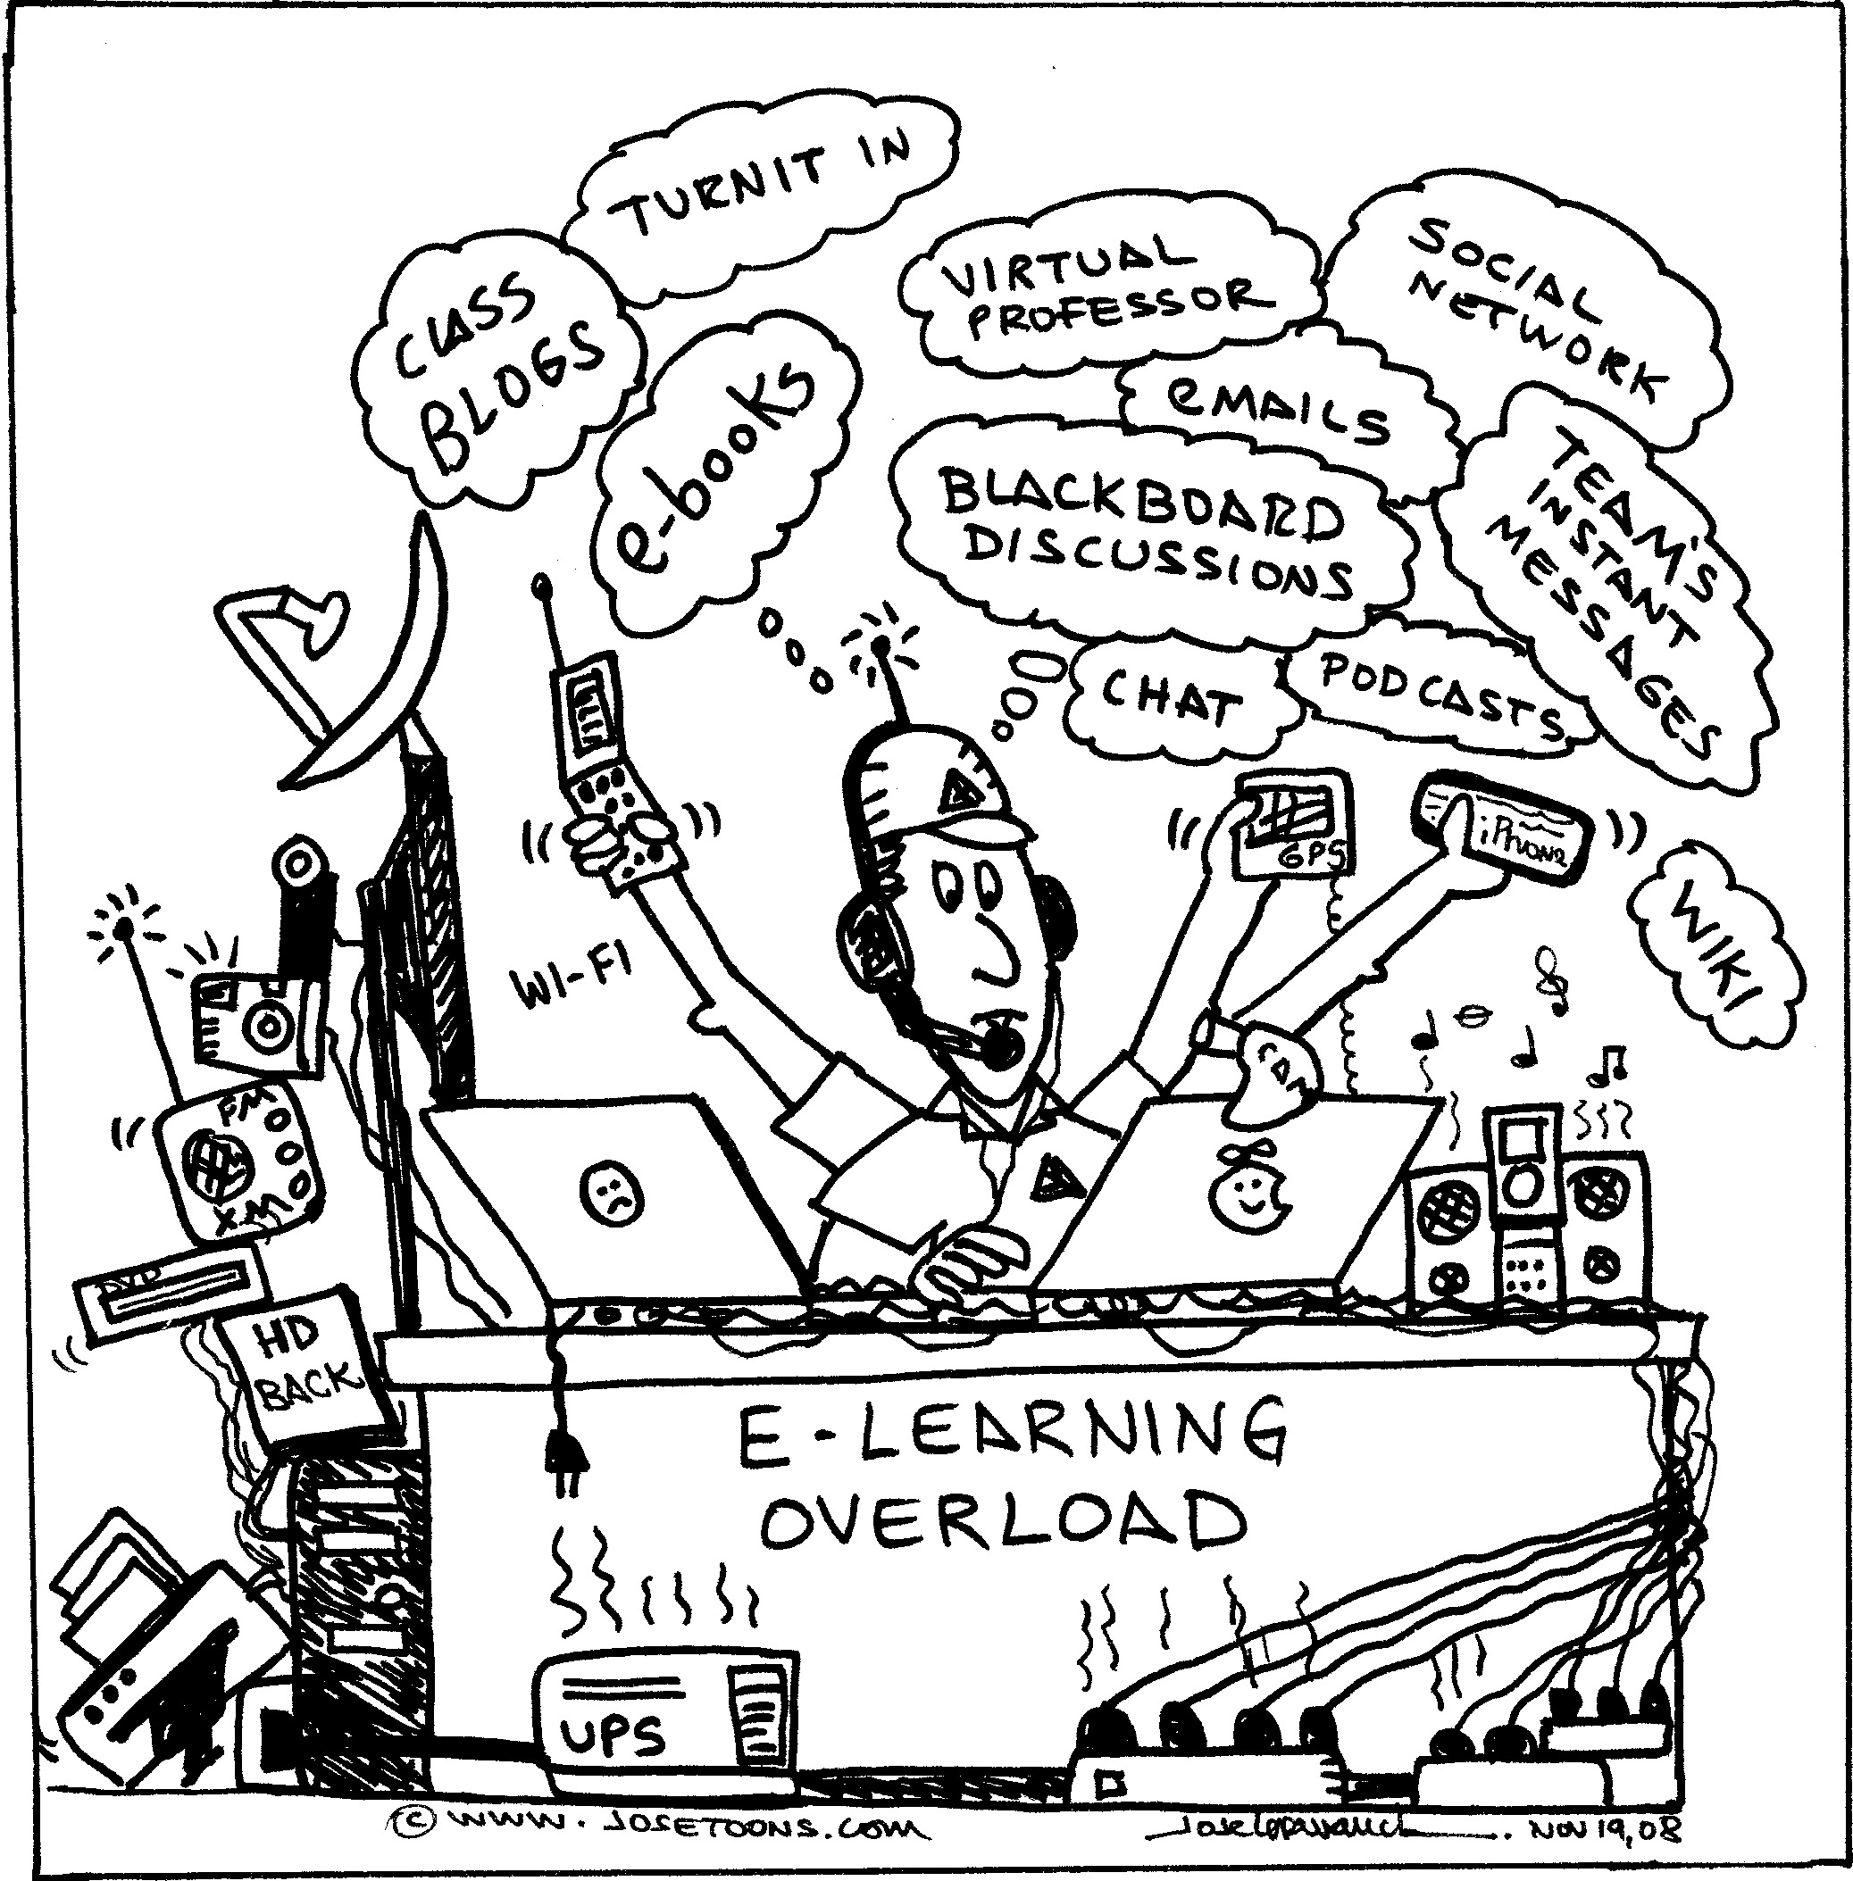
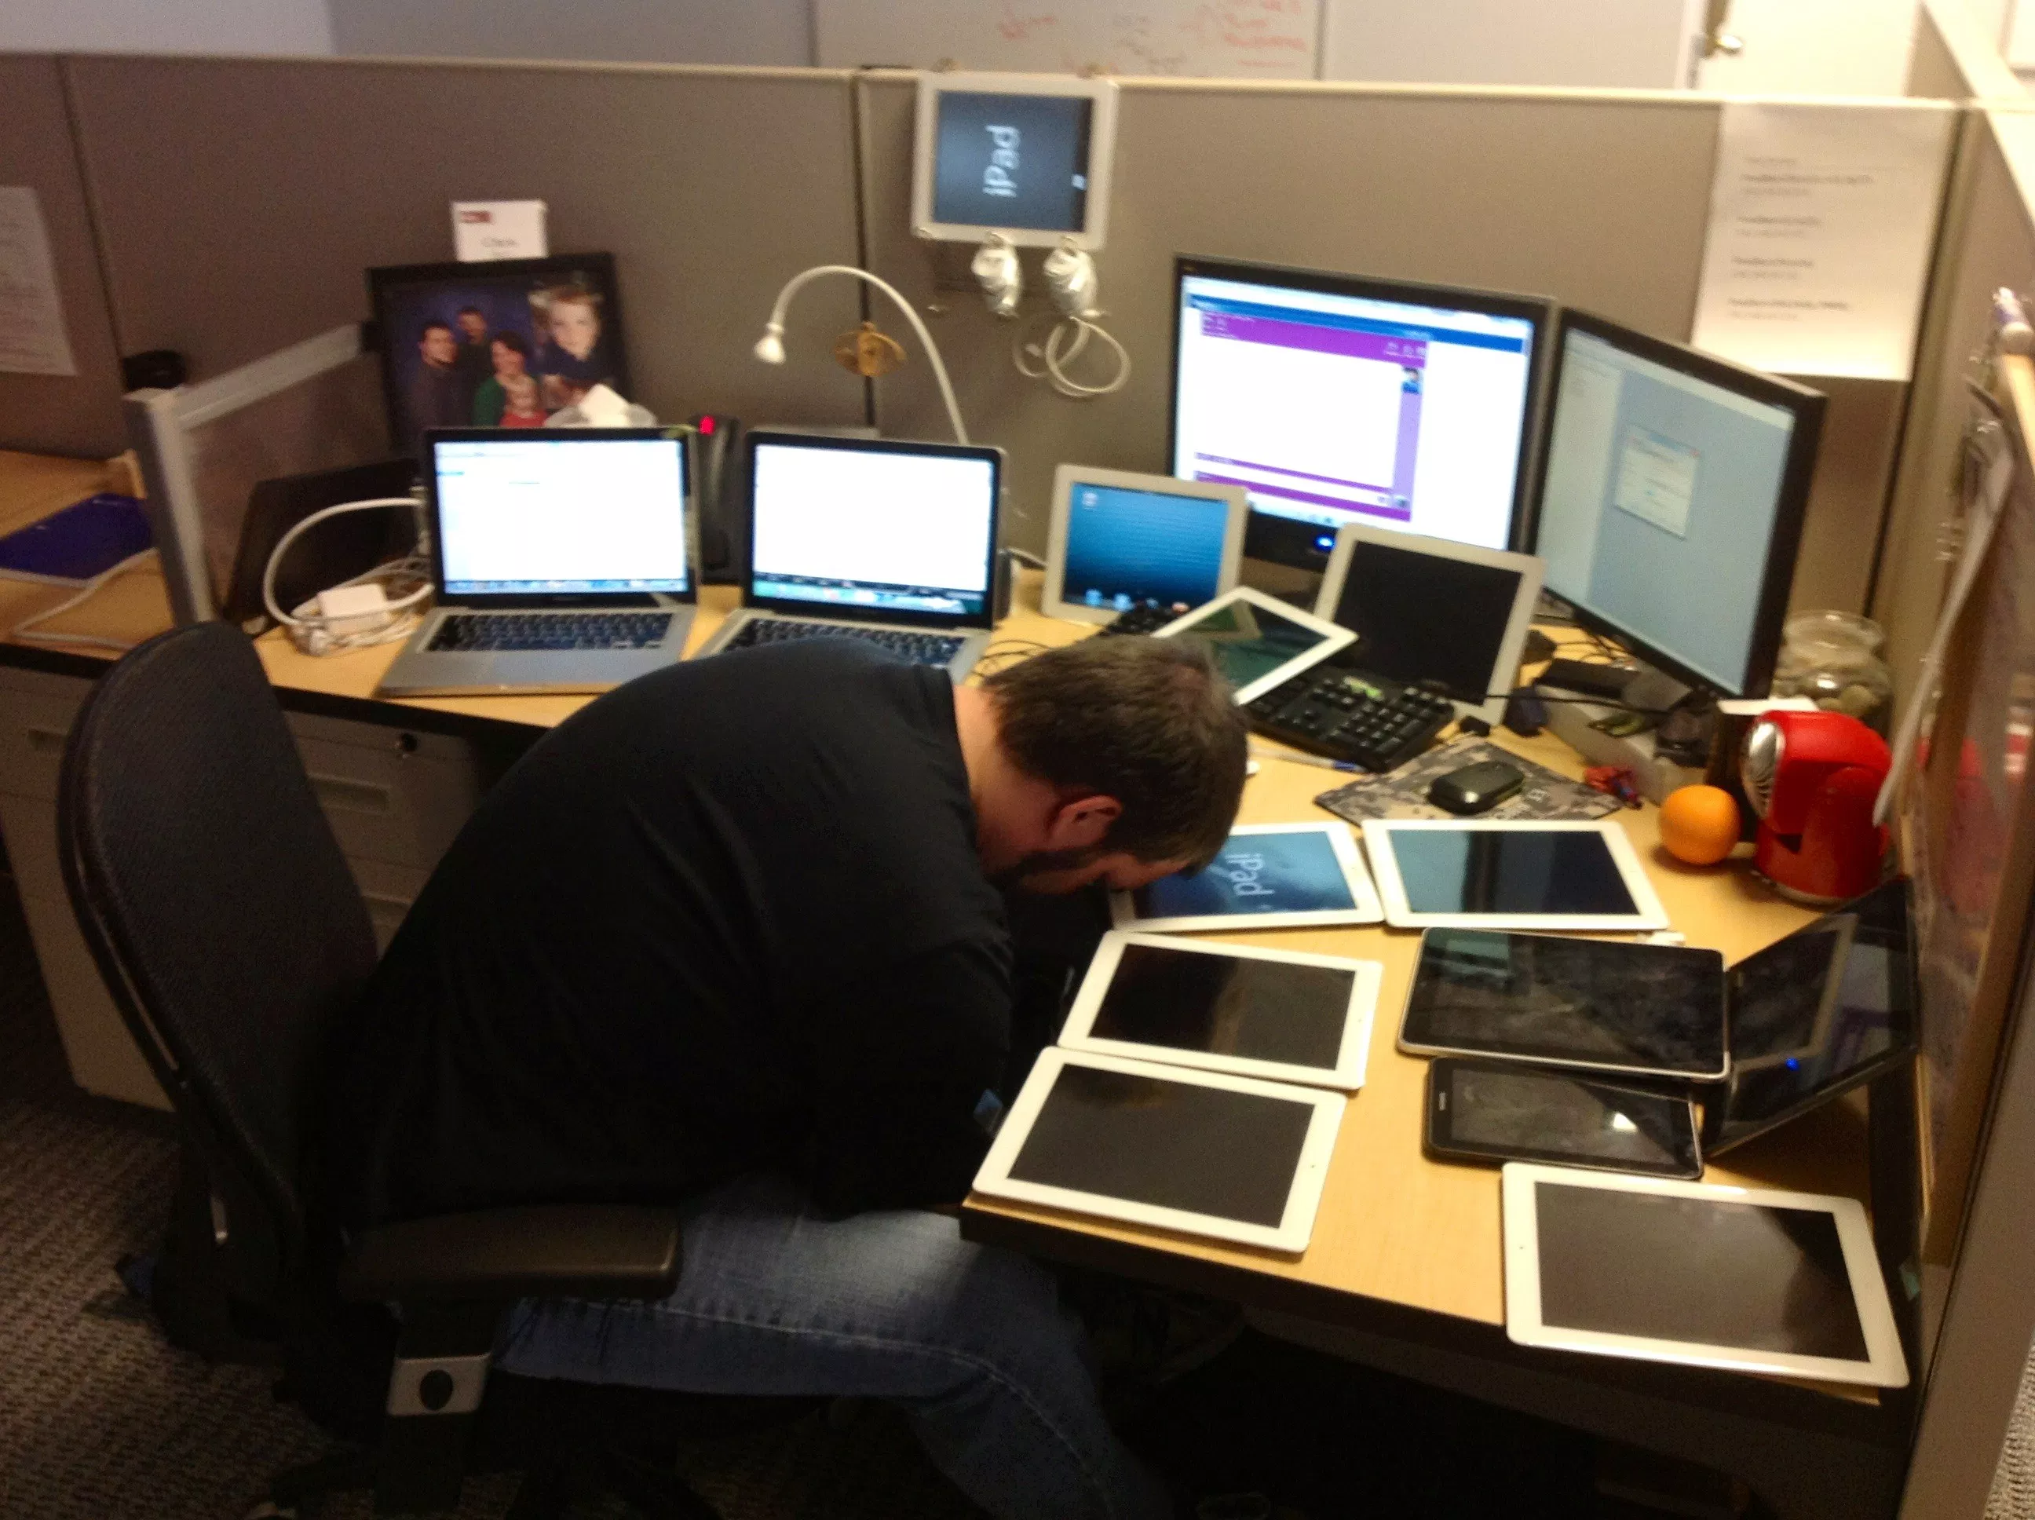
Stress and Technology: Technostress
Technostress- a feeling of anxiety or mental pressure from overexposure or involvement with technology
Stress caused by an inability to cope with modern technology
Just putting a phone on a table between two people, with no one picking it up, can lead to lower levels of closeness, connection, and meaning in their conversation
Choose carefully with technology:
Is it useful to you?
Establish boundaries and balance

Slide 37
Studying Psychological Disorders
Chapter 14, Section 1, pages 457-466

Slide 38
Psychological Disorders
Psychological disorder- a clinically significant collection of symptoms (syndrome) characterized by serious disruptions in an individual’s thoughts, feelings, and/or actions
Abnormal behavior- patterns of behaviors, thoughts, or emotions considered pathological (diseased or disordered) for one of four reasons
Deviance
Distress
Danger
Dysfunction
Normal and abnormal exist on a continuum, and it has varied over time how we define the ends
Not everything weird is abnormal. Many people with disorders generally act normal
There is an incorrect correlation with danger and mental disorders. Many people with mental illnesses are not dangerous and are more often the victims

Slide 40
Psychological Disorders
Normal and abnormal exist on a continuum, and it has varied over time how we define the ends
Historically- evil spirits, witchcraft, humors
Treated with trephining, exorcism, torture, asylum
Psychiatry- the branch of medicine that deals with the diagnosis, treatment, and prevention of mental disorders
Take a medical model approach- mental disorders being caused by primarily physiological issues
Psychologists include physical but many other factors- sociocultural, behavioral, evolutionary, humanistic, psychodynamic, cognitive
Both focus on understanding that disorders are not signs of weakness, rather a function of many things contributing, like any other illness
Also an understanding that most will recover and can achieve normal, productive lives

Slide 41
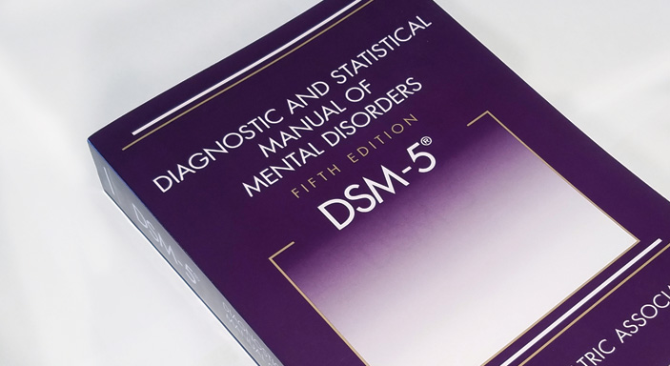
Classifying Psychological Disorders
Need a standardized way to conduct scientific research and have a standard communication between mental health professionals
Diagnostic and Statistical Manual of Mental Disorders (DSM)- a manual developed by the American Psychiatric Association that is used primarily to classify psychological disorders
First published 1952
Latest version released in 2013

Slide 42
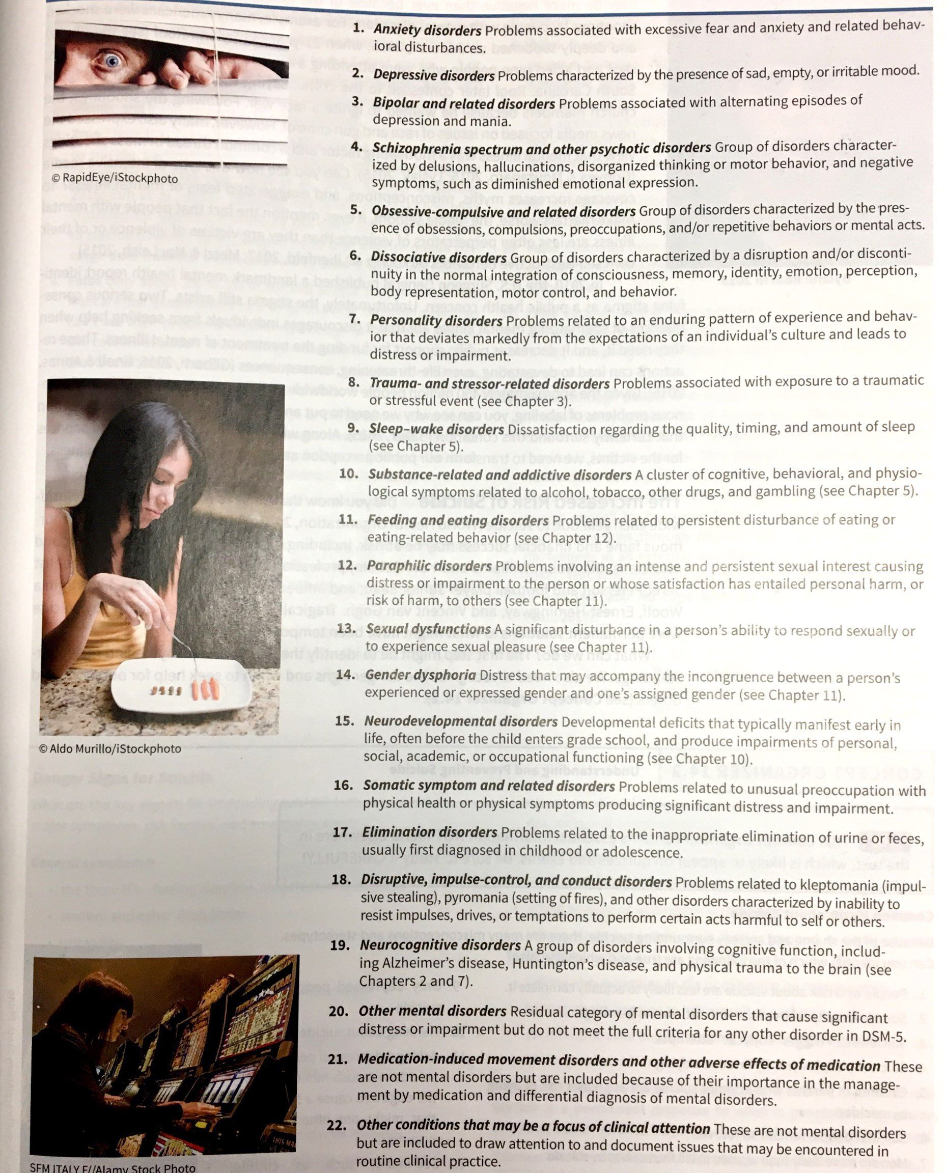

Slide 43
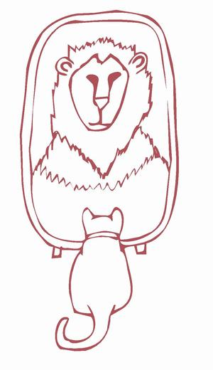
Classifying Psychological Disorders: DSM Terms
Constantly changing list of disorders, descriptions, categories, and associated terms
Neurosis- a condition in which a person does not have signs of brain abnormalities and does not display grossly irrational thinking or violate basic norms but does experience subjective distress
No longer included in DSM (based from Freud), have been redistributed into categories
Psychosis- a serious psychological condition in which thoughts and perceptions are so impaired that the individual loses contact with external reality; has two major associated symptoms:
Delusion- a false, imaginary belief that persists despite clear evidence to the contrary, such as delusions of grandeur
Hallucination- a false, imaginary perception that occurs without an external, objective source, such as hearing voices that others cannot hear
May occur with mental disorder or from substance abuse
Insanity- the legal (not clinical) designation for a situation in which an individual cannot be held responsible for his/her actions or is incompetent to manage his/her own affairs because of mental illness
A legal term indicated the inability to tell right from wrong, not our common use of the term

Slide 44
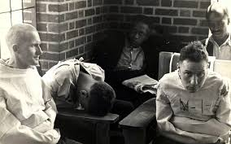
Describing and Evaluating the DSM
400 disorders, 22 categories, we will talk about 7 categories
Comorbidity- the co-occurrence of two or more disorders in the same person at the same time, as when a person suffers from both depression and alcoholism
Potential issues with a DSM diagnosis:
Lacks discussion of ethical, political, economic, etc. underlying the classifications involved
May lead to overdiagnosing for insurance purposes
Cultural bias- Western European and U.S.
Overreliance on medical model and perhaps unfairly labeling people
Rosenhan’s study

Slide 45
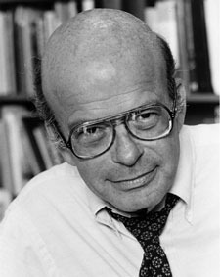
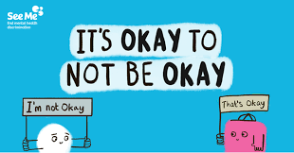
Special Issues in Psychological Disorders
Rosenhan’s study: 8 psychologists presented themselves to hospitals with symptoms of hearing voices, but no other symptoms other than their truths. Each were admitted and kept for an average of 19 days despite stopping reporting symptoms. All have permanent record label of “schizophrenia in remission”
The stigma of mental illness
Media coverage, for example, of mass shootings by people with mental disorders
Myths, misconceptions, and exaggerated fears, ignoring that many with mental disorders are actually victims
2010, U.S. Surgeon General published report saying stigma is public health concern
Stigma exists- discourages individuals from seeking help and decreases public support for funding

Slide 46
Prevalence and Financial Impact of Mental Disorders
According to the World Health Organization, more than 450 million people exhibit some sort of mental disorder.
The 12-month prevalence rate of mental disorders of all kinds for adults in the U.S. is 26.2%. The comparative figure in Europe is 27%.
The 12-month prevalence rate of mental disorders of all kinds for children in the U.S. is 13.1% (8.6% classified as ADHD).
In 2007, there were about 35,000 suicides in the U.S. About 95% of these suicides were committed by individuals age 19 and over (CDC statistics).
Mental illness is the leading cause of disability in children (Whitaker, 2010).
Mental disorders constitute more than 28% of the burden of disability in the U.S. and Canada (WHO statistics).
Expenditures for mental disorders constitute 6.2% of all health care expenditures ($100 billion in 2002) (NIMH statistics).
The average amount spent for mental health care in the U.S. is about $1,500 per person (NIMH statistics).

Slide 47
Anxiety Disorders
Chapter 14, Section 2, pages 467-471

Slide 48
Special Issues in Psychological Disorders
Important things to understand about an increased risk of suicide
Those who complete suicide often talk about it beforehand/give warnings
Suicides can trigger copycat attempts
Many do not want to die, they just don’t know how to keep living
There is a high correlation of parents who attempt or complete suicide and their children
Being suicidal is often temporary
Men are more likely to commit suicide
When a person comes out of a depression and seem to be doing better, this increases their risk
Suicide is high among those who are depressed, but not exclusive to
Thinking about suicide is common
Asking a person about if they have thoughts of suicide is helpful, not harmful
Those who engage in nonsuicidal self-injury are at greater risk, but it is not inevitable
Nonsuicidal self-injury- a serious behavior problem in which people deliberately harm themselves without lethal intent

Slide 49
Danger Signs of Suicide
General symptoms
The three H’s- feeling helpless, hopeless, and hapless
Alcohol and other drug abuse
Irritability
Loss of interest in daily activities
Persistent fatigue and lack of energy and strength
Insomnia or excessive sleeping
Difficulty concentrating or feeling very restless
Noticeably reduced or increased appetite
Risk factors
Previous history of substance abuse or suicide attempt
Family history of substance abuse, suicide attempt, suicide, or mental illness
Firearms, medications, or other methods for suicide readily available
Recent emotional trauma, such as incarceration, loss of a loved one, or loss of an important job
Emergency signs
Increasing use of alcohol or other drugs
Acting anxious or agitated or displaying extreme mood swings
Talking about unbearable pain, feeling trapped, or being a burden to others
Talking about wanting to die or having no reason to live
Talking about wanting to kill oneself or seeking revenge
Social withdrawal and/or sleeping too little or too much
Seeking methods for suicide, such as buying a gun
What to do
Remember suicide is a permanent response to what is generally a temporary problem. Get help!
Don’t ignore the warning signs
Don’t equate suicide with selfishness
Don’t be afraid to discuss suicide
Don’t abandon the person after the suicidal crisis has seemingly passed
Stay with the person
Have empathy, unconditional positive regard, genuineness, and actively listen
Find help fast

Slide 50
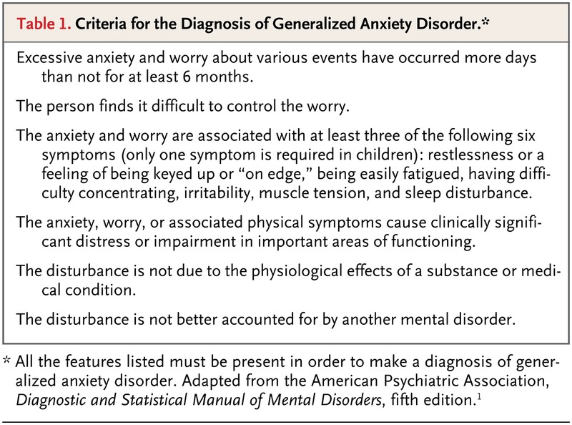
Anxiety Disorders
Anxiety disorder- one of a group of psychological disorders characterized by disabling (uncontrollable and disruptive) fear or anxiety, accompanied by physiological arousal and related behavioral disturbances
Generalized anxiety disorder- an anxiety disorder characterized by persistent, uncontrollable, and free-floating, nonspecified anxiety
Lasts at least 6 months
Muscle tension and autonomic fear reactions → often leads to symptoms of headaches, heart palpitations, dizziness, insomnia
Twice as many women as men

Slide 51
Panic Disorder
Panic disorder- an anxiety disorder characterized by repeated, sudden onsets of intense terror and inexplicable panic attacks
Many of us have experienced panic, this is not the same
Symptoms: severe heart palpitations, trembling, dizziness, difficulty breathing, feelings of impending doom, can feel like a heart attack
Diagnosed when future attacks become a concern

Slide 52
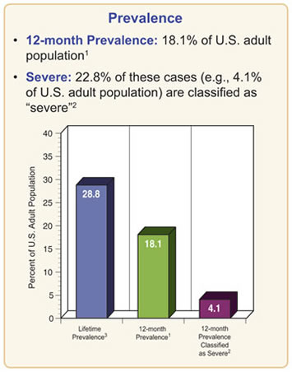
Phobias
Phobia- a persistent and intense, irrational fear and avoidance of a specific object, activity, or situation
Significantly interferes with daily life
Agoraphobia- restrict normal activities because of fear of having a public panic attack with no access to help, may confine themselves to their homes
Specific phobia- fear of a specific object or situation, like claustrophobia or acrophobia
Social anxiety disorder- aka social phobia, irrational fear of embarrassing themselves in social situations like public speaking or eating in public

Slide 53
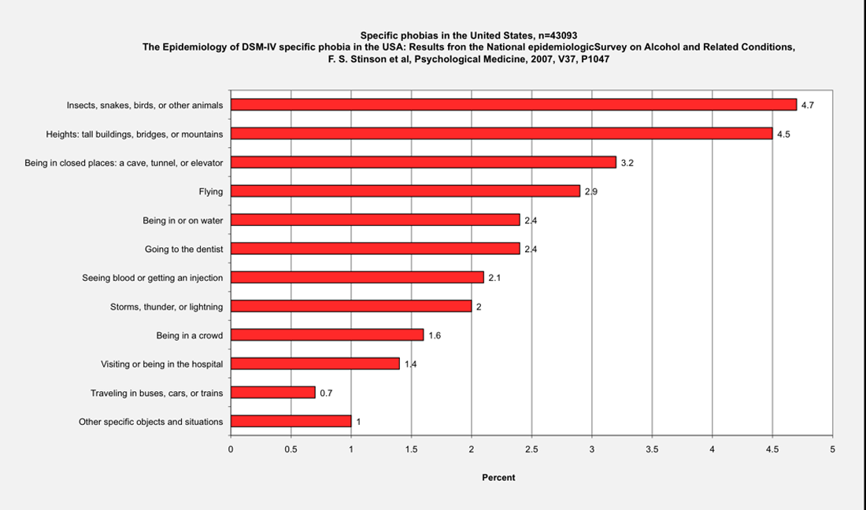

Slide 55
Explaining Anxiety Disorders
Psychological factors
Faulty cognitive processes- habits that make them prone to fear and staying hyper focused on scanning for danger, not safety; often magnify information and ordinary threats and failures and are hypersensitive to others’ opinions of them
Maladaptive learning- inadvertent and improper conditioning through classical conditioning (remember Little Albert)
Modeling and imitation, like from parents to their children
Biological factors
Predisposition to fear things that were dangerous to our ancestors
Panic comes from overreaction of autonomic nervous system
Sex hormones may be involved since women outnumber men in anxiety disorders
Sociocultural factors
Abuse can be a link to developing GAD and social anxiety
Rise in anxiety disorders recently, probably from fast-paced lives with increased mobility, decreased job security, decreased family support
Other cultures have different forms of anxiety, supporting these factors

Slide 56
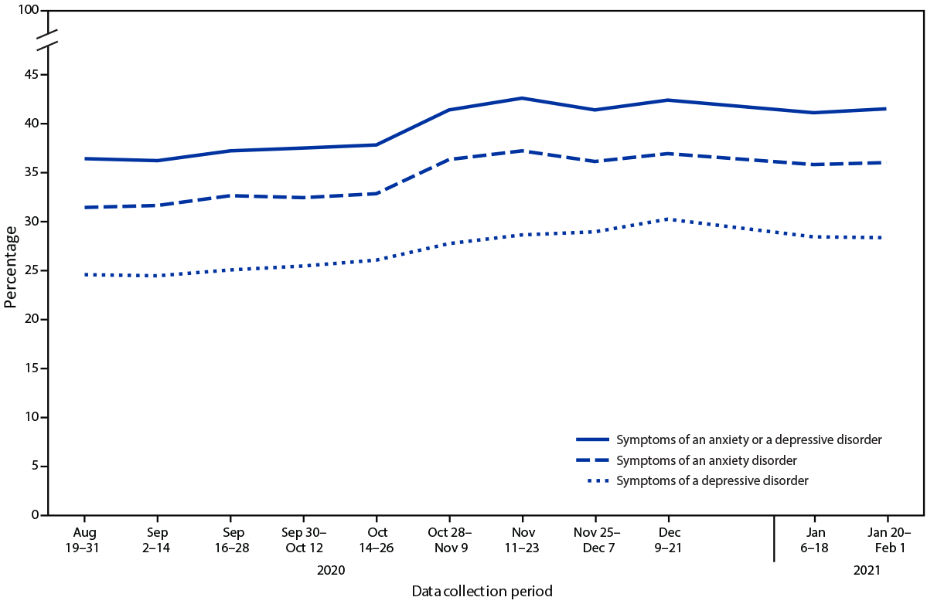
Pandemic Effects
During August 19–31, 2020, through December 9–21, 2020, significant increases were observed in the percentages of adults who reported experiencing symptoms of
an anxiety disorder (from 31.4% to 36.9%)
depressive disorder (from 24.5% to 30.2%)
at least one of these disorders (from 36.4% to 42.4%)
Notes:
https://www.cdc.gov/mmwr/volumes/70/wr/mm7013e2.htm

Slide 57
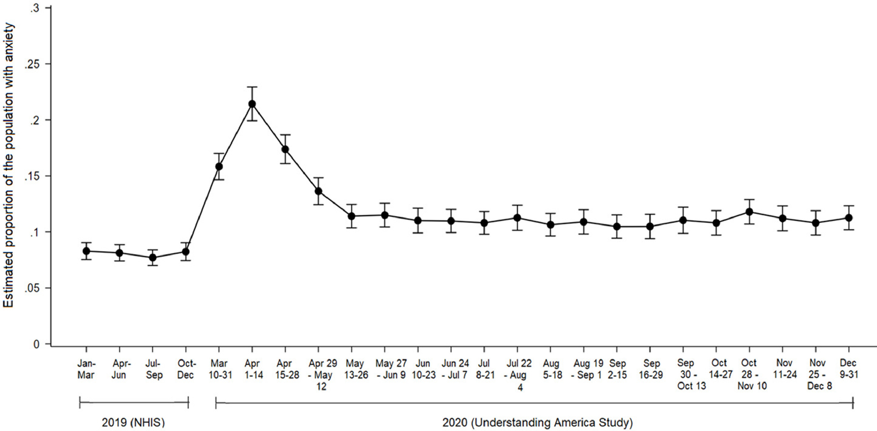
Pandemic Effects
The COVID-19 pandemic has been predicted to contribute to mental health problems
Representative studies tracking anxiety from before to during the pandemic are needed
This study examines changes in anxiety symptoms from 2019 to December 2020.
Findings suggest that anxiety rose from 2019 levels at the onset of the COVID-19 pandemic
Anxiety levels declined substantially as stay-at-home orders were lifted in most states
Findings highlight the importance of mental health supports when entering lockdown
Notes:
https://www.sciencedirect.com/science/article/pii/S0165032721001889

Slide 58
Depressive and Bipolar Disorders
Chapter 14, Section 3, pages 472-475

Slide 59
Mood Disorders
Depressive disorders- a group of psychological disorders characterized by profound and persistent sadness, despair, and/or decreased interest in things that were once pleasurable; moods severe enough to interfere with the ability to function
Not just a sadness following a sad event
Major depressive disorder (MDD)- a psychological disorder characterized by significant symptoms of depression that occur nearly every day and last for two weeks or more
May also interfere with concentration, making decisions, and being social
May cause sleep disruption, weight loss or gain, fatigue
Often have difficulty recognizing “thinking errors” that may lead them to focusing on the negatives
Affects the whole body
Increased risk for cancer, cardiovascular disease, and younger death

Slide 60
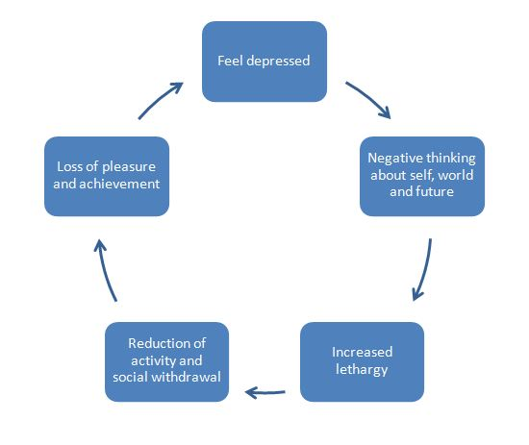
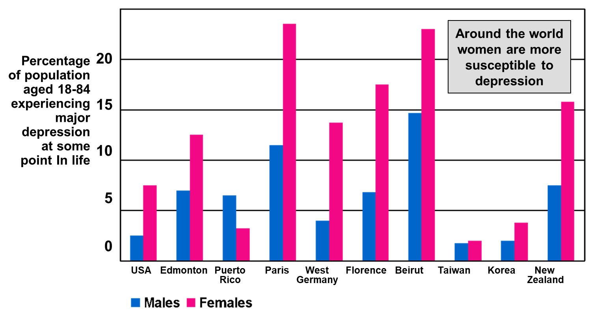

Slide 61
Bipolar Disorder
Bipolar disorder- a psychological disorder characterized by repeated episodes of mania (unreasonable elation, often with hyperactivity) alternating with depression
Mania- a state of abnormally elevated mood (either euphoric or irritable); also characterized by mental and physical hyperactivity, insomnia, and poor judgment
Manic phase- elation, extreme confusion, distractibility, racing thoughts, exaggerated sense of self-esteem, irresponsible behavior (shopping sprees, insulting remarks), rapid thought change or speech; may be more mild as optimism
Can last for a few days or few months; ends abruptly
Following depressive episode usually last 3x as long
Depressive phase- like major depressive disorder- feelings of failure, sinfulness, worthlessness, despair, lethargic, despair, unresponsiveness
Low lifetime risk: 0.5-1.6%
High suicide rate: 10-20%

Slide 62
Bipolar Example
Manic phase: On admission she slapped the nurse, addressed the house physician as God, made the sign of the cross, and laughed loudly when she was asked to don the hospital garb. This she promptly tore to shreds...She sang at the top of her voice, screamed through the window, and leered at the patients promenading in the recreation yard.
Depressive phase: The patient lay in bed, immobile, with a dull, depressed expression on his face. His eyes were sunken and downcast. Even when spoken to, he would not raise his eyes to look at the speaker. Usually, he did not respond at all to questions, but sometimes, after apparently great effort, he would mumble something about the ”Scourge of God”

Slide 63
Mood Disorders

Slide 64
Explaining Depressive and Bipolar Disorders
Biological Factors
Neurotransmitters, genes, brain structure and function
Imbalances of neurotransmitters- GABA, serotonin, norepinephrine, dopamine
Link between depression and diet
Both disorders may be inherited
Mild depression may be evolutionary response to loss, MDD would be extreme version
Diminished brain activity in depression, increased activity for mania
May also be linked to mild traumatic brain injuries that have affected brain functioning

Slide 65
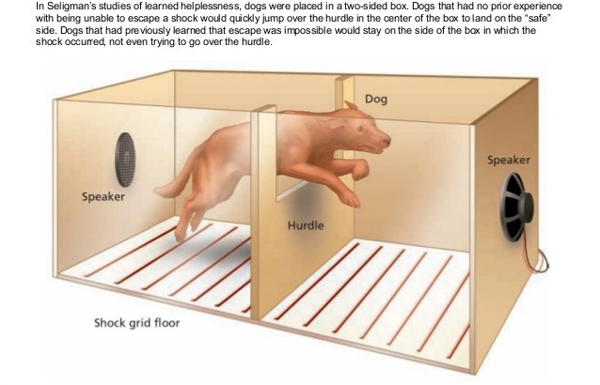
Explaining Depressive and Bipolar Disorders
Psychological Factors
Different perspectives have different explanations
Psychoanalytic- anger tuned inward, aftermath of loss
Cognitive- negative thinking patterns
Humanistic- self demand for perfection, positive growth is blocked
Behavioral- learned helplessness- Seligman’s term for a state of helplessness, or resignation, in which human or nonhuman animals fail to act to escape from a situation due to a history of repeated failures in the past
Seligman’s experiment with the dog getting shocked in a box
Depression comes from attributing failure to causes that are internal, stable, and global

Slide 66
Explaining Depressive and Bipolar Disorders
Sociocultural factors
Environmental factors
Link between high internet/cell phone use and depression/anxiety if used to avoid negative feelings
Disturbances in interpersonal relationships
Histories of abuse or assault

Slide 67
Schizophrenia
Chapter 14, Section 4, pages 476-479

Slide 68
Schizophrenia
Schizophrenia- a group of severe psychological disorders involving major disturbances in perception, language, thought, emotion, and/or behavior
May have issues caring for themselves, relating to others, or holding a job
May lead to a state of psychosis (loss of contact with reality)
About 1% will develop it, half who are admitted to mental hospitals are diagnosed with it
Emerges usually during adolescence- 45 years old
Equally prevalent in men and women, but shows earlier and stronger in men
Multiple personalities are not a trait
The word means “split mind” indicating the split from reality

Slide 69
Schizophrenia

Slide 70
Symptoms of Schizophrenia
Perception
Senses may be enhanced or diminished
Difficulty concentrating
May experience hallucinations (auditory most common) but can also be visual and olfactory
Rarely will hurt others, more likely to be self-destructive
Language and thought
Words lose their meaning, impaired logic, disorganized thoughts
Rapid topic jumping, “word salad”
"The pain in my head is the fusion of egg and sperm, but it only takes a father to make a baby, then the world ends."
Psychosis- delusions of persecution, grandeur, or control

Slide 71
Symptoms of Schizophrenia
Emotion
May be exaggerated and rapid or flattened affect (almost no emotional response)
Behavior
Unusual actions, usually specific to the person suffering from illogical/distorted thoughts
May become cataleptic (immobile)

Slide 72
Types of Schizophrenia

Slide 73
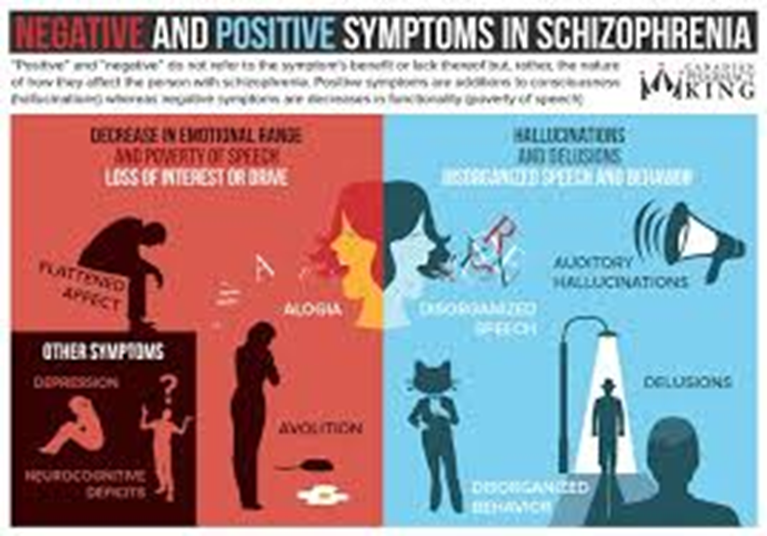
Classifying Schizophrenia
Previous subtypes: paranoid, catatonic, disorganized, undifferentiated, and residual
Criticized for lack of diversity in prognosis, cause, or response
Positive schizophrenia symptoms- additions or exaggerations of normal functions
Delusions, hallucinations
More common in cases of rapid development
Associated with better adjustment before the onset and better prognosis
Negative schizophrenia symptoms- loss or absence of normal functions

Slide 74
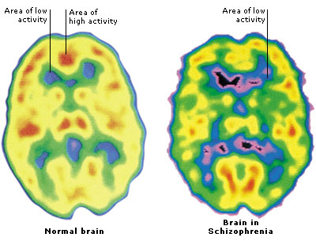
Explaining Schizophrenia
Biological factors
The risk for schizophrenia increases with genetic similarity
Dopamine hypothesis- overactivity of dopamine neurons causes some forms
Shown through increases in dopamine producing/worsening symptoms and drugs that reduce dopamine activity reducing/eliminating symptoms
Larger cerebral ventricles and right hemisphere dysfunction
Lower levels of activity in specific areas

Slide 75
Risk of Developing Schizophrenia

Slide 76
Explaining Schizophrenia
Prenatal and other environmental influences
Prenatal stress, viral infections, birth complications, low birth weight, immune responses, maternal malnutrition, advanced paternal age
Diathesis-stress model- an explanation for the cause of certain disorders, such as schizophrenia, which suggests that people inherit a predisposition (or diathesis) that increases their risk for psychological disorders when exposed to environmental or emotional stress (more than they can handle)
aka stress-vulnerability model
Increased risk for people in stressful living environments and who experience severe trauma before age 16

Slide 77
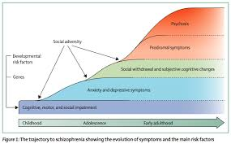
Diathesis-Stress Model
Notes:
https://www.youtube.com/watch?v=xbagFzcyNiM

Slide 78
Other Disorders
Chapter 14, Section 5, pages 480-483

Slide 79
Adjustment Disorders
Stress-related conditions
You experience more stress than would normally be expected in response to a stressful or unexpected event, and the stress causes significant problems in your relationships, at work or at school.
Work problems, going away to school, an illness, death of a close family member or any number of life changes can cause stress. Most of the time, people adjust to such changes within a few months. But if you have an adjustment disorder, you continue to have emotional or behavioral reactions that can contribute to feeling anxious or depressed.

Slide 80
Why Can’t the Prince Walk?
There is an ancient Persian legend about a physician named Rhazes who was called into the palace for the purpose of diagnosing and treating a young prince. Apparently, the prince could not walk. After the usual examination of the day, Rhazes determined that there was nothing wrong with the prince’s legs, at least not physically. With little more than a hunch, Rhazes set out to treat what may be the first recorded case of conversion. In doing so, he took a risk: Rhazes unexpectedly walked into the prince’s bathroom brandishing a dagger and threatened to kill him. Upon seeing him, “the startled prince abruptly fled, leaving his clothes, his dignity, his symptom, and undoubtedly part of his self-esteem behind.”

Slide 81
Somatoform Disorders
Somatoform disorder- a condition in which there is no apparent physical cause; the physical symptoms are brought about by psychological distress
Factitious- Factitious disorder is a serious mental health disorder in which a person appears sick or produces physical or mental illness. People with factitious disorder deliberately produce symptoms of an illness for the purpose of receiving care and attention in a medical setting. The symptoms aren’t intended to get them practical benefits — the gain is believed to be mainly psychological.

Slide 82
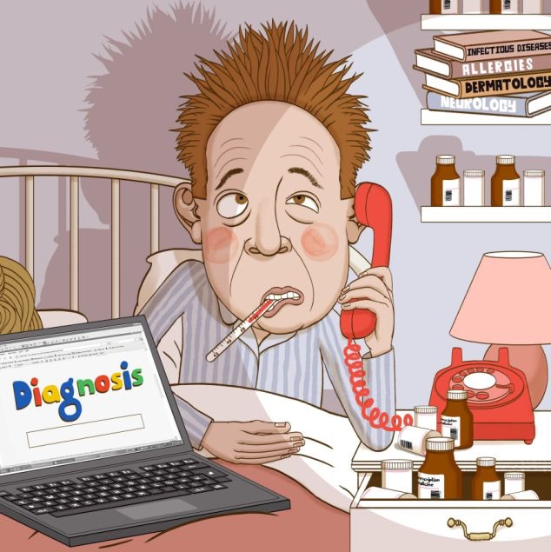
Somatoform Disorders
Conversion disorder- changing emotional difficulties into a loss of a specific voluntary body function
Helps to identify if reaction is calm, not panic
Hypochondriasis- a person in good health becomes preoccupied with imaginary ailments
Do not fake their symptoms, unrealistically interpret normal aches/pains as symptoms of a more serious illness

Slide 83
Obsessive- Compulsive Disorder
OCD- a psychological disorder characterized by persistent, unwanted, fearful thoughts (obsessions) and irresistible urges to perform repetitive and/or ritualized behaviors (compulsions)
Higher incidence in adult women and males in childhood
We all have double-checks and worries but OCD perform these rituals for at least an hour a day
People with OCD usually realize the actions are irrational, but an anxiety builds until the compulsion is performed
Usually treated with drugs, cognitive-behavioral therapy, and remediation therapy

Slide 84
Ted Talk: https://www.youtube.com/watch?v=btO3kE2RrEY
Day in the Life: https://www.youtube.com/watch?v=a-T19wbcEA4
Misconceptions of OCD: https://www.youtube.com/watch?v=W0-siMlKnCQ

Slide 85
Dissociative Disorders
Dissociative disorders- one of a group of psychological disorders characterized by a sudden break (dissociation) in conscious awareness, self-identity, and/or memory (not a psychosis)
Dissociative identity disorder (DID)- a psychological disorder characterized by the presence of two or more distinct personality systems (or identities) in the same individual
Previously known as Multiple Personality Disorder
Each identity has unique personality and experiences, transition occurs suddenly and usually triggered by stress
“core” personality that does not know of other identities but is aware of lost time
Rooted in traumatic experiences
Controversial on the validity of the disorder

Slide 86
Personality Disorders
Personality disorder- a psychological disorder characterized by chronic, inflexible, maladaptive personality traits which cause significant impairment of social and occupational functioning
Antisocial personality disorder (psychopaths or sociopaths)- a personality disorder characterized by egocentrism and a lack of conscience, remorse, or empathy for others
Manipulative and willing to use others for personal gain
Feel little personal distress, often act impulsively, may harm others
May not stay long at jobs or school, often history of truancy or expulsion
May be charming with good insights on others’ weaknesses
Potential genetic predisposition, low autonomic activity, right hemisphere abnormalities, reduced gray matter, biochemical disturbances, environmental disturbances

Slide 87
Personality Disorders
Borderline personality disorder- a psychological disorder characterized by severe instability in emotions, relationships, and self-image, along with impulsive and self-destructive behaviors (like truancy, promiscuity, drinking, gambling, eating sprees)
Often see themselves and others in absolute terms- perfect or worthless, leading to broken social relationships and careers
Intense loneliness and chronic fear of abandonment, often leading to self-fulfilling prophecy of abandonment
Professional intervention is proven to be effective
Causes- environmental factors (abuse, trauma, neglect), genetics (impaired functioning of frontal lobes and limbic system)

Slide 88
Gender and Cultural Effects
Chapter 14, Section 6, pages 484-489

Slide 89
Gender Differences
Established gender differences
Depression shows double rates in women than men
May be because poverty is a contributor for psychological disorders and women are more likely than men to be in lower SES groups
Women are also more likely to experience other contributors- wage disparity, discrimination, sexual harassment, trauma, partner abuse, chronic stress
Women may also be genetically predisposed
Recent research shows a link for wage disparity and depression
May also be the way men vs. women internalize or externalize emotions- women tend to vent and ruminate more
Common symptoms of depression are more acceptable for women, leading men to express depression in less stereotypical ways (acting out or impulsively) leading to underdiagnosed

Slide 90
Culture and Psychological Factors
Rates of schizophrenia vary widely around the world
Could be from actual differences or from differences in definition, diagnosis, reporting, symptoms, beliefs of causes, and stressors for triggers
Prognosis for schizophrenia is sometimes better in nonindustrialized societies
Might be because the symptoms make it difficult to survive in industrialized societies
Might be because industrialized countries have families who are less likely to feel responsible for people with schizophrenia

Slide 91
Avoiding Ethnocentrism
Most research is conducted in Western cultures
Culture-general symptoms (universal)- nervous, trouble sleeping, low spirits, weak all over, personal worries, restless, feel apart/alone, can’t get along, hot all over, worry all the time, can’t do anything worthwhile, nothing turns out right
Culture-bound symptoms- unique to groups and only appear in one population
Depression in North America and Europe show feelings of guilt, China often shows conversion of depression into physical symptoms
Culture-bound disorders, although may be disappearing from globalization

Slide 93
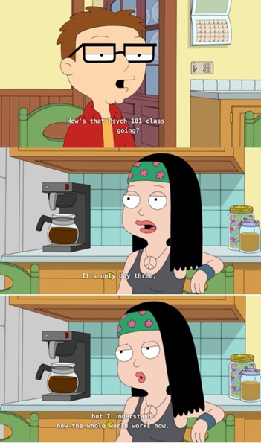
Psychological Disorders on a Personal Note
Psychology student syndrome- a condition often seen in psychology students concerned that they are experiencing the symptoms of a psychological disorder they’re studying
Also using what is learned in a psychology class to “diagnose” someone of a psychological condition without full knowledge or proper certification
Resilience- the ability to recover from or adapt effectively in the face of adversity
Good intellectual functioning, relationships with caring adults, the ability to regulate their attention, emotions, and behavior
May develop as posttraumatic growth
Can develop through practicing self and other compassion, meditation, adjusting perception of adversity, self-efficacy, internal local of control, optimistic, attributional style

