Slide 1
Abnormal Behavior Warm-Ups
Unit 10 Outline
Chapter 3 and 14

Slide 2
Chapter 3, Section 1
What relationships (specifically) exists between social media and stress?
Describe two of the following sources of stress: hassles, frustration, cataclysmic events, acculturative stress
What are the three stages of the GAS?
How do the SAM system and HPA axis work together for stress?
What are two effects of stress on cognitive functioning?

Slide 3
Chapter 3, Section 2
What are two potential illnesses caused by chronic stress?
Why/how does PTSD causes its symptoms?
What are at least two ways to help someone who has PTSD?
Reminder- sleep log analysis due on Friday

Slide 4
Chapter 3, Section 3
Assess the validity of the two stress tests from yesterday. Explain your reasoning
What kind of situations do we normally use problem-focused coping skills for versus emotion-focused coping?
What is the purpose of defense mechanisms?
What are at least two of the positive “side effects” of people who have positive affect and optimism?

Slide 5
Chapter 3, Section 4
What physical effects does prolonged job stress have?
What other effects (name three) does job stress have?
What characteristics does job satisfaction have?
How can you reduce technostress?

Slide 6
Chapter 14, Section 1
How do we define abnormal behavior?
How do psychologists differ from psychiatrists when assessing a psychological disorder?
What is the DSM?
Is insanity a legal or clinical term?
What happened (briefly) in Rosenhan’s study?

Slide 7
Chapter 14, Section 2
What are the characteristics of an anxiety disorder?
What is the difference between having a panic attack and having panic disorder?
What is agoraphobia?
What are the two major psychological factors that contribute to anxiety disorders?
What nervous system is involved in anxiety disorders?

Slide 8
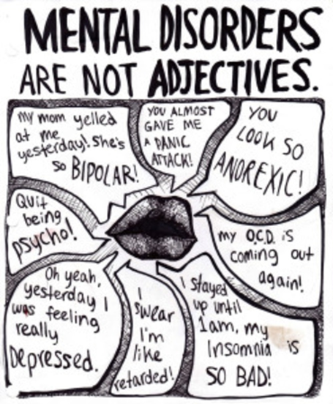
Chapter 14, Section 3 and 4
What characterizes MDD from Bipolar?
What are two biological reasons for depressive and bipolar disorders?
What did Seligman identify as a psychological factor for mood disorders?
What five areas of a person’s normal functioning are affected by schizophrenia?
What is the difference between positive and negative schizophrenia symptoms?
What is the importance of the picture to the left?

Slide 9
Chapter 14, Section 5
What are obsessions versus compulsions?
What are the common terms used for those with antisocial personality disorder?
How can those suffering from borderline personality disorder fall into a self-fulfilling prophecy of abandonment?

Slide 10
Chapter 14, Section 5+6
If you missed class on Tuesday, complete this warm-up then fill in the “terms” column on the paper you picked up. Do not work on the back scenarios yet. This completes your make-up work for Tuesday
What are obsessions versus compulsions?
What are the common terms used for those with antisocial personality disorder?
How can those suffering from borderline personality disorder fall into a self-fulfilling prophecy of abandonment?
Today’s warm-up for Section 6:
Name two gender differences for psychological disorders
What is at least one possible reason rates of schizophrenia vary around the world?
Name three culture-general symptoms
What is psychology student syndrome? How can you avoid it?
-Test corrections for unit 9 are due on March 8^{th.} All late work for this quarter is due on Friday night!

Slide 11
Chapter 14, Section 6
Name two gender differences for psychological disorders
What is at least one possible reason rates of schizophrenia vary around the world?
Name three culture-general symptoms
What is psychology student syndrome? How can you avoid it?

Slide 12
Test Day!
Put your phone in the phone pocket
Get out a separate sheet of paper
Begin filling out your answer sheet- write your name, write your ID number, bubble in your ID number
Put your name on the separate sheet of paper
The sooner you’re ready, the sooner we can start!
You got this ☺

