Slide 1
Scientific Foundations of Psychology Chapter 1
History and Approaches
Research Methods

Slide 2
What is Psychology?
Chapter 1, Section 1A, pages 1-4

Slide 3
What is Psychology?
The scientific study of behavior and mental processes
Pseudopsychologies
Psychics, mediums, palmistry, psychometry, psychokinesis, astrology
It explains learning, remembering, communication, relating to others
Attempts to understand, measure, and explain the nature of intelligence, motivation, and personality

Slide 4
The Randi Challenge
Uri Geller: https://www.youtube.com/watch?v=N3vGGf-ZIkc
https://www.youtube.com/watch?v=x_NuZDaR46I
https://web.randi.org/
1964-2015
$1,000-$1,000,000
Notes:
James Randi Exposes Uri Geller and Peter Popoff https://www.youtube.com/watch?v=x_NuZDaR46I

Slide 5
Goals of Psychology
Describe, explain, predict, change/influence
Description- gather info about behavior and present conclusions
purely observational or correlational
Explanation- explain why people behave as they do
Able to manipulate variables to explain
Prediction- predict (from knowledge) what people will think or feel in different situations
Influence- influence behaviors in helpful ways
Basic science-research for its own sake
Applied science- use psychological findings to solve immediate problems
All accomplished using the scientific method

Slide 6
Question
Imagine that you are a psychologist and a patient has arrived at your office to discuss their problem (shyness). Using the four goals of psychology, outline a possible plan to help the patient. Your plan should meet all the goals.

Slide 7
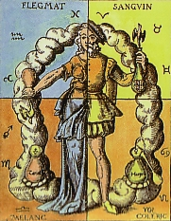
History of Psychology- The Beginnings
Psyche (mind) and logos (word)
GREEKS- studied behavior; people are rational
FOUR HUMORS- Hippocrates; an imbalance of the humors (phlegm, blood, black bile, yellow bile) caused sickness
RENAISSANCE- experimentation through observation
17th CENTURY PHILOSOPHERS- Descartes introduces dualism (mind and body are separate)

Slide 8
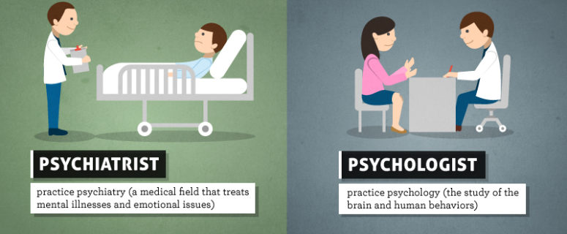
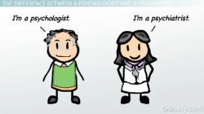
Psychology vs. Psychiatry
PSYCHOLOGY studies the mind and behavior of humans and animals
Cannot prescribe medication
PSYCHIATRY is a specialty of medicine that deals with mental, emotional, or behavioral disorders
Can prescribe medication

Slide 9
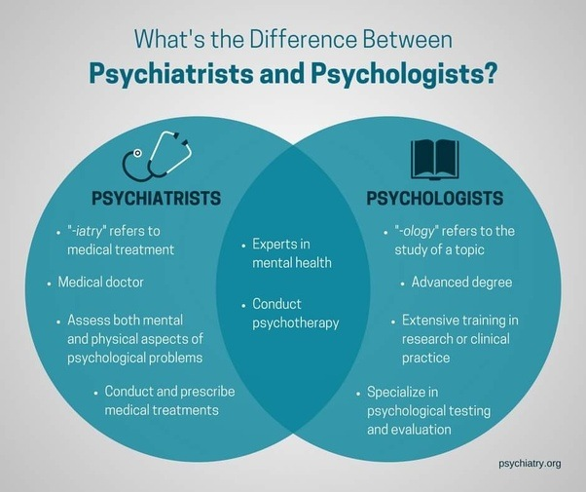

Slide 10
Origins of Psychology: Approaches and perspectives of Psychology
Chapter 1, Section 1b, pages 5-12

Slide 11
History of Psychology
A. Early years
Structuralism
Functionalism
Behaviorism
B. Later years
Psychoanalytic/psychodynamic
Humanism
Inheritable traits
Gestalt
C. More contemporary approaches
Evolutionary
Biological
Developmental
Cognitive
Sociocultural
Biopsychosocial

Slide 12
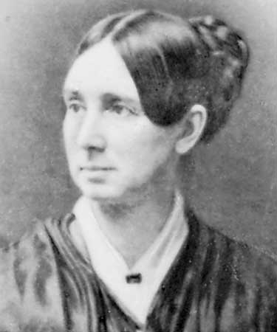
History of Psychology
Dorothea Dix
1802-1887
Worked towards bettering the environment, improving conditions for psychological institutions, and changing the negative reputation of these populations

Slide 13
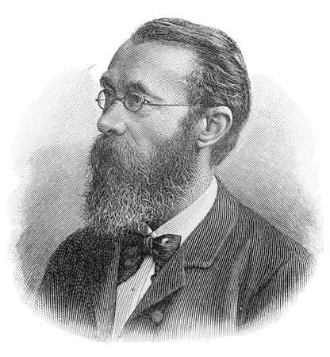
A. Structuralism
Wilhelm Wundt- considered the father of psychology and 1st modern psychologist
Established 1st psychology lab in Germany in 1879
Introspection- a method of
self-observation in which participants
report their thoughts and feelings

Slide 14
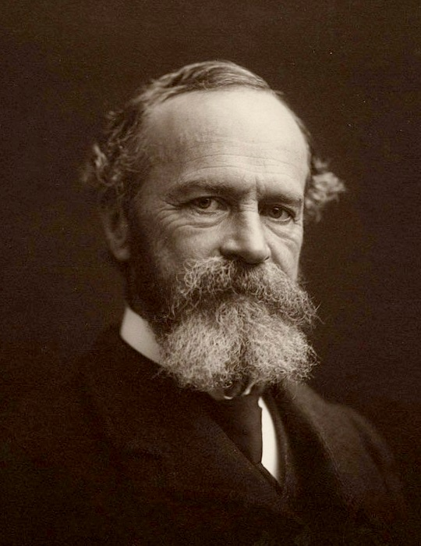
A. Functionalism
William James- 1st American-born psychologist
Father of American psychology
How do organisms use their perceptual abilities to function and adapt to their environments (the function of consciousness)

Slide 15
A. Structuralism vs. Functionalism
Structuralism- focus on the basic elements that make up conscious mental experiences
Wilhelm Wundt and Edward Titchener
Identify the elements of thoughts, then determine how these elements combine to form the whole experience
Self-observation led to disagreement, cannot study animals, failed except for leading to study scientifically
Functionalism- how the mind functions to adapt human and nonhumans to the environment
William James
Ask why do we have the emotion of anger? What function does it serve? How does it help us adapt to the environment?
Narrowed the focus of psychology to dealing with mental processes

Slide 16
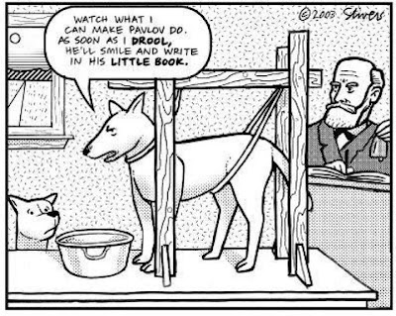
A. Behaviorism
Analyzes how organisms learn or modify their behavior based on their response to events in the environment
Objective, observable environmental influences on overt behavior
John B. Watson- founder
Ivan Pavlov (famous dog salivation experiment)
Stimuli and responses
Often nonhuman subjects, but transfers

Slide 17
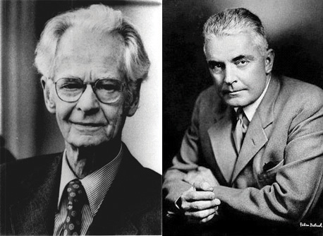
A. Behaviorism continued
John B. Watson- studied only observable and measurable behavior
Based on Pavlov’s experiments
“Little Albert” experiment
B.F. Skinner- studied conditioning, the concept of reinforcement, written in Walden Two, Skinner’s box with rat

Slide 18
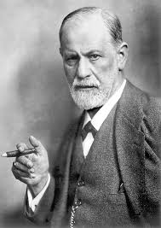
B. Psychoanalytic/Psychodynamic
Sigmund Freud- most famous psychologist
Introduced the idea that we are motivated by unconscious instincts and urges
Sex and aggression
Unaware of our true motives
Psychological problems are caused by a conflict between acceptable behavior and unacceptable, unconscious desires
1st to have patients lie on a couch and speak freely about their thoughts (free association)
Unconscious processes and unresolved past conflicts

Slide 19
How big is the unconscious mind
How Big is the Unconscious Mind? - Horizon: Out of Control? - BBC Two – YouTube

Slide 20
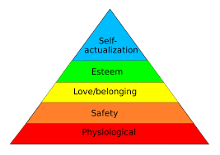
B. Humanistic
Realization of human potential and unique ability to make voluntary choices
Free will, self-actualization, and human nature as naturally positive and growth-seeking
Focuses on
Nonverbal experience
The unity of mind
Altered states of consciousness
Carl Rogers, Abraham Maslow
Influenced currently popular positive psychology

Slide 21
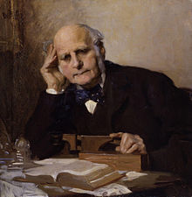
B. Inheritable Traits
Sir Frances Galton- introduces idea of inheritable traits
Heredity influences a person’s abilities, character, and behavior
Started the nature (inheritable traits) versus nurture (environmental influences) debate
What is your opinion on how much nature versus nurture influences a person’s development?

Slide 22
B. Gestalt
Studied how people perceive and experience objects as whole patterns
Emphasizes that the whole of anything is greater than its parts, we cannot deduce the value of the whole by just looking at the individual traits
Uses phenomenology- description of direct psychological experience, adding a humanistic approach
Max Wertheimer, Wolfgang Kohler, Kurt Koffka

Slide 23
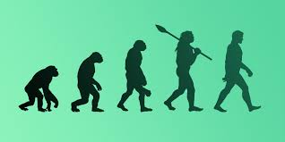
C. Evolutionary
Focuses on natural selection, adaptation, and evolution of behavior and mental processes
Based on Charles Darwin’s theory of evolution

Slide 24
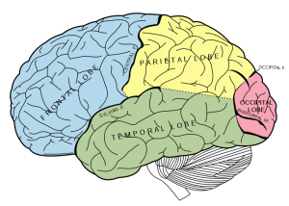
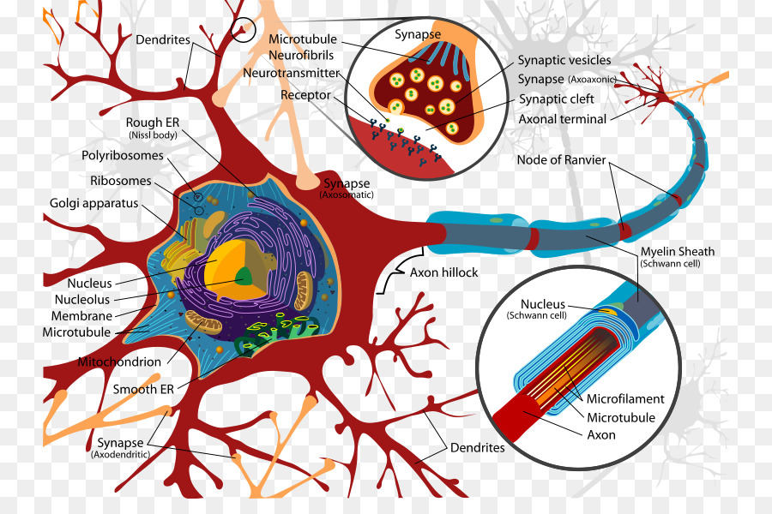
C. Biological
How physical and chemical changes in our bodies influence our behavior
Emphasizes genetics and other biological processes in the brain and other parts of the nervous system

Slide 25
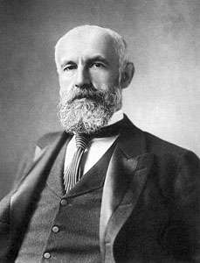
C. Developmental
G. Stanley Hall
Considered the founder of child and educational psychology
1st Psychology Ph.D. in America, 1st President of APA
Designed hundreds of questionnaires, recognizing their use in psychology
Significant developmental research in children
Mental growth proceeds by evolutionary stages

Slide 26
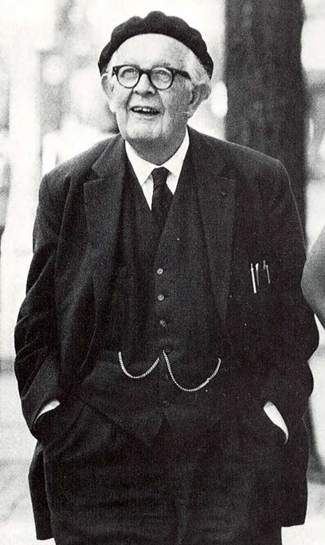
C. Cognitive/Developmental
Jean Piaget- developmental psychology
Identified stages of cognitive development
Contributions include a theory of cognitive child development, detailed observational studies of cognition in children, and a series of tests to reveal cognitive abilities

Slide 27
C. Cognitive
Studies mental processes/information processing
How we process, store, retrieve, and use information and how thought processes influence our behavior
Thinking, feeling, learning, remembering, making judgements

Slide 28
C. Sociocultural
Influence of cultural and ethnic similarities and differences on behavior and social functioning
Social interactions and cultural determinants of behavior and mental processes

Slide 29
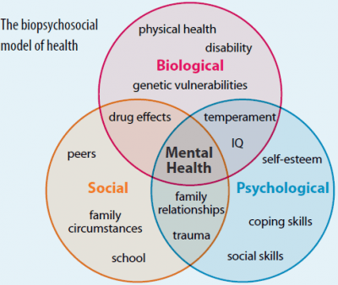
C. Biopsychosocial
Most current approach
Combining the different approaches: biological processes, psychological factors, and social forces
All three forces affect and are affected by on another

Slide 30
Example of Approaches: Aggression
Behaviorists- we learn at an early age that it can be advantageous
Cognitive- thoughts contributing to aggressing
Biopsychologists- results from neurotransmitters, hormones, and structures
Evolutionary- conveys a survival or reproductive advantage that evolved from successfully facing pressures

Slide 31
Application of Psychology: Psychology as a Profession

Slide 32
Psychology Application
Biological- neuroscience and studying the nerve cells, parts of the brain, and genetics
Clinical- diagnosis, cause, and treatment of disorders
Counseling- “normal” problems of adjustment
Cognitive- restructuring of thought processing
Developmental- the stages children to death
Studying emotional, cognitive, biological, personal, and social changes that occur as an individual matures

Slide 33
Psychology Application continued
Educational- concerned with helping students learn, creating different teaching methods
Experimental- studies sensation, perception, learning, motivation, and/or emotion in carefully controlled lab conditions
Monitored by the APA (American Psychological Association)
Industrial/Organizational- workplace productivity, impacts of technology, female vs. male leadership, applying principles of psychology to improve business

Slide 34
Compiled 2009 https://www.psychology.org/degrees/masters/#careers

Slide 35
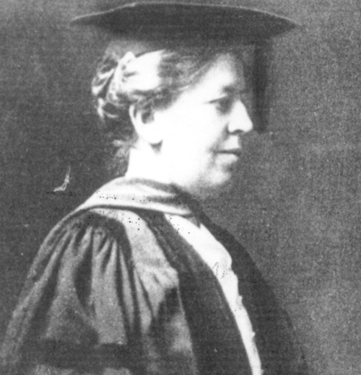
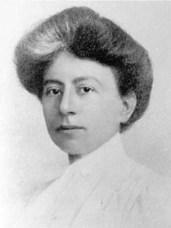
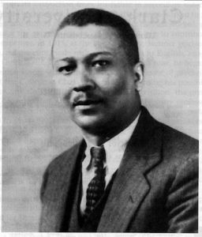
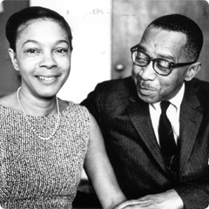
American Psychological Association
Scientific and professional organization representing psychology
Monitors all academic work within the field
Mary Whiton Calkins- first female president
Studied under William James, Yale refused to give her Ph.D., fought discrimination
Margaret Floy Washburn- wrote influential books, second female president of APA, first woman to receive Ph.D. in psychology
Francis Cecil Sumner- 1st African-American to earn a Ph.D. in psychology, chaired a leading psychology department
Kenneth B. Clark- first African-American to be APA President
Mamie Clark- African-American psychologist who worked with her husband (Kenneth B. Clark) to research the negative effects of prejudice (results directly influenced ruling of Brown v. Board of Education)

Slide 36
The science of psychology
Chapter 1, Section 2, pages 13-19

Slide 37
Basic vs. applied
Basic research- knowledge for its own sake
Applied research- using that knowledge to change existing world problems

Slide 38
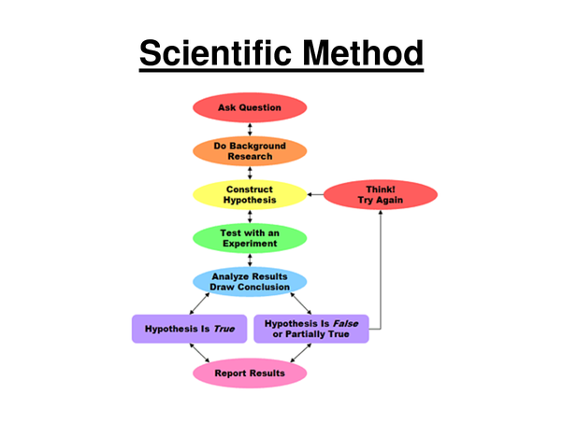
The scientific method
Cycle of conducting an experiment
Lit review→ hypothesis→ research design→ statistical analysis→ peer-reviewed scientific journal→ theory
It is important to design an experiment that is able to be replicated
Meta-analysis helps to come to a final conclusion when studies contradict each other

Slide 39
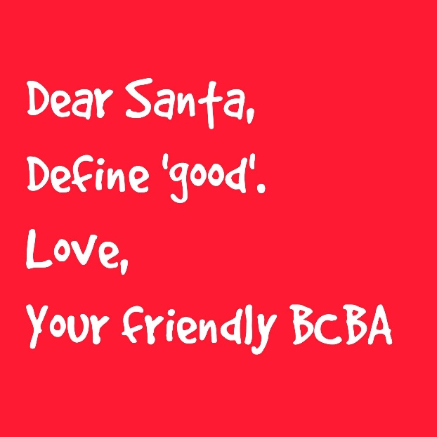
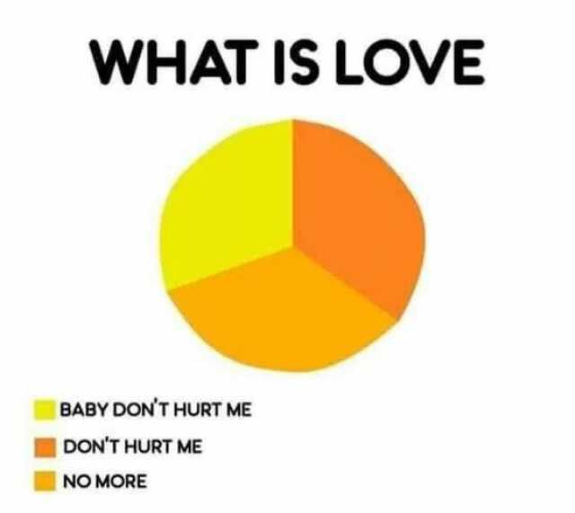
Within an experiment
Must make hypothesis testable
Need to operationally define the variables in ways that are detailed and measurable
A clear definition on how a variable will be measured- what is love? What is success?
Allows replication
Experiments end with a theory- this is tested and retested to change over time

Slide 40
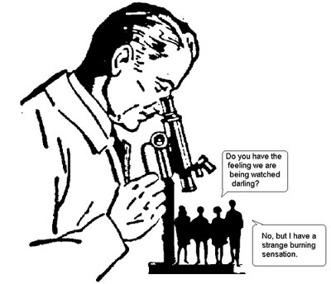
Ethical guidelines from the APA: human participants
Informed consent
Voluntary participation
Restricted use of deception and debriefing
Confidentiality
Alternative activities

Slide 41
Ethical guidelines from the APA: nonhuman participants (animals)
Beneficial for comparative psychology- animals can be studied for a long time and have aspects of their lives controlled that would be unethical on humans
Much advancement has been made with animal research for human and animal benefits

Slide 42
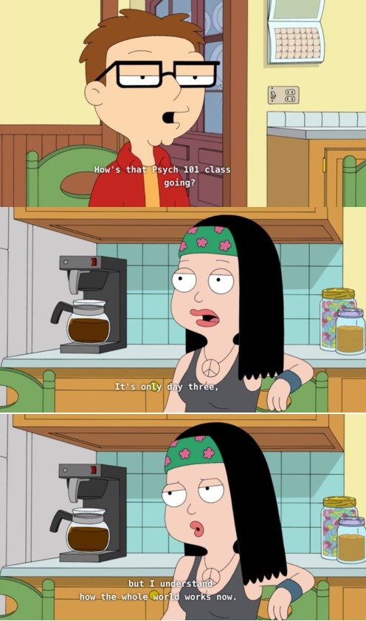
Ethical guidelines from the APA: clients in therapy
In general, therapists must keep all information about a client private
They may break this in certain cases
The client threatens violence to themselves or others
A criminal case- abusing a child, etc.
Public safety comes first
Anyone who violates APA codes can face varying consequences

Slide 43
Research methods
Chapter 1, Section 3A, pages 20-25

Slide 44
Types of research
Descriptive
Correlational
Biological
Experimental

Slide 45
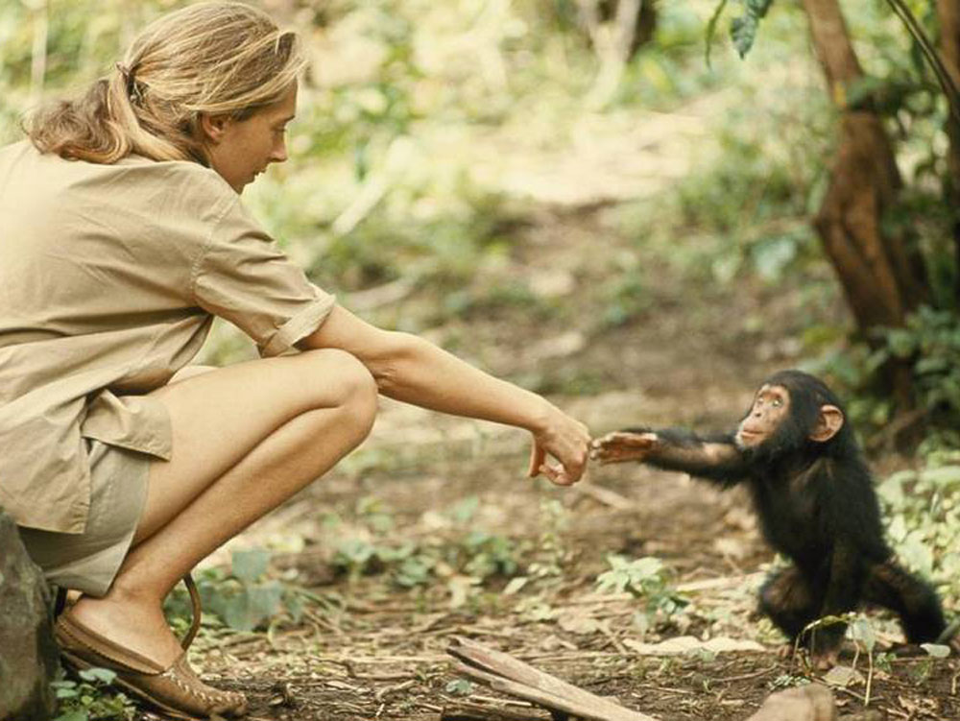
Descriptive research- naturalistic observation
Observing and recording behavior and mental processes in the participant’s natural state or habitat without interfering
Advantages | Disadvantages
Obtain data about a natural behavior rather than lab behavior Easier to collect data Allows descriptions as they occur | Difficult to stay unobtrusive Time consuming Lack of researcher control Harder to study infrequent behavior Researcher and participant biases (like experiment) Cannot explain cause and effect

Slide 46
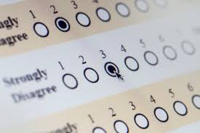
Descriptive research-surveys
Questions a large sample of people to assess their behaviors and attitudes
Advantages | Disadvantages
Gather data from wider sample | Reliance on self-reported data Potentially dishonest participants Cannot explain causation Researcher and participant biases (like experiment)

Slide 47
Descriptive research- case studies
In-depth study of a single research participant
Advantages | Disadvantages
Can study a rare case that would be hard to study with other methods Gives detailed information | Lack of generalizability Inaccurate or biased recall among participants Researcher and participant biases (like experiment)

Slide 48
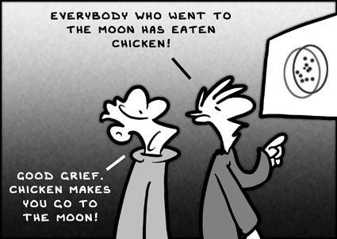
Correlational research
Researcher observes or measures (without directly manipulating) two or more naturally occurring variables to find the relationships between them; Identifies relationships and assess how well one variable predicts another
Advantages | Disadvantages
Answers often asked questions for data and news Help learn a safer and more productive life Clarify relationships that cannot be tested by other methods Allows prediction | Correlation is NOT causation Confounding variables/third factor often involved but not measured

Slide 49
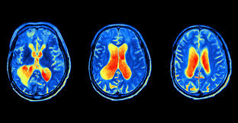
Biological research
Types of neuroimaging:
Brain dissection
Ablation/lesions
Observation/case studies
Electrical recordings (EEG)
Electrical stimulation of the brain (ESB)
Computed tomography (CT) scan
Positron emission tomography (PET) scan
Magnetic resonance imaging (MRI)
Functional magnetic resonance imaging (fMRI)
Transcranial magnetic stimulation (TMS)
Scientific studies of the brain and other parts of the nervous system; identifies contributing biological factors
Advantages | Disadvantages
Most or all of the advantages of other methods | fMRI shows brain activity that could be caused by many different biological processes than what is being tested Many or all of disadvantages of the other methods

Slide 50
Research methods
Chapter 1, Section 3B, pages 26-31

Slide 51
Experimental research
carefully controlled scientific procedure that involves manipulation of variables to determine cause and effect
Advantages | Disadvantages
Most powerful method Can isolate causing factor (IV) Only way to show causation Can identify cause and effect | Ethical concerns Practical limitations Lab conditions Experimenter bias Ethnocentrism Sample bias Participant bias Confounding variables

Slide 52
Random assignment vs. random selection
Random selection/sampling- how you draw the sample of people for your study from a population
Relates to external validity (generalizability) of your results
If done, it allows to better represent the larger group
Random assignment- how you assign the sample that you draw to different groups or treatments in your study
Relates to internal validity
If done, helps to make sure our treatment/experimental groups are similar to each other before treatment
Can have neither, one, or both
Notes:
Random Selection & Assignment
Random sseelleeccttiioonn is how you draw the sample of people for your study from a
population. Random aassssiiggnnmmeenntt is how you assign the sample that you draw to
different groups or treatments in your study.
It is possible to have both random selection and assignment in a study. Let's say you
drew a random sample of 100 clients from a population list of 1000 current clients of
your organization. That is random sampling. Now, let's say you randomly assign 50
of these clients to get some new additional treatment and the other 50 to be controls.
That's random assignment.
It is also possible to have only one of these (random selection or random assignment)
but not the other in a study. For instance, if you do not randomly draw the 100 cases
from your list of 1000 but instead just take the first 100 on the list, you do not have
random selection. But you could still randomly assign this nonrandom sample to
treatment versus control. Or, you could randomly select 100 from your list of 1000
and then nonrandomly (haphazardly) assign them to treatment or control.
And, it's possible to have neither random selection nor random assignment. In a
typical nonequivalent groups design in education you might nonrandomly choose
two 5th grade classes to be in your study. This is nonrandom selection. Then, you
could arbitrarily assign one to get the new educational program and the other to be
the control. This is nonrandom (or nonequivalent) assignment.
Random selection is related to sampling. Therefore it is most related to the external
validity (or generalizability) of your results. After all, we would randomly sample so
that our research participants better represent the larger group from which they're
drawn. Random assignment is most related to design. In fact, when we randomly
assign participants to treatments we have, by definition, an experimental design.
Therefore, random assignment is most related to internal validity. After all, we
randomly assign in order to help assure that our treatment groups are similar to each
other (i.e., equivalent) prior to the treatment.
Copyright ï¿½2006, William M.K. Trochim, All Rights Reserved
Purchase a printed copy of the Research Methods Knowledge Base
Last Revised: 10/20/2006
Random Selection & Assignment http://www.socialresearchmethods.net/kb/random.php
1

Slide 53
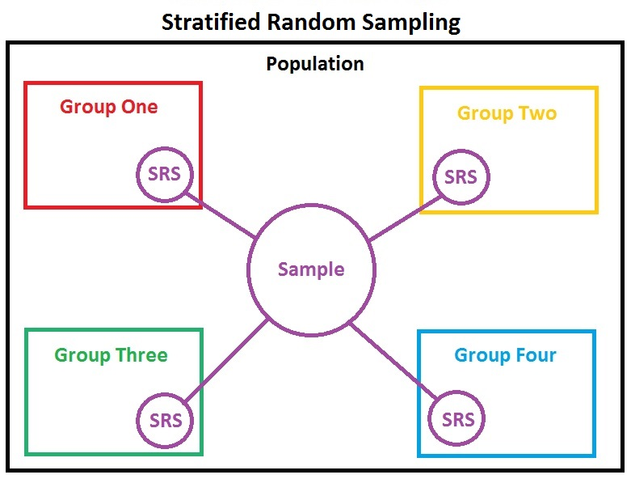
Random vs. stratified sample
Stratified sample- representative of various subgroups of the population
People are put into mutually exclusive, non-overlapping groups, then chosen randomly from each group. Each group is represented in final sample.
Random sample- everyone has an equal chance of getting picked

Slide 54
Experimental research
Independent variable- the factor that is being changed by the experimenter, applied to the experimental group
Dependent variable- the factor that is being measured by the experimenter to see if it changed by the IV
Experimental group- gets the IV
Control group- does not get the IV, may be given placebo
Goal- Does the IV cause the predicted change in the DV? Did I prove or disprove my hypothesis?

Slide 55
Experimental research
Confounding variable- variables that you cannot control for (e.g. age)
Operational definitions- important for replication
in behavioral research, operational definitions are important for measuring accurately

Slide 56
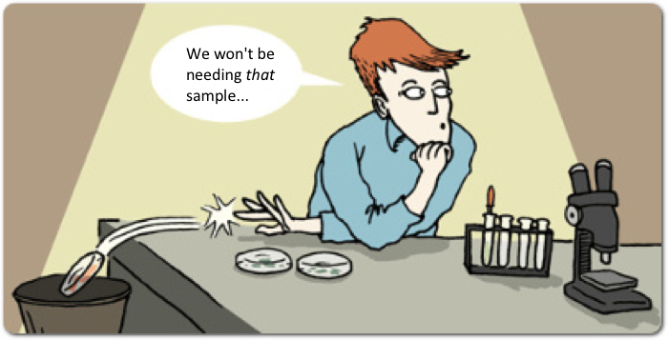
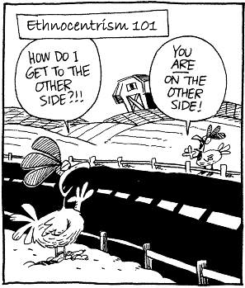
Researcher problems and solutions
Experimenter bias- the researcher influences the results in the expected/hypothesized direction
Fix it with→ single or double blind studies, placebos
Example- Clever Hans horse
Ethnocentrism- believing that one’s culture is typical of all cultures or viewing one’s own culture as central and correct, then judging others on this standard
Fix it with→ cross cultural sampling- conduct experiment in multiple cultures
Notes:
https://www.youtube.com/watch?v=hAJlAuEo7Ac

Slide 57
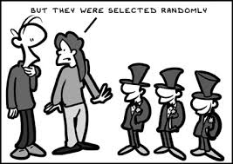
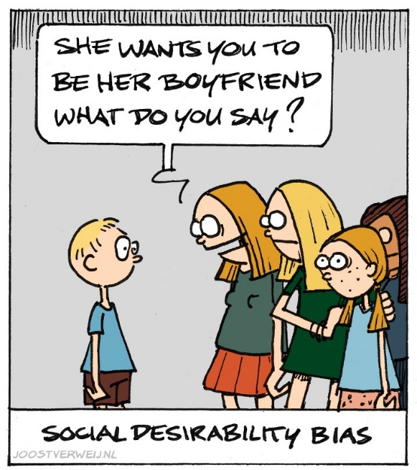
Participant problems and solutions
Sample bias- when research participants are not representative of the larger population
Fix it with→ random/representative sampling
Fix it with→ random assignment
Participant bias- when experiment conditions influence the participant’s behavior or mental processes
Fix it with→ anonymous participation, guarantees for privacy/confidentiality
Fix it with→ double blind studies/placebos
Fix it with→ deception (often seen as unethical)
Social desirability response

Slide 58
Statistical concepts
Reference: A-1 – A-10

Slide 59
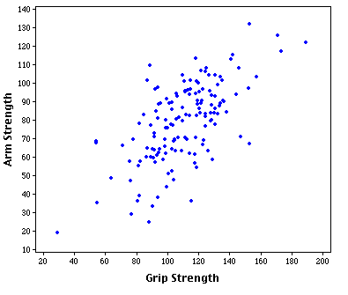
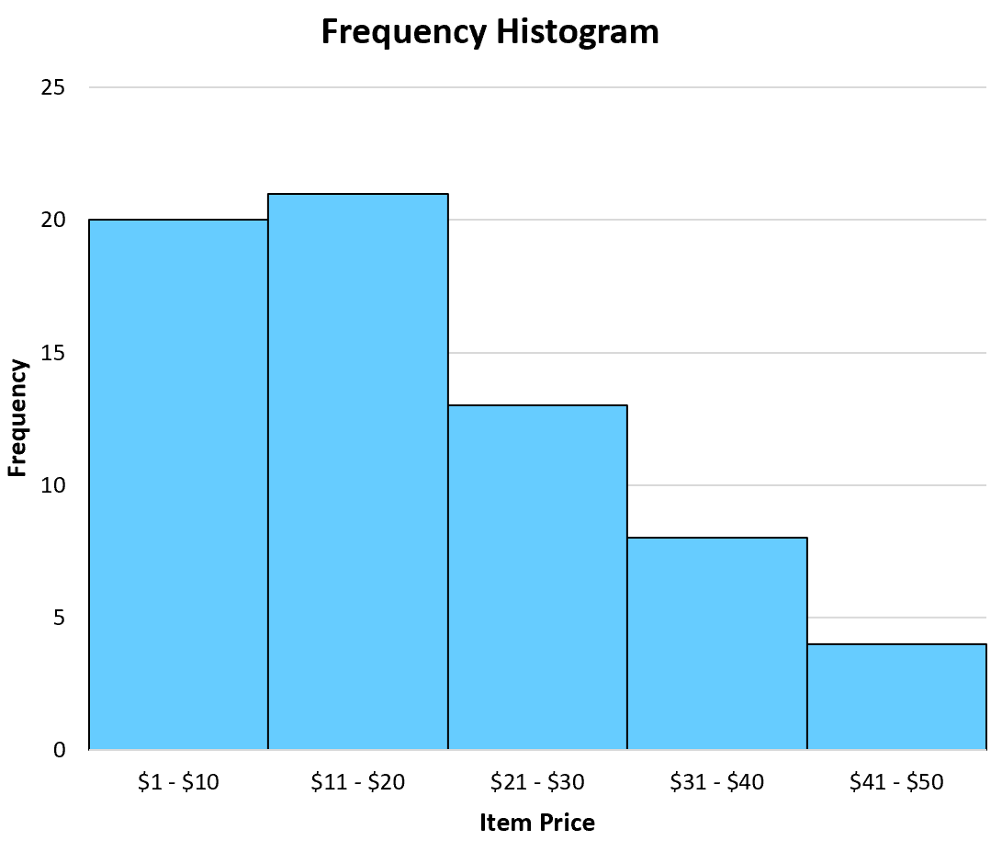
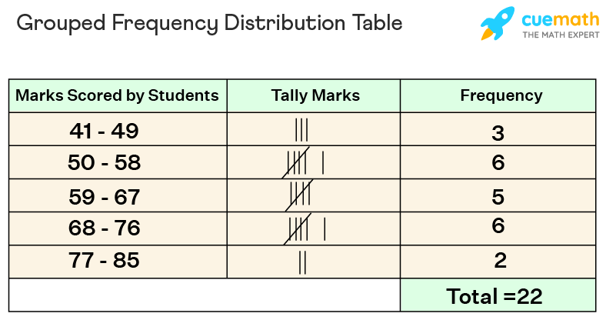
Types of Graphs
Scatterplot →

Slide 60
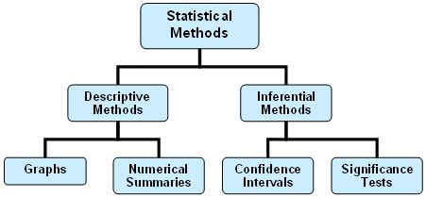
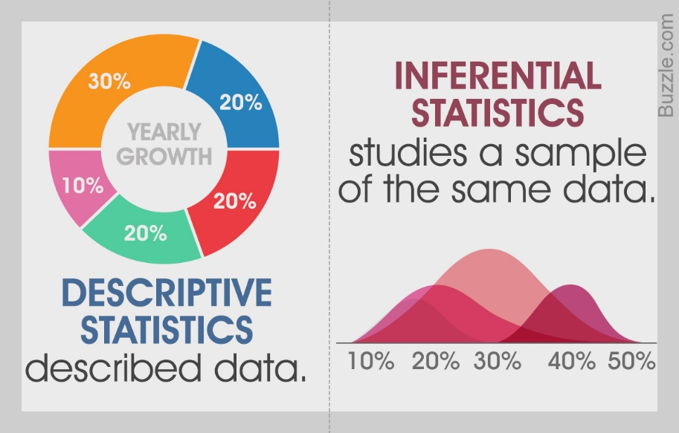
Descriptive statistics vs. inferential statistics
Descriptive statistics- used only to describe the sample or summarize information about the sample
Inferential statistics- used to make inferences or generalizations about the broader population

Slide 61
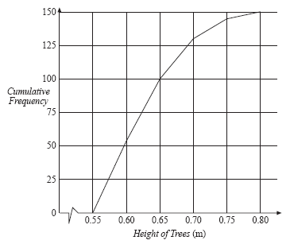
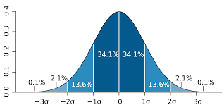
Descriptive statistics: Analyzing data
Frequency distribution- an arrangement of data that indicates how often a particular score or observation occurs
Normal curve- bell-shaped, symmetrical frequency distribution graph of normally distributed data

Slide 62
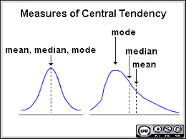
Descriptive statistics: Measures of central tendency
A number that describes something about the “average” score of a distribution
Mean, median, mode

Slide 63
Descriptive statistics: Measures of variability
Variability- a measure of difference, or spread of data; aka the range
Standard deviation- a measure of variability that describes the average distance of every score from the mean
Scores above the mean will have a positive deviation, below will have a negative deviation
If distribution is spread out, deviation is large; if bunched up, it is small

Slide 64
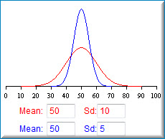
Descriptive statistics: Standard deviation

Slide 65
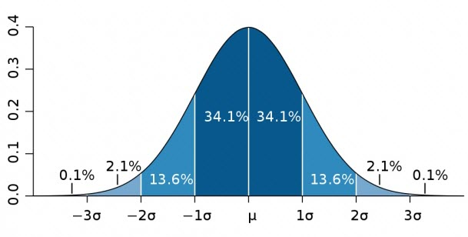
Standard Deviation Graph
A normal distribution forms a bell-shaped curve
In a normal distribution, 2/3 of the scores lie between one standard deviation above and one standard deviation below the mean

Slide 66
Descriptive statistics: Correlation coefficients
Describes the direction and strength of the relationship between two sets of variables
Correlation is the degree of relatedness
Usually the Pearson correlation coefficient r
(+) indicates positive
(-) indicates inverse/negative relationships
From -1 to +1
± 0.60 to ±1.0 is strong
±0.30 to ± 0.60 is moderate
0 to ± 0.30 is weak
1 is a perfect correlation and rare

Slide 67
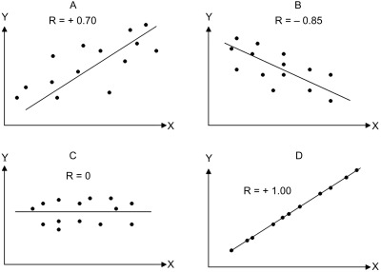

Slide 68
Inferential statistics
Numerical methods used to determine whether research data support a hypothesis or whether results were due to chance
Statistical significance- evaluates the likelihood that results were due to chance
Limit is set by researcher
If researcher says the probability that their results were due to chance is less than 1-5% (0.01-0.05), it is considered statistically significant

Slide 69
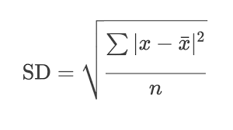
How to calculate standard deviation
Decide if you want to figure out population standard deviation or sample standard deviation- ask yourself if you are focusing on just your people in your study or if you want to generalize to the whole population?
Focusing on just your participants→ population standard deviation
Want to generalize to whole population of your participant demographics→ sample standard deviation
Standard deviation is signified by Greek symbol σ (sigma) and is calculated by finding the square root of the variance.
For population standard deviation, to find the variance:
Figure out the mean (you already have this from the front page table)
Find the squared difference: For each number (each group member’s data), subtract the mean and square the result (the squared differences)
Find the average of the squared differences
Find the square root of the variance= the standard deviation
*If sample standard deviation, use same calculations, but divide by N-1 instead
When you have "N" data values that are:
The Population: divide by N when calculating Variance (like we did)
Sample: divide by N-1 when calculating Variance
https://www.mathsisfun.com/data/standard-deviation.html#WhySquare

