Slide 1
¿QUIÉN SOY YO? – NAME COLLAGE
You are to use either your first or last name and make a collage that represents you and who you are.
Requirements:
You must have a REAL picture of yourself
Each letter has to have a sentence in it (I will show you an example)
It must be colorful and creative!☺ Make
it good as it will be hanging on the
wall for all to see.
This will be due on Thursday.

Slide 2
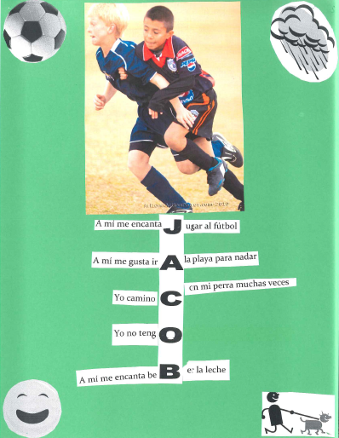
hermanas

