Slide 1
Welcome to Parent Night of Learning 2022-2023

Slide 2
Contact Information
Email: Dylewicz.nicole@cusd80.com
Phone: 480-862-6265

Slide 3
Centers
Small group
Address student IEP goals
Encourage creativity and independence
Peer group work
Working as a team

Slide 4
Daily Reading Logs
Leveled readers sent home each Monday
Please practice with your child and sign the log
Return books on Friday for new books

Slide 5
Social Emotional Learning
Students learn each color zone to indicate feelings
Each desk has a copy for students to reflect upon
Each zone teaches techniques to implement when feeling a certain emotion
Ex: Red zone: Deep breathing

Slide 6
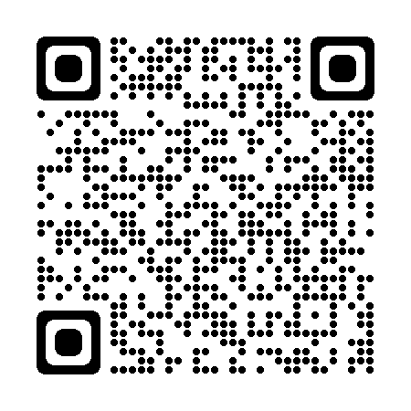
School Breakfast/Lunch
Start of School Flyer.pdf
Meals are no longer universally free
Elementary Breakfast $2.00
Elementary Lunch $3.00

Slide 7
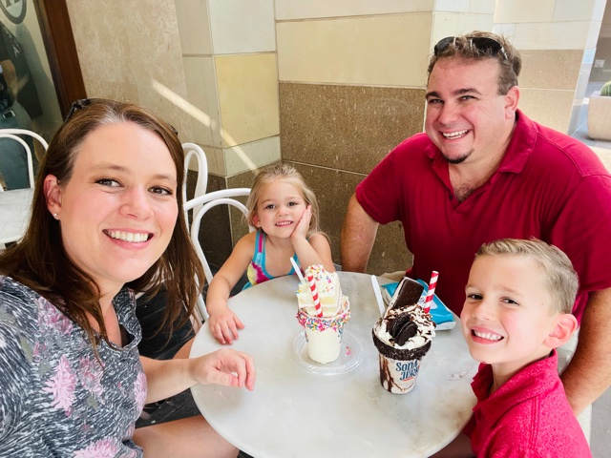
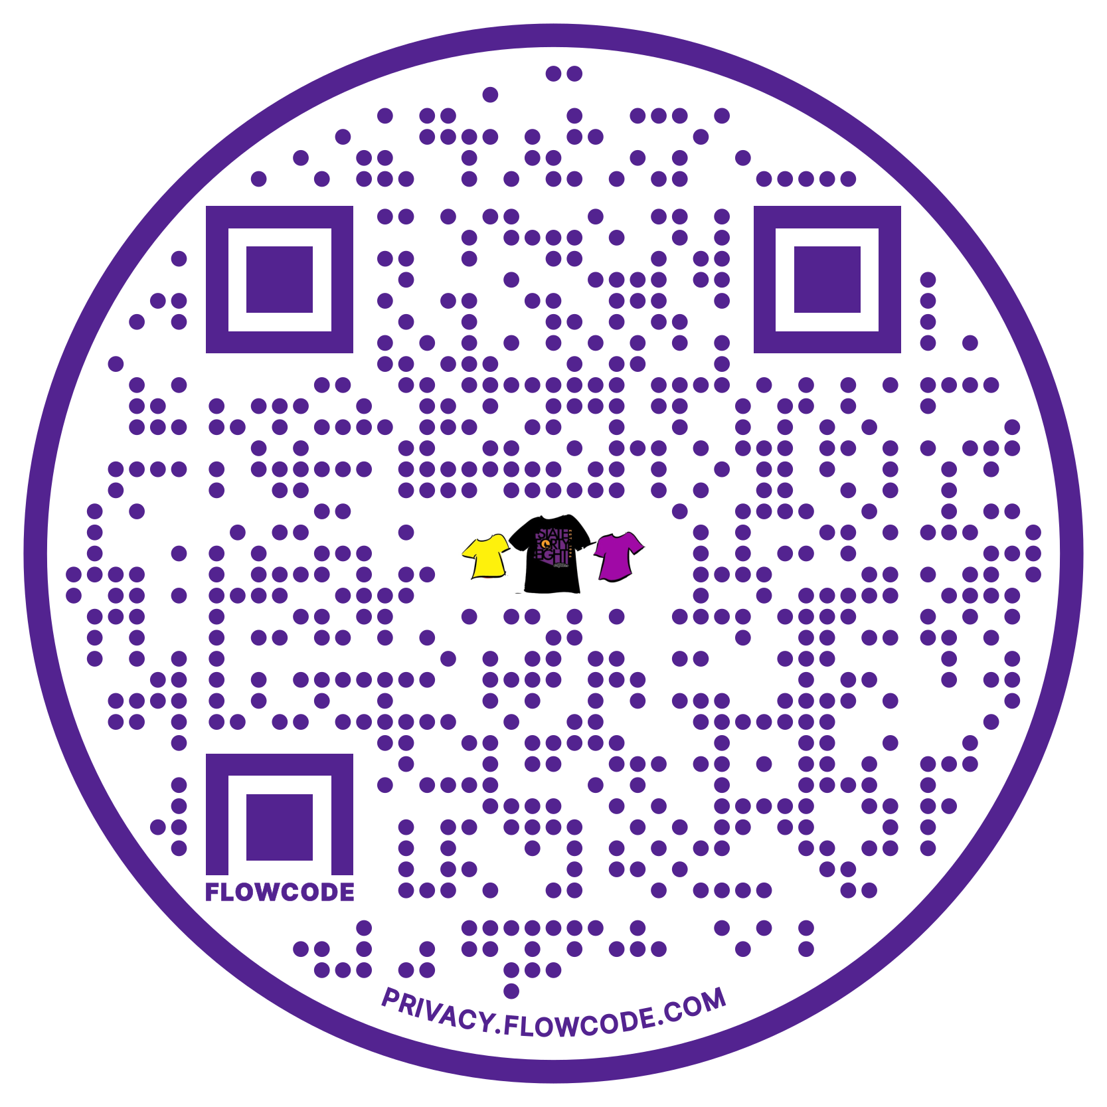
Conley PTO
Who are we?
What does PTO do?
Support teachers (appreciation luncheons, conference meals, supplies stipend, and more)
Fund school activities (scholarships, reindeer games, etc)
Fun community events
Fundraisers
Scan me to Order
Jennifer Farino, Treasurer
What’s coming up next?
Melissa Rivers, President
Restaurant Night
At Peter Piper Pizza: Thursday, August 11th (anytime between 4pm - 8pm)
Our First PTO Meeting
Date: Wednesday, August 17, 2022
Time: 5:30pm
Location: Conley Elementary Media Center
What are other ways I can help?
Tiffani Chavez, Secretary
Ongoing Fundraisers
Fry’s Community Rewards: Use organization name Conley Elementary School PTO or Organization Number VG693
Box Tops for Education: Download the app and scan your receipt or clip box tops and send to your child’s teacher
School Cents: Submit receipts from Chandler Fashion Center and The Boulevard Shops to earn money for Conley from July 1 – January 15
Connect with us!
Email: ConleyCoyotesPTO@gmail.com
Facebook: conleycoyotesptochandleraz/
Website: http://www.runpto.com/u/conley/
Instagram: conleycoyoteden/

Slide 8
Any Questions?

