Slide 1
Class of 2025
SENIORS

Slide 2
BEGINNING OF THE YEAR
Senior credit check meetings w/ counselor ✔
Narrow Down List of Colleges
Start thinking about your next steps
FAFSA
Letters of Recommendation
Scholarships
Job Opportunities
NCAA Athletes – Website: Eligibility Center

Slide 3
Meet the Counselors
Student Last Name | Counselor | Room Number
A-BUF | Ms. Celaya | C125
BUG-DIL | Dr. Massey | C125
DIM-GUR | Mrs. Trujillo | C223
GUS-KEM | Mrs. Tietjen | C223
KEN-MCC | Ms. Furrow | E100
MCD-PAP | Mrs. Anaya | E100
PAQ-SAE | Mr. Spykstra | E200
SAF-TOS | Ms. Romero | E200
TOT-Z | Mr. Kanner | C226
Social Worker | Mrs. Bravo | A122
Social Worker | Mrs. Azurida | H127D
Career Center | Mrs. Schreyer | D100

Slide 4
GRADUATION REQUIREMENT CLASS OF 2025
CURRICULUM AREA | CUSD CREDITS | IN-STATE UNIVERSITY CREDITS
English | 4 | 4
Math | 4 | 4
Laboratory Science | 3 | 3
Social Studies | 3 | 2
Career & Technical Edu/Fine Arts | 1 | 1
World Language | 0 | 2 (Two years of same language)
Physical Education | 1 | 0
Comprehensive Health | .50 | 0
Required Courses | 16.5 | 16
Elective Courses | 5.5 | 0
TOTAL REQUIRED CREDITS | 22 CREDITS | 16 Credits
And Must Pass Civics Test

Slide 5
CORE GPA
Your core GPA is comprised of the grade points associated with your core classes. Your core classes are those that are reviewed for admissions, scholarships and placement into most universities.
4 English
4 Math
2 Social Studies
3 Lab Sciences
2 World Languages
1 Fine Art or CTE
(16 total)
How do you calculate your “Core” GPA?
CORE GPA CALCULATOR

Slide 6
DUAL ENROLLMENT
Credit transfer to in-state and some out-of-state colleges
Verify on Course Equivalency Guide on AZ Transfer to see how credit may transfer - aztransfer link
Dual Enrollment credit is reported on CGCC’s transcript, not HHS
Be sure to request a CGCC transcript for your select college upon high school graduation
HHS Dual Enrollment Page

Slide 7
COLLEGE OPTIONS
In-State
Offer both public and private universities
University, college and community college options
Located in your home state
Affordable tuition
Housing optional (vary by college, if available)
Commute options
Nearby family or support system
Out-of-State
University, college and community college options
Offer both public and private universities
Explore a new area and get outside your comfort zone.
Meet more people from different backgrounds and be more incentivized to make new friends.
You’ll have more independence and get a feel for what it’s like to live on your own.
Tons of choices! If you’re open to attending college out-of-state, you’ll have a huge range of different types of schools
Resources: Should you really go college-out-of-state

Slide 8
TRI-UNIVERSITY
Admissions have opened for
ASU, NAU & UA
(GCU also opened)
Apply Now
Self-Report
Acceptance Letters to go out first week of September
Preliminary Scholarship Letters to go out starting October

Slide 9
WUE Western Undergraduate Exchange
The Western Undergraduate Exchange is a program of the Western Interstate Commission for Higher Education (WICHE).
Students in western states may enroll in more than 140 two-year and four-year college in WUE schools/programs at a reduced tuition level
Several Schools in the following states participate:
Alaska, Arizona, California, Colorado, Hawaii, Idaho,
Montana, Nevada, New Mexico, North Dakota, Oregon,
South Dakota, Utah, Washington, and Wyoming.
*WICHE/WUE WEBSITE

Slide 11
WHEN TO APPLY & WHAT TO DO
COLLEGE
Admissions applications open in July, August and September
Honors typically requires additional application
Request letters of recs, complete resumes, personal statements early
Track deadlines
Early action/Early decision, or regular
Have an in-state backup plan
ACT/SAT
ACT Testing Dates
SAT Testing Dates
Community College Placement Test
FINANCIAL AID
Opens December 1
Apply and verify/validate with selected schools by deadlines
Annual renewal required
Application assistance through colleges/universities are FREE
SCHOLARSHIPS
Merit
Donor/Private
Financial Need
Apply often
Join the College and Career Center Google Classroom!
CODE: : 3nkyceo
Official Transcript Requests
Website: Parchment

Slide 12
LETTER OF RECOMMENDATION
Required for many universities and scholarships
Letters of Recommendation form available -Ask your counselor
Be Proactive (some programs require letters before fall break e.g. Common App, Quest Bridge, Flinn, Military Academy - Teacher input)
Allow your recommender 2 weeks to complete the letter (Letters will not be written over breaks or holidays, and does not count as the two week notice.)
Appointment with the counselor is recommended

Slide 13
TECH & TRADE SCHOOLS
Vary in size, entry requirements, cost and quality
Research
Visit the school
Speak with students and employers
Arizona Tech & Trade Schools (short list)
Arizona Automotive Institute
The Refrigeration School, Inc
AZ Vocational Training
East Valley Institute of Tech.
Conservatory of Recording Arts
UEI College
AZ Medical Training Institute
Carrington College
Avalon, Empire Beauty School
Cortiva Institute

Slide 14
MILITARY CAREERS
Career options through each service branch
Army or Air Force National Guard
US Army
US Navy
US Marines
Air Force
Both students and parents need to be involved in the process
Explore careers, humanitarian/mission service, travel, caring for others, etc.
Potential benefits: network, exposure, improve skills, mature, and gain experience
Gain and add experiences to resume

Slide 15
MAKE IT COUNT!
Senioritis is LEGIT
MAINTAIN Attendance
MAINTAIN performance
GET/REMAIN active and involved
Have a PLAN
TIME MANAGEMENT is extremely important this year. Students need to make time to research their post high school options and scholarships this fall!
TIPS/SUGGESTIONS:
Visit college websites (virtual tours) now through fall break
Create account on PARCHMENT
Continue to apply for admissions and scholarships
Decision making is a process, it’s okay to ask for guidance

Slide 16
RESOURCES
SCHOLARSHIP RESOURCES
Career Center website
Apply to colleges early to be considered for merit scholarships
Honors colleges may have additional scholarships
Common Scholarship Databases:
Fastweb.com
Scholarship.com
Specific colleges of study for alumni and foundation scholarships
Chandler Education Foundation
Going Merry
Scholly App +
FAFSA RESOURCES
FAFSA click here for FAFSA website
FAFSA Application
click here to fill out the FAFSA Form
Each college/institution offers free assistance with FAFSA questions and applications
Do not pay anyone to complete or assist you with FAFSA Apps
SAT/ACT
ACT Testing Dates
SAT Testing Dates

Slide 17
GRADUATION RECOGNITION
Class of 2025
All CUSD high schools will be using the Cum Laude recognition program. This program will replace the concept of designating a valedictorian and salutatorian at graduation. Under the Cum Laude program more of our academic successful seniors will be recognized.
Graduation and Academic Distinction
Three categories are awarded for superior work. This honor is based upon the 7th SEMESTER grade point average.
Cum Laude - meaning "with praise". To qualify a student must achieve a 3.75 - 4.24 weighted grade point average.
Magna Cum Laude - meaning "with great praise". To qualify a student must achieve a 4.25 - 4.49 weighted grade point average.
Summa Cum Laude - meaning "with the highest praise". To qualify a student must achieve a 4.5 - 5.0 weighted grade point average.
National Honor Society
Senior class students who are members of National Honor Society will receive their tassel from the National Honor Society sponsor.

Slide 18
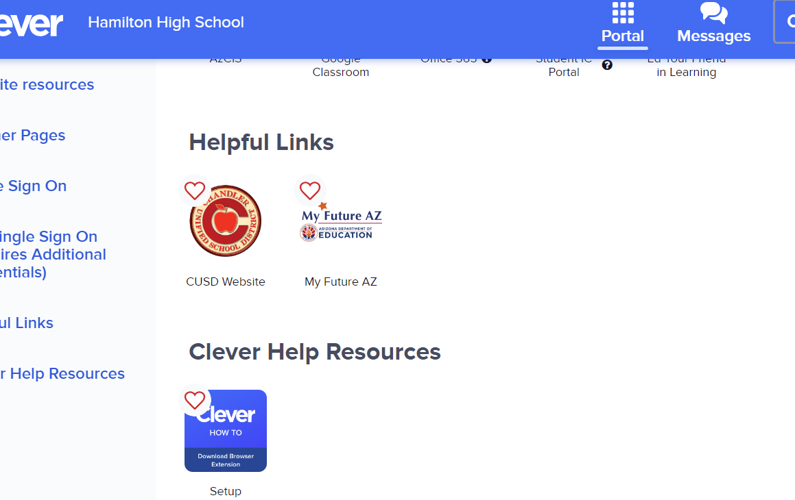
Senior ECAP
Open Chrome
Go to Clever and login
Click on My Future AZ

Slide 19
My Future AZ
Enter your PERSONAL EMAIL
85248
12th
Birthdate
Hamilton High School

Slide 20
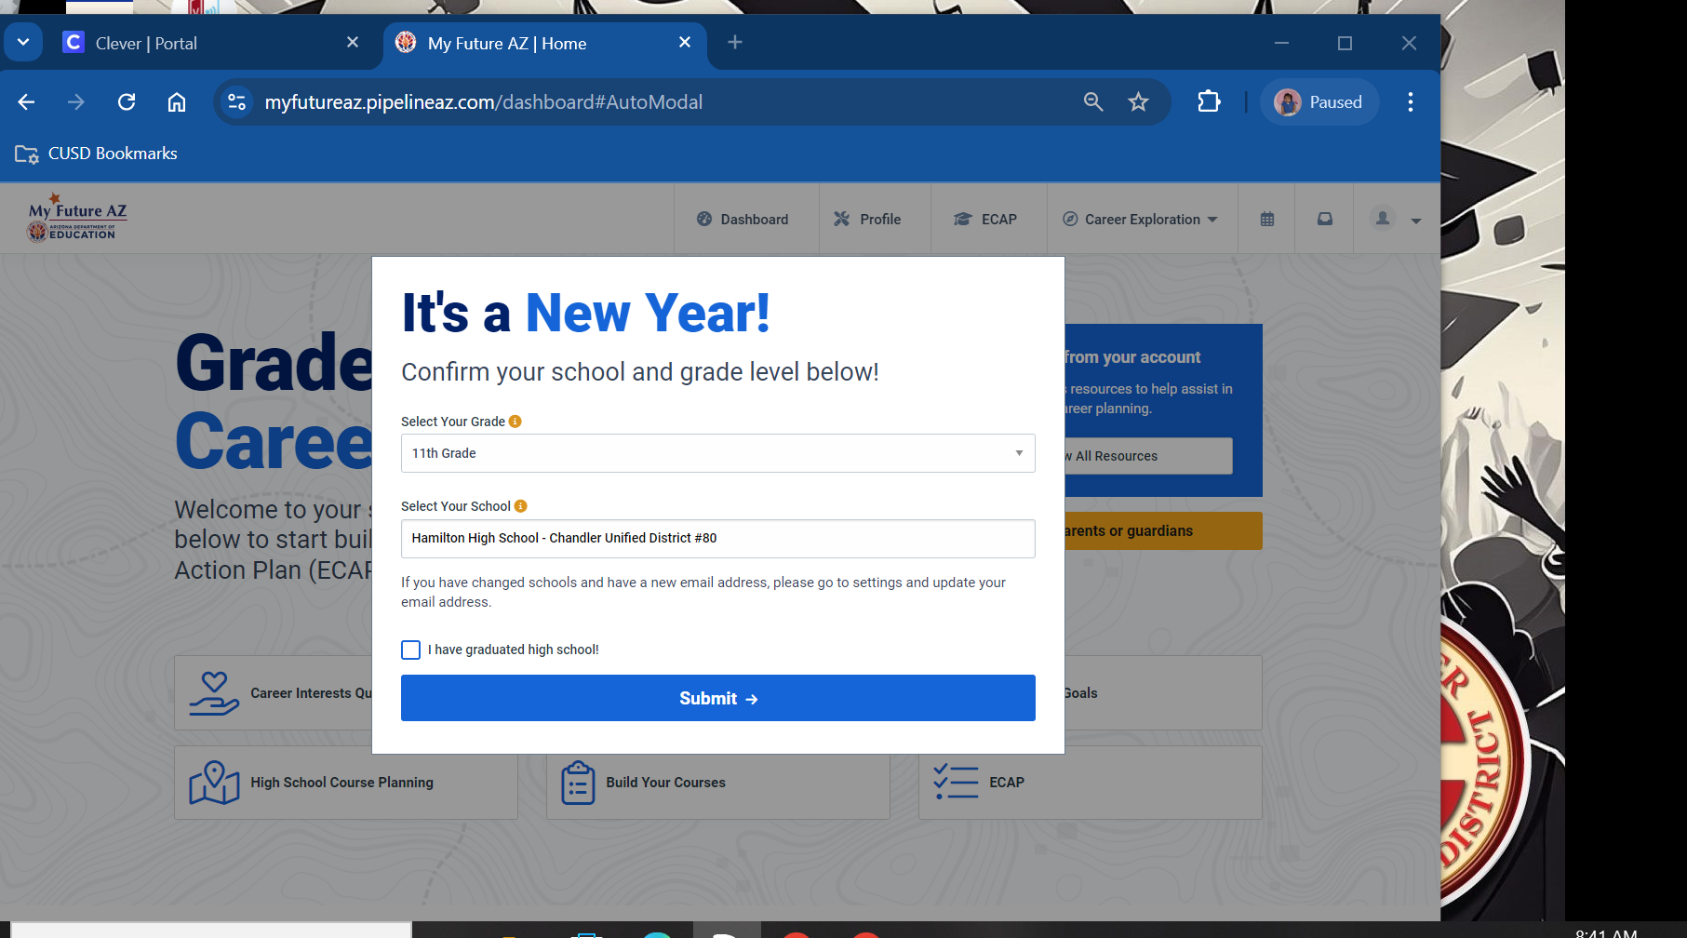
Update Your Grade Level
Make sure to change to 12th grade and that school is Hamilton

Slide 21
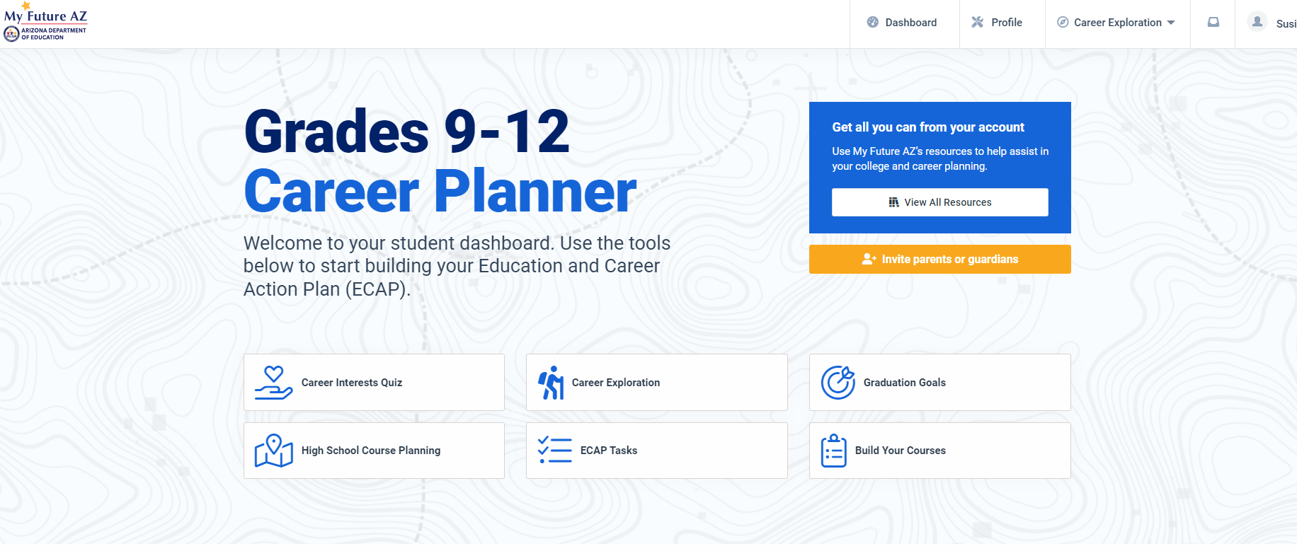
Click On Graduation Goals

Slide 22
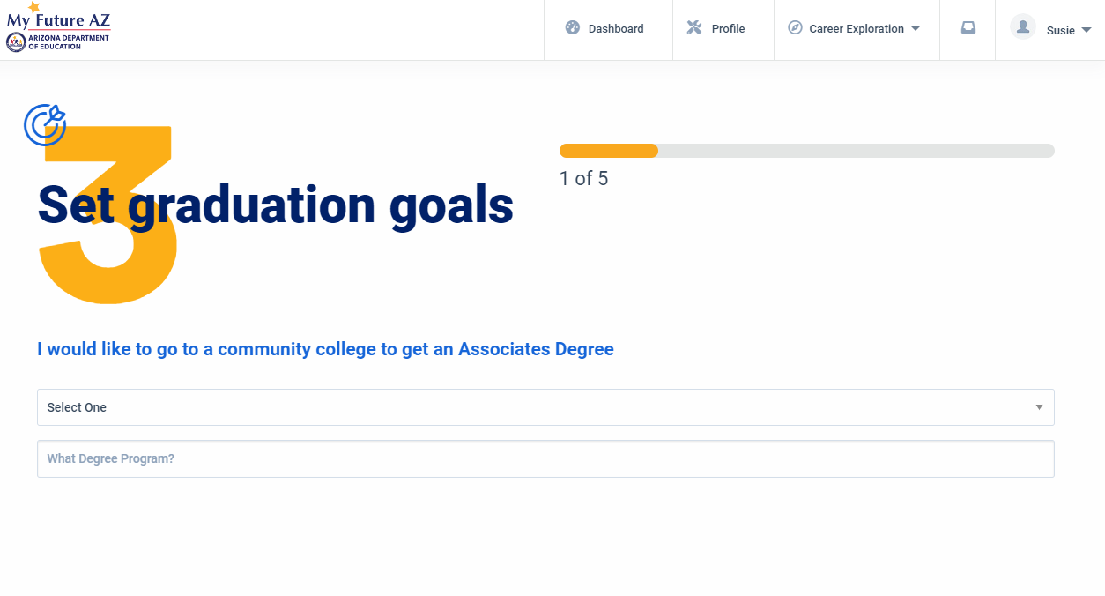
Fill Out Your Post Secondary Goals
Answer questions and Click Submit at the bottom.

Slide 23
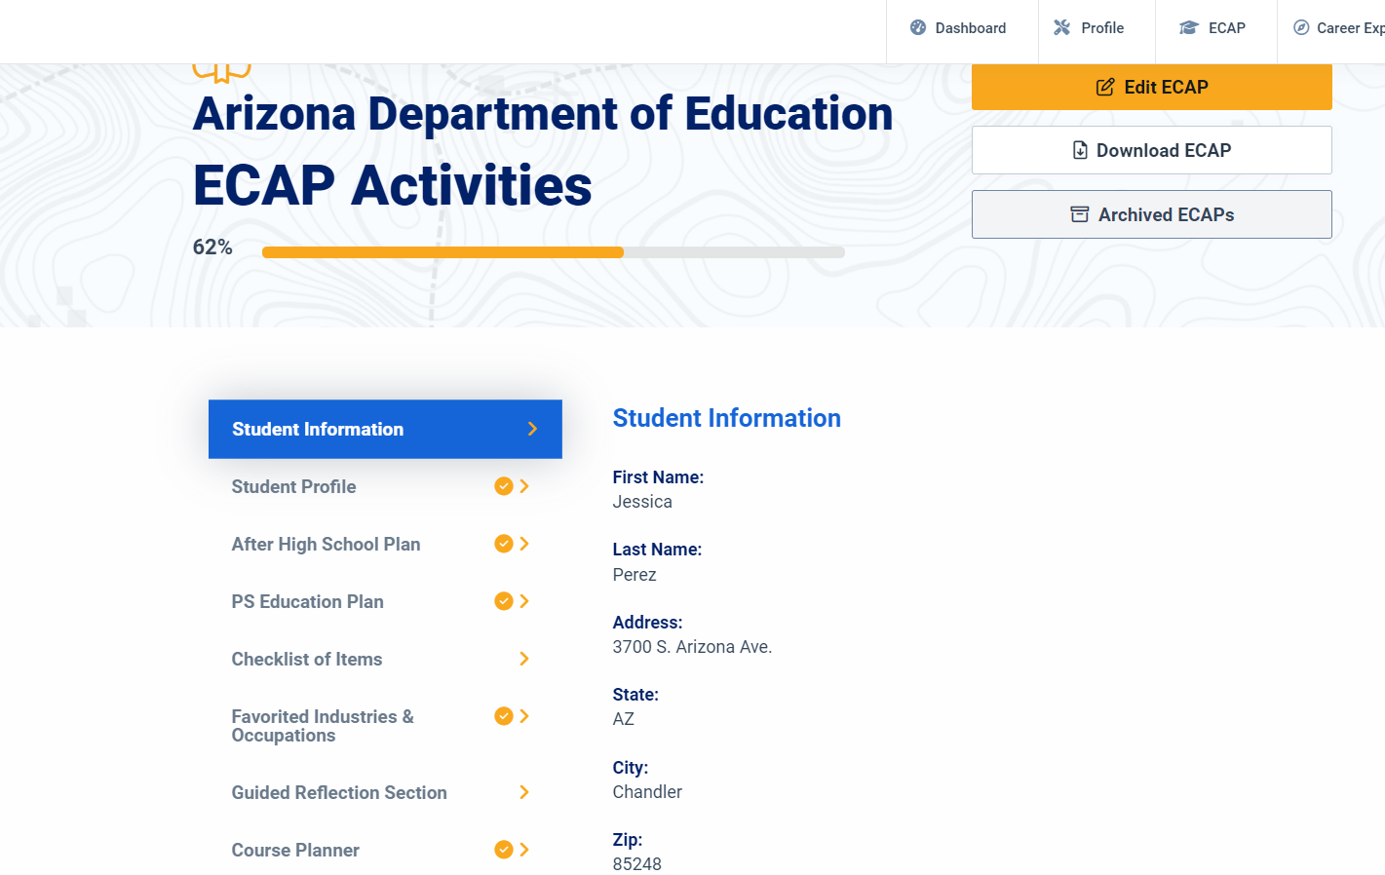
ECAP CHECKLIST
1
2
Make Sure all areas have Check Marks
EXCEPT
COURSE PLANNER and CHECKLIST OF ITEMS

Slide 24
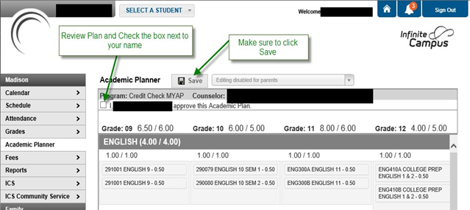
Infinite Campus Parent Portal
Have Parents approve your course plan in their Infinite Campus Parent portal!
(Instructions to be handed out)

Slide 26
Warning Signs
Decline in school performance and behavior
Changes in school attendance
Talking, or joking, about suicide or making suicide threats
Loss of interest in things they used to enjoy
Unusual interest in death and dying
Taking unnecessary risks
Feelings of hopelessness
Depression
Bullying - Both the target of bullying and the bully are at risk
Change in Friendships - withdrawing from friends and social activities
Mood swings or personality changes
Increased use of alcohol or drugs
Giving away prized possessions
Changes in eating and sleeping habits
samsha.gov
Notes:
Four out of five individuals considering suicide give some sign of their intentions, either verbally or behaviorally.
Review Warning signs on slide
Highlight that this is not an all encompassing list. Encourage students to trust their gut when talking to their friends. If you are concerned about someone, take action - seek out an adult right away. When in doubt take action- it’s better to lose a friendship that lose a friend. When we take action we communicate that we care deeply about that friends well being.

Slide 27
988
988 offers 24/7 access to trained crisis counselors who can help people experiencing mental health-related distress.
That could be:
Thoughts of suicide
Mental health or substance use crisis
Any other kind of emotional distress
People can call or text 988 or chat 988lifeline.org for themselves or if they are worried about a loved one who may need crisis support.
Notes:
988 is a new resource that you can call, text or chat if you or someone you know is having thoughts of suicide or experiencing a mental health crisis or substance use crisis.
988 connects you directly to free, confidential, and compassionate support. When you call, text or chat 988, you’ll be quickly connected to trained crisis counselors who will listen to your concerns, provide support, and connect you to additional resources if needed. You can chat at 988lifeline.org.

Slide 28
Effects of Social Media
Notes:
Explain that what they see on social media is not necessarily true of what is happening in a person’s life. Ask for examples (families that look “Perfect” but are actually struggling, filters used to look better, posting pictures with friends when they actually feel very alone) This would be a great opportunity to point out the stat saying that 54% of teens fear that their friends are having more fun than them.
Discuss some of the statistics in the graphics.
Ask students to share how they feel that social media has impacted their lives (distracted from studying, spend more time alone and less with friends/family, increases arguments with parents/guardians, etc). Ask students if they have ever taken time away from their phones and what that felt like, how did it impact their life?

Slide 29
Additional Resources
911
988
Teen Lifeline 602-248-TEEN (8336)
Text Crisis Line 741-741
Suicide Prevention Lifeline 800-273-TALK (8255)
EMPACT 480-784-1500
Trevor Project LGBTQIA+ 1 866 488-7386
A Friend Asks App
Notes:
As discussed in the previous slides, sometimes concerns are too big and need additional outside support from a trusted adult. A trusted adult can be a parent, family member, school counselor, coach, teacher, social worker, mentor, or other adult you feel safe speaking to.
EXPLAIN school procedure here for scheduling an appointment with a school counselor or social worker on your campus.
Other resources off campus include these on the slide. In an immediate emergency, always call 911. The other numbers listed can assist if you or someone you know need help. 988- we already discussed that today. You can call, text or chat with trained crisis counselors if you, or someone you know, is experiencing a mental health crisis or having thoughts of suicide. Teenlife Line is another resource. This number is also on the back of your student identification. Some of you may remember that Teen Lifeline was present at Link Crew Day and provided information regarding Teen Lifeline and what it is like to call the phone number. Teen Lifeline is a FREE RESOURCE. Suicide prevention hotline/EMPACT is another resource available to you. And, lastly, A Friend Asks App which we already discussed in detail.
***Students could be allowed to take out cell phones to enter phone numbers into contacts. Encourage students to take minute to download the A Friend Asks App. Discuss that all of these are FREE resources.
If after listening to this presentation you would like to speak to a counselor please (EXPLAIN procedure for following up with students that day and the location for finding a counselor.)

