Slide 1
Anxiety
Triggers- Where does it come from- How does it feel

Slide 2
Anxiety
What is Anxiety? What does that word mean to you?
Does anyone in your family have anxiety that you know of?
Anxiety and depression have been linked to genetics and is apart of our biological heritage.
Anxiety is very common (1 in 3 teens, 2007-2012).
Do you experience physical symptoms related to anxiety?
Anxiety is an arousal of energy- body’s natural reaction to stress or our perceived “threats” or “danger”. Brain releases chemicals (stress hormone cortisol) which is what can cause physical symptoms throughout the body.

Slide 3
Where does Anxiety come from?
Part of our biological heritage:
A long time ago our ancestors lived in a world filled with life threatening dangers, predators, starvation, heights, disease, drowning.
From these things the human psyche evolved to avoid danger.
Fear was protective and helped with survival.

Slide 4
Anxiety “Rules”
Our ancestors operated on these 4 “rules” (will discuss more next week)
Detect Danger- How many of you think of all the things that could go wrong? The what ifs?
Catastrophize Danger- Any negative consequences that may come your way, if it even happens will be intolerable.
EX: Getting a bad grade on a test will ruin your chances for college
You have an argument with a friend and the friendship is over
Control the Situation- The belief that you have the power to keep all bad things from happening.
How many of you feel if you worry about something (play the what if game) you can control the outcome?
How does that usually work out?
Avoid or Escape- Believe if you can’t control it, avoid the situation altogether.
How many of you have done this? Anxiety Fee by Robert Leahy

Slide 5
Hope
Challenge the “anxiety rules”:
No longer live in the world our ancestors did
Yet our brains continue to operate as though nothing has changed.
Good News:
We can choose which direction our thoughts will go and how they influence us.
Just have to learn techniques to reducing our anxiety.
Accepting anxiety- normal part of life- doesn’t have to consume us or “scare” us
Anxiety is really a false alarm that is set off by our thoughts and feelings.
Keep in Mind
Regret is about the past
Worry is about the future
Free from worry and regret is the present. Freedom lies in the present.

Slide 6
Unravel the “rules” that lead to anxiety
Anxiety Free by Robert Leahy

Slide 7
Detect Danger See Things Realistically
Old Rule: Detect Danger
See Things Realistically
Think of all the things that could go wrong.
The what ifs?
Am I thinking on facts or simply feelings?
Is my imagination getting the best of me?
What is the likelihood of the outcome I am worried about?

Slide 8
See Things Realistically
For example: I am worried about my class presentation. I am afraid it won’t go well.
Go through the previous questions in your mind (or on paper) and answer them. For example:
I have many things on my side
I am prepared. I have something to say
I have reviewed the material
I have done this before
My mind can come up with all sorts of “what ifs”, but I am treating them as if they are real, rather than what they are- products of the imagination?
Do you agree “what ifs” are products of our imagination?
There are as many reasons to think I will be successful as to think I will fail.
I am equating possibility with probability. What does that mean to you guys?

Slide 9
Catastrophic Thinking Normalize Consequences
Normalize Consequences
Catastrophic Thinking
In the past you may have assumed that any setbacks would be catastrophic.
Ask yourself this?
What has actually happened in the past?
What is the worst that is likely to happen?
How bad would it be if it did happen?
Any negative consequences that may come your way, if it even happens will be intolerable.
EX: Getting a bad grade on a test will ruin your chances for college
You have an argument with a friend and the friendship is over

Slide 10
Normalize Consequences
Going back to the test. Yes, you could fail the test that’s always a possibility but so is getting a good grade on the test.
Failure and success are everyday occurrences. If you fail the test it is not the end of the world you may be upset, but you can learn from it and keep trying your best.
Getting out of your own head and negative thinking to more confident and positive thoughts is so helpful.
Imagining the worst possible consequence is a hopeless game: there’s a “doomsday” scenario to everything. But the only “emergency” in most cases is the one going on in our mind.
The message that you will be humiliated by the class presentation is a false alarm. False alarms are not the same thing as reality.
The notion of catastrophe is a thought not a fact.
Most importantly your anxiety is not catastrophic.

Slide 11
Normalize Consequences
To have sweaty palms or an accelerated heartbeat may be unpleasant but its not catastrophic.
Anxiety is simply an arousal of energy. You can observe this energy by being mindful and sit with it, allowing it to pass through you like the energy you get from exercise or dancing to music. Those also cause arousal.
Once you think of anxiety as arousal- or simply “noise” or “false alarms”- you can learn to let it go.
Anxiety does not foretell any particular outcome in the real world; it merely attaches itself to our thoughts, feelings and fears as a defense mechanism.

Slide 12
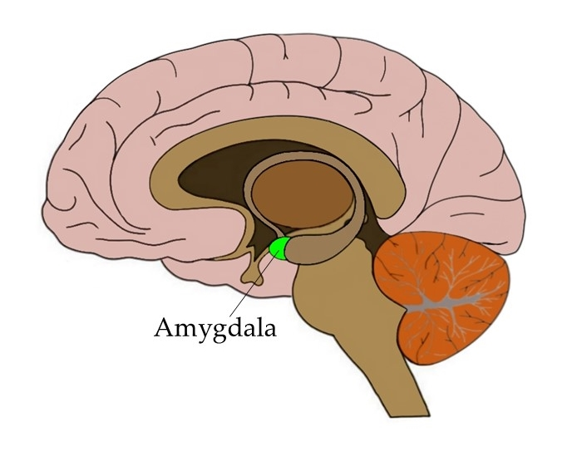
Amygdala
Emotion activation
Labeling deactivation
Our thoughts’/feelings/emotions activate our
Amygdala which releases chemicals and stress hormones which causes uncomfortable physical
symptoms. Labeling (or identifying these thoughts/feelings/emotions deactivates the
Amygdala and allows us to start to think clearer which helps our body and mind to calm down.

Slide 13
Control the Situation Let go of Control
Control the Situation
Let Go of Control
The belief that you have the power to keep all bad things from happening.
Part of human nature to want to take control of things we fear so that things don’t get “out of control”.
Reality-
A lot beyond our control
Just leads to more anxiety and the cycle continues
Letting go of control-
Allows for openness and acceptance of your thoughts and feelings good or bad.
Learn that your thoughts, sensations and anxious emotions will decrease on their own because now you aren’t feeding the bear.

Slide 14
Avoid or Escape Embrace
Embrace Your Anxiety
Avoid or Escape Your Anxiety
Have to be willing to stretch your limits, get out of your comfort zone and know that you will be ok.
“A comfort zone is a beautiful place, but nothing grows there”
Only way to teach yourself that you can do it is to face the anxious thoughts or problem.
Realize symptoms of anxiety are our bodies reaction to false alarms and those feelings are temporary you will get through it and be ok. It may be uncomfortable in the moment, but the feelings will pass.
Believe if you can’t control it, avoid the situation altogether.
Old rule says avoid anything that makes you anxious; ex: making new friends, confronting a tough situation, etc.

