Slide 1
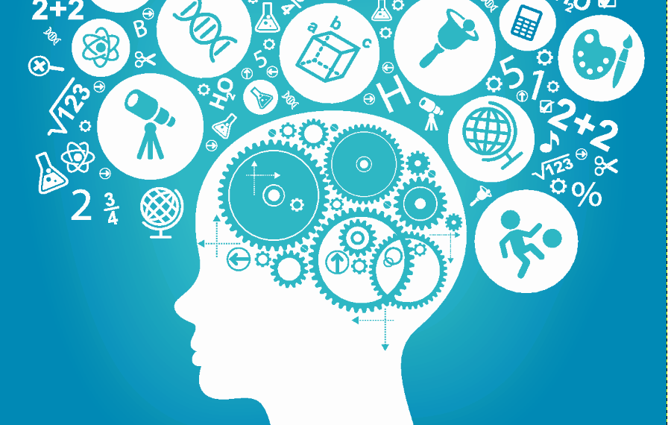
The emotional world of Teens
Fostering your Teen’s social/emotional intelligence
Michael Klinkner, MSW, LCSW
Dr. Elizabeth Fedrick, PhD, LPC
Notes:
Introduction: Education, Career/teaching, experience, dissertation on attachment theory/parent-child relationship

Slide 2
What is emotional intelligence?
The ability to be aware of and effectively regulate one’s own emotions, as well as the ability to be aware of and show empathy towards others’ emotional states.
“Emotional intelligence is generally said to include at least three skills: emotional awareness, or the ability to identify and name one’s own emotions; the ability to harness those emotions and apply them to tasks like thinking and problem solving; and the ability to manage emotions, which includes both regulating one’s own emotions when necessary and helping others to do the same” (Psychology Today).
Notes:
Liz

Slide 3
How does emotional intelligence develop?
“Emotional development is actually built into the architecture of young children’s brains in response to their individual personal experiences and the influences of the environments in which they live. Indeed, emotion is a biologically based aspect of human functioning that is “wired” into multiple regions of the central nervous system” (National Scientific Council on the Developing Child, 2011).
Genetics
Environment/Life experiences
Parenting style
Notes:
Mike

Slide 4
How does emotional intelligence develop?
Starts in infancy with interactions with caregivers
- How the parent responds to a child’s need and
call for help.
- Children at this age are incapable of regulating
emotions, and thus the parental response to the
child’s emotions and needs will lay the
groundwork for learning who/what is safe and
how to respond in times of distress.
The development of the “adaptive child” begins at this
time when a child determines what behaviors are
necessary to stay safe and get their needs met (being
loud/disruptive, misbehaving in order to receive any
type of attention people pleasing, meeting parents
needs first, etc.).
Notes:
Mike

Slide 5
How does emotional intelligence develop?
The parent-child relationship is the child’s first exposure to relational dynamics and is the foundation for what the child will expect out of future relationships
These early life experiences lead to core beliefs of self, others, and the world as a whole
Core beliefs are what set the stage for thoughts, feelings, and behaviors in future situations
Notes:
Mike

Slide 6
The role the brain plays in emotional functioning & regulation
Parts of the brain responsible for emotional processing & regulation:
-Amygdala
“Conversely, when a parent expresses defensive behaviors or heightened negative affect, the rodent work has shown that such cues are quite effective in amplifying amygdala reactivity” (National Scientific Council on the Developing Child, 2011).
“Stimuli related to a (regulated) parent can modulate a physiological response to threat, namely that parental cues can dampen elevations in the stress hormone cortisol (in humans)” (National Scientific Council on the Developing Child, 2011).
-Prefrontal cortex
Notes:
Liz

Slide 7
The role the brain plays in emotional functioning & regulation
“This complex neurobiological interstate takes years to reach maturity. It is often the case that slow developing systems are highly susceptible to environmental pressures; that is, they exhibit a high degree of plasticity” (Tottenham, 2017)
Starting around 8 to 10 months, children begin to look at the facial expressions of others to help themselves decide what to do. In a way, children become able to "read" the emotional meaning of another person's facial expressions. This is called social referencing–looking for emotional clues about a situation in the faces of other people.
Notes:
Liz

Slide 8
The amygdala
Contributes to emotional processing
Susceptible to stressful events
Leads to fight, flight, freeze response
Releases neurotransmitters needed to handle a threat
Designed to store emotional memories to protect us from similar threats in the future
Not always accurate when sensing threats

Slide 10
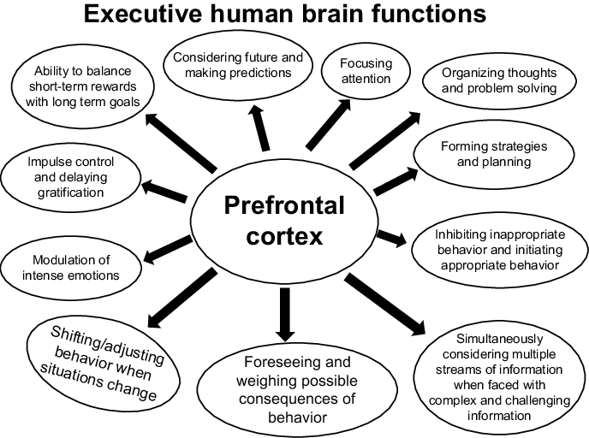
Prefrontal cortex

Slide 11
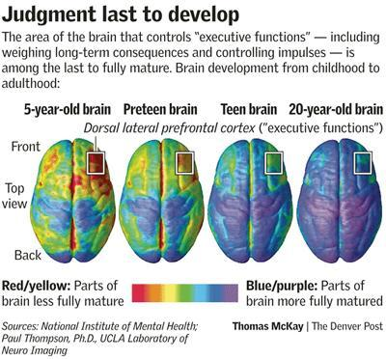
Prefrontal cortex
Does not finish developing until mid-20s
Limbic system (emotion centers of the brain) develops at a much quicker rate
Due to slow rate of development, is more susceptible to neuroplasticity and change

Slide 12
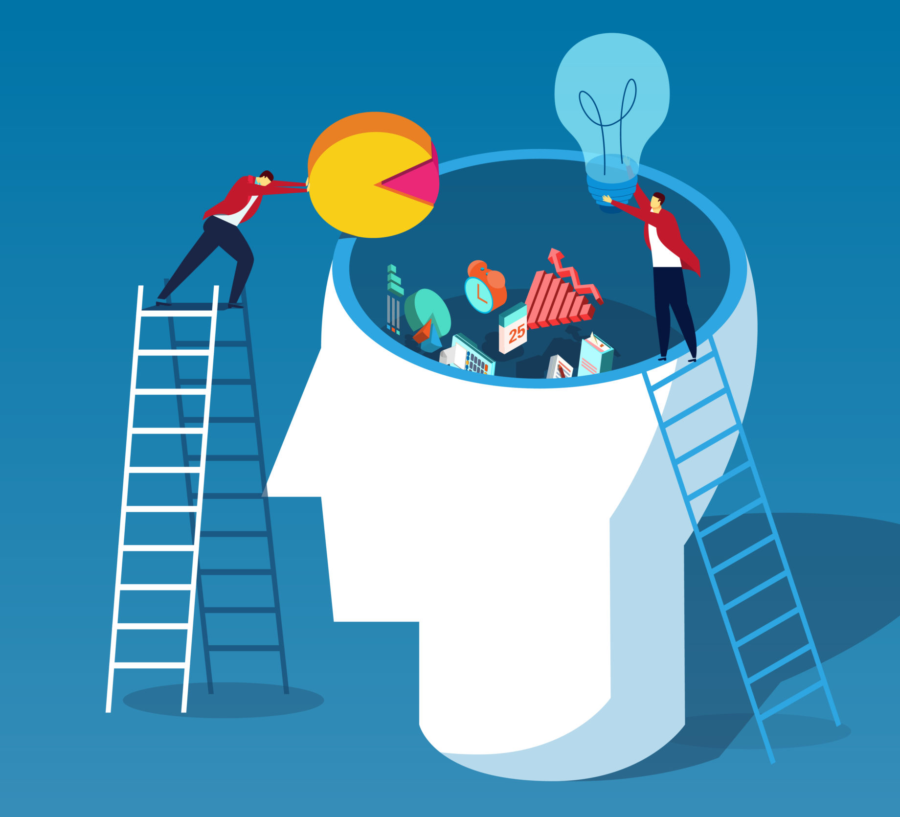
The impact of parenting styles
Permissive
Uninvolved
Authoritarian
Authoritative
Notes:
Mike

Slide 13
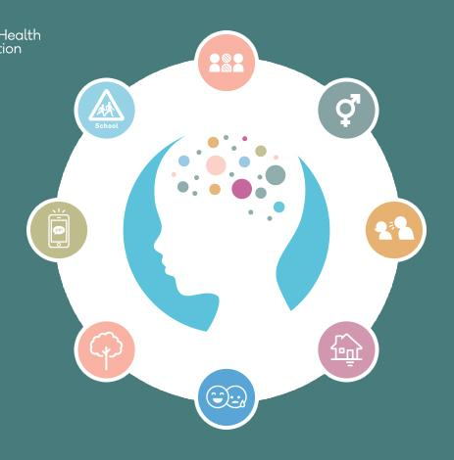
What can we do to support optimal social/emotional development?
Emotion coaching: VIR (validate, investigate, regulate)
Co-regulation
Intentional activities
Positive labeled praise
One-on-one time
Avoid power struggles
Acknowledge and apologize for mistakes
Notes:
Mike

Slide 14
Parenting evolved
Validate Investigate Regulate
Notes:
Liz

Slide 15
validate
Be the calmest version of yourself you can be
Let the child know their feelings are valid
Label the emotion if they can’t
Use calming skills, if need to
Use statements like: ”that sounds like a lot.” “That would be hard.”
Be careful to not give them the idea that they just “need to get used it” or “just get over it.”
Notes:
Liz

Slide 16
INVESTIGATE
Ask the right questions and wait for the answers
Help your child focus on how they see the situation and when it got started
Some examples are: “what started the emotion?” “When did you first start to get upset?”
“What was the worst part for you?” “Does this kind of thing happen a lot?”
“Is there any other way of looking at that situation, maybe from someone else’s point of view?”
Notes:
Mike

Slide 17
REGULATE
Help them feel in control
Help them explore their options: “what part can you solve?” “What do you think are the best options?” “Which option makes you feel the best?” “What part of this do you think you can change?” “What step are you ready to take right now?”
Collaborate-get and use their inputs and opinions to solve the issue
Break the problem down into smaller parts if needed
Provide reassurance and cheerleading
Notes:
Liz

Slide 18
CO-REGULATION
Research indicates that when a teen sees and experiences a calm caregiver, they can also start to effectively regulate.
Losing our tempers does not teach a child how to regulate theirs.
Yelling, shaming, and chaos increases amygdala activity and decreases a child’s ability to effectively regulate.
Consider time-ins when appropriate.
Remember, we are products of our environment. Thus, what a teen sees, experiences, and learns is acceptable, will dictate future behaviors.
Notes:
Liz

Slide 19
Intentional activities
Date your teen
Schedule regularly
Get their input on activity/restaurant/etc.
Prepare conversation starters
Ask open-ended questions
Ask about emotions/experiences
Share about your emotions/experiences
Notes:
Mike

Slide 20
Positive labeled praise
Catch your teen doing something right
Praise 3x more than you redirect
Label the specific positive behaviors that you are trying to increase
Try to “let things go” when appropriate
Use reward-based systems
Notes:
Liz

Slide 21
One-on-one time
Spending quality time with your teen leads to improved relational functioning, demonstrates their value and importance, promotes safety in the relationship (valuable when difficult situations arise in the future)
Your teen picks the activity
This is not the time to ask questions or teach life lessons
Show interest (put your phone down)
Running errands does not count as a primary source of one-on-one time
Notes:
Liz

Slide 22
Avoid Power struggles
Consider what is triggering you in that moment. What about your teen’s behavior is leading you to a dysregulated state?
A power struggle is sending the message that you are equals (diminishes authority)
Give your teen choices and allow freedom when appropriate (is the request because it is convenient/your personal opinion vs. a safety or well-being expectation)
Know when to walk away (pick your battles)
Consistency is key (people will do what they know they can get away with)
Notes:
Mike

Slide 23
Acknowledge mistakes
The willingness to apologize to your teen and take ownership of your mistakes will go a long way and teaches your teen how to do the same.
Parents are human too
Acknowledge mistakes (people do not “deserve” to be yelled at)
Apologize (I made a mistake when I lost my temper with you, I am sorry)
Do better next time
It is not about the rupture, it is about the repair
Notes:
Liz

Slide 24
Be present
The most important thing you can do to foster your teen’s social/emotional intelligence is to be present and aware
Be aware of teen’s love language (Five Love Languages Quiz)
Make time to ask open-ended questions
Be consistent (so your teen knows what to expect)
Focus on what your teen is doing RIGHT
Notes:
Mike

Slide 25
Questions & Answers Email: efedrick@evolvecounselingaz.com mklinkner@evolvecounselingaz.com

