Slide 1
Unit 3: Cognition
Chapter 7 and 8

Slide 2
Memory
Chapter 7

Slide 3
The Nature of Memory: Sensory and Short-Term Memory
Chapter 7, Section 1A, pages 221-227

Slide 4
What is Memory?
Memory- an internal record or representation of some prior event or experience
Generally seen as a constructive process- actively involved in processing, storing, and retrieving the information
Not as accurate as we’d like to think

Slide 5
Memory Models
Information-processing model- memory is like a computer- encoding (processing information into the memory system), storage (retaining information over time), and retrieval (recovering information from memory storage)
Parallel distributed processing- multitasking- taking in and processing information in different ways at the same time
Best explained for survival situations, not single
memory experiences
Traditional three-stage memory model-
related to information-processing, three steps to
dealing with memory
Sensory, short-term, long-term

Slide 6
Combined information-processing and three-stage models

Slide 7
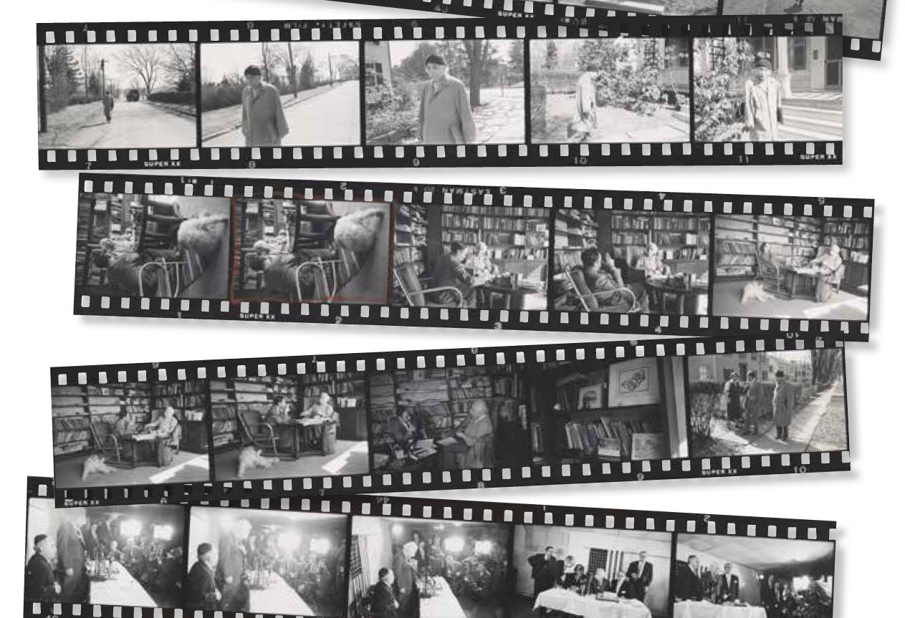
Sensory Memory
Sensory memory- holds our sensory information (incoming sounds, sights, smells, tastes, touches)
Lasts up to ½ second for visual information (iconic memory), 2-4 seconds for auditory (echoic memory)
Large capacity
It’s why we can watch movies without
noticing the frames
Allows us to not be overwhelmed by all
incoming information
Allows for continuity and stability

Slide 8
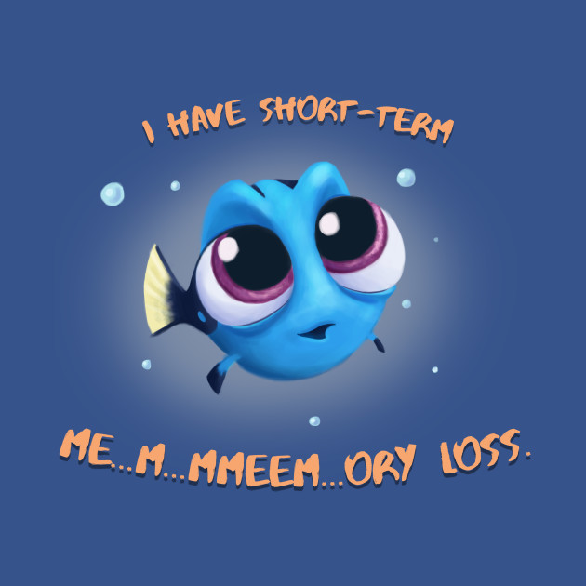
Short-Term Memory
Short-term memory- second stage that temporarily stores information and decides whether to send it to long-term memory
Limited to 7±2 items (5-9 items) depending on the person’s active rehearsal
George A. Miller identified this range, also a founder of the cognitive field
Lasts only about 30 seconds without rehearsal
Also known as your working memory
Ways to keep information in your short-term memory (not moving it to long-term or losing it)
Maintenance rehearsal
Chunking

Slide 9
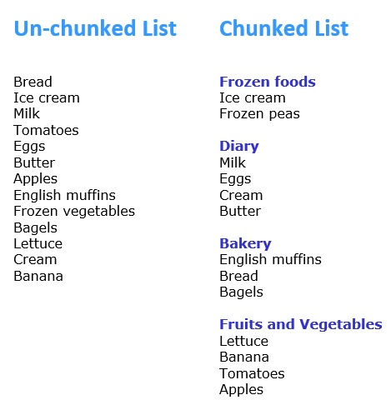
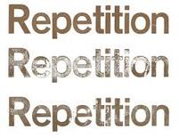
Short-Term Memory Strategies
None of these try to keep information for long-term/find meaning in it
Maintenance Rehearsal- repeating information to yourself or out-loud
Phone numbers when you dial
Chunking- grouping items to make them easier to remember
Phone numbers are 2 items with 555-6794, instead of 7
HOMES- Huron, Ontario, Michigan, Erie, Superior

Slide 10
The Nature of Memory: Long-Term Memory
Chapter 7, Section 1B, pages 228-232

Slide 11
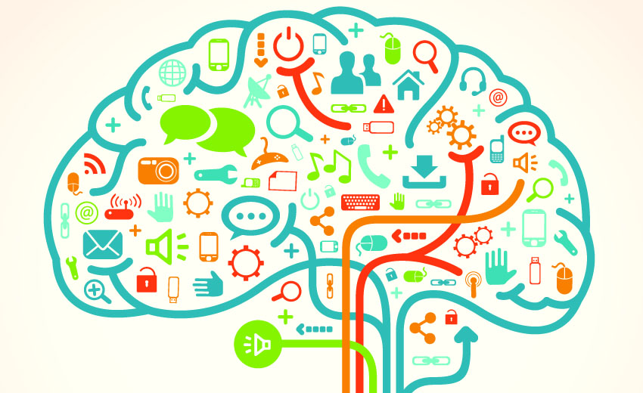
Long-Term Memory
Long-term memory- third stage that stores information for long periods of time
Relatively permanent
Relatively limitless
Stored according to categories or features- how effectively we do so affects how well we can retrieve the information

Slide 13
Types of Long-Term Memory
Explicit/declarative memory- long-term memory that is intentionally learned and explicit knowledge- can directly explain the knowledge
Semantic memory- facts, general knowledge
First president of the US, months of the year, your name
Episodic memory- explicit memory of our past experiences, short-lived or long-lived
What you ate for breakfast, your first day of high school
Implicit/nondeclarative/procedural memory- unintentionally learned knowledge
Can be recalled unconsciously, often involving skills like sports or even basics like brushing your teeth

Slide 14
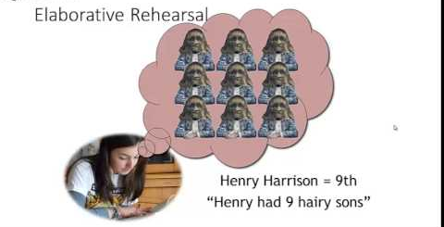
Improving Long-Term Memory
Encoding (processing information into the memory system) and LTM
Levels of processing- the depth of mental processing occurring when the information is first encountered→ how well the information is later retrieved
Deeper levels (making personal connections, taking time to process, working with the information in different ways, etc.) results in better retrieval- elaborative rehearsal (deeper level than maintenance rehearsal for short-term memory)

Slide 15
Encoding Cognitive Processes
Effortful vs. automatic processing
Effortful processing- requires attention and a degree of conscious effort to study/try to remember the information- this information
Automatic processing- occurs without trying- what you ate, who you had a conversation with
Deep vs. shallow processing
Deep processing- focusing on an item’s meaning and relating it to something else
Shallow processing- little attention to meaning, simple memorization
Focused vs. divided attention
Focused attention- focused on one source of information in the environment
Divided attention- the ability to respond simultaneously to multiple tasks

Slide 16
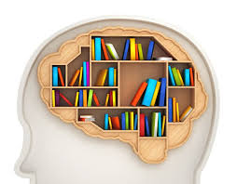
Improving Long-Term Memory
Storage (retaining information over time) and LTM
Best improved by dividing information into categories, like you see in textbooks or on lecture slides (similar to chunking process)
Some of this is done automatically when you sleep

Slide 17
Improving Long-Term Memory
Retrieval (recovering information from memory storage) and LTM
Serial-position effect (aka primacy-recency effect)- best able to recall information at beginning (primacy) or end (recency) of list
Recall vs. Recognition
Priming- prior exposure to a stimulus creates or inhibits the taking in of new information, consciously or unconsciously
May cause déjà vu- cues from the current situation may subconsciously trigger retrieval of an earlier similar experience
Encoding specificity principle- memory retrieval is increased when we have matching context, moods, and states
context-dependent memory, mood congruence, state-dependent memory

Slide 18
Memory Challenge
Write down ALL of the responses that come to mind in the order they occur
Are you ready?

Slide 19
Name the seven dwarfs

Slide 20
How did you do?
Difficulty of the task
How hard or easy is the task?
Tip-of-the-tongue phenomenon
Did you know, but were unable to retrieve a name?
What letter does it start with?
How many syllables does it have?
Organization of memory by sound, letter, and meaning
Is there a pattern in the way you recalled the names?
How many of you recalled lazy, clumsy, droopy, or grouchy?

Slide 21
Recall vs. Recognition
Recall- requries you to retrieve previously learned information with only general, nonspecific cues
involves a two-step process (i.e.essay tests)
generation of possible targets and identification of genuine ones
Recognition- requires you to recognize the correct response with specific cues
easier because you only have to decide if it is correct (i.e. multiple choice tests)
Asking you to name the seven dwarfs with no other cues was a recall task
Would you better be able to remember names with a recognition task?

Slide 22
Grouchy, Gabby, Fearful, Sleepy, Smiley, Jumpy, Hopeful, Shy, Droopy, Dopey, Sniffy, Wishful, Puffy, Dumpy, Sneezy, Lazy, Pop, Grumpy, Bashful, Cheerful, Teach, Doc, Shorty, Nifty, Happy, Wheezy, and Stubby

Slide 23
Solution
How was the recognition task compared to recall?
Answers: Sneezy, Sleepy, Happy, Doc, Grumpy, Dopey, Bashful

Slide 24
Forgetting
Chapter 7, Section 2, pages 233-237

Slide 25
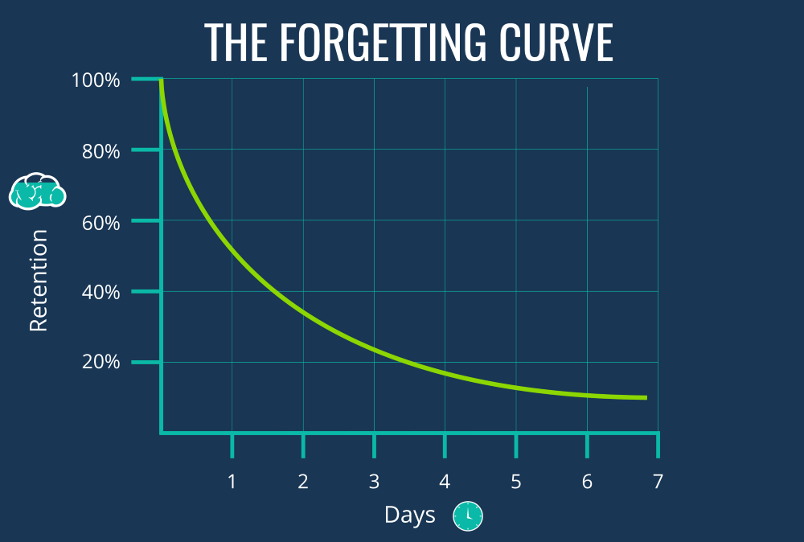
Forgetting
We forget very quickly
Ebbinghaus’s forgetting curve shows how quickly
Relearning- learning information for a second time usually takes less time than the original learning
5 theories- decay, interference, motivated forgetting, encoding failure, retrieval failure

Slide 26
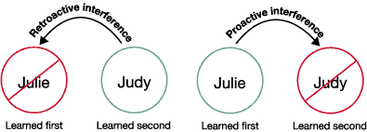
Why We Forget
Decay theory- because memory is stored physically, the information deteriorates over time (use it or lose it)
The forgetting curve- we lose information over time if we are not consciously working with it- defined by Hermann Ebbinghaus
Interference theory- caused by two competing memories
Proactive (first learned blocks second learned) or Retroactive (second learned blocks first learned)
Motivated forgetting theory- we forget unpleasant or anxiety-producing information consciously (suppression) or unconsciously (repression)

Slide 27
Retroactive vs. Proactive Interference

Slide 28
Why We Forget
Encoding failure theory- our sensory memory passes the information to short-term, but during STM, we decide it is not important to remember so the information never gets passed to long-term memory
Retrieval failure theory- not that the memory has been forgotten, but because of issues with getting memory out of long-term memory
Tip-of-the-tongue phenomenon

Slide 29
Which penny is the real thing?
Notes:
Answer: A

Slide 30
Legitimate Forgetting
Misinformation effect- information received after an event may alter and distort a memory
Often seen in leading questions for an eyewitness testimony
Source amnesia- forgetting the true source of a memory
Sleeper effect- information from an unreliable source, which was at first disregarded, gains credibility because the source is forgotten through source amnesia
often associating accurate information to be from a credible source when it is not
Information overload- trying to memorize too much information at once
Distributed practice vs. massed practice- spacing effect by Ebbinghaus- better to space out studying

Slide 31
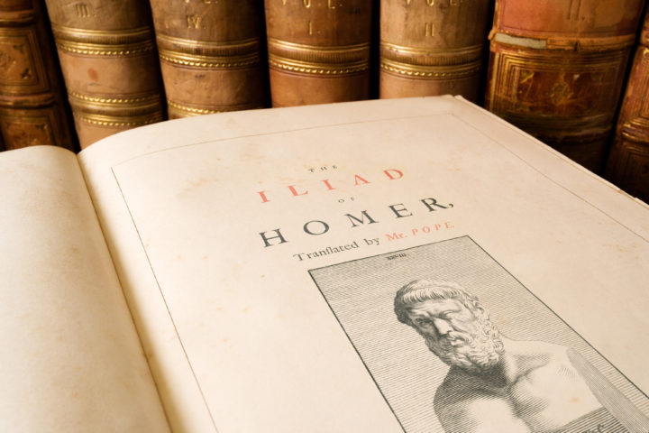
Cultural Difference in Memory and Forgetting
Cross-cultural studies have shown differences in memory across cultures
Cultures that have an oral tradition may perform better on recall tests from oral stories
Formal schooling shows to improve overall memory as it is a soft skill required for students
People across all cultures remember information that matters to them and adapt their skills to meet the demands of their environment

Slide 32
Biological Bases of Memory
Chapter 7, Section 3, pages 238-243

Slide 33
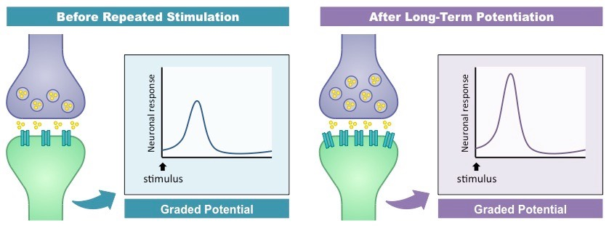
Neuronal and Synaptic Changes in Memory
Learning modifies the neural networks
Long-term potentiation- increase in the strength of neural firing
Occurs by repeated stimulation causing dendrites to grow more spines
Or by the ability of a certain neuron to release or accept neurotransmitters can be increased or decreased

Slide 34
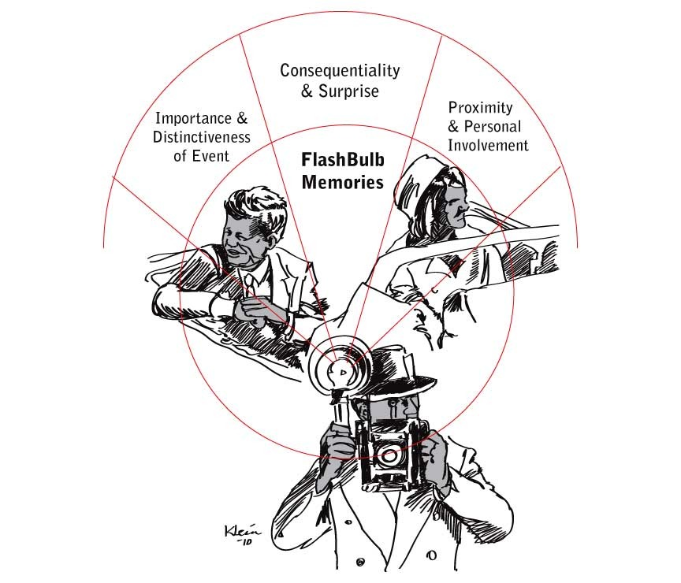
Hormonal Changes and Memory
Fight or flight hormones (epinephrine or cortisol)→stimulation of the amygdala→ stimulation of the hippocampus and cerebral cortex→ increase in encoding and storage of new information
May be from an evolutionary perspective of paying attention during dangerous situations
Flashbulb memories- vivid images of situations that occur because of a special kind of encoding that occur when events are extreme and/or personal
Also related to fight or flight hormones

Slide 35
Location of Memories
New research suggests that memory involves many different areas in the brain
fMRI and other research techniques can tell us what structures are being used for specific memory operations
Amygdala, basal ganglia and cerebellum, cerebral cortex, hippocampal formation, thalamus

Slide 36
Biological Causes of Memory Loss: Injury and Disease
Injury
Most common form is TBI, also can be caused by drug use or severe psychological stress
Infant amnesia- relative lack of early declarative memories
Retrograde amnesia- loss of memory for events before a brain injury
May be because of consolidation (process of neurons change to adapt to new memories), retrograde amnesia wipes away memories that the neurons had not adapted to yet
Anterograde amnesia- inability to form new memories after a brain injury
Alzheimer’s disease- progressive mental deterioration characterized by severe memory loss
Tend to lose more explicit memories instead of implicit

Slide 37
Memory Distortions and Improvement
Chapter 7, Section 4, pages 244-250

Slide 38
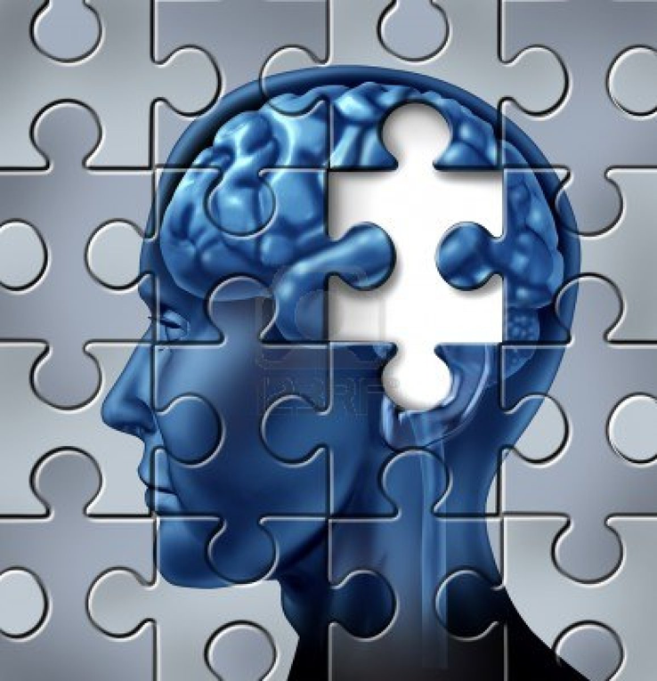
Understanding Memory Distortions
We have a need for logic and consistency
So we fill in the gaps, make corrections, rearrange, etc. to make sense
And summarize, edit, augment for efficiency
Our filtering process also occurs during sleep
The criminal justice system has many concerns over eyewitness testimony
Once considered reliable, is now seen as extremely unreliable
What hurts testimony
Eyewitnesses talking to each other can create false details, even when the eyewitness is confident
Suspects in line-up with lead suspect standing out
Assuming criminal is in the lineup
Guessing for identification
What improves testimony
Accounts taken at the time of first ID of the suspect are often reliable
Quick judgments improve accuracy by 20-30%
Suspects in line-up looking similar
Understanding that criminal may not be in the lineup
Not guessing for identification

Slide 39
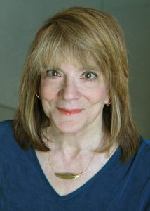
False Memories
Eidetic memory- (aka photographic memory)- no evidence that this exists
Only 10 cases of eidetic autobiographical memory
https://www.youtube.com/watch?v=hpTCZ-hO6iI
Elizabeth Loftus is a leader in the field- she has studied how memories can be changed by the things we are told
Meta-analysis showed that when told a fake but believable story, 46% of participants believed they had experienced it and 30% of them went into further detail
Leading questions can create false memories (up to 98% in the telephone study)
False memories can grow and stay over a long time
Brain scans may show us areas that are used during false memories

Slide 41
Repressed Memories
Extreme controversy over repressed memories theory
Repression- according to Freud’s psychoanalytic theory, a basic coping or defense mechanism that prevents anxiety-provoking thoughts, feelings, and memories from reaching consciousness
Theories
Actively forgotten (like motivated forgetting)
Memories are so painful, they only exist in the unconscious
Criticisms
With painful memories, the issue is usually forgetting the memory, not remembering it
False memories may be created by therapists through constructive process or source amnesia
Our superordinate goal is to respect and protect victims and the wrongfully accused

Slide 42
Tips for Memory Improvement
Encoding
Pay attention and reduce interference
Strive for a deeper level of processing (elaborative rehearsal), not just maintenance rehearsal (shallow processing)
Counteract the serial-position effect
Spend extra time paying attention to information in the middle or switch up the order when reviewing
Use mnemonic devices- memory aids or tricks for encoding
Storage- improve your organization
Chunking
Create hierarchies

Slide 43
Tips for Memory Improvement
Retrieval
Use practice testing
Manage your time
Avoid cramming- leads to fast short-term learning but less effective
Use distributed practice
Get sleep- we process new information when we sleep, being sleepy during studying or an exam can affect overall performance
Employ self-monitoring- make sure you understand information as you go along, use different speeds for fast/easy material, slow down if you need
Employ overlearning- study until you know you know the information
Use the encoding specificity principle
Keep the context, mood, and state the same when learning something to be retrieved later
There is a learning curve- the more you do something, the better you get at it

Slide 44
Thinking, Language, and Intelligence
Chapter 8

Slide 45
Thinking
Chapter 8, Section 1, pages 257-266

Slide 46
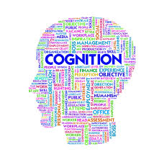
Cognition
Cognition- the mental activities of acquiring, storing, retrieving, and using knowledge
Basic units: mental images, concepts, language

Slide 47
Foundations of Thought
Mental image- mental representation of a previously stored sensory experience, includes all sensory components of the experience
Concepts- mental representations of a group or category that share similar characteristics, concrete or abstract ideas

Slide 48
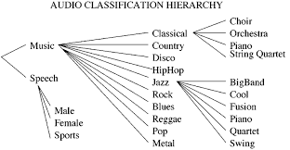
Development of Concepts
Three processes for developing concepts:
Artificial/formal concepts- created with logical rules or definitions
Often in sciences or academic fields, like defining a rhombus
Natural concepts/prototypes- based on the ‘best example’ or typical representative of that concept
Defining dogs
Hierarchies- a flow chart, grouping specific concepts as subcategories within broader concepts

Slide 49
Problem Solving
Involves moving from a given state (the problem) to a goal state (the solution)
Three steps:
Preparation
Production
Evaluation
https://www.youtube.com/watch?v=rRwiaNFRt2w

Slide 50
1. Preparation
Identifying given facts- make a list of all the known items of information
Separating relevant from irrelevant facts- what is important to pay attention to, what is not important to be concerned about
Defining the ultimate goal- what is the long-term goal

Slide 51
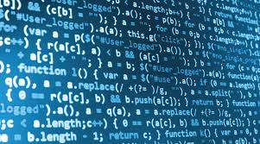
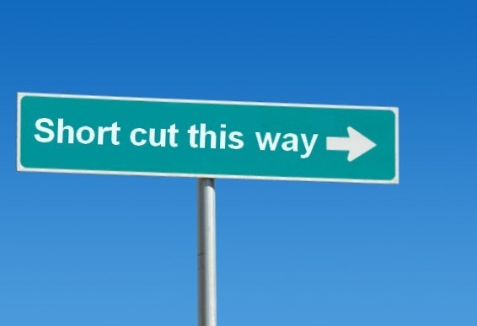
2. Production
Generate possible solutions and apply one depending on what works best
Algorithm- logical, step-by-step procedure that will always produce a solution
Mathematic equations, maps
Heuristics- a simple rule or shortcut that does not promise a solution, but narrows down the alternatives
Figuring out what classes to take (what electives are you interested in), where to go to college (look at the cheaper ones with your interests)

Slide 52
3. Evaluation
Choose a hypothesis from the production (2nd) stage that best fits the preparation (1st) stage
Apply the hypothesis
Action must follow the solution to actually meet the end goal

Slide 53
Barriers to Problem Solving
Mental sets- persisting in using problem-solving strategies that have worked in the past rather than trying new ones
“The definition of insanity is trying the same thing over and over again and expecting a different result”
Functional fixedness- tendency to think of an object functioning only in its usual or customary way

Slide 54
The Matchstick Problem
How would you arrange six matches to form four equilateral triangles?

Slide 55
The Matchstick Problem- Solution
A mental set may have caused a barrier to solving the problem
i.e.- matchsticks can only be used laying down

Slide 56
The Candle-Mounting Problem
Using these materials, how would you mount the candle on a bulletin board?

Slide 57
The Candle-Mounting Problem- Solution
Solving this problem requires recognizing that a box needs not always serve as a container
Functional fixedness may have stopped this thought process

Slide 58
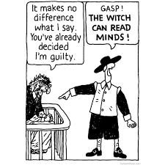
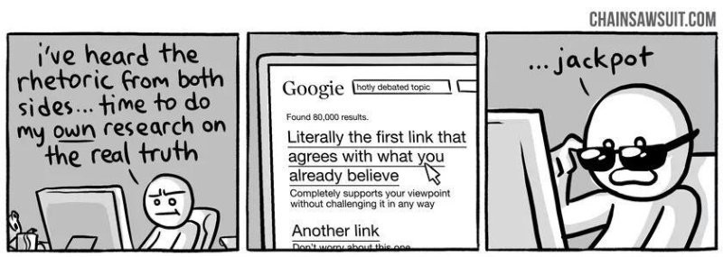
Barriers to Problem-Solving Continued
Confirmation bias- preferring information that confirms preexisting positions or beliefs, while ignoring or rejecting contradictory evidence

Slide 59
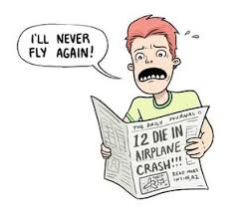
Barriers to Problem-Solving Continued
Availability heuristic- judging the likelihood or probability of an event based on how readily available other instances of the event are in memory
You see reports and TV shows about shark attacks- leading you to believe it is something that often occurs (average of 19 a year, 1 fatality every two years)
Representativeness heuristic- estimating the probability of something based on how well the circumstances match (represent) our previous prototype
You understand what you’re going to get when you go to a McDonald’s
Assuming a fashion model is unintelligent/did not go to an Ivy League
Coin flips

Slide 60
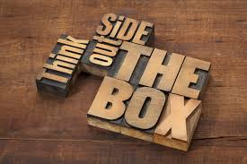
Creativity
Creativity- ability to produce valued outcomes in a new way
Three elements- originality, fluency, flexibility
Originality- noticing something unique
Fluency- coming up with many possible solutions
Flexibility- able to shift to another approach if it is not working

Slide 61
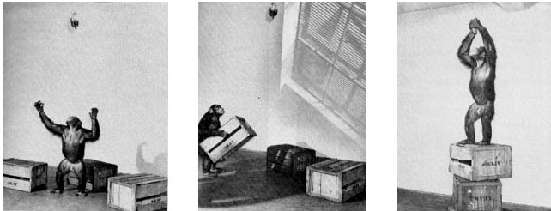
Creativity Research
Wolfgang Köhler with his experiment on insight
Insight- ‘aha’ moment, apparent sudden realization of the solution to a problem

Slide 62
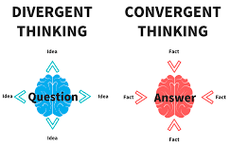
Measuring Creativity
Divergent thinking- thinking in which many possibilities are developed from one starting point
Convergent thinking- lines of thinking converge/come together on one correct answer
Characteristics of a creative person are hard to measure but psychologists agree on some of these
Cognitively encode and store information differently, solve problems differently
Buy low, sell high- try something that others might not (investment theory- Sternberg and Lubart)
Intellectual ability, knowledge, thinking style, personality, motivation, environment

Slide 63
A Scenario for You
An old money-lender offered to cancel a merchant’s debt and keep him from going to prison if the merchant would give the money-lender his lovely daughter. Horrified yet desperate, the merchant and his daughter agreed to let providence decide. The money-lender said he would put a black pebble and a white pebble in a bag and the girl would draw one. The white pebble would cancel the debt and leave her free. The black one would make the money-lender’s, although the debt would be canceled. If she refused to pick, her father would go to prison. From the pebble-strewn path they were standing on, the money-lender picked two pebbles and quickly put them in the bag, but the girl saw he had picked up two black ones. What would you have done if you were the girl?

Slide 64
Solution
This problem was devised by psychologist Edward De Bono, who believes that conventional directed thinking is insufficient for solving new and unusual problems. His approach to problem solving requires use of nondirected thinking to generate new ways of looking at the problem situation.
When the girl put her hand into the bag to draw out the fateful pebble, she fumbled and dropped it, where it was immediately lost among the others. “Oh,” she said, “well, you can tell which one I picked by looking at the one that’s left.” The girl’s lateral thinking saved her father and herself.

Slide 65
Language
Chapter 8, Section 2, pages 266-272

Slide 66
Language
Language- a form of communication using sounds and symbols combined according to specified rules
Building blocks: phonemes, morphemes, grammar
Phonemes- smallest basic unit of speech or sound
Morphemes- smallest meaningful unit of language (a combination of sounds)

Slide 67
Phonemes and Morphemes
“Fearlessness” has 9 phonemes and 3 morphemes
Phonemes . . . . . . . . .
F E A R L E S S N E S S
Morphemes Fear less ness

Slide 68
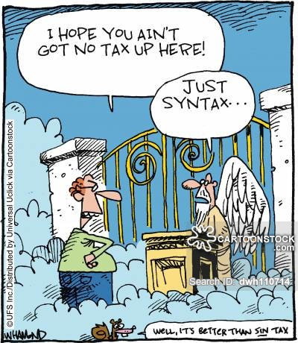
Grammar
Grammar- system of rules (syntax and grammar) used to create language and communication
Syntax- language rules that explain how words can be combined to form meaningful phrases and sentences
I am happy vs. Happy I am
Semantics- set of rules for using words to create meanings, the study of meaning in language
I went out on a limb for you vs. Humans have several limbs

Slide 69
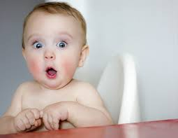
Language Development in Children
Children develop language skills all around the same time
Children are born with (innate) universal emotional expressions and certain communications (Darwin)
Birth- sounds about distress
2 months- coo
4 months- babbling (all language sounds)
9 months- babbling (native language sounds)
12 months-single words
Almost 2 years- two word sentences
2-3 years- sentences of several words
5 years- mostly complete, complexity continues to develop

Slide 70
Language Features During Development
Cooing- vowel-like sounds
Ooooh, aaaaah
Babbling- consonants added to vowels
Bahbahbah, dahdahdah
Overextension- using words to include objects that do not fit the word’s meaning
Calling all women “Mommy”
Telegraphic speech- two or three word sentences of young children that contain only the most necessary words (as a telegram does)
Grandma go bye-bye? Me want cookie
Overgeneralize- applying the basic rules of grammar even to cases that are exceptions to the rule
I goed to the zoo, two mans

Slide 71
Language Development Theories
Chomsky- children are prewired, born with the ability to develop language
Language Acquisition Device (LAD)- a neurological ability that enables a child to analyze language and extract the basic rules of grammar, is activated by being exposed to adult speech
Representing the nature side of language development
Nurture side of language development focuses on learning language through rewards, punishments and imitation that shape the behavior
Most psychologists agree on a combination
Research comes from various methods
Case study: Genie
https://www.youtube.com/watch?v=VjZolHCrC8E

Slide 72
Gender and Culture Diversity
New research is indicating that there is nonverbal communication that can show ethnicity or background- the way we smile, wave, walk
We focus on different nonverbal behaviors depending on how our culture values emotions
All of this can lead to cross-cultural misunderstandings

Slide 73
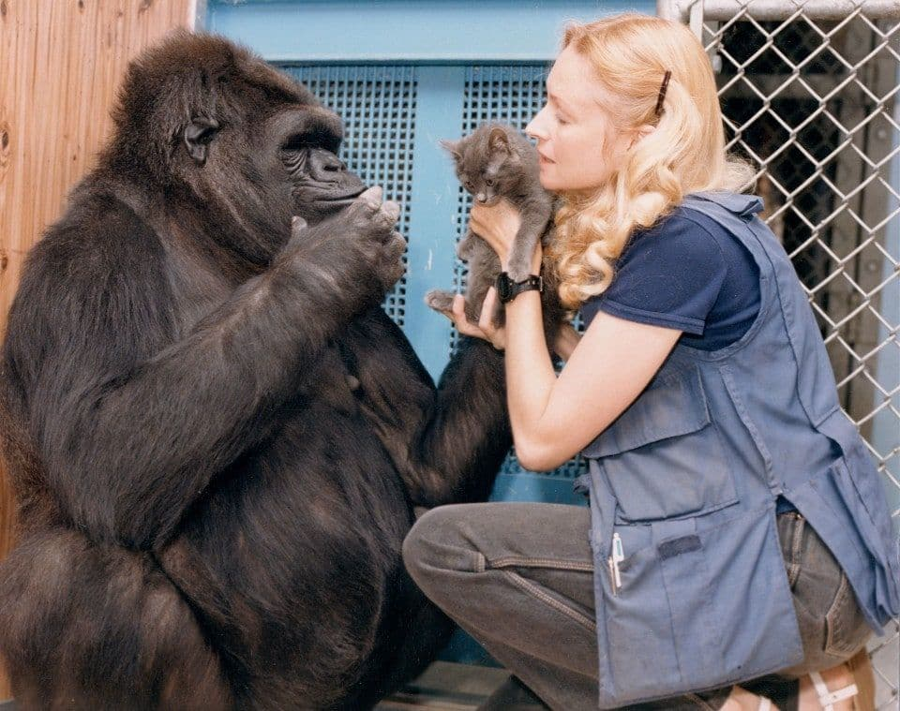
Animals and Language
Animals can communicate- this does not mean they have a language
Famous studies with chimpanzees and gorillas
Washoe and Koko use ASL to communicate basic needs and wants, a chimp Lana used symbols on a computer
Dolphins can communicate with hand signals or audible commands, they are sensitive to syntax and content
Criticism
These animals are unable to understand subtle meaning, use language creatively, or communicate about abstract ideas
Animals may be ‘communicating’ because of operant conditioning
It has not been scientifically well documented
Supporters say animals have created words and can understand sentence structure
Nonhuman animal language is less complex, less creative, and has fewer rules

Slide 74
Intelligence
Chapter 8, Section 3, pages 272-276

Slide 75
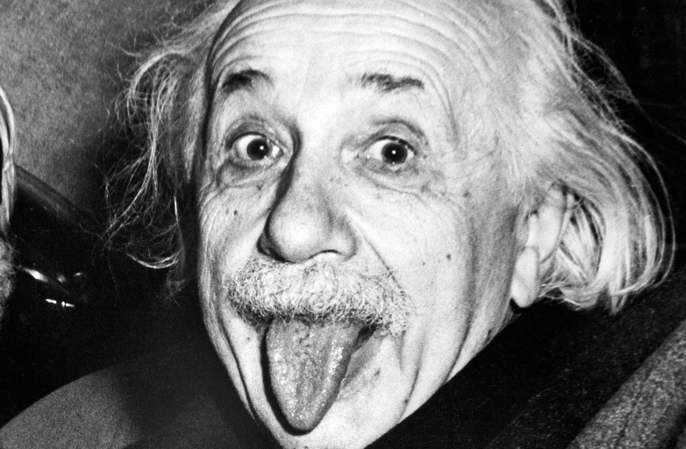
Intelligence
Intelligence- the global capacity to think rationally, act purposefully, and deal effectively with the environment
It is an abstract concept
Spearman said that intelligence is a single factor (general intelligence[g]) that combines many intellectual behaviors
Thurstone said there are seven mental abilities, Guilford expanded to 120

Slide 76
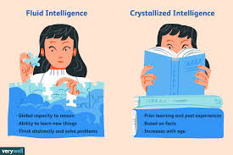
Cattell’s Intelligence Subtypes
Instead of general intelligence, there are two subtypes
Fluid intelligence (gf)- aspects of innate intelligence, including reasoning abilities, memory, and speed of information processing
relatively independent of education and decline as people age
Crystallized intelligence (gc)- knowledge and skills gained through experience and education that tend to increase over the life span

Slide 77
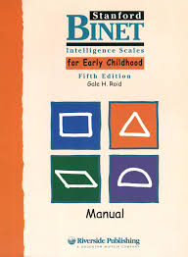
Measuring Intelligence
Stanford-Binet Intelligence Scale- includes verbal and nonverbal tasks
Measures mental age (what average age abilities do yours match)
IQ (Intelligence Quotient)= Mental Age
___________________ x100
Chronological Age
100 is average
IQ is not often calculated, it is now mostly comparison to average scores (distributions)
Weschsler Tests (WAIS) - most widely used, gives an overall score with specific skills (verbal comprehension, perceptual reasoning, working memory, processing speed) in percentile scores
Advantages- designed for age groups, can look at abilities separately or together, non-English speakers can be tested

Slide 78
Standards for Psychological Tests
Reliability- a test’s consistency, the ability of a test to give the same results under similar conditions (readministration)
Validity- the ability of a test to measure what it is intended to measure
Standardization- administered and scored the same way every time (uniform procedures) and establishment of a norm (average scores)
Percentile system- ranking of test scores that indicates the ratio of scores lower and higher than a given score
Percentiles are created by giving test to large sample of people

Slide 79
Percentile Scoring

Slide 80
The Intelligence Controversy
Chapter 8, Section 4, pages 276-283

Slide 81
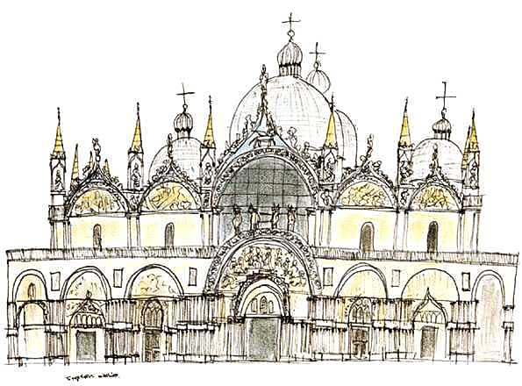
Extremes in Intelligence
Intellectually disabled- a condition of limited mental ability
Indicated by intelligence scores below 70
Deficits potentially in reasoning, problem solving, academic learning, adaptive functioning, including communication, social participation and personal independence
Produces difficulty in adapting to the demands of life
Varies from mild to profound
Savant syndrome- condition in which a person with an intellectual disability exhibits exceptional skills or brilliance in some limited field
Example- computation, playing piano, drawing
Stephen, age 13, could not speak coherently or cross
the road by himself

Slide 82
Extremes in Intelligence Continued
Mental giftedness- typically defined as IQ of 130+
Some may display greater academic, occupational success, and athletic ability, especially if they have exceptional motivation or an encouraging environment
May just be offered greater intellectual opportunities- but still show average life skills and rates of successes

Slide 83
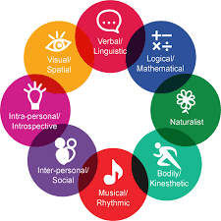
Theories about Multiple Intelligences
Gardner- theory of multiple intelligences- based on seeing people lose some intellectual abilities but not all from brain damage
Logical/mathematical, spatial, musical, bodily/kinesthetic, naturalistic, interpersonal, intrapersonal, linguistic, (spiritual/existential)
Are these just skills?
Sternberg- triarchic theory of successful intelligence- all learned intelligences
Analytical, creative, practical
Goleman- Emotional Intelligence- the ability to perceive, understand, manage, and utilize emotions accurately and appropriately
Argues that the other theories ignore these abilities
Critics find misuse of term- as if we have the answer to handling emotions

Slide 84
Differences in IQ
Nature
Higher IQ test scores correlates to responding quicker on perceptual judgments
PET scans show that more intelligent brains work smarter/more efficiently
Bigger does not necessarily mean better, although some correlation has been found, especially when focused on certain areas
A faster brain is more intelligent
An intelligent person’s brain works smarter/more efficiently
Nurture
Twin studies- strong hereditary influences on personality, psychopathy, and intelligence
Neglect cases tell us a lot too
Higher gray-matter volume and IQ in children without siblings and non-breast-fed babies
Skepticism- look for similar adoptive environments, shared womb and first months together; confirmation bias
Once again, a combination is recognized

Slide 85
Cultural Influences on IQ and IQ Testing
Certain questions may be easier understood by specific cultures or the cultures of the researchers who wrote. Some points to be made:
IQ tests may be culturally biased and therefore an inaccurate measure of capability- disproportionate representation of minorities in sampling and in certain fields
Race is a social construct that is impossible to define- therefore making any race generalization impossible
Intelligence is not a fixed trait- research shows constantly fluctuating averages, Flynn effect
Environmental factors may override genetic potential and later affect IQ test scores- access and attitudes about education, language exposure, etc.
Negative stereotypes about people of color can cause some group members to doubt their abilities

Slide 86
Cultural Influences on IQ Testing
Stereotype threat- negative stereotypes about minority groups cause some members to doubt their abilities, leading to decreased motivation and therefore performance
Self-Doubt
Anxiety
Negative stereotype
Decreased performance
Reduced motivation
“Disidentifying”

