Slide 1
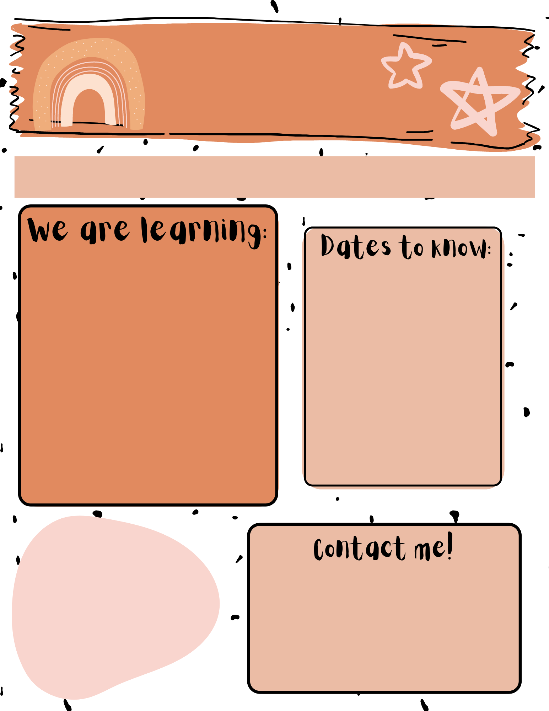
FIFTH GRADE NEWS
Week of: August 15th, 2022
Reading: Captain Arsenio
Writing: Paragraph Writing
Spelling: Module 1 Week 4
Math: Unit 1 Test this week
Social Studies: American Revolution
August 19th: Cash for Classroom Due
August 22nd: Cheer Registration
YOU CAN DO HARD THINGS! ☺
Miss Spykstra
Spykstra.Nicole@cusd80.com
480-883-4052
Ms Moreno
Moreno.Monique@cusd80.com
480-883-4053

