Slide 1
Unit 5: Sensation and Perception
Chapter 4

Slide 2
Understanding Sensation
Chapter 4, Section 1, pages 116-122

Slide 3
Sensation and Perception
Sensation- process of detecting, converting, and transmitting raw sensory information from the external and internal environments to the brain
Perception- process of selecting, organizing, and interpreting sensory information into meaningful patterns

Slide 4
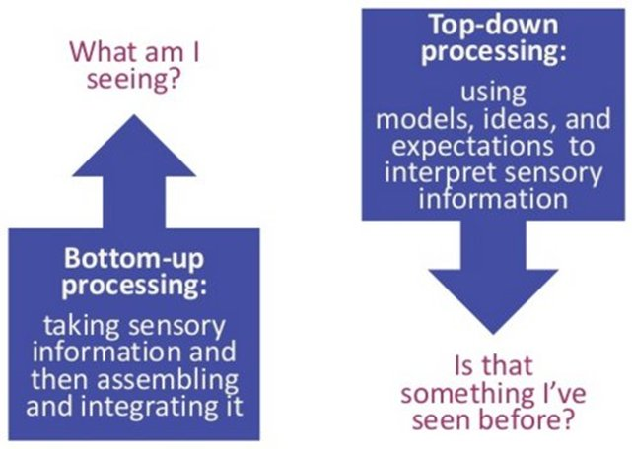
Processing
Bottom-up processing- information processing beginning “at the bottom,” with raw sensory data that are sent “up” to the brain for higher-level analysis
Data driven processing that moves from the parts to the whole
Top-down processing- information processing starting “at the top,” with higher level cognitive processes (such as, expectations and knowledge), and then working down
Conceptually driven processing that moves from
the whole to the parts

Slide 5
Processing the Senses
Synesthesia- a mixing of sensory experiences (e.g., “seeing” colors when a sound is heard)
Different Ways of Knowing by Daniel Tammet: https://www.youtube.com/watch?v=Pzd7ReqiQnE
Steps
Sensory detection- receptors detect environment information
Transduction- converting a receptor’s energy into neural impulses that are sent on to the brain
Coding- converting sensory inputs into different sensations
Sensory reduction- filtering and analyzing incoming sensations before sending a neural message to the cortex
Helps us not be overwhelmed, also supports survival

Slide 6
How We Measure the Senses
Psychophysics- studies the link between the physical characteristics of stimuli and our sensory experience of them
Founded by Gustav Fechner, a leader in experimental psychology
Absolute threshold- the minimum amount of a stimulus that an observer can reliably detect (50% of the time)
Our senses: vision (candle flame= 30 miles); hearing (watch ticking 20 feet); taste (1 tsp of sugar in 2 gallons of water); smell (1 drop of perfume in 3 room house); touch (bee’s wing falling a distance of 1 cm onto your cheek)
Difference threshold- the minimal difference needed to notice a stimulus change, aka just noticeable difference (JND)
Depends more on change than the absolute size
Weber’s Law- by Ernst Weber, the larger or stronger a stimulus, the larger the change required for a person to notice that anything has happened to it
Fechner’s law- the concept that the magnitude of a subjective sensation increases proportional to the logarithm of the stimulus intensity

Slide 7
Absolute Threshold
Difference Threshold
100
Percentage
of correct
detections
75
50
Subliminal
stimuli
25
0
Low
Absolute
threshold
Medium
Intensity of stimulus

Slide 8
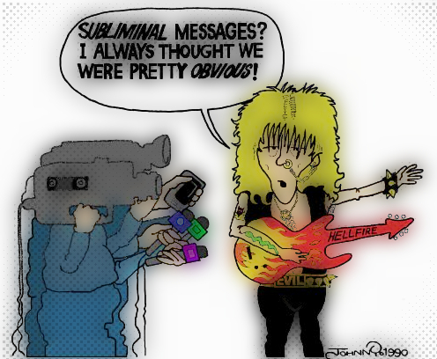
Subliminal Perception
Subliminal- pertaining to stimuli presented below conscious awareness
People used to be concerned with subliminal messages that were below the absolute threshold, in marketing or music
New research
There are subliminal stimuli that we process without being consciously aware of it
It is highly unlikely that the subliminal stimuli changes behavior

Slide 9
Sensory Adaptation
Sensory adaptation- decreased sensitivity due to repeated or constant stimulation
Examples- air fresheners, AC running, clothes
From an evolutionary perspective- don’t need to overwhelm constant stimuli- could be good or bad
Smell and touch adapt quickly, vision never does, pain rarely does (to alert us to do something about it)

Slide 10
Sensory Adaptation and Pain
Endorphins are released for stimuli as natural painkillers to inhibit pain perception instead of getting used to the pain
Gate-control theory- theory that pain sensations are processed and altered by mechanisms within the spinal cord
Rubbing an injury uses the large fibers to override the small pain signals (a distraction)
We can lessen some pains by shifting our attention away from the pain impulses or by sending other signals to compete with the pain signals
We may generate pain to compete
In the absence of normal input, the nerve cells send conflicting messages to the brain (static), for tinnitus, this is interpreted as ringing
Phantom pain is similar- without normal input, the brain interprets the static as pain

Slide 11
How We See and Hear
Chapter 4, Section 2, pages 123-129

Slide 12
Vision
Chapter 4, Section 2A, pages 123-127

Slide 13
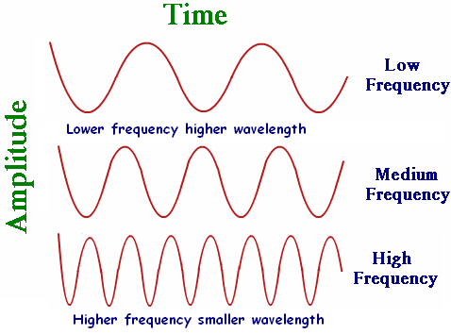
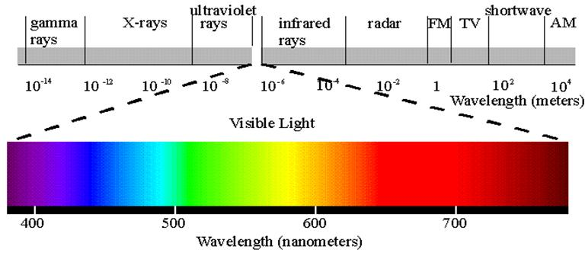
Waves of Light
Wavelength- distance between the crests (or peaks) of light or sound waves
The shorter the wavelength, the higher the frequency
Determines the hue (color) we see
Frequency- how often a light or sound wave cycles (i.e., the number of complete wavelengths that pass a point in a given time
Amplitude- height of a light or sound wave
Determines the brightness/intensity of the light (vision) or the loudness (sound)
Light is waves of electromagnetic energy that we see only a portion of (visible spectrum)

Slide 14
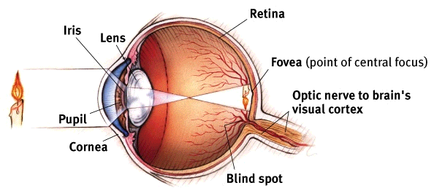
Eye Anatomy and Function
Light → cornea → iris →pupil → lens → retina (rods and cones) → neural signals → optic nerve → visual cortex in the brain
Light reflects off object and enters the cornea
Light passes through the pupil, the iris muscles open (dilate) or close depending on intensity or emotions
Lens focuses light onto the back surface of the eyeball (retina), reverses image right to left and top to bottom
Retina transduces the light into neural signals using rods and cones
Neural signals are sent through activation of the bipolar and ganglion cells
Signals travel through optic nerve to the brain’s visual cortex

Slide 15
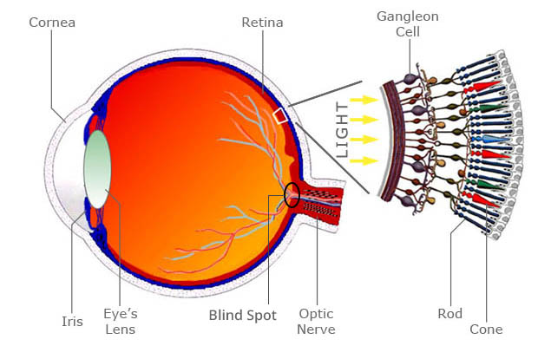
Eye Anatomy
Accommodation- automatic adjustment of the eye, which occurs when muscles change the shape of the lens so that it focuses light on the retina from objects at different distances
Retina- light sensitive inner surface of the back of the eye, which contains the receptor cells for vision (rods and cones)
Rods- visual receptor cells in the retina that detect shades of gray and are responsible for peripheral vision, dim light, and night
Cones- visual receptor cells concentrated near the center of the retina, responsible for color vision and fine detail, sensitive in brightly lit conditions
Fovea- tiny pit in the center of the retina filled with cones that is responsible for sharp vision
Blind spot- point where the blood vessels and optic nerve enter and exit the eyeball, contains no receptor cells for vision which creates a blind spot

Slide 17
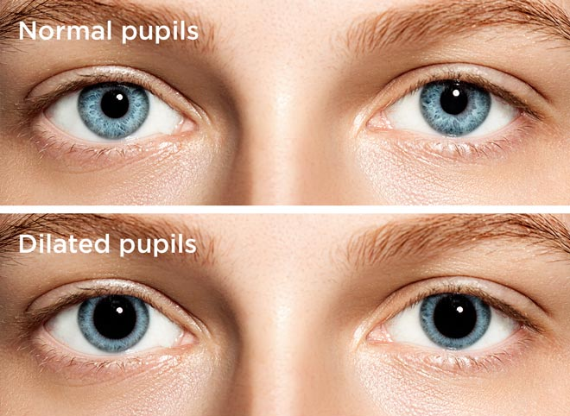
Vision
Psychological factors influence pupil size
disgusted= smaller
Like something= larger
afraid= open wide
Binocular fusion- the process of combining the images received from the two eyes into a single, fused image
Retinal disparity- the differences between the images stimulating each eye

Slide 18
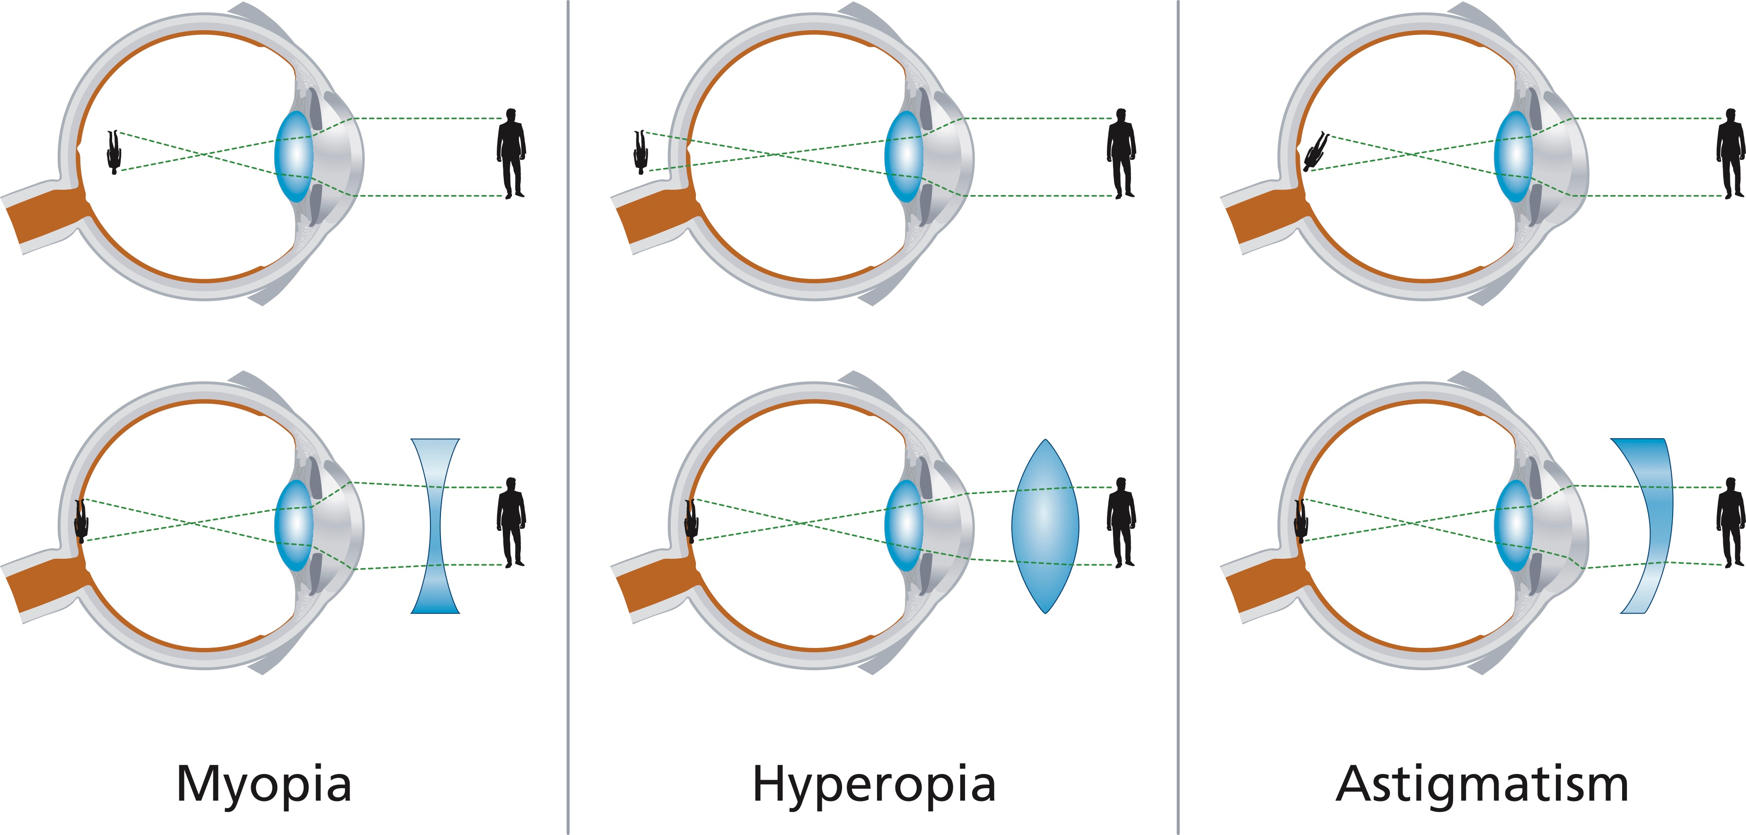
Problems with Vision
Nearsightedness (myopia)- visual acuity problem resulting from the cornea and lens focusing an image in front of the retina, the eyeball is too long
Farsightedness (hyperopia)- visual acuity problem resulting from the cornea and lens focusing an image behind the retina, the eyeball is too short/tall
Dark adaptation- seeing in the dark requires the rods (nighttime and peripheral vision) to take over (which takes awhile) while cones adjust quickly but never fully function
Light adaptation happens more quickly because cones adjust more quickly

Slide 19
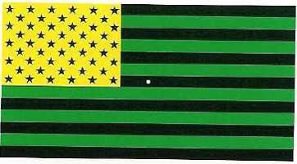
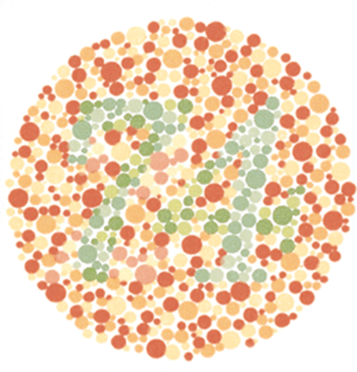
Color Vision
We can distinguish millions of hues, from infancy, but we’re not sure why or how
Trichromatic (three-color theory)- color perception results from three types of cones in the retina, each most sensitive to either red, green, or blue. Other colors result from a mixture of these three.
Opponent-process theory- color perception is based on three systems of color opposites – blue-yellow, red-green, black-white
Both are correct, making it a dual-process theory
Color is processed in a trichromatic way at the level of the retina (cones) and an opponent way at the level of the optic nerve and thalamus (brain)
Color blindness comes from having a genetic deficiency in the red-green or blue-yellow or both systems; most see some colors
Normal vision (trichromats), two colors (dichromats), black-white (monochromats)
https://www.youtube.com/watch?v=YcedXDN6a88

Slide 20
Rods and Cones Demonstration
You’ll try this with your face partner
One student will become the subject and the other the experimenter.
The experimenter stands behind the subject and chooses a brightly colored item (pen, pencil or ruler). Don’t show/tell the subject what color the object is!
The experimenter instructs the subject to fixate on a distant point.
The experimenter moves the object slowly from behind the head into the peripheral vision. If this movement is slow enough, the subject will detect the object before the subject can determine the color.
After trying it until it works, switch roles and repeat the demonstration.

Slide 21
Hearing
Chapter 4, Section 2B, pages 127-130

Slide 22
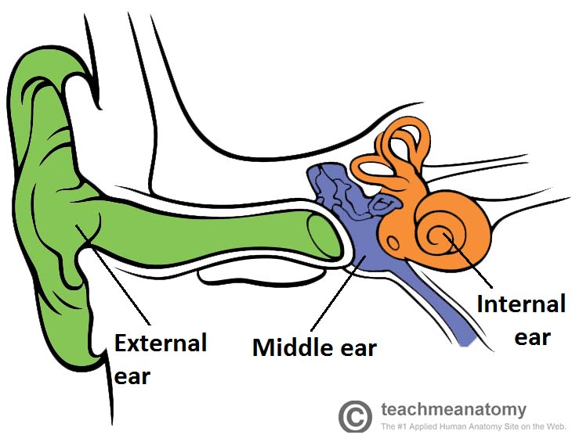
Hearing
Audition- sense of hearing
Outer ear- pinna, auditory canal, ear drum, which funnel sound waves in the middle ear
Middle ear- hammer (malleus), anvil (incus), stirrup (stapes), which concentrate eardrum vibrations onto the cochlea’s oval window, together known as the ossicles
Inner ear- cochlea, semicircular canals, vestibular sacs, which generate neural signals sent to the brain
Cochlea- three-chambered, snail-shaped structure in the inner ear containing receptors for hearing

Slide 23
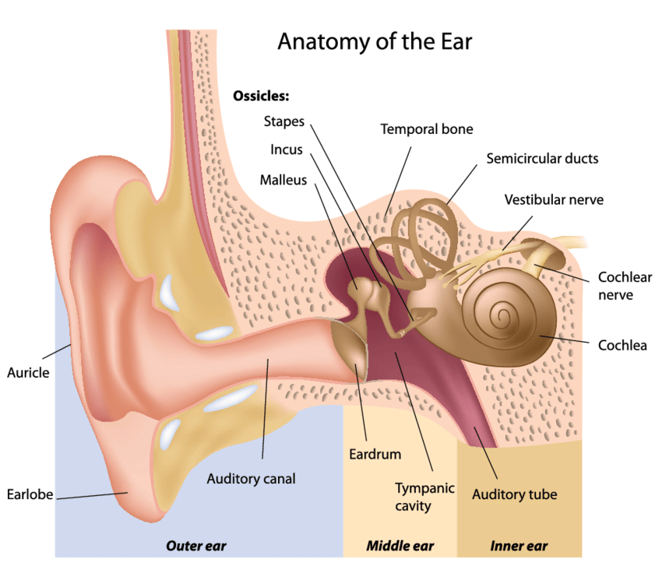
How the Ear Hears
Sound waves → pinna (outer ear)→auditory canal (outer ear) → eardrum (outer ear) → middle ear (hammer, anvil, stirrup) → oval window → cochlea (inner ear ) → cochlea’s basilar member → neural messages → auditory nerve → temporal lobe
Pinna channels and focuses sound waves through auditory canal
Collected sound waves cause the eardrum to vibrate
Vibrations from the eardrum are passed through the middle ear
The stirrup/stapes presses on the oval window membrane to make it vibrate
Movement of the oval window creates waves in the cochlea’s fluid
As the waves travel, the hair cells on the basilar membrane bend from side to side, which stimulates the cells to translate/transduce the mechanical energy into electrochemical impulses
The electrochemical/neural impulses are sent through the auditory nerve to the temporal lobe
https://www.youtube.com/watch?v=eOXuM1J8wNs

Slide 25
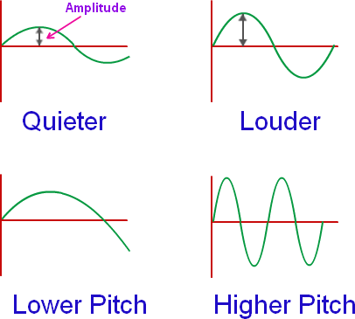
Sounds
Sound waves, like light waves, have frequency (wavelength), amplitude (intensity/height), complexity
Amplitude determines loudness, measured in decibels (0-140)
High peaks/low valleys= loud
Small peaks/valleys= soft
Complexity determines timbre (purity) and allows us to distinguish source/what kind of sound

Slide 27
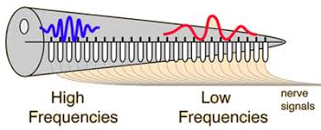
Pitch of Sounds
Frequency of sound/vibration rate determines the pitch of the sound
High frequency= high notes, low frequency = bass tones
Place theory- pitch perception is linked to the particular spot on the cochlea’s basilar membrane that is most stimulated
Frequency theory- pitch perception occurs when nerve impulses sent to the brain match the frequency of the sound wave
Both are correct, but place theory best explains high-pitched sounds, while frequency theory best explains low-pitched sounds
Perfect pitch is a genetic trait that seems to be necessarily combined with early musical training, these people also have trouble identifying notes surrounding A (maybe because it is used as a tuning sound)
This all may be a demonstration of neuroplasticity
Place theory

Slide 28
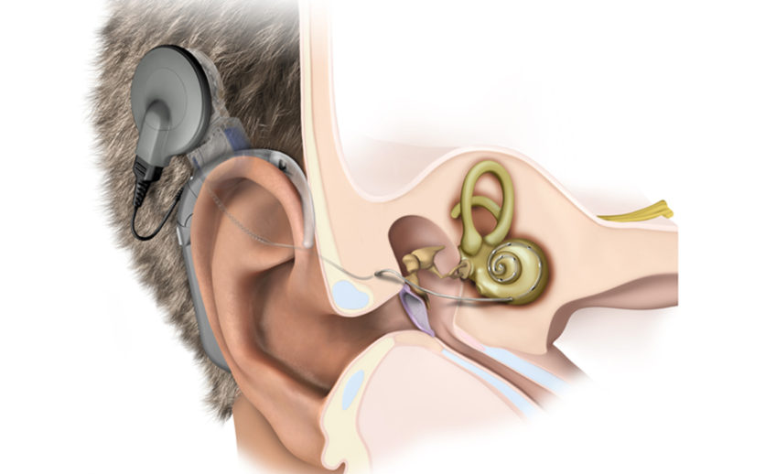
Problems with Hearing
Conduction deafness- middle-ear deafness resulting from problems with transferring sound waves to the inner ear
Would be addressed with a hearing aid
Causes- malformation, fluid, infection, etc.
Nerve deafness- inner-ear deafness resulting from damage to the cochlea hair cells, or auditory nerve
Would be addressed with a cochlear implant- works by bypassing hair cells and directly stimulating the nerve
Causes- disease, biological change (aging), exposure to loud noise
Prevention- avoid exceptionally loud experiences, pay attention to changes in hearing/first signs of hearing loss (reduced sound, tinnitus)
Sound illusions: https://www.youtube.com/watch?v=kzo45hWXRWU
Yanny vs. Laurel: https://www.youtube.com/watch?v=yDiXQl7grPQ

Slide 29
Our Other Senses
Chapter 4, Section 3, pages 130-135

Slide 30
Chemical Senses: Olfaction (Smell)
Olfaction- sense of smell
Pheromones- airborne chemicals that affect behavior, including recognition of family members, aggression, territorial marking, and sexual mating
Airborne molecules→ nose or back of throat → olfactory epithelium (membrane of roof of nasal cavity → hair-like receptor cells → neural impulse → olfactory bulb in brain → temporal lobe, limbic system, etc.
Inhale molecules through nose or back of throat
Molecules travel to olfactory member at the roof of the nasal cavity
Receptor cells on the membrane make contact with the air and the molecules bind to receptors (lock and key)
Stimulated receptor cells send a neural impulse to brain’s olfactory bulb in the brain under the frontal lobes
Patterns of activation are coded with a sense of smell in the olfactory bulb
Messages travel to other parts of the brain like the temporal lobe and limbic system

Slide 32
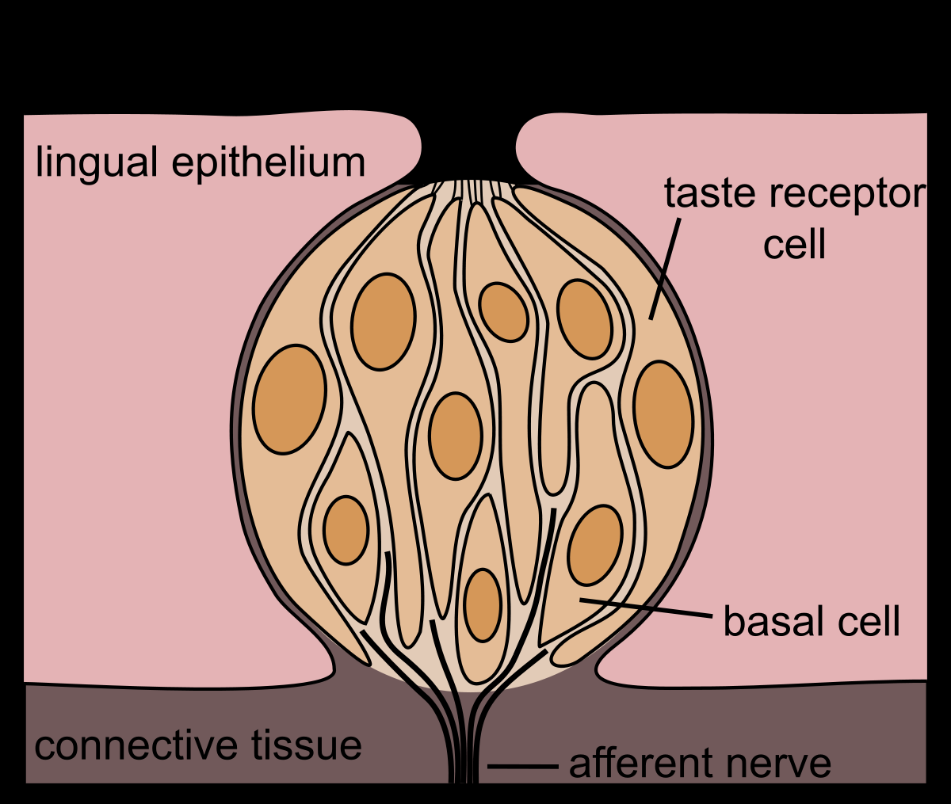
Chemical Senses: Gustation (Taste)
Gustation- sense of taste; closely related to sense of smell
Five major taste sensations- sweet, sour, salty, bitter, umami (savory)
Taste receptors (taste buds) respond differently to different food and liquid molecules
Taste buds are in papillae bumps
Infants/children are picky about taste because as we grow older, our taste buds die and are replaced a slower rate than infants
Pickiness is also related to an evolutionary perspective (bitter=poisonous, sweet= nonpoisonous and energetic)
Notes:
Taste strips: three basic results: bland, bitter, or vile.
PTC paper is used to test whether a person is a "taster", "non-taster", or somewhere in between. The ratio of tasters to non-tasters varies between populations, but every group has some tasters and some non-tasters. On average, 75% of people can taste PTC, while 25% cannot.
PTC tastes bland, bitter or even vile depending on your genes. There is a single gene that codes for a protein found in our tongues. PTC will bind with the protein if it's present, and you will certainly be able to taste it. However, if the protein is not present, the PTC will not bind and you won't taste anything.

Slide 33
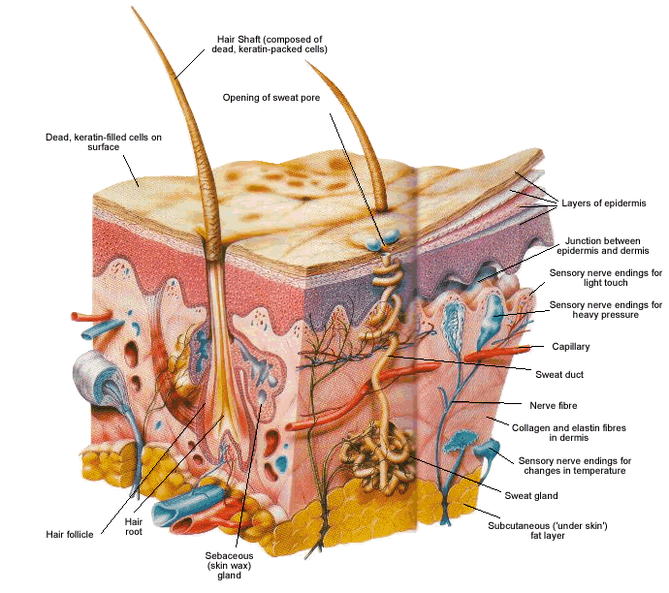
The Body Senses: Skin Senses
The skin is vital as it protects the organs and provides survival information, such as temperature and injuries
Three skin sensations- touch/pressure, temperature (warm and cold), pain
These sensations occur in various concentrations and depths in the skin
Skin receptors may register other senses (such as sound)

Slide 34
The Body Senses: Vestibular Senses
Vestibular sense- sense of balance (body orientation and position with respect to gravity and 3-D space)
Structure is located in the inner ear, made up of vestibular sacs and semicircular canals
Hair cell receptors in the semicircular canals move with liquid as the head moves → sends brain balance information
Vestibular sacs at the end of the semicircular canals send information about the angle of the head
Motion sickness comes from the vestibular sense becoming overloaded or confused, especially by random motions

Slide 35
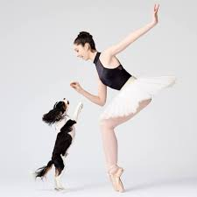
The Body Senses: Kinesthesia
Kinesthesia- sensory system for body posture, orientation, and bodily movement
Receptors are found throughout the body- muscles, joints, tendons
Tells us which muscles are relaxed/contracted, how body weight is distributed, where are arms and legs are

Slide 36
Two-Point Threshold Activity
Using the toothpicks at the station, have your partner close their eyes while you touch various parts of them (fingertip, back, arm, leg, foot, etc) with BOTH tips at the same time.
Have your partner indicate for each if it felt like one point or two.
You may also want to try starting with the toothpicks on her forearm at the crease of her elbow and slowly drawing them gently down to the tip of her index finger. What begins as a single sensation changes into two.
Keep track below of the body area and whether your partner indicated that it felt like one or two points.
Please throw away the toothpicks after use.
Switch partners and repeat

Slide 37
Understanding Perception
Chapter 4, Section 4, pages 135-146

Slide 38
Chapter 4, Section 4A
Pages 135-142

Slide 39
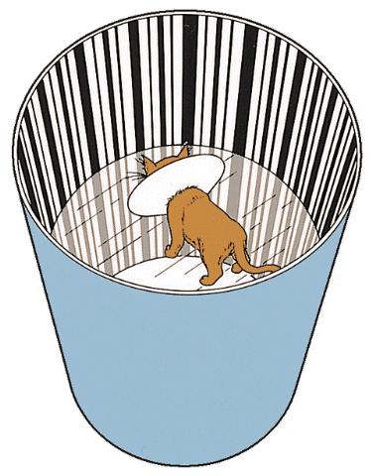
Perception: Selection
Three steps for perception: Selection, Organization, Interpretation
Illusion- false or misleading perceptions that are produced by actual physical distortions
Auditory: https://www.youtube.com/watch?v=kzo45hWXRWU
Step One – Selection: choosing the important messages
Selective attention- filtering out and attending only to important sensory messages
Cocktail party phenomenon
Feature detectors- specialized neurons that respond only to certain sensory information
Temporal, occipital lobes- faces
Interaction with the environment/specific stimuli is necessary for development of these receptors
David Hubel and Torten Wiesel conducted groundbreaking experiments on cats demonstrating the use of the visual cortex
Habituation- tendency of the brain to ignore environmental factors that remain constant
This applies to music, relationships, etc.
Different than sensory adaptation- sensory adaptation has the receptor cells decrease the messages, perception is a decrease in the brain’s processing
We like stimuli that is intense, novel, moving, contrasting

Slide 40
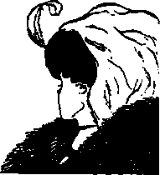
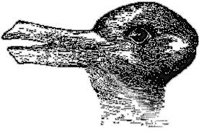
Perception: Organization
Step Two – Organization: We need to organize the information in a meaningful way
We need to take the parts of what we see and organize them into patterns that create a whole
Gestalt principles explain how we see form
Fundamental Gestalt principle is figure-ground- the ability to differentiate an object from its surrounding area
When this is vague, reversible figure occurs
Some are visual, others are time-based, sound, etc.
Gestalt laws seem to only apply if someone has had a formal education (in geometrical concepts) or in interpreting 2-d drawings

Slide 41
Gestalt Principles

Slide 42
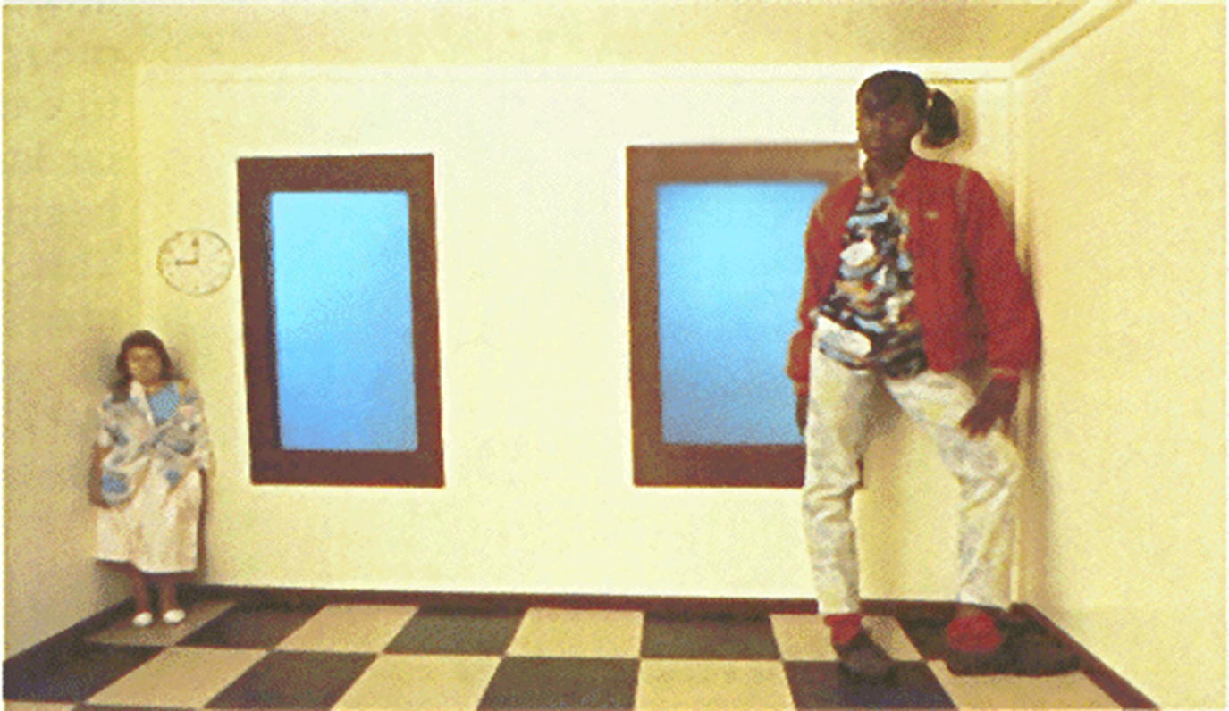
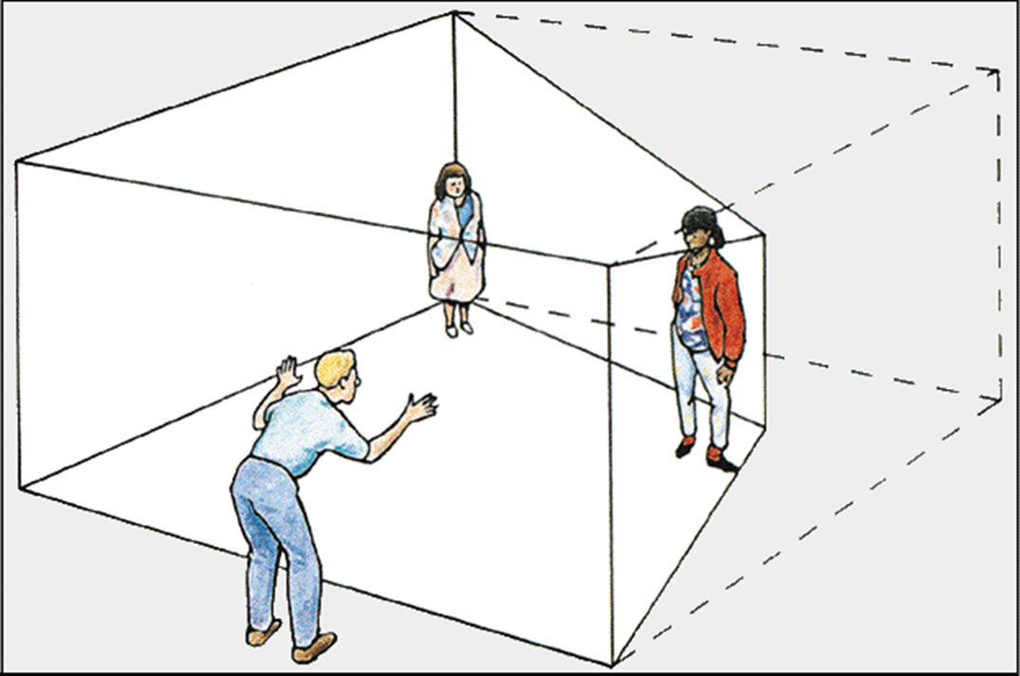
Perceptual Constancies
Perceptual constancies- tendency for the environment to be perceived as remaining the same even with changes in sensory input
We learn to perceive; our perception is influenced by our needs, beliefs, expectations
Size constancy- understanding that things in the foreground of our vision are in front of things behind them, with everything as the normal size
Shape constancy- if a shape is rotated, we still perceive it as the same shape
Color constancy- understanding that the color of objects remain constant despite differently lit conditions
Brightness constancy- understanding that the brightness of a vision remains constant despite differently illuminated conditions

Slide 43
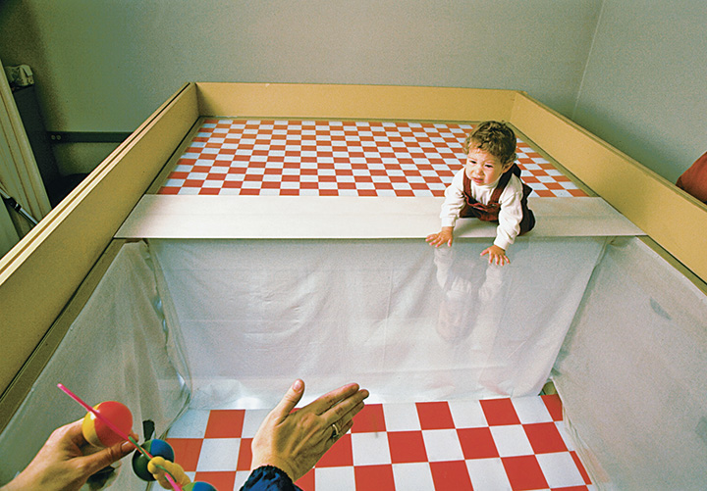
Depth Perception
Depth perception- the ability to perceive three-dimensional space and to accurately judge distance
Heavily rely on vision for perceiving distance
Primarily a learned ability, but also partially inborn
Research with the visual cliff for infants give us evidence for nature
We use binocular cues and monocular cues
https://www.youtube.com/watch?v=DrzmvI6iMrE
Visual cliff experiment showed that infants perceive a difference in depth, based on their heart rate change.

Slide 44
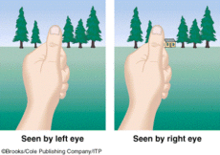
Binocular Depth Cues
Binocular depth cues- visual input from two eyes that allows perception of depth or distance
Retinal disparity- binocular cue to distance in which the separation of the eyes causes different images to fall on each retina
Far objects project on different areas than the near objects: far=near the nose, near = closer to the ears
Convergence- binocular depth cue in which the closer the object, the more the eyes converge/turn inward, the strain of eye muscles created by this tell your brain to interpret distance
Retinal disparity and convergence, and depth perception work best when looking directly at the object “keep your eye on the ball”

Slide 45
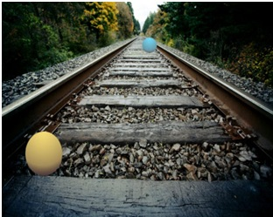
Monocular Depth Cues
Monocular depth cues- visual input from a single eye alone
that contributes to perception of depth or distance
Binocular cues only work up to the length of a football field
Linear perspective- parallel line converge or angle toward one another as they recede into the distance
Interposition- objects that obscure or overlap other objects are perceived as closer
Relative size- close objects cast a larger retinal image than distant objects
Texture gradient- nearby objects have a coarser and more distinct texture than distant ones
Aerial/atmospheric perspective- distant objects appear hazy and blurred compared to close objects because of intervening atmospheric dust or haze
Light and shadow- brighter objects are perceived as being closer than distant objects
Relative height- objects positioned higher in our field of vision are perceived as farther away
Accommodation- muscles in the eye adjust the shape of the lens as it focuses on an object and sends neural messages to the brain
Motion parallax- when we are moving, closer objects seem to move more quickly and farther objects seem to move more slowly or not at all

Slide 46
Monocular Depth Cues

Slide 47
Chapter 4, Section 4B
Pages 143-147

Slide 48
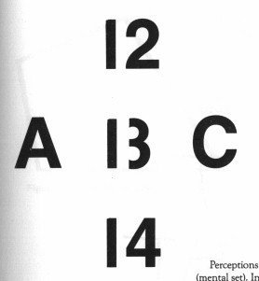
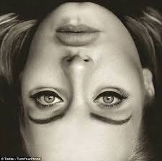
Perception: Interpretation
Step Three – Interpretation: using the information received to explain and make judgments about the external world
Perceptual adaptation- the brain’s ability to get used to the environment and be able to function properly
E.g. upside down world→ after time, we would adapt to seeing the world like that
Perceptual set- readiness to perceive in a particular manner based on expectations
We see what we expect to see
Frame of reference- our perceptions of people, objects, situations are affected by their context

Slide 49
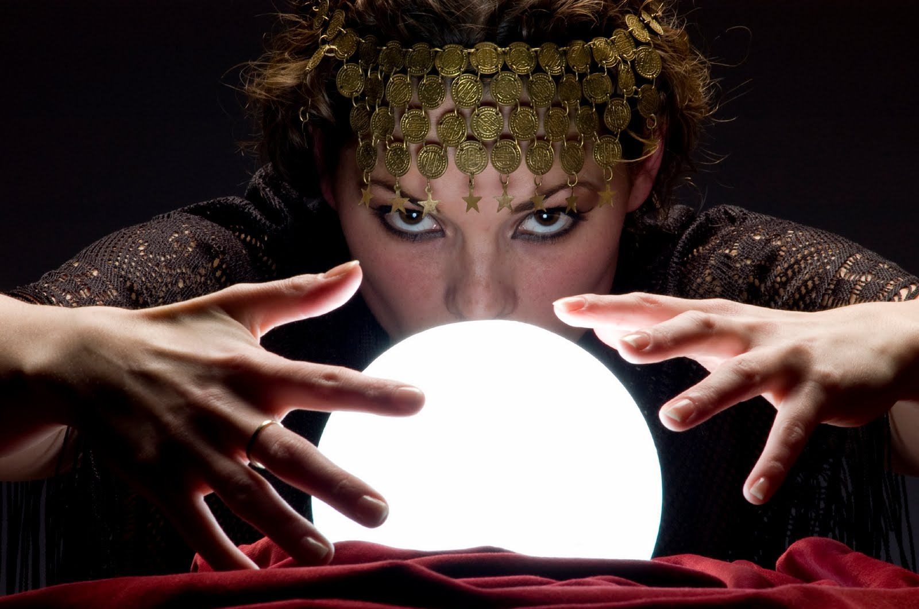
Extrasensory Perception (ESP)
Extrasensory perception (ESP)- perceptual, or “psychic,” abilities that supposedly go beyond the known senses
Clairvoyance, telepathy, psychokinesis, precognition
Research often used Zener cards- 5 symbols on 25 cards; ask the ESP person to accurately guess → if they guess correctly above the chance probability, it is credited to ESP
First researcher- Rhine- criticized because the cards were see-through and experimenter could give cues
Claims of ESP are criticized most for lack of stability and replicability
Why do people still believe?
Seeing possible as probable
An explanation for the strange occurrences of the world
Selectively paying attention to the things we want to see or hear related to ESP (or want to believe)

