Slide 1
States of Consciousness
Unit 9
Chapter 5

Slide 2
Understanding Consciousness
Chapter 5, Section 1, pages 152-156

Slide 3
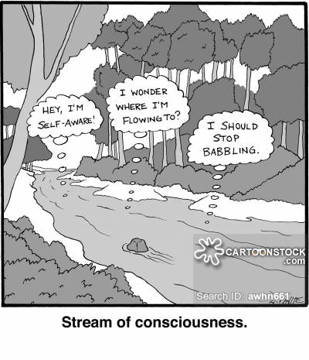
consciousness
Consciousness- our awareness of ourselves and our environment
William James compared consciousness to a stream that is constantly changing yet always the same- the person may change the direction or not→ stream of consciousness
Altered state of consciousness- a temporary mental state, other than ordinary mental consciousness, that occurs during sleep, dreaming, psychoactive drug use, and hypnosis
Awareness comes from our cerebral cortex (particularly our frontal lobes), while arousal comes from brain-stem activation

Slide 4
https://www.youtube.com/watch?v=Ahg6qcgoay4

Slide 5
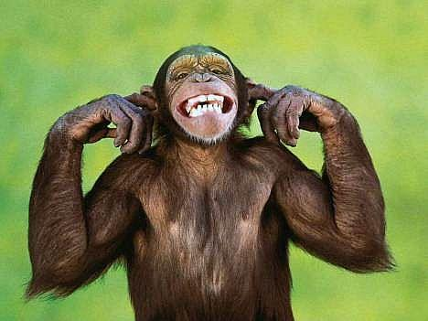
Selective attention
Selective attention- the process of focusing conscious awareness onto a specific stimulus, while filtering out a range of other stimuli occurring simultaneously
You can control what you are paying attention to, but you may also end up missing clearly visible stimuli, especially if you are distracted
Inattentional blindness- the failure to notice a fully visible, but unexpected stimulus when our attention is directed elsewhere; aka perceptual blindness
This can also occur for other senses, like inattentional deafness
It applies to first responder situations, driving, etc.
Test: https://www.youtube.com/watch?v=Ahg6qcgoay4

Slide 6
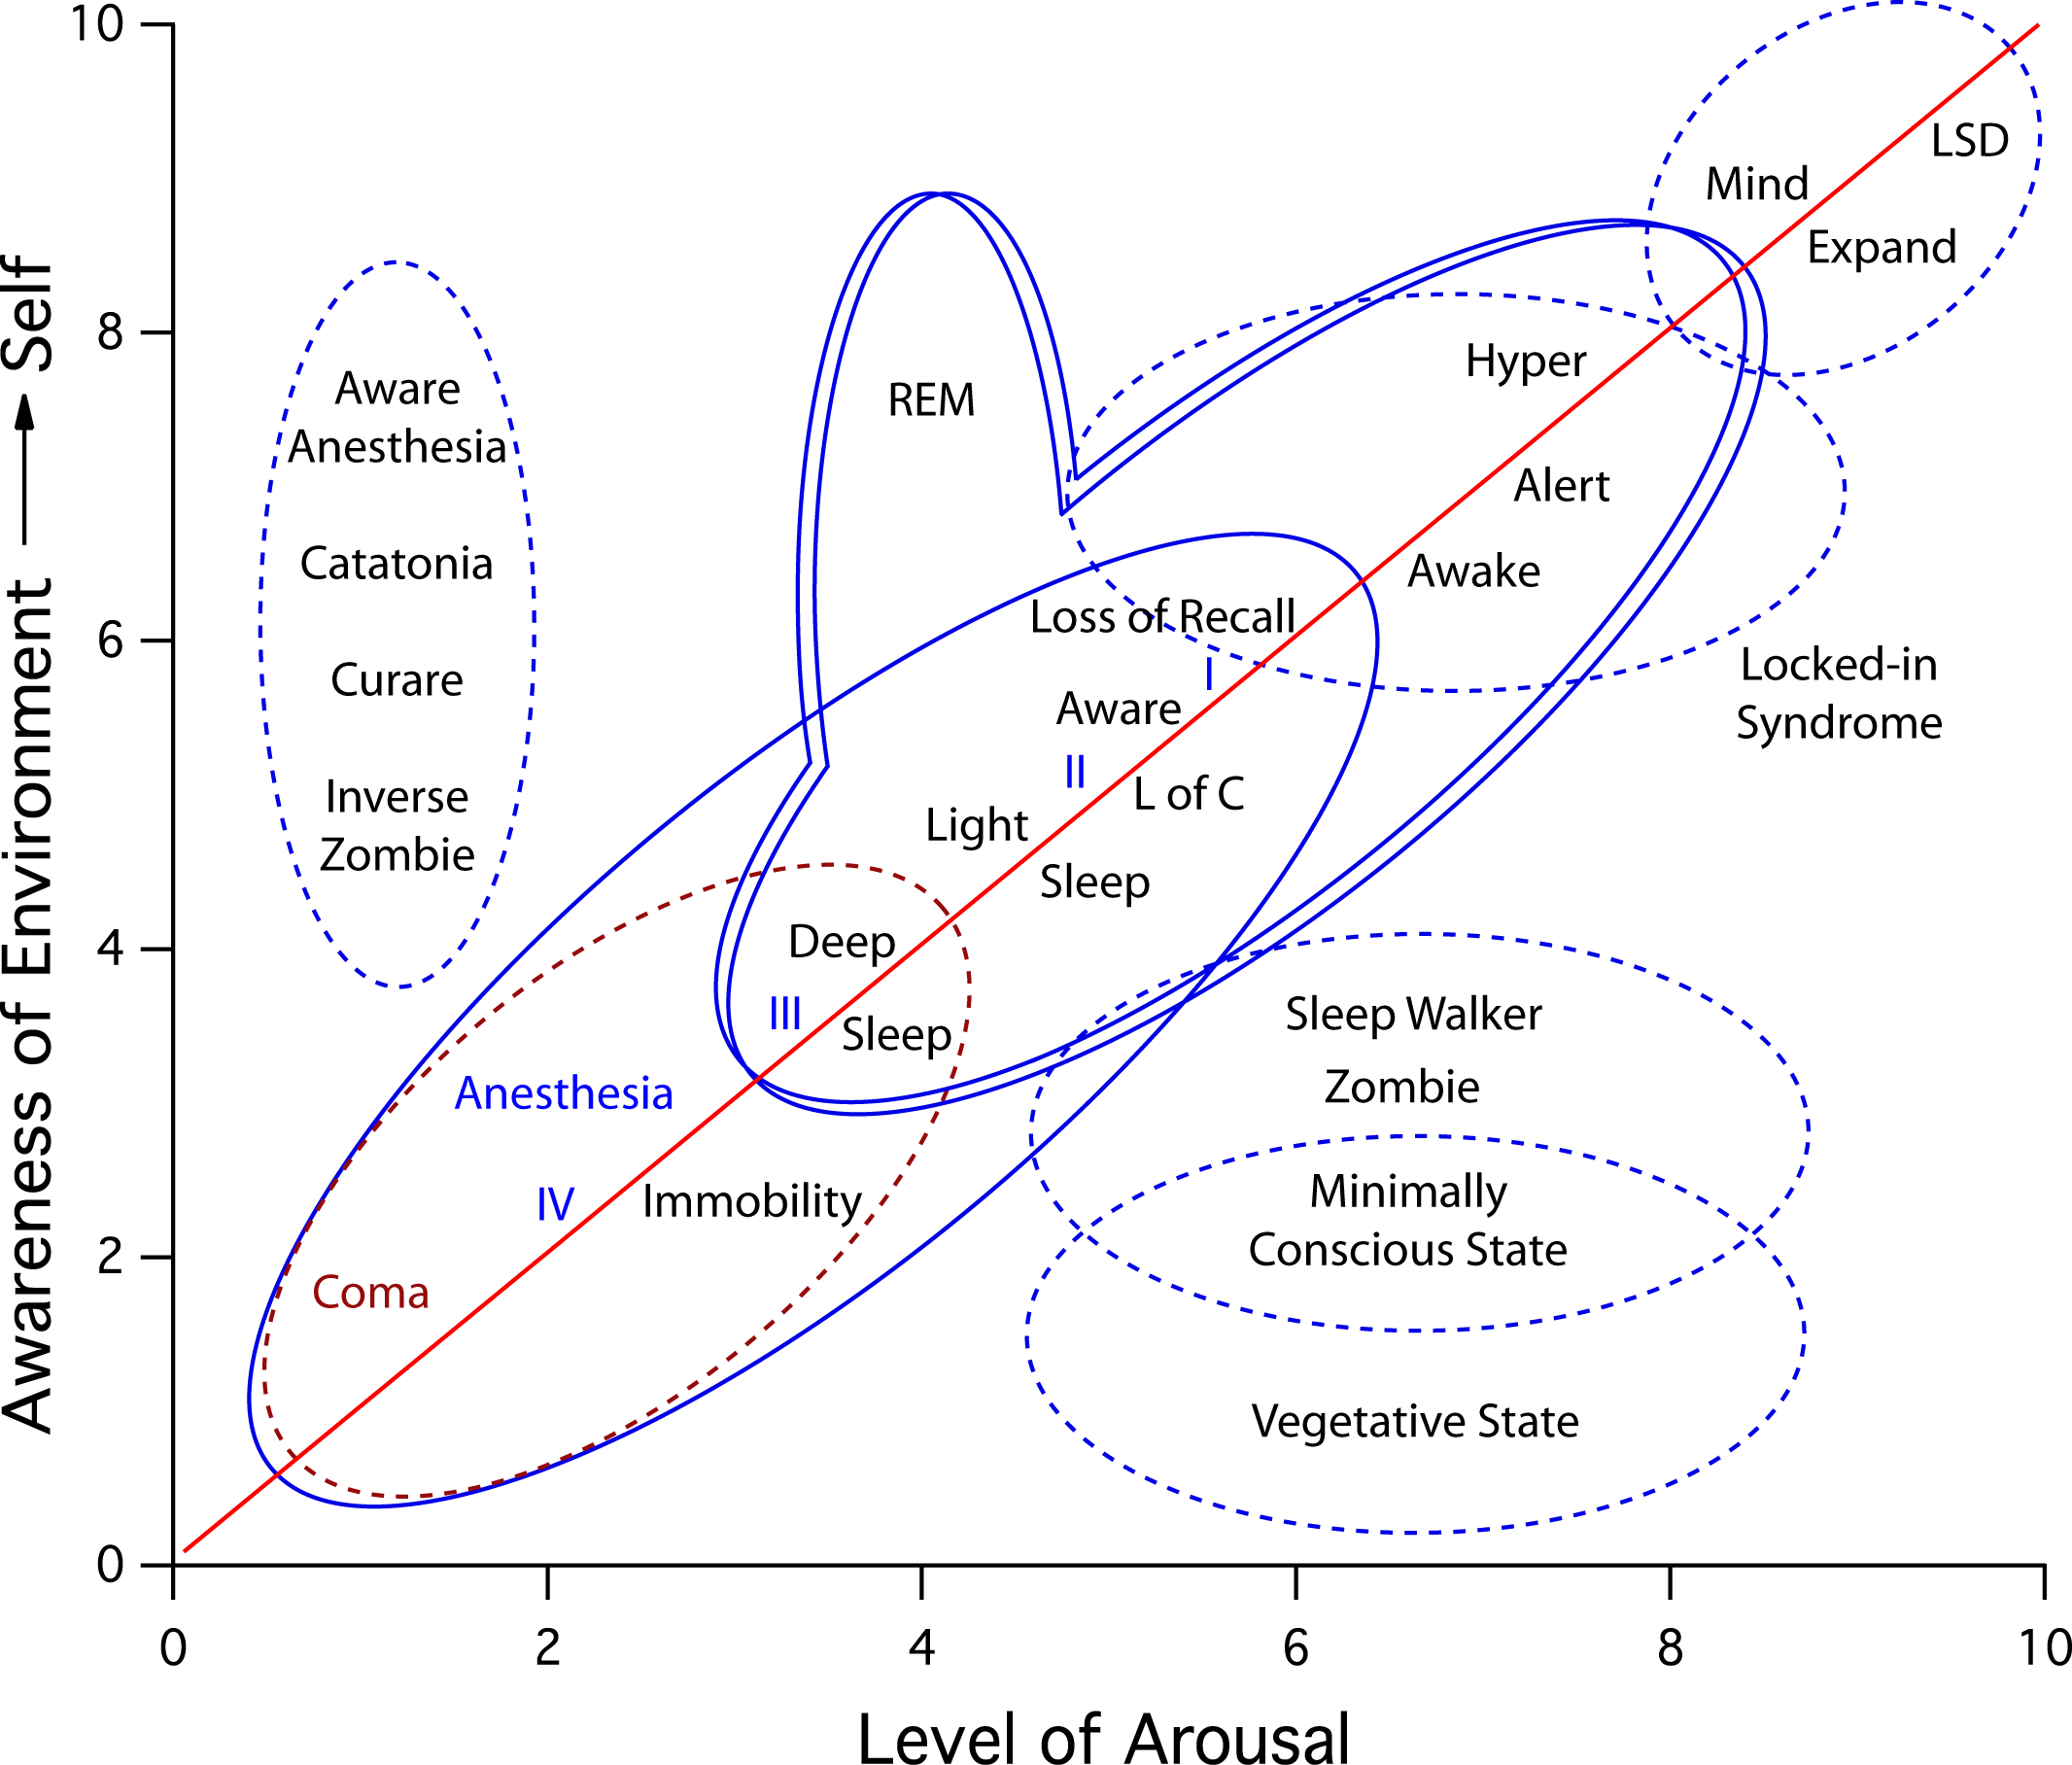
Levels of Awareness
Our awareness operates along a continuum, depending on what task we are engaged in
Controlled processes- mental activities that require focused attention and generally interfere with other ongoing activities
Automatic processes- mental activities that require minimal attention and generally have little impact on other activities
First learning to drive a car (controlled) vs. now easily driving a car (automatic)

Slide 7
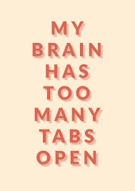
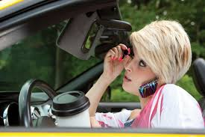
Consciousness research
Regarding research on distracted driving, talking on a cell phone during driving triples the level of likelihood of collision
You have to use selective attention to switch back and forth between driving and the phone
This is worse for inexperienced drivers since driving is still more of a controlled process
Multitasking and school: multitaskers paid less attention to detail, showed poorer memory, and had more trouble switching from one task to another
Media multitasking in students saw a correlation with lower scores on standardized tests, poorer performance on behavioral measures of working memory capacity, greater impulsivity, and lesser growth mindset
Takeaway- if you need to be keeping yourself safe or are learning something you need to remember or in a similar situation- don’t multitask

Slide 8
Understanding Sleep and Dreams
Chapter 5, Section 2, pages 157-167

Slide 9
Understanding Sleep and Dreams: Circadian Rhythms and Sleep, Jet Lag, Sleep Deprivation, REM and NREM Sleep, Four Sleep Theories
Chapter 5, Section 2A, pages 157-163

Slide 10
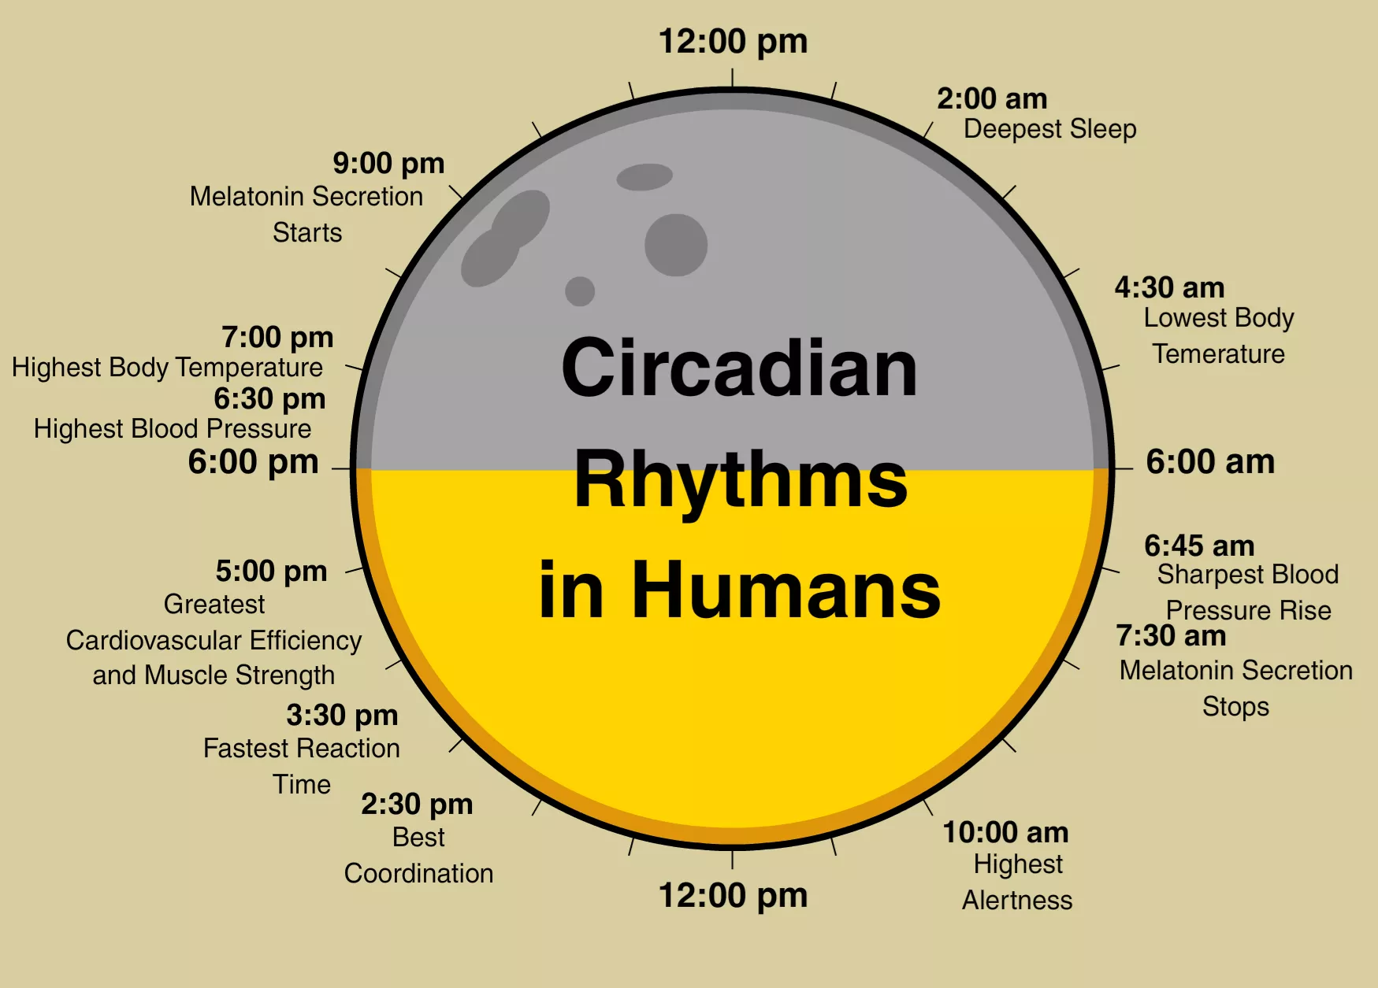
Circadian rhythm
Circadian rhythm- the internal biological clock governing bodily activities that occur on a 24-25 hour cycle
Sleep/wake cycle, alertness, core body temperature, moods, learning efficiency, blood pressure, metabolism, immune responses, pulse rate
Controlled by suprachiasmatic nucleus (SCN) (part of the hypothalamus) by receiving information about light and darkness, sending it to our pineal gland which releases melatonin hormones
The SCN detects levels of melotonin and adjusts the output from the pineal gland to keep the levels balanced

Slide 11
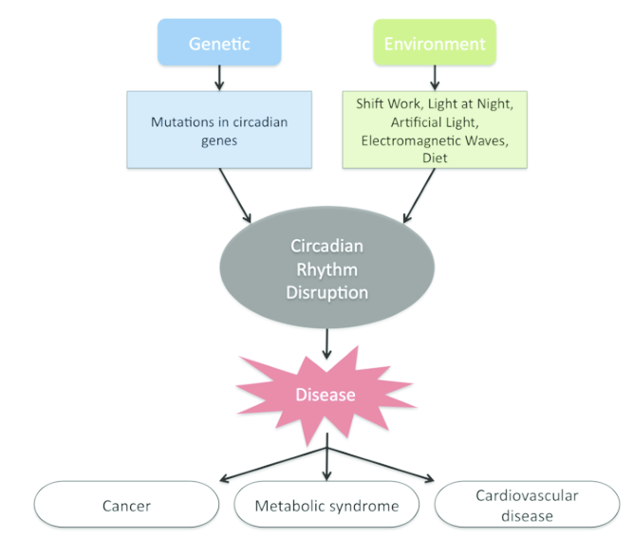
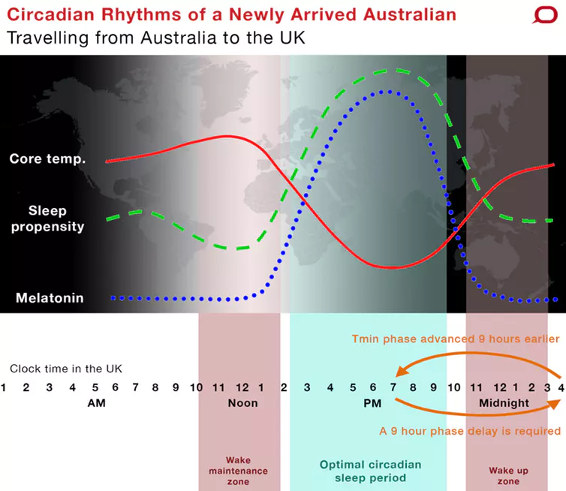
Circadian rhythms
Puberty shifts circadian rhythms
Adults release melotonin around 10 pm to signal sleep time, but teenagers get that melotonin release around 1 am
Effects of this are seen in schools and the time they start high school
Disruptions to the circadian rhythm can cause health concerns- increase risk of cancer, heart disease, autoimmune disorders, obesity, sleep disorders, accidents, advanced aging, decrease cognitive abilities
Jet lag is caused by a disruption of the circadian rhythm
Traveling eastward is worse

Slide 12
Sleep deprivation
Effects (reduced cognitive and motor performance, irritability, increased cortisol levels) are the same as those associated with stress
Other effects include increased risk of cancer, heart disease, and impairment of the immune system (which is why it can lead to getting sick more often)
Sleep-deprived individuals are more likely to react emotionally due to activation of the amygdala
This all leads to concerns about those who work jobs who have work shifts

Slide 13
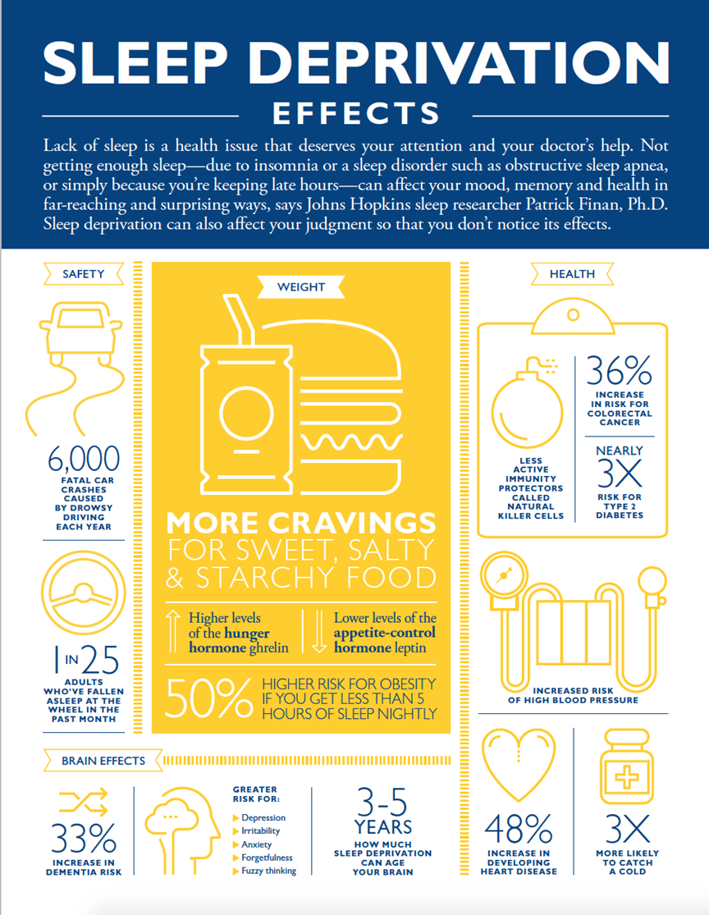

Slide 14
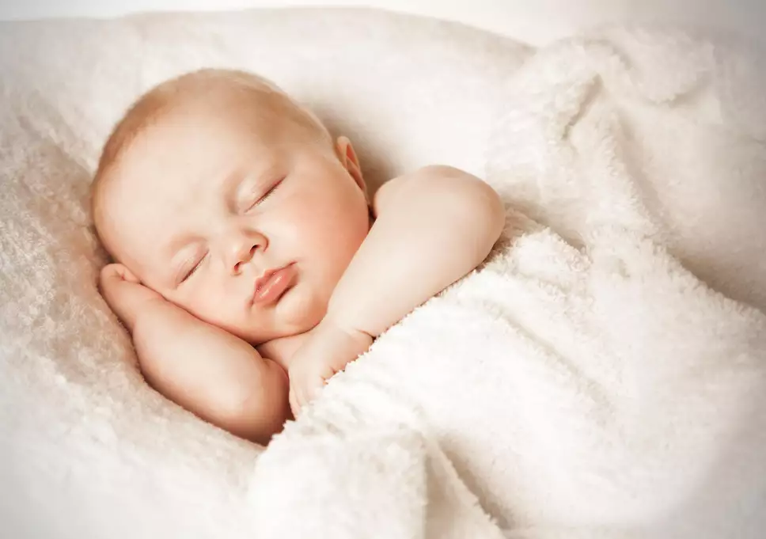
Sleep Cycles
Studied in sleep labs- participants are hooked up to EEG and other physiological recording devices during sleep
We spend about 25 years of our life sleeping
Sleep operates in cycles (usually)
Individuals have 4-5 deep sleep cycles then the rest of the night is light sleep
Each cycle is about 90 minutes
NREM (non-rapid-eye-movement) sleep- the sleep stages (1-3) during which a sleeper does not show rapid eye movements
REM (rapid eye movement) sleep- the fourth stage of sleep, marked by rapid eye movements, irregular breathing, high-frequency brain waves, paralysis of large muscles, and often dreaming

Slide 15
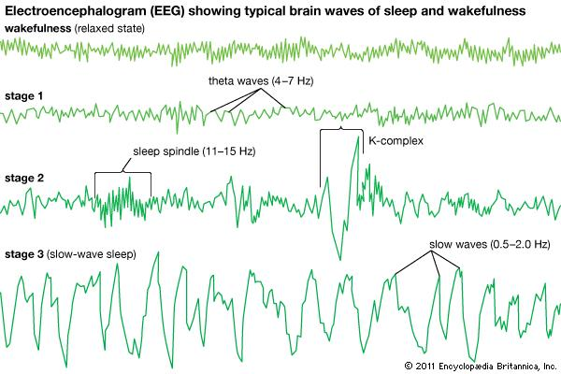
Sleep: NREM Sleep Cycles
NREM sleep
Drowsy through stage 3 of sleep
Dreams may occur during this
Stage 1- lighter stage
Hypnagogic hallucinations- hear things or feel like you’re floating
Myoclonic jerks- falling feeling then sudden muscle movement
Stage 2- lighter stage
Lesser muscle activity
Sleep spindles- sudden surge in brain wave frequency
Stage 3- deep sleep
Hard to wake up, or if they do- disoriented
Sleepwalking, sleep talking, bedwetting

Slide 16
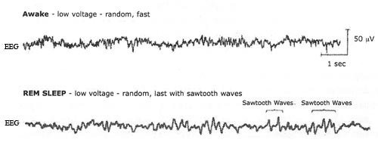
Sleep: REM Stage
REM sleep
Eye movement indicate dreaming
Breathing and pulse rates are fast and irregular
Muscles are deeply relaxed (almost feel paralyzed), which is why you can’t act out your dreams
Not being able to move but being in a light stage of sleep→ paradoxical sleep

Slide 17
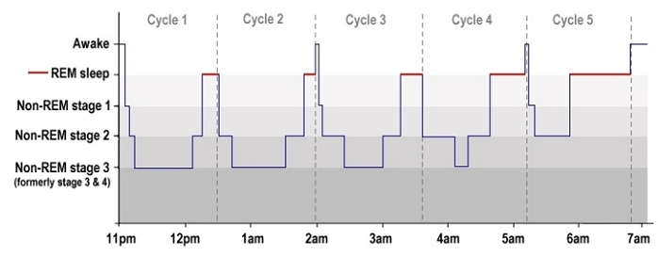
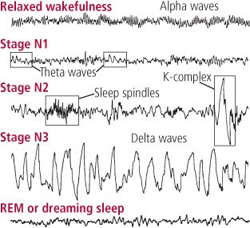

Slide 18
Sleep information
Around eight hours of sleep is needed for everyone, although some individuals’ lifestyles/ages/health may change that
Dreaming
Research have found that dreams have little meaning
Most adults dream, some may just not remember it
Kids dream about 25% of their sleep time during ages 3 through 8
Dreams occur in real time
Most dreams are in color
Those who are blind only report visual images if they lost their sign after around age 7
Learning while sleeping has minimal effect during stage 1 and 2 of sleep but generally not

Slide 19
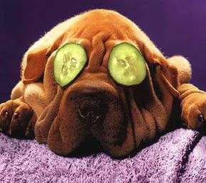
Sleep theories
Adaptation/protection theory- sleep evolved to conserve energy (calories) and provide protection from predators (avoid being prey at night)
Animals who have the highest likelihood of being eaten by others, a higher need for food, and lowest ability to hide tend to sleep the least
Repair/restoration theory- sleep allows the organism to repair their bodies or recuperate from depleting daily waking activities
Repairs chemicals and body tissues, brain repairs itself and clears waste products
Recovers from physical and emotional demands
If deprived of REM sleep, people catch up later by spending more than usual time in REM

Slide 20
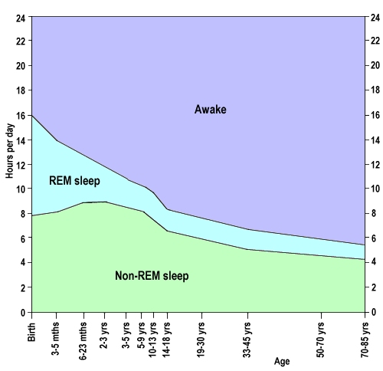
Sleep theories
Growth/development theory- deep sleep (stage 3) is correlated with physical development, including changes in the structure and organization of the brain
Infants spend more time in stage 3 than adults→ our brains change and we release fewer hormones and sleep less
Learning/memory theory- sleep is important for learning and for the consolidation, storage, and maintenance of memories
REM sleep increases after periods of stress or intense learning
We also may need sleep to get rid of unnecessary things we learn in the day

Slide 21
Understanding Sleep and Dreams: Four dream theories, Sleep-wake disorders
Chapter 5, Section 2B, pages 163-167

Slide 22
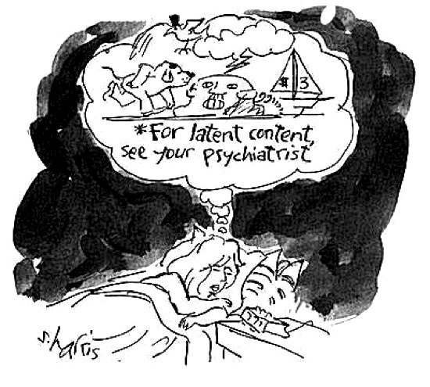
Dream theories
Wish-fulfillment view- Freud’s belief that dreams provide an outlet for unacceptable desires
Manifest content- the “surface” or remembered, story line, which contains symbols that mask the dream’s latent content (the true meaning)
Latent content- a dream’s unconscious, hidden meaning, which is transformed into symbols within the dream’s manifest content (story line)
Found mostly to be untrue, especially because interpretation is subjective

Slide 23
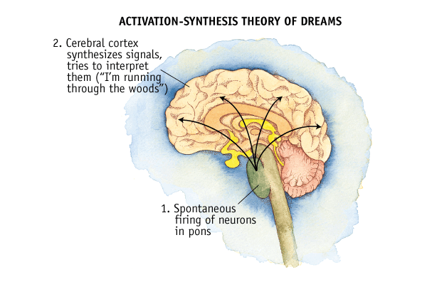
Dream theories
Activation-synthesis theory- dreams are a by-product of random, spontaneous stimulation of brain cells during sleep, which the brain combines (synthesizes) into coherent patterns (dreams)
There may be meaning with dreams if the stimulation of a brain area displays the emotions in the dream (stimulation from the amygdala brings a fearful dream)
Our personalities, motivations, memories, experiences would shape how the dream is made
Cognitive view- dreaming is a type of information processing that helps us organize and interpret our everyday experiences
Research shows similarities between content of dreams and waking fears, thoughts, and concerns

Slide 24
Differences in dreams
Men and women share common dream themes
Women report dreams on children/family, household objects, indoor events
Men report dreams about violence, strangers, weapons, achievement, outdoor events
There may be an influence of gender roles on these reports
Across cultures
Dreams about basic human needs and fears
Children dream about monsters or scary animals
Most misfortune than good fortune
Dreamer is often the victim of aggression than the cause of it
Common Dream Themes:
Being attacked or pursued
Falling
Sexual experiences
Being lost
Being paralyzed
Flying
Being naked in public
School, teachers, studying
Arriving too late
Death of a loved one or dead people as alive

Slide 25
Sleep-wake disorders
40 million Americans suffer from chronic sleep disorders, and another 30 million experience occasional symptoms
Insomnia- a sleep disorder characterized by persistent problems in falling or staying asleep, or awakening too early
Symptoms- feeling poorly rested the next day
May have other psychological disorders
There is a correlation between students who send a lot of texts and those with insomnia symptoms, but not in Africa or South America hunter-gatherer societies
Treatment:
Over-the-counter doesn’t usually work
Prescriptions work but inhibit the quality of stage 3 and REM sleep
Some prescriptions may work for anxiety, etc. but may lead to dependence
Melatonin may be best option for meds
Non-prescription based treatment, like not using/watching electronics around bedtime

Slide 26
Tips for insomnia
The only thing you do in your bedroom should be sleep
Exercise
Keep regular sleep/wake hours
Avoid stimulants
Avoid late meals
Stop worrying
Use pre-sleep rituals
Practice yoga
Use progressive muscle relaxation
Use fantasies of tranquil settings
Use deep breathing
Try a warm bath

Slide 27
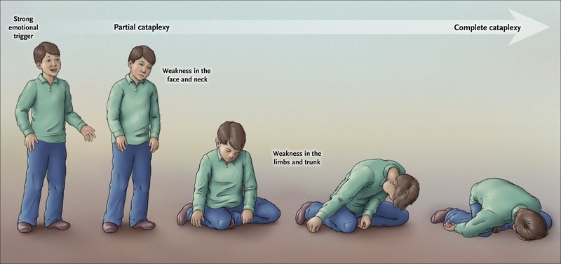
Sleep-wake disorders
Narcolepsy- characterized by uncontrollable sleep attacks
May experience sudden, incapacitating attacks of muscle weakness or paralysis called cataplexy
Do not know all the causes, but we know it is genetic, may be caused by degeneration of neurons
No known cure; long naps and stimulant/anti-depressant drugs may reduce frequency
https://www.youtube.com/watch?v=1PuvXpv0yDM

Slide 28
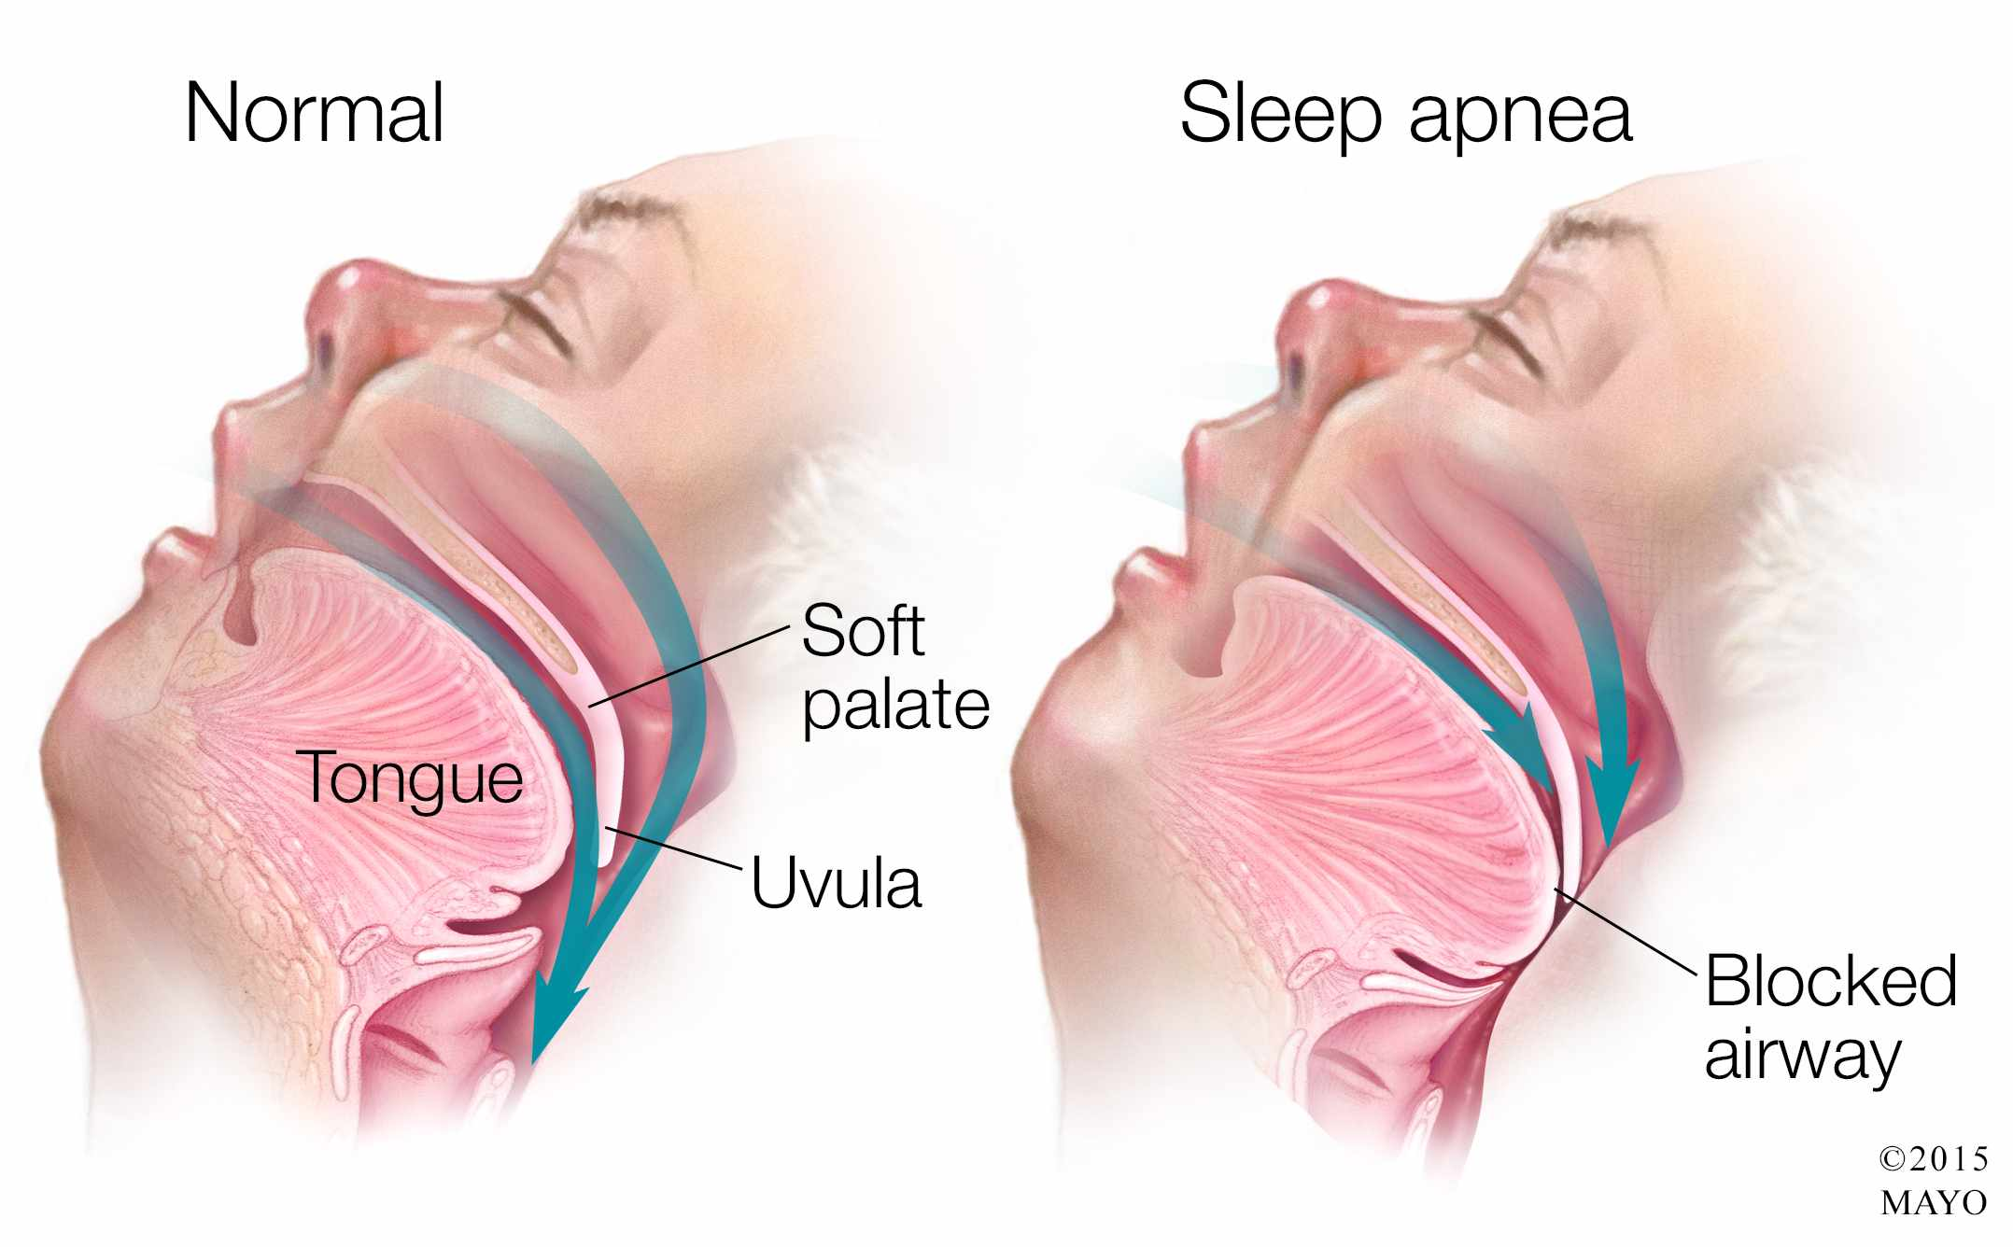
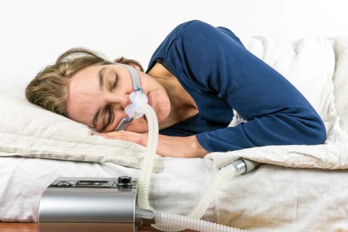
Sleep-wake disorders
Sleep apnea- disorder of the upper respiratory system that causes a repeated interruption of breathing during sleep; it also leads to loud snoring, poor-quality sleep, and excessive daytime sleepiness
Results from blocked upper airway passages and/or the brain’s failure to send signals to the diaphragm
Many are unaware of the disorder and don’t understand the effects
Linked with high blood pressure, strokes, cancer, depression, and heart attacks
Treatment:
Creative ways to make sure you do not sleep on your back (if that is the cause)
Dieting and restriction of alcohol use
Dental appliances or CPAP
Occasional snoring is normal, chronic snoring is not

Slide 29
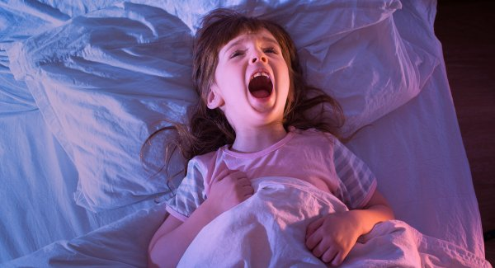
Sleep-wake disorders
Sleepwalking- occurs during NREM sleep
Normally harmless
Try to wake them
4% of adults have at least one episode each year
Sleep talking- occurs during any stage, but most often NREM
Nightmares- anxiety-arousing dreams that generally occur near the end of the sleep cycle, during REM sleep
Night terrors- abrupt awakenings from NREM sleep accompanied by intense physiological arousal and feelings of panic
Patience and soothing reassurance are best ways to help
All more common among young children or adults under stress

Slide 30
Lucid Dreaming
https://www.youtube.com/watch?v=WpYsl6DlM28 12 minutes
https://www.youtube.com/watch?v=OK3SfNxbK3Y 14 minutes

Slide 31
Psychoactive drugs
Chapter 5, Section 3, pages 168-176

Slide 32
History of Drugs
Legal and illegal drugs
Used for 1000s of years
Marijuana
2737 BC (Chinese Emperor)
Cocaine
15th century (Inca Empire)
Tobacco
1492 (Columbus)
Brought habit to Spain
Laudanum (U.S.)
Opium dissolved in alcohol
Main ingredient in many OTC meds
Coca-Cola
1886 (Atlanta)
Coco leaves (cocaine)
Alcohol
10,000 years ago (Late Stone Age)
Produced mead (fermented honey)

Slide 33
Psychoactive drugs
Psychoactive drugs- a chemical that changes mental processes, such as conscious awareness, mood, and perception
Drugs affect our neurotransmitters
Agonists- a substance that binds to a receptor and triggers a response that mimics or enhances a neurotransmitter’s effect
Enhances the neuron’s ability to synthesize more neurotransmitters → the similar shapes of the drug allows them to bind to the receptor sites → the drugs block reuptake or degradation leading to excess neurotransmitters to stay in the synapse
Antagonists- a substance that binds to a receptor and triggers a response that blocks a neurotransmitter’s effect
Decreases the neuron’s ability to synthesize, store, and release neurotransmitters → the drugs bind with the receptor and is dissimilar enough to block the message

Slide 34
Psychoactive drugs

Slide 35
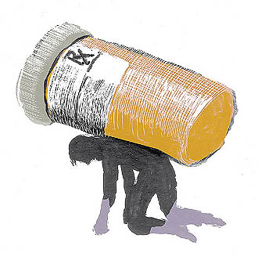
Drug abuse
Drug abuse- a type of drug taking that causes emotional or physical harm to the drug user or others
Compulsive, frequent, and intense drug intake
Addiction- a broad term that describes a compulsive craving for a substance, thing, or activity despite harmful consequences
Psychological dependence- the psychological desire or craving to achieve a drug’s effects
Physical dependence- the changes in bodily processes that make a drug necessary for minimal functioning

Slide 36
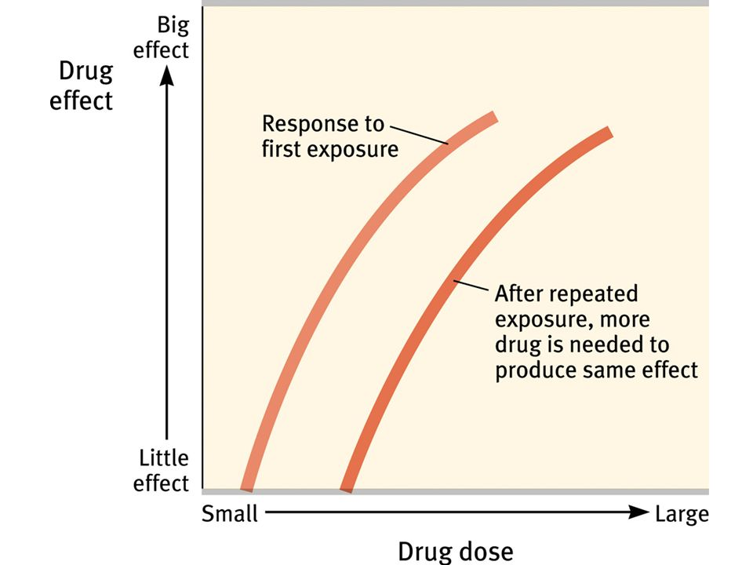
Drug abuse
Withdrawal- the discomfort and distress, including physical pain and intense cravings, experienced after stopping the use of an addictive drug
Clearly shows physical dependence
Both psychological and physical dependence are damaging
Tolerance- the bodily adjustment to continued use of a drug in which the drug user requires greater dosages to achieve the same effect
Can also experience cross-tolerance
Psychoactive drugs can lead to episodes of psychosis, hallucinations, or delusions

Slide 37
Addiction and its effects on careers
Time management- the behavior involved takes time away from work, family, friends, etc.
Ever notice this with social media/technology?
Quality and quantity of sleep- sleep deprivation and all of its negative effects
Interpersonal relationships- being sleep deprived and taking time for the addictive behavior may lead to poor social relationships
Impression management- negative affect others’ view of you
Overall performance- inconsistent work quality, increased absenteeism, poorer concentration, lack of focus

Slide 39
depressants
Depressant- a drug that decreases bodily processes and overall responsiveness by using the central nervous system to suppress or slow down
“downers”
Physical and psychological dependence is easily acquired, leading to strong potential for abuse
Examples: alcohol, barbiturates, anxiolytics (antianxiety or tranquilizing drugs), alprazolam (Xanax), flunitrazepam (rohypnol, “date-rape drug”, “roofies”), ketamine (special K), gamma-hydroxybuyrate (GHB)
Most commonly used- alcohol
Men and women have different rates of breaking down the alcohol
Stimulant at low doses, depressant at high doses
At high levels (>0.5%), it can cause a coma or death
Alcohol has severe consequences, especially when overconsumed. There are dangers including drunk driving, sexual aggression, and violence. See page 172 for further details

Slide 40
depressants
Desired Effects
Tension reduction
Euphoria
Disinhibition
Drowsiness
Muscle relaxation
Undesirable effects
Anxiety
Nausea
Disorientation
Impaired reflexes and motor functioning
Amnesia
Loss of consciousness
Shallow respiration
Convulsions
Coma
Death

Slide 41
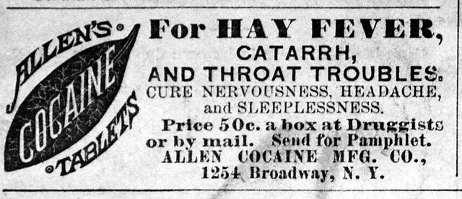
stimulants
Stimulants- a drug that increases overall activity and general responsiveness
“uppers”
Examples- cocaine, amphetamine (“crystal meth,” “speed”), 3,4-methylenedioxy-methamphetamine (MDMA, “ecstasy,” “molly”), caffeine, nicotine
Cocaine was once used for medical purposes and sodas, but any amount can be fatal as it affects heart functioning
Status drug of the 1970s, leading to the creation of “crack” made from byproducts of cocaine
Nicotine in cigarettes and chewing tobacco are also dangerous- smoking and tobacco-related illnesses are among the leading causes of death and worldwide concern
Why is it still used? It is highly addictive and has cognitive awards

Slide 42
Stimulants
Desired Effects
Exhilaration
Euphoria
High physic land mental energy
Reduced appetite
Perceptions of power
Sociability
Increased alertness
Relaxation
Undesirable Effects
Irritability
Anxiety
Sleeplessness
Paranoia
Hallucinations
Psychosis
Elevated blood pressure and body temperature
Convulsions
Death
Insomnia
Restlessness
Increased pulse rate
Mild delirium
Ringing in the ears
Rapid heartbeat
Increased blood pressure
Stomach pains
Vomiting
Dizziness
Cancer
Heart disease
Emphysema

Slide 43
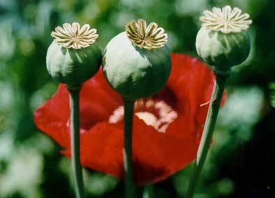
Opiates/opioids
Opiates/opioids- a drug derived from opium that numbs the senses and relieves pain
Sometimes classified as depressants because they depress the CNS
But they also excite some areas of the CNS as they mimic natural endorphins
Because they mimic endorphins, after repeated use, the body stops creating natural endorphins→ withdrawal becomes painful from a strong physical addiction
Examples- morphine, heroin (“H,” “smack,” “horse”), codeine, oxycodone
May be considered the worst drug crisis in American history- the number who have died from overdose outnumbers car accident or gun related deaths

Slide 44
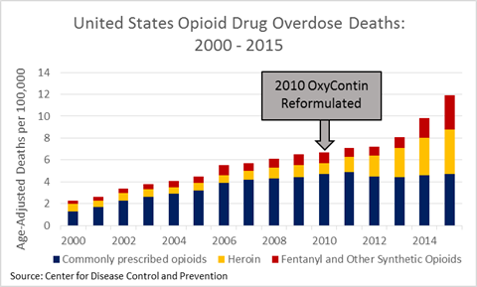
Opioid Crisis
Notes:
https://www.jec.senate.gov/public/index.cfm/republicans/2017/6/the-opioid-crisis

Slide 45
Opiates/opioids
Desired effects
Euphoria
“Rush” of pleasure
Pain relief
Prevention of withdrawal
Sleep
Undesirable effects
Nausea
Vomiting
Constipation
Painful withdrawal
Shallow respiration
Convulsions
Coma
Death

Slide 46
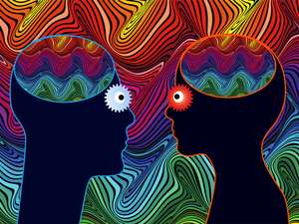
Hallucinogens
Hallucinogens- a drug that produces sensory or perceptual distortions
Sometimes used for religious purposes, or “mind-expanding”- research shows there is higher neural activity
Aka psychedelics
Examples- LSD (lysergic acid diethylamide, mescaline (extract from the peyote cactus), psilocybin (extract from mushrooms), PCP (phencyclidine), marijuana
May affect sense of time
Controversy of marijuana
Research supports relief of chemotherapy side effects, chronic pain and other health problems
Concern of health effects- respiratory problems, psychosis, interrupted menstrual cycle- although one study shows no increase in physical health problems other than poor teeth health, “gateway” drug (also little supporting research), also concern over cognitive- decrease in IQ, educational achievement, and cognitive functioning but there may be third variable
We still need more research but it is damaging to pregnancy and under 18; may be linked to psychotic illnesses and cognitive/motor declines, is habit forming

Slide 47
Hallucinogens
Desired effects
Heightened aesthetic responses
Euphoria
Mild delusions
Hallucinations
Distorted perceptions and sensation
Relaxation
Mild euphoria
Nausea relief
Undesirable effects
Panic
Nausea
Longer and more extreme delusions
Hallucinations
Perceptual distortions “bad trips”
Psychosis
Perceptual and sensory distortions
Fatigue
Increased appetite
Lack of motivation
Paranoia

Slide 48
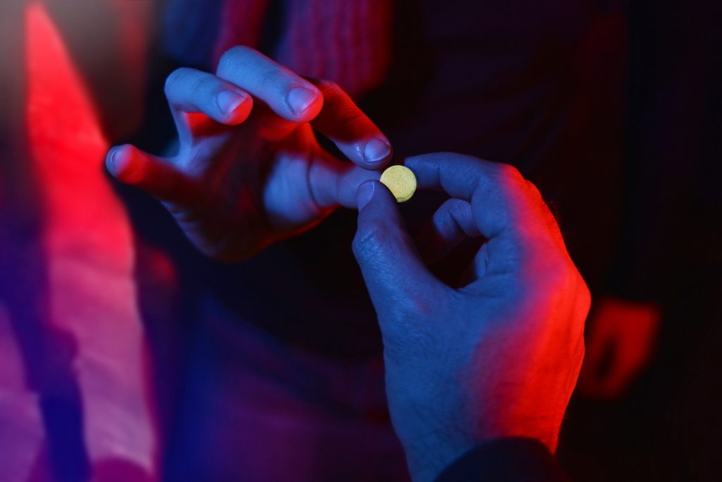
Club Drugs
Club drugs- drugs often used by teenagers and young adults
Often include- roofies, ecstasy, GHB, special K, crystal meth, bath salts, LSD
Many have serious effects
Ecstasy- potentially fatal damage to hippocampal cells, reduction of serotonin- memory/sleep/mood/appetite problems
One positive potential- special K may help treat major depression, suicidal behaviors, and bipolar disorders
Other dangers besides physical- legality, cheap knock-offs that are more dangerous, aggression, motor coordination during activities

Slide 49
Meditation and Hypnosis
Chapter 5, Section 4, pages 176-179

Slide 50
Meditation
Monkey mind meditation: https://www.youtube.com/watch?v=ksp3iSUDqfo
Meditation- a group of techniques generally designed to focus attention, block out distractions, and produce an altered state of consciousness
Believed to enhance self-knowledge and well-being through reduced self-awareness
Research shows it reduces the brain cells that are devoted to focusing on multiple tasks at once
Physiological effects- heart rate, oxygen consumption, sweat gland responses, brain activity, change sympathetic and parasympathetic responses, increase responsiveness to sensory stimuli
Psychological effects- reduce pain, anxiety, and stress; lower blood pressure, improve overall cognitive functioning, improve decision making, emotion regulation, and attention processing
30 minutes of meditation may provide the same relief as antidepressants

Slide 51
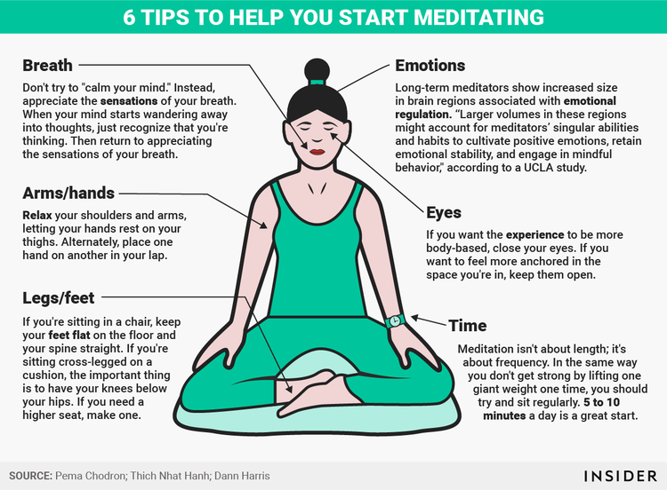
meditation
Types of meditation
Transcendental- repeated mantras
Mindfulness meditation- Buddhist traditions, focus on the present moment
Breath meditation- concentration on breathing

Slide 52
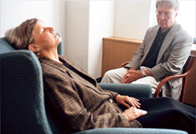
hypnosis
Hypnosis- an altered state of consciousness characterized by deep relaxation and a trance-like state of heightened suggestibility and intense focus
Characteristics of the hypnotic state
Narrow, highly focused attention (tuning out competing sensory stimuli)
Increased use of imagination and hallucinations
A passive and receptive attitude
Decreased responsiveness to pain
Heightened suggestibility
Requires a willing, conscious choice to relinquish control to be in a state of suggestibility
Hypnotized people retain awareness of themselves and can refuse suggestions
Hypnotized people do not have superhuman strength or memory
Used for surgery, treatment of pain, control of anxiety/fear during dentistry visits or childbirth, relaxing during psychotherapy

Slide 53
Activity
Stretch your arms in front of you, making sure the palms are facing each other at the same height and about two inches apart.
Close your eyes

Slide 54
activity
Imagine that your right arm is getting heavier and heavier, while your left arm is getting lighter and lighter
To help yourself, imagine that your right hand is holding a strap wrapped around several heavy books, while your left hand is holding a string tied to a helium balloon.

Slide 55
Activity debrief
Have your hands actually moved? Are they still two inches apart?
What do you think happened?

