Slide 1
Biological bases of behavior: Neuroscience
Unit 2, chapter 2

Slide 2
Neural bases of behavior: the micro level
Chapter 2, Section 1, pages 45-53
Notes:
https://www.youtube.com/watch?v=W4N-7AlzK7s

Slide 3
Neurons
Chapter 2, Section 1A, pages 45-48
Notes:
https://www.youtube.com/watch?v=qPix_X-9t7E

Slide 4
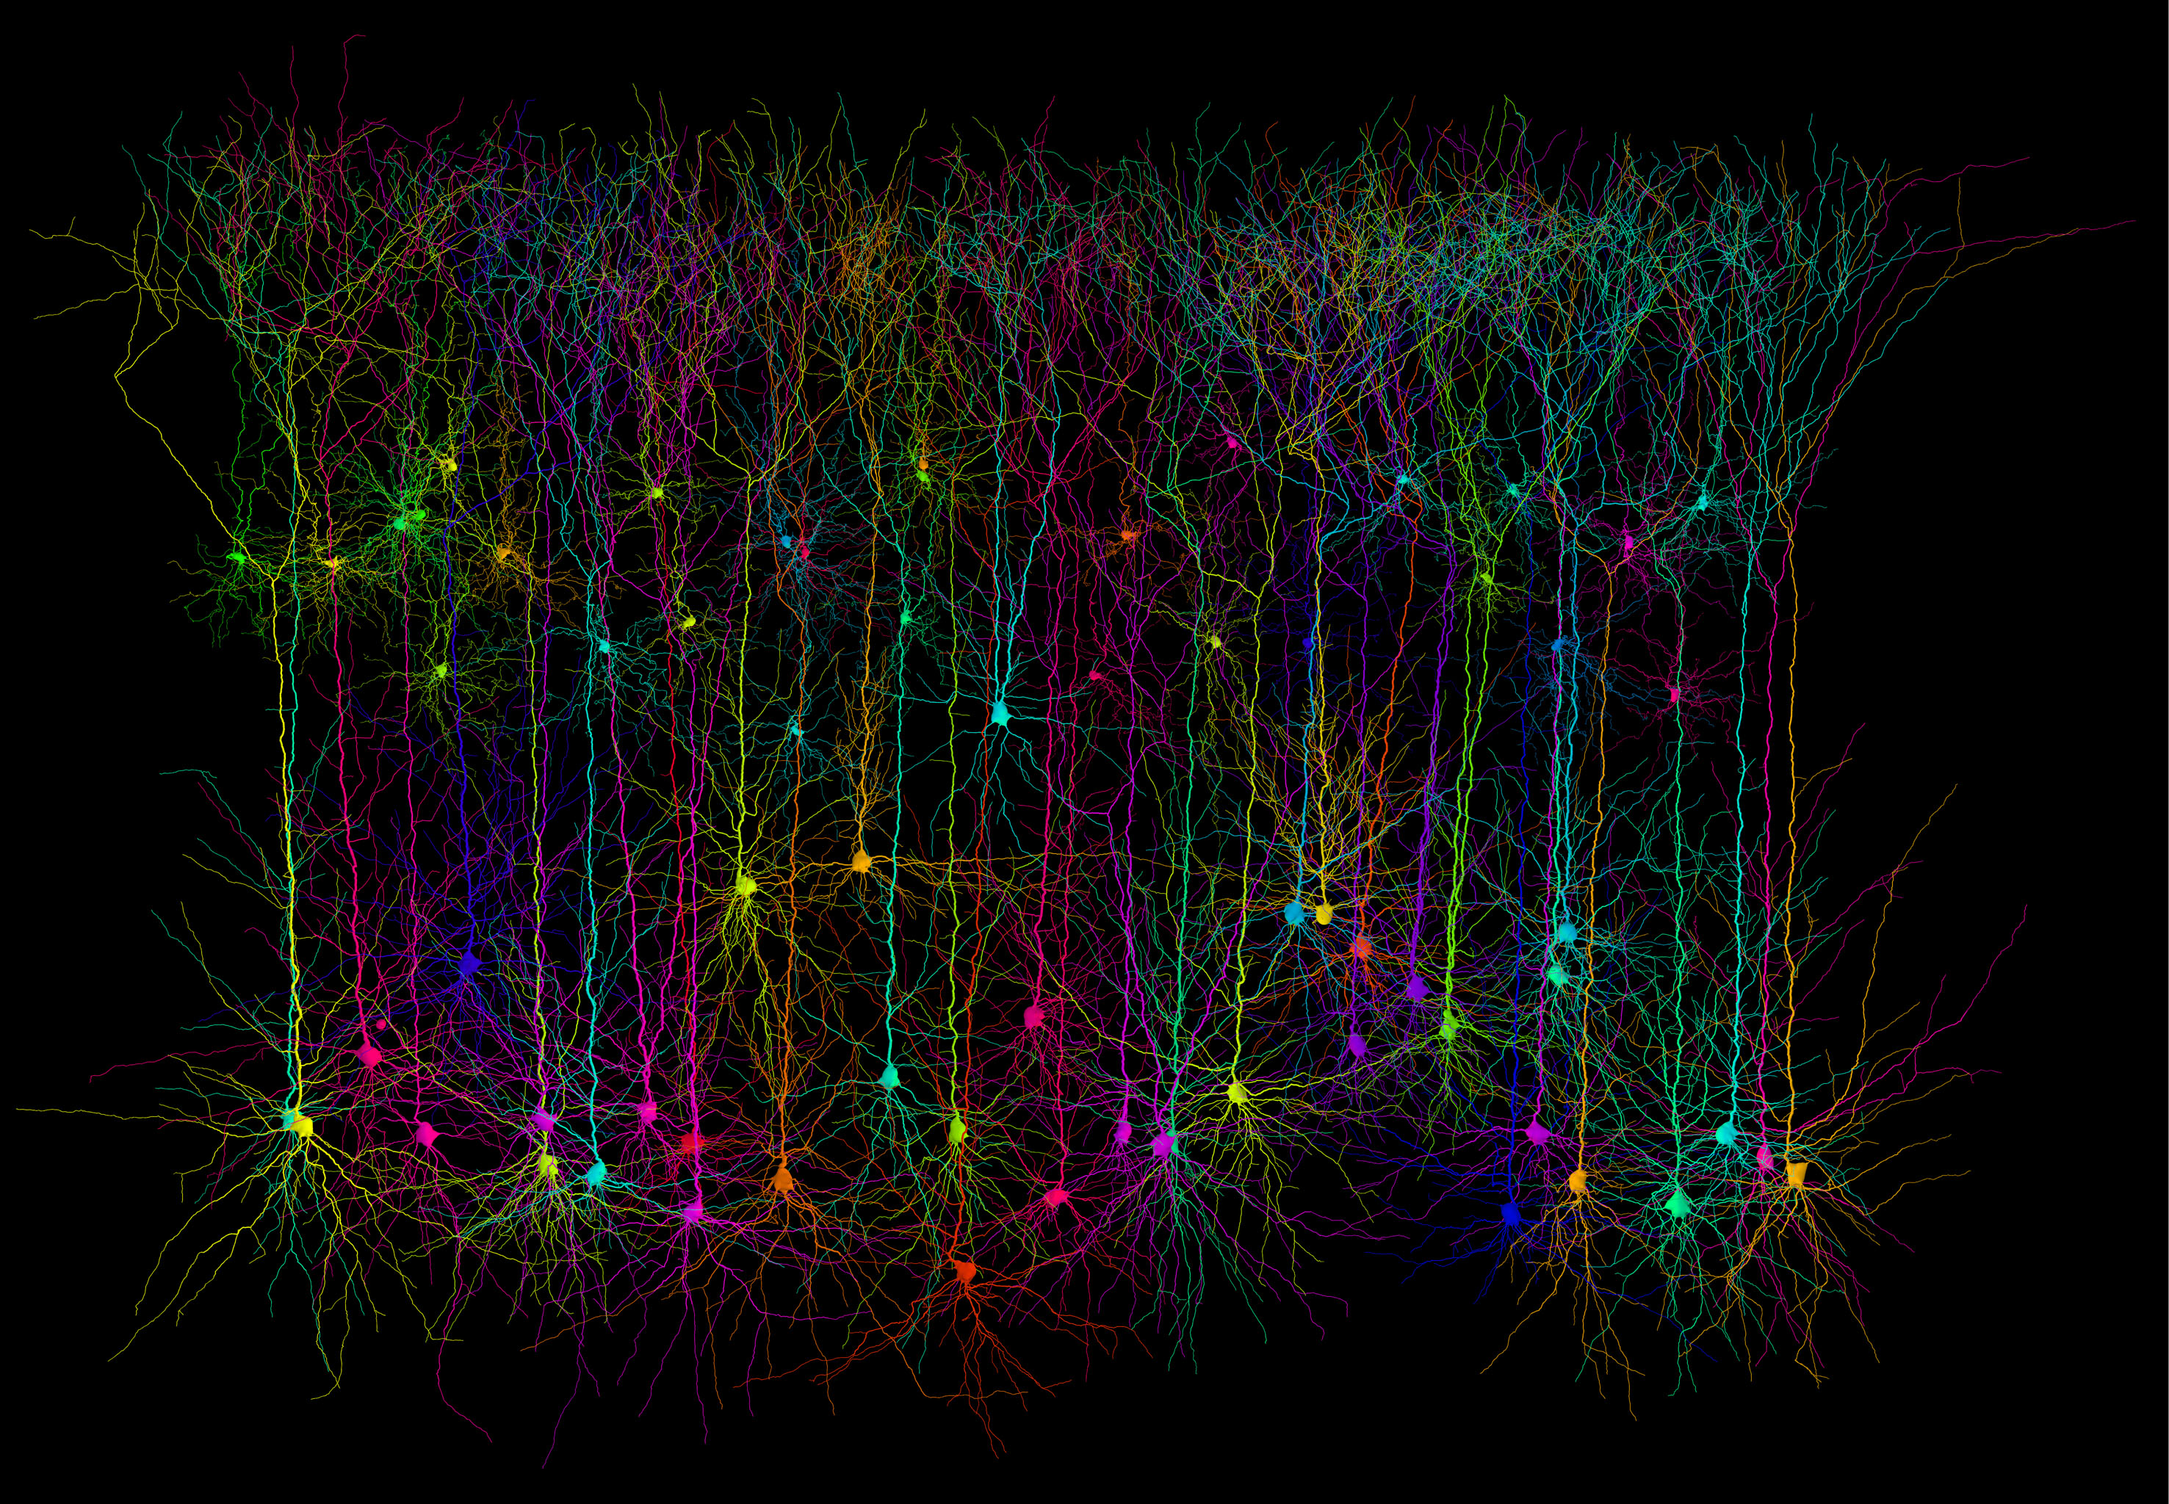
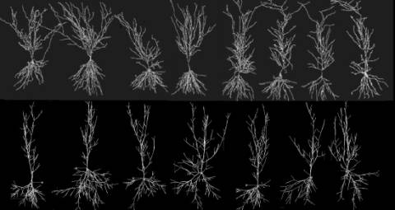
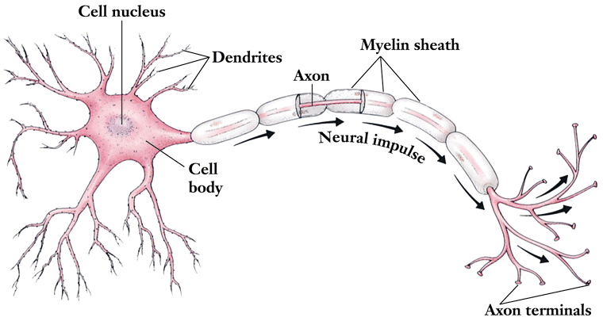
neurons
Brain and nervous system consist of neurons- long, thin cells of nerve tissue along which messages travel to and from the brain
Basic building blocks of the nervous system
Operates all-or-none
Receives and transmits electrochemical information
Glial cells are responsible for providing structural, nutritional, and other support for the neurons
Also a part of the communication system
“glue”

Slide 5
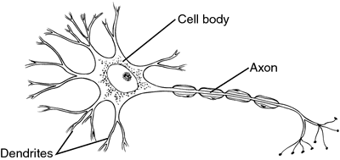
Parts of the neuron
Dendrites:
Little branches reaching out from neuron
Receives electrochemical information from other neurons and brings it to the cell body

Slide 6
Parts of the neuron
Cell body
Accepts messages from the dendrites
IF it gets enough stimulation, the cell body will pass the message on

Slide 7
Parts of the neuron
Axon
The extension of a neuron
Carries information/message away to other neurons, muscles, or glands

Slide 8
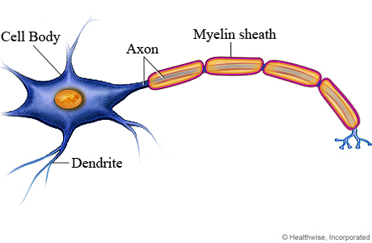
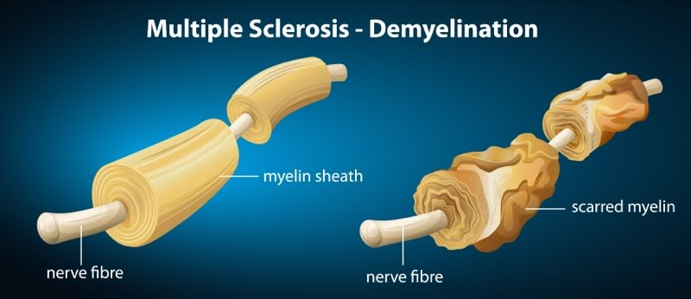
Parts of the neuron
Myelin sheath
A layer of fatty cells that covers the axons of neurons in segments
Protects the axon
Speeds up impulses
Makes the vastly greater transmission speed of neural impulses possible
Related to Multiple Sclerosis- myelin gradually deteriorates

Slide 9
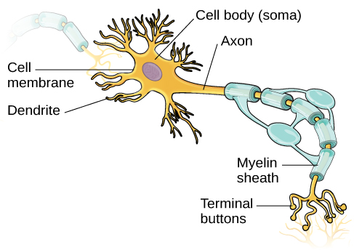
Parts of the neuron
Terminal buttons
Branches at the end of the axon that reach out
Releases neurotransmitters (chemicals) to move the message from the sending neuron to the receiving neuron

Slide 10
Neural communication: Action potential within the neuron
Action potential- a brief traveling electrical charge that carries the message along the axon
Steps
Resting potential- without any stimulation, a neuron is positively charged on the outside, negatively charged on the inside
Action potential initiation- depolarization opens the gates of the axon and allows the positive sodium ions on the outside to enter, changing the inside of the neuron to a positive charge
All or nothing
Message moves along to the next axon and the gate
opens again to depolarize to resting potential
Crowd wave analogy
Notes:
https://www.youtube.com/watch?v=OZG8M_ldA1M

Slide 11
Neurons and the Endocrine System
Chapter 2, section 1B, pages 49-53

Slide 12
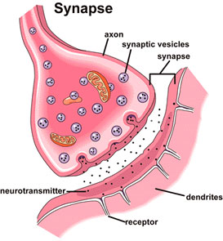
Neural communication: between neurons
Send a chemical signal- action potential reaches end of axon terminals, tells it to release chemicals (neurotransmitters)
The neurotransmitters travel across a synapse (gap) to another neuron
Synapse- the gap between the cells
Receiving a chemical signal- released neurotransmitters will excite (start) or inhibit (stop) a new action potential in the neighbor neuron
Works like a lock and key- not all will be received
Any extra neurotransmitters are taken back in by the sending neuron (reuptake) or dissolve
Notes:
https://www.youtube.com/watch?v=VitFvNvRIIY&t=9s

Slide 13
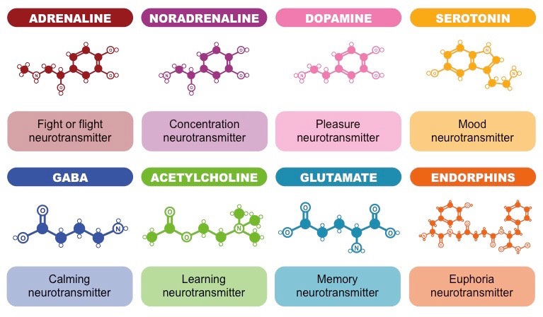
Neurotransmitters: to be familiar with
Neurotransmitters- chemicals released by neurons, which determine the rate at which other neurons fire (excites or inhibits)
Serotonin
Acetylcholine (ACh)
Dopamine
Noreprinephrine (NE) or noradrenaline
Epinephrine (or adrenaline)
GABA (gamma aminobutyric acid)
Endorphins

Slide 14
endorphins
Mimics morphine
Elevates mood, reduces pain
There are specialized receptors for mood and pain sensations

Slide 15
Neurotransmitter interactions
Disease
Neurotransmitters are often linked to disease in one of a few possible ways
Abnormally high or low levels of at least one neurotransmitter
Malfunctioning neuron receptors
Drugs
Most drugs act by changing the amount of neurotransmitters

Slide 16
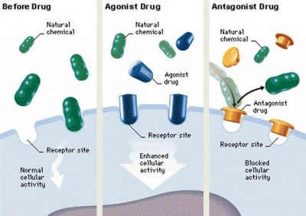
Drugs and neurotransmitters
Reuptake
Normal conditions- extra neurotransmitters left in the synapse either attach to another receptor, break down/dissolve, or are taken back up by the sending neuron(reuptake)→this keeps neurotransmission within normal limits
When an addictive drug is consumed, it dramatically increases or decreases neurotransmission to the point of not keeping a normal limit
Agonists and antagonists
Agonists- bind to the receptors on a receiving neuron, and produces an effect within the cell
Examples: heroin, oxycodone, methadone, hydrocodone, morphine, opium
Antagonists- bind to the receptors on a receiving neuron, and does not cause an effect, but blocks a receptor to a natural agonist
Examples: naltrexone and naloxone
Notes:
https://www.drugabuse.gov/news-events/nida-notes/2017/03/impacts-drugs-neurotransmission

Slide 17
Endocrine system
A set of glands that secrete hormones to send messages into the bloodstream
Difference between neurotransmitters and hormones:
Neurotransmitters are released beside the cell to excite or inhibit, sending direct messages
Hormones are released directly into the bloodstream to diffuse throughout the body, group message to the body
Roles of the different parts of the endocrine system
Sex hormones- testosterone, endocrine
Pituitary- body growth
Adrenal- stress hormones
Kidneys- blood pressure
Pancreas- sugar from the blood
Stomach/intestines- digestion and elimination
Hypothalamus- messages during time of stress

Slide 18
Endocrine System

Slide 19
Nervous system organization
Chapter 2, section 2, pages 54-60

Slide 20
Nervous
system
Peripheral
Central
(brain and
spinal cord)
Autonomic (controls
self-regulated action of
internal organs and glands)
Skeletal (controls
voluntary movements of
skeletal muscles)
Sympathetic
(arousing)
Parasympathetic
(calming)

Slide 21
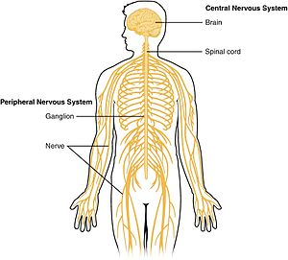
The nervous system
The nervous system- the body’s speedy, electrochemical communication system
Consists of all the nerve cells of the peripheral and central nervous systems
Central nervous system (CNS)- the brain and spinal cord
Processing and organizing information
Peripheral nervous system (PNS)- nerves branching out from the spinal cord
the sensory and motor neurons that connect the CNS to the rest of the body, working to send messages

Slide 22
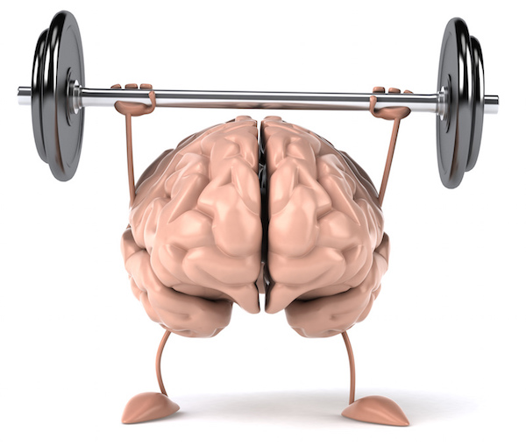
Neuroplasticity with traumatic brain injury (TBI)
Neuroplasticity- ability of the brain to reorganize and change its structure and function throughout life
When a part of the brain is damaged through TBI, neuroplasticity may allow for unaffected neurons to help take over the functions of the damaged area
The brain “relearns” the function just as it learned it initially
Neurogenesis- new neurons are made
Is done naturally, but artificial trials with stem cells are researching potentially using this for paralyzed patients
Concussions: https://www.youtube.com/watch?v=F4foY1EtmKo

Slide 23
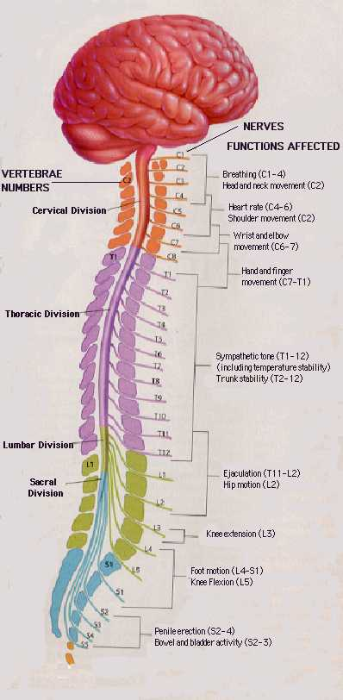
Spinal cord
Relays messages but also involved in voluntary and involuntary movements
Responsible for many reflexes, including infancy reflexes

Slide 24
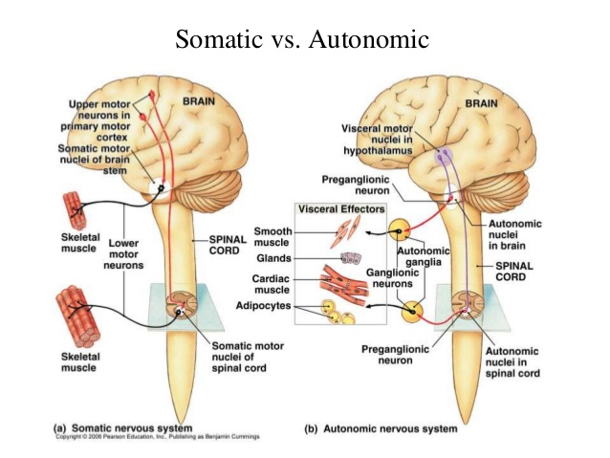
Somatic and autonomic
Somatic (skeletal) nervous system- sensory receptors and voluntary skeletal muscles
Communication throughout body
Autonomic nervous system- involuntary but necessary tasks- internal biological functions, glands, muscles of the internal organs
Auto (independently)
Heartrate, digestion, pupil dilation, breathing

Slide 25
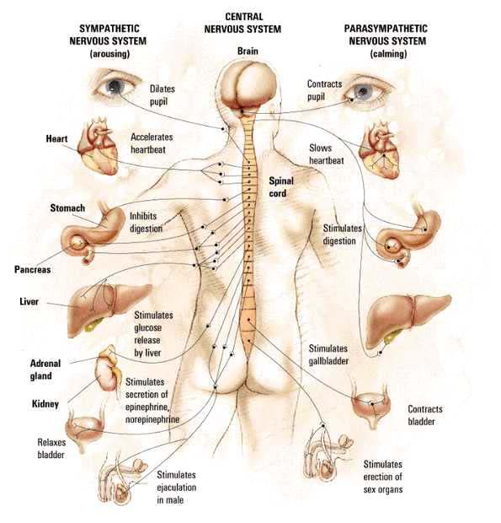
Autonomic nervous system
Sympathetic nervous system- (fight, flight, fright)
Arouses the body, mobilizing its energy in stressful situations
Parasympathetic nervous system- the relaxation response
Calms the body and conserves energy

Slide 26
The brain
Chapter 2, Section 3, structures, pages 61-67

Slide 27
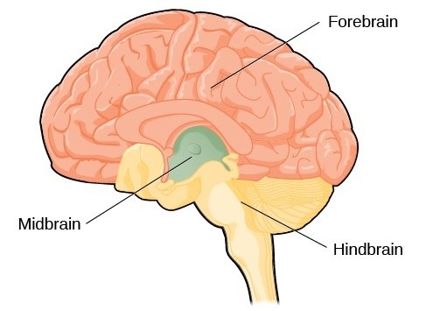
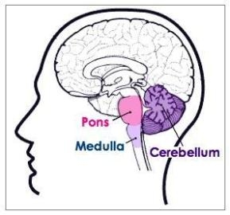
hindbrain
Involved in the basic processes of life
Located at the base of the skull
Brainstem- beginning where the spinal cord swells as it enters the skull; responsible for automatic survival functions
Medulla- controls the automatic body functions like breathing and heartbeat
Cerebellum- cauliflower shaped “little brain”, responsible for voluntary fine muscle movement and balance, also some perception and cognition
Pons- respiration, movement, waking/sleep, dreaming

Slide 28
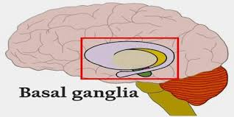
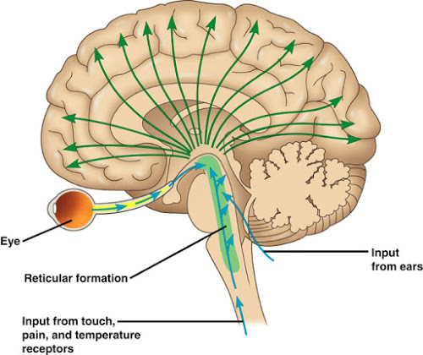
midbrain
Collection of structures responsible for coordinating movement patterns, sleep, and arousal
Integrates sensory information and relays it upward
Hosts reticular formation- filters senses and alerts higher brain centers for important events/controls arousal
Basal ganglia- responsible for motor control, action selection, motor learning, executive functions and behaviors, and emotions

Slide 29
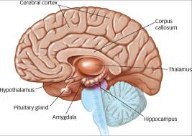
forebrain
Largest and most prominent
Cerebral cortex wraps around thalamus, hypothalamus, and limbic system
Responsible for sensory and motor control and thinking and language processing
Protected by the dura
Thalamus- top of the brainstem, like two footballs, the brain’s sensory relay/switchboard
Takes in sensory information and relays them to the appropriate areas on cerebral cortex
Hypothalamus- under the thalamus, controls functions/drives (hunger, thirst, sex, aggression)
Contains pituitary gland- “master gland” that controls other hormone glands

Slide 30
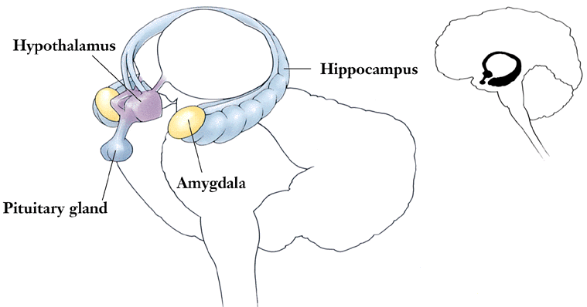
Forebrain continued: limbic system
Limbic system- group of structures along the border between the cerebral cortex and lower-level brain structures
Responsible for emotions (fear and aggression), drives (food and sex), memory, pleasure/reward
Amygdala, hippocampus, thalamus, hypothalamus, basal ganglia, cingulate gyrus
Hippocampus- forming and retrieving memories
Amygdala- production and regulation of emotions (strong ones like aggression and fear)

Slide 31
Case studies
Phineas Gage
https://www.youtube.com/watch?v=vb8Jg1PAL90
https://www.youtube.com/watch?v=FrULrWRlGBA
Drawing a Clock: Susannah Cahalan TEDxAmsterdamWomen
https://www.youtube.com/watch?v=oqrzvYnrI9A

Slide 32
The brain
Chapter 2, Section 4a, The Cerebral cortex (Lobes), pages 68-73

Slide 33
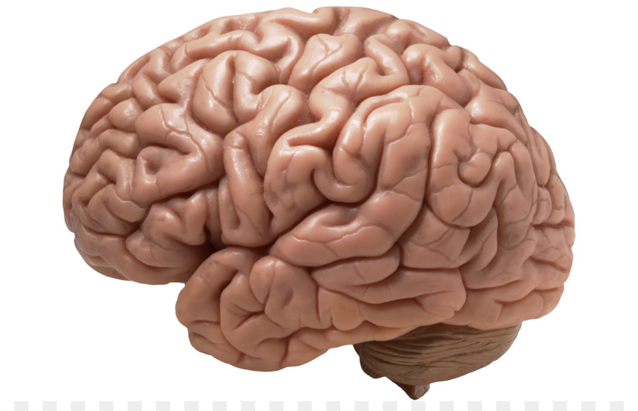
Cerebral cortex
Responsible for most complex behaviors and higher mental processes
Ultimate control and information processing center
Wrinkled gray matter that covers forebrain
Divided into two hemispheres
Hemispheres host lobes- different regions of the cerebral cortex

Slide 34
Cerebral cortex

Slide 35
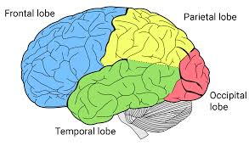
Frontal lobes
Largest of the lobes at the top front portion of the hemispheres
Receive and coordinate messages to other lobes
Responsible for higher functions that make humans unique- organization, planning, creative thinking
Left area- Broca’s area- speech production
Paul Broca- discovered damage to Broca’s area causes speech difficulty but not language comprehension
Located in the left hemisphere
Motor control for voluntary movements
Phineas Gage
https://www.youtube.com/watch?v=vb8Jg1PAL90
https://www.youtube.com/watch?v=FrULrWRlGBA

Slide 36
Parietal lobes
Behind the frontal lobes
Information from senses all over the body- pressure, pain, touch, temperature, location of body parts

Slide 37
Temporal lobes
Located behind temples of brain
Auditory perception, language comprehension, memory, emotional control
Wernicke’s area- involved in language comprehension, discovered by Carl Wernicke
Patients could speak but could not understand language
Located in the left hemisphere

Slide 38
Occipital lobes
Located at the back of the brain
Vision and visual perception
Shape, color, motion perception

Slide 39
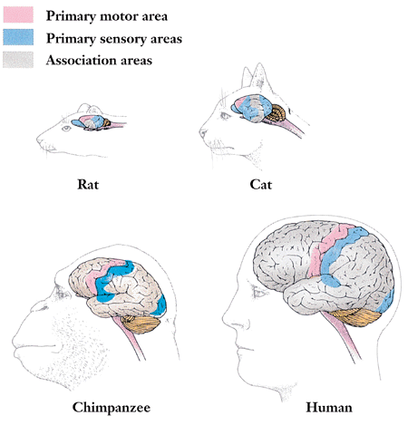
Association areas
Areas of the cerebral cortex that are not involved in primary motor or sensory functions
Involved in higher mental functions which enable judging, planning, learning, remembering, thinking, speaking

Slide 40
The brain
Chapter 2, Section 4B, Split-brain and Tbi, pages 74-76

Slide 41
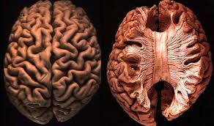
Split-brain research
Left and right hemispheres control the opposite side
With split-brain surgery (cutting what connects the hemispheres), we are able to separate functions of different hemispheres
Corpus callosum- large bundle of nerve fibers connecting the two brain hemispheres that carries messages between the hemispheres

Slide 42
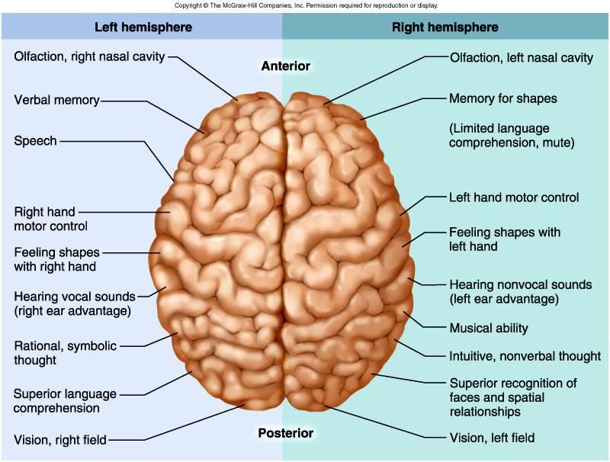
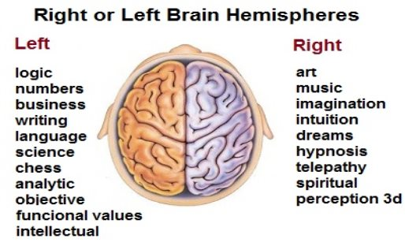
Hemispheric specialization and Lateralization
Hemispheric specialization and lateralization- functions being focused within one hemisphere
Seen through split-brain research
But both hemispheres play overlapping and synchronized roles

Slide 43
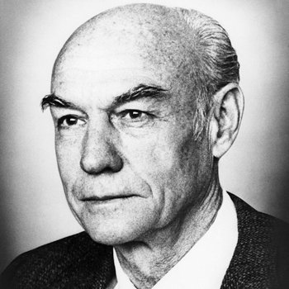
Split-brain researchers
Michael Gazzaniga
Initiated split-brain research with volunteer split-brain patients
Further studied functional lateralization of the brain and how hemispheres communicate with each other
Roger Sperry
Researched split-brains, identified the separate functions of the left and right hemispheres, and their connection with the cutting of the cerebral callosum to relieve epilepsy
Won the Nobel prize with Hubel and Wiesel

Slide 45
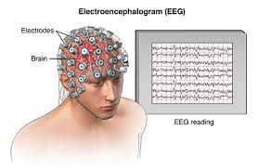
How psychologists study the brain
Recording- Electroencephalograph (EEG)- a machine used to record the electrical activity of large portions of the brain using electrodes
Electrodes are wires that are inserted into the brain to record data
Stimulating- using electrodes to set off firing of neurons
Lesions- naturally or experimentally caused destruction of brain tissue
Accidents- draw a connection between damaged parts of the brain and person’s behavior

Slide 46
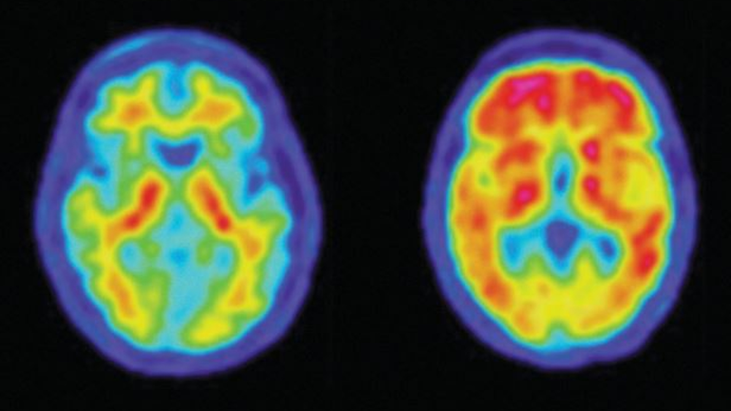
How psychologists study the brain: imaging
CT (computed tomograph) scan- a series of x-ray photographs taken from different angles, made into a 3D image, aka CAT scan
PET (positron emission tomograph) scan- a visual display of brain activity that detects where a radioactive form of glucose goes while the brain performs a given task
MRI (magnetic resonance imaging)- a technique that uses magnetic fields and radio waves to produce computer – generated images that distinguish among different types of soft tissue
Allows us to see structures within the brain

Slide 47
Our genetic influence
Purple book: chapter 2, Section 4, pages 80-86

Slide 48
How long have our traits been around
Behavioral genetics tells use how genes and the environment affect us
Evolutionary psychology helps us see how the adaptation process to our environment affects us
Most traits are a combination of many genes and depend on the gene being dominant or recessive
Environmental factors (nurture) include family, culture, education, and individual experiences

Slide 49
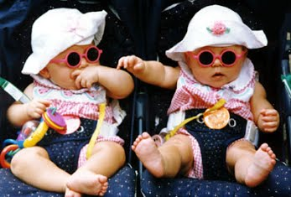
How to study inheritance
Twin studies
Family studies
Adoption studies
Genetic abnormalities
Genes are not fixed or inflexible
Hereditability estimates do not apply to individuals
Genes and the environment are inseparable

Slide 50
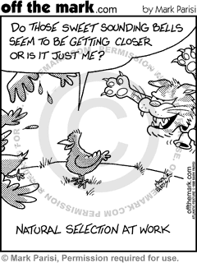
Evolutionary psychology with hereditability
Darwin’s natural selection- when a genetic trait gives a person reproductive advantage over others
This may apply to psychology as well- socially, physically, etc.
Sex differences dating back to hunter-gatherer days may explain current cognitive differences (but is purely correlational)

