Slide 1
Unit 6: Learning
Chapter 6

Slide 2
Classical Conditioning
Chapter 6, Section 1, pages 185-193

Slide 3
Classical conditioning part a
Chapter 6, Section 1A, pages 185-190

Slide 4
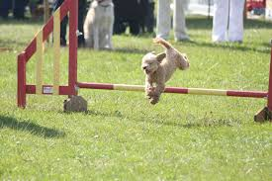
Learning
Learning- relatively permanent change in behavior or mental processes due to experience
Includes classical conditioning, operant conditioning, and social learning
Conditioning- process of learning associations between environmental stimuli and behavioral responses
Some behavior is inborn, some is learned

Slide 5
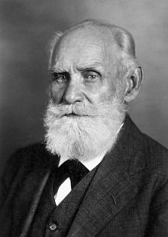
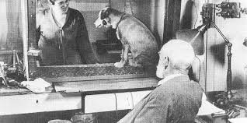
Pavlov and Classical Conditioning
Classical conditioning- learning that occurs when a previously neutral stimulus (NS) is paired/associated with an unconditioned stimulus (UCS) to elicit a conditioned response (CR)
Discovered by Ivan Pavlov, during his work with dog and the role of saliva in digestion
Pavlov discovered that a dog salivated when receiving food
He then tested if he could “pair” a ringing tone with the sight of the food by ringing the tone and immediately giving the dog food
After repeatedly pairing the tone and food, the dog would start salivating at just the tone

Slide 6
Classical Conditioning Variables
Unconditioned stimulus (UCS)- stimulus that elicits an unconditioned response without previous conditioning
Unconditioned response (UCR)- unlearned reaction to an unconditioned stimulus (UCS) that occurs without previous conditioning
For unconditioned stimulus and response, think of a newborn baby’s response- what comes automatically?
Neutral stimulus (NS)- stimulus that, before conditioning, does not naturally bring about the response of interest
Conditioned stimulus (CS)- previously neutral stimulus that, through repeated pairings with an unconditioned stimulus (UCS), now causes it a conditioned response (CR)
Conditioned response (CR)- learned reaction to a conditioned stimulus (CS) that occurs because of previous repeated pairings with an unconditioned stimulus

Slide 7
Pavlov’s Experiment: Classical Conditioning

Slide 8
Pavlov’s Experiment: Classical Conditioning

Slide 9
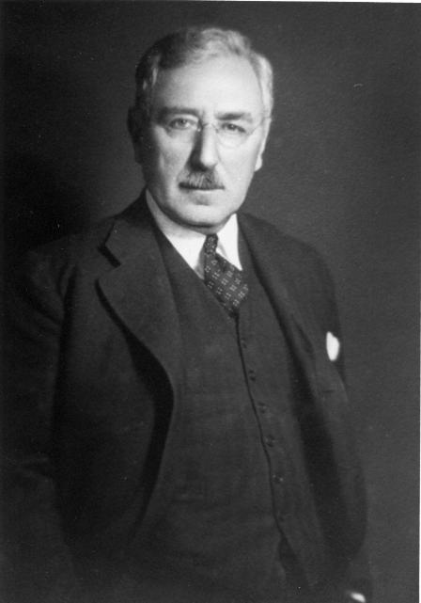
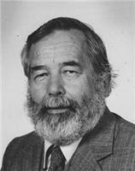
Other Classical Conditioning Studies
E.B. Twitmyer- studied at the same time as Pavlov, but with humans
Twitmyer started with the knee jerk reflex produced by hitting the knee with a hammer
He paired the sound of a bell with hitting the knee, eventually with pairings, participants would do the knee jerk reflex from just the sound of a bell
His studies showed classical conditioning in humans and classical conditioning using involuntary actions
John Garcia- studied taste aversion (the Garcia effect) in rats
Presented new tastes then exposed the rats to radiation or drugs, causing the rats to become nauseated → rats avoided the new taste in the future
Rats would not develop aversions to sounds or sights even if paired with radiation or drugs
Showed how taste aversions occur (also associated with survival) and that at least rats could not develop aversions to sights or sounds
Robert Rescorla- created the Rescorla-Wagner theory that emphasized that the surprise of the unconditioned stimulus first paired with the neutral stimulus increases the association learning

Slide 10
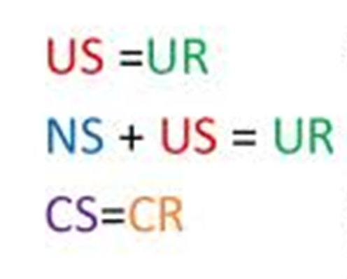
Classical Conditioning: Paradigms

Slide 11
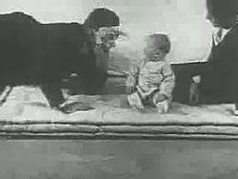
Watson and Classical conditioning
John Watson’s Little Albert experiment
Watson classically conditioned an infant (Little Albert) by pairing a loud/startling noise with the infant’s interest in a white, fluffy rat. This generalized to anything white and fluffy and become a phobia for Little Albert
https://www.youtube.com/watch?v=9hBfnXACsOI
UCS= loud noise
UCR= fear
CS= rat, white fluffy object
CR= fear
Watson introduced a psychological field on behaviorism and studying psychology through observable behaviors
His research led to later research on getting rid of fears (phobias)
Watson also showed that our likes/dislikes, fears, prejudices are conditioned emotional responses (CER)- classically conditioned response to a previously neutral stimulus

Slide 12
Classical Conditioning in Advertising

Slide 13
Classical Conditioning Part b
Chapter 6, Section 1B, pages 191-194

Slide 14
Acquisition
Acquisition- basic classical conditioning when a neutral stimulus (NS) is consistently paired with an unconditioned stimulus (UCS) so that the NS comes to elicit a conditioned response (CR)
There are four ways to pair stimuli
*Delayed conditioning- NS before UCS, and remains until UCR begins, considered the most effective
Simultaneous conditioning- NS presented at the same time as the UCS
Trace conditioning- NS presented and then taken away, or ends before UCS presented
Backward conditioning- UCS presented before NS

Slide 15
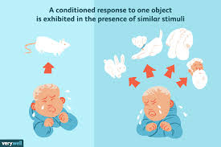
Generalization and Discrimination
Stimulus generalization- stimuli similar to the original CS elicit a CR
Shown in Watson’s Little Albert experiment- Albert expanded (generalized) his CR of fear from white fluffy rats to all white fluffy things
Stimulus discrimination- only the CS elicits the CR
Understanding that a white fluffy rat is different than a Santa Claus mask and only being afraid of the rat
Generalization seems to happen naturally, but discrimination has to happen with practice/experience
Stimulus generalization

Slide 16
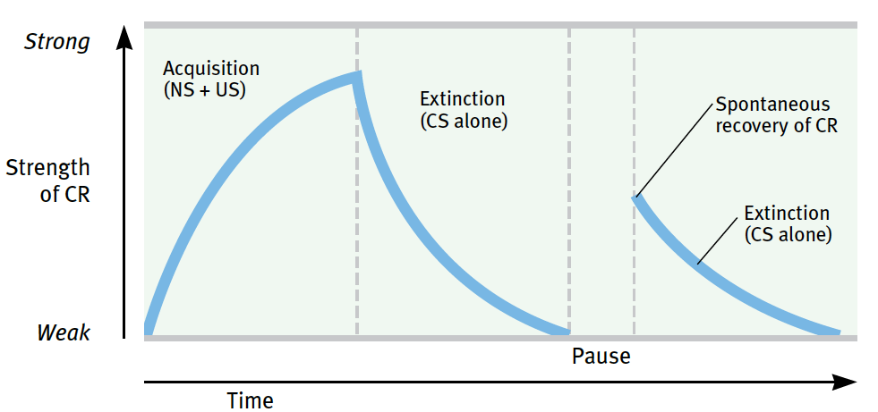
Extinction and Spontaneous Recovery
Extinction- repeatedly presenting the CS without the UCS, which gradually weakens the CR
Evidence that all learning is only relatively permanent, but it is not unlearning, just a decrease in the response
Example- when Pavlov repeatedly presented the bell tone without also presenting food, the dog’s salivation at the sound of the bell gradually decreased
Spontaneous Recovery- sudden reappearance of a previously extinguished conditioned response
Response occurs much faster a second time around
Robert Rescorla- demonstrated extinction and relearning in his experiments

Slide 17
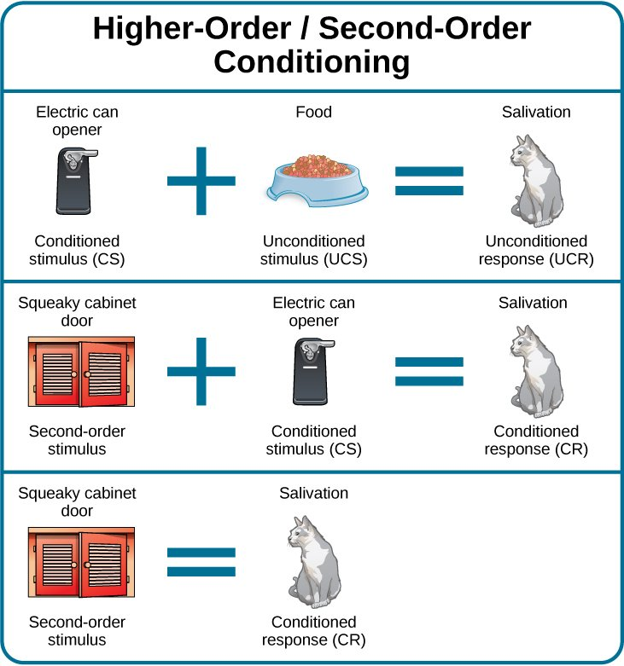
Higher-Order Conditioning
Higher-order conditioning- neutral stimulus (NS) becomes a conditioned stimulus (CS) through repeated pairings with a previously conditioned stimulus (CS)
Explains associations with symbols, etc. in advertising

Slide 18
Operant Conditioning
Chapter 6, section 2, pages 194-206

Slide 19
Operant Conditioning: Part A
Chapter 6, section 2a, pages 194-200

Slide 20
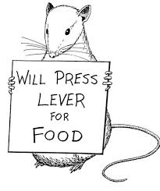
Operant Conditioning
Operant conditioning- learning through the consequences of voluntary behavior
Reinforcement- strengthens a response and makes it more likely to recur
Punishment- weakens a response and makes it less likely to recur
Different from classical conditioning
Classical is passive and involuntary, operant is active and voluntary

Slide 21
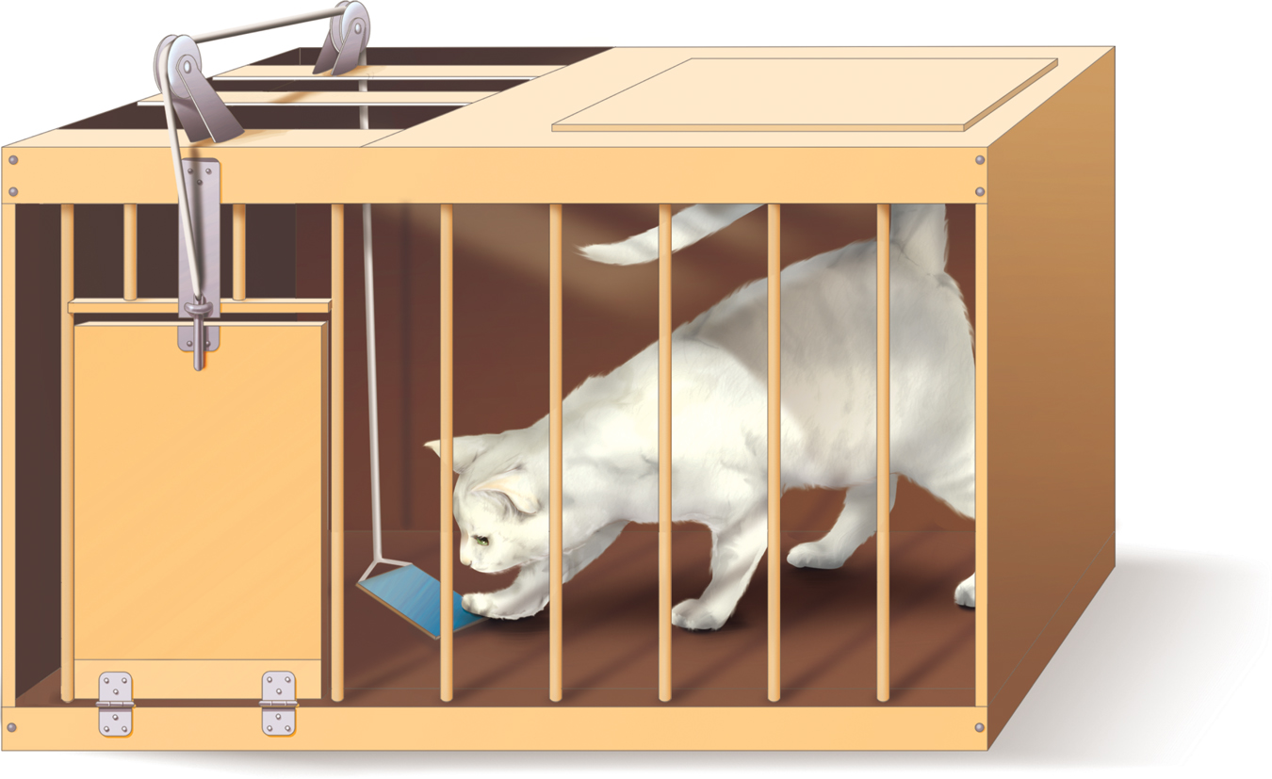
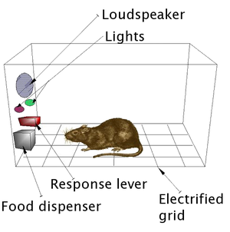
Thorndike and Skinner
Law of effect- Thorndike’s rule that the probability of an action being repeated is strengthened when it is followed by a pleasant or satisfying experience
Introduced looking at voluntary behavior and how consequences change it
Skinner disliked the focus on pleasantry → argued we should look at only external, observable behavior and what increases or decreases the voluntary behavior
Also warned at assuming something is a reward or punishment since it depends on the person
Used Skinner’s box to look at rats pushing levers for food

Slide 22
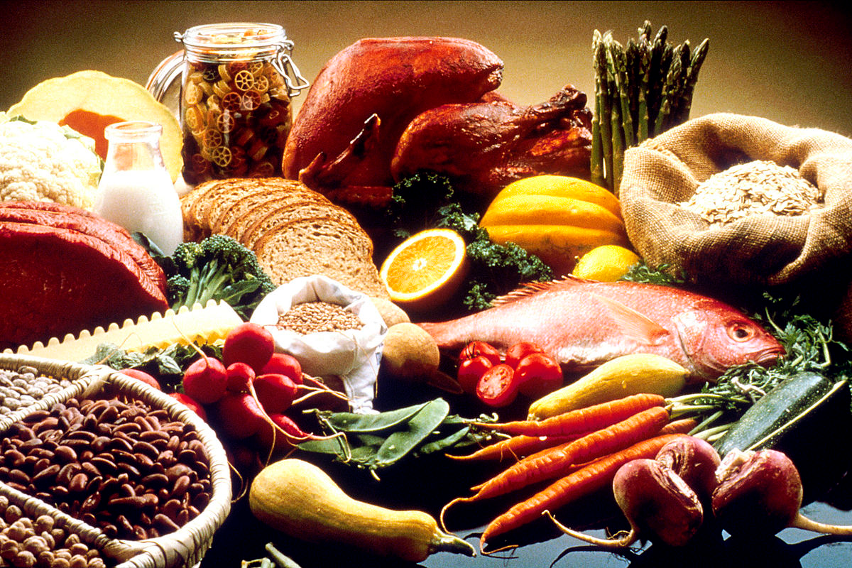
Primary vs. Secondary Reinforcers
Focusing on the consequence and if it strengthens (increases) or weakens (decreases) the response
Primary reinforcers- stimuli that increase the probability of a response because they satisfy an unlearned, biological need (food, water)
Secondary reinforcers- stimuli that increase the probability of a response because of their learned value (money, possessions, social approval)

Slide 23
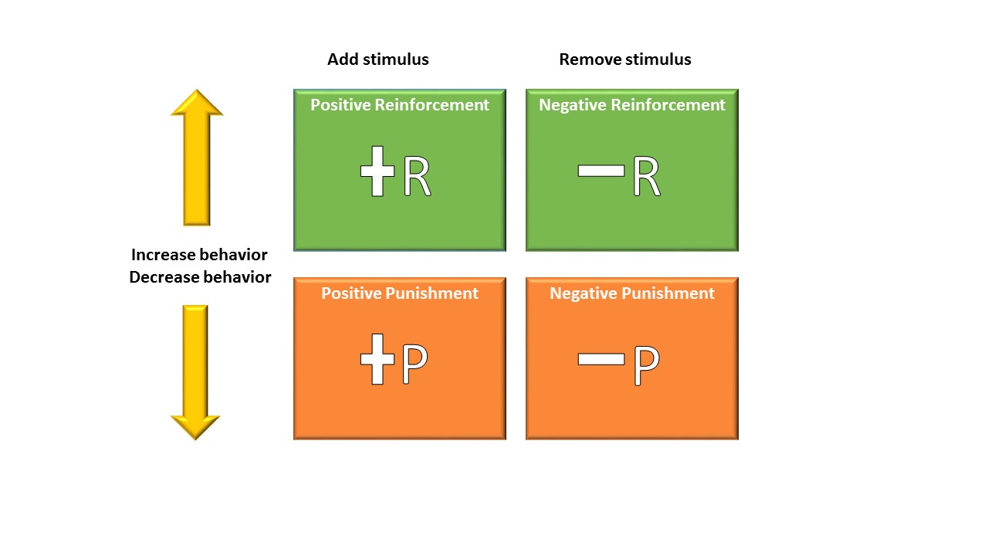
Positive vs. Negative Reinforcement
Positive (+) reinforcement- ADDING or presenting a stimulus, which strengthens a response and makes it more likely to recur
Example- a dog gets a treat when she shakes hands
Negative (-) reinforcement- TAKING AWAY or removing a stimulus, which strengthens a response and makes it more likely to recur
Example- annoying beeping stops when you put on your car seatbelt
Not punishment- this is strengthening a behavior, punishment decreases/weakens the behavior
Premack principle- using a naturally occurring high-frequency (more desirable) response to reinforce and increase low-frequency (less desirable) responses
Example- hanging out with your friends as a reinforcer for doing your homework

Slide 24
Schedules of Reinforcement
There are different ways to reinforce depending on the rate or interval at which responses are reinforced- timing and frequency matters
Biggest distinction comes from continuous or partial schedules
Continuous reinforcement- every correct response is reinforced
Partial (intermittent) reinforcement- some, but not all, correct responses are reinforced
Continuous reinforcement leads to faster learning, but partial reinforcement is more often experienced in everyday life
Continuous reinforcement is less efficient, especially for keeping long-term behaviors
Partial reinforcement is also more resistant to extinction
Best case is to start with continuous reinforcement, then move to partial reinforcement

Slide 25
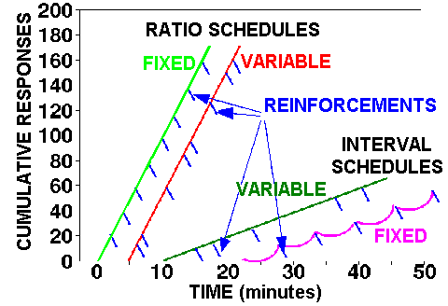
Types of Partial Reinforcement
Schedules are based on either the number of correct responses or amount of time that passes before reinforcement is given
Schedules are also based on fixed (predictable) or variable (unpredictable) schedules
Which schedule is chosen depends on the behavior being studied and the speed of learning desired

Slide 26
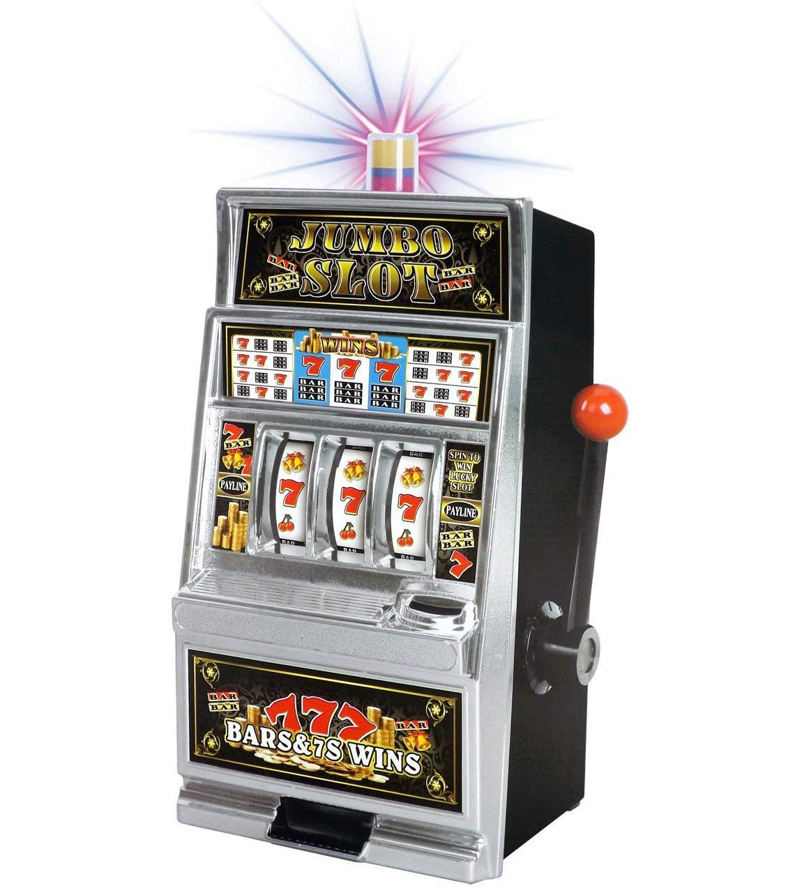
Ratio Schedules of Reinforcement
*Fixed ratio (FR)- reinforcement occurs after a PREDETERMINED set of RESPONSES; the ratio (number or amount is fixed)
Highest rate of response, brief dropoff after reinforcement
Example- every fourth answer, paid per page
Variable ratio (VR)- reinforcement occurs UNPREDICTABLY for number of RESPONSES; the ratio (number or amount) varies
High response, no pause after reinforcement, resistant to extinction
Example- slot machines- the gambler won’t be able to tell when the next pay
off is going to occur, it also increases the gambler’s resistance to quitting, the
gambler will fear that the next player will hit the jackpot if they quit now

Slide 27
Interval Schedules of Reinforcement
Fixed interval (FI)- reinforcement occurs after a PREDETERMINED amount of TIME has elapsed; the interval (time) is fixed
Responses increase as time for next reinforcer gets near, dropoff after reinforcement and during interval
Example- studying for the test the night before, followed by not studying; taking a break after 30 minutes of studying
Variable interval (VI)- reinforcement occurs UNPREDICTABLY for the amount of TIME; the interval (time) varies
Relatively low but steady response rates because respondents cannot predict when reward will come
Example- trying to call a friend and have them answer

Slide 30
Understanding the consequences
Do they know when the reinforcement is coming?
If yes → fixed
If no → variable
Is it an amount of time or a number?
If time → interval
If number → ratio

Slide 31
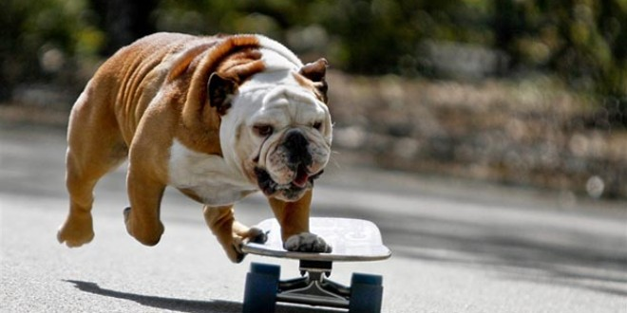
Shaping
Shaping- reinforcement delivered for successive approximations of the desired response
Used for teaching complex behaviors
Molding the desired behavior by first rewarding any act similar to that behavior, then requiring even closer approximations to the desired behavior before giving the reward
Often used for teaching tricks to animals
Can also be successive approximation- same idea of take small steps toward a goal
https://www.youtube.com/watch?v=TtfQlkGwE2U

Slide 32
Operant Conditioning: Part B
Chapter 6, section 2b, pages 194-200

Slide 33
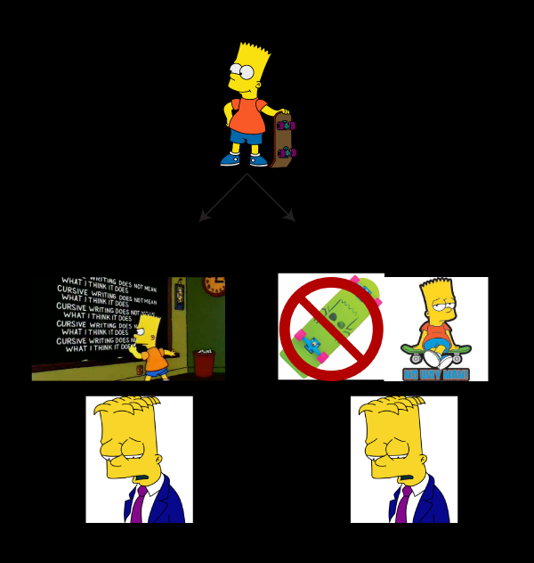
Punishment
Positive punishment- ADDING OR PRESENTING a stimulus that weakens a response and makes it LESS likely to recur
Having to do chores because you disobeyed your parents, getting yelled at for being late
Negative punishment- TAKING AWAY OR REMOVING a stimulus that weakens a response and makes it LESS likely to recur
Getting your car keys taken away if you miss curfew, taking phone away when you’re tardy

Slide 34
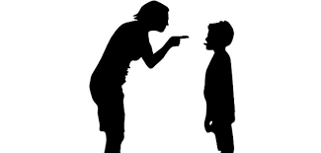
Consequences of Punishment
While we would love to focus on reinforcers, they are not always enough
Punishment is not always from authority figures and we often unintentionally punish desired behaviors- like yelling at a dog when it finally comes to you
To be effective, it needs to be immediate and consistent
The individual learns what not to do, but not always what they should do
Other side effects- increased aggression, passive aggressiveness, avoidance (the behavior or the punisher), inappropriate modeling, temporary suppression versus elimination, learned helplessness
Seligman- studied learned helplessness in dogs by
putting them in boxes where they could not escape being
shocked after they had first learned they could escape
Robert Rescorla demonstrated learned helplessness as well
through the contingency theory (learned helplessness due to no perceived connection/contingency exists between response and reinforcer)

Slide 35
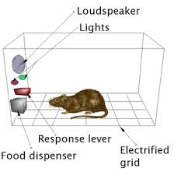
Wrapping UP Conditioning
Using reinforcement and punishment effectively
Provide clear directions and feedback
Use appropriate timing
Be consistent
Follow correct order of presentation
Combine key learning principles
See summary table on pages 188, 191, 195, 198, 199, 203, 204 in your book
Discriminative stimulus- cue signaling when a specific response will lead to the expected reinforcement
A rat learns to press a bar and get food only when a light is flashing

Slide 37
Classical vs. Operant Conditioning

Slide 38
Cognitive-Social Learning
Chapter 6, section 3, pages 201-206

Slide 39
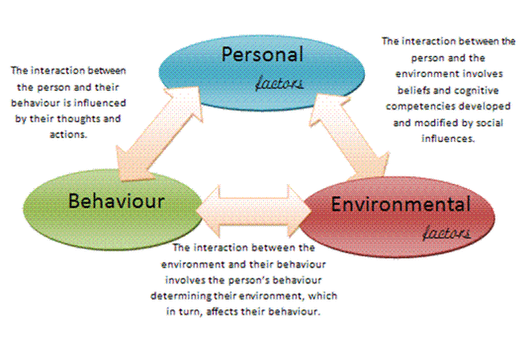
Cognitive-Social Learning
Cognitive-Social Theory- emphasizes the roles of thinking and social learning in behavior
Adds step to look at stimulus-organism-response
Cognitive learning- form of altering behavior that involves mental processes and may result from observation or imitation

Slide 40
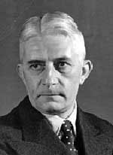
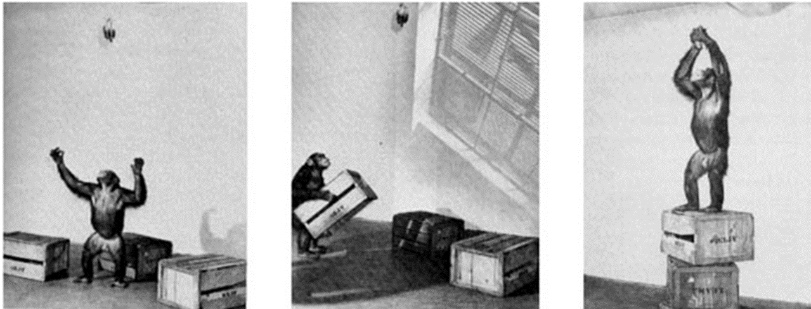
Köhler’s Study of Insight
Studied insight- sudden understanding of a problem that implies the solution
Wolfgang Köhler took chimpanzees and would hang bananas just outside of their reach; he then observed how they would figure out how to get the bananas
The result was not simple stimulus-response- it took what he called insight
Köhler then made it so they had to use two sticks to reach the banana- once they learned
how to do this, it was called
insight learning

Slide 41
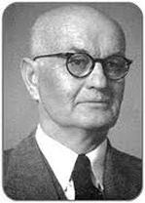
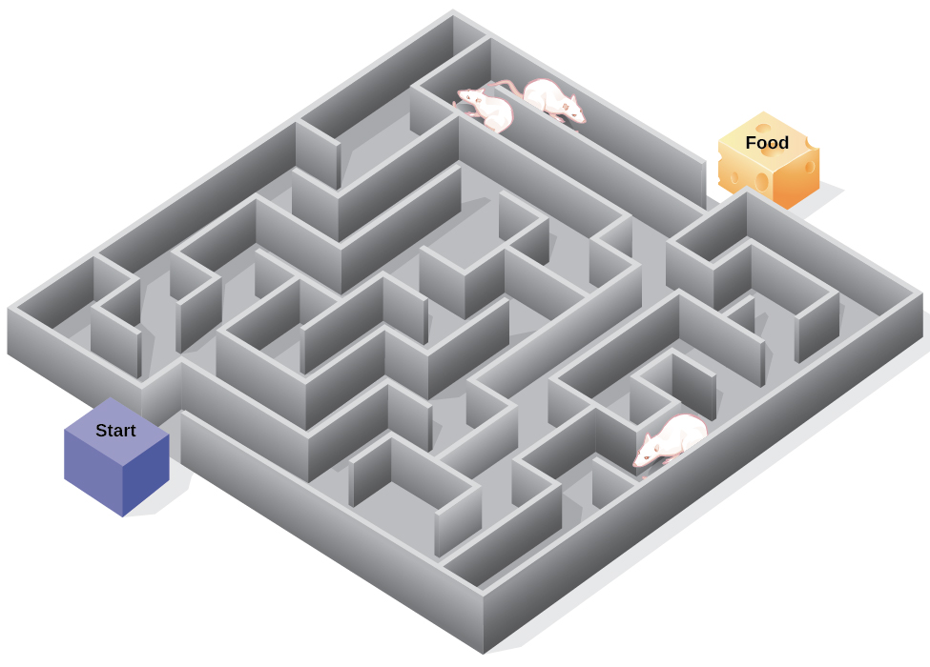
Tolman’s Study of Latent Learning
Cognitive map- mental image of a three-dimensional space that an organism has navigated
Latent learning- hidden learning that exists without behavioral signs
Edward Tolman took rats in mazes in three groups- one that was allowed to wander, one that was reinforced with food every time, one that was allowed to wander then reinforced on day 11
The rats that were reinforced on day 11 quickly caught up to the group reinforced from the beginning- this is because of latent learning and creating a cognitive map as they were wandering for the first 10 days

Slide 42
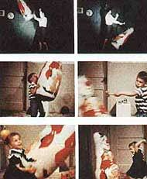
Observational Learning
Observational learning- learning new behaviors or information by watching and imitating others (aka social learning or modeling)
May be used to observe a new behavior, disinhibition- watching someone else engage in a threatening activity to help a phobia
Vicarious learning is a part of observational learning that is learned through only indirect sources like hearing or observation, not hands-on
We are most likely to observe and imitate someone like according to gender, age, and race, etc. and someone we admire
Albert Bandura’s Bobo doll experiment- Bandura had children watch a live or televised experience of an adult in a room with a Bobo doll and toys. The adults would show aggressiveness when hitting the doll. The children were then put in the same room and the children showed observational learning as they aggressively hit the doll the same way the adults did.
https://www.youtube.com/watch?v=Pr0OTCVtHbU
He identified four processes in observational learning

Slide 43
Key Factors in Observational Learning
Attention- paying attention to demonstration
Retention- note and remembering directions and demonstrations
Reproduction- imitating the model from motivation and motor skills
Reinforcement- repeating the behavior if the model was reinforced for the behavior

Slide 44
Cross-Cultural effects of Observational Learning
Parents, educators, and politicians are concerned with the positive and negative effects of observational learning in regards to what children see on TV
There are some positive effects- some shows have been created to show positive role models and behaviors, like education and health
A soap opera in Mexico increased literacy rates
A radio show in Tanzania increased accurate knowledge on AIDS
We have to be careful with not equating causation and correlation
but some research with control groups have shown positive effects
Scaffolding- providing temporary assistance while a learner acquires
new skills where a more experienced person adjusts the amount of
guidance to fit the student’s current performance level, often involves
shaping and modeling

Slide 45
The Biology and application of Learning
Chapter 6, section 4, pages 211-215

Slide 46
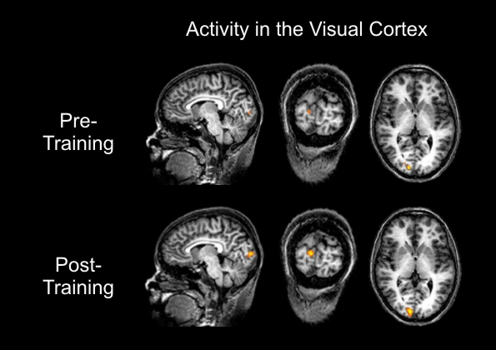
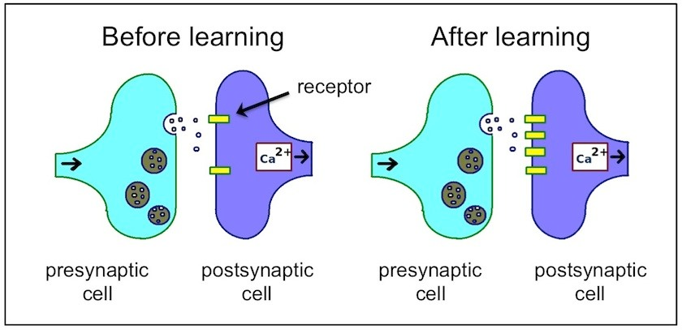
The Adaptive Brain
When we learn, our brain creates new synaptic connections and alter many of our brain structures
First studied in rats, showing that those who grow up in stimulus-rich environments have differently shaped and sized brains than those in deprived environments
To span to humans, adults in stimulating environments perform better on intellectual and perceptual tasks
Mirror neurons- neurons that respond when we perform an action and respond the same way when we watch others perform the same action- very individualized in the brain
Explains empathy, potentially autism (still being studied), and observational learning

Slide 47
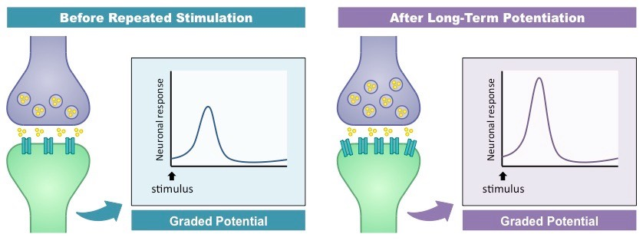
Neuronal and Synaptic Changes
Learning modifies the neural networks
Long-term potentiation- increase in the strength of neural firing
Occurs by repeated stimulation causing dendrites to grow more spines
Or by the ability of a certain neuron to release or accept neurotransmitters can be increased or decreased

Slide 48
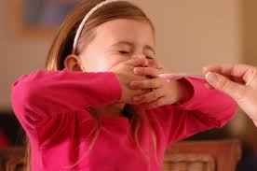
Evolution and Learning
Learning is an adaptation that enables organisms to survive and prosper in a constantly changing world
Taste aversion- classically conditioned negative reaction to a particular taste that has been associated with nausea or other illness
Could have helped us in cave days to avoid poisonous foods
Biological preparedness- built-in (innate) readiness to form associations between certain stimuli and responses
We more easily have phobias of snakes, darkness, heights, etc. than knives, electric outlets, etc.
John Garcia- studied taste aversion (the Garcia effect) in rats
Presented new tastes then exposed the rats to radiation or drugs, causing the rats to become nauseated → rats avoided the new taste in the future
Rats would not develop aversions to sounds or sights even if paired with radiation or drugs → evolutionary adaptation to associate nausea with food or drink
Showed how taste aversions occur (also associated with survival) and that at least rats could not develop aversions to sights or sounds

Slide 49
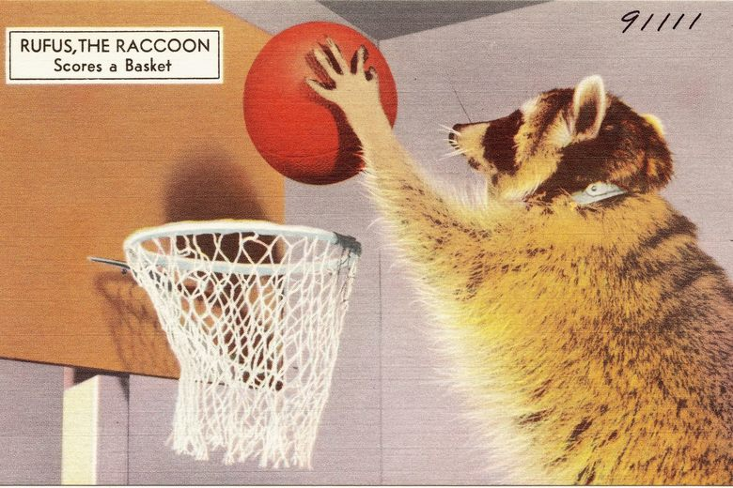
Instinctive Drift
Instinctive drift- when an animal’s conditioned responses shift (or drift) back toward innate response patterns
Brelands tried to teach a chicken to play baseball
The chicken got to the point of pulling a string to swing a bat and hit the ball, but would chase after the ball as food instead of running to first base
There are biological constraints that limit the generality of conditioning principles

Slide 50
Using Conditioning and Learning Principles
Chapter 6, Section 5, pages 232-238 (from old textbook)

Slide 51
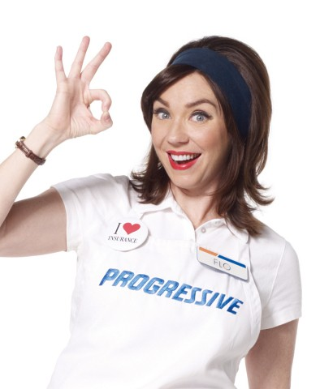
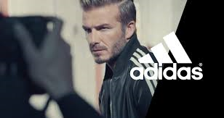
Classical Conditioning in Application
Marketing
Companies pair the product or logo (NS) with pleasant images (CS) → higher-order conditioning → the pleasant images trigger favorable responses (CR)
The product or logo becomes the CS while CR is also purchasing products
Can also lead to urges to engage in harmful behavior

Slide 52
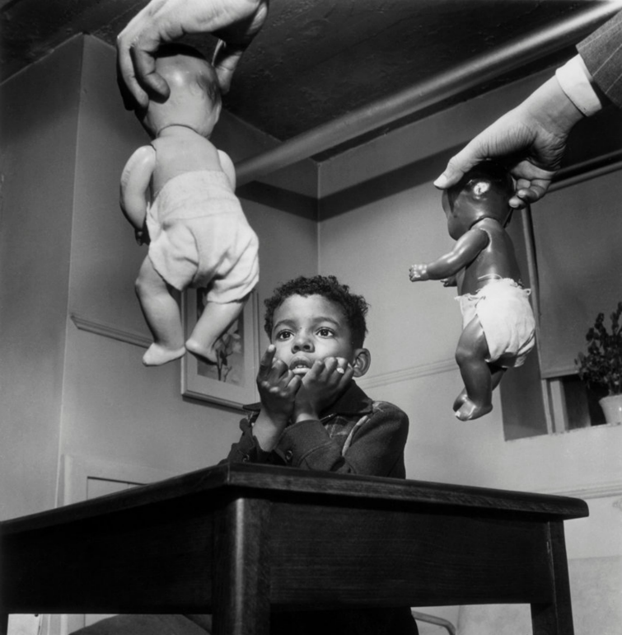
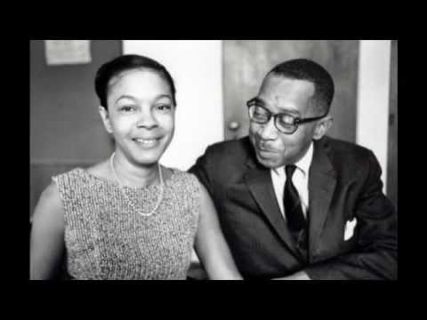
Classical Conditioning in Application
Prejudice
Clark study- when given a choice between a white or black doll, both black and white children chose the white dolls, stating that the white doll was good and nice and the black doll was bad, dirty, ugly
Recent studies still show this effect
Children had learned to associate inferior qualities with darker skin and positive qualities with lighter skin
These principles can be applied to any kind of prejudice
Before: NS (member of disliked group) → no response
Before: UCS (parent’s negative reaction) → UCR (child is upset and fearful)
During: NS (member of disliked group) + UCS (parent’s negative reaction) → UCR (child is upset and fearful)
After: CS (member of disliked group) → CR (child is upset and fearful)
-Kenneth and Mamie Clark
-Kenneth was first African American president of APA
-Their research contributed to Brown v. Board of Education (ruled segregation of public places was unconstitutional)

Slide 53
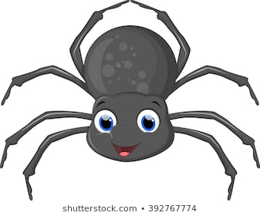
Classical Conditioning in Application
Medical treatments
Often used for treating alcohol dependence
Before: smell or taste of alcohol (NS) + nausea-producing drug (UCS) → vomit or feel sick (UCR)
After: smell of taste of alcohol (CS) → vomit or feel sick (CR)
Also unfortunate effect of chemotherapy, reverse classical conditioning is used to help treat
Phobias
Fear of something usually comes from classical conditioning- associating the NS (spider) with a UCS (like hearing a friend scream at the sight of it)→ CR is the fear
Can be addressed by behavior modification techniques

Slide 54
Operant conditioning in Application
Prejudice
Can also be learned through operant conditioning- behavior is reinforced by parents or gaining approval/self-esteem
Could be negative experience that is generalized to all members
Biofeedback- involuntary bodily process (such as blood pressure or heart rate) is recorded, and the information is fed back to an organism to increase voluntary control over that bodily function
Can be used to treat hypertension and anxiety by lowering blood pressure and muscle tension; also epilepsy, urinary incontinence, cognitive functioning, chronic pain, headaches

Slide 55
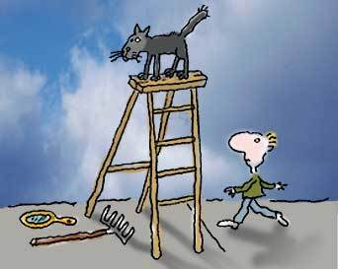
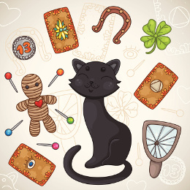
Operant Conditioning in Application
Accidental reinforcement and superstitious behavior
Skinner gave pigeons food every 15 seconds, they picked up habits with accidentally associating whatever behavior they were doing before the 15 second interval ended with a reinforcer
This leads to the many superstitious behaviors of people- throwing salt, knocking on wood, not opening umbrellas inside, lucky charms, etc.

Slide 56
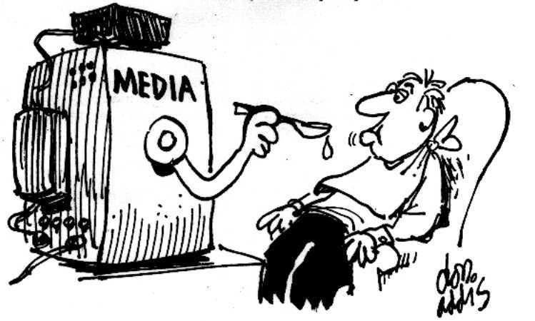
Cognitive-Social Learning in Application
Prejudice
Learning through models in the same social groups, media, etc.
Seeing “normal” models of different people
It is learned- which means it can be reversed
Media influence
Seeing fashion, toy choice, “the good life”
Good and bad behavior
Helping those in need
Research shows a correlation and causation between observing violent behavior and later desensitization and increased aggression, including video games

