Slide 1
How to support your Mental Health
@pumasmatter
#YouMatter

Slide 2
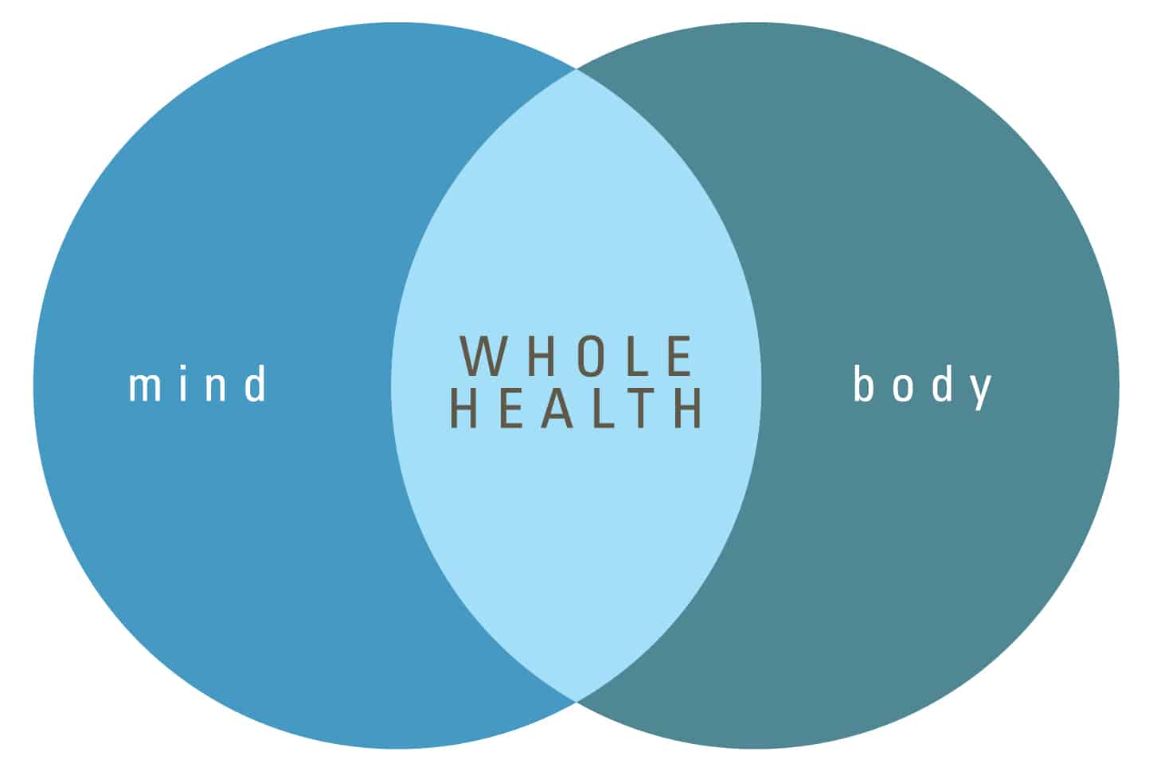
Whole Health Matters
When hungry ______
When thirsty ______
When sick _____
When struggling mentally or emotionally (sad, anxious, angry, etc.) _________
***Meeting mental health needs is just as important as meeting basic needs
Were one body- physical and mental health are connected
Notes:
Frist we must acknowledge that our mental and physical health are connected- Whole Health Matters
When your hungry what do you do?
When your thirsty what do you do?
When you sick what do you do?
When you struggling mentally or emotionally what do you do? Sometimes were not as quick to know what to do. Seeking help for our mental health is just as important as meeting our basic needs like drinking and eating.
When our mental health is suffering it is likely going to impact our physical health and vice vera. We must take care of our mind and body.

Slide 3
Depression and Anxiety
Mental health challenges are common. Depression and Anxiety are amongst the most common mental health struggles among youth and adults.
The good news is there is HOPE.
Depression and anxiety are treatable. Sometimes medication is necessary but often we have the power within us to learn how to cope with life’s challenges and change our thought patterns which effect our feelings and emotions to overcome our mental health struggles.
Always keep in mind life is eb and flow and most things are temporary just because you may be struggling now doesn’t mean you’ll struggle forever.

Slide 4
Depression

Slide 5
Notes:
In order to break the cycle of depression we must understand that we have the power to change the way we view situations, react to situations and how we allow situations or others to make us feel.
Often times its human nature to wrap our self worth up in what other say, do, or think about us. But reality is if you're looking to others for approval and to make you feel good you will likely be let down. Everyone has their own struggles and its not uncommon for others to project their pain, hurt and struggles on to you, which means unkind words and behavior isn’t about you it’s a projection of how they feel about themselves. The person you need approval and love from is yourself. Know your own worth and capabilities despite what others say and do.
Sometimes situations and things happen to us that are hard and upsetting and it is ok to not be ok. Allow yourself to feel upset and hurt just don’t stay stuck there.

Slide 6
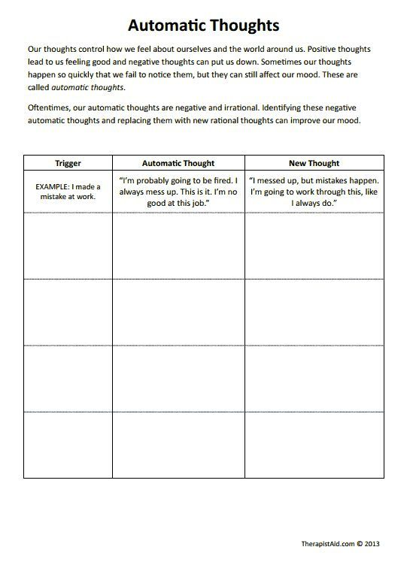
Notes:
This is an example of how you can switch your thinking based on things that trigger you and lead you to feel bad about yourself. Use this record sheet to identify your triggers, what automatic thoughts come with it and replace it with a new more positive thought.

Slide 7
Coping- Doing things differently
Do something different (to what you normally do)
Consider what demands you can reduce and ask others for help
Practice Mindfulness and meditation
Focus your attention fully on another activity
Relaxation techniques (listen to music, grounding techniques, progressive muscle relaxation, take a bath etc.)
Spend time with others (friends, family)
Journal, draw and/or color
Communicate your needs- others have to know how to help you. Set boundaries when needed.
Doing something active- Exercise
Set time away from your phone and screen and get outside. Fresh air is super helpful in balancing our mood.
Engage in a hobby or other interest- if you don’t have one start trying news things and see what you like.
Limit your responsibilities (its ok to say no)
Right down your thoughts and feelings, get them out of your head.
Just take one step at a time (don’t plan too far ahead)
Positive self talk- encourage yourself, tell yourself I can do this-I’ve done this before this too will pass. Find a positive coping statement that works for you.
Talk to someone (friend, family, therapist)
Eat a balanced diet, drink less caffeine and more water

Slide 8
Ideas for coping continued
To express intense emotions:
~ Draw/paint/color
~ Start a journal/blog/vlog
~ Write a story or poetry
~ Compose music
~ Play a musical instrument
~ Doodle on paper
~ Sing
~ Talk to yourself
~ Build/craft something
To release tension or vent anger:
~ Punch a cushion
~ Throw Socks ~ Use a stress ball or fidget tool
~ Make noise/scream as load as you can
~ Squeeze clay, putty or playdoh
~ Stomp your feet
~ Clean something
~ Tear up paper
~ Draw slash lines on paper

Slide 9
Ideas for coping continued
To calm or sooth yourself: Things that inspire you or to focus on
~ Take a hot shower or warm bath ~ Cook/bake
~ Pet or cuddle your dog/cat/animal ~ Listen to music
~ Wrap yourself in a blanket ~ Read a new book
~ Massage your neck, hands, or feet ~ Watch a YouTube personality that
~ Listen to calming music inspires you
~ Hug something soft ~ Memorize a song
~ Paint your nails ~ Eat your favorite foods
~ Watch a favorite movie ~ Think about someone else- perform one
~ Read a book act of kindness
~ Go for a walk or drive ~ Volunteer somewhere
~ Sit in a café and people watch ~ Search online for and practice positive
~ Count ceiling tiles or lights affirmations
~ Mediate/practice mindfulness

Slide 10
Ideas for coping continued
Because you feel disconnected/numb
~ Talk to friends or loved ones
~ Take a COLD shower
~ Hold ice in bend of your leg or arm
~ Chew something strong like chili, lemon, or peppermints
~ Snap a rubber band on your wrist for brief periods of time
~ Focus deeply on a piece of chocolate as you eat it
~Talk to a therapist or counselor
~ Blow up a balloon and pop it
~ Connect online with help forums
~ Concentrate on things that made you happy in the past

Slide 11
Anxiety

Slide 12
Did you know?
92% of what you worry about is a waste of time and energy. Meaning it won't change the outcome of a situation or change what already happened (only 8% of our worry is legitimate).
Furthermore 40% of what you worry about will never even happen and 30% of what we worry about has already happened.
Worry is something that consumes us but doesn’t do a whole lot of good.
So Here is one thing you can to do take control of your worry instead of the worry controlling you.
Postpone worry:
1. Make a decision to postpone worry
2. Decide on a time to problem solve
3. Use a coping strategy or two
4. Follow through with problem solving at that time
Schedule “worry time”. Each day schedule 15 or so minutes to worry. If you begin to worry and it is not “worry time”. Make note of it and save it for “worry time”.
This allows you to stay more focused and productive. You may also find that with time the worry that you had earlier that morning isn’t a problem anymore as the day went on.

Slide 13
Ways to cope with anxiety
**Refer to worksheets on how to do the below ideas for coping
Grounding Techniques
Deep Breathing
Practice Mindfulness
Progressive Muscle Relaxation
Challenging Irrational Thoughts
Guided Imagery
Use a coping technique/skill that works for you. Everyone is different with what helps and calms them (refer to coping ideas from previous slides).
Use positive self talk/coping thoughts to get through difficult or distressing situations.
Circle of control (see next slide)

Slide 14
Circle of control
Try doing a circle of control
On the inner circle you write the things you can control and on the outer circle you write the things you can’t control.
This is a visual activity that can help you recognize where to focus your energy (focus on what you can control rather than things you can’t and try not to dwell on the things you can’t control).
You can take it a step further with the things you can’t control and write what you can do to feel more comfortable with those things that are ultimately out of your control (example: wear a mask, keep my distance, wash my hands if COVID is a worry).
NOTE: We can’t control our thoughts. Random thoughts pop in our head all day long. Where stress, anxiety and depression come from is our reaction to those thoughts or how we allow others to make us feel about ourselves. With practice we can control how we allow those thoughts and others to affect us. So, we don’ have control of our thoughts (or what others say and do) but we do have control of our feelings, emotions and reactions.

Slide 15
Mindfulness

Slide 16
The Need
Stress and anxiety→ new normal in schools
Affects student’s ability to pay attention→ connect with each other→ engage in learning
Mindfulness
helps to increase attention and focus and decrease stress and anxiety.

Slide 17
What is Mindfulness?
Why Mindfulness?
Rationally respond to a situation rather than react on emotion.
Ability to pause → Be present/sit with our feelings, good or bad.
Mindful of anything in our experience.
Walking, Driving, Eating, etc.
We spend years developing intelligence in school
Strengthen our bodies through sports and exercise
Practice things of interest (musical instruments, dance, etc.)
All to improve and develop our skill set
Must do the same for our mind. Must exercise our mind in order to strengthen it.
Notes:
Paying attention to our experience in a way that allows us to respond rather than react.
Ability to pause and take a moment to be present and sit with our feelings, good or bad.
Can be mindful of anything in our experience.
Bring mindful attention to our daily activities like walking, eating, etc.
Why Mindfulness
Spend a lot of time developing intelligence in school

Slide 18
Relevance
Our mind →our most powerful asset.
When we develop and strengthen our mind → increase our ability to:
Focus
Recognize and manage our emotions
Make better decisions
Empathize in our relationships
Have you ever…
Said something you wish you could take back
Done something you later regretted
Felt angry or out of control
Anxious or nervous for an exam, performance, or game.
Had troubling falling asleep because your mind won’t stop
Notes:
Our mind is perhaps our most powerful asset. When we develop and strengthen our mind we increase our ability to:

Slide 19
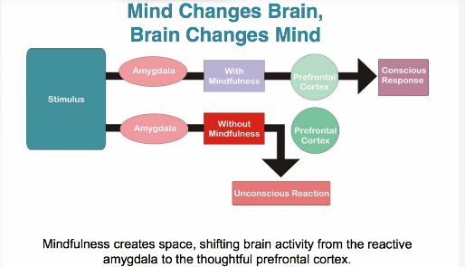
Mindfulness creates space…replacing impulsive reactions with thoughtful responses.
Notes:
When a situation happens or we have thoughts our amygdala fires which creates a feeling or emotion. With mindfulness when we take a moment to pause and sit with that thought or situation that just happened good or bad we engage our prefrontal cortex which allows us to think more clearly, rationally and logically.

Slide 20
Mindfulness and the Brain
Difficult emotions release chemicals in the brain→ prevents learning→ react rather than respond
Mindfulness stops these chemicals.
When you pause and identify emotions and feelings there is a physiological shift towards relaxation.
Can’t learn in fight/flight/freeze mode. Learning requires access to prefrontal cortex.
Mindfulness helps re-engage the prefrontal cortex
Notes:
Difficult emotions (anger, worry and stress) release chemicals in the brain--can prevent students from learning--- can make us react, say or do things we didn’t want to.
Can’t absorb information in fight/flight/freeze states. Learning requires receptivity- access prefrontal cortex.
Mindfulness helps re-engage the prefrontal cortex (able to think, act, problem solve).

Slide 21
Dispelling myths of Mindfulness thought meditation

Slide 22
How Mindfulness Works
Takes practice like anything else.
Techniques are simple:
~ Pause for a moment and be mindful of sound, breath, movement, thoughts, emotions and other things.
~ 3-2-4 or 4-5-7 breathing
~ Own rhythm of breathing keeping your mind focused on your breath
Short periods of paying attention on purpose.
If practiced daily, it will help strengthen and develop your mind just as exercise does for the body.
Notes:
For mindfulness to work, it has to be something that you practice like anything else.
Techniques to mindfulness are quite simple.

Slide 23
Something to keep in mind:
Ruminating and regret is about the past- Rumination leads to Depression.
Worry is about the future. Leads to anxiety.
Free from worry and rumination/regret is the present- stay in the present moment as much as possible

Slide 24
Mindful Minute
Face Forward
Sit in upright relaxed position
Let your body relax/sink into chair
Close your eyes
Get in touch with your body. Feel your back against the chair, your feet on the ground, your hands by your side or in your lap
Take a couple deep breaths in and out
Continue to breath in and out at your own pace
Notice the sounds around you
If there are thoughts entering your mind it is ok just imagine them flowing through like a stream of water.
Don’t wish them away just sit with them. You can use anchor words like “thinking” or “wandering” to acknowledge them and then bring your attention back to your breathing
Feel your stress/tension exiting your body with every exhale and imagine a sense of peace with every inhale
Going to turn off my voice for a few so you can sit quiet for a moment. Continue to focus on your breathing
You may open your eyes and slowly bring your attention back to the room

