Slide 1
Create an UT EID
Ms. Parrrrrrrrrrrrrk

Slide 2
Click!
Notes:
https://quest.cns.utexas.edu/

Slide 3
Wait, Ms. Park! I already have a UT EID! Then Click me!

Slide 4
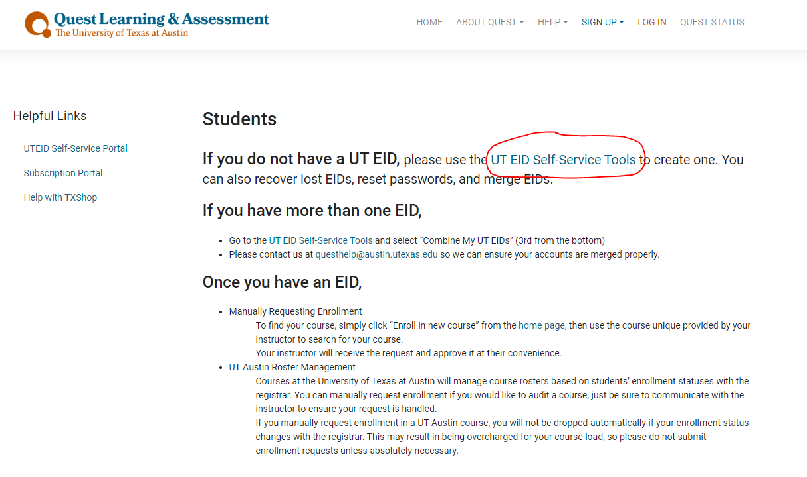

Slide 5
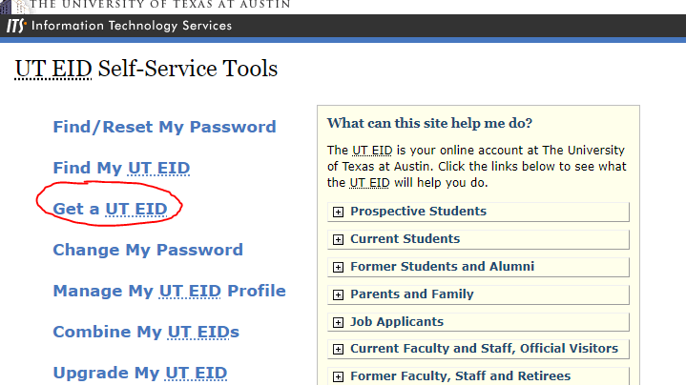

Slide 6
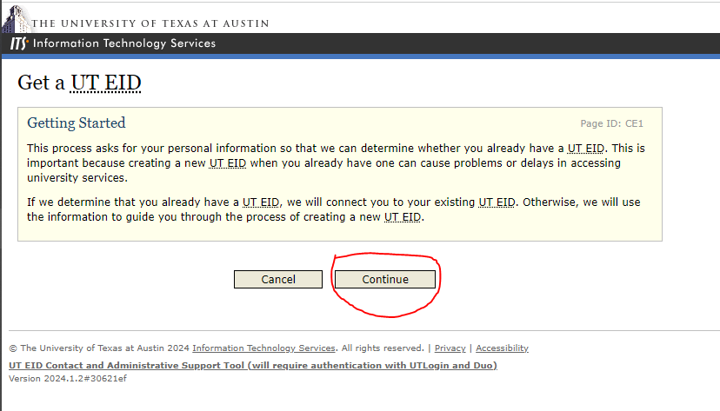

Slide 7
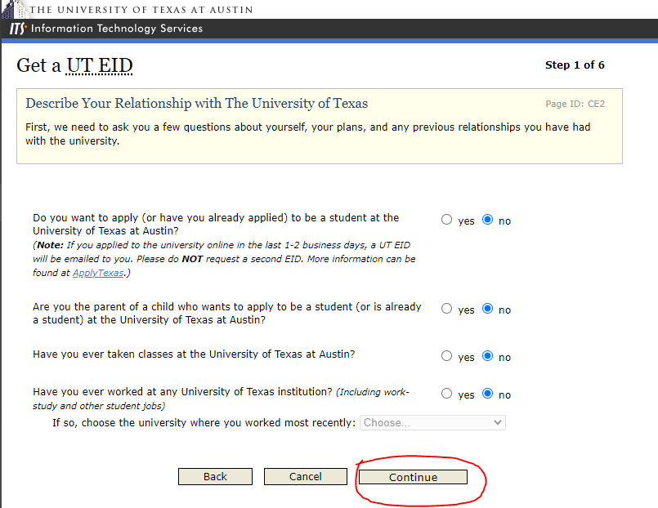

Slide 8
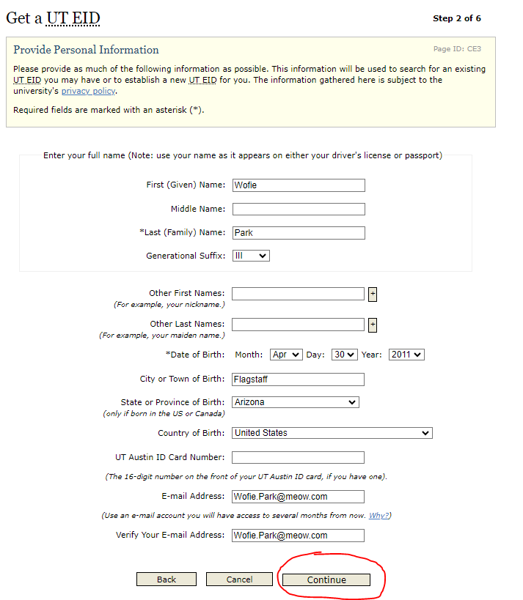

Slide 9
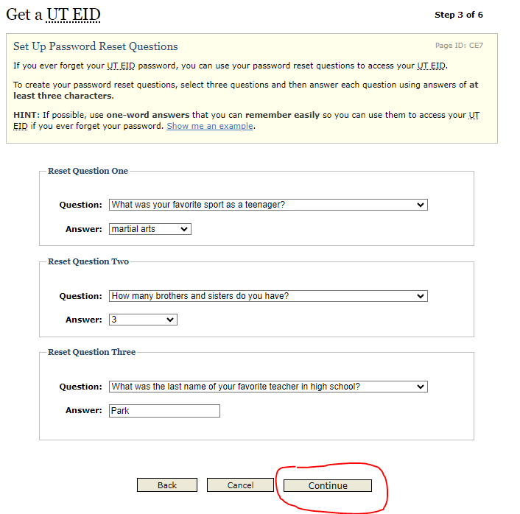

Slide 10
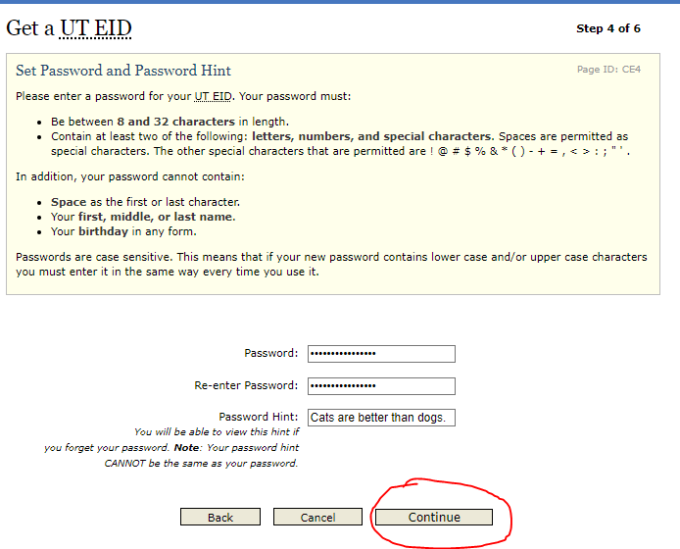

Slide 11
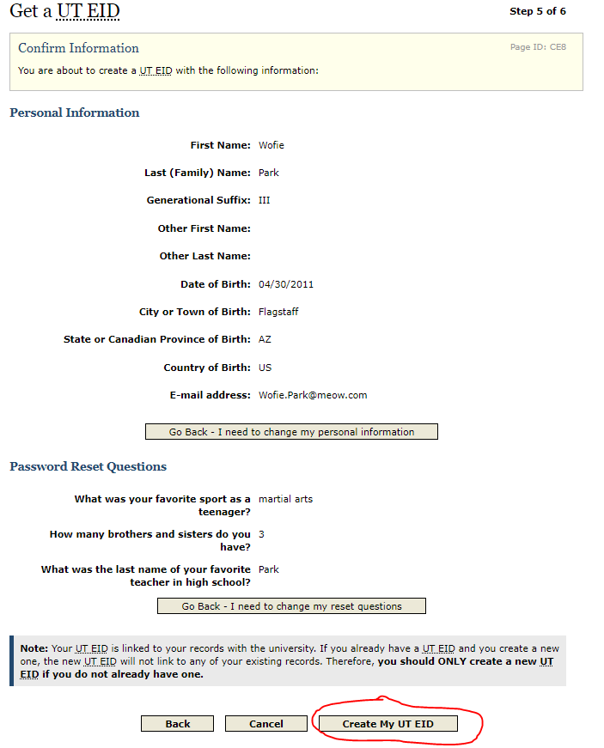

Slide 13
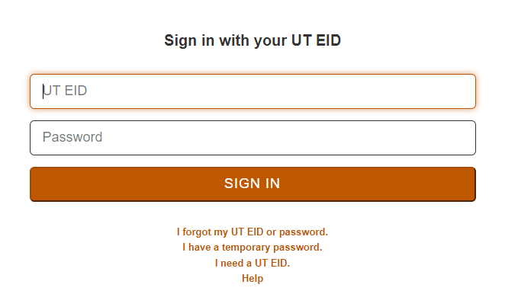

Slide 15
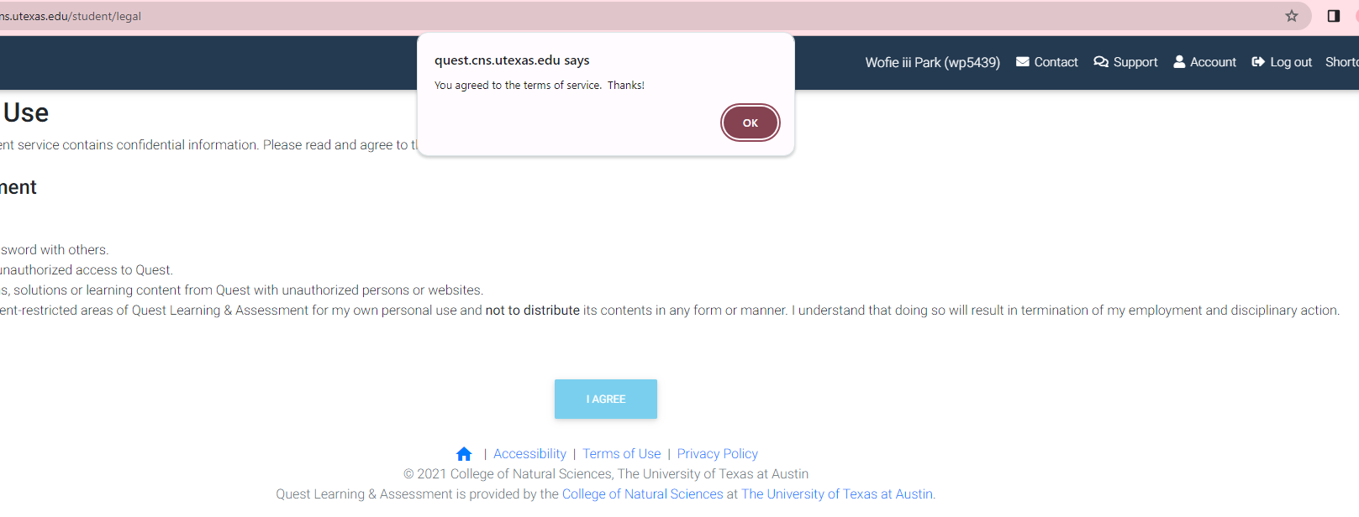

Slide 16
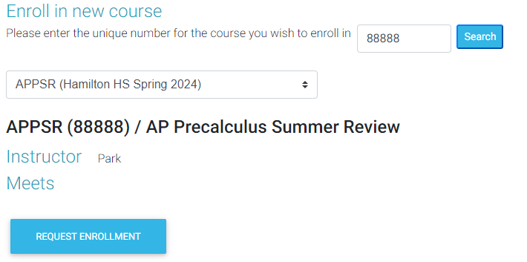
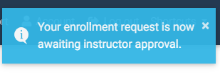
1
I post your unique number for AP Precalculus Summer Review
88888
2
Click the arrows to find the course!
APPSR (Hamilton HS Spring 2024)
3
4

Slide 17
What Now?
Wait until Ms. Park approves your requests. Make sure you request it before the last day of school. Otherwise, she will approve whenever she feels like it.
Questions?
Park.Juhee@cusd80.com
C114

